Slide 1

GDP-I Workshop
Team Members:
Kopparthi Sai Dinesh
Chepuri Tagore Charith,
Emani Aasrita,
Dasari Vamshika,
Maddela Tejaswi,
Veldanda Sailaxmi

Slide 2
Contents
Android Studio
Android Project Contents
How an Android Application runs?
App Components
Manifest file
Node.js
Data Visualization
Tableau
Advantages of Tableau
Data Cleaning Process
Tableau Prep Builder
Navigating the Tableau Prep Builder Process

Slide 3
Android Studio
Android Studio is the official integrated development environment (IDE) for Android app development
It offers features like code editing, debugging, and emulation to streamline the development process.
Applications can also be developed using other notable IDEs like Eclipse, but Android Studio gets better support from Google.

Slide 4
Android Project Contents
Java - Your java code
Res - Your XML resources
Drawable = images
Layout = user interface
Menu = menu items
AndroidManifest - list of application components, minimum SDK, app name, icon, theme, etc.

Slide 5
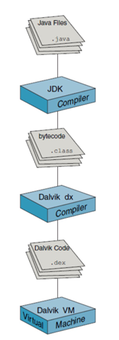
How an Android Application runs?
Application is written in Java.
Then it is compiled into java byte code (.class).
The secondary compiler Dalvik designed for android produces the .dex code.
It is then wrapped into an Android package (.apk file)
This can run on Dalvik Virtual Machine(DVM) which compiles small frequently used fragments of code to native (Just-in-Time).
ART which is most recent compiles an entire app at installation and produces a native app. This make the app:
Faster
Less battery-intensive
Improve garbage collection

Slide 6
App Components
Each Android application is made up of multiple app components.
Activities
An app is collection of related activities
One activity is main activity which invokes other activities as needed
Services
A background process that usually runs a long-running operation (e.g., downloading a file)
Content Providers
Allow apps to access structured data in a uniform fashion regardless of its underlying organization
Broadcast Receivers
An app component that responds to messages broadcast either by the OS or by other apps
Intents - asynchronous messages that tie all the above together

Slide 7
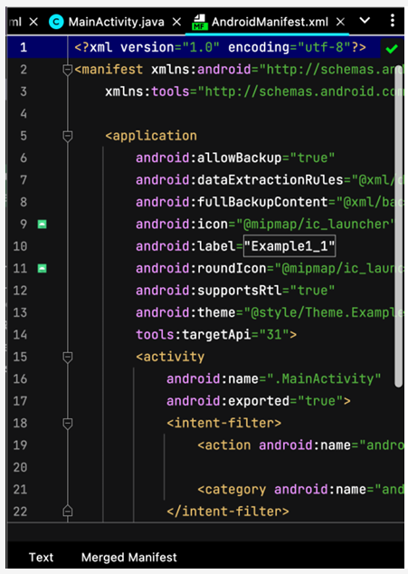
Manifest file
AndroidManifest.xml which exists in the root directory lets application tell the OS what its components are.
Components are defined by xml tags and names the implementing classes:
<activity>
<service>
<provider>
<receiver>
AndroidManifest.xml also defines the name of the app, permissions, icons, target SDK level, required libraries.

Slide 8
Node.js
Node.js is an open-source, server-side runtime environment built on Chrome's V8 JavaScript engine.
It allows you to run JavaScript on the server, making it a popular choice for building web and android applications.
Runs on a single process so avoids some concurrency issues. Does not spin off a thread for each request.

Slide 9
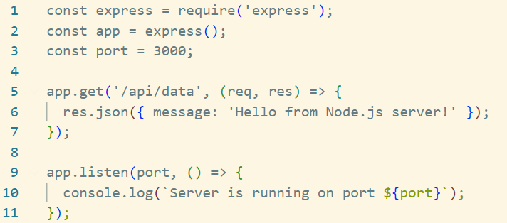
Node.js – Creating a Simple Server.
Server listens on port 3000
Has an API route /api/data that returns a JSON response.
Android app can make a request to http://your-server-ip:3000/api/data to get the data.

Slide 10
Data Visualization
Data visualization is the process of presenting data in a visual format to make it easier to understand and draw insights from. Here are four key points to explain data visualization simply:
Clarity: Data visualization uses charts, graphs, and images to represent data, making complex information more accessible and understandable at a glance.
Insight: It helps reveal patterns, trends, and relationships within data that might be difficult to discern in raw numbers or text.
Communication: Data visualization is a powerful tool for effectively conveying information to a wide audience, enabling people to make informed decisions.
Decision-Making: By transforming data into visual representations, it aids in decision-making processes, fostering a deeper understanding of information and supporting data-driven choices.

Slide 11
Tableau
Tableau is a popular data visualization tool that helps you turn complex data into easily understandable visualizations like charts, graphs, and dashboards.
It allows users to connect to various data sources, such as spreadsheets, databases, and cloud services, to create interactive and dynamic visualizations.
Tableau offers a user-friendly interface with drag-and-drop functionality, making it accessible to people with varying levels of technical expertise.
It's widely used in business intelligence and analytics to explore data, discover insights, and communicate findings through compelling and interactive visuals.

Slide 12
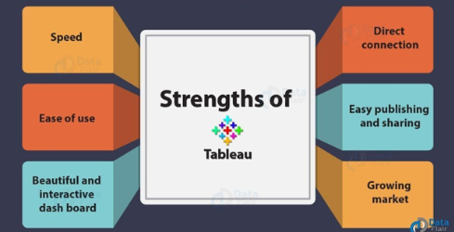
Advantages of Tableau

Slide 13
Data Cleaning Process
Data cleaning is a crucial step in data preparation to ensure the accuracy and quality of your data. Here are two simple steps to explain the data cleaning process:
Identify and Handle Missing Data: You can choose to either remove rows with missing data or fill in the missing values with appropriate data .This ensures that your dataset is complete and usable for analysis.
Remove Duplicates: Check for and remove duplicate entries in your data. By eliminating duplicate records, you ensure that each data point is unique and representative of the information you are working with.

Slide 14
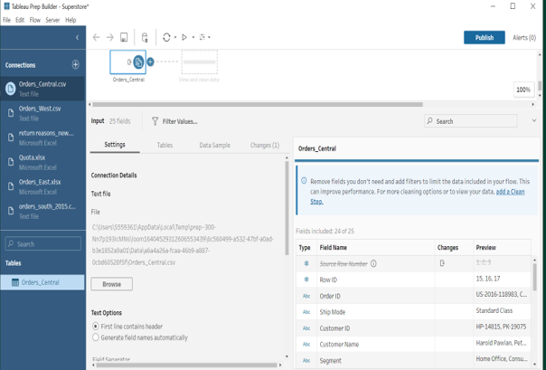
Tableau Prep Builder
It helps you clean and transform your data by removing duplicates, handling missing values, and formatting data for analysis.
You can combine data from multiple sources, such as Excel, databases, or CSV files, into a unified dataset.
Tableau Prep Builder provides a user-friendly, visual interface for data wrangling, making it accessible to non-technical users.
It simplifies the process of preparing data for analysis in Tableau, allowing you to save time and create more accurate, insightful visualizations.

Slide 15
Navigating the Tableau Prep Builder Process
Tableau Prep Builder is a data preparation tool that helps you clean, shape, and transform your data for analysis in Tableau. Here's the process in simple terms:
Connect Data: Start by connecting to your data sources, like spreadsheets or databases.
Profile Data: Tableau Prep automatically profiles your data to show you its structure and quality.
Clean Data: You can clean and filter the data to remove errors, duplicates, or irrelevant information.
Combine Data: You can combine data from multiple sources and create new fields.
Transform Data: Apply various transformations to your data, like pivot, split, and join operations.
Visualize Steps: Tableau Prep visualizes each step of your data preparation, so you can see the changes you're making.
Output Data: Once your data is ready, you can save it or output it to Tableau Desktop for analysis.
In essence, Tableau Prep Builder simplifies the process of getting your data into a clean, usable format for creating insightful visualizations and reports in Tableau.

Slide 16
THANK YOU

