Slide 1
GDP-I Week-5 Progress
Team Members:
Kopparthi Sai Dinesh,
Chepuri Tagore Charith,
Emani Aasrita,
Dasari Vamshika,
Maddela Tejaswi,
Veldanda Sailaxmi

Slide 2
Contents
Work Completed
Contribution
Blockers
Next Steps

Slide 3
Work Completed
We have put together data concerning the quantity of departments and the respective programs offered within those departments at our university.
We have successfully finalized interactive wireframes for 50% of the application utilizing Figma.

Slide 4
Work Completed
Total eleven schools/departments in our university
Agricultural Sciences – 15 Programs
Business – 23 Programs
Communication & Mass Media – 10 Programs
Computer Science & Information Systems – 21 Programs
Education – 28 Programs
Fine and performing arts – 10 Programs
Health science & Wellness – 26 Programs
Humanities & Social Sciences – 21 Programs
Literature, Language & Writing – 10 Programs
Mathematics & Statistics – 9 Programs
Natural Science – 35 Programs
Program types available - Minor, Bachelor's Degree, Certificate, Graduate Certificate, Master's Degree, Accelerated Bachelor's to Master's and Specialist in Education.
Programs offered in Maryville, Online and Maryville/Online.

Slide 5
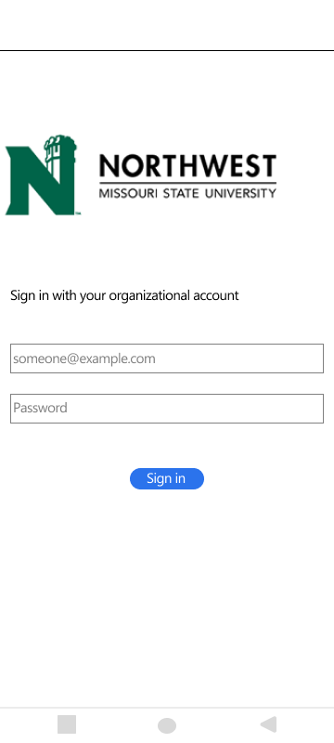
Work Completed - Login Screen
Text Field elements to enter Username and Password
'Sign In' button to enable users to authenticate their access once they have entered their credentials.

Slide 6
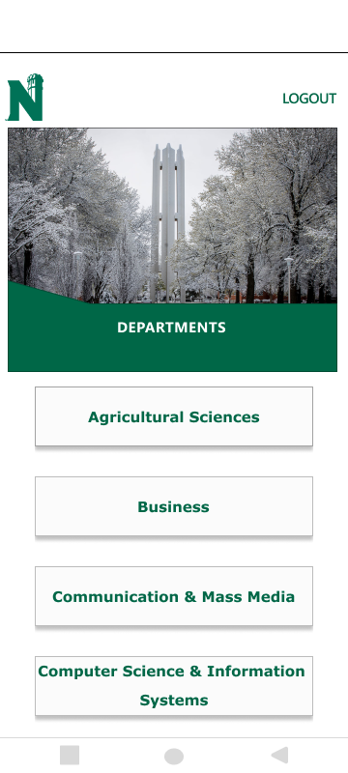
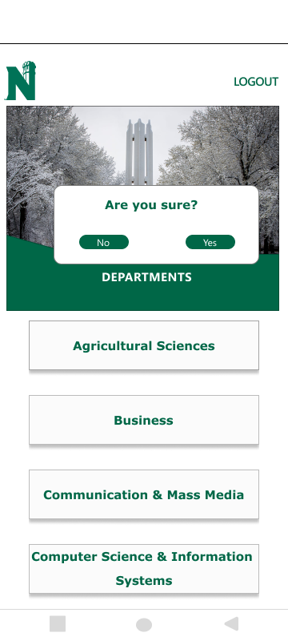
Work Completed - Departments Screen
'Logout' button that will trigger the display of an alert dialog.
Logout alert:
Selecting 'Yes' will redirect users to the login screen, while opting for 'No' will allow users to remain on the current screen
Scrollable view to present and enable users to select their preferred departments.

Slide 7
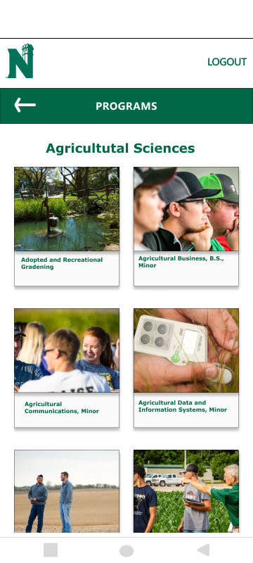
Work Completed - Programs Screen
'Logout' button that will trigger the display of an alert dialog.
‘Back’ button which navigates user back to department screen
Scrollable view for the presentation of programs within the 'Agricultural Science' department, enabling users to make selections.

Slide 8
Contribution
Team Member | Tasks Completed
Veldanda Sailaxmi | Collecting data pertaining to the departments and programs at Northwest Missouri State University and storing it in an Excel file.
Maddela Tejaswi | Collecting data pertaining to the departments and programs at Northwest Missouri State University and storing it in an Excel file.
Emani Aasrita | Designing and implementing the wireframe for the application's login screen.
Kopparthi Sai Dinesh | Developing designs for both the departments and programs screens.
Chepuri Tagore Charith | Compiling the design elements for the departments screen to finalize the wireframe.
Dasari Vamshika | Compiling the design elements for the programs screen to finalize the wireframe.

Slide 9
Blockers
Given the dissatisfaction with the initial wireframe designs, the work has been reset, and the process was started from the beginning.

Slide 10
Next Steps
Target to complete the wireframe design for the entire application within the upcoming week
Commence with the setup of the development environment.

Slide 11
Thank You

