Slide 1
GDP-I Week-11 Progress
Team Members:
Kopparthi Sai Dinesh,
Chepuri Tagore Charith,
Emani Aasrita,
Dasari Vamshika,
Maddela Tejaswi,
Veldanda Sailaxmi
1

Slide 2
Contents
Work Completed in Previous Week
Work Completed in Present Week
Contribution
Next Steps
2

Slide 3
Work Completed in Previous Week
Installation of Android Studio and other relevant tools like GitBash, GitHub Desktop etc.
Created an Android Project Named – “NWClassTrackr”
Minimum SDK: API 24 (“Nougat: Android 7.0)
Build configuration language: Kotlin DSL (build.gradle.kts)
Looking into capabilities of Firebase for Database.
Realtime Database
Authentication
3

Slide 4
Work Completed in Present Week
Re-Creation of project due to configuration issues.
Creation of constrained XML layout for login screen
Working on integrating our app with firebase.
4

Slide 5
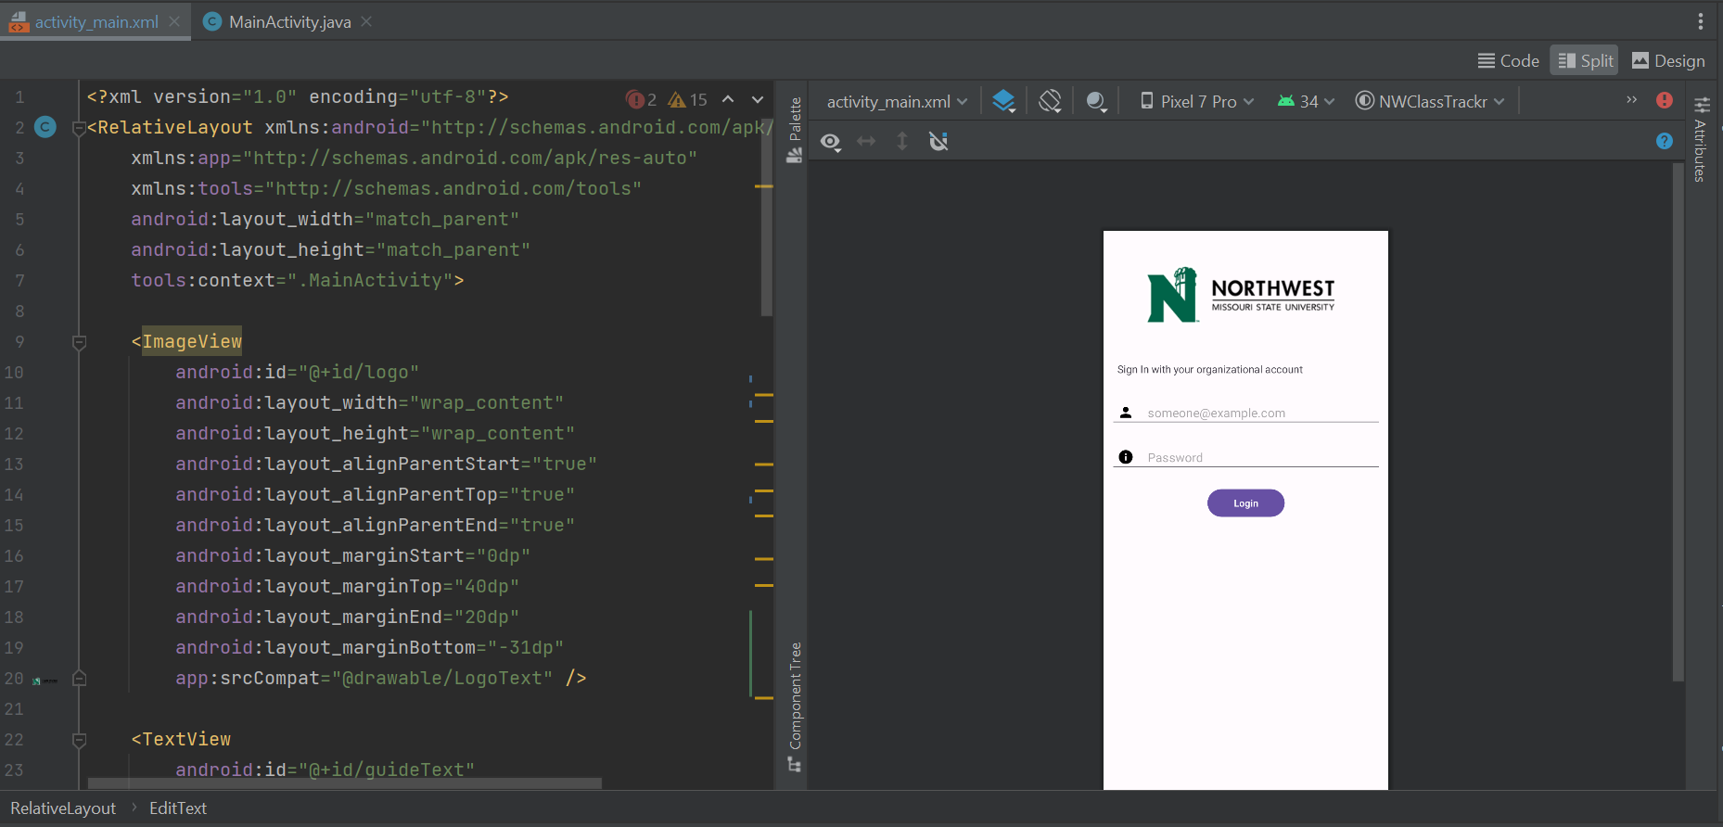
Work Completed in Present Week – Login Layout
Design View for the Login Screen
XML code for the login screen
5

Slide 6
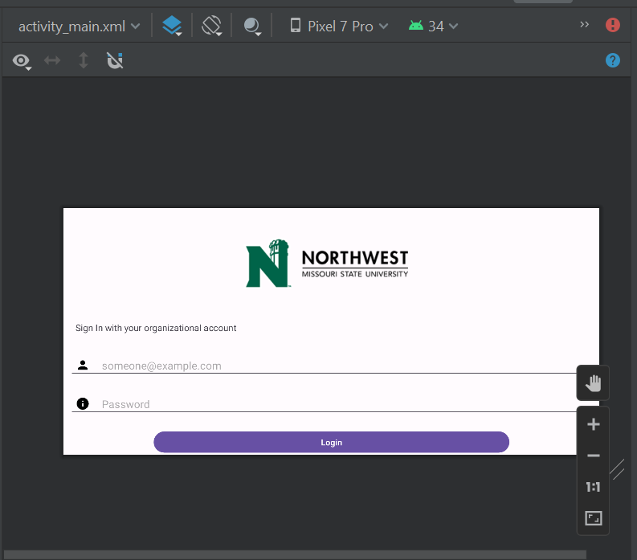
Work Completed in Present Week
Landscape layout for the login page
6

Slide 7
Contribution
Team Member | Tasks
Veldanda Sailaxmi | Identifying the configuration issues within the project and creating a new project with suitable configurations.
Emani Aasrita | Identifying the configuration issues within the project and creating a new project with suitable configurations.
Maddela Tejaswi | Going through the firebase documentation to integrate the firebase project to android project.
Dasari Vamshika | Going through the firebase documentation to integrate the firebase project to android project.
Chepuri Tagore Charith | Creation of XML layout for login screen.
Kopparthi Sai Dinesh | Creation of XML layout for login screen.
7

Slide 8
Next steps
Creating java file for the Login Screen.
Create XML Layout for the Department Screen.
Continuing with the research for development tools and technology
8

Slide 9
THANK YOU

