Slide 1
Control flow 44643 Mobile Computing - iOS
Instructor: Dr. Chandra Mouli
Northwest Missouri State University

Slide 2
Table of contents
Introduction
For-In Loops
While Loops
Conditional Statements
Control Transfer Statements
Early Exit
Conclusion

Slide 3
Introduction
Swift provides a variety of control flow statements.
These include while loops to perform a task multiple times.
if, guard, and switch statements to execute different branches of code based on certain conditions.
Statements such as break and continue to transfer the flow of execution to another point in your code.
Swift also provides a for-in loop that makes it easy to iterate over arrays, dictionaries, ranges, strings, and other sequences.

Slide 4

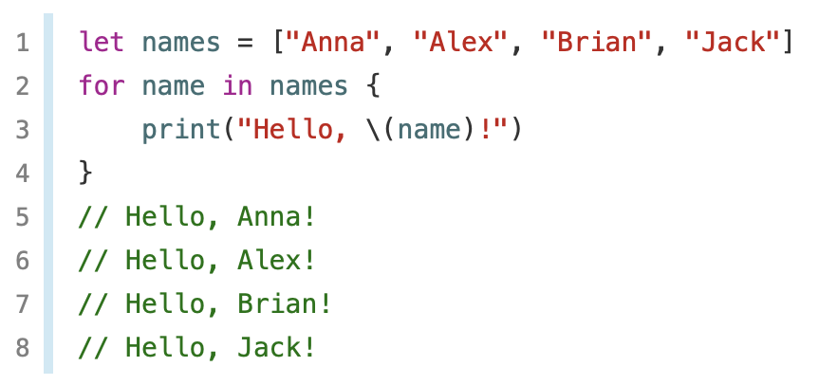
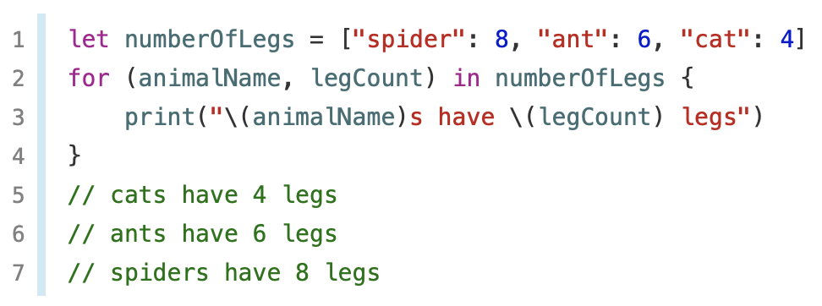
For-In Loops
for-in loop to iterate over a sequence, such as items in an array, ranges of numbers, or characters in a string.
This example uses a for-in loop to iterate over the items in an array.
Iterate over a dictionary to access its key-value pairs.

Slide 5
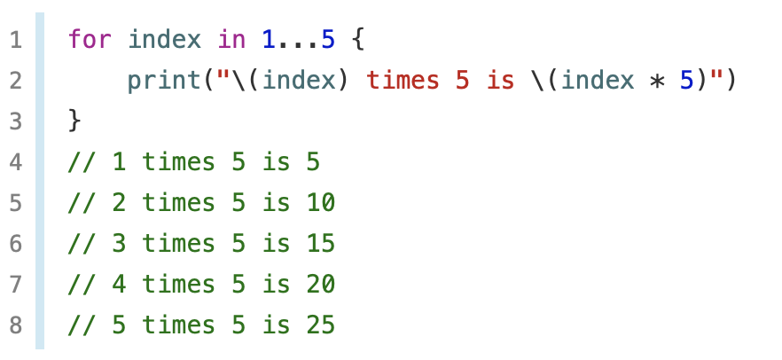
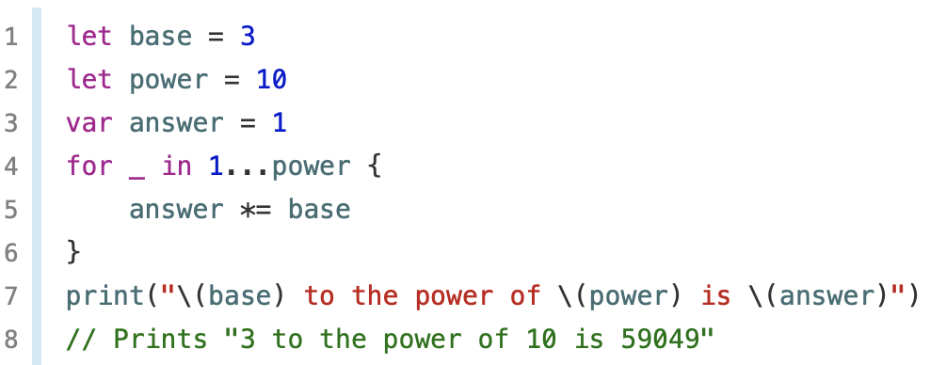
For-In Loops
for-in loops with numeric ranges.
If value from a sequence is not needed, then we can ignore the values by using an underscore in place of a variable name.

Slide 6
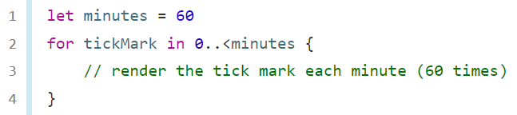
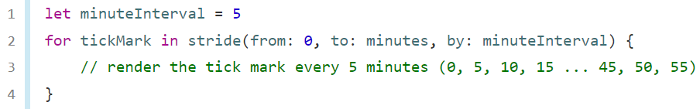
For-In Loops
In some situations, you might not want to use closed ranges, which include both endpoints.
Use the stride(from:to:by:) function to skip the unwanted marks.

Slide 7
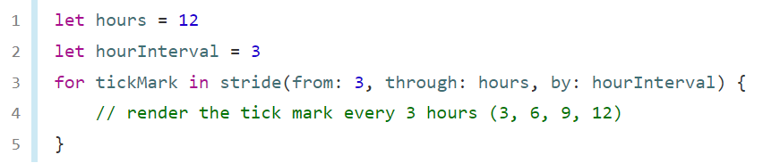
For-In Loops
Closed ranges are also available, by using stride(from:through:by:) instead:

Slide 8
While loops
A while loop performs a set of statements until a condition becomes false.
These kinds of loops are best used when the number of iterations isn’t known before the first iteration begins.
Swift provides two kinds of while loops:
while evaluates its condition at the start of each pass through the loop.
repeat-while evaluates its condition at the end of each pass through the loop.

Slide 9
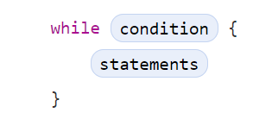
While loops
A while loop starts by evaluating a single condition. If the condition is true, a set of statements is repeated until the condition becomes false.
General form of a while loop:

Slide 10
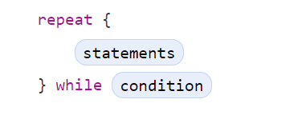
While loops
The other variation of the while loop, known as the repeat-while loop, performs a single pass through the loop block first, before considering the loop’s condition.
The repeat-while loop in Swift is analogous to a do-while loop in other languages.

Slide 11
Conditional Statements
Swift provides two ways to add conditional branches to your code: the if statement and the switch statement.
Typically, you use the if statement to evaluate simple conditions with only a few possible outcomes.
The switch statement is better suited to more complex conditions with multiple possible permutations and is useful in situations where pattern matching can help select an appropriate code branch to execute.

Slide 12
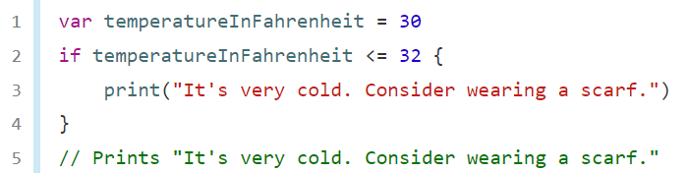
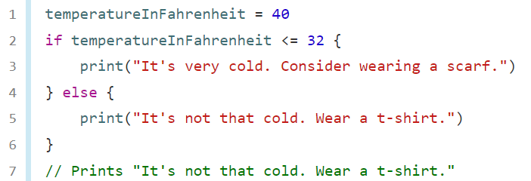
Conditional Statements
In its simplest form, the if statement has a single if condition. It executes a set of statements only if that condition is true.
The if statement can provide an alternative set of statements, known as an else clause, for situations when the if condition is false.

Slide 13
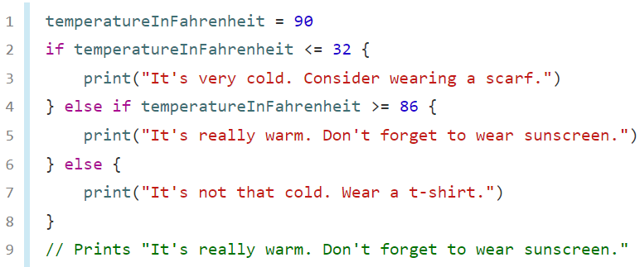
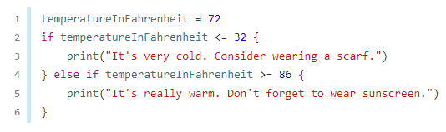
Conditional Statements
You can chain multiple if statements together to consider additional clauses.
The final else clause is optional, however, and can be excluded if the set of conditions doesn’t need to be complete.
Because the temperature is neither too cold nor too warm to trigger the if or else if conditions, no message is printed.

Slide 14
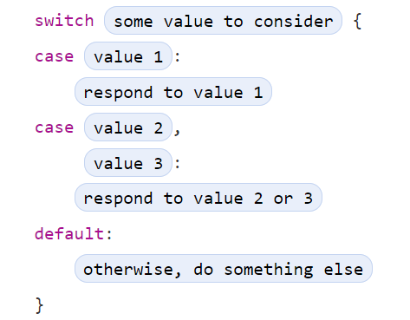
Conditional Statements
A switch statement considers a value and compares it against several possible matching patterns.
It then executes an appropriate block of code, based on the first pattern that matches successfully.
A switch statement provides an alternative to the if statement for responding to multiple potential states.

Slide 15
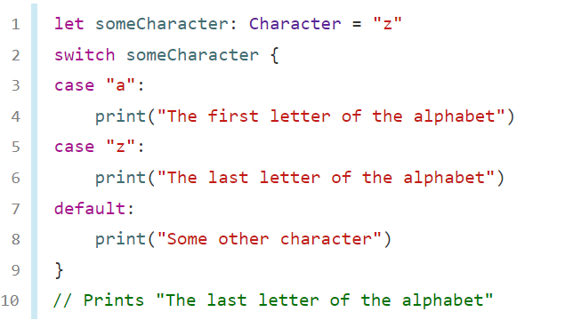
Conditional Statements
Like the body of an if statement, each case is a separate branch of code execution. The switch statement determines which branch should be selected.
This procedure is known as switching on the value that’s being considered.
Every switch statement must be exhaustive.
If it’s not appropriate to provide a case for every possible value, you can define a default case to cover any values that aren’t addressed explicitly. This default case is indicated by the default keyword and must always appear last.
This example uses a switch statement to consider a single lowercase character called someCharacter:

Slide 16
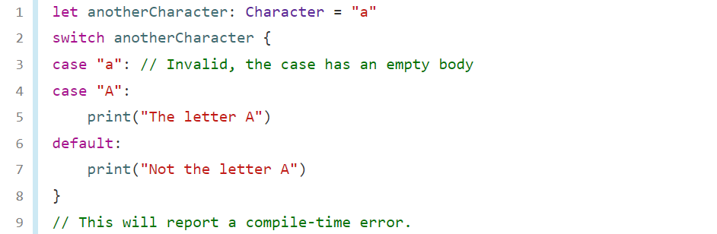
Conditional Statements
switch statements in Swift don’t fall through the bottom of each case and into the next one by default.
Instead, the entire switch statement finishes its execution as soon as the first matching switch case is completed, without requiring an explicit break statement.
The body of each case must contain at least one executable statement. It isn’t valid to write the following code, because the first case is empty.

Slide 17
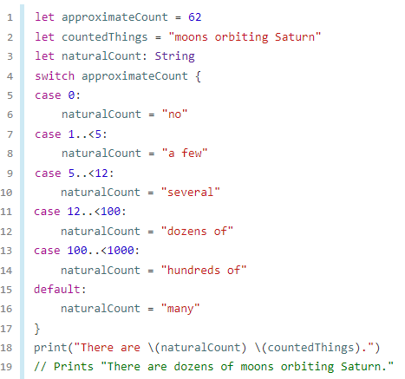
Conditional Statements
Interval Matching: Values in switch cases can be checked for their inclusion in an interval.

Slide 18
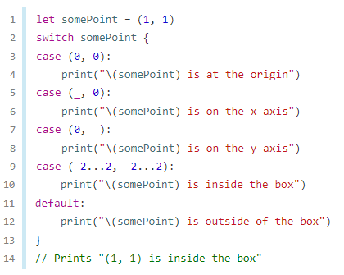
Conditional Statements
Tuples can be used to test multiple values in the same switch statement.
Each element of the tuple can be tested against a different value or interval of values.
Alternatively, use the underscore character (_), also known as the wildcard pattern, to match any possible value.
The example below takes an (x, y) point, expressed as a tuple of type (Int, Int), and categorizes it on the graph that follows the example.

Slide 19
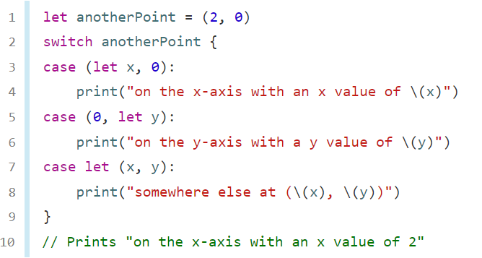
Conditional Statements
A switch case can name the value or values it matches to temporary constants or variables, for use in the body of the case. This behavior is known as value binding.

Slide 20
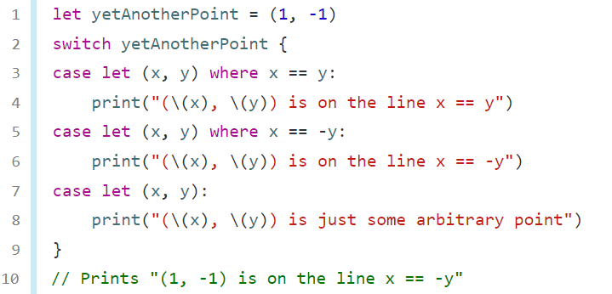
Conditional Statements
A switch case can use a where clause to check for additional conditions.
The example below categorizes an (x, y) point on the following graph.

Slide 21
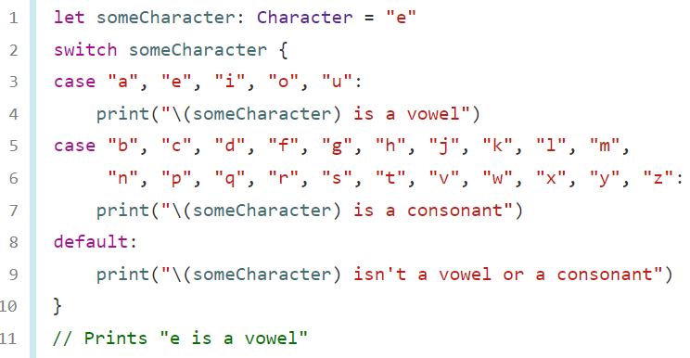
Conditional Statements
Compound Cases: Multiple switch cases that share the same body can be combined by writing several patterns after case, with a comma between each of the patterns.

Slide 22
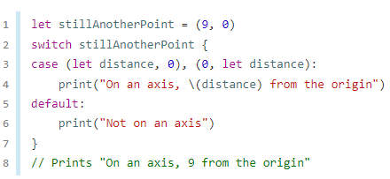
Conditional statements
Compound cases can also include value bindings.
All of the patterns of a compound case have to include the same set of value bindings, and each binding has to get a value of the same type from all of the patterns in the compound case.
This ensures that, no matter which part of the compound case matched, the code in the body of the case can always access a value for the bindings and that the value always has the same type.

Slide 23
Control Transfer Statements
Control transfer statements change the order in which your code is executed, by transferring control from one piece of code to another. Swift has five control transfer statements:
continue
break
fallthrough
return
throw

Slide 24
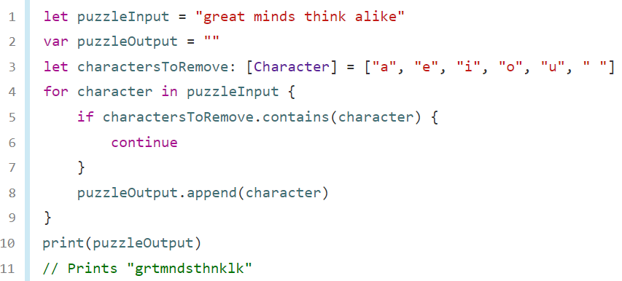
Control Transfer Statements
The continue statement tells a loop to stop what it’s doing and start again at the beginning of the next iteration through the loop.

Slide 25
Control Transfer Statements
When used inside a loop statement, break ends the loop’s execution immediately and transfers control to the code after the loop’s closing brace (}). No further code from the current iteration of the loop is executed, and no further iterations of the loop are started.

Slide 26
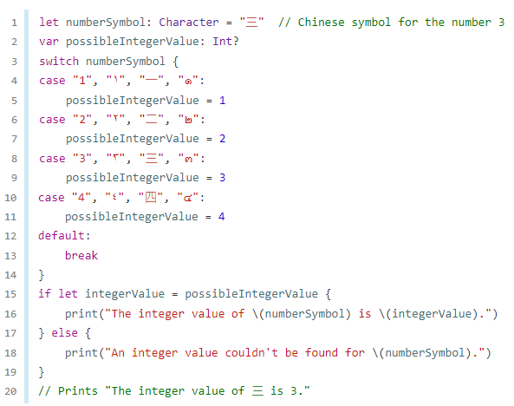
Control Transfer Statements
When used inside a switch statement, break causes the switch statement to end its execution immediately and to transfer control to the code after the switch statement’s closing brace (}).

Slide 27
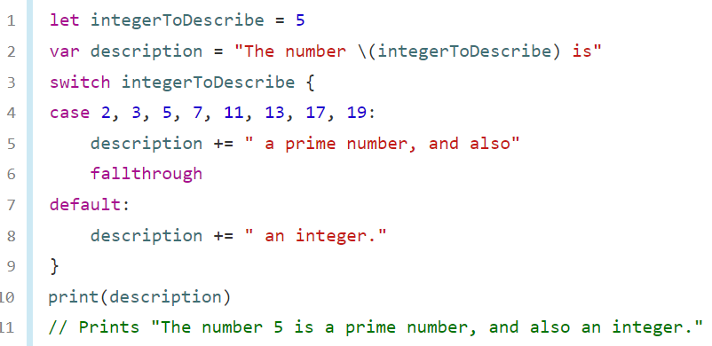
Control Transfer Statements
In Swift, switch statements don’t fall through the bottom of each case and into the next one.
That is, the entire switch statement completes its execution as soon as the first matching case is completed.
To explicitly fall through at the end of a particular switch case, use the fallthrough keyword.

Slide 28
Early Exit
A guard statement, like an if statement, executes statements depending on the Boolean value of an expression.
You use a guard statement to require that a condition must be true in order for the code after the guard statement to be executed.
Unlike an if statement, a guard statement always has an else clause—the code inside the else clause is executed if the condition isn’t true.

Slide 29
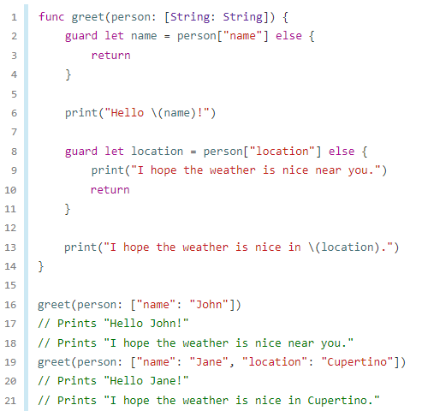
Early Exit
If the guard statement’s condition is met, code execution continues after the guard statement’s closing brace.

Slide 30
Conclusion
Swift provides a variety of control flow statements.
Swift’s switch statement is considerably more powerful than its counterpart in many C-like languages.
Swift also provides a for-in loop that makes it easy to iterate over arrays, dictionaries, ranges, strings, and other sequences.

Slide 31
Reference
https://www.swift.org/documentation/#swift-language

Slide 32
Control flow 44643 Mobile Computing - iOS
Instructor: Dr. Chandra Mouli
Northwest Missouri State University

