Slide 1
Auto Layout 44643 Mobile Computing - iOS
Instructor: Dr. Chandra Mouli
Northwest Missouri State University

Slide 2
Table of contents
Introduction
Auto Layout without Constraints
Auto Layout Attributes
Anatomy of a Constraint
Sample Equations
Creating Nonambiguous, Satisfiable Layouts
Constraint Inequalities
Constraint Priorities
Intrinsic Content Size
Control-Dragging Constraints
The Stack, Align, Pin and Resolve Tools
Conclusion

Slide 3

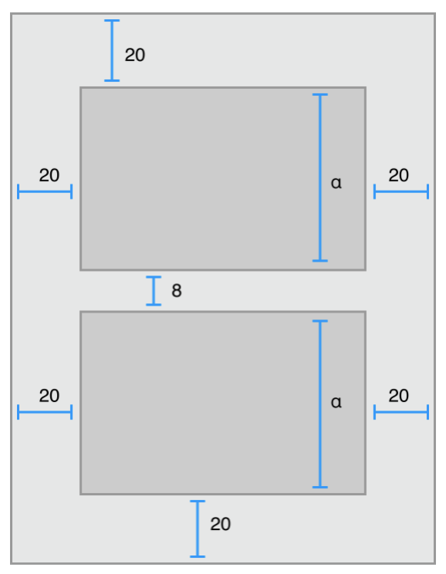
Introduction
Auto Layout dynamically calculates the size and position of all the views in your view hierarchy, based on constraints placed on those views.
Auto Layout defines your user interface using a series of constraints.
Constraints typically represent a relationship between two views.
Auto Layout then calculates the size and location of each view based on these constraints.
Produces layouts that dynamically respond to both internal and external changes.

Slide 4
Auto layout without Constraints
Stack views provide an easy way to leverage the power of Auto Layout without introducing the complexity of constraints.
A single stack view defines a row or column of user interface elements.
Stack view arranges these elements based on its properties.
axis: (UIStackView only) defines the stack view’s orientation, either vertical or horizontal.
orientation: (NSStackView only) defines the stack view’s orientation, either vertical or horizontal.
distribution: defines the layout of the views along the axis.
alignment: defines the layout of the views perpendicular to the stack view’s axis.
spacing: defines the space between adjacent views.

Slide 5
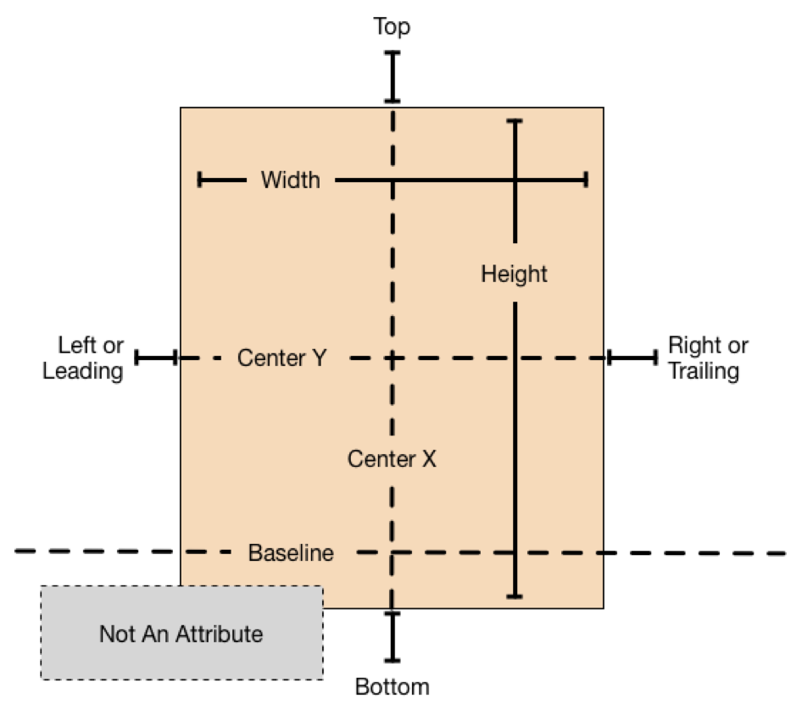
Auto Layout Attributes
In Auto Layout, the attributes define a feature that can be constrained.
In general, this includes the four edges (leading, trailing, top, and bottom), as well as the height, width, and vertical and horizontal centers.
Text items also have one or more baseline attributes.

Slide 6
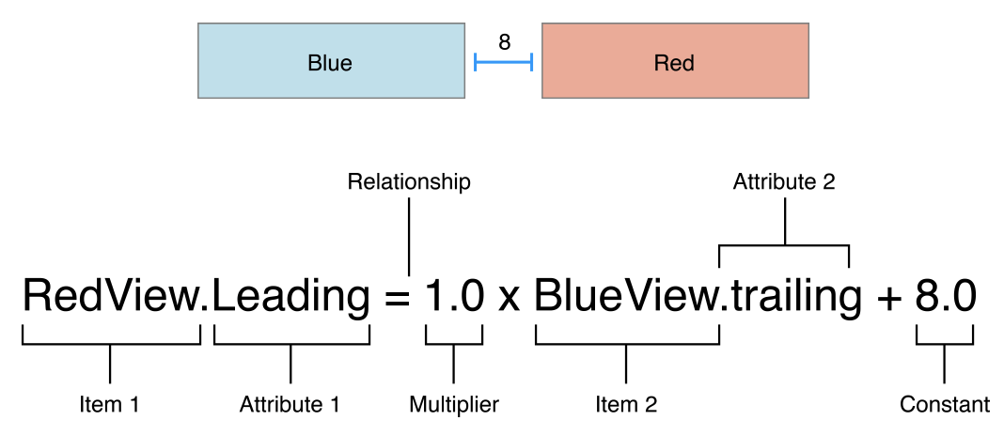
Anatomy of a Constraint
The layout of your view hierarchy is defined as a series of linear equations.
Each constraint represents a single equation.
Goal is to declare a series of equations that has one and only one possible solution.

Slide 7
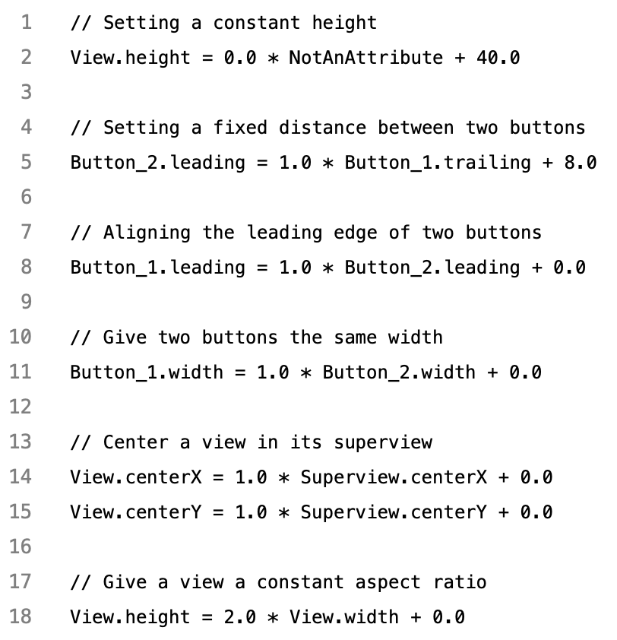
Sample equations for common constraints

Slide 8
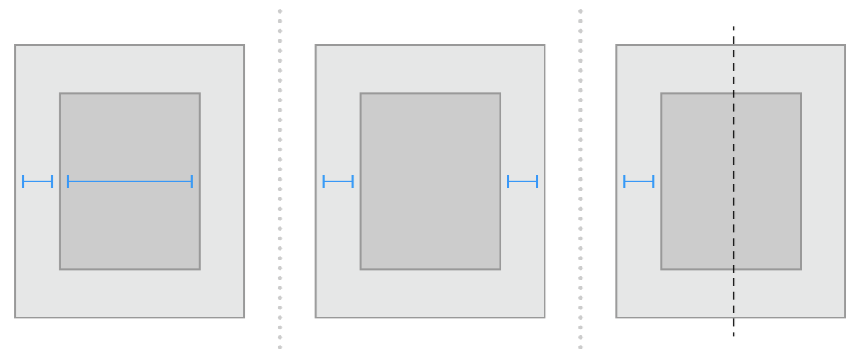
Creating Nonambiguous, Satisfiable Layouts
Ambiguous constraints have more than one possible solution. Unsatisfiable constraints don’t have valid solutions.
The first layout constrains the view’s leading edge relative to its superview’s leading edge. It also gives the view a fixed width. The position of the trailing edge can then be calculated based on the superview’s size and the other constraints.
The second layout constrains the view’s leading edge relative to its superview’s leading edge. It also constrains the view’s trailing edge relative to the superview’s trailing edge. The view’s width can then be calculated based on the superview’s size and the other constraints.
The third layout constrains the view’s leading edge relative to its superview’s leading edge. It also center aligns the view and superview. Both the width and trailing edge’s position can then be calculated based on the superview’s size and the other constraints.
Only the horizontal constraints

Slide 9
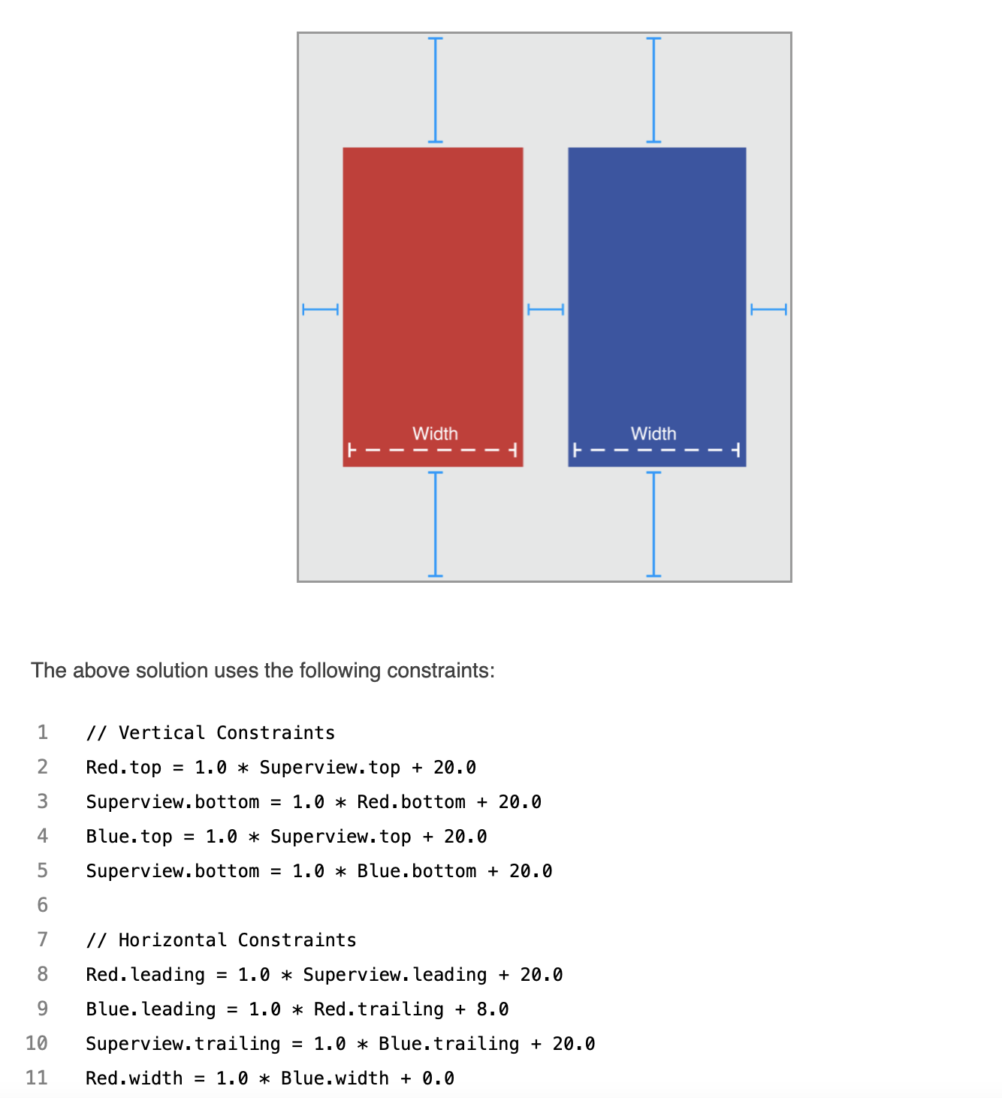
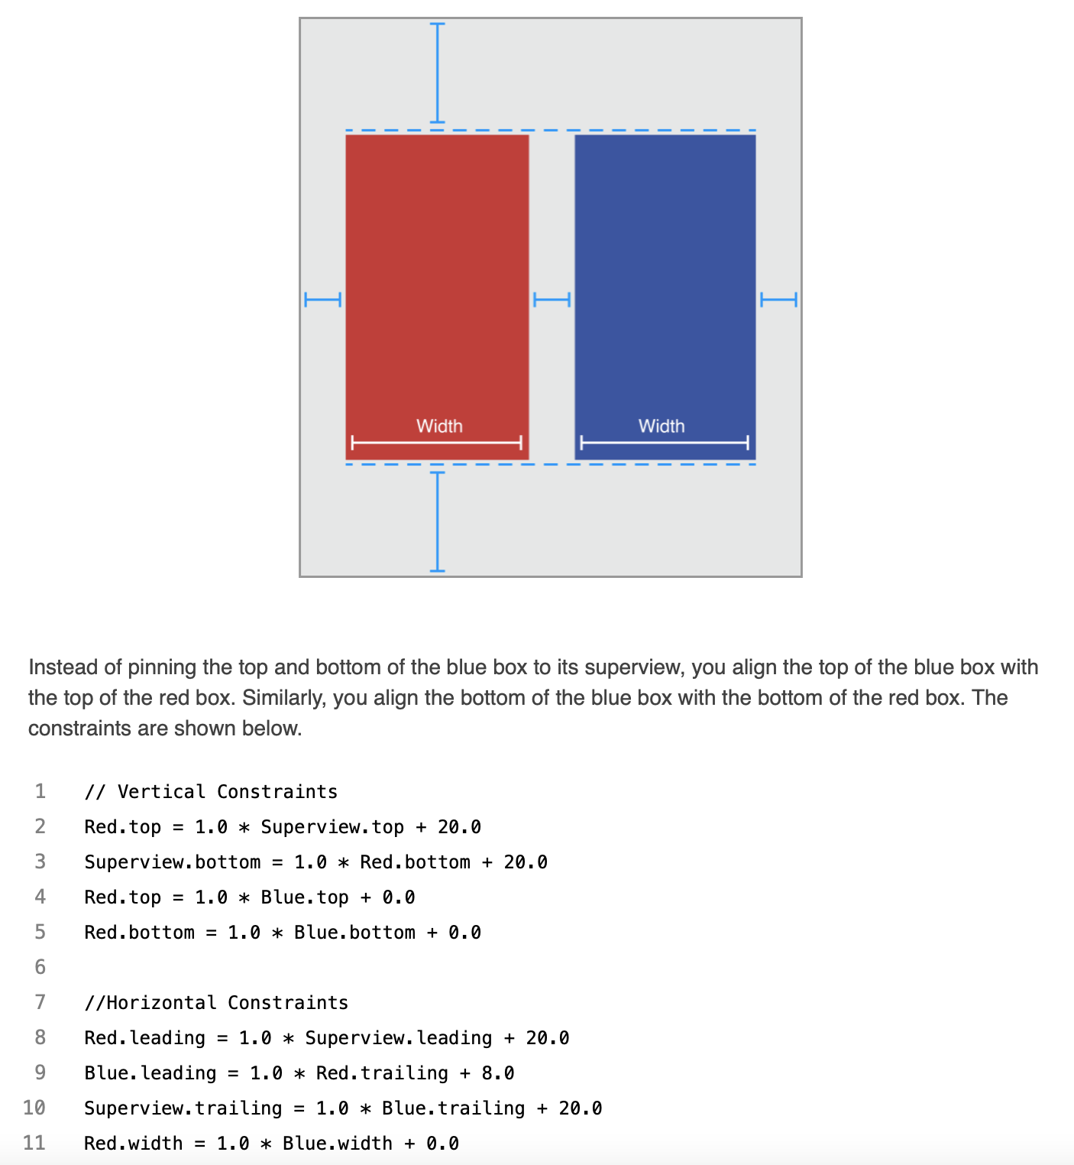
Creating Nonambiguous, Satisfiable Layouts
Assuming the superview’s size is already set (for example, the root view of a scene in iOS), a nonambiguous, satisfiable layout requires two constraints per view per dimension (not counting the superview).

Slide 10
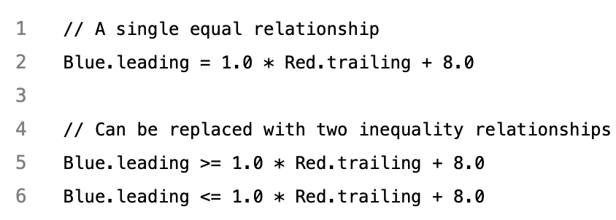
Constraint Inequalities
Constraints can represent inequalities as well.
Specifically, the constraint’s relationship can be equal to, greater than or equal to, or less than or equal to.
As soon as you start using inequalities, the two constraints per view per dimension rule breaks down.
You can always replace a single equality relationship with two inequalities.

Slide 11
Constraint Priorities
All constraints have a priority between 1 and 1000. Constraints with a priority of 1000 are required. All other constraints are optional.
If auto layout cannot satisfy an optional constraint, that constraint is skipped, and it continues on to the next constraint.
Priorities should generally cluster around the system-defined low (250), medium (500), high (750), and required (1000) priorities.

Slide 12
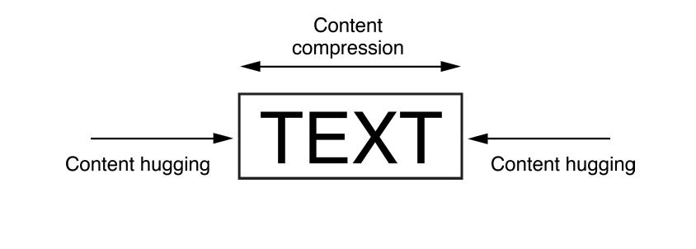
Intrinsic Content Size
Some views have a natural size given their current content. This is referred to as their intrinsic content size.
For example, a button’s intrinsic content size is the size of its title plus a small margin.
The intrinsic content size is based on the view’s current content.
Auto Layout represents a view’s intrinsic content size using a pair of constraints for each dimension.
The content hugging pulls the view inward so that it fits snugly around the content. The compression resistance pushes the view outward so that it does not clip the content.
By default, views use a 250 priority for their content hugging, and a 750 priority for their compression resistance. Therefore, it’s easier to stretch a view than it is to shrink it.

Slide 13
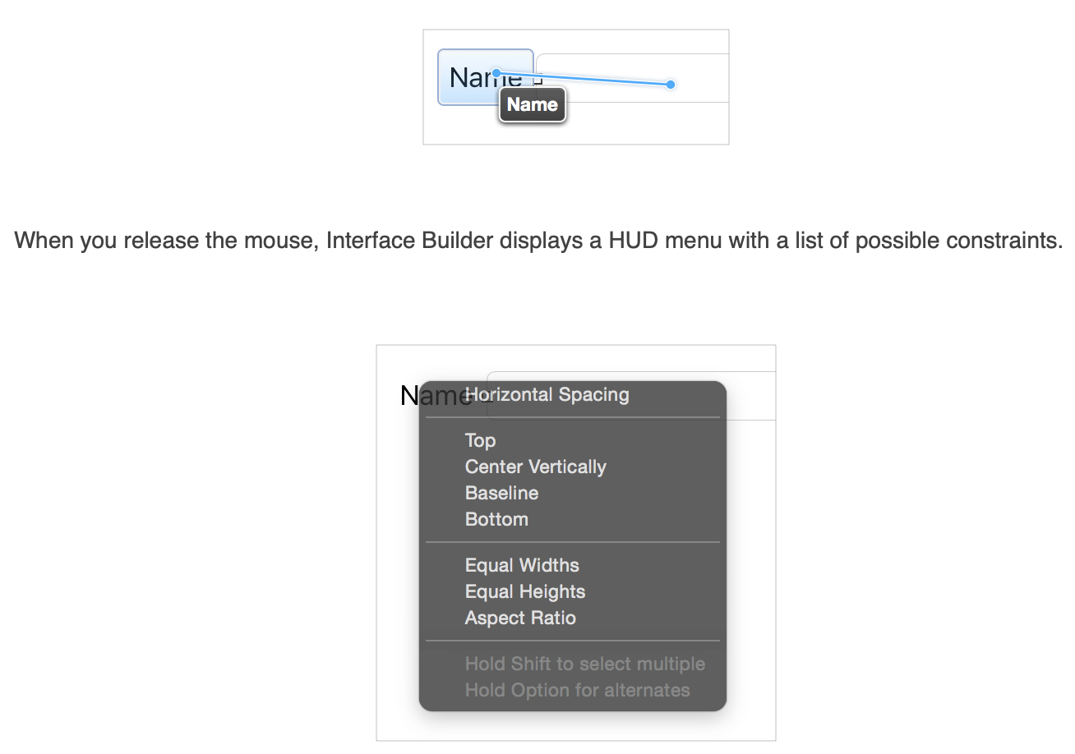
Control-Dragging Constraints
To create a constraint between two views, Control-click one of the views and drag to the other.

Slide 14
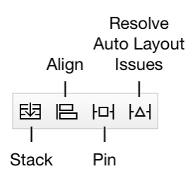
the Stack, Align, Pin and Resolve Tools
Interface Builder provides four Auto Layout tools in the bottom-right corner of the Editor window. These are the Stack, Align, Pin, and Resolve Auto Layout Issues tools.
The Stack tool allows you to quickly create a stack view.
The Align tool lets you quickly align items in your layout.
The Pin tool lets you quickly define a view’s position relative to its neighbors or quickly define its size.
The Resolve Auto Layout Issues tool provides a number of options for fixing common Auto Layout issues.

Slide 15
Conclusion
Constraint-based approach to design allows you to build user interfaces that dynamically respond to both internal and external changes.

Slide 16
Reference
https://developer.apple.com/library/archive/documentation/UserExperience/Conceptual/AutolayoutPG/index.html - //apple_ref/doc/uid/TP40010853-CH7-SW1

Slide 17
Auto layout 44643 Mobile Computing - iOS
Instructor: Dr. Chandra Mouli
Northwest Missouri State University

