Slide 1
UIView animations 44653 mobile Computing – iOS
Instructor: Dr. Chandra Mouli
Northwest Missouri State University

Slide 2
Table of contents
Introduction
UIView Animations
UIViewPropertyAnimator
Conclusion

Slide 3
Introduction
Animating UIView properties
frame/center, bounds, transform (translate, rotate, scale), alpha (opacity), backgroundColor.
Animating Controller transitions (as in a UINavigationController)
Core Animation – An underlying powerful animation framework
OpenGL and Metal
3D
SpriteKit
“2.5D” animation
Dynamic Animation
“Physics”-based animation

Slide 4
UIView Animations
Changes to several view properties can be animated.
frame
bounds
center
transform
alpha
backgroundColor
To animate your changes, create a UIViewPropertyAnimator object and use its handler block to change the values of your view's properties.
If you want to start the animations immediately after the creation of your animator, use the runningPropertyAnimator(withDuration:delay:options:animations:completion:) method.

Slide 5

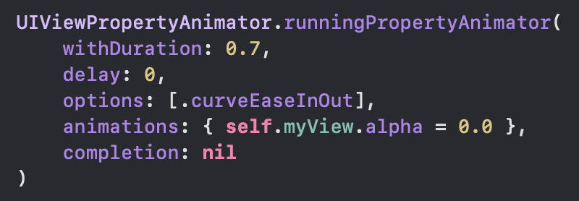
Example 1

Slide 6
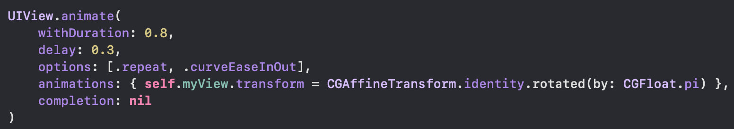
Example 2
We can also use UIView’s overloaded animate method, but animations using UIViewPropertyAnimator are preferred.

Slide 7
UIView Animations
Check out the UIView’s animation options.
https://developer.apple.com/documentation/uikit/uiview/animationoptions
Provide your changes to a UIView’s properties in a closure as an argument to animations parameter.
If required, you can also define code in a closure as an argument to completion parameter to run after animations finish.

Slide 8
Conclusion
Use UIViewPropertyAnimator’s class method runningPropertyAnimator(withDuration:delay:options:animations:completion:) to animate a UIView’s properties.

Slide 9
UIView animations 44653 mobile Computing – iOS
Instructor: Dr. Chandra Mouli
Northwest Missouri State University

