Slide 1
GDP-I Week-10 Progress
Team Members:
Kopparthi Sai Dinesh,
Chepuri Tagore Charith,
Emani Aasrita,
Dasari Vamshika,
Maddela Tejaswi,
Veldanda Sailaxmi

Slide 2
Contents
Work Completed in Previous Week
Work Completed in Present Week
Contribution
Next Steps

Slide 3
Work Completed in Previous Week
Defined system architecture for the project.
Set-up a collaborative git repository for the project.

Slide 4



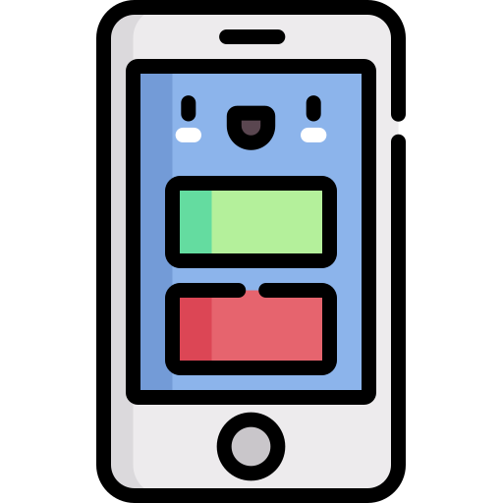
Work Completed in Previous Week – System Architecture
Frontend
Backend
Authentication
Server
Database
User Interface

Slide 5
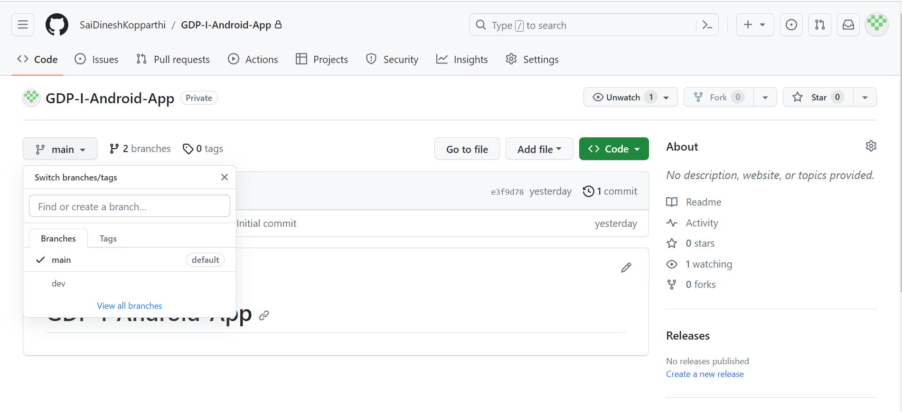
Work Completed in Previous Week – Git Repository
Branch ‘main’ : Source code hosting.
Branch ‘dev’: Branch for development.

Slide 6
Work Completed in Present Week – Android Project Creation
Installation of Android Studio and other relevant tools like GitBash, GitHub Desktop etc.
Created an Android Project Named – “NWClassTrackr”
Minimum SDK: API 24 (“Nougat: Android 7.0)
Build configuration language: Kotlin DSL (build.gradle.kts)

Slide 7
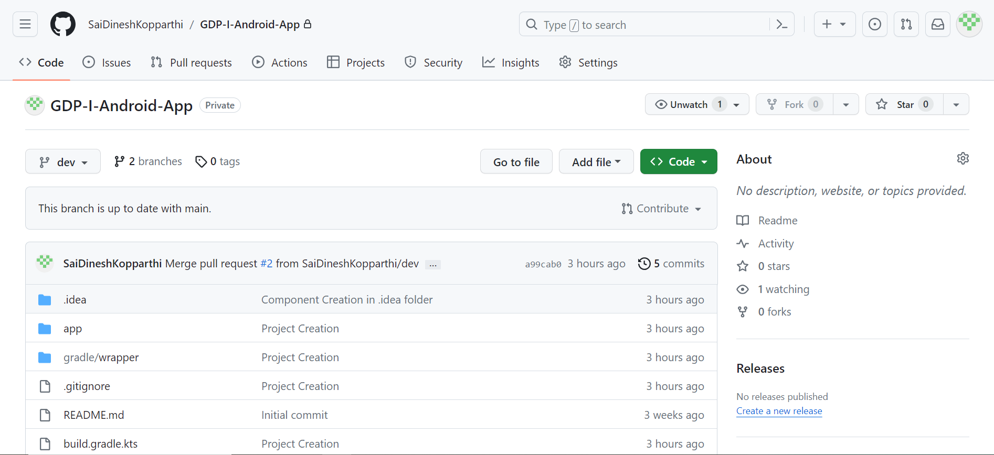
Work Completed in Present Week – GitHub Integration
Project integrated into the GitHub repository set-up for application development
dev and main in same state. Development work will be continued in dev

Slide 8
Work Completed in Present Week – Research into Development tool stack.
Looking into capabilities of Firebase for Database.
Realtime Database
Authentication

Slide 9
Contribution
Team Member | Tasks
Veldanda Sailaxmi | Installed tools required for application development and integrated project with GitHub
Emani Aasrita | Installed tools required for application development and integrated project with GitHub
Maddela Tejaswi | Installed tools required for application development and integrated project with GitHub
Dasari Vamshika | Installed tools required for application development and integrated project with GitHub
Chepuri Tagore Charith | Installed tools required for application development and integrated project with GitHub
Kopparthi Sai Dinesh | Installed tools required for application development and integrated project with GitHub. Research into Firebase for database.

Slide 10
Next steps
Creation of XML layouts and java files for the application.
Continuing with the research for development tools and technology.

Slide 11
THANK YOU

