Slide 1
GDP-I Week-13 Progress
Team Members:
Kopparthi Sai Dinesh,
Chepuri Tagore Charith,
Emani Aasrita,
Dasari Vamshika,
Maddela Tejaswi,
Veldanda Sailaxmi
1

Slide 2
Contents
Work Completed in Previous Week
Work Completed in Present Week
Contribution
2

Slide 3
Work Completed in Previous Week
Implementing java file for the Login Screen.
Developing XML Layout for the Department Screen.
Continued with the research for development tools and technology
3

Slide 4
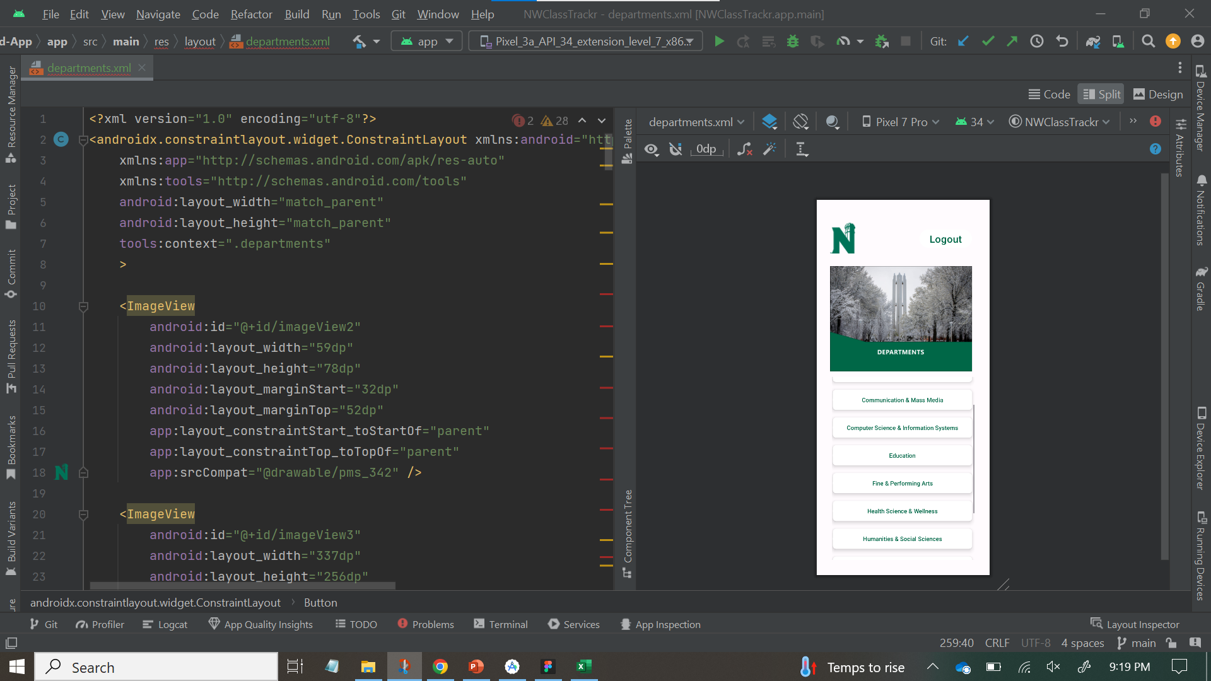
Work Completed in Present Week
XML Code for the department screen
Design view with embedded scroll view and each buttons embedded inside a card view widget

Slide 5
Contribution
Team Member | Tasks
Veldanda Sailaxmi | Implementing Scroll view in the XML Layout
Emani Aasrita | Adding and customizing buttons in the XML Layout
Maddela Tejaswi | Implementing Scroll view in the XML Layout
Dasari Vamshika | Adding and customizing buttons in the XML Layout
Chepuri Tagore Charith | Implementing card view widget in the XML Layout
Kopparthi Sai Dinesh | Implementing card view widget in the XML Layout
7

Slide 6
THANK YOU

