Slide 1
Mobile Computing - iOS
Instructor: Dr. Chandra Mouli
Northwest Missouri State University

Slide 2
Table of contents
Course logistics.
Introduction to iOS App Development.
Installation of Xcode and other required tools.
Conclusion.

Slide 3
Course logistics
Read course syllabus document that is available on Canvas.

Slide 4
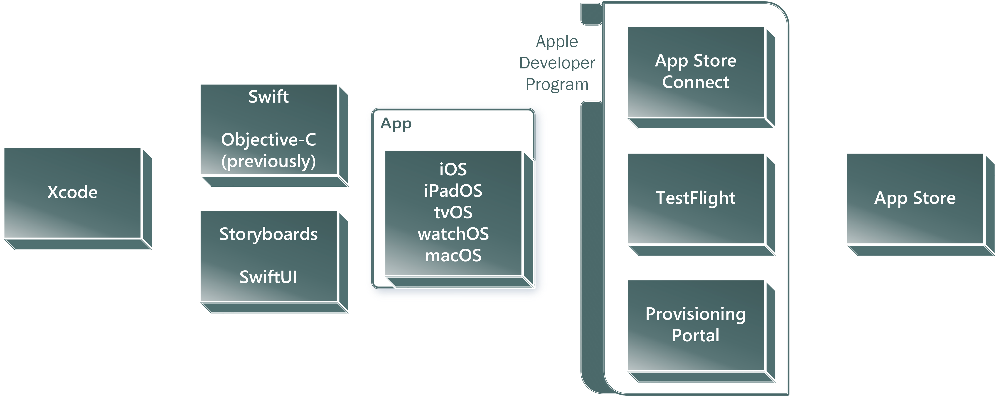
Introduction to iOS App Development

Slide 5
Installation of Xcode and other required tools
Xcode – latest version.
GitHub integration.

Slide 6
Conclusion
We discussed the course logistics, and iOS App Development.
Acquired required software/tools.

Slide 7
Mobile Computing - iOS
Instructor: Dr. Chandra Mouli
Northwest Missouri State University

