Slide 1
basic operators 44643 Mobile Computing - iOS
Instructor: Dr. Chandra Mouli
Northwest Missouri State University

Slide 2
Table of contents
Introduction
Assignment operator
Arithmetic operators
Remainder, unary minus, unary plus
Compound assignment operators
Comparison operators
Ternary conditional operator
Range operators
Logical operators
Conclusion

Slide 3
Introduction
Swift supports the operators you may already know from languages like C, Java, and improves several capabilities to eliminate common coding errors.
The assignment operator (=) doesn’t return a value, to prevent it from being mistakenly used when the equal to operator (==) is intended.
Operators are unary, binary, or ternary.
Unary operators operate on a single target (such as -a).
Binary operators operate on two targets (such as 2 + 3).
Ternary operators operate on three targets (a ? b : c).
In the expression 1 + 2, the + symbol is an operator, and its two operands are the values 1 and 2.

Slide 4
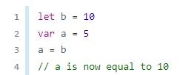

Assignment operator
The assignment operator (a = b) initializes or updates the value of a with the value of b.
If the right side of the assignment is a tuple with multiple values, its elements can be decomposed into multiple constants or variables at once.

Slide 5
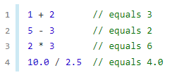
Arithmetic operators
Swift supports the four standard arithmetic operators for all number types.
Addition (+)
The addition operator is also supported for String concatenation.
Subtraction (-)
Multiplication (*)
Division (/)

Slide 6


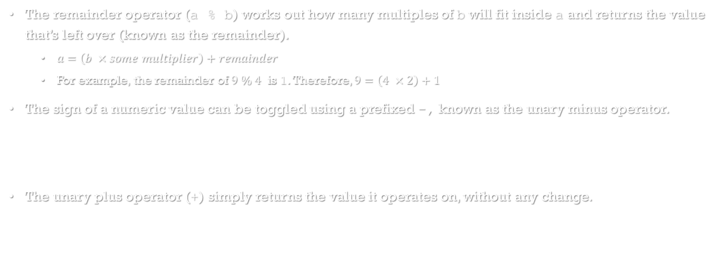
Remainder, unary minus, unary plus
The remainder operator (a % b) works out how many multiples of b will fit inside a and returns the value that’s left over (known as the remainder).
$a=\left(b ×some multiplier\right)+remainder$
For example, the remainder of $9 \% 4$ is 1. Therefore, $9=\left(4 ×2\right)+1$
The sign of a numeric value can be toggled using a prefixed -, known as the unary minus operator.
The unary plus operator (+) simply returns the value it operates on, without any change.

Slide 7

Compound assignment operators
Swift provides compound assignment operators that combine assignment (=) with another operation. One example is the addition assignment operator (+=).

Slide 8
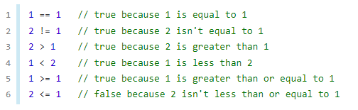
Comparison operators
Swift supports the following comparison operators:
Equal to (a == b)
Not equal to (a != b)
Greater than (a > b)
Less than (a < b)
Greater than or equal to (a >= b)
Less than or equal to (a <= b)
Swift also provides two identity operators (=== and !==), which you use to test whether two object references both refer to the same object instance.

Slide 9
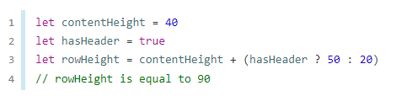
Ternary Conditional Operator
The ternary conditional operator is a special operator with three parts, which takes the form question ? answer1 : answer2
It’s a shortcut for evaluating one of two expressions based on whether question is true or false.
If question is true, it evaluates answer1 and returns its value; otherwise, it evaluates answer2 and returns its value.

Slide 10
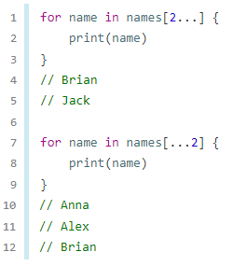
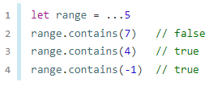
Range operators
The closed range operator (a...b) defines a range that runs from a to b, and includes the values a and b. The value of a must not be greater than b.
Range 1…5 has values 1, 2, 3, 4, 5.
The half-open range operator (a..<b) defines a range that runs from a to b, but doesn’t include b. The value of a must not be greater than b.
Range 1..<5 has values 1, 2, 3, 4.
Examples of one-sided ranges:

Slide 11
Logical operators
Logical operators modify or combine the Boolean logic values true and false. Swift supports the three standard logical operators found in C-based languages:
Logical NOT (!a) – It inverts a Boolean value so that true becomes false, and false becomes true.
Logical AND (a && b) – It creates logical expressions where both values must be true for the overall expression to also be true.
Logical OR (a || b) – It creates logical expressions in which only one of the two values must be true for the overall expression to be true.

Slide 12
Conclusion
An operator is a special symbol or phrase that you use to check, change, or combine values.
Swift supports the operators you may already know from languages like C and improves several capabilities to eliminate common coding errors.
https://docs.swift.org/swift-book/LanguageGuide/AdvancedOperators.html

Slide 13
Reference
https://www.swift.org/documentation/#swift-language

Slide 14
basic operators 44643 Mobile Computing - iOS
Instructor: Dr. Chandra Mouli
Northwest Missouri State University

