Slide 1
Collection Types 44643 Mobile Computing - iOS
Instructor: Dr. Chandra Mouli
Northwest Missouri State University

Slide 2
Table of contents
Introduction
Collection Types
Mutability of Collections
Arrays
Sets
Dictionaries
Conclusion

Slide 3
Introduction
Swift provides three primary collection types, known as arrays, sets, and dictionaries for storing collections of values.
Arrays are ordered collections of values.
Sets are unordered collections of unique values.
Dictionaries are unordered collections of key-value associations.

Slide 4

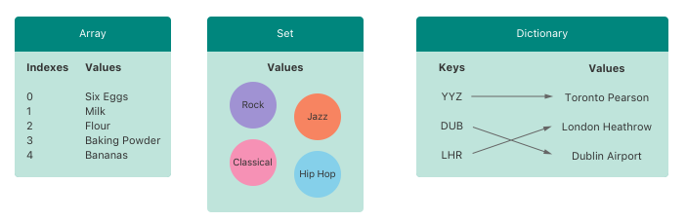
Collection types
Arrays, sets, and dictionaries in Swift are always clear about the types of values and keys that they can store.

Slide 5
Mutability of Collections
Creating an array, a set, or a dictionary, and assign it to a variable, the collection created will be mutable.
This means that you can change (or mutate) the collection after it’s created by adding, removing, or changing items in the collection.
Assigning an array, a set, or a dictionary to a constant, that collection is immutable, and its size and contents can’t be changed.

Slide 6

arrays
An array stores values of the same type in an ordered list. The same value can appear in an array multiple times at different positions.
Declaration:
Creating an Empty Array:

Slide 7

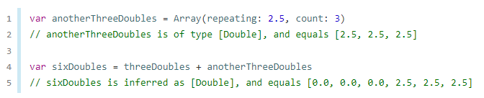
Arrays
Creating an Array with a Default Value:
Creating an Array by Adding Two Arrays Together:

Slide 8

Arrays
Initialize an array:
To find out the number of items in an array, use its read-only count property.

Slide 9
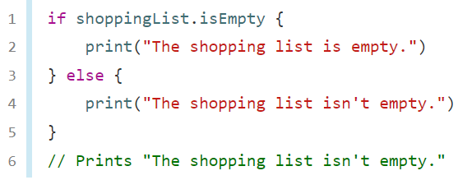
arrays
Use the Boolean isEmpty property as a shortcut for checking whether the count property is equal to 0.

Slide 10
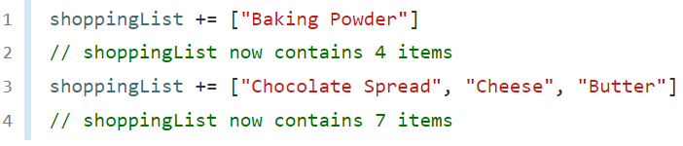
arrays
Add a new item to the end of an array by calling the array’s append(_:) method.
Alternatively, append an array of one or more compatible items with the addition assignment operator (+=).

Slide 11


arrays
Retrieve a value from the array by using subscript syntax. Arrays in Swift are zero-indexed.
Use subscript syntax to change an existing value at a given index.
Subscript syntax can be used to change a range of values at once. To replace elements "Chocolate Spread", "Cheese", and "Butter" with "Bananas" and "Apples“.

Slide 12
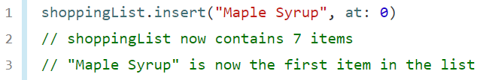
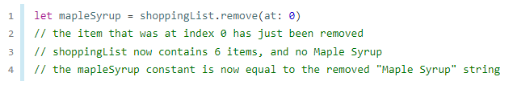
arrays
Insert an item into the array at a specified index using array’s insert(_:at:) method.
Remove an item from the array with the remove(at:) method.

Slide 13

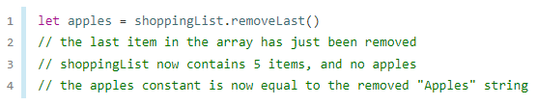
Arrays
Any gaps in an array are closed when an item is removed.
To remove the final item from an array, use the removeLast() method rather than the remove(at:) method to avoid the need to query the array’s count property.

Slide 14
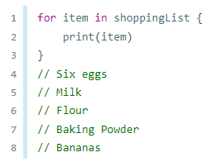
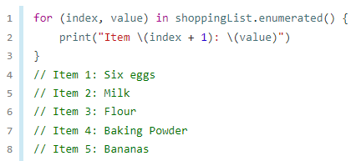
arrays
Use for-in loop to iterate over an array.
To get the integer index of each item as well as its value, use the enumerated() method to iterate over the array instead.
For each item in the array, the enumerated() method returns a tuple composed of an integer and the item.

Slide 15
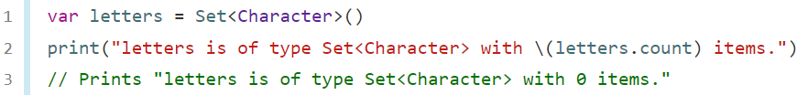
Sets
A set stores distinct values of the same type in a collection with no defined ordering.
A type must be hashable in order to be stored in a set
Use a set instead of an array when the order of items isn’t important, or when you need to ensure that an item only appears once.
Creating and Initializing an Empty Set:
Initialize a Set with an Array Literal:

Slide 16
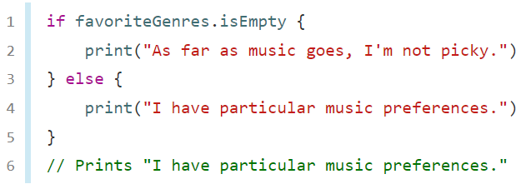
sets
To find out the number of items in a set, use its read-only count property:
Use the Boolean isEmpty property as a shortcut for checking whether the count property is equal to 0:

Slide 17

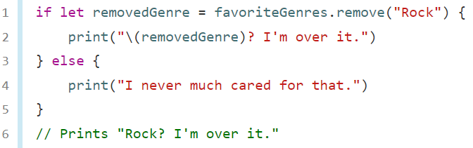
sets
Add a new item into a set by calling the set’s insert(_:) method:
Remove an item from a set by calling the set’s remove(_:) method, which removes the item if it’s a member of the set, and returns the removed value, or returns nil if the set didn’t contain it.
All items in a set can be removed with its removeAll() method.

Slide 18
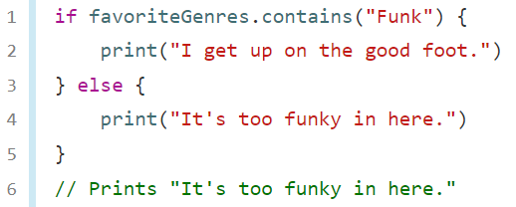
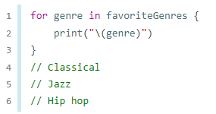
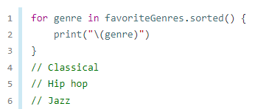
Sets
To check whether a set contains a particular item, use the contains(_:) method.
Iterating Over a Set:

Slide 19
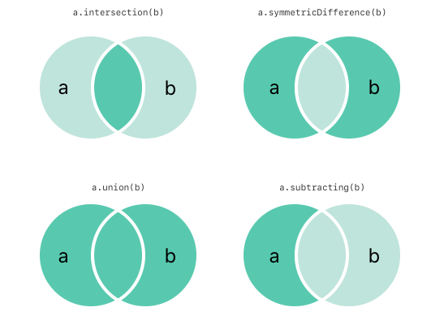
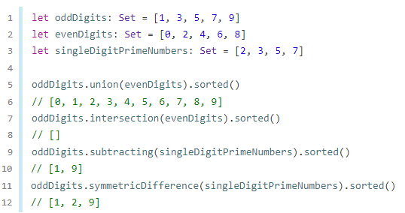
Set Operations

Slide 20
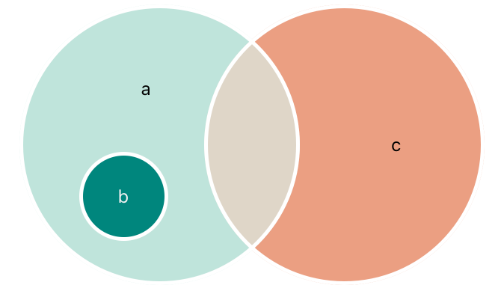
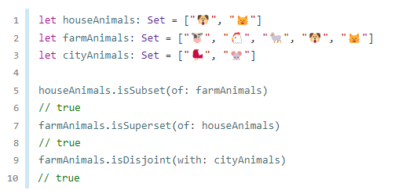
Set operations

Slide 21


Dictionaries
A dictionary stores associations between keys of the same type and values of the same type in a collection with no defined ordering.
A dictionary Key type must conform to the Hashable protocol, like a set’s value type.
Each value is associated with a unique key, which acts as an identifier for that value within the dictionary.
A key-value pair is a combination of a key and a value.
Creating an Empty Dictionary:

Slide 22
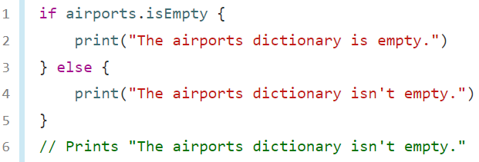
Dictionaries
To find out the number of items in a Dictionary use its read-only count property:
Use the Boolean isEmpty property as a shortcut for checking whether the count property is equal to 0:

Slide 23


Dictionaries
Add a new item to a dictionary with subscript syntax:
Use subscript syntax to change the value associated with a particular key:

Slide 24
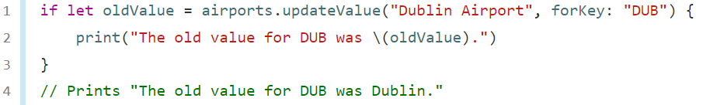
Dictionaries
Use dictionary’s updateValue(_:forKey:) method to set or update the value for a particular key.

Slide 25
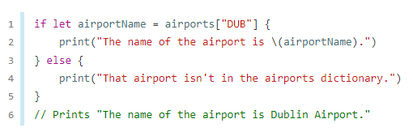
Dictionaries
Use subscript syntax to retrieve a value from the dictionary for a particular key.

Slide 26
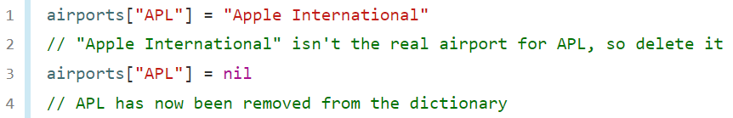
Dictionaries
Use subscript syntax to remove a key-value pair from a dictionary by assigning a value of nil for that key.

Slide 27
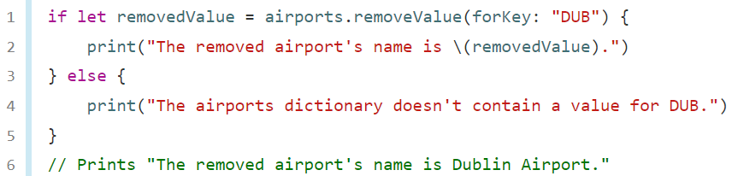
Dictionaries
Remove a key-value pair from a dictionary with the removeValue(forKey:) method. This method removes the key-value pair if it exists and returns the removed value, or returns nil if no value existed.

Slide 28
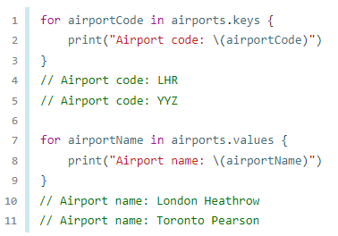
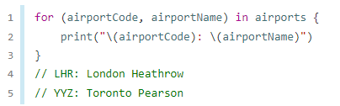
Dictionaries
Iterating Over a Dictionary:
Retrieve an iterable collection of a dictionary’s keys or values by accessing its keys and values properties.

Slide 29
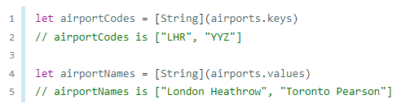
dictionaries
If you need to use a dictionary’s keys or values with an API that takes an Array instance, initialize a new array with the keys or values property.
Swift’s Dictionary type doesn’t have a defined ordering. To iterate over the keys or values of a dictionary in a specific order, use the sorted() method on its keys or values property.

Slide 30
Conclusion
Arrays, sets, and dictionaries in Swift are always clear about the types of values and keys that they can store.
This means that you can’t insert a value of the wrong type into a collection by mistake.
It also means you can be confident about the type of values you will retrieve from a collection.

Slide 31
Reference
https://www.swift.org/documentation/#swift-language

Slide 32
Collection Types 44643 Mobile Computing - iOS
Instructor: Dr. Chandra Mouli
Northwest Missouri State University

