Slide 1
Enumerations 44643 Mobile Computing - iOS
Instructor: Dr. Chandra Mouli
Northwest Missouri State University

Slide 2
Table of contents
Introduction
Enumeration Syntax
Matching Enumeration Values with a Switch Statement
Iterating over Enumeration Cases
Associated Values
Extracting associated values
Raw Values
Initializing from a raw value
Recursive Enumerations
Conclusion

Slide 3
Introduction
An enumeration defines a common type for a group of related values and enables you to work with those values in a type-safe way within your code.
If a value (known as a raw value) is provided for each enumeration case, the value can be a string, a character, or a value of any integer or floating-point type.
Alternatively, enumeration cases can specify associated values of any type to be stored along with each different case value.
They adopt many features traditionally supported only by classes, for example, instance methods and initializers.

Slide 4

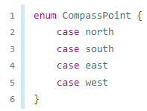


Enumeration Syntax
Enumerations are introduced with the enum keyword, and their entire definition is placed within a pair of braces.
Like other types in Swift, their names start with a capital letter.
Here are a few examples, CompassPoint and Planet.
Multiple cases can be on a single line

Slide 5


Enumeration Syntax
The type of directionToHead is inferred when it’s initialized with one of the possible values of CompassPoint.
Once directionToHead is declared as a CompassPoint, you can set it to a different CompassPoint value using a shorter dot syntax.

Slide 6
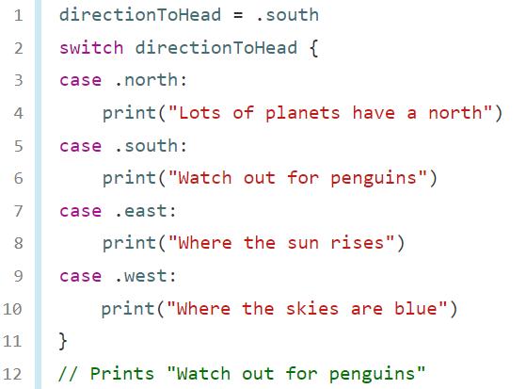
Matching Enumeration Values with a Switch Statement
You can match individual enumeration values with a switch statement.

Slide 7
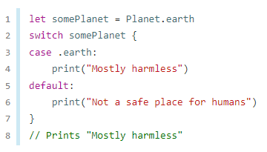
Matching Enumeration Values with a Switch Statement
When it isn’t appropriate to provide a case for every enumeration case, you can provide a default case.

Slide 8
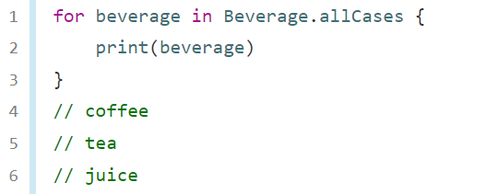
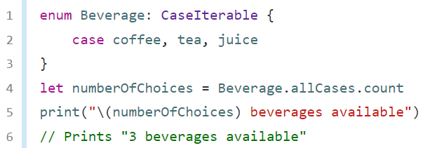
Iterating over Enumeration Cases
Protocol
For some enumerations, it is useful to have a collection of all of that enumeration’s cases.
Write : CaseIterable after the enumeration’s name.
Use allCases property like any other collection—the collection’s elements are instances of the enumeration type.
Example: Beverage.allCases

Slide 9
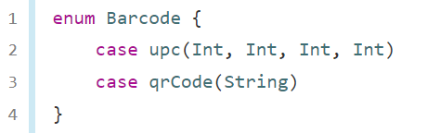
Associated Values
It is sometimes useful to be able to store values of other types alongside these case values.
This additional information is called an associated value, and it varies each time you use that case as a value in your code.

Slide 10
Associated Values
Create new barcodes using either type.
Assign the same product a different type of barcode.

Slide 11
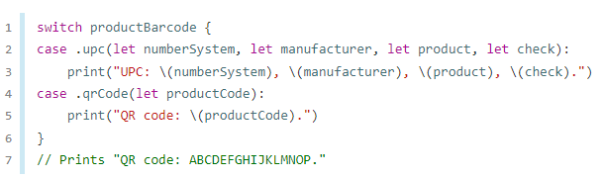
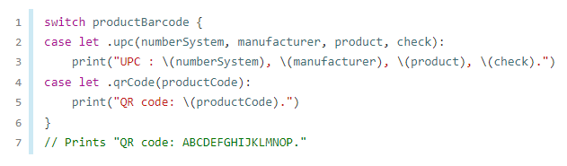
Extracting associated values
Extract each associated value as a constant (with the let prefix) or a variable (with the var prefix) for use within the switch case’s body.
If all of the associated values for an enumeration case are extracted as constants, or if all are extracted as variables, use a single var or let before case name.

Slide 12
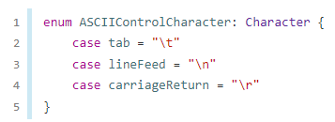
Raw values
As an alternative to associated values, enumeration cases can come prepopulated with default values (called raw values), which are all of the same type.
Here’s an example that stores raw ASCII values alongside named enumeration cases.
Raw values are not the same as associated values.
The raw value for a particular enumeration case is always the same.

Slide 13

Raw values
When working with enumerations that store integer or string raw values, you don’t have to explicitly assign a raw value for each case, Swift automatically assigns the values.
In the example above, Planet.mercury has an explicit raw value of 1, Planet.venus has an implicit raw value of 2, and so on.
When strings are used for raw values, the implicit value for each case is the text of that case’s name.

Slide 14
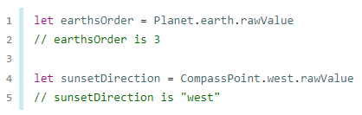
Raw values
Access the raw value of an enumeration case with its rawValue property.

Slide 15

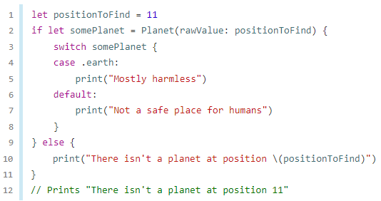
Initializing from a Raw Value
If you define an enumeration with a raw-value type, the enumeration automatically receives an initializer that takes a value of the raw value’s type (as a parameter called rawValue) and returns either an enumeration case or nil.

Slide 16
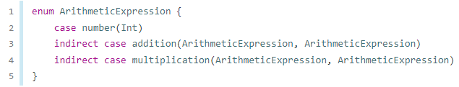
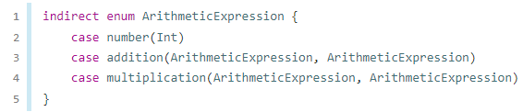
recursive enumerations
A recursive enumeration is an enumeration that has another instance of the enumeration as the associated value for one or more of the enumeration cases.
Use indirect keyword before a recursive enumeration case.
We also write indirect before the beginning of the enumeration to enable indirection for all of the enumeration’s cases that have an associated value:

Slide 17
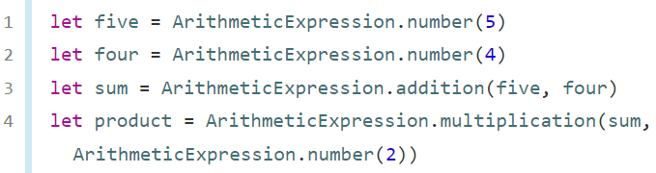
recursive enumerations
The code shows the ArithmeticExpression recursive enumeration being created for (5 + 4) * 2

Slide 18
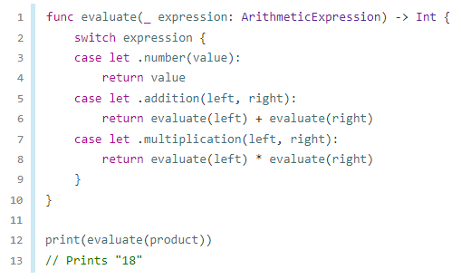
recursive enumerations
A recursive function is a straightforward way to work with data that has a recursive structure.

Slide 19
Conclusion
Enumerations in Swift are flexible, and don’t have to provide a value for each case of the enumeration.
Swift enumeration cases don’t have an integer value set by default, unlike languages like C and Objective-C.
Enumerations in Swift are first-class types in their own right, they adopt many features traditionally supported only by classes.

Slide 20
Reference
https://www.swift.org/documentation/#swift-language

Slide 21
Enumerations 44643 Mobile Computing - iOS
Instructor: Dr. Chandra Mouli
Northwest Missouri State University

