Slide 1
initialization 44643 mobile Computing – iOS
Instructor: Dr. Chandra Mouli
Northwest Missouri State University

Slide 2
Table of contents
Introduction
Initializer syntax
Struct initialization
Class initialization
Conclusion

Slide 3
Introduction
Initialization is the operation of setting up an instance of a type.
It entails giving each stored property an initial value and may involve other preparatory work.
Structures and classes are required to have initial values for their stored properties by the time initialization completes.
Initializers are written with the init keyword.

Slide 4
Initializer Syntax
Even though they are methods on a type, initializers are not preceded with the func keyword and do not return values.
struct CustomType {
init(someValue: SomeType){
// Initialization code goes here…
}
}
This general syntax does not differ among structures, enumerations, and classes.

Slide 5

Struct initialization
Structures can have both default and custom initializers.
Empty initializer: Sets the new instance’s properties to the default values specified.
Memberwise initializer: A memberwise initializer has a parameter for each stored property on the type.
If there is no initializer for a custom struct, provide the necessary values through default values or memberwise initialization.

Slide 6
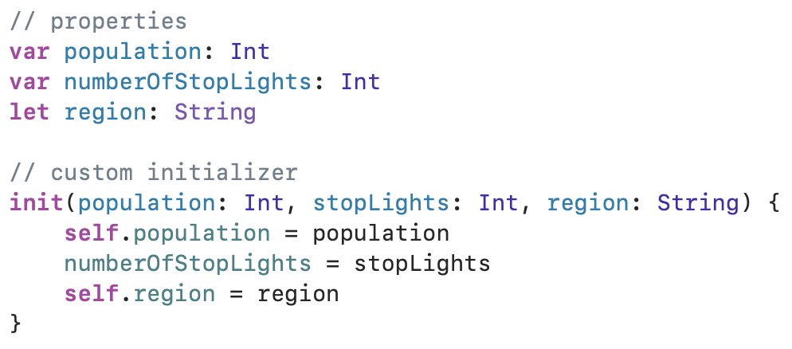
Custom initializers for structs
When there is a custom initializer, Swift will not provide any free initializers (default memberwise initializer).
First, remove all the default values that are given to properties.

Slide 7
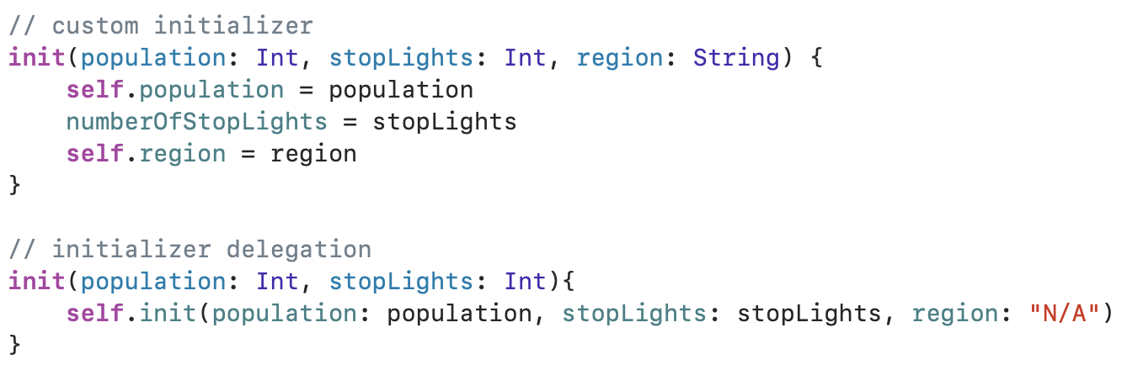
Initializer delegation
Define initializers to call other initializers on the same type. Initializer delegation is relatively straightforward for structures and enumerations. It is somewhat more complicated for classes because of inheritance.

Slide 8
Class initialization
The general syntax for initialization in classes looks very similar to initialization in value types (e.g., structs).
Nonetheless, there are some different rules for classes that must be observed. These are mainly due to inheritance.
Classes add the concepts of designated and convenience initializers.
Designated initializers are responsible for making sure that an instance’s properties all have values before initialization completes, thus making the instance ready to use.
Convenience initializers supplement designated initializers by calling across a class to its designated initializer.
The role of convenience initializers is typically to create an instance of a class for a very specific use case.

Slide 9
Default initializers for classes
Classes get a default, empty initializer if you provide default values to all properties and do not write your own initializer.
Classes do not get a free memberwise initializer like structs.

Slide 10

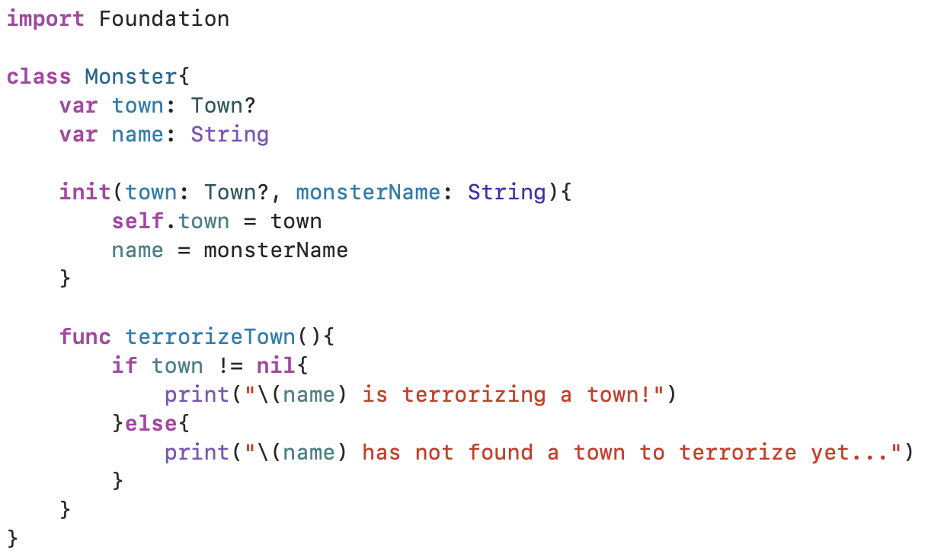
Initialization and class inheritance

Slide 11
Automatic initializer inheritance
If a subclass provides default values for all new properties it adds, then there are two scenarios in which it will inherit its superclass’ initializers:
If the subclass does not define any designated initializers, it will inherit its superclass’ designated initializers.
If the subclass implements all of its superclass’ designated initializers – either explicitly or via inheritance – it will inherit all of its superclass’ convenience initializers.
However, classes do not typically inherit their superclass’ initializers.

Slide 12
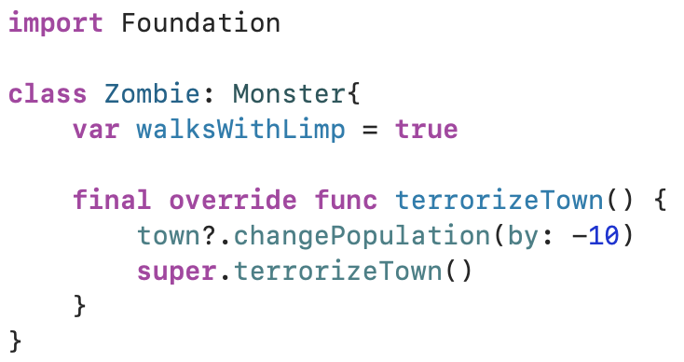
Example

Slide 13
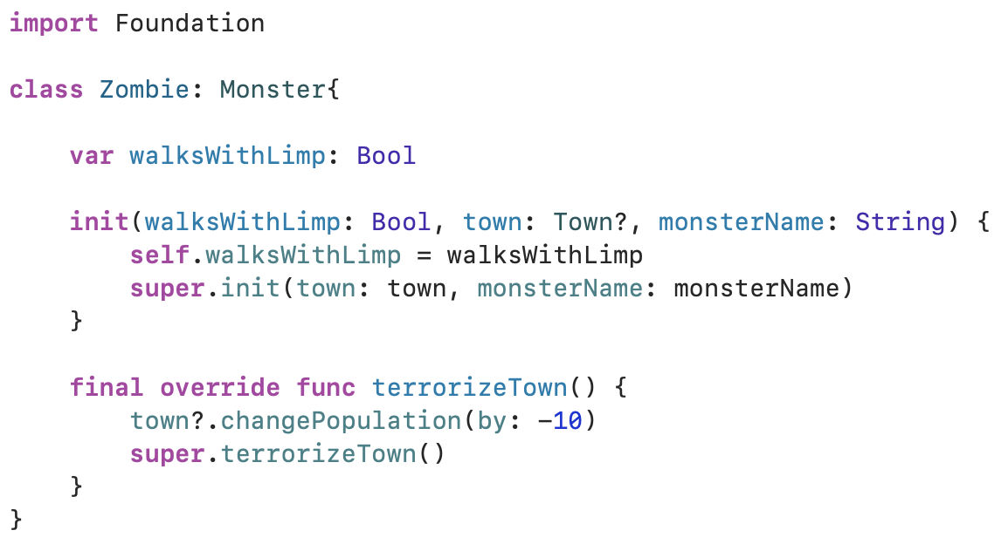
designated initializers
Classes use designated initializers as their primary initializers.
If a class has a superclass, then its designated initializer must also call its superclass’ designated initializer.

Slide 14
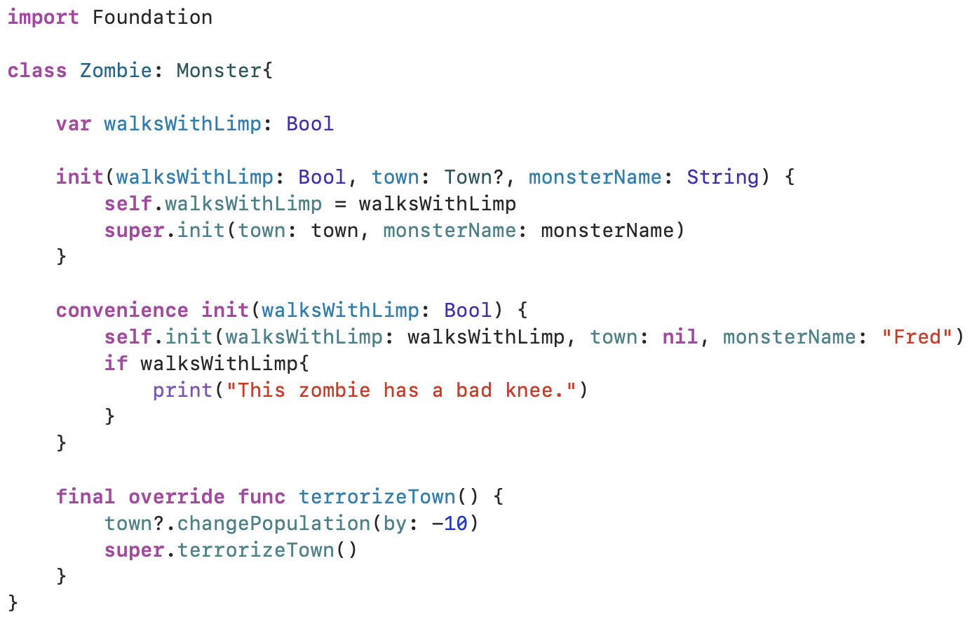
Convenience initializers
All convenience initializers call across to another initializer on the same class.
Eventually, a convenience initializer must call through to its class’ designated initializer.

Slide 15
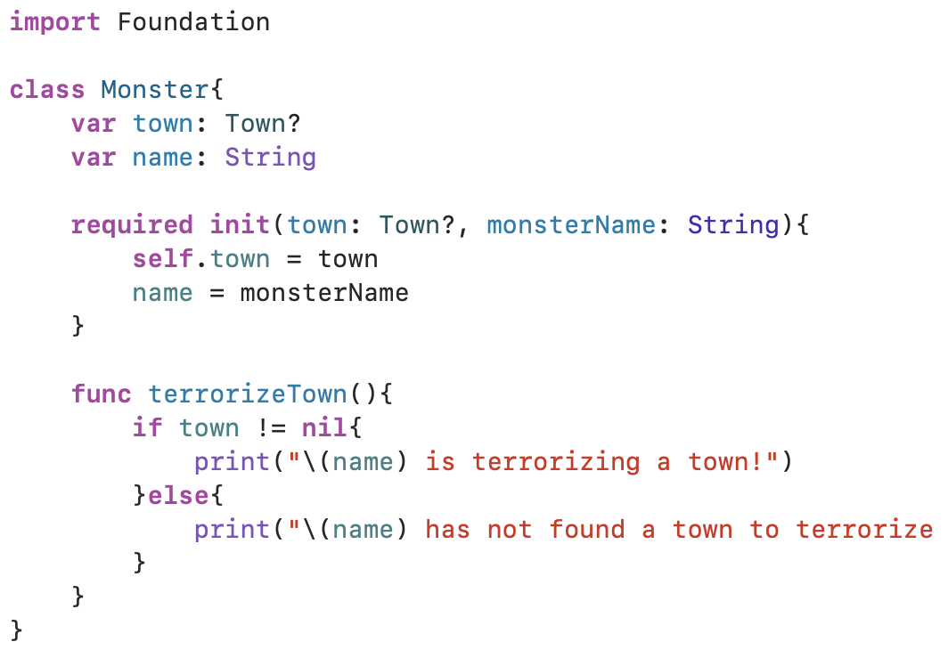
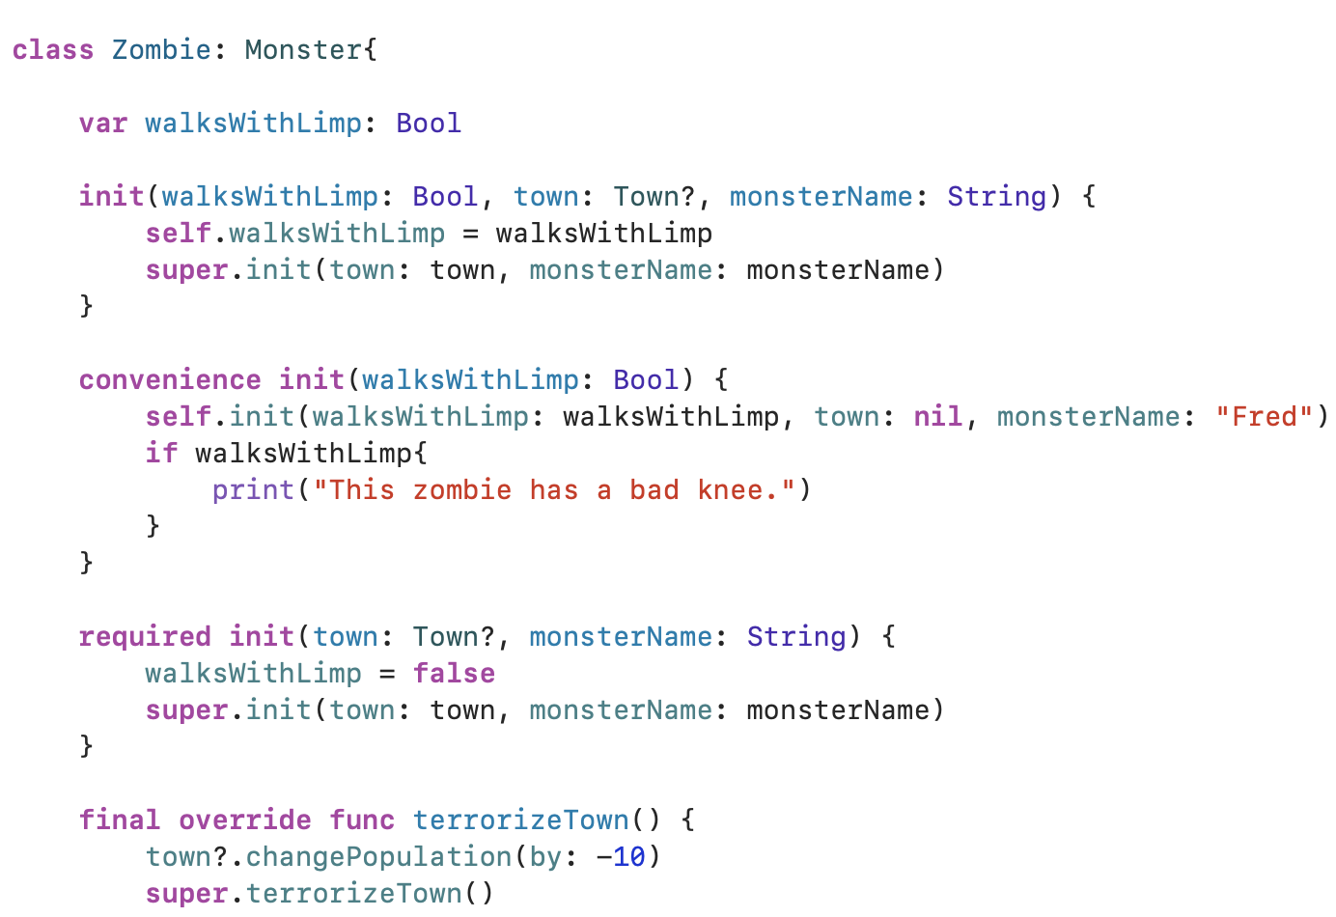
Required initializers

Slide 16
deinitialization
It is part of the process of removing instances of a class from memory when they are no longer needed.
It is limited to reference types and is not available for value types.
In Swift, a deinitializer is called immediately prior to when the instance is removed from memory.
A class can only have one deinitializer. Deinitializers are written with deinit and take no arguments.

Slide 17
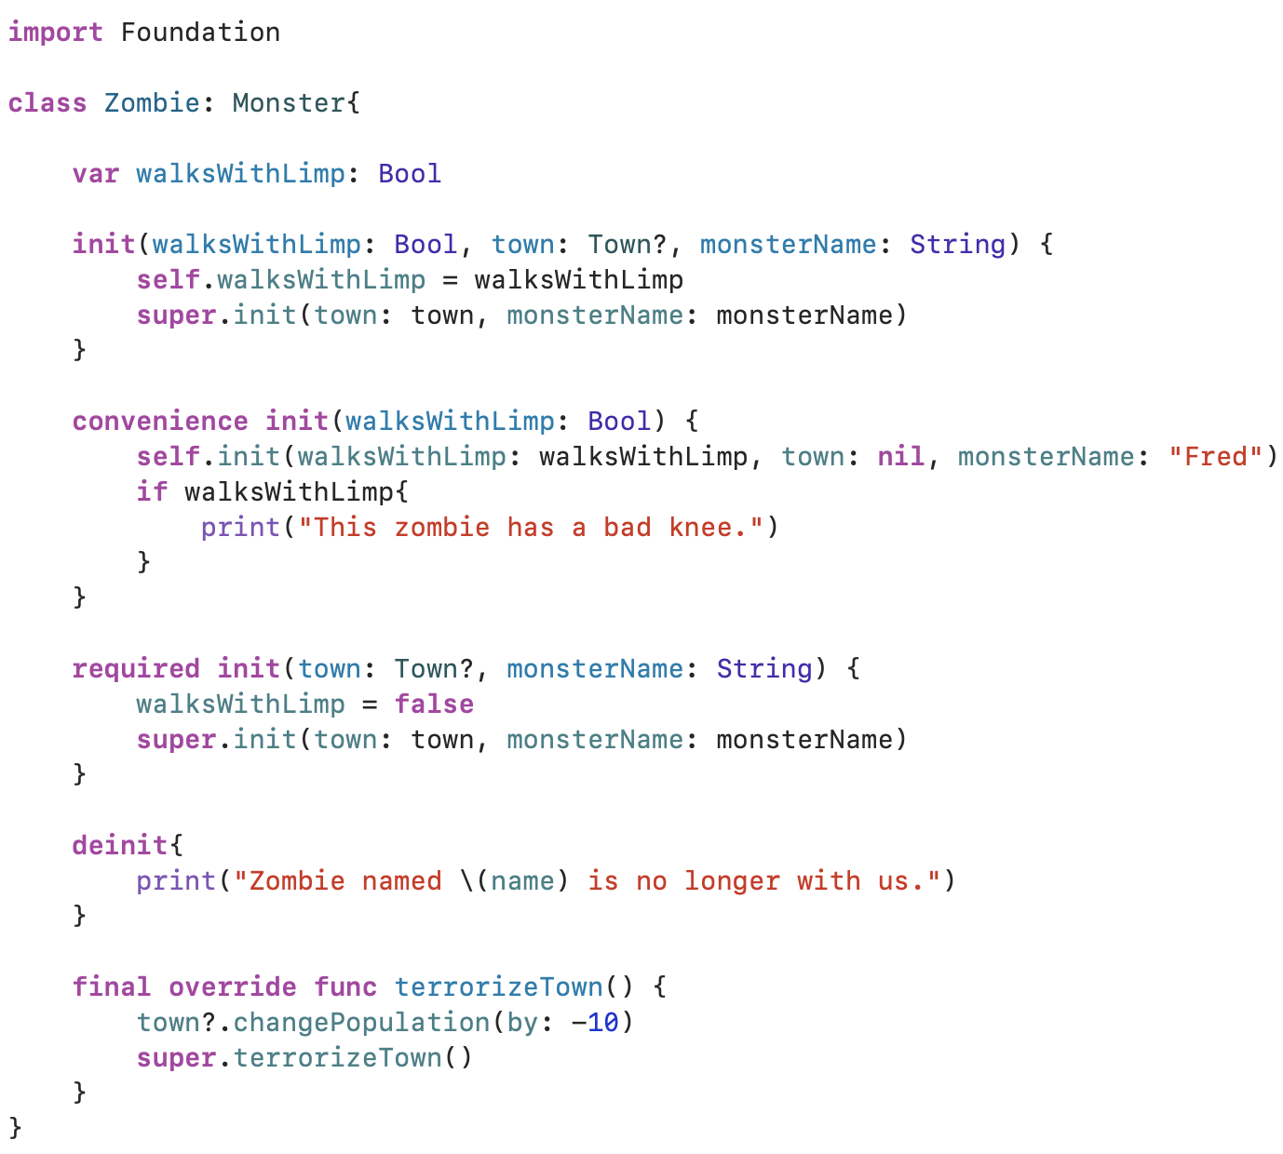
Example
An example of a deinitializer in Zombie class.

Slide 18
Conclusion
Initializers help you create an instance with the appropriate values.
Structures and classes are required to have initial values for their stored properties by the time initialization completes.

Slide 19
Reference
Mathias, M., & Gallagher, J. (2016). Swift Programming: The Big Nerd Ranch Guide. Pearson Technology Group.

Slide 20
initialization 44643 mobile Computing – iOS
Instructor: Dr. Chandra Mouli
Northwest Missouri State University

