Slide 1
Time Series Forecasting For Demand Prediction on Super Market Grocery Sales
22MCA21T: Research Methodology and IPR
22MCA252TL: Data Science I
Team Members
1RV22MC071: PRAVEENGOUDA BIRADAR
1RV22MC084: SAIKUMAR P

Slide 2
Agenda
Introduction
Objectives
Description of the data set
Requirement Analysis
Literature Survey
Proposed Methodology
Implementation
Results and Conclusion
References

Slide 3
Experiential Learning
Introduction
In the dynamic world of retail, effective inventory management is crucial for supermarkets to ensure products are available to meet customer demands while avoiding overstocking or understocking.
Data-driven approaches, especially time series forecasting, play a pivotal role in anticipating future trends and demands. This project seeks to employ cutting-edge data science techniques to forecast grocery sales, enabling supermarkets to optimize their supply chain, reduce costs, and improve overall operational efficiency.
This predictive capability will empower the supermarket chain to optimize inventory management, enhance resource allocation, and make informed decisions to meet customer needs effectively.

Slide 4
Experiential Learning
Objectives
Develop accurate sales forecasting models: This objective focuses on creating advanced data-driven models that can predict future grocery sales with precision. Accurate forecasts are essential for planning inventory and resources effectively.
Optimize inventory management: The goal here is to use the sales forecasts to ensure that supermarkets maintain the right inventory levels. This avoids overstocking (which ties up capital and space) and understocking (which can lead to lost sales and dissatisfied customers).

Slide 5
Experiential Learning
Reduce costs and improve supply chain efficiency: By leveraging forecasting data, supermarkets can identify cost-saving opportunities in procurement, warehousing, and transportation. This objective aims to make supply chain processes more efficient and cost-effective.
Enhance customer satisfaction and decision-making: The final objective is to improve the overall customer experience by ensuring that products are consistently available. Additionally, the project aims to provide valuable insights and reports to support informed decision-making across the supermarket chain, ultimately benefiting both customers and the organization.

Slide 6
Experiential Learning
Description of the data set
We have downloaded the Time series forecasting for product demand prediction on super market grocery sales from Kaggle. It has 1500 rows and 10 attributes.
Profit: The profit earned from the order.
Order ID : Id of the order
Customer Name : Name of the customer
Category: category of the product
Sub category: category of the product
City : city of the super market
Order Date : date of order
Sales : Number of sales in a particular date
Discount : Discount given on the particular product
Profit : Profit gained on the particular product

Slide 7
Experiential Learning
Requirement Analysis
Hardware Requirement
Minimum
CPU: Dual-core processor
RAM: 4 GB
Storage: 20 GB of free disk space
CPU: Quad-core or higher processor
RAM: 8 GB or more

Slide 8
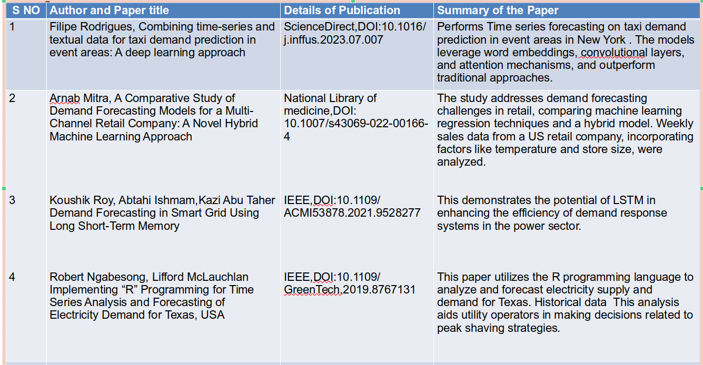
Literature Survey

Slide 9
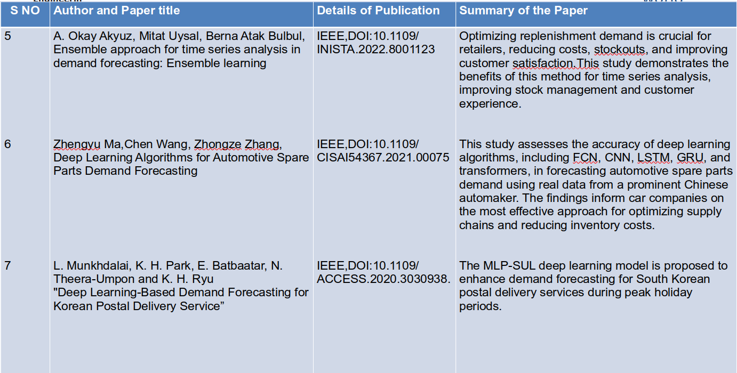
Literature Survey

Slide 10
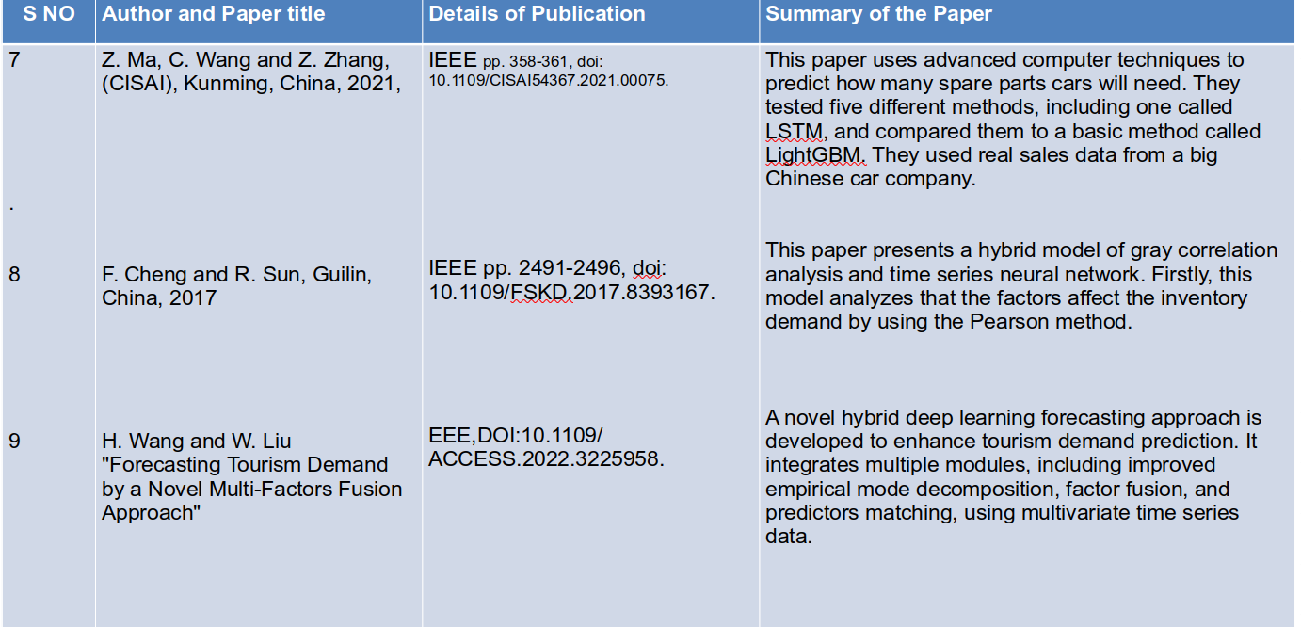
Literature Survey

Slide 11
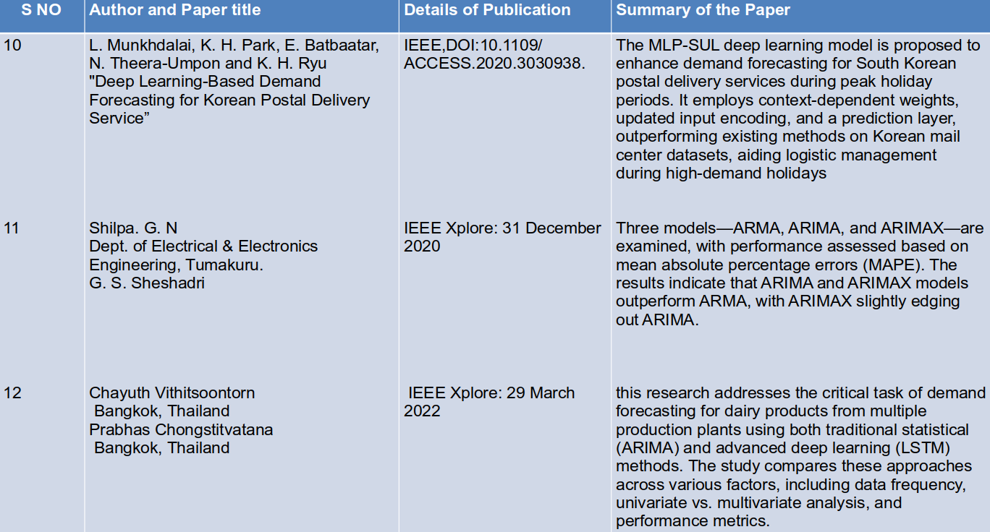
Literature Survey

Slide 12
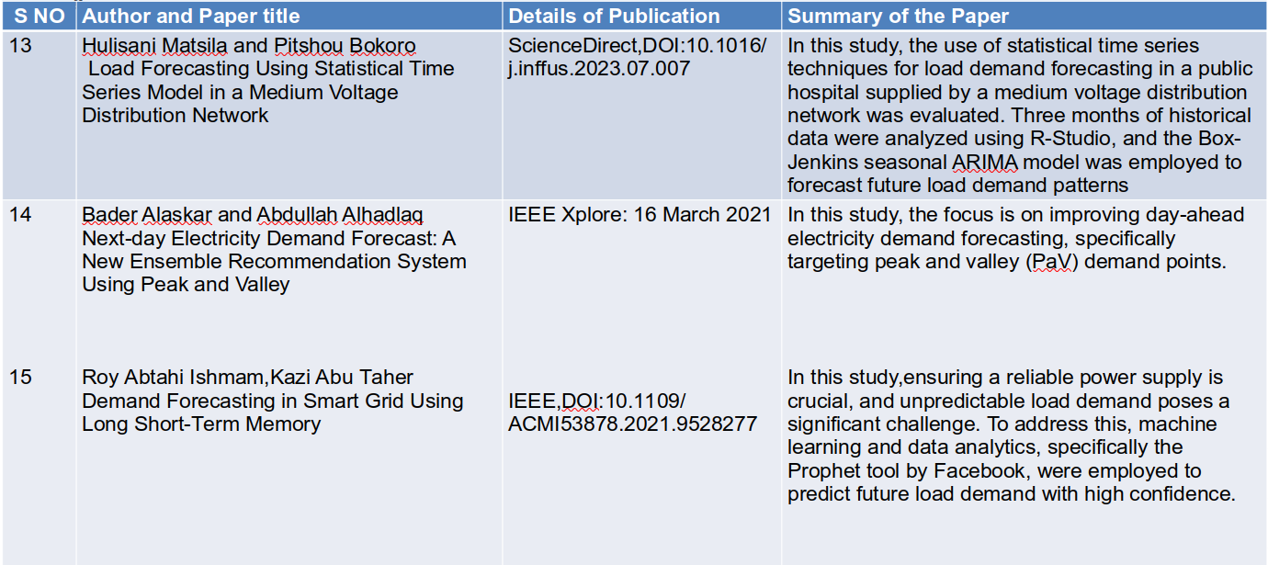
Literature Survey

Slide 13
Literature Survey
Summery of Literature Survey:
Most projects in this area emphasize the importance of accurate demand prediction for various applications, including product demand prediction ,energy management, supply chain optimization, and resource allocation.Common objectives include improving resource utilization, reducing operational costs, and enhancing customer satisfaction by meeting demand efficiently.
Common models used in demand prediction projects encompass a range of techniques, each with its own strengths and applications ARIMA ,Exponential Smoothing Methods,Machine Learning Algorithms Various machine learning algorithms are employed, including regression models, random forests, and neural networks. These algorithms capture complex relationships and non-linear patterns in demand data.Prophet: Prophet is a specialized tool developed by Facebook for time series forecasting. It excels in handling time series data with seasonality and holiday effects, simplifying the modeling process.
To advance Time Series Forecasting for Demand Prediction in supermarket grocery sales, focus on data quality improvement, advanced modeling (e.g., deep learning and ensemble methods), feature engineering, and hyperparameter tuning. Incorporate automation and real-time forecasting for agility, collaborate across disciplines, and integrate demand forecasts into supply chain management. Regular monitoring, experimentation, and ethical considerations ensure ongoing development and accurate predictions for optimized inventory management and customer satisfaction.
Importance of Time Series Forecasting:Time series forecasting is essential for supermarkets to optimize their inventory levels, reduce carrying costs, and meet customer demand efficiently. Accurate predictions help ensure that products are available when needed while minimizing overstock or understock situations.
Feature Engineering:Incorporating relevant features such as holidays, promotions, and external factors like weather can improve the accuracy of forecasts. Feature engineering plays a crucial role in capturing underlying patterns in the sales data.

Slide 14
Experiential Learning
Proposed Methodology
Tools and Techniques
Python: A widely used programming language for data analysis, manipulation, and modeling.
Pandas: A powerful library for data manipulation and analysis.
NumPy: A fundamental package for numerical computations.
Matplotlib and Seaborn: Libraries for data visualization.
Scikit-Learn: A machine learning library that includes various regression and time series forecasting algorithms.
StatsModels: A library specifically designed for statistical modeling and hypothesis testing

Slide 15
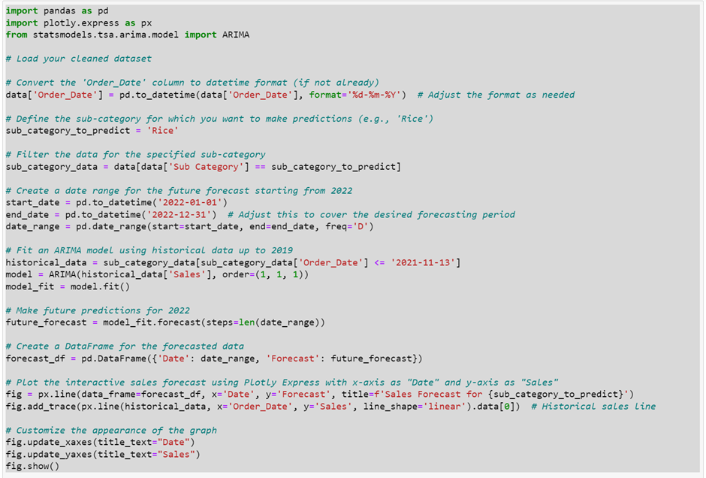
Experiential Learning
Implementation

Slide 16
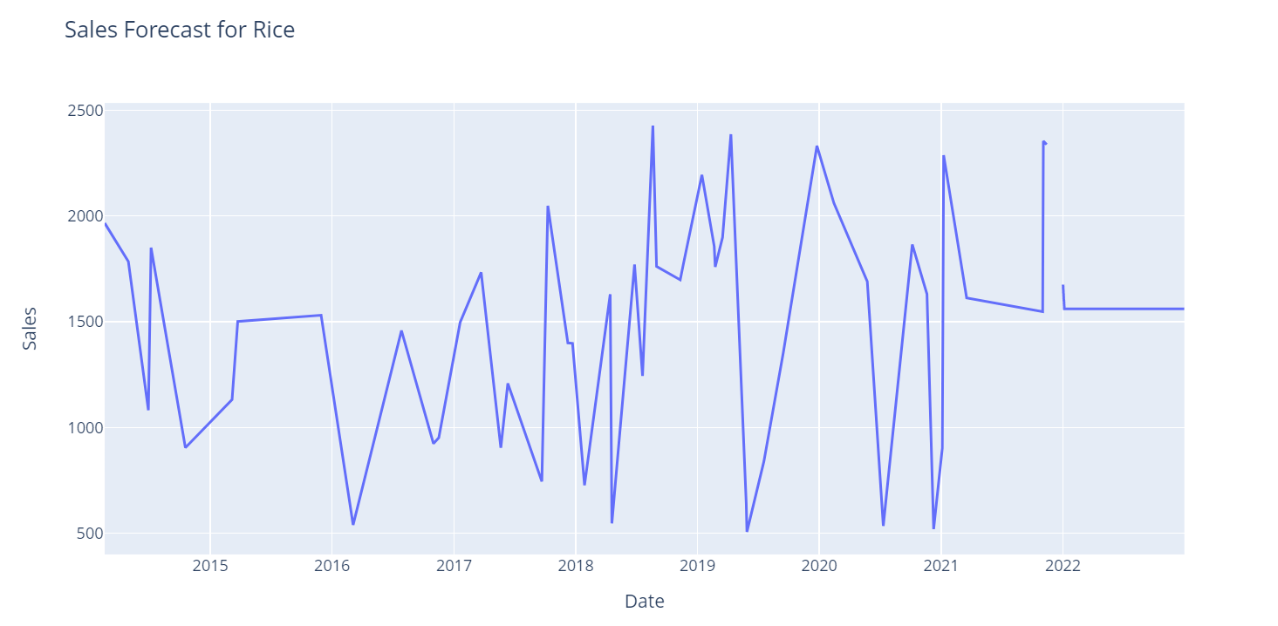
Experiential Learning
Results and Conclusion

Slide 17
Experiential Learning
Conclusions:
Time series forecasting for demand prediction in a supermarket's grocery sales is a critical aspect of inventory management and supply chain optimization. Here's a summary and conclusion on this topic:
Importance of Time Series Forecasting:
Time series forecasting is essential for supermarkets to optimize their inventory levels, reduce carrying costs, and meet customer demand efficiently. Accurate predictions help ensure that products are available when needed while minimizing overstock or understock situations.
Data Quality Matters:
The accuracy of time series forecasts heavily depends on the quality of historical sales data. Clean, complete, and well-maintained data are crucial for building reliable forecasting models.
Choosing the Right Model:
There are various time series forecasting models available, including ARIMA, Exponential Smoothing, and machine learning approaches like LSTM and Prophet. The choice of model should depend on the nature of the data, seasonality, and trend patterns.
Feature Engineering:
Incorporating relevant features such as holidays, promotions, and external factors like weather can improve the accuracy of forecasts. Feature engineering plays a crucial role in capturing underlying patterns in the sales data.

Slide 18
Experiential Learning
References
Hyndman, R. J., & Athanasopoulos, G. (2018). Forecasting: principles and practice. OTexts.
Box, G. E. P., Jenkins, G. M., Reinsel, G. C., & Ljung, G. M. (2015). Time series analysis: forecasting and control. Wiley.
Makridakis, S., Wheelwright, S. C., & Hyndman, R. J. (1998). Forecasting: methods and applications. Wiley.
Brockwell, P. J., & Davis, R. A. (2016). Introduction to time series and forecasting. Springer.
Chatfield, C. (2016). The analysis of time series: an introduction. CRC Press.
Forecasting with Python: A Complete Guide (https://www.analyticsvidhya.com/blog/2018/02/time-series-forecasting-methods/)
Statsmodels Documentation for Time Series Analysis (https://www.statsmodels.org/stable/tsa.html).
Facebook Prophet Documentation (https://facebook.github.io/prophet/)
ARIMA Model - Wikipedia (https://en.wikipedia.org/wiki/Autoregressive_integrated_moving_average).

