Slide 1
SMART IRRIGATION
MINI PROJECT
USING IOT (Low power consumption)
Presented by:-
RAPETI SAI KUMAR (N160490)
MOUGANA ARPAN (N160308)
ARATLAKOTA RAGHU (N160054)
SHAIK APSIYA (N160545)
SHAIK AFRIN (N160741)
.
Project Guide:- Mr.Bharat Ganji (Asst.Professor(C),ECE,RGUKT Nuzvid)

Slide 2
ABSTRACT :-
Agriculture plays the major role in economics and survival of people in India. Nowadays Indian agriculture faces a major problem due shortage of water. And wastage of water is also a major concern. In order to overcome this problem we have to use water more efficiently. We are trying to achieve this with our project
The main aim of this project is to design low cost Automated Irrigation System using a Wireless Sensor Network.
The Purpose of this project is to provide iot based system for irrigation to reduce the manual monitoring of the field and get the information to the user using wireless module.
The development of this project at experimental scale within a single plant is presented and the implementation was to demonstrate that the automatic irrigation can be used to reduce water use.

Slide 3
LITERATURE SURVEY :-
This system developed an automated irrigation system for the farmer on the basis of wireless sensor network. This system continuously monitors the parameters temperature, humidity, and moisture of soil.
An algorithm used with threshold values of soil moisture to be maintained continuously. System starts or stops irrigation based on moisture content of the soil. This system proposes low cost moisture sensor based data acquisition system required for automated irrigation system [1]-[2].

Slide 4
.
Irrigation system helps to grow crops with a minimum possible amount of water, protect the plants from frost and dust suppression. As a result of advancements in technology and a seemingly sharp decline of available manual labour adversely affecting the agricultural yield, the need for a proper utilization of available resources is imminent [3]
Development of smart drip irrigation system using IoT is feasible and cost-effective. The system is completely automatic which turn on the solenoid valve using a relay based on necessity. [3]

Slide 5
A remote control for drip irrigation is the most beneficial approach for the farmers. This system reduces the extra manpower of the farmer for his farm like supplying water to plants
With only one or two sensor nodes of this system we can cover larger area of farm easily by attaching Drip irrigation to this model. So that monitoring at one or two places can identify when to water the farm. [3]

Slide 6
SMART IRRIGATION BY EMBEDDED SYSTEMS :-
Automation in the field of irrigation with smart technology is a great combination. The technologies such as embedded systems and automation made this system to be unique.
X-bee pro modules and Pic Microcontrollers are integrated together for the irrigation. Xbee pro modules are Embedded Solutions providing wireless end-point Connectivity to the devices.
These modules use the IEEE networking protocol for fast point-to-multipoint or peer-to-peer networking [4].

Slide 7
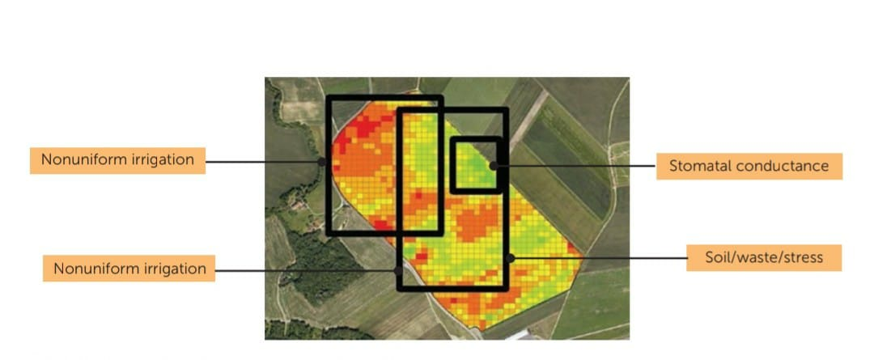
How thermal imaging can be used in agriculture :
Thermal imaging could be used to determine the relation between water status of the plant/field and radiation emission, and therefore can be utilized as a measure for water stress and irrigation distribution.
Thermal imaging is a method of using infrared radiation and thermal energy to gather information about objects, in order to formulate images of them, even in low visibility environments [5].

Slide 8
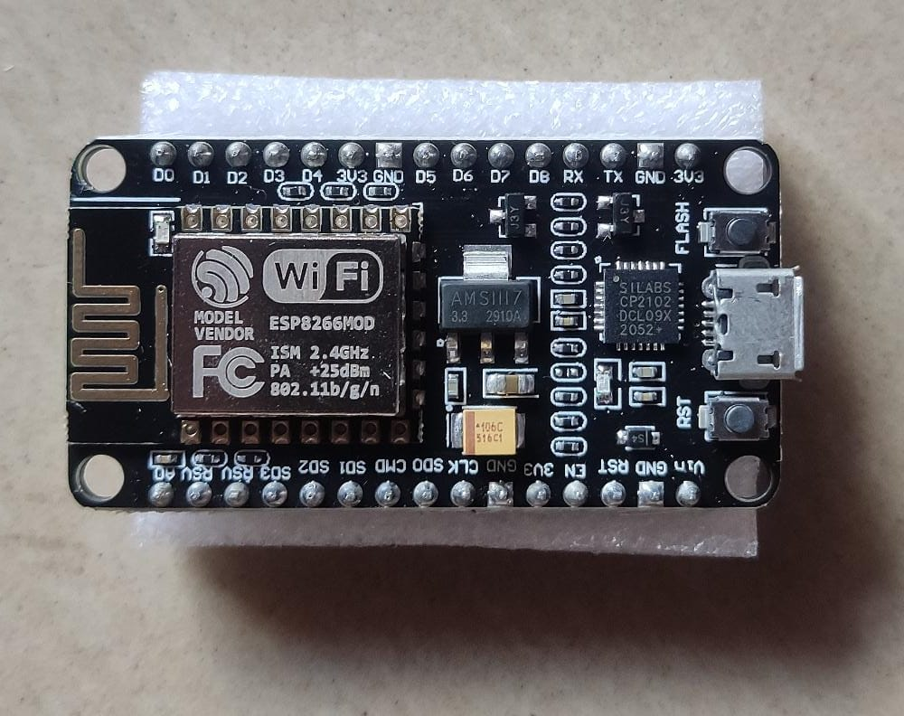
THINGS NEED TO KNOW :- NODEMCU
Open source firmware
It consists ESP866 WIFI module in it
Can be programmed with help of Arduino IDLE as it is open firmware
Why Node MCU is popular
1) cheap and small 2)powerful -13 GPIO Pins including 12 digital and 1 analog pin
3)low power consumption 4)easy to program

Slide 9
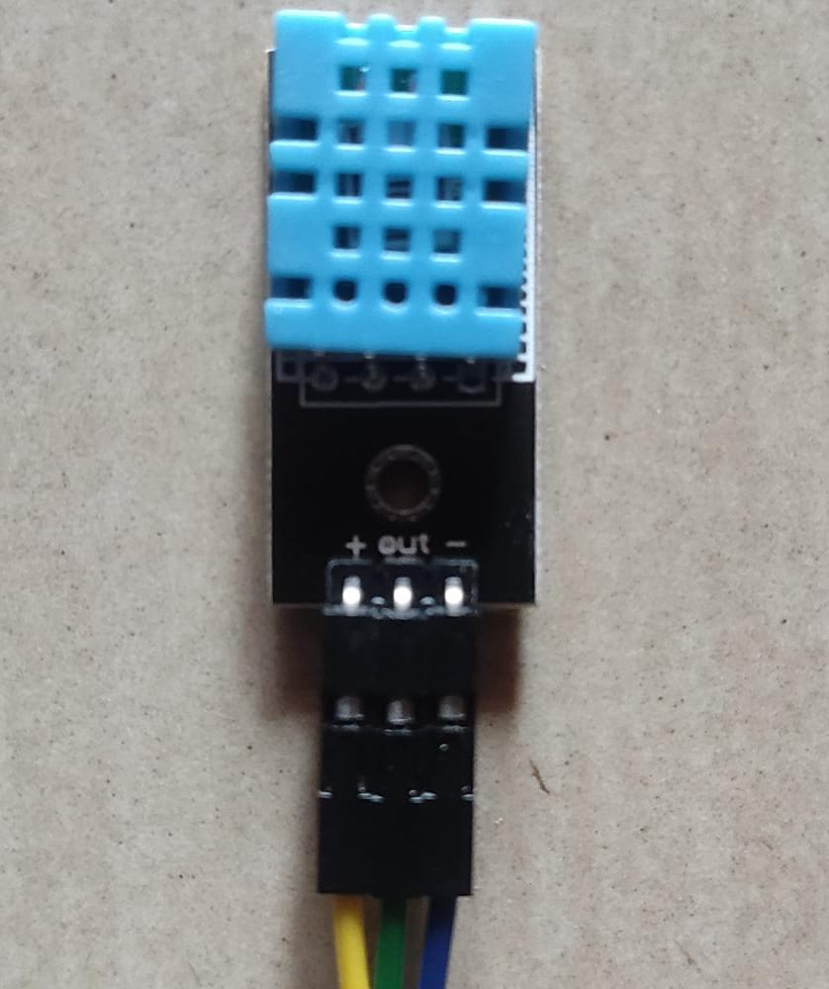
DHT 11 SENSOR
DHT11 is a low-cost digital sensor for
Sensing Humidity and Temperature
Working Principle of DHT11 Sensor
DHT11 sensor consists of a capacitive humidity sensing element and a thermistor for sensing temperature. The humidity sensing capacitor has two electrodes with a moisture holding substrate as a dielectric between them. Change in the capacitance value occurs with the change in humidity levels. The IC measure, process this changed resistance values and change them into digital form.

Slide 10
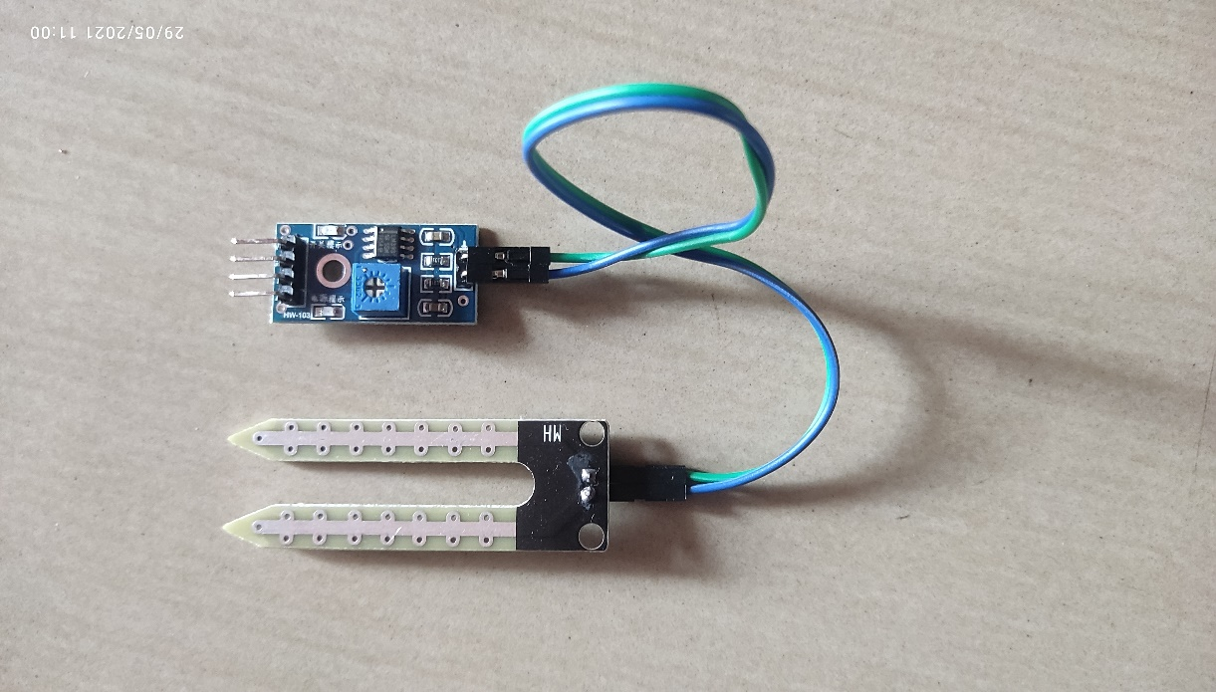
SOIL MOISTURE SENSOR
Soil moisture sensors measure or estimate the amount of water in the soil.
The working of the soil moisture sensor is pretty straightforward.
The fork-shaped probe with two exposed conductors, acts as a variable resistor (just like a potentiometer) whose resistance varies according to the water content in the soil.

Slide 11
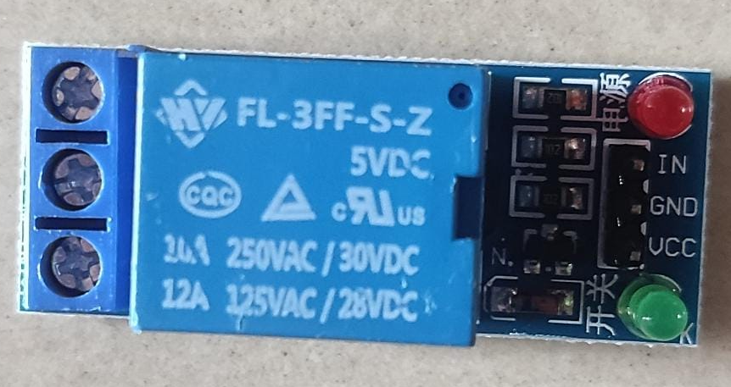
RELAY MODULE
Relay is electrically operated switch. Generally used relay modules are 5v/12v.
The Relay uses an electromagnetic to mechanically switch electrical appliances.
Using Relays is safe as there is no physical contact between NodeMCU and AC devices.
Relay have a coil which is energized by a supply of 5v, when coil energized switching takes place based on NO-NC configuration.
NC
NC
NO
COM
COM
NO
TWO CONFIGURATIONS OF THE RELAY MODULE
NO VOLTAGE APPLIED
VOLTAGE APPLIED (5V)

Slide 12
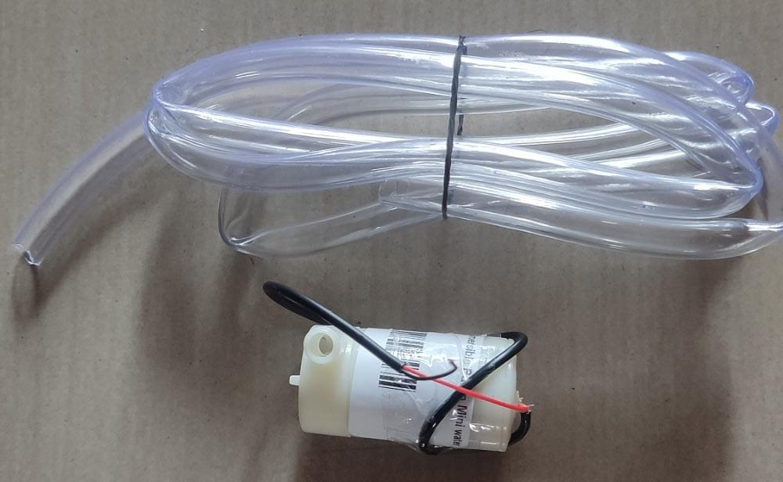
DC MOTOR
DC motor which converts electrical energy in the form of Direct Current into mechanical energy in the form of rotational motion of the motor shaft .
Node MCU based ESP8266 can be used to control the speed and rotational direction of DC Motor. Node MCU has a PWM feature on its GPIO pins using which we can control the DC motor.
So used this DC motor which operates at 3-6V to pump the water needed for irrigation

Slide 13
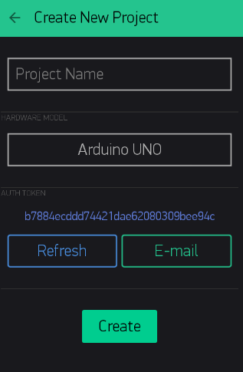
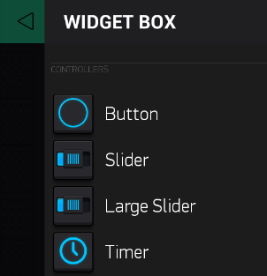
BLYNK IOT PLATFORM
Blynk is the most popular open source IoT platform for connecting devices to the cloud, designing apps to remotely control and monitor them, and managing thousands of deployed products.
The main focus of the Blynk platform is to make it super-easy to develop the mobile phone application for the project.
With the help of AUTH Token received from the app to our registered email we will be connecting the hardware to the blynk cloud. While others cannot access our project without the auth token.

Slide 14
To Reduce The Nodemcu Power Consumption:
In idle state with powered Wi-Fi the NodeMCU V2 has a current consumption around 70mA. With an operating voltage of 3.3V, NodeMCU V2 needs the following power in idle state:
W = U * I = 3.3V * 70mA = 231mW
Therefore the energy consumption per year for a NodeMCU will be:
E = W * 365 * 24 = 2.024 kWh
Which costs less than 500 for the bill which is not affordable to everyone. So in case if we use a Lithium battery with 1000mAh (Operation voltage: 3.7V), then
T = 1000mAh / 70mA = 14.3h
So we have to change the battery every day. This does not make sense. Moreover it is only the theory that we can use the whole energy of the battery.

Slide 15

DEEP SLEEP :
If we want to use an external power supply and save the most energy possible, we should go with the deep-sleep mode! The ESP8266 power consumption reduces in theory to
W= 20µA * 3.3V = 66µW.
Our external battery with 1000mAh will last a lot longer.
T = 1000mAh / 20µA = 50,000h = 2083 days = 5.7 years.
(note that this lifetime cannot be used due to some major influences around the battery that will reduce the theoretical lifetime of your system)

Slide 16
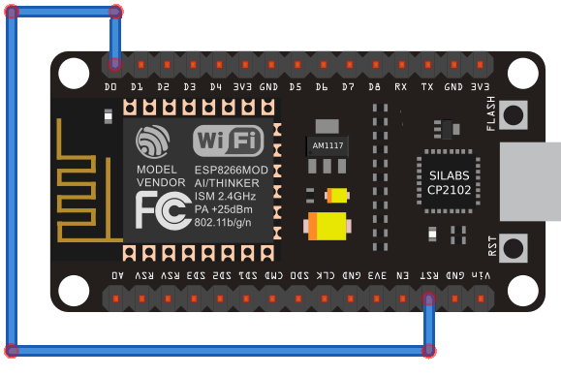
To enable the deep-sleep mode we have to use the following line of code: ESP.deepSleep(uint32 time_in_us)
Interface For The Deep Sleep mode :

Slide 17
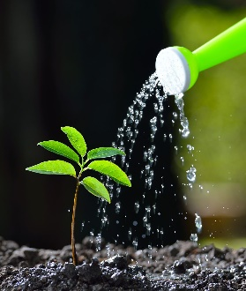
BLOCK DIAGRAM :
SMART PHONE
WITH BLYNK APKZ
MOTOR
NODEMCU
WITH ESP8266 WI-FI MODULE
BLYNK CLOUD
RELAY
SOIL MOISTURE SENSOR
TEMP & HUMIDITY
SENSOR
TWO MODES: SELF MODE AND MANUAL MODE
POWER SUPPLY

Slide 18
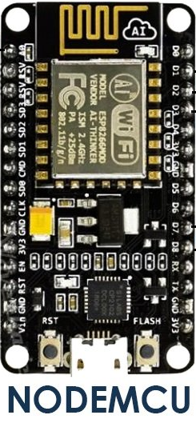
CIRCUIT CONNECTION :-
SOIL MOISTURE
SENSOR
A0
D0
D2
DHT SENSOR
D3
3.3v
GND
GND
3.3v
RST
RELAY
SWITCH
GND
MOTOR
3.3v
POWER SUPPLY

Slide 19
WORKING:
This system measures the amount of water present in the soil and also the humidity and temperature with the help of soil moisture and Dht11 sensors. Now the measured data is sent to the nodemcu through the connected digital and analog pins. With the Presence of ESP8266 module in nodemcu the board is connected to the internet. Now the received data is sent to the blynk cloud server with the help of Blynk libraries used. So that we can see the data from our android phone and even control the nodemcu from our android device from anywhere to irrigate the farm.
As there are two modes in our system self-mode or manual-mode. Depending upon the user input the system works. Once if all this process completes if the farm if completely irrigated then the nodemcu will be set in deep sleep to save the power. After one hour it awakes automatically and checks whether to irrigate or not.
With only one or two sensor nodes of this system the whole farm is covered easily by attaching Drip irrigation to this model. So that monitoring at one or two places can identify when to water the farm.

Slide 20
FLOW CHART:-
START
AUTO OR MANUAL
HIGH
READ INPUT VALUE(SWITCH)
LOW
MANUAL MODE
SELF MODE
MEASURE SENSOR VALUES AND STORE
READ MOTOR SWITCH
IF SOIL MOIST<=THRESHOLDD
NO
DEEPSLEEP
(TO SAVE POWER)
LOW
HIGH
YES
TURN PUMP ON FOR A WHILE AND OFF
PUMP OFF
PUMP ON
LOW
CHECK
DEEPSLEEP
MODE
HIGH

Slide 21
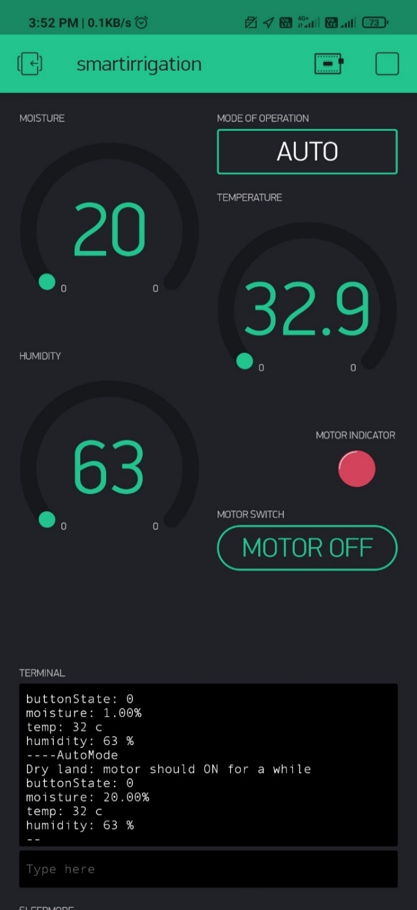
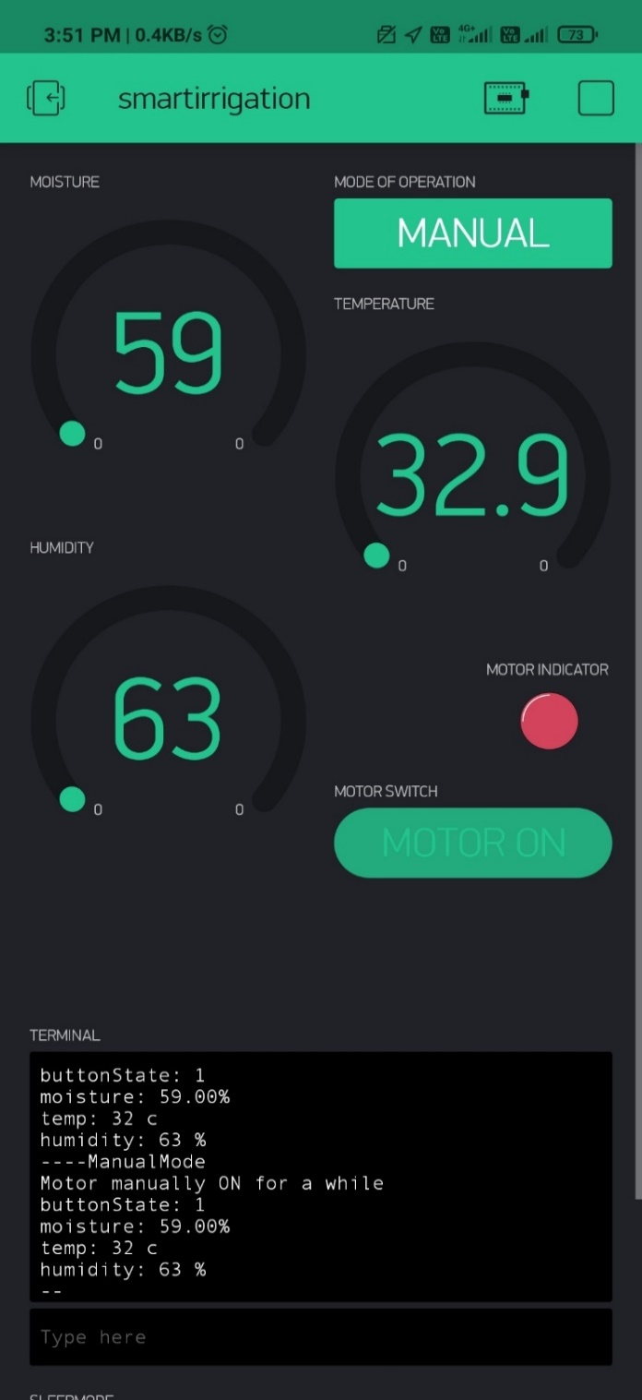
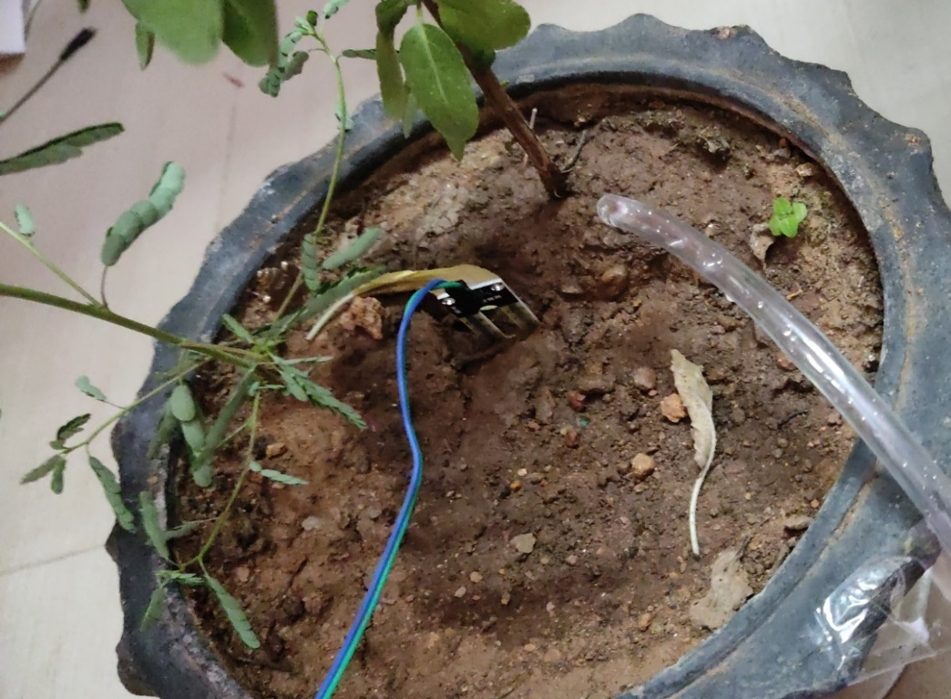
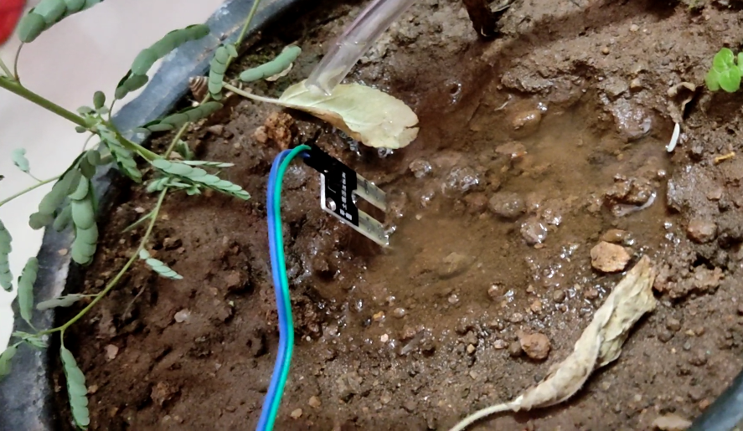
RESULTS AND OBSERVATIONS:

Slide 22
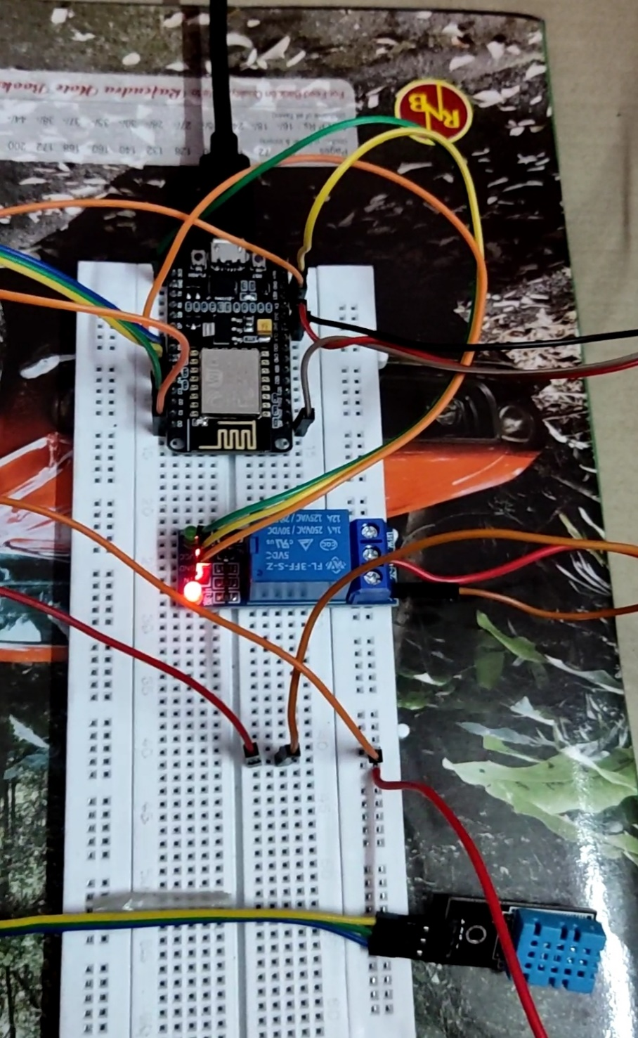
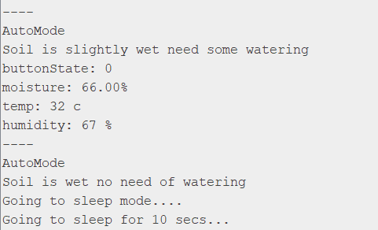
SERIAL MONITOR OUTPUT
IN ARDUINO IDE

Slide 23
REFERENCES :-
[1] Sneha Angal “Raspberry pi and Arduino Based Automated Irrigation System “International Journal of Science and Research (IJSR) ISSN (Online): 2319-7064.
[2] Ocoleanu Constantin Florin and Nechita Adrian Mihai “Solution For Water Management Using A Smart Irrigation System” 2019 International Conference on Electromechanical and Energy Systems (SIELMEN)
[3] Anushree Math, Layak Ali and U Pruthviraj “Development of Smart Drip Irrigation System Using IoT” 2018 IEEE Distributed Computing, VLSI, Electrical Circuits and Robotics
[4] K K Namala, Krishna Kanth Prabhu A V, Anushree Math, Ashwini Kumari and Supraja Kulkarni “Smart irrigation with embedded system” 2016 IEEE Bombay Section Symposium (IBSS)
[5] Muhammad Farhan Aizat bin Zainal Azman, Ruwaida Ramly, Juliana Jaafar and Aznida Abu Bakar Sajak “Thermal Imaging for Smart Agriculture Irrigation System to support IR 4.0 Initiative” 2020 IEEE 8th R10 Humanitarian Technology Conference (R10-HTC)
[6] Ravi Kishore Kodali, Subbachari Yerroju and Shubhi Sahu “Smart Farm Monitoring Using LoRa Enabled IoT” 2018 Second International Conference on Green Computing and Internet of Things (ICGCIoT)
[7] Sheth M, and Rupani P, “Smart Gardening Automation using IoT With BLYNK App” 2019 3rd International Conference on Trends in Electronics and Informatics (ICOEI)
[8] Syeda Iqra Hassan, Muhammad Mansoor Alam, Usman Illahi, Mohammed A. Al Ghamdi, Sultan H. Almotiri and Mazliham Mohd Suud “A Systematic Review on Monitoring and Advanced Control Strategies in Smart Agriculture” IEEE Acess(Volume 9)
[9] Sanku Kumar Roy, Sudip Misra, Narendra Singh Raghuwanshi, and Sajal K. Das “AgriSens: IoT-Based Dynamic Irrigation Scheduling System for Water Management of Irrigated Crops” IEEE Internet of Things Journal ( Volume:8, Issue:6, March 15,2021 )

