Slide 1
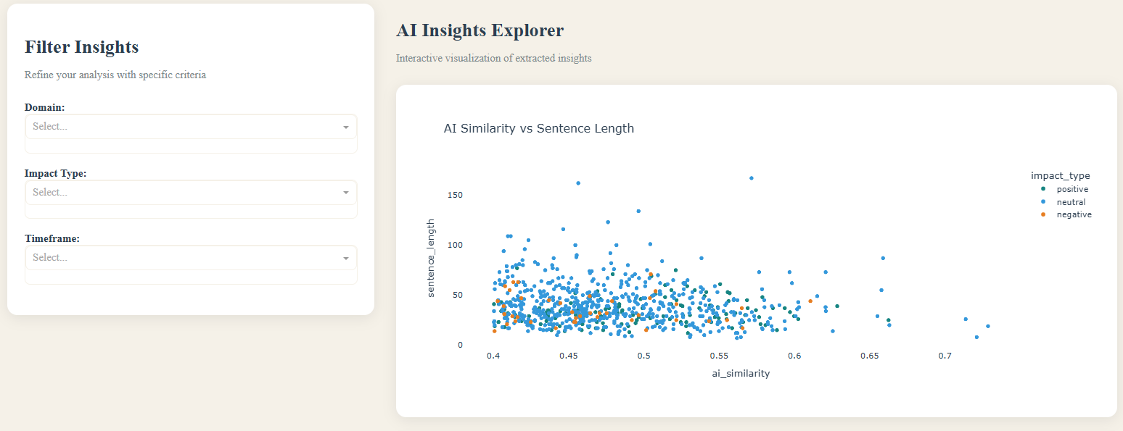

Chrono-Insight Overview: High-Fidelity Filtering & Exploration
Filtering Architecture
The dashboard utilizes a rigorous similarity score filter (visualized in the scatter plot) to isolate high-relevance data points (Score > 0.40). This ensures noise reduction, presenting only the most pertinent information for analysis.
Concise & Specific Insights
Positive Impact Assessment
Strategic Implication
The scatter plot clearly reveals a strong correlation between sentence length and AI relevance. This allows us to specifically target insights that are "concise and highly specific," making them ideal for immediate, actionable reporting and strategic decision-making.
The Detailed View table, typically integrated with the Explorer, demonstrates that the articles predominantly discuss the impacts of AI in a positive light. This is evident from the vast majority of neutral and positive impacts denoted in the sentence explorer graph.
The distinct clustering of Neutral/Positive sentiment in the 0.45–0.60 similarity range indicates that the textual data is highly relevant to the topic of AI. Moreover, the graph shows that the majority of insights are either neutral or positive, signaling a generally optimistic outlook on AI's implications.

Slide 2
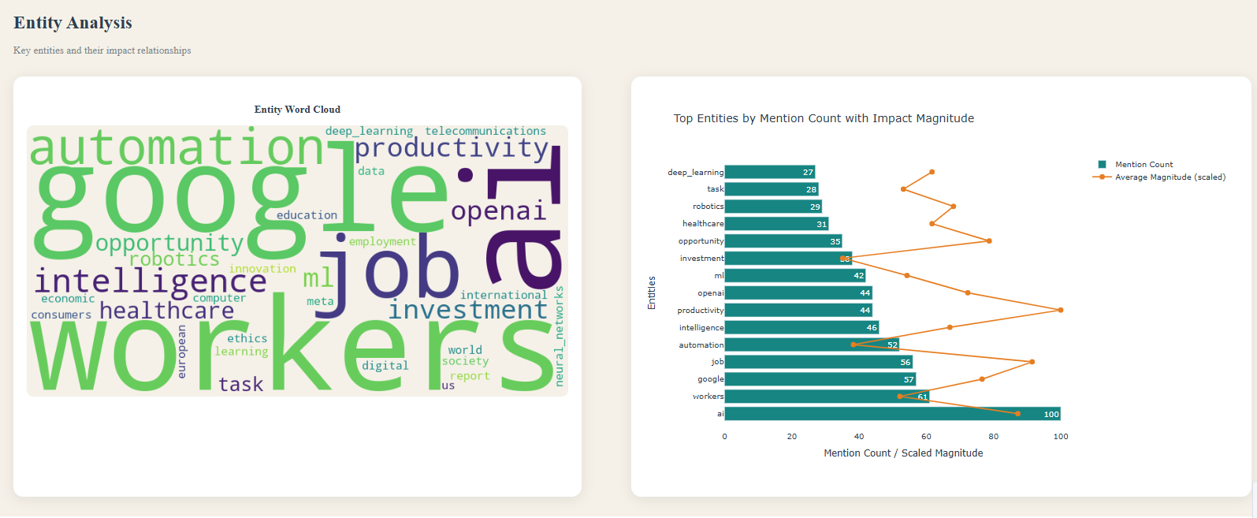
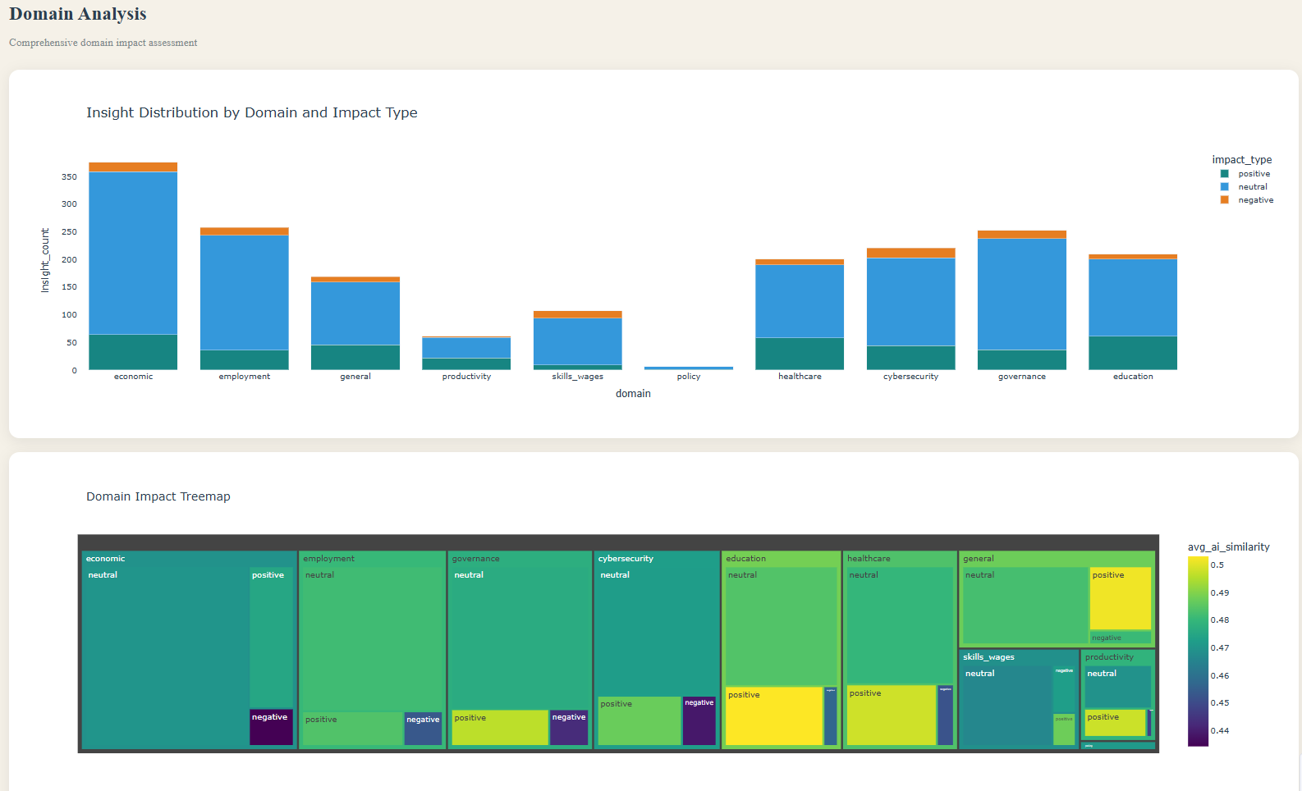




Domain & Entity Analysis: The Shift to Human-Centric Impact
Entity Dominance & Impact
Domain & Infrastructure Link
The Word Cloud visually confirms that "Workers," "Jobs," and "Tasks" are central topics, appearing with equal or greater prominence than technical terms. The Top Entities Chart further reveals that "Workers" (Rank #2) and "Jobs" (Rank #5) carry high Average Impact Magnitudes. This indicates that the most significant predicted changes are occurring at the human level, rather than solely at the macroeconomic level.
The Domain Analysis chart shows that Employment is the second-highest volume domain (approx. 250 insights), far exceeding niche areas. This validates "Labor Transformation" as a primary driver of AI research. Additionally, the prominence of "Google" and "OpenAI" adjacent to "Workers" suggests the labor market is reacting to specific enterprise infrastructure, rather than abstract automation concepts.
Human-Centric Focus
Significant Magnitude
Enterprise Influence
Our analysis shows a clear shift towards understanding AI's effects on human roles, skills, and task augmentation, highlighting the centrality of the "worker" in the AI narrative.
The high average impact magnitude for entities like "Workers" and "Jobs" underscores the profound and direct influence AI is having on the workforce.
The data suggests that specific companies and their AI infrastructure are significant factors shaping discussions around labor market transformation.
Strategic Implication
While "Economic" insights dominate in pure volume, the intensity of the "Employment" domain proves that the substantive impact of AI is being measured by its effect on human roles, skills, and task augmentation. This necessitates a human-centric approach to strategy.

Slide 3
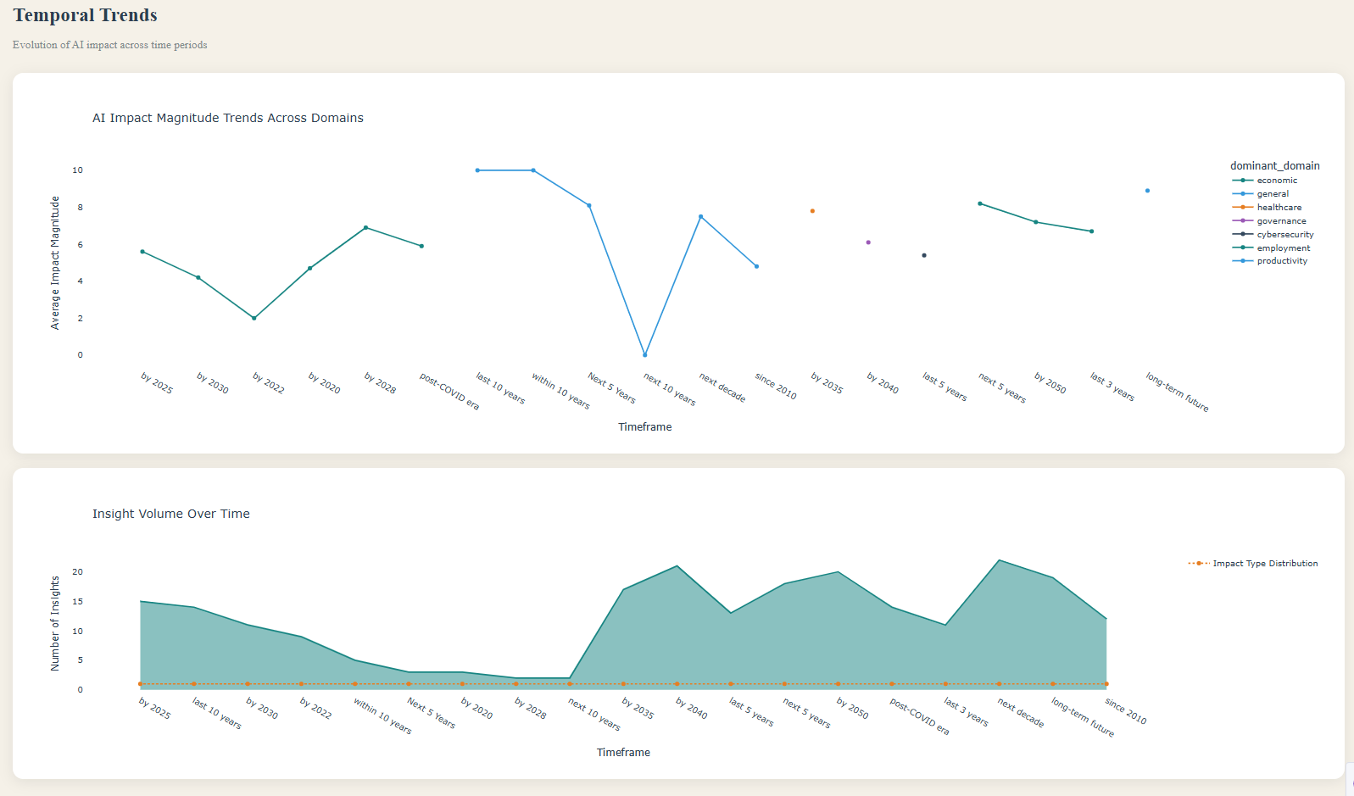




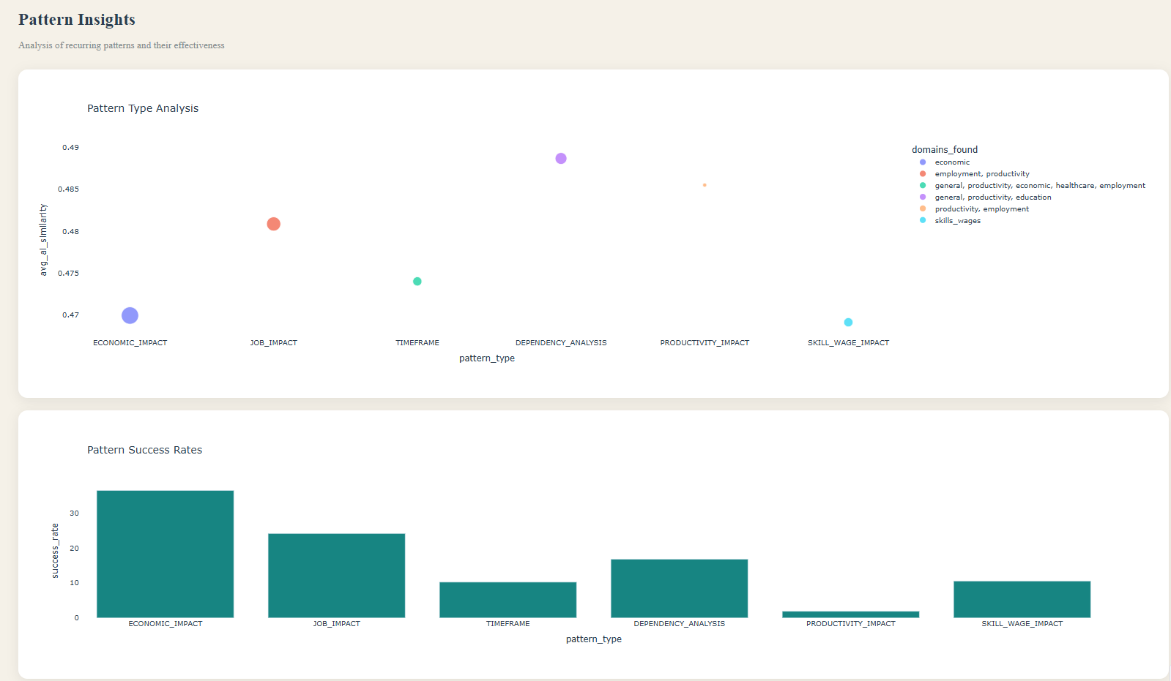

Temporal & Pattern Trends: The Timeline of Disruption
Critical Period: 2025–2040
Immediate Volatility
The Temporal Trends view highlights a distinct peak in insight volume for the "Next Decade" and "By 2035" timeframes. This identifies the current period as a critical window for AI adoption and workforce restructuring, demanding immediate attention.
The Average Impact Magnitude line chart shows high volatility in the "Employment" trendline over the next 5 years. This indicates an expected "shock" period of intensive AI implementation before a potential long-term stabilization of the market.
Reliable Extraction
Complex Dependencies
The Pattern Insights view demonstrates that "JOB_IMPACT" patterns achieved one of the highest success rates in the pipeline. This confirms that employment-related claims in source texts are structured, clear, and highly reliable for decision-making processes.
The high score for "Dependency Analysis" proves that AI impact is rarely simple. The data describes complex changes to daily workflows, confirming that AI is reshaping roles rather than just replacing them.
Strategic Implication
The convergence of high "Job Impact" pattern recognition and a "Front-Loaded" temporal timeline suggests that organizations must prioritize immediate reskilling strategies (1-3 year horizon) rather than waiting for long-term theoretical shifts. Proactive measures are crucial for navigating this period of rapid change.

Slide 4
How to Access the Dashboard

Slide 5
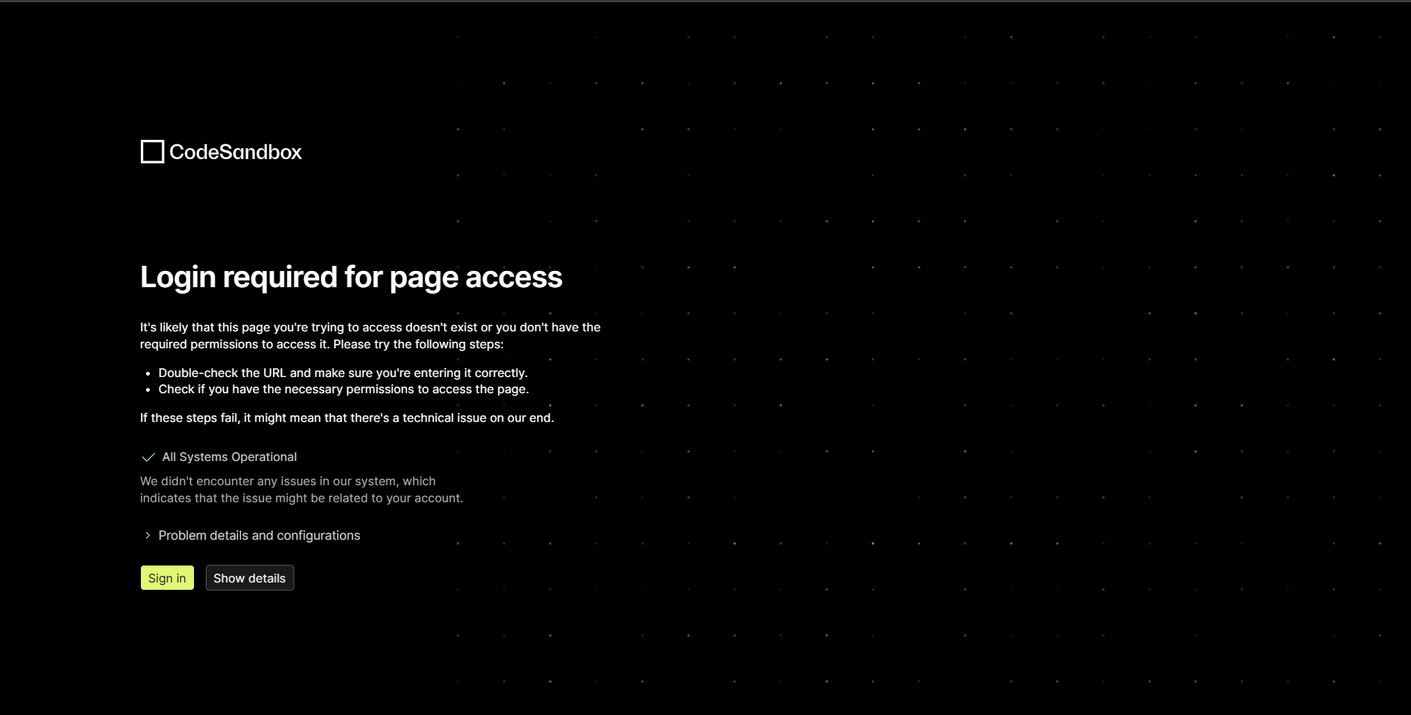
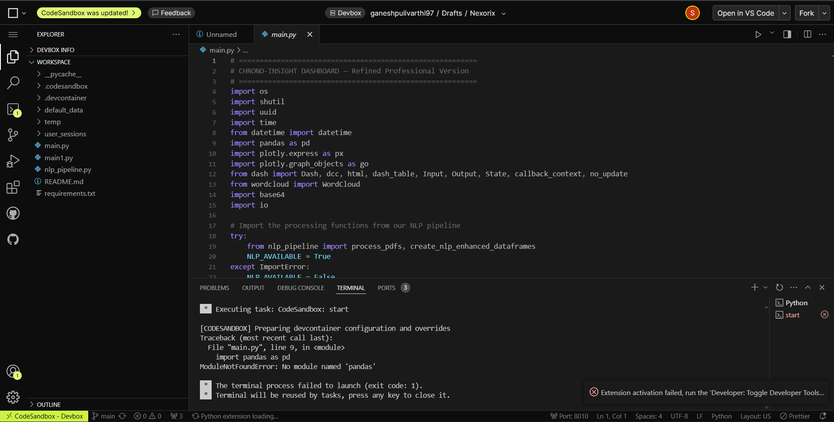

Step 1:
Click the link to open Codesandbox - Nexorix_Dashboard
Step 2:
You will be asked to login using a Codesandbox account. If you do not have one, please create an account as you can’t access the dashboard without one.
Step 3:
Once you sign in, you’ll be met with a similar screen. This is our repository with all the codes. It is a shared space. Please do not make any changes to it. Hit FORK present at the top right of the page. That will transfer the repo to your own personal space.

Slide 6
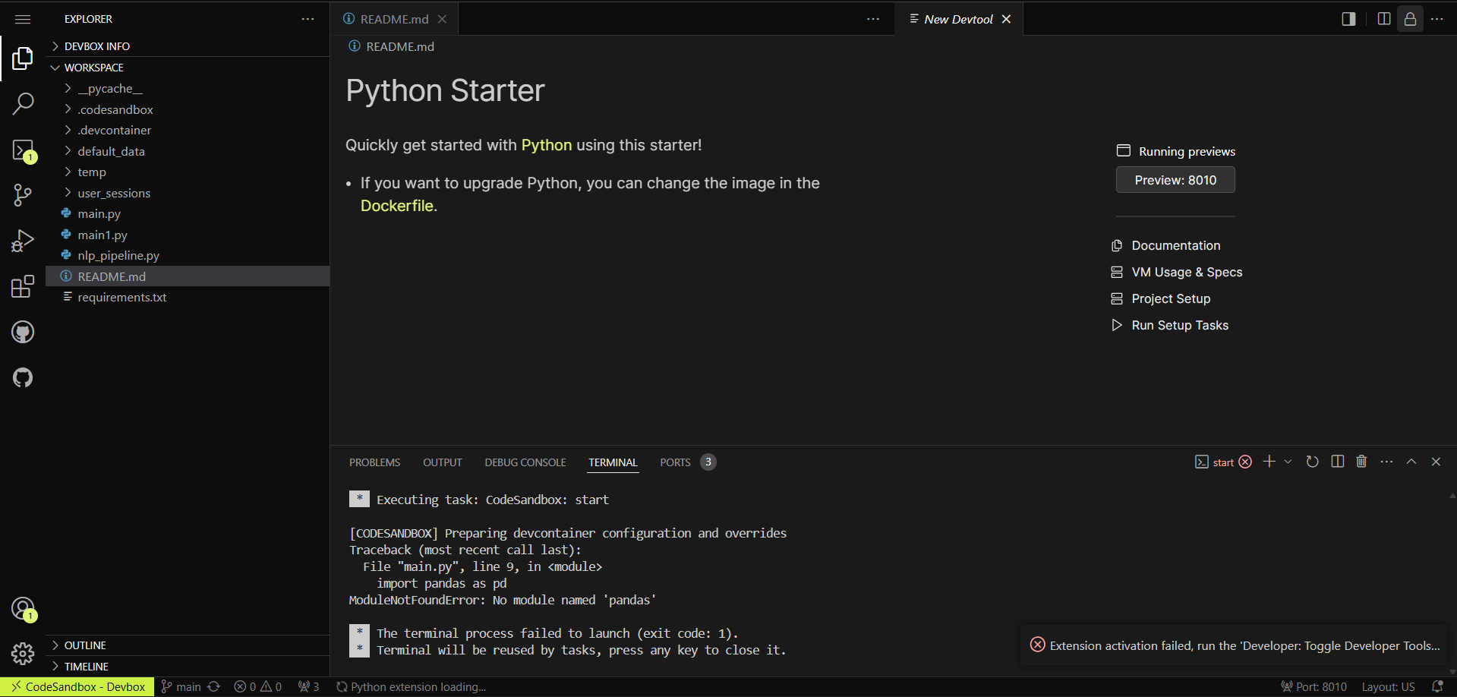
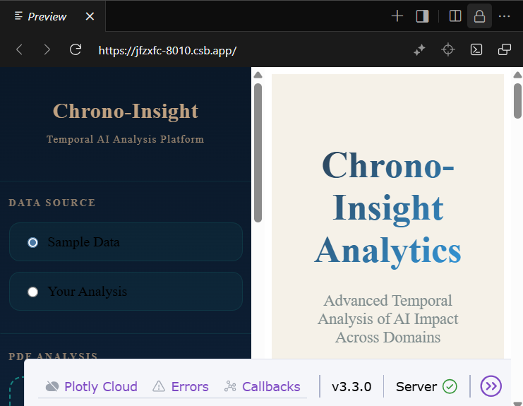
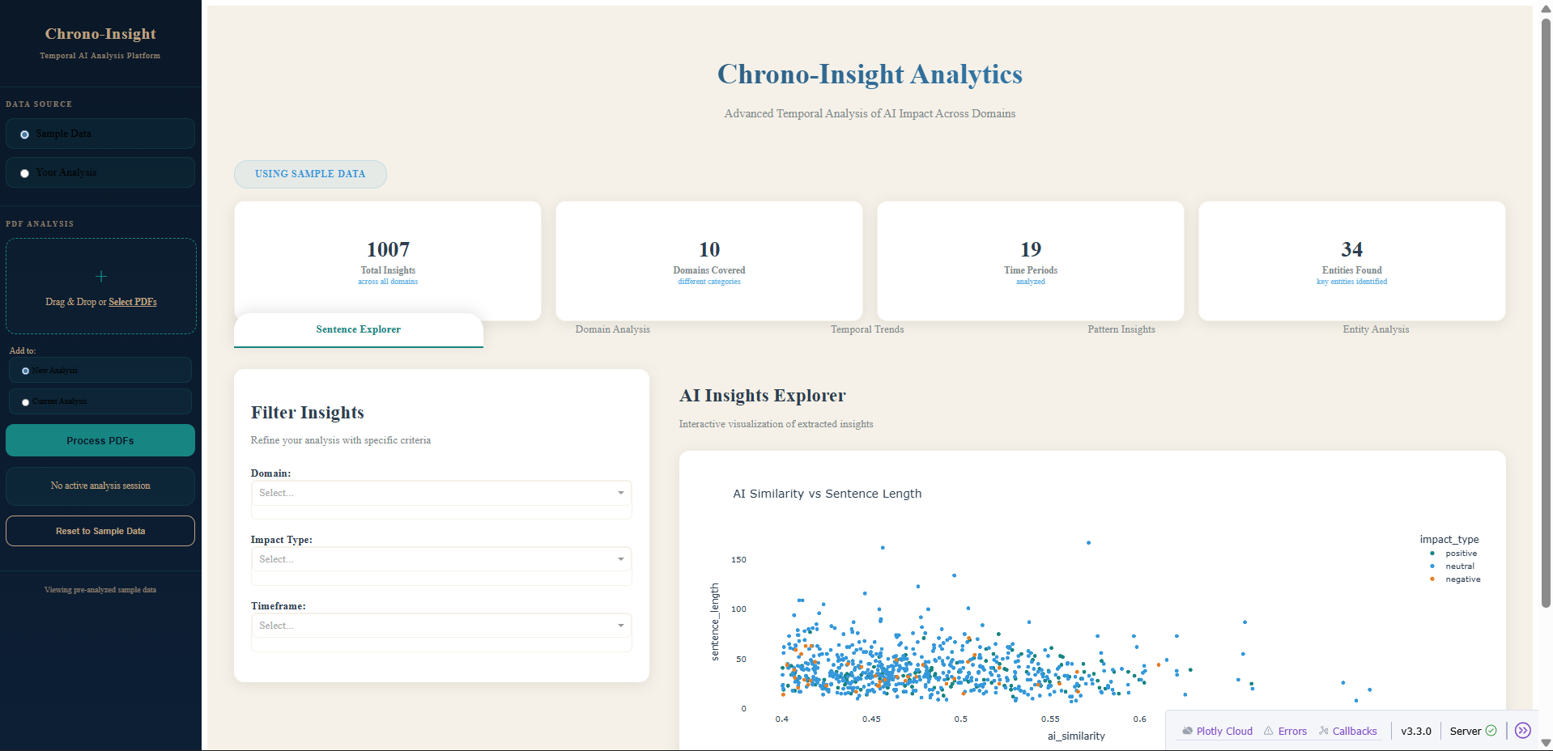
Step 4:
Once you hit fork, you should be seeing the following screen. If on the right side, you see “Preview 8010”, click it. If perchance you do not see the “Preview 8010” button, go to Step 7.
Step 5:
Once you hit Preview, you’ll be seeing the dashboard app on the right side of the screen. Click the top right icon to open the whole app in a new tab on your browser.
Step 6:
You now have access to the dashboard app. If it does not look like this on your browser it is likely zoomed in. Zoom out to 80% (using Ctrl – [minus]) to view the full dashboard.

Slide 7
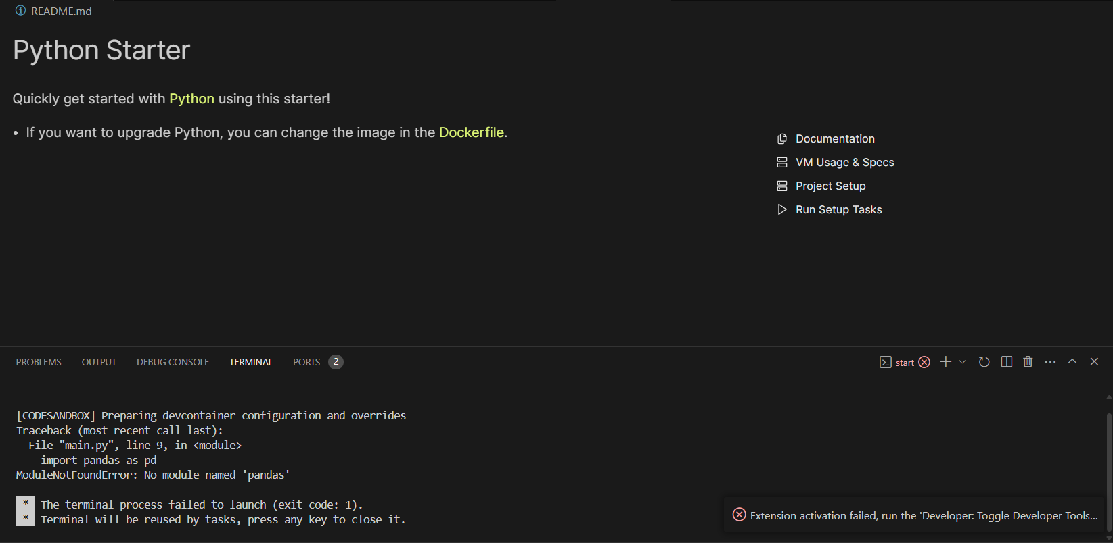
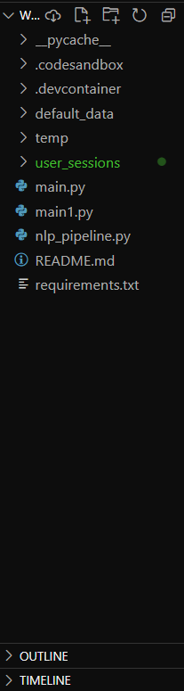
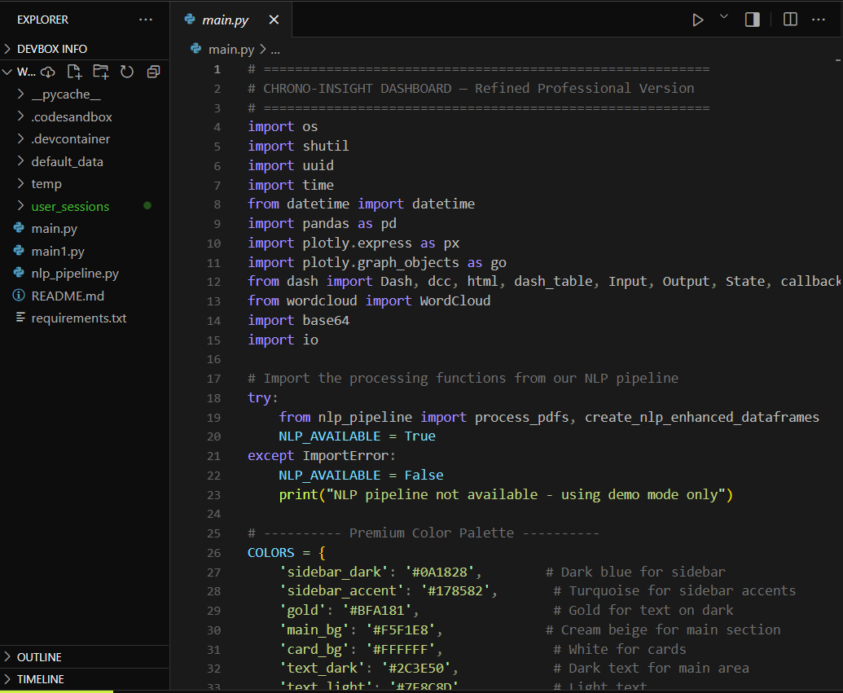
Step 7:
If you DO NOT see the Preview 8010 button on the right side of the screen, click on the terminal on the bottom, and hit Enter on your keyboard. It will make the terminal go away on your screen.
Step 8:
Now, click main.py on the left side of the screen.
Step 9
Now, click on the sideway triangle button to run the code.

Slide 8
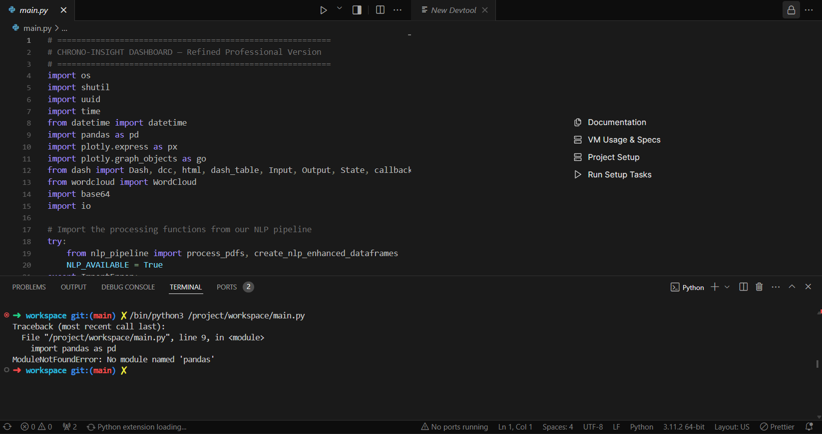
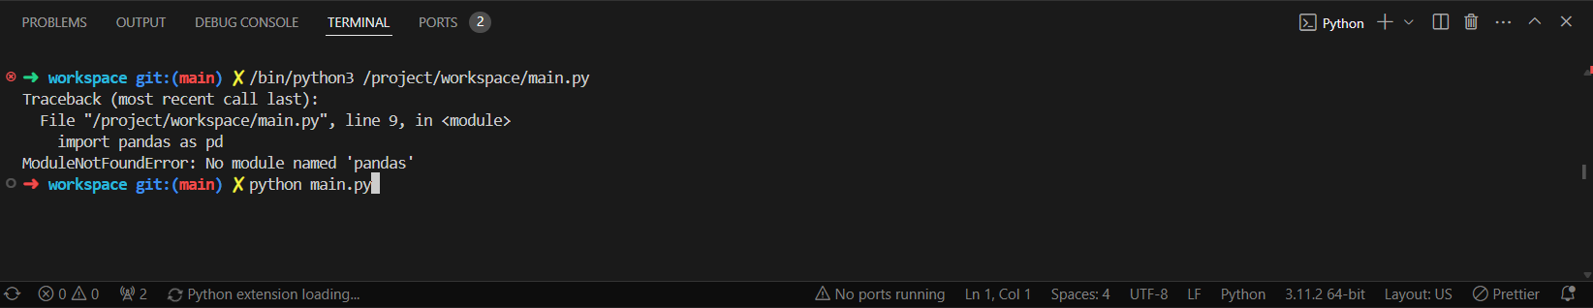
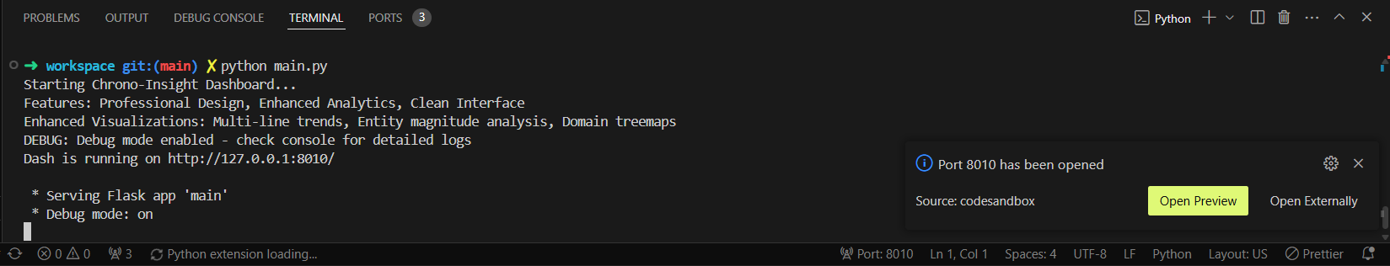
Step 10:
When you hit the sideway triangle button, you will be prompted with an error “no module named pandas” in the terminal. Do not worry, that is supposed to happen. Now, type in “python main.py” in the terminal and hit Enter on the keyboard.
Step 11:
Once you hit Enter, the code will begin executing. It will take a minute for it to start running. Once the dashboard goes live, you will have a small window popup on the right bottom corner. Hit “Open Externally” to open the dashboard in a new tab on your browser.
Step 12:
And there you have it. You can now access the dashboard fully, and even get visualizations for your own uploads. If the screen is too zoomed in, and it doesn’t look like the one shown here, zoom out to 80% using “Ctrl – [minus]”.

