Slide 1
Analyst Presentation
November 2, 2016

Slide 2
Safe Harbor
This presentation has been prepared by Kellton Tech Solutions Limited solely to provide information about the Company.
No representation or warranty, express or implied is made as to, and no reliance should be placed on, the fairness, accuracy, completeness or correctness of such information or opinions contained herein. None of the Company nor any of its respective affiliates, advisers or representatives, shall have any liability whatsoever (in negligence or otherwise) for any loss howsoever arising from any use of this presentation or its contents or otherwise arising in connection with this presentation.
The information contained in this presentation is only current as of its date. The Company may alter, modify or otherwise change in any manner the content of this presentation, without obligation to notify any person of such revision or changes. Certain statements made in this presentation may not be based on historical information or facts and may be "forward-looking statements", including those relating to the Company’s general business plans and strategy, its future financial condition and growth prospects, and future developments in its industry and its competitive and regulatory environment. Actual results may differ materially from these forward-looking statements due to a number of factors, including future changes or developments in the Company’s business, its competitive environment, information technology and political, economic, legal and social conditions in India.
Please note that this presentation is based on the publicly available information on Kellton Tech including but not limited to Company’s website and Annual Reports.
This communication is for general information purposes only, without regard to specific objectives, financial situations and needs of any particular person. Please note that investments in securities are subject to risks including loss of principal amount.
This presentation does not constitute an offer or invitation to purchase or subscribe for any shares in the Company and neither any part of it shall form the basis of or be relied upon in connection with any contract or commitment whatsoever.

Slide 3
Agenda
Digital Transformation (DT)
01
Digital Start Ups
02
Enterprise Adoption of DT
03
EMEA Opportunity
04

Slide 4







Introductions
Niranjan Chintam
Executive Chairman
Wharton Business School
Krishna Chintam
Managing Director
Kellogg School of Management
Karanjit Singh
CEO, India
National Institute of Industrial Engineering
Srinivas Potluri
CEO, USA
Kellogg School of Management
Brian Bokanyi
VP, Operations, USA
Gerard Eivers
GM, EMEA
Kevin Huston
VP, Business Development, USA

Slide 5




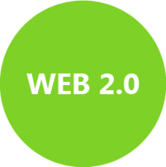



Journey So Far…
Digital Transformation

Slide 6
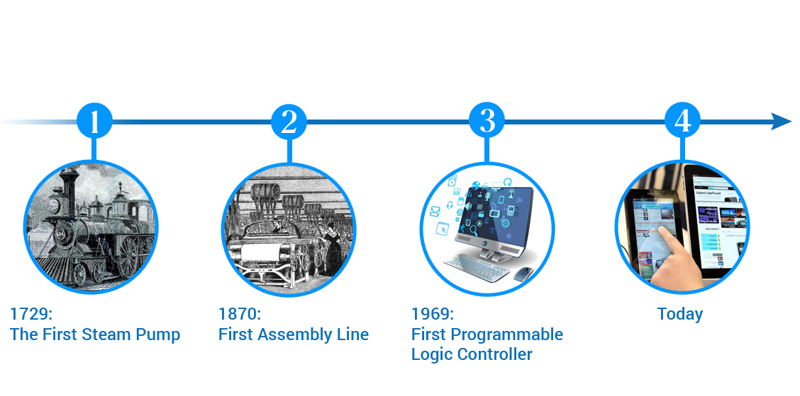
The 4th Industrial Revolution
The inexorable shift from simple digitization (the Third Industrial Revolution) to innovation based on combinations of technologies (the Fourth Industrial Revolution) is forcing companies to reexamine the way they do business.
How 4th Industrial Revolution Transformation is Different from its Predecessor
Innovations can be developed and diffused faster than ever
Falling marginal production costs, and the rise of platforms that aggregate and concentrate activity in multiple sectors, augment returns to scale
This global revolution will affect – and be shaped by – all countries, and have a systems-level impact in many areas

Slide 7





Digital Startups
Digital Transformation Partner
In-house Partner
Outsourced Sole Development Partner
Unicorn
Startup

Slide 8














Clients

Slide 9


Digital Transformation Wrappers
Social
Digital Customer Experience with front end wrappers
Digital systems integration leveraging Social APIs
Processing of Machine and User Generated data
Real time and streaming Analytics for the end user
Digital Ready Wrapper
IoT
Mobile
Enterprise Solutions
Cloud
Analytics

Slide 10
Enterprise Solutions
Workforce Engagement
Digital Core
Operations
Business Networking
Customer Engagement
Suppliers
Customers
IoT, Big Data & Analytics
Notes:
Enterprises are in the business of provision of products or services. Traditional enterprises engage with customers through their CRM systems. Production of goods and services happen in the core operations of the enterprise. The information flows in the enterprises are supported by the enterprise resource planning and supply chain planning systems. The focus of the operations team is to deliver operational excellence through efficiencies and effectiveness. The production of goods and services require materials and supplies. The collaboration with suppliers is supported by supplier relationship management systems. Full lifecycle of a product is managed through product life cycle management systems. innovation is what provided companies the competitive advantage.
Arrival of the social changed the way customers, suppliers and employees interact. Arrival of cloud changed the way infrastructure is provisioned utility computing with elastic demand and applications are deployed and serviced, Cloud and SaaS. Cloud Based Business Operating Systems are becoming the digital core. The engagement front end applications evolved for suppliers (business networks), employees (workforce engagement), and customers (customer engagement).
Arrival of IoT, enabled cost effective maintenance of the plant and machinery as well as end products. It has been made possible by IoT through condition based maintenance of the producing assets as well as produced products with intelligent sensors. Big Data and Analytics are enabling ongoing innovation and providing next competitive advantage for the enterprises embracing digital disruption.

Slide 11







Enterprise Adoption of DT

Slide 12





EMEA Opportunity
IoT based logistics and supply chain event management solution
Transformational real estate solution
Transformational payment processing platform
National Health Service
Widespread adoption across industries

Slide 14

A Leading Oil and Gas Corporation improves Real-time Integrated Monitoring of its Activities across Geographies
Kellton Tech designed, developed and delivered a robust SAP S/4 HANA cloud ERP, SCM and in-memory analytics solution to streamline the operations
Challenge: Par Pacific Holdings, Inc. is a Houston, Texas, US based publicly-traded Fortune 1000 (#953) company with interests in energy related assets and revenue of over USD 2 billion. Par is challenged to provide a solution to: Harness the reserves at refinery more efficiently Streamline the distribution operations that transport crude oil to refining hubs Provide unified view of all operations reflecting real-time developments Kellton Tech has been chosen as the partner of choice based on our deep domain expertise and solution capabilities
Solution: Conducted Digital Strategy Assessment of the company encompassing their complete applications landscape (SAP and Oracle ERP Applications) Designed, Developed, Provisioned, Implemented, enhancing and maintaining the Cloud S/4 HANA based SAP Solutions covering ERP ECC, GRC and In-memory Analytics Leveraged and enhanced SAP Industry Solution for Oil & Gas: Hydrocarbon Management
Impact: Real-time visibility of the extracted crude oil, its transport and distribution to refining hubs In-memory Analytics to enable prompt, informed decision-making Improved cost-efficiency, optimized operational efficiencies, and timely transport and distribution In just three months, Par optimized its back-office while developing a scalable cloud ERP landscape to support its continued growth in the Midstream and Downstream Oil & Gas sector Kellton Tech’s association with Par extends beyond 5 years and we have been their go-to partner for all things SAP “We want to thank Kellton Tech for being a great partner, as both a software re-seller and services provider for several of our strategic initiatives.” Rick Castro, CIO Par Pacific

Slide 15
A Gas Conglomerate realizes Efficiency Gains from Integrated Revenue, Operations and Spend Management
Kellton Tech designed and implemented an integrated SAP S/4 HANA cloud for Revenue, ERP, Fixed Assets Management as well as SAP Concur Spend Management cloud for AFE (Authorization for Expenditure) tracking
Challenge: Howard Energy Partners (HEP), is a 5 year old growing business, headquartered in San Antonio, Texas, US and has a revenue of over USD 300 million. HEP has 20+ legal entities and offers an integrated midstream platform that includes infrastructure and services from wellhead to market. HEP’s challenges are in terms of: Standard processes and COA across the entire organization Integrate Revenue, Operations, Fixed Assets and Spend Management (AFE) across the entities and disparate systems A solution that can be managed by lean in-house IT and scalable with future acquisitions in Mexico SAP Americas introduced Kellton Tech to Howard based on our Cloud Solutions and Oil & Gas industry expertise
Solution: Reviewed the As-Is Business Processes in Revenue, Operations, Fixed Assets and Spend Management supported by MAS 100 ERP from Sage and Concur Spend Management Designed, Developed, Provisioned, Implemented, enhancing and maintaining the Cloud S/4 HANA and Concur based SAP Solutions Implemented OpenText ECM/ BPM cloud and SAP Business Planning and Consolidation Extending the solution for ongoing acquisitions
Impact: Integrated and Scalable System of Record for all the companies within the conglomerate Reduced IT spend with cloud based solution, eliminated legacy on-premise applications; optimal utilization of in-house IT staff Improved Revenue and Spend Management with clear attribution and apportioning Kellton Tech’s association with HEP is for over an year and we have been their go-to partner for all things SAP

Slide 16
14th largest US Municipality capitalizes on IoT Smart Grid and Meters for Data-driven Process Automations
Designed, developed and implemented smart connection management solution leveraging smart grids and smart metering alerts
Challenge: Orlando Utilities Commission (OUC) (2nd largest municipality in Florida) is a municipally-owned public utility providing water and electricity services to 234,000 customers in Orlando, Florida and portions of adjacent unincorporated areas of Orange County, as well as St. Cloud, Florida, in Osceola County. OUC’s operations are challenged by: Growing number of customers Delayed payments Manual enforcement of disconnection and reconnection OUC selected Kellton Tech based on our pioneering work in IoT and Digital Transformation Solutions leveraging Digital Business Platforms
Solution: Designed, developed and implemented IoT based solution connecting the Smart Meters through Smart Grids Integrated the Customer Care, Billing, Operations and Self Service portals leveraging Software AG Digital Business Platform Provided Architectural Strategy, Roadmap and Implementation, Enterprise Service Bus processes about 130K unique transactions between different applications on daily basis Extensively involved in provisioning of Smart Grid and Smart meters, Field Order, Outage management, Secure account management, and Payment Gateway for customers and third party vendors Compliance with Energy & Utilities industry data standards
Impact: Over 200K OUC customers use Self Service portal for customer care, billing, outage and payment services Automated decision-making in various scenarios of bill payments IoT based scalable and extensible solution Kellton Tech shares 7 year long relationship with OUC. Our contract is renewed every 3 years

