Slide 1


Online Voting System
Discover a secure and accessible digital voting platform that empowers citizens to participate in the democratic process from the comfort of their homes or on the go.
An online voting system is a software platform that allows groups to conduct votes and elections securely. High-quality online voting systems balance ballot security, accessibility, and the overall requirements of an organization's voting event.

Slide 2
Admin Operations
Admin can add eligible voters to the voting system portal, which generates a unique voter ID for different voters.
Admin can add different positions(places) where the elections are occurring.
Admin can add different candidates(politicians) to different positions.
Users can log in to the portal by using their unique voter ID and after login, they can see the candidates, and then vote for their candidate.
There is a feature that voters can vote for multiple elections at a time when they login to the election portal using their voter ID.

Slide 3


Ballot Creation and Management
1
Intuitive Ballot Design
Ballots are crafted with clear instructions and an easy-to-use interface for voters.
2
Ballot Previewing
Voters can review and confirm their selections before final submission.
3
Ballot Versioning
Administrators can easily update and distribute new ballot versions as needed.

Slide 4

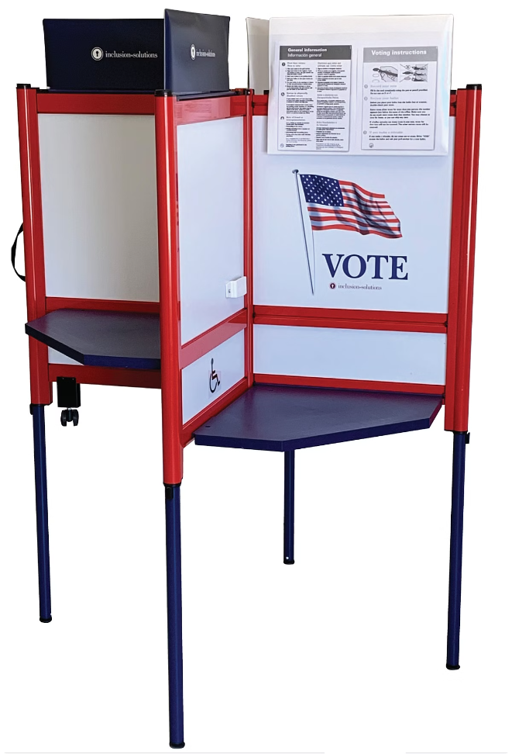
Secure Vote Casting
Process
End-to-End Encryption
Votes are encrypted from the moment they are cast, ensuring privacy and integrity.
Anonymous Balloting
Voters' identities are decoupled from their votes, preventing linking of individuals to their choices.
Instant Verification
Voters can immediately confirm that their votes have been recorded correctly.
Tamper-Evident Audit Trail
A secure, transparent log off all voting activities is maintained for post-election
audits.

Slide 5





Real-time Vote Tabulation and Results
Rapid Counting
Intuitive Dashboards
Verifiable Integrity
Global Accessibility
Votes are tallied and reported in near real-time, allowing for timely election results.
After Completion of Voting, the results are tabulated which includes no.of votes polled for different candidates
Voters can access election results from anywhere in the world, ensuring transparency.
Interactive dashboards provide clear visuali-zations of vote tallies and trends.

Slide 6





Robust Security Measures
Cryptographic Safeguards
Advanced encryption protects vote data and voter identities throughout the process.
Monitoring and Anomaly Detection
Real-time monitoring and advanced analytics identify and mitigate potential threats.
Transparent Auditing
Regular, independent audits of the system's security and integrity are conducted.

Slide 7

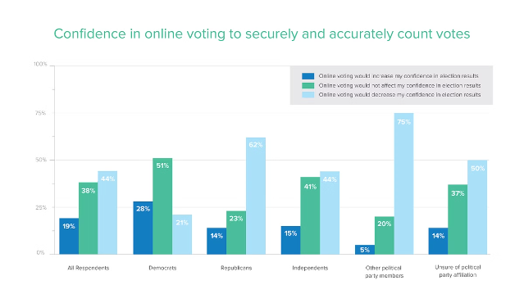
Conclusion and Future Considerations
The online voting system offers a secure, accessible, and user-friendly platform that empowers citizens to participate in the democratic process. As technology continues to evolve, the system will adapt to incorporate emerging innovations and address emerging challenges, ensuring the integrity and inclusivity of elections for generations to come.

