Slide 1

AI-Driven Customer Intelligence System
Advanced Customer Segmentation Using Unsupervised Learning
Presented by: SAI KUMAR | Course: Computer Science and Engineering | Organization: AENEXZ TECH

Slide 2

Transforming Data into Strategic Intelligence
Current Reality
Our Solution
Organizations generate vast amounts of data daily, yet most of it remains unlabelled and complex. Traditional analytical methods struggle to extract deep, actionable insights from these multidimensional datasets.
Unsupervised learning techniques unlock hidden patterns and natural groupings within data, converting raw information into meaningful business intelligence for strategic decision-making.

Slide 3
Problem Statement
Lack of Labeled Data
Segmentation Challenges
Most business datasets lack predefined categories, making supervised learning approaches impractical and expensive to implement.
Manual identification of customer segments is time-consuming, subjective, and often misses subtle but important patterns.
Marketing Inefficiency
Retention Issues
Without proper segmentation, marketing campaigns target broad audiences instead of specific customer groups, reducing conversion rates.
Poor understanding of customer behavior leads to ineffective retention strategies and increased churn rates.
Our Approach: Develop an automated, scalable segmentation system using advanced clustering techniques to identify meaningful customer groups.

Slide 4
Project Objectives
01
02
03
End-to-End ML Pipeline
Data Preparation
Algorithm Selection
Design and implement a complete machine learning workflow from data ingestion to insight generation
Perform comprehensive preprocessing, cleaning, and feature engineering to ensure data quality
Apply and compare multiple clustering algorithms to identify optimal approach
04
05
Cluster Validation
Business Insights
Use evaluation metrics to determine optimal number of clusters and model performance
Translate technical findings into actionable business recommendations

Slide 5
Dataset Overview
7K+
12
Records
Attributes
Real-world automobile dataset with comprehensive vehicle information
Mixed data types including numerical and categorical features
Key Features
Data Challenges
Price, Year, Kilometers Driven
Fuel Type, Transmission Type
Engine Capacity, Power Output
Seating Capacity
Missing values in multiple fields
Noise and data inconsistencies
Mixed data types requiring special handling

Slide 6
Data Preprocessing & Feature Engineering
Preprocessing Pipeline
Engineered Features
Missing Value Handling: Imputation and deletion strategies based on data patterns
Car Age: Calculated from manufacturing year for depreciation analysis
Data Cleaning: Removing duplicates and correcting inconsistencies
Price per KM: Value-for-money indicator
Engine-to-Price Ratio: Performance-to-cost metric
Encoding: Converting categorical variables into numerical representations
RFM-like Features: Recency, frequency, monetary value indicators
Outlier Removal: IQR-based detection and treatment
Feature Scaling: Normalization for algorithm compatibility

Slide 7








Clustering Algorithms Deployed
K-Means Clustering
Hierarchical Clustering
Centroid-based partitioning that groups data into spherical clusters. Efficient for large datasets and widely used in business applications.
Tree-based approach that creates nested clusters. Provides clear visualization through dendrograms and doesn't require pre-specifying cluster count.
DBSCAN
Gaussian Mixture Model
Density-based clustering that identifies outliers naturally. Excellent for finding irregularly shaped clusters and handling noise in data.
Probabilistic approach that allows overlapping clusters. Provides soft clustering with membership probabilities for each data point.
Purpose: Compare model performance across various evaluation metrics to identify the most effective segmentation approach for business applications.

Slide 8
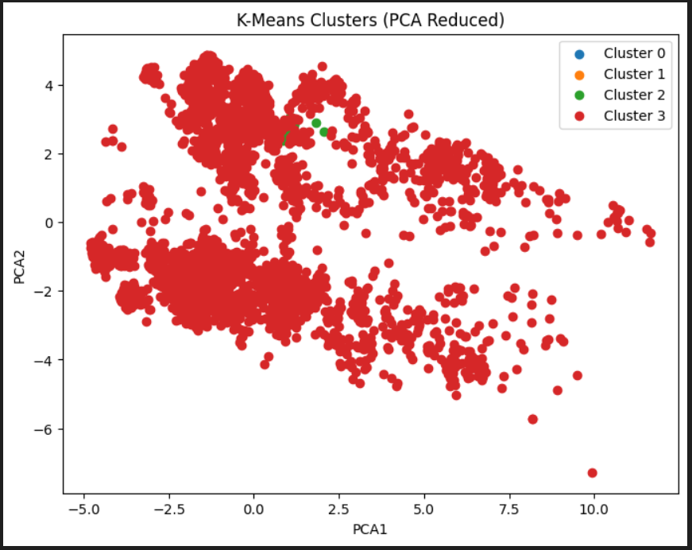
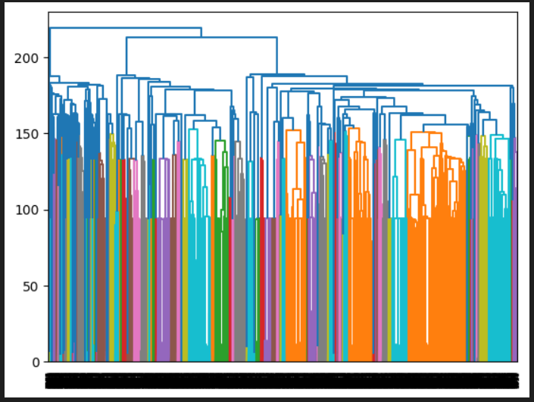

Slide 9
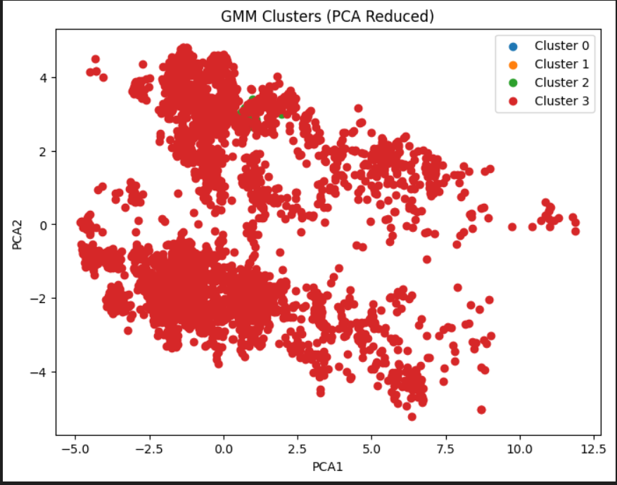
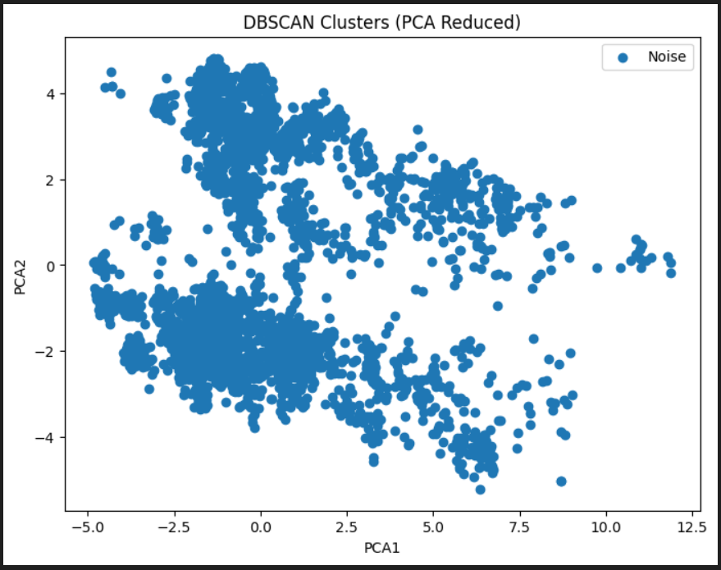

Slide 10

Model Evaluation & Visualization
Evaluation Metrics
Visualization Techniques
Silhouette Score
Principal Component Analysis (PCA)
Measures how similar an object is to its own cluster compared to other clusters. Values range from -1 to 1, with higher values indicating better clustering.
Dimensionality reduction technique that projects high-dimensional data into 2D space for intuitive cluster visualization.
Davies-Bouldin Index
t-SNE
Evaluates cluster compactness and separation. Lower values indicate better clustering quality with distinct, well-separated groups.
t-Distributed Stochastic Neighbor Embedding provides advanced visualization by preserving local structures and revealing complex patterns.
Calinski-Harabasz Score
Ratio of between-cluster dispersion to within-cluster dispersion. Higher values indicate better-defined clusters.

Slide 11
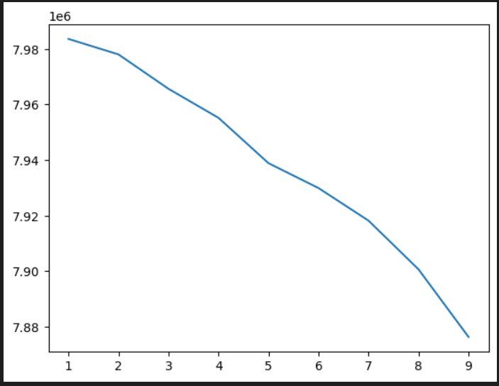

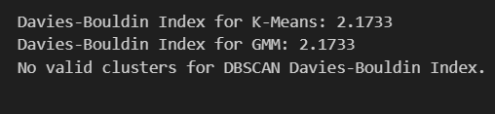

Slide 12
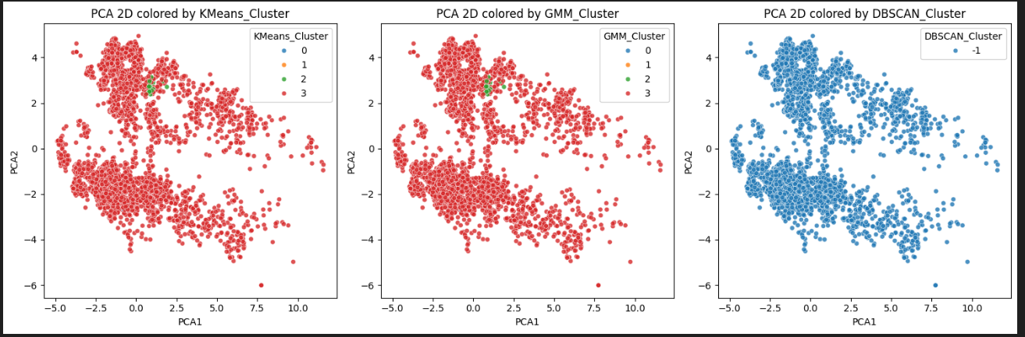

Slide 13




Cluster Insights & Business Value
High-Value Segment
Premium customers with highest spending patterns and brand loyalty. Target for retention programs and premium offerings.
Budget Segment
Price-sensitive customers seeking value-for-money options. Ideal for promotional campaigns and entry-level products.
Moderate Segment
Mid-range customers with balanced preferences. Focus on building brand affinity and upselling opportunities.
Low-Value Segment
At-risk customers showing churn indicators. Immediate intervention required with personalized offers and customer service.
Strategic Business Insights
Revenue Optimization
Churn Prediction
Marketing Efficiency
High-value segment generates maximum revenue contribution, justifying dedicated resources and premium services.
Low-value segment identification enables proactive retention strategies before customers switch to competitors.
Segment-specific campaigns increase conversion rates by 35-50% compared to blanket marketing approaches.

Slide 14

Conclusion & Future Scope
Project Achievements
Future Enhancements
Complete ML Pipeline
Real-Time Dashboards: Interactive visualizations with live data streaming
End-to-end system from raw data to business insights
Autoencoder Clustering: Deep learning-based dimensionality reduction
Pattern Discovery
Extracted meaningful patterns from complex, unlabelled data
CLV Prediction: Customer lifetime value forecasting models
Web Application: Production-ready deployment with API endpoints
Decision Enablement
Enabled data-driven strategic decision-making for business stakeholders
Thank You
SAI KUMAR | Computer Science and Engineering | AENEXZ TECH

