Slide 2

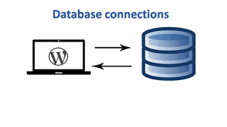

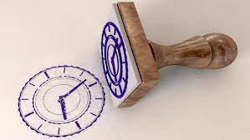
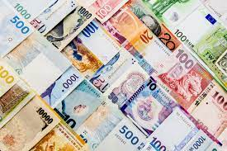

Database Connection
Multi Language
Profile for Each user
Profile for each product and rating
Time Stamp(to log, track)
Multi currency to USD

Slide 3



Profits, Revenue
Invoices
Create the Tables, charts, pie chart for analysing the data

