Slide 1
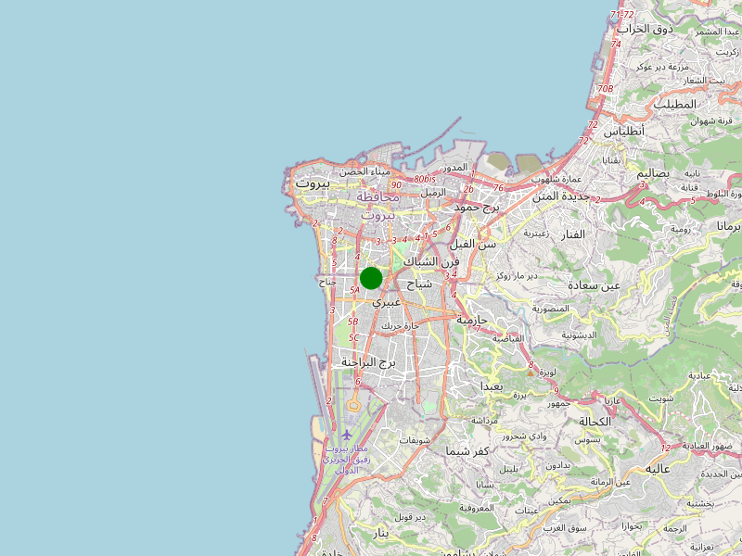



Weather Forecast
Beirut
Precipitation
• 0% precip probability
Temperature
• Average 59.7F
Atmospheric Conditions
• Forecast: Cloudy
• Cloud Cover: Unfavorable
• ISR Visibility: >10k - Very Good
• Illum: >50% - Favorable
• RW Operations: Unfavorable
• Fog: Unfavorable
Day | Today | Wed |  | Thu |  | Fri |  | Sat
 | PM | AM | PM | AM | PM | AM | PM | AM | PM
Temp | Max 63F | Min 54F | Max 63F | Min 52F | Max 65F | Min 51F | Max 63F | Min 53F | Max 63F
Wind | N @ 3mph | E @ 2mph | N @ 4mph | E @ 4mph | E @ 2mph | SE @ 5mph | SW @ 3mph | SE @ 4mph | S @ 5mph
Gusts | 9-15mph | 10mph | 11-14mph | 11-15mph | 9-13mph | 13-16mph | 9-13mph | 10-13mph | 13mph
Date | Nautical TwilightBegin | Civil Twilight Begin | Sunrise | Sunset | Civil Twilight End | Nautical Twilight End | Moon Rise | Moon Set | % Illum @ 0000Z
2024-12-17 | 03:38 | 04:09 | 04:37 | 14:31 | 14:59 | 15:30 | 16:33 | 06:42 | 96.49%
2024-12-18 | 03:39 | 04:10 | 04:38 | 14:32 | 15:00 | 15:31 | 17:40 | 07:26 | 91.55%
2024-12-19 | 03:39 | 04:10 | 04:38 | 14:32 | 15:00 | 15:31 | 18:43 | 08:02 | 84.89%

