Slide 1
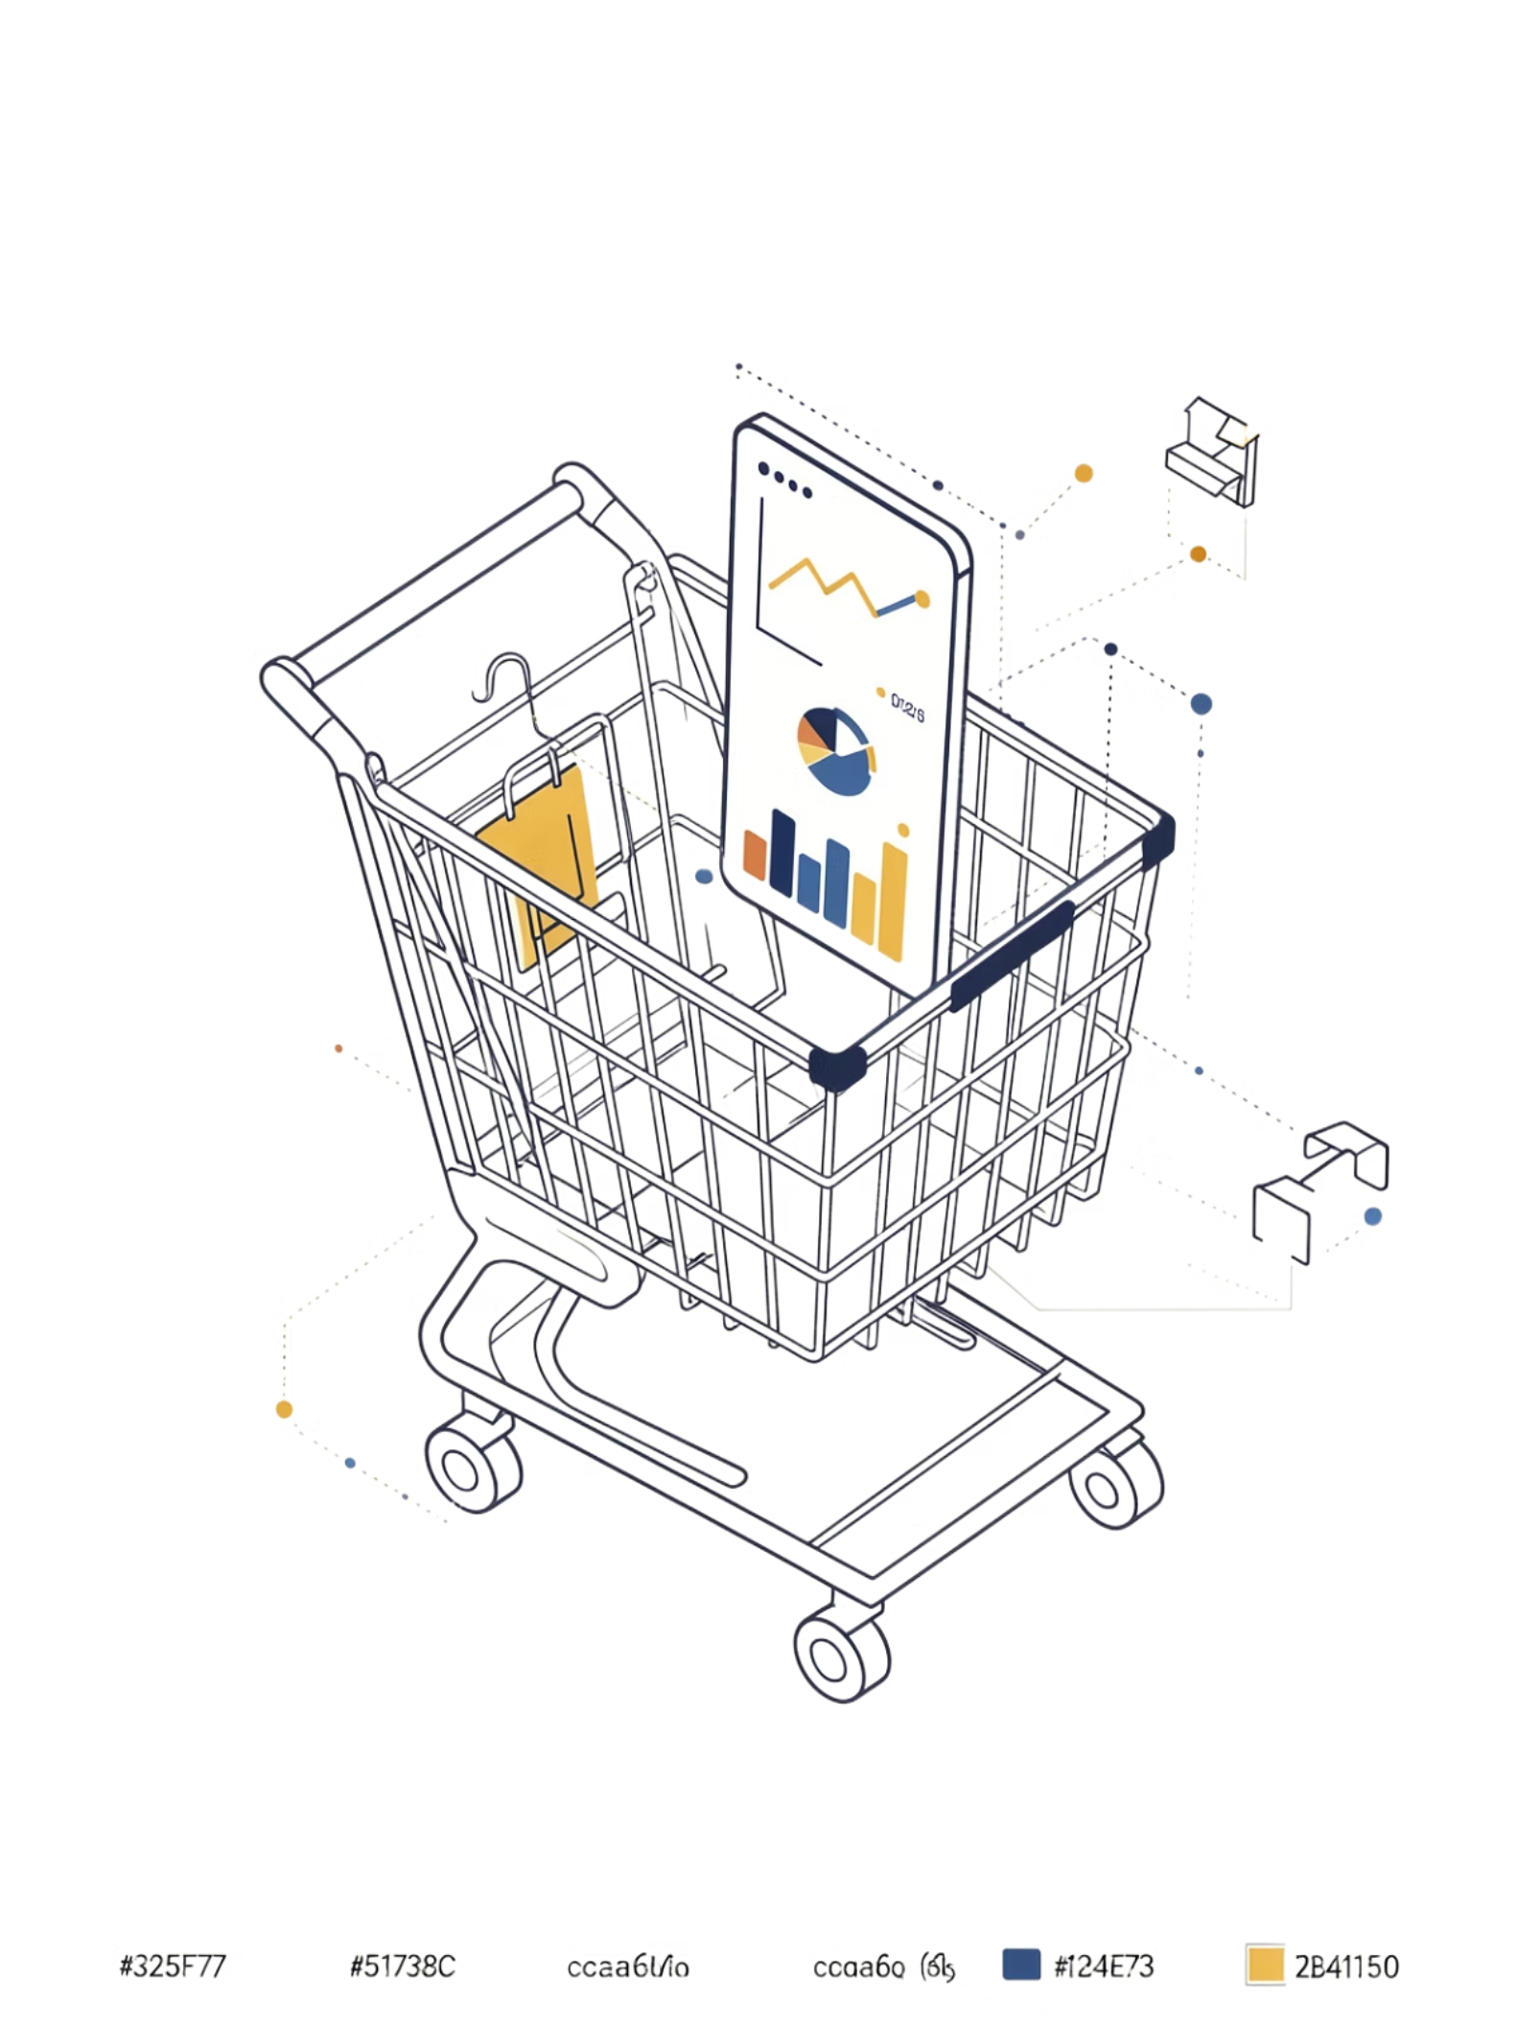
Customer Shopping Behavior Analysis
Uncovering insights from 3,900 transactions across product categories — spending patterns, customer segments, and subscription behavior.
3,900
Purchases analyzed
18
Data columns
Python + SQL
Analysis stack
Power BI
Interactive dashboard

Slide 2
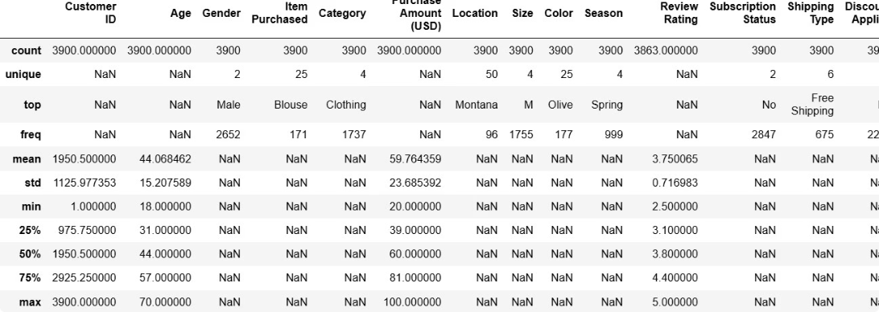
Data Preparation & EDA
Python Pipeline
01
Load & Explore
pandas, df.info(), .describe()
02
Clean & Impute
37 missing ratings filled with category median
03
Feature Engineering
age_group, purchase_frequency_days columns created
04
Load to PostgreSQL
Cleaned DataFrame exported for SQL analysis

Slide 3
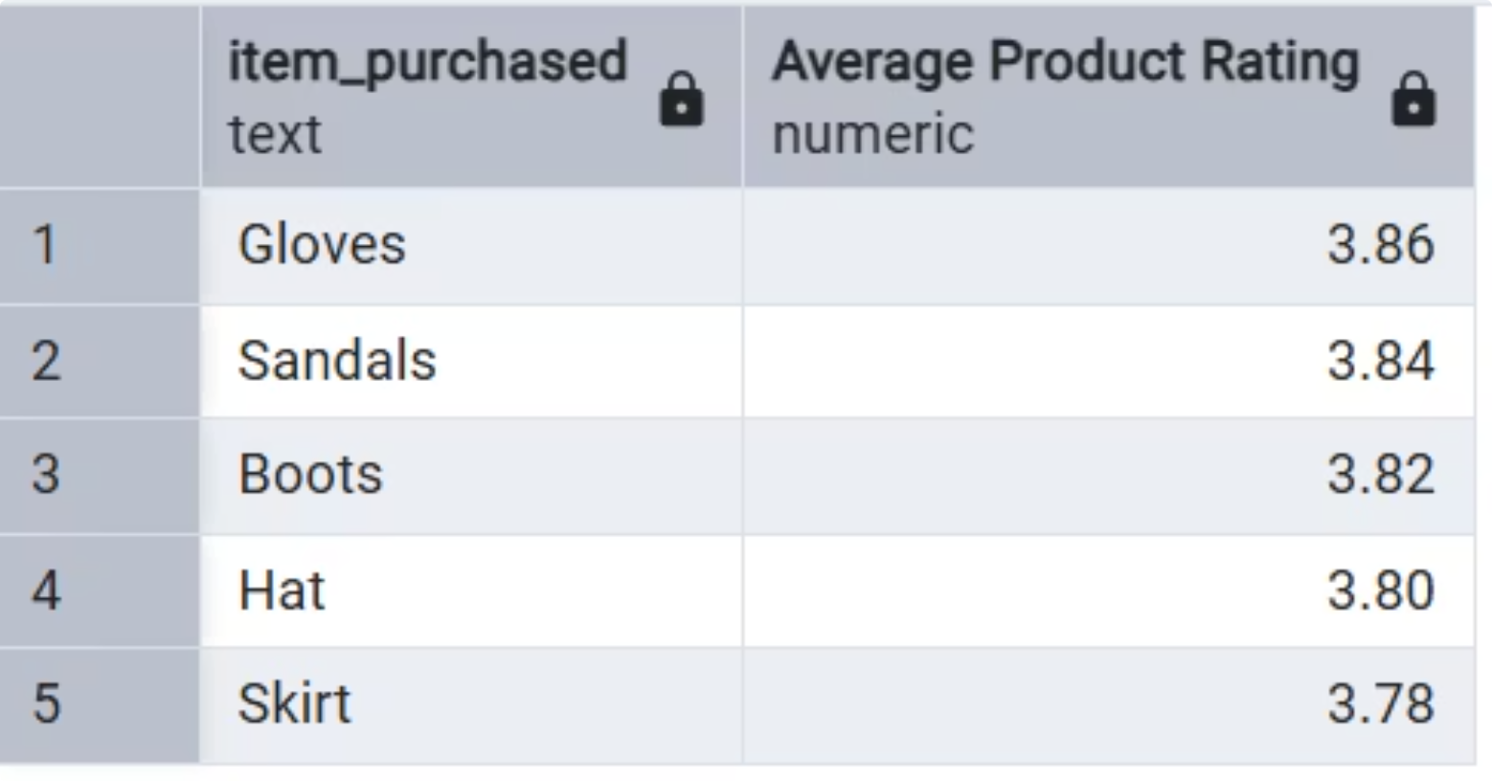
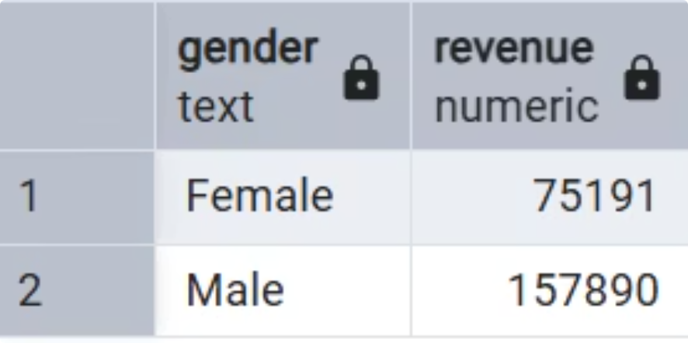
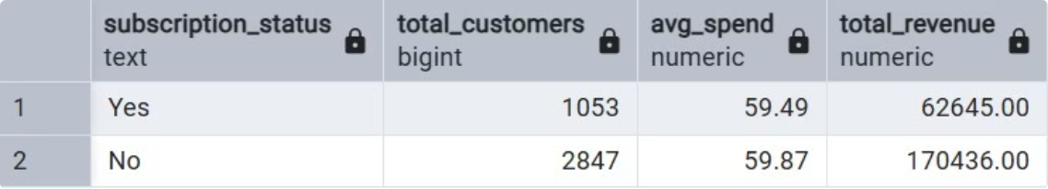
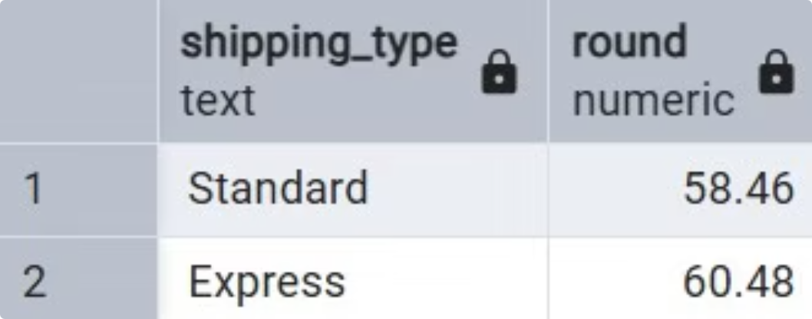
SQL Analysis: Key Business Questions
Top 5 Products by Rating
Revenue by Gender
Subscribers vs. Non-Subscribers
Shipping Type Comparison

Slide 4
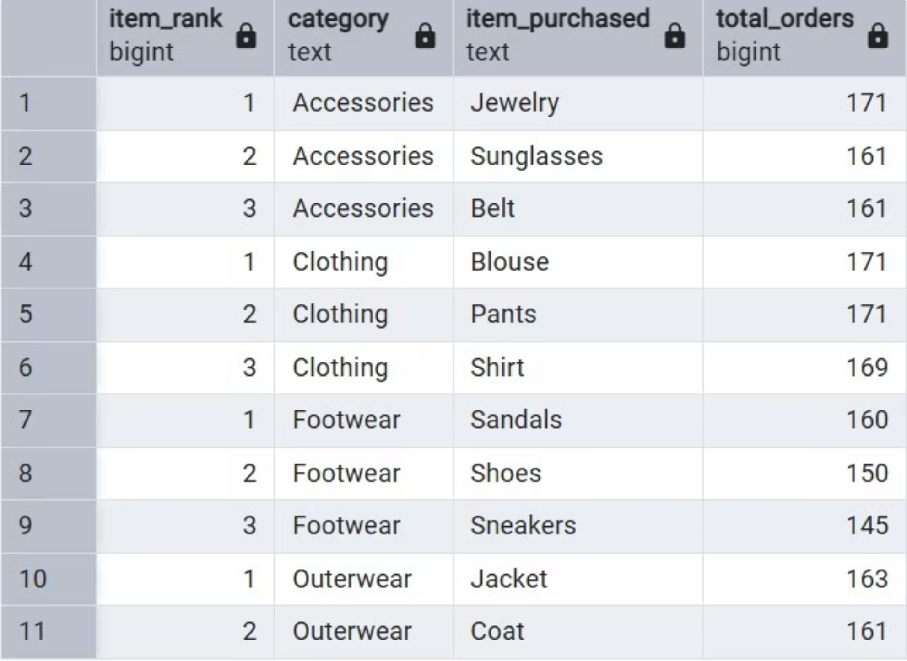
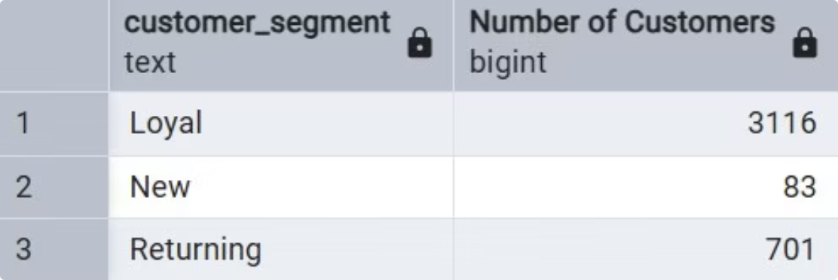
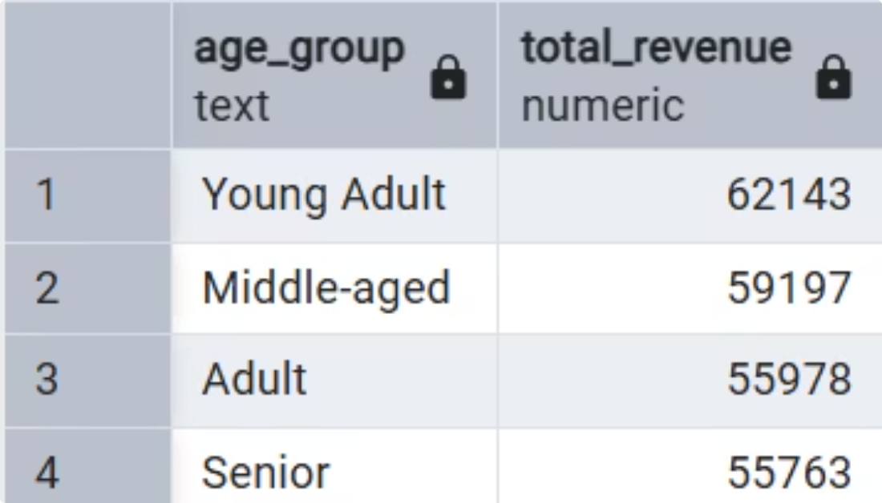
Segmentation & Category Insights
Top 3 Products per Category
Customer Segments
Revenue by Age Group

Slide 5
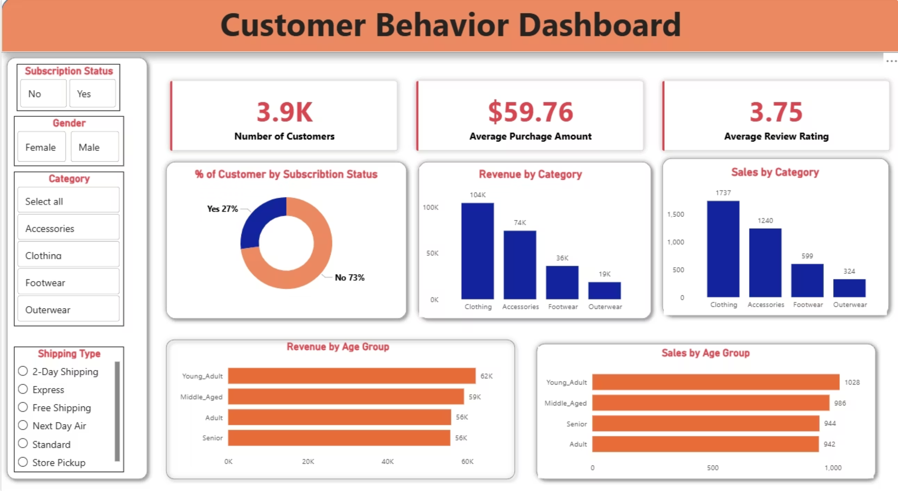

Power BI Dashboard & Recommendations
Boost Subscriptions
Loyalty Programs
Promote exclusive subscriber benefits
Reward repeat buyers → move to "Loyal" segment
Discount Policy
Targeted Marketing
Balance sales boosts with margin control
Focus on high-revenue age groups & express-shipping users

