Slide 1
Group : Mikes
Team Members
Neelima Kommareddy
Sindhu Anugula
Kalwa Sailaxmi

Slide 2
Project Topic
Healthcare Chatbot: Utilizing Artificial Intelligence for Medical Diagnosis

Slide 3
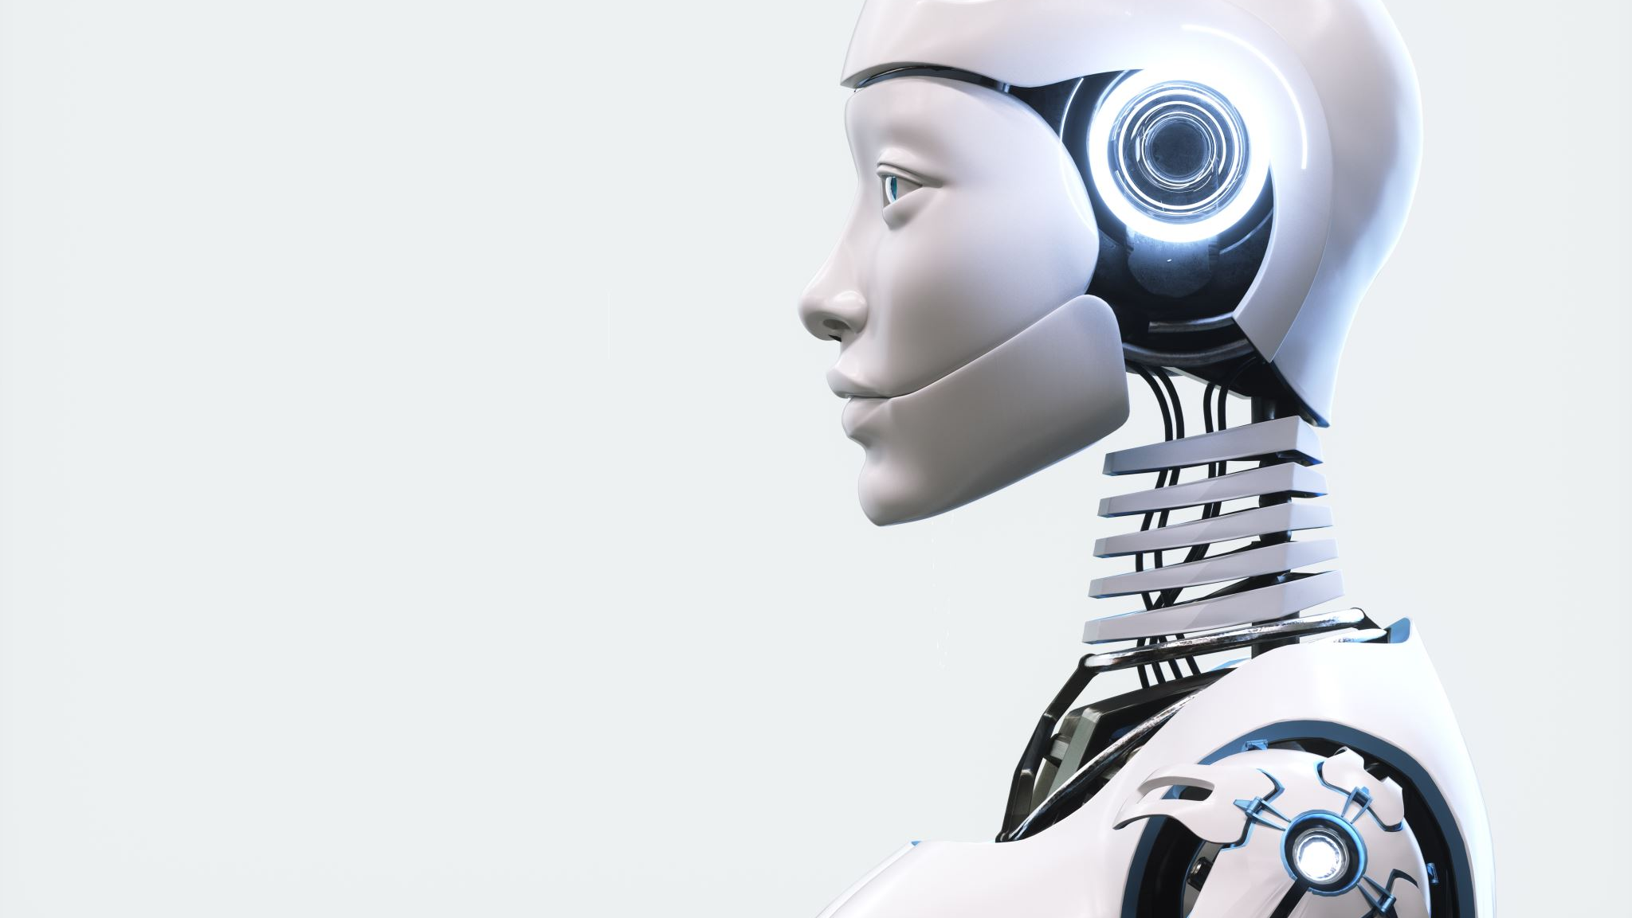
Statement of Project
The purpose of this project is to develop an AI-powered healthcare chatbot that can help with diagnosis. In order to give patients a convenient way to submit their symptoms and obtain a preliminary diagnosis, the chatbot will be built. If necessary, the chatbot will also offer suggestions for additional medical assessment. Enhancing the precision and effectiveness of medical diagnosis is the aim of this initiative, particularly when patients do not have quick access to a healthcare provider.

Slide 4

APPROACH
Data Collection
We will collected a large dataset of medical records and symptoms to train our AI model.
Model Development
We will develop a deep learning model that uses natural language processing to analyze patient symptoms and provide accurate diagnoses.
Integration with Chatbot
We will integrate our AI model with a chatbot interface to provide users with an easy-to-use and accessible platform for medical diagnosis.

Slide 5

Deliverables
Functional Healthcare Chatbot :- Our team will develop a functional healthcare chatbot that utilizes AI to assist in medical diagnosis.
Integration with Medical Databases :- The chatbot will be integrated with various medical databases to provide accurate and up-to-date information.
User Testing Results :- We will provide user testing results to evaluate the effectiveness and efficiency of our chatbot.

Slide 6

Evaluation Methodology
Accuracy Metrics :- The accuracy of the chatbot's diagnosis will be evaluated using metrics such as precision, recall, and F1 score.
User Feedback :- User feedback will be collected through surveys and interviews to evaluate the chatbot's usability, effectiveness, and overall satisfaction.
Data Analysis :- We will analyze the data collected by the chatbot to identify trends and patterns in medical diagnoses.

Slide 7

Thank You

