Slide 1
DAEN 328
Term Project – Phase 2
Full Stack Data Engineering Pipeline
Officer Show of Force - Phoenix
Team Members: Roberto Cuellar III, Brody Mitchell, Jay Yan, Elias Ortiz
May 2026
1 / 12

Slide 2
01 · OVERVIEW
Project Overview
PROJECT NAME
Pipeline
Components
Officer Show of Force - Phoenix
TEAM MEMBERS
API / DATA SOURCE
Extract
Roberto Cuellar III
Brody Mitchell
Elias Ortiz
Jay Yan
https://www.phoenixopendata.com/api/3/action/datastore_search
Transform
GOAL / PROBLEM STATEMENT
Load
The goal of this project is to identify common characteristics, geographical trends, or underlying themes that result in officers using forceful techniques against offenders
Visualize
The initial pipeline extracts data from the API in batches where it is then processed through data cleaning methods
The cleaned data is then ported into a database to perform read-only queries that will be reflected in the streamlit dashboard
Finally, Dockerizing the application allows for the files to be stored and ran in a single container
HIGH-LEVEL SUMMARY
Dockerize
2 / 12

Slide 3
02 · DATA SOURCE
API and Data Overview
API NAME & ENDPOINT
AUTHENTICATION
RATE LIMITS / PAGINATION
https://www.phoenixopendata.com/api/3/action/datastore_search
None, Public Access Data Source
None
SAMPLE RAW JSON RESPONSE
KEY FIELDS
{'help': 'https://www.phoenixopendata.com/api/3/action/help_show?name=datastore_search',
'success': True,
'result': {'include_total': True,
'limit': 1000,
'offset': 0,
'records_format': 'objects',
'resource_id': '7e9d5fc7-ce02-4108-80af-369b1b54c4ff',
'total_estimation_threshold': None,
'records': [{'_id': 1,
'INC_IR_NO': '202500000255424',
'INC_IA_NO': 'SOF25-0005',
'INC_DATE': '2025-02-18T00:00:00',
'INC_YEAR': '2025',
'INC_TIME': '23:11',
'INC_DAY_WEEK': 'Tuesday',
'INC_BEAT': 'Maricopa',
'HUNDRED_BLOCK': '1XXXX West Rancho Santa Fe Boulevard',
'INC_CITY': 'Avondale',
'INC_STATE': 'AZ',
'INC_ZIPCODE': '85392',
'INC_PRECINCT': 'Out of City',
'CIT_NUMBER': '44041',
'CIT_GENDER': 'Male',
'CIT_AGE': '30',
'SUBJ_AGE_GROUP': '30s',
'CIT_RACE': 'Black',
'CIT_ETHNICITY': 'Non-Hispanic',
'SIMPLE_SUBJ_RE_GRP': 'Black or African American',
'CITIZEN_CHARGE': 'None',
'HIGHEST_SHOW_FORCE': 'Gun',
'SHOW_FORCE_COUNT': 1},
INC_IR_NO – unique report number for each record
CIT_GENDER – citizen gender (male, female)
CIT_AGE – citizen age
CIT_RACE – citizen race
CITIZEN_CHARGE – category of charge (criminal vs. traffic, misdemeanor/felony/criminal)
HIGHEST_SHOW_FORCE – kind of force used against citizen (gun, impact munitions, taser, irritants)
INC_TIME – time of incident
Format: JSON
Updates: Monthly
Rows per Batch: 1000
3 / 12

Slide 4
03 · ARCHITECTURE
Pipeline Schema
Pipeline Diagram
API
ETL.py
PostgreSQL
Streamlit
ETL Container
PostreSQL Container
Streamlit Container
Port 5432
Port 8501
EXTRACT
TRANSFORM
LOAD
The bulk of the columns are converted to numeric types, inserting “NA” for missing values, and normalizing capitalization and other string formatting. Functions like pd.to_numeric(), df.replace(), pd.isna(), and df.apply() are common methods used to achieve this goal.
Data is fetched in batches using the requests library on the data records.
current_batch = response.json()['result']['records']
To connect to the PostgreSQL database, the code uses psycopg2 to connect via parameters from the .env file. Next, we execute a query that creates all the necessary tables for our schema and commit the changes.
4 / 12

Slide 5
04 · TRANSFORM
Data Cleaning and Transformation Steps
NORMALIZATION
MISSING VALUES STRATEGY
Replace 'Not Available' with NA; standardize categorical values (race, ethnicity);
strip/clean strings (e.g., remove "Beat", "(Airport)"); enforce consistent formats
Replace 'Not Available' → NA → None;
drop rows missing primary keys (INC_IR_NO, CIT_NUMBER);
leave other missing values as NULL (no blanket drop)
TYPE CONVERSION
FORMAT STANDARDIZATION
Strings → datetime (INC_DATE);
strings → numeric (INC_IR_NO, INC_YEAR, ZIPCODE, AGE, COUNTS);
extract time from datetime (INC_TIME)
Standardize date-time format using pandas datetime;
normalize race/ethnicity labels (e.g., "whi" → "White");
force state = 'AZ'; consistent age groups (20s, 30s, etc.)
DUPLICATE REMOVAL
DERIVED COLUMNS
drop_duplicates() applied after splitting into normalized tables
(incident_reports, citizens, incident_details)
INC_TIME extracted from INC_DATE;
SUBJ_AGE_GROUP derived from CIT_AGE (bucketed ranges);
incident_detail_num created as unique ID
BEFORE → AFTER EXAMPLE ROW
AFTER:
date = 2020-01-01 13:45:00, time = 13:45:00, race = "White",
age = NULL, beat = "123"
BEFORE:
INC_DATE = "2020-01-01T00:00:00", INC_TIME = "13:45", CIT_RACE = "whi",
CIT_AGE = 150, INC_BEAT = "Beat 123 (Airport)"
5 / 12

Slide 6
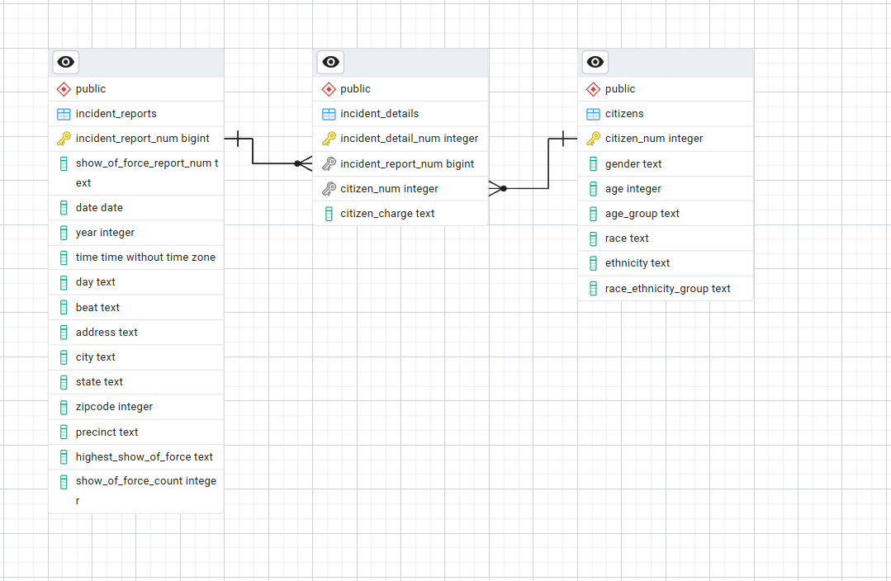
05 · LOAD
PostgreSQL Table Schema Overview
6 / 12

Slide 7
05 · LOAD
PostgreSQL Table Schema
Table: incident_reports
Column
Type
Nullable
Key
Description
incident_report_num
bigint
NO
PK
Unique incident report number primary key
show_of_force_report_num
text
YES
Report number for when show of force is used
date
date
YES
Date of report
year
Integer
YES
Year of report
day
Text
YES
Month and day of report
Beat
text
YES
Police beat area where incident occured
INDEXES / CONSTRAINTS
PK on incident_report_num to ensure each incident report is unique
7 / 12

Slide 8
05 · LOAD
PostgreSQL Table Schema
Table: incident_details
Column
Type
Nullable
Key
Description
incident_detail_num
integer
NO
PK
Unique incident detail number, primary key
incident_report_num
bigint
YES
FK
Incident report number, foreign key
citizen_num
integer
YES
FK
Number assigned to citizen in incident report, foreign key
citizen_charge
text
YES
Reported charge against citizen offender
INDEXES / CONSTRAINTS
PK on incident_detail_num;
FK on incident_report_num linking to incident_reports;
FK on citizen_num linking to citizens
8 / 12

Slide 9
05 · LOAD
PostgreSQL Table Schema
Table: citizens
Column
Type
Nullable
Key
Description
citizen_num
integer
NO
PK
Number assigned to citizen in incident report, primary key
gender
text
YES
Citizen gender (male, female)
age
integer
YES
Citizen age
age_group
text
YES
Age group of citizen (20s, 30s, …)
race
text
YES
Citizen race
ethnicity
text
YES
Citizen ethnicity
INDEXES / CONSTRAINTS
PK on citizen_num to ensure each citizen record is unique
9 / 12

Slide 10
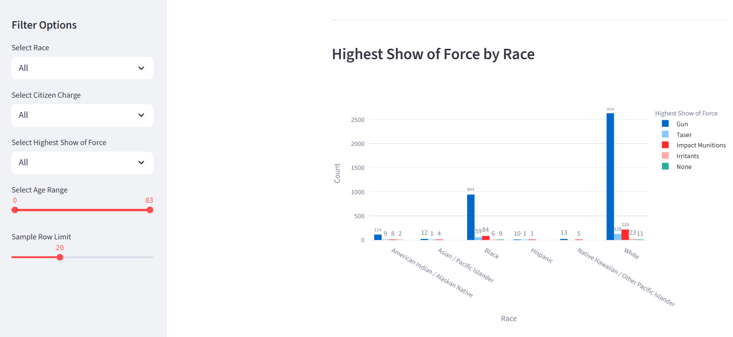
06 · VISUALIZE
Streamlit Dashboard Overview
01
Chart 1
DASHBOARD SCREENSHOT
Pie Chart: Race Distribution of Citizens in Incidents
[ Paste screenshot here ]
02
Chart 2
Bar Chart: Most Common Citizen Charges
03
Chart 3
Bar Chart: Distribution of Highest Show of Force
04
Chart 4
Grouped Bar Chart: Highest Show of Force by Race
05
Chart 5
INTERACTIVE CONTROLS
Stacked Bar Chart: Distribution of Charge by Race
We have dropdowns to filter by race, citizen charge, and show of force, as well as sliders to look at the statistics within certian age ranges and to control the displayed sample size
10 / 12

Slide 11
08 · FUTURE WORK
Recommended Future Steps
01
Caching Expensive Queries
04
Cloud Deployment
Use st.cache_data to improve the load times of computationally expensive queries
Deploy the Docker container to Google Cloud Run
02
Scheduling and Monitoring
05
Error Logs and Alerts
Use Apache Airflow to run the pipeline automatically, on a user-defined schedule.
Scheduling Data Pipelines with Apache Airflow: A Beginner’s Guide
Create an alert system that notifies managers when a run fails
03
Security Measures
If something like the Streamlit dashboard were to be shared outside of the group, we could implement an authentication step to make sure the use cases are safe.
LESSONS LEARNED
Something that we could have done differently is further refine our database schema so that there is less redundancy in columns. For example, removing the ‘age_group’ feature as we already have age, removing the ‘state’ feature as they are all in the Phoenix area, and choosing between keeping the date variable or the day and year variables.
11 / 12

Slide 12
REFLECTION
What did you learn
throughout this course?
🎤
What was the most challenging part of building a full ETL pipeline?
Open
discussion
How did your understanding of data engineering change?
What tool or concept will you carry into your career?
What would you do differently if you started over?
12/ 12

