Slide 1
FitCompute pro
Major Project Review
By
Sailendhira Shankar M
21BCA045
On
29.01.2024

Slide 2
Problem Statement
Existing System
Proposed System
AGENDA
Tech stacks
Data Flow Diagram
ER Diagram
Conclusion

Slide 3
Problem statement
India has been experiencing a rising trend in obesity over the past few decades. The prevalence of obesity has increased significantly, not only in urban areas but also in rural regions.
Limited access to tools for individuals to assess and monitor their own health status.
Lack of awareness about the risks associated with obesity and unhealthy lifestyles.

Slide 4
Existing system
Discuss the inconvenience of accessing multiple applications for different health-related tasks.
Existing health and fitness applications in the market often lack user-friendliness, creating a barrier for individuals seeking a seamless and intuitive experience in managing their well-being.

Slide 5
Proposed system
Handling the challenges individuals face in managing their health and fitness
effectively.
Avoiding all the inconvenience of accessing multiple applications for different
health-related tasks.
Developing a user-friendly website interface.
Implementing accurate calculation algorithms.
Providing valuable fitness knowledge through the quiz feature.
Enhancing accessibility for users of all backgrounds.

Slide 6





Tech stacks
Frontend
Backend

Slide 7
Data flow Diagram
Level 0:
User details
user
FitCompute pro
View details
Level 1:
BMI Calculator
Login
Confirmation
Validation
Maintenance
Cal calculator
user
user
Login
Register
BFP Calculator
Registration
Fitness Quiz

Slide 8
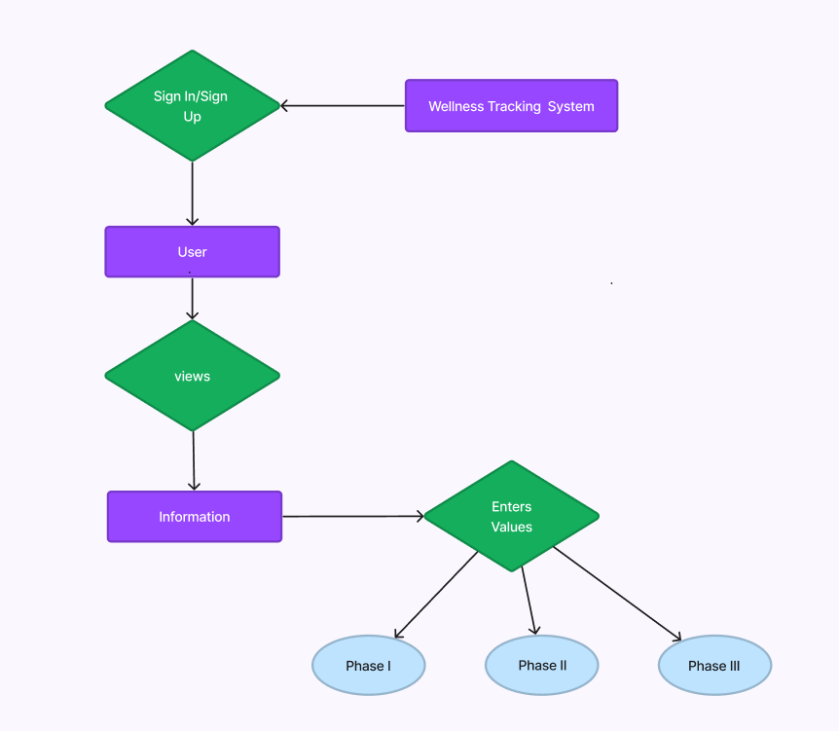
ER Diagram

Slide 9
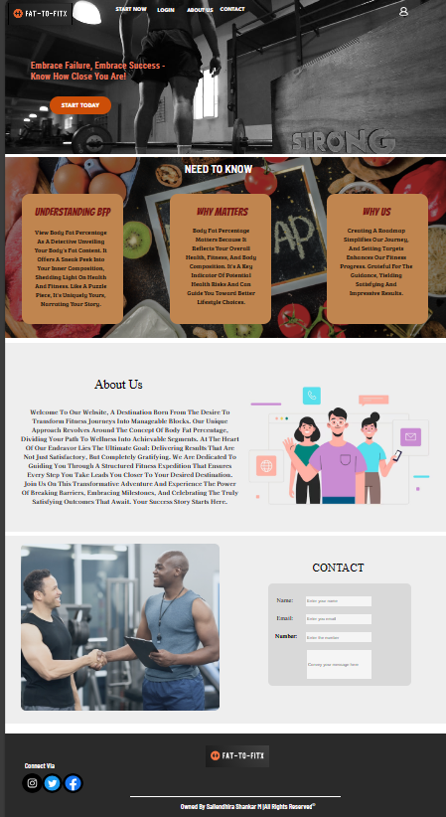
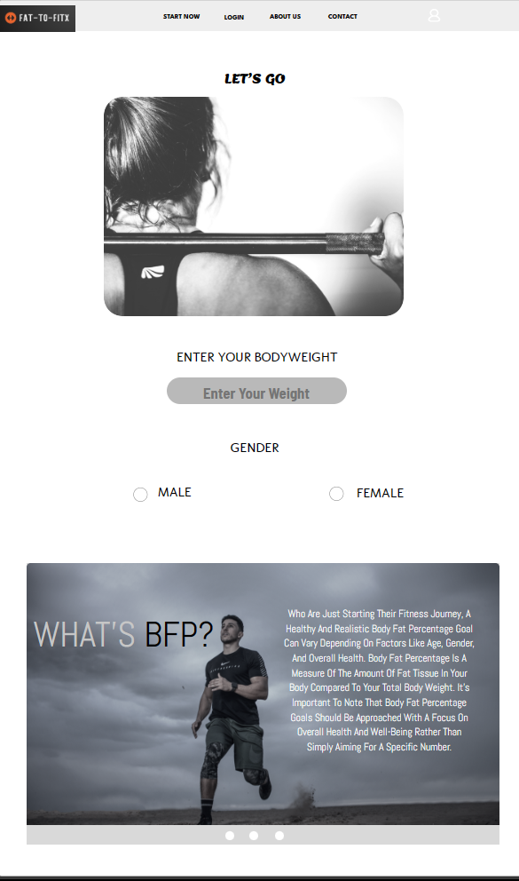
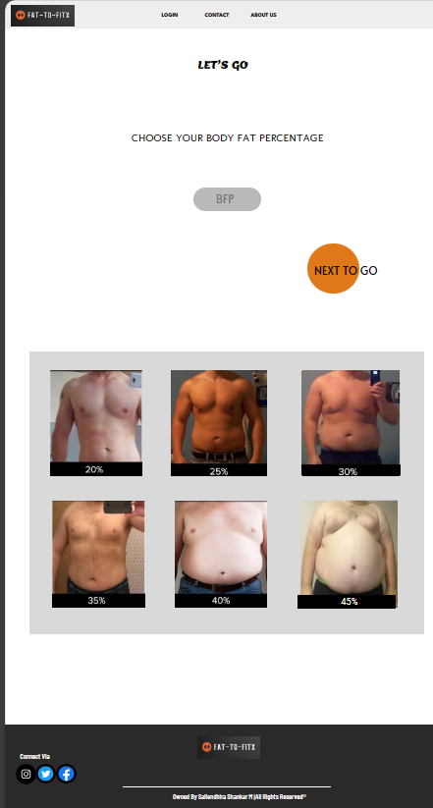
Screenshots
Home Screen
Input Screen
Input Screen

Slide 10
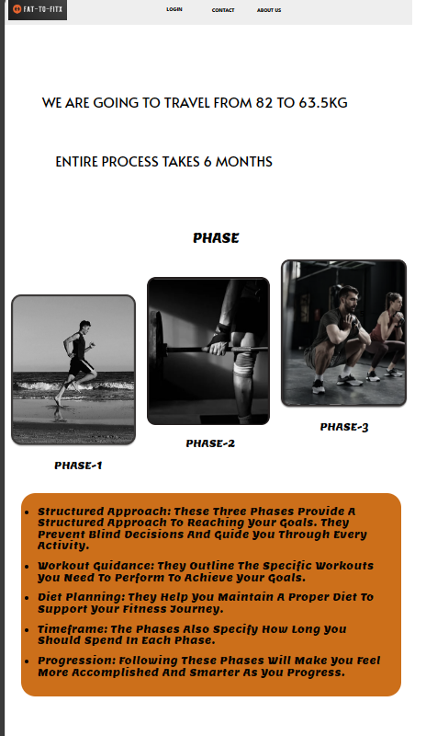
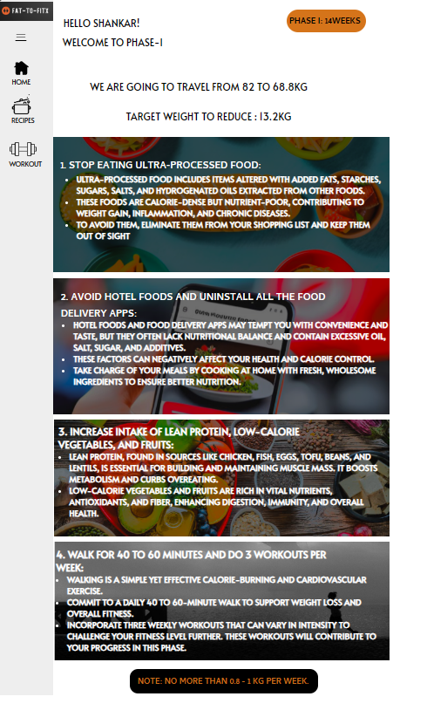
Output Screens

Slide 11
Scope of Future Enhancement
Enhanced Nutrition Insights: Future enhancements may include more detailed nutritional insights, helping users with meal planning and understanding macronutrient intake.
Health Monitoring Expansion: Expanding the system's capabilities to monitor additional health metrics, like heart rate and blood pressure, for a more holistic approach to wellness tracking.
Community Building: Enhance social features to encourage user interaction and the formation of a supportive community, promoting motivation and accountability.

Slide 12
Conclusion
“Many of life's failures, are people who did not realize how close they were to success when they gave up”.

