Slide 1

TRANSPORT AND TELECOMMUNICATION INSTITUTE
Bachelor of Natural Sciences in Computer Science
Course Work
Riga 2020
Made by:
Arturs Gabetovs
Student code: 61908
Group: 4902BDA

Slide 2

Aim of my Course work
To build maximum understandable program, with all knowledge which a gained from 2 semesters
My theme of the work:
Warehouse inventory accounting program
for grocery store.

Slide 3
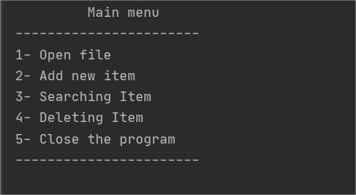
Design of my program.
“The simpler the design, the easier it is to understand.”

Slide 4
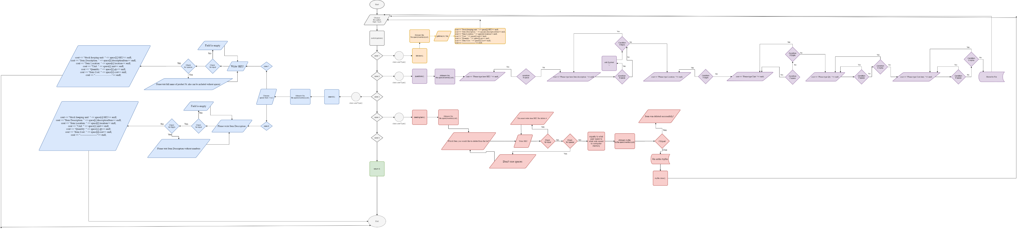
Flowchart

Slide 5
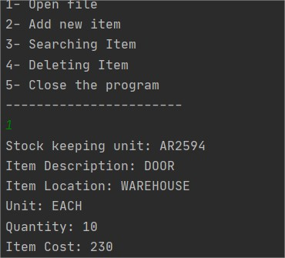
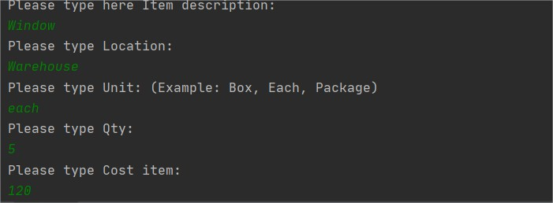
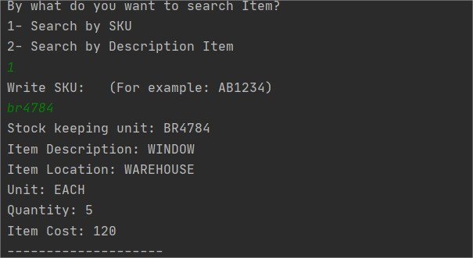
Testing program:
Open File
Add new Item
Search Item

Slide 6
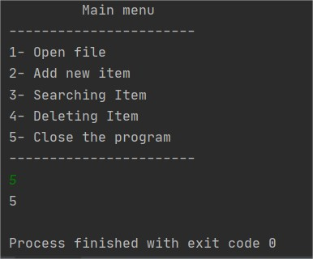
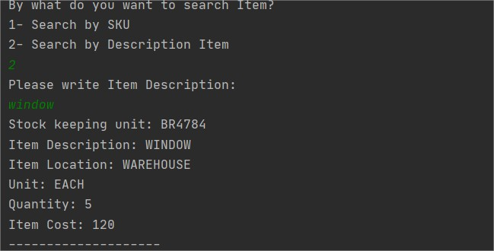
Continue with searching and after finally closing program with return statement.

Slide 7
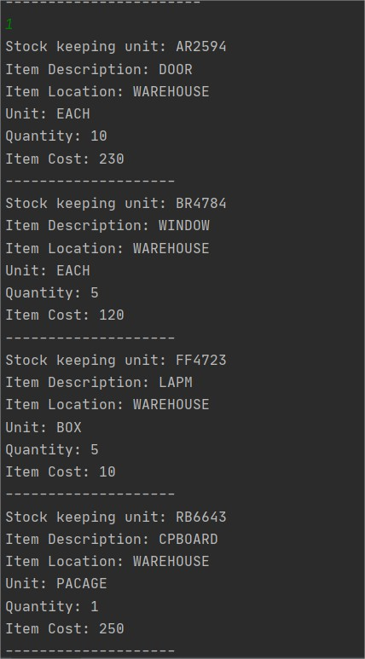
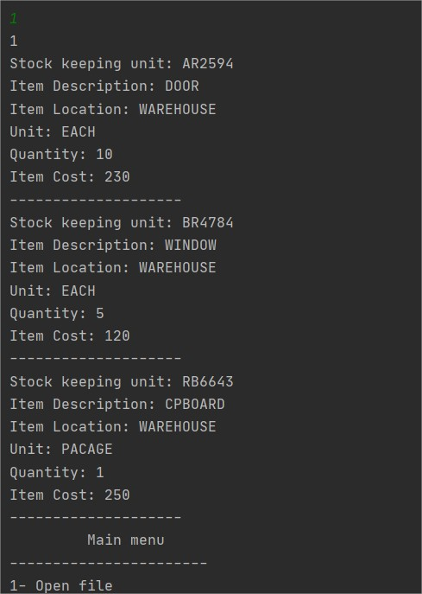
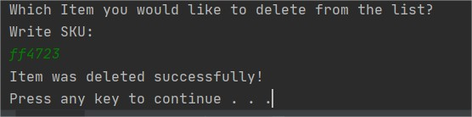
Delete function.

Slide 8

A great time was spent with this work and a nice challenge to see what actually we got from two semesters which was passed so fast.

