Slide 1
Containerization with Docker
What you are going to learn.
At the end of this module you will be able to:
Docker Engine
Docker Networking
Docker Network Type/Modes:
Labs
Satyam Kumar Pandey
DevopsTraining@Feb2019

Slide 2
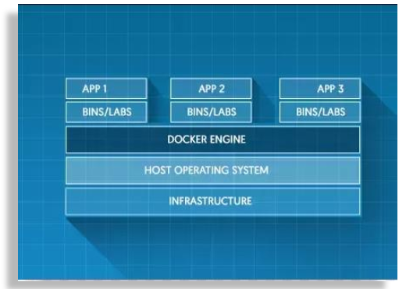
Containerization with Docker
Docker Engine
Docker Engine is the part of Docker which create and runs Docker Containers
It is a core of a Docker platform which acts as a lightweight run time that runs Docker Containers.
Docker Engine Know how to talk to the kernel, make the system class to create, operate and manage containers, which we as users of docker don’t have to worry about.
Satyam Kumar Pandey
DevopsTraining@Feb2019

Slide 3
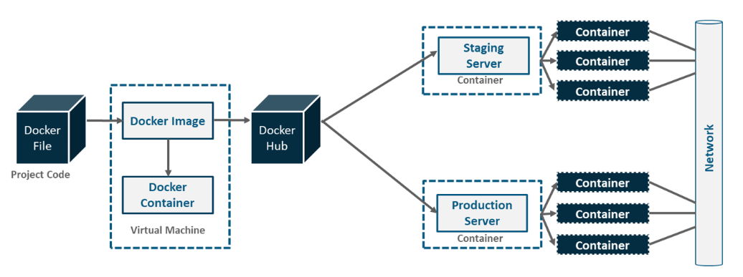
Containerization with Docker
Docker Networking
Satyam Kumar Pandey
DevopsTraining@Feb2019

Slide 4
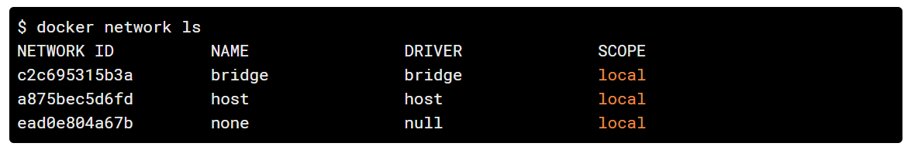
Containerization with Docker
Docker Networking
Docker networking utilizes already existing Linux Kernel Networking features like (iptables, namespaces, bridges etc.).
With Docker Networking, :
we can connect various docker images running on same host or across multiple hosts.
Provide complete isolation for containers
This enables building web application that works together securely.
Docker Network Type/Modes:
Bridge
Host
Overlay
None
Macvlan
When docker is installed, it creates three networks automatically.
Satyam Kumar Pandey
DevopsTraining@Feb2019

Slide 5
Containerization with Docker
Bridge Networking Mode
This is default network driver/type/mode if driver is not being specified .
When you start Docker, a default bridge network (also called bridge) is created automatically, and newly-started containers connect to it unless otherwise specified.
All the containers connected to the internal bridge can now communicate with one another. But they can’t communicate outside the bridge network.
With -p flag however, we can map the docker port to the native port.
$ docker run -p 4000:80 microservice-demo
Satyam Kumar Pandey
DevopsTraining@Feb2019
Notes:
In terms of networking, a bridge network is a Link Layer device which forwards traffic between network segments. A bridge can be a hardware device or a software device running within a host machine’s kernel.
In terms of Docker, a bridge network uses a software bridge which allows containers connected to the same bridge network to communicate, while providing isolation from containers which are not connected to that bridge network. The Docker bridge driver automatically installs rules in the host machine so that containers on different bridge networks cannot communicate directly with each other.

Slide 6
Containerization with Docker
Host Networking Mode
Host Network driver are used when isolation of container network stack from the sdocker host is not required
If a container is running on same port and host network is being suse, then application will be avilable on the same port on host’s IP address
It work only on Linux Os and not on Windows or Mac OS.
Shares TCP/IP stack, namespace etc of host OS. That is, all of the network interfaces defined on the host will be accessible to the container.
Below command connects the microservice docker image to the host network.
$ docker run --net=host microservwice-demo
Satyam Kumar Pandey
DevopsTraining@Feb2019

Slide 7
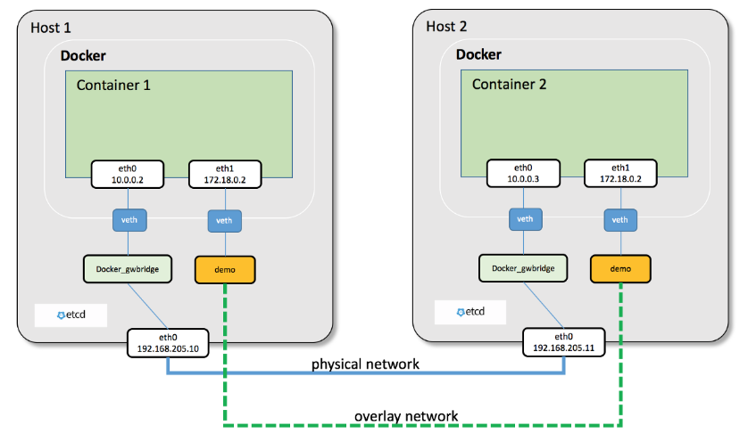
Containerization with Docker
Overlay Networking Mode
Overlay Networking provides simple and secure multi host networking. The overlay network makes use of VXLAN over underlying network.
Containers that are part of Overlay Network can communicate with containers regardless of the host. Containers part of Overlay network see each other if they are on same L2 network.
Each container in the Overlay network receives two IP address.
First IP allows for communication between the containers across host. While second IP maps to VXLAN-VTEP endpoint and contains all the actual data between hosts.
Allow Secure Communication
#docker network create –d overlay myoverlay
Satyam Kumar Pandey
DevopsTraining@Feb2019

Slide 8
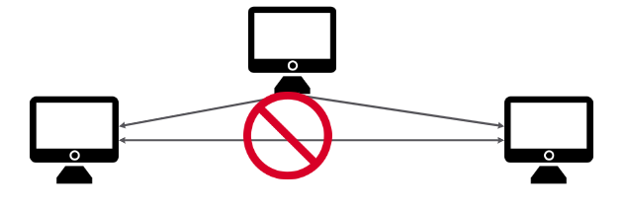
Containerization with Docker
None Networking Mode
It helps to disable all the networking stack on a container.
It is not available for swarm services.
Network –node flag is used while starting the
container to completely disable the networking stack.
Satyam Kumar Pandey
DevopsTraining@Feb2019

Slide 9
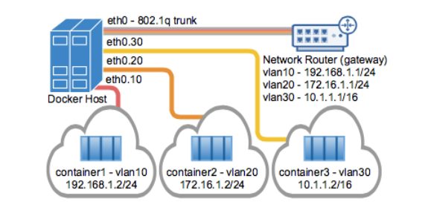
Containerization with Docker
Macvlan Networking Mode
Macvlan assign a Mac Address to a container which helps it to appears a physical device on the network
This type of network is used by legacy application or application which are supposed to be directly connected to physical network.
Maclan network can be isolated by using various physical network interface.
It’s a hardware way of networking where each of the containers are given a hardware or MAC address. As a result, each of the containers have a full TCP/IP stack of their own. So, it means each container act as a physical device directly connected to the underlying network.
Satyam Kumar Pandey
DevopsTraining@Feb2019

Slide 10
Containerization with Docker
Differences between user-defined bridges and the default bridge
User-defined bridges provide better isolation and interoperability between containerized applications.
User-defined bridges provide automatic DNS resolution between containers.
Containers can be attached and detached from user-defined networks on the fly.
Each user-defined network creates a configurable bridge.
Satyam Kumar Pandey
DevopsTraining@Feb2019

Slide 11
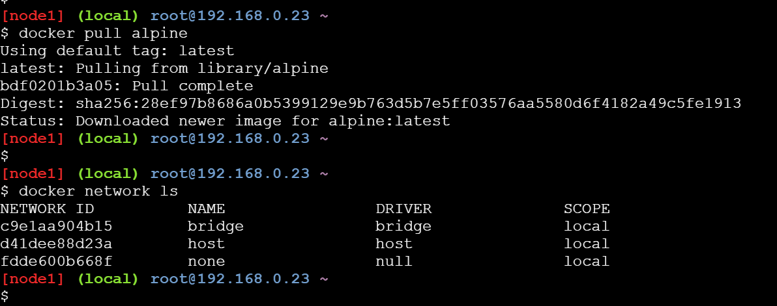
Containerization with Docker
Labs
Pulling alpine image using docker pull alpine
List all the network present in the host
Satyam Kumar Pandey
DevopsTraining@Feb2019

Slide 12
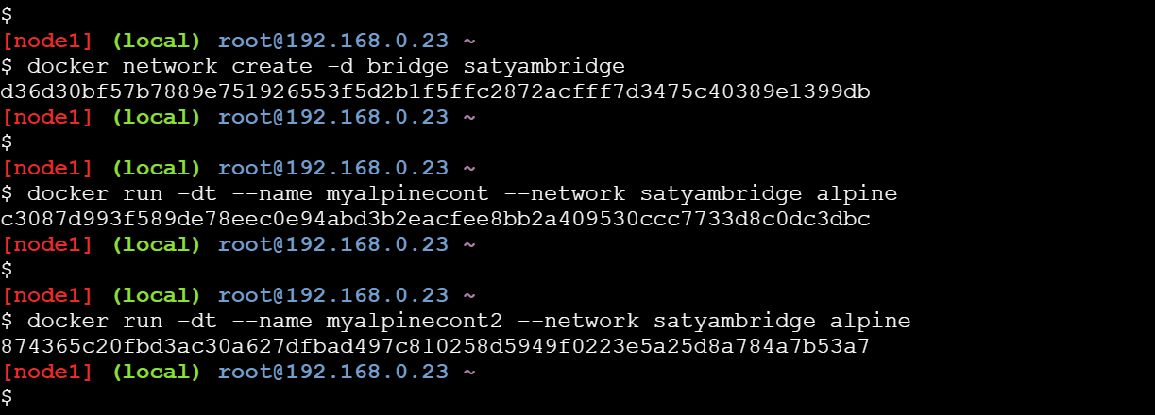
Containerization with Docker
Labs
Creating bridge network
Creating a container and adding in the bridge network
Creating another container and adding in the bridge network
Satyam Kumar Pandey
DevopsTraining@Feb2019

Slide 13
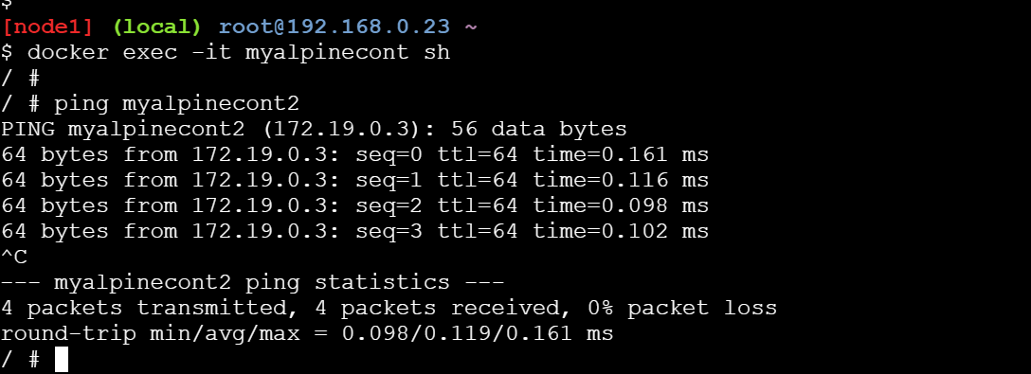
Containerization with Docker
Labs
Login to the first container & try to ping another container, ping will happen as it is under same network
Created by us
Satyam Kumar Pandey
DevopsTraining@Feb2019

Slide 14
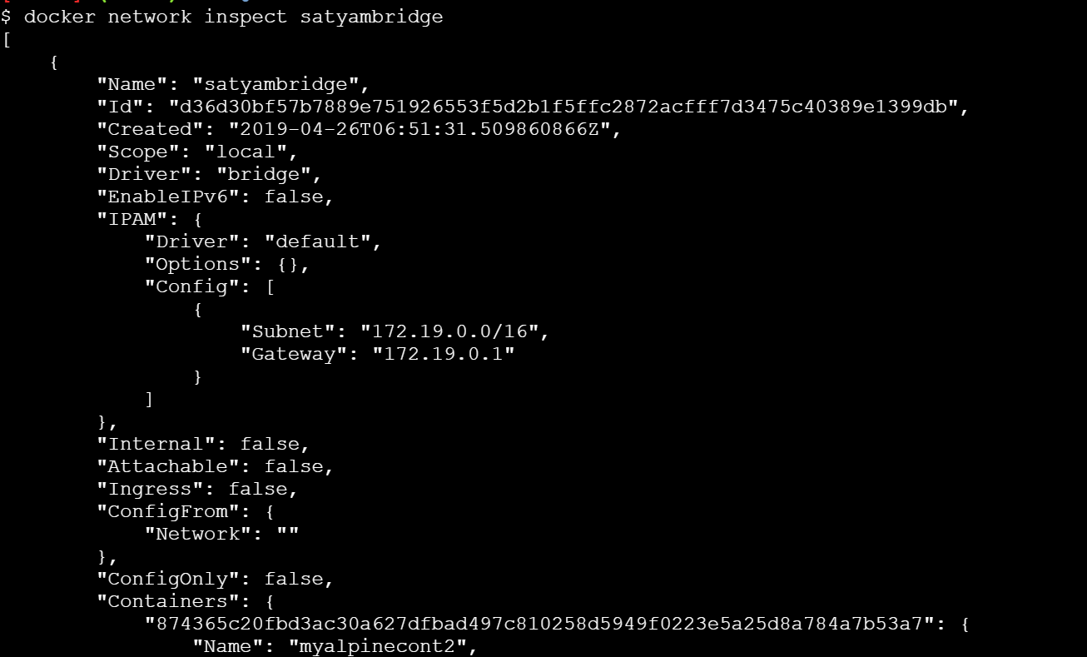
Containerization with Docker
Labs
Check the details of network which we have created
Satyam Kumar Pandey
DevopsTraining@Feb2019

