Slide 1
Containerization with Docker
What you are going to learn.
At the end of this module you will be able to:
Installation of Docker on AWS
Creating a AWS ECR repository
Tagging our Docker image
Pushing Docker Image to AWS ECR
Pushing Docker Image to Docker Registry
Satyam Kumar Pandey
DevopsTraining@Feb2019

Slide 2
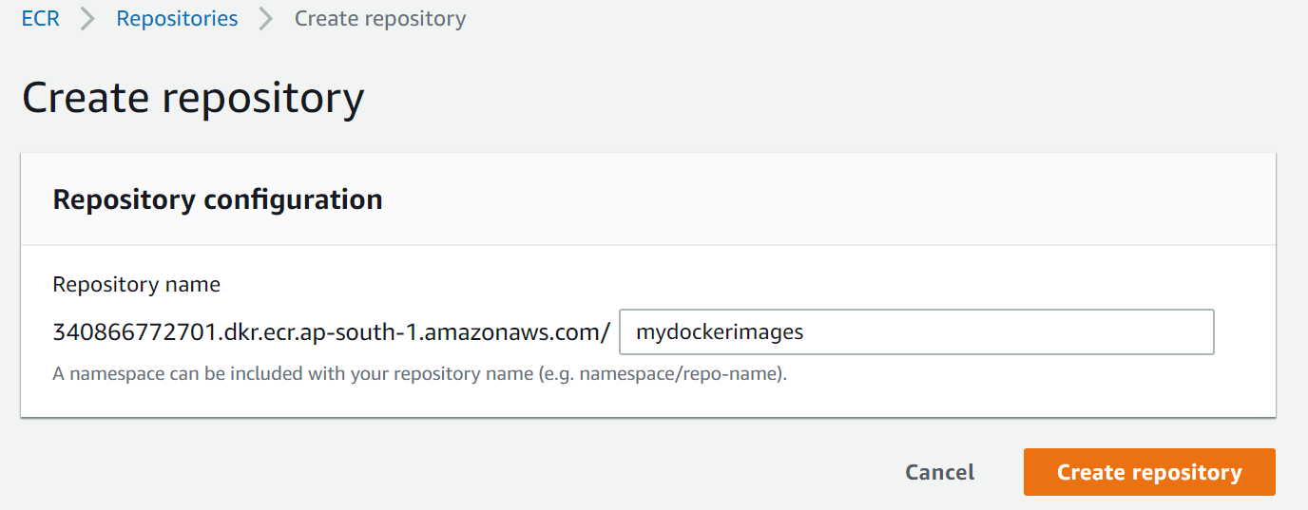
Containerization with Docker
Creating Docker repo on AWS ECR
Satyam Kumar Pandey
DevopsTraining@Feb2019

Slide 3
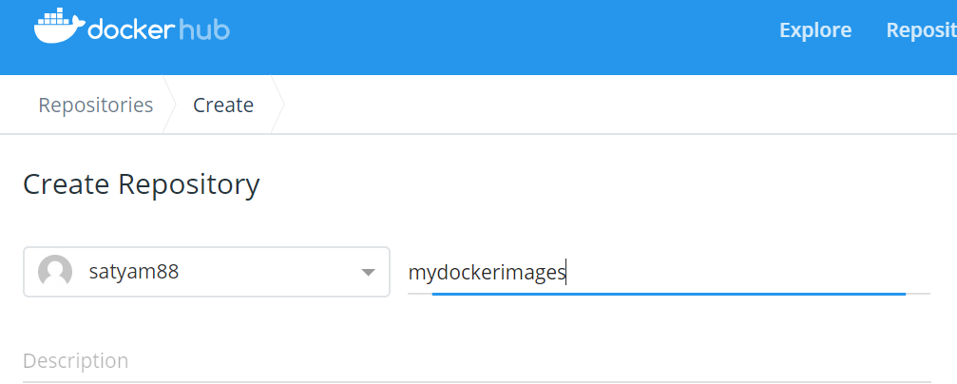
Containerization with Docker
Creating Docker repo on Docker Hub
Login to https://cloud.docker.com/
Satyam Kumar Pandey
DevopsTraining@Feb2019

Slide 4
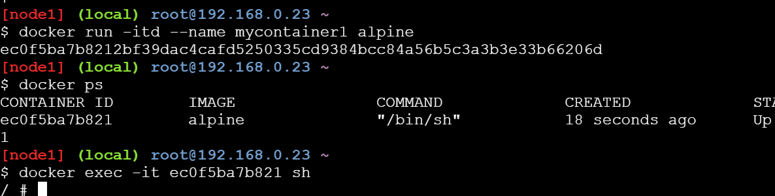
Containerization with Docker
Write your Docker file build image from that
FROM alpine:3.4
RUN apk update
RUN apk add curl
RUN apk add vim
RUN apk add git
RUN apk add wget
In the above Docker file we will be using alpine as our base image and then updating all the packages
$ docker build -t tools .
Step 1/6 : FROM alpine:3.4
3.4: Pulling from library/alpine
---------------------------------
Successfully tagged tools:latest
Using docker build command we can create image from dockerfile .
Satyam Kumar Pandey
DevopsTraining@Feb2019
Notes:
FROM alpine:3.4
RUN apk update
RUN apk add curl
RUN apk add vim
RUN apk add git
RUN apk add wget
===================

Slide 5
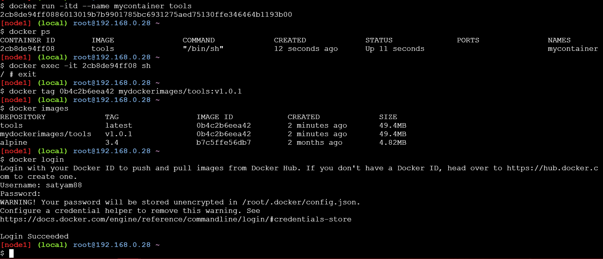
Containerization with Docker
Tag your Docker Image
Satyam Kumar Pandey
DevopsTraining@Feb2019

Slide 6
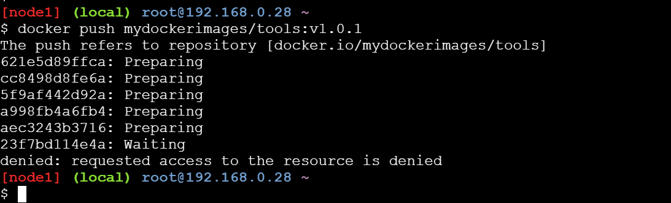
Containerization with Docker
Push your Docker Image to Docker Hub
Satyam Kumar Pandey
DevopsTraining@Feb2019

