Slide 1

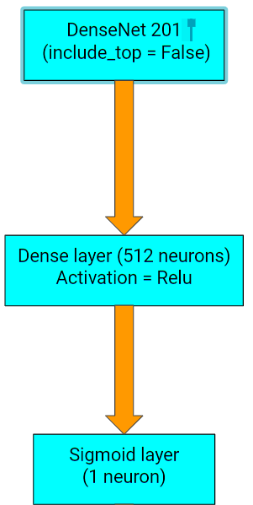
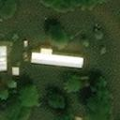
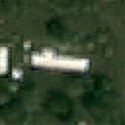
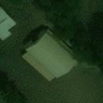
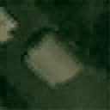
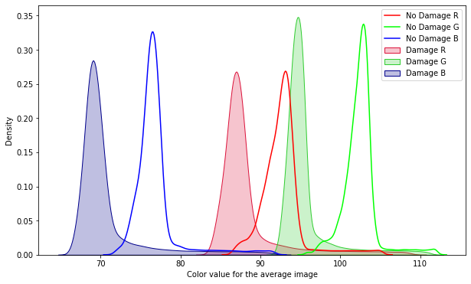
Classifying Images Post Hurricane using Satellite Imagery
Prathyush P Rao, M.K. Vishal Rishi, Saili Myana, and Sai Sumanth Madicherla
Motivation:
The latest hurricane - Hurricane Iota, had 61 total fatalities, and 41 are still missing, affected majorly the Central American regions of Honduras and Nicaragua.
The manual way to quantify damage is time-consuming and labour-intensive. This paves the way for AI.
Model:
Conclusion:
Reconstructed images using deconvolution layers gives us an idea of the effectiveness of Transfer learning in learning compact features
Data set:
Our dataset comprised satellite images from "Geo-satellite sensor" and "Geo Bigdata", consisting of top view satellite images of damaged and undamaged houses.
The average distribution of various colors in the dataset is an important aspect helping the model classify.
Future work:
Building localization
A system that interacts with local support and expert analysts
Accurately assess damage around the globe
Results:
Category | Accuracy | AUROC
test_1 | 96.2% | 94.6%
test_2 | 93.4% | 93.9%
validation | 93.5% | -
References:
1.Google AI Blog: Machine Learning-based Damage Assessment for Disaster Relief (googleblog.com)
2.Machine Learning For Natural Disaster Relief: How Can ML Aid Humanitarian Efforts? | 365 Data Science

