Slide 1

Regional Data Governance Strategy
R9 Data Governance Team
January 2023

Slide 2
Overview
Part 1 -Why
  Past efforts
  Why are we doing this?
Part 2 - What
  What is data governance
  How we get there?
  Who is doing this?
  How does this affect us?
Part 3 - How
  Path forward

Slide 3
Uniting past efforts with Data Governance
2013 GIS Strategy document
2017 Data Summit
2018 GIS File Structure Standard
2022 Data Governance Cadre

Slide 4
Why are we doing this?
Region 9 lacks a comprehensive strategy to collect, manage, analyze, and distribute our natural resource data and the information products derived from those data. Without good regional data governance, we make ourselves;
Vulnerable by taking risks in decision making which has led to Objections, Appeals, and Litigation through inconsistent analysis and communication.
We risk credibility and mis-perception with our Partners and the Public by distributing poor or incomplete data.
We are inefficient in our work processes and our ability to incorporate new technologies because we lack some basic standardization and guidance.
Notes:
Our strategic approach to governance will help us modernize our information systems and enable us to have the confidence in our data to improve stewardship of resources utilizing data-driven analyses to maximize our return on investment.
Data Governance is a foundational pillar of our Region’s strategic action plan toward working in a more integrated manner to increase the pace and scale of restoration across our landscapes.
This strategy directly supports our USDA Strategic Goals:
Objective 1: Modernize information technology infrastructure, facilities, and support services to improve the customer experience.
Objective 4: Improve stewardship of resources and utilize data-driven analyses to maximize the return on investment.
It also is firmly aligned with our National Priorities: uplifting and empowering employees through capacity building, being good neighbors and providing excellent customer service, and improving the condition of our Forests and Grasslands.
This strategy aligns with the IT Modernization that USDA is implementing and is also directly tied to national expectations for each Region around the business acumen and results driven performance metrics – building capacity, improving customer service, reducing inconsistency, and becoming more efficient across the Region and across programs.

Slide 5
Why do people resist?
Loss of identity, power or prestige
Personality traits (introvert vs. extrovert, capacity to embrace change)
They are overloaded with current responsibilities, with no time to learn new skills
They feel there’s no value in changing for them personally (“What’s in it for me?”)
No one sought their input to devise the solution or program
Past initiatives failed

Slide 6
Other pitfalls…
The data governance program and strategy don’t evolve as the business changes.
The data steward role is not formally recognized in formal job descriptions.
The Agency or IT believes a tool is all that’s needed to address data quality problems.
The initial scope of the data governance program is too big or too fraught with risk.
The Agency forms a data governance cadre in response to a data quality crisis and does not spend the time to create a plan and gain cross-functional buy-in.
The Agency tries to force fit a top-down data governance methodology in a bottom-up culture. No one identifies indirect stakeholders affected by a new program, including program managers, resource specialists, and GIS.

Slide 7
Part 1 - Questions/Discussion

Slide 8
What is Data Governance?
Data Governance is a Forest Service business function for planning, controlling, and delivering data and information assets (FSM 6800). It is a shared responsibility between data stewards, data managers, and leadership to support appropriate, real-world use of data and information assets.

Slide 9
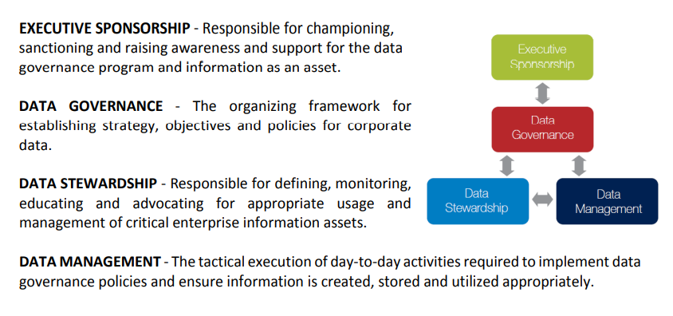
Data Governance Hierarchy

Slide 10
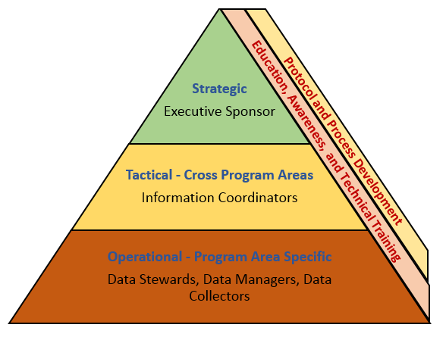
Elements of Data Governance
Programmatic Elements
Organization Framework
Roles and Responsibilities
Notes:
DG is a FS business function for planning, controlling, and delivering data and information assets. It is the organizing framework for establishing strategy, objectives and policies for corporate data.
DG is a shared responsibility between data managers, data stewards, and leaders to support appropriate, real-world use of data and information assets.
As with any program, it contains Strategic, Tactical, and Operational components.
DG is a shared responsibility to support appropriate, real-world use of data and information assets.
We are already governing data but Region 9 lacks formal policy and best practices.
We have looked at this from a programmatic perspective several times in the past but have never effectively implemented it.

Slide 11
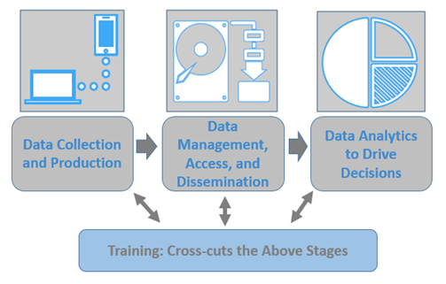
Elements of Data Governance
Technical
Elements
Procedural Workflows
Skilled Employees
Notes:
Data Governance has technical elements associated with the entire data lifecycle.
It’s not only about what data we have but how we collect it, store it, make it accessible (internally/externally) and how we analyze it to help inform decisions.
While technology can help solve some information problems, it’s the people behind the data that really solve them.
Data does not explain itself; it needs to be transformed, summarized, analyzed, to turn it into information to drive decisions

Slide 12
Key Concepts - Data Governance
Coordinating data stewardship and data management duties necessitates data governance.
Data governance is:
Strategic management, control and monitoring of data and information assets
Decision-making on data policies, procedures and services in enterprise data management systems
Representative, shared, deliberate decision-making between data stewards, data managers, leadership, and stakeholders
Enacted at any level or office to improve coordination of data management activities

Slide 13
The Benefits of Data Governance
Increased Credibility
Reduced Vulnerabilities
Efficiencies
Notes:
Our publics are demanding access to our data and information.
Internally, we are becoming a more tech- and data-savvy workforce.
Without good data governance practices, we are making ourselves Vulnerable by taking risks in decision making.
We risk credibility and miss-perception with our Partners and the Public by distributing poor or incomplete data
And we’re inefficient in our work processes because we lack some basic standardization

Slide 14
High-Level data roadmap
Year 0: Establish the vision, charter, goals, benefits and roadmap.
Year 1: Establish oversight and execution teams; implement sustainable processes; identify success measures.
Year 2+: Execute and evolve operations; drive continuous improvement; achieve best-in-class recognition for data management practices

Slide 15
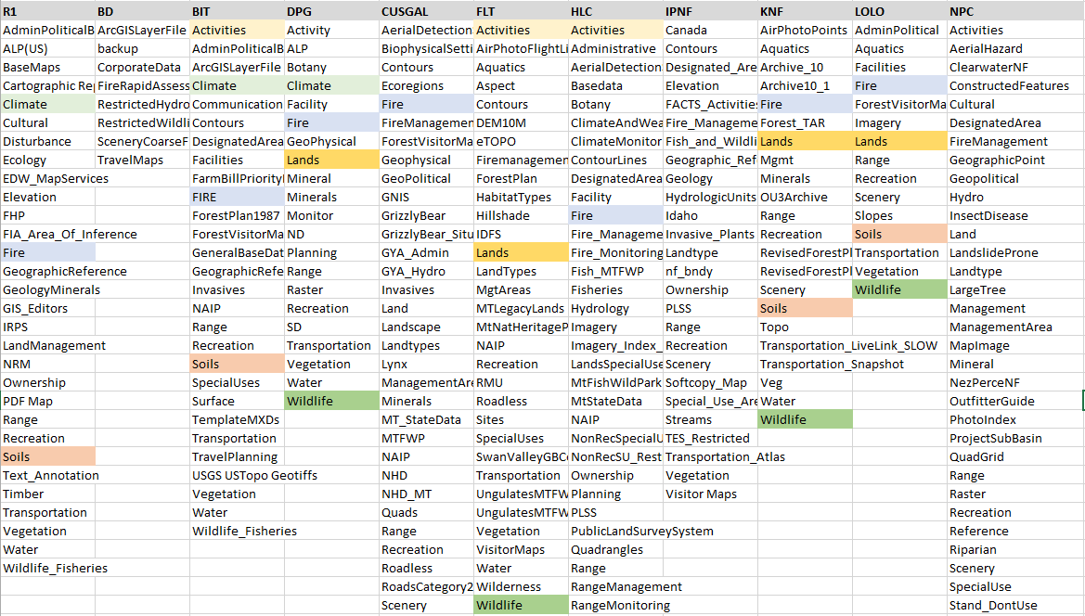
Regional Data Comparisons
Data Accessibility: Comparison of R9 GIS Libraries; Variability in File Structures
Notes:
This slide shows the variability in how Forests store their GIS Data.
Although there is consistency in some data elements, there is none for several common data layers including:
Management Areas
Soils
Wildlife
Salvage NEPA uses those data so it was impossible to develop consistent applications and tools to help make those analytics more efficient.

Slide 16
Moving from Strategy to Implementation
What are we going to do?
DG Strategy - Action Items
Identify critical work needed for all data stages
Establish core DG knowledge, skills and abilities
Monitor to ensure success
Notes:
- It seems it takes an event to highlight opportunities and challenges
- The issues with mobile devices , inconsistent protocols, and lack of priority commitment are not unique to Region 1 but we do now have the urgency to focus and address these issues about our data and the use of technology.
- To implement a strategy takes time, investments, skills, and leadership commitment
- With every new process, or system – there are new features and enhancements, but we also loose some of the old stand-by processes. It’s part of the evolution with technology and it’s a trade-off.
- The first step is to identify the critical elements of data management through the life cycle.
- Establish “core data” – along with its’ data governance, the needed skills and understanding required for Data Governance at each level of the organization.
- Then establish the milestones and monitor our progress to ensure we are meeting our regional needs.

Slide 17
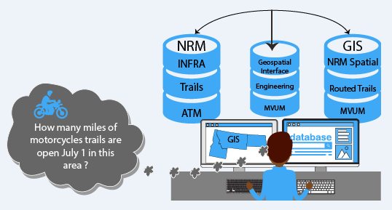
Critical work
Identify Core Data Elements
Notes:
Establishing the “Core Data” will ensure that the Region focuses our limited resources on essential data that will lead to pertinent information for decision-making and public response.
A challenge we face even with “Core Data” is developing common terminology to address questions externally as well as internally .
Internally we work with the systems and realize they are used for a variety of uses in the agency but this has lead complex systems.
- This complexity makes answering simple questions from the public cumbersome –
The completion of a “Data Relationship Matrix” will provide the blue print of linking core data – to the data system - to the relevant internally and external queries.

Slide 18
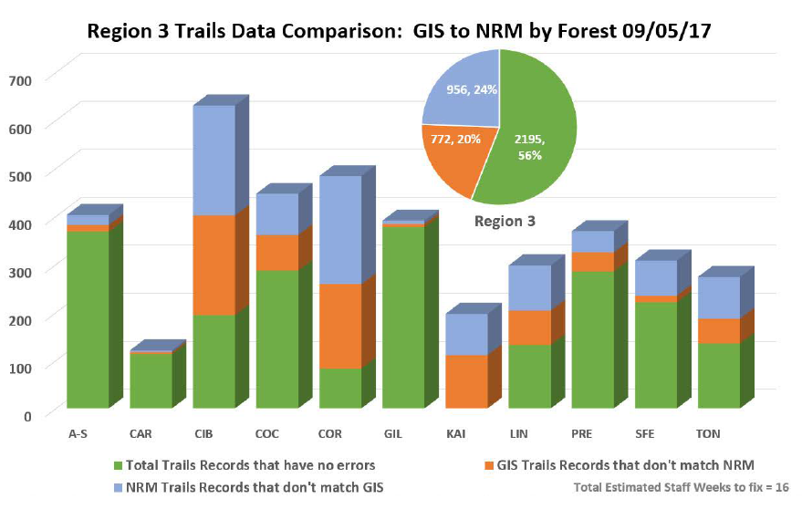
Critical work
Identify Core Data Elements
Data Assessments
Notes:
Once we establish the “Core Data” we need to use readily available tools, or develop them, to assess the status of the data across the Region. This will identify our gaps, and the opportunities for improvement. Next we need to develop a plan to get us on the back on the path. Here’s an example from R3 evaluating trails information.
These tools provide an evaluation work flow that give Data Stewards the opportunity to assess data consistently over time and ensure we are trending toward the benefits intended.
We also need to be strong partners in the modernization of our corporate systems to ensure our data will migrate from system to system, and be accessible for analyzing to meet our Regional needs and sharing with our partners.

Slide 19
Critical work
Identify Core Data Elements
Data Assessments
Workflow and Protocol Development
Notes:
Although the basis for developing our corporate system were the resource protocols by program area, many of the areas had multiple protocols without a set priority. This has added to the complexity of the systems.
A Regional Data Governance strategy will help identify and enforce priority protocols within the Region or geographic area that can be done to a standard, consistently.
This workflow all also include how we analyze the data we collected to standard and produce key finding reports that can be referenced in project files across the Region and then up-dated consistently when new data becomes available.

Slide 20
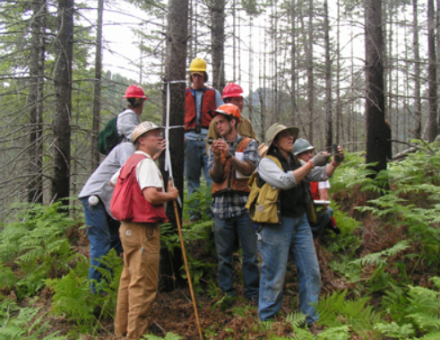
Moving from Strategy to Implementation
Knowledge, Skills, and Abilities
Communities of Practice
Notes:
To move from a strategy becomes a cultural change and its in-graining the concepts of quality data that can be openly shared.
Developing a “community of practice” forum ensures that we can evaluate and evolve work processes and empower users to communicate across organizational boundaries, support decisions, and provide the data to tell our story of accomplishments and challenges.

Slide 21

Knowledge Skills and Abilities
Communities of Practice
Technical Training
Notes:
Implementation means enhancing the training opportunities across resources programs to empower employees to be more effective at their jobs which includes both Virtual and Classroom Sessions to:
- Become proficient in utilizing corporate databases and tools
- Learn and integrate our regional data assets and tools.
- Standardize processes to incorporate new and emerging technologies, like our mobile data collection across the Region
As employees increase their skills, we can mentor and develop champions – then allow these champions to become shared resources to help others across the Region.

Slide 22
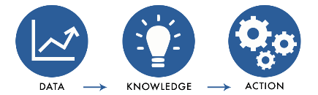
Knowledge Skills and Abilities
Communities of Practice
Technical Training
Leadership Seminars
Decision Making/ Actions
Notes:
Provide the opportunities for leadership to actively in engage in effectively utilizing data and information assets.
- Opportunities to evaluate the information and technology being utilized
“What does data governance mean for me as Forest Supervisor/Staff Officer/District Ranger? How do I contribute?” to ensure quality information supports decisions we are making today and tells our story.

Slide 23
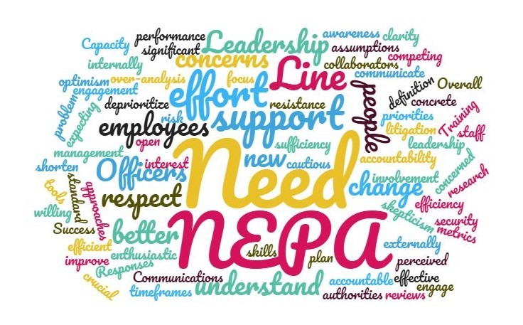

Moving from Strategy to Implementation
Measure/Monitor Success
Integrate with EADM
DG Cadre
Data Metrics
Personal Accountability
Notes:
We are on this journey together – Currently the initiative to streamline and become more efficient in our environmental analysis and decision-making processes (EADM) should include:
- Information and technology as critical elements to ensure that we
- Leverage and use the right technology
- Evaluate and standardize any new analysis procedures
- Monitor the outcomes to ensure we are moving toward the desired outcome.
A Data Governance Advisory Board or / (RIM Board) : Provide the Leadership guidance and investments needed to move forward
Opportunity for leadership to be engaged and be more aware of the impacts/benefits of Data Governance Policies and adapt the policies.
Develop the opportunities to recognize employee efforts to share their skills and build the cultural that’s using quality data to accomplish their work.

Slide 24
Achievable Objectives (next 18 months)
Programmatic
Data Governance Organizational Structure
Region’s Strategic Action Plan and Environmental Analysis and Decision-making processes.
Education, Awareness, and Technical Training sessions.
(RIM) Board and RIM Technical Team.
Technical
Develop Data Relationship Matrix
Develop Data Assessment Tools
Mobile Technologies
Notes:
Implementation is going to take time but there are some things we feel are achievable in the mid-term.
Programmatically,
Organizational Structure in place and establish communication networks and platforms.
Integrate best practices into the Region’s Strategic Action Plan and EADM processes.
Conduct EATT sessions on each NF; including New Employee Orientation material.
Consolidate and re-focus the work of the RIM Board and RIM Technical Team.
Technically,
Data Relationship Matrix to show how corporate and local data bases and assets interrelate to meet specific needs and which provides the most pertinent information across programs.
Data Assessment Tools for ‘core’ datasets to focus data maintenance/improvement initiatives and improve response times for answering common, data-driven questions.
Develop consistent field data collection forms, workflows, and sample designs (where appropriate) using new and emerging Mobile Technologies.

Slide 25
How does this affect us?
Overall
Leaders
Data Manager
Data Stewards
Data Collectors
Notes:
Improving data governance in Region 1 will be an evolution and not revolution; although we may need to make some revolutionary suggestions to evolve.
There will be less autonomy for Units to maintain unique data collection, storage, QA/QC, and analytic processes.
There will be a change in the status quo for how Data Management positions are filled and funded in the Region (currently a diverse mix of positions, grade levels and BLI fund codes).
The time needed to implement data governance best practices will vary by role (and incumbent). Impacts to Leaders will be less, Data Managers will be more, and somewhere in the middle for Data Stewards.

Slide 26
How does this affect us?
Improved regional data governance will provide the overarching structure needed to strategize my data priorities.
By following regional data standards and workflows, I can focus more on quality assurance/accountability for my program area.
This would allow me to be more efficient in my job.
– Cynthia Valle, NPC Program Manager
Notes:
This will require a cultural shift

Slide 27
Who is going to do this?
Roles and Responsibilities
  Leaders
  Information Management Coordinators
  Data Stewards
  Data Managers
  Data Collectors
Notes:
Much of the needed capacity for implementation of a successful data governance program currently exists within our regional organization in Unit and RO level data stewards and data managers.
Long-term sustainability and success is achieved by local-level capacity and as a result, local-level capacity issues may likely arise in the future as skillsets and positions shift through attrition.
However, in the short-term, there are a few critical gaps at the regional and sub-regional levels that need to be filled to provide the programmatic and technical skills for getting the Data Governance Program off on a successful footing.

Slide 28
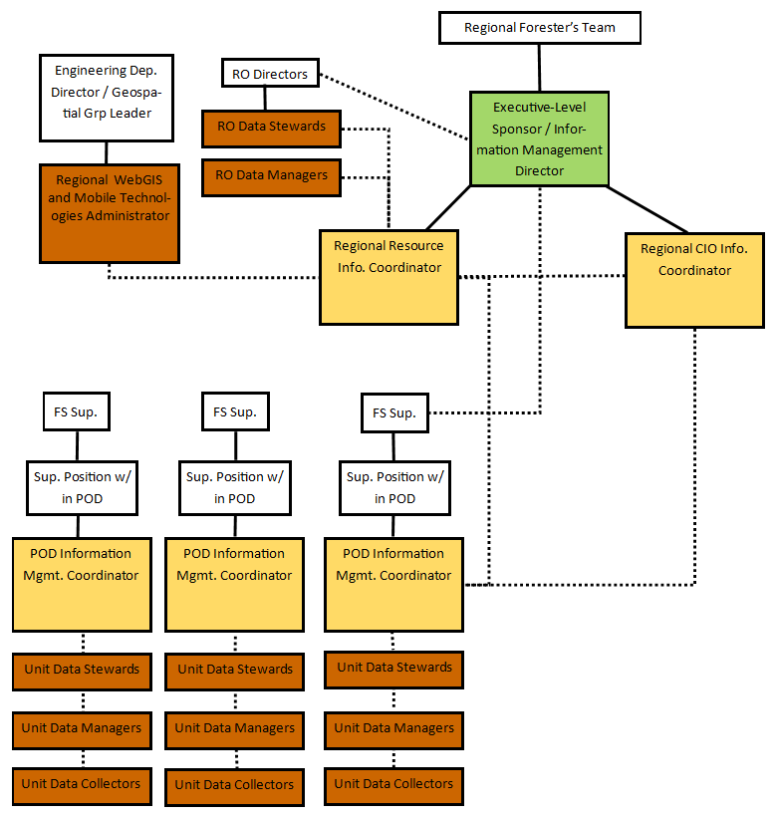
Target Organization
Notes:
An intermediate-level of coordination to implement data governance policy between the Region and Units is necessary because there is often huge disparities in data assets and procedures across administrative units in R1.
Developing at least pod-level consistencies will be more achievable in the short-term and efforts are undertaken to eventually get to regional consistency standards in the long term.
By developing and implementing better consistency across pods, there will eventually be less of a need for localized data management specialists as data stewards and resource staff will have the skills to fulfill their own data management and stewardship responsibilities.

Slide 29
Part 2 - Questions/Discussion

Slide 30
Regional Data Governance Team
Kirsten Tighe (RO Co-chair)
Jeff Erwin (RO GIS-team leader)
Notes:
Background:
After Jan RLT Decision to “Commit to recognizing and institutionalizing Data Governance in Region 1.”
Creation of Regional DG working group, spring 2017
Representation from majority of units, resources, levels of organization (team members listed here)
Surveyed other regional efforts (4 other regions have gone through similar process)
Monthly meetings, in-person workshop in early Jan
Check-ins with RFT

Slide 31
Part 3 - Questions/Discussion

Slide 32
Breakout
How will we support this new organization?
Identify the tradeoffs.
Did we miss something?
How will we as leaders support and cultivate this cultural shift and hold people accountable? For example:
    Forest Meetings?
    Performance Metrics?
  Group discussion and recommendation - 30 min

