Slide 1


Region 9 Data Governance
“Data Governance is a Forest Service business function for planning, controlling, and delivering data and information assets (FSM 6800). It is a shared responsibility between data stewards, data managers, and leadership to support appropriate, real-world use of data and information assets”.

Slide 2
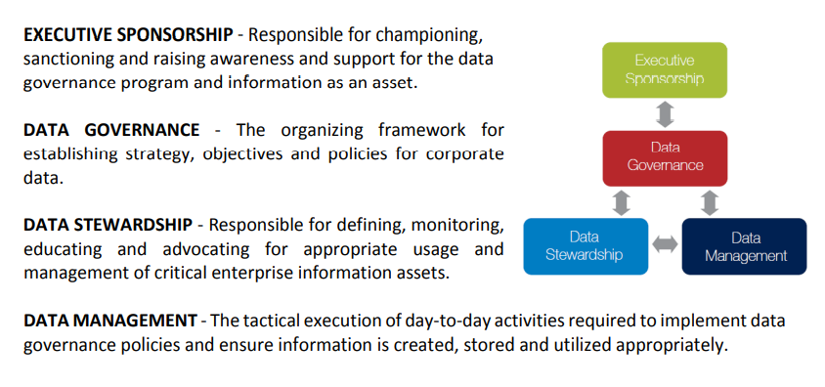
Data Governance Structure

Slide 3
Data Governance Cadre Structure
Advisory in nature
Representation:
Eastern States Sub-region
Vacant
Northwestern States Sub-region
Vacant
Southern States Sub-region
Vacant
Regional Office
Jeff Erwin – GIS Program
Minimum commitment of one FY
Will meet every two weeks
Use Data Governance Channel to manage content and action items
GIS Program Data Governance SharePoint – updating as we go.

Slide 4
Initial Cadre Action Items
Overall focus
Revisit our current Data Management plan – Eastern Region GIS file Structure V2 – 2018
Enhance existing Data Stewardship practices – Assigned roles, promoting accountability, and introduce training
Intial scope
Establish which existing unit datasets can be migrated to the National standard without conflicting with Forest plans and migrate data
Review data sets that cannot be migrated due to the Forest plan and develop a strategy to migrate
Examine unit SDEs for data sets that duplicate existing corporate data and develop a strategy for moving to corporate sources
Examine Unit and Regional SDEs to assess what may be able to be maintained in the Regional SDE
Review Forest data sets for common traits/uses/attributes and develop Regional data standards
Work with local units to establish a plan to address data quality improvement efforts

Slide 5
Milestones
All units migrated to EPAS
All units switched to feature datasets
Import data to National DD where applicable
In work - Review National Data Assessment and work on data quality

Slide 6
Next steps
Promote and strengthen Regional Data Stewards presence/guidance
Promote existing Data Stewardship training resources
Develop a Regional Forester endorsed Data Governance Strategy document
Implement Data Governance Strategy and re-examine progress on and annual basis
Work on Regional data standards where applicable

