Slide 1
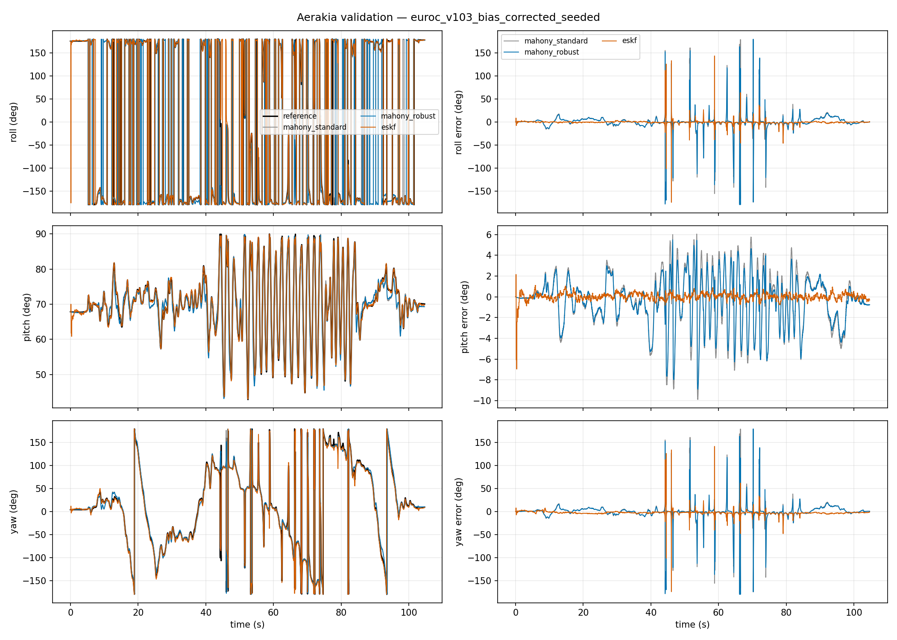
AERAKIA
算法优化展示集
2026.07.17 - 2026.07.21
用同工况配对结果、姿态轨迹和工况覆盖，复盘这轮优化如何逐步收敛。
三组严格可比的 EuRoC 配对验证
姿态 RMSE 降幅：63% / 43% / 40%
Notes:
[Sources]
Validation metrics and image paths: aerakia-flight-algorithms/reports/aerakia-optimization-showcase/showcase-data.json

Slide 2
PAIRED RESULTS
三组同工况配对验证均显示姿态误差下降
配对约束：相同数据集、参考真值、辅助观测设置和初始化族。姿态 RMSE 为四元数测地线误差，单位为度。
最大的可比收益
63%
MH_01_easy
8.80 deg -> 3.25 deg
V1_03 raw IMU: 43%
V1_03 Vicon: 40%
Aerakia optimization campaign | July 17-21, 2026
2
Notes:
[Sources]
Source: aerakia-flight-algorithms/reports/aerakia-optimization-showcase/showcase-data.json (comparable_variants).

Slide 3
CAMPAIGN TIMELINE
优化是按验证能力逐步展开的
Jul 17
建立 EuRoC 独立姿态与导航基线
MH_01 baseline: 3.72 deg attitude RMSE
Jul 17
加入 Vicon tilt-only cold-start
post-alignment tilt RMSE: 0.860 deg
Jul 18
验证 heading recovery 与 bias correction
observable yaw RMSE: 0.920 deg; recovery: 0.995 s
Jul 18
扩展到飞行、aggressive motion 与 outage
Blackbird / INSANE / UrbanNav / IDF-DS
Jul 21
保留负结果，拒绝证据不足候选项
magnetic study + correlated static prior not promoted
结论：这轮工作同时增强了结果、覆盖和“什么不能上线”的证据边界。
Aerakia optimization campaign | July 17-21, 2026
3
Notes:
[Sources]
Sources: git history in aerakia-flight-algorithms (2026-07-17..2026-07-21); validation/public/*.json.

Slide 4
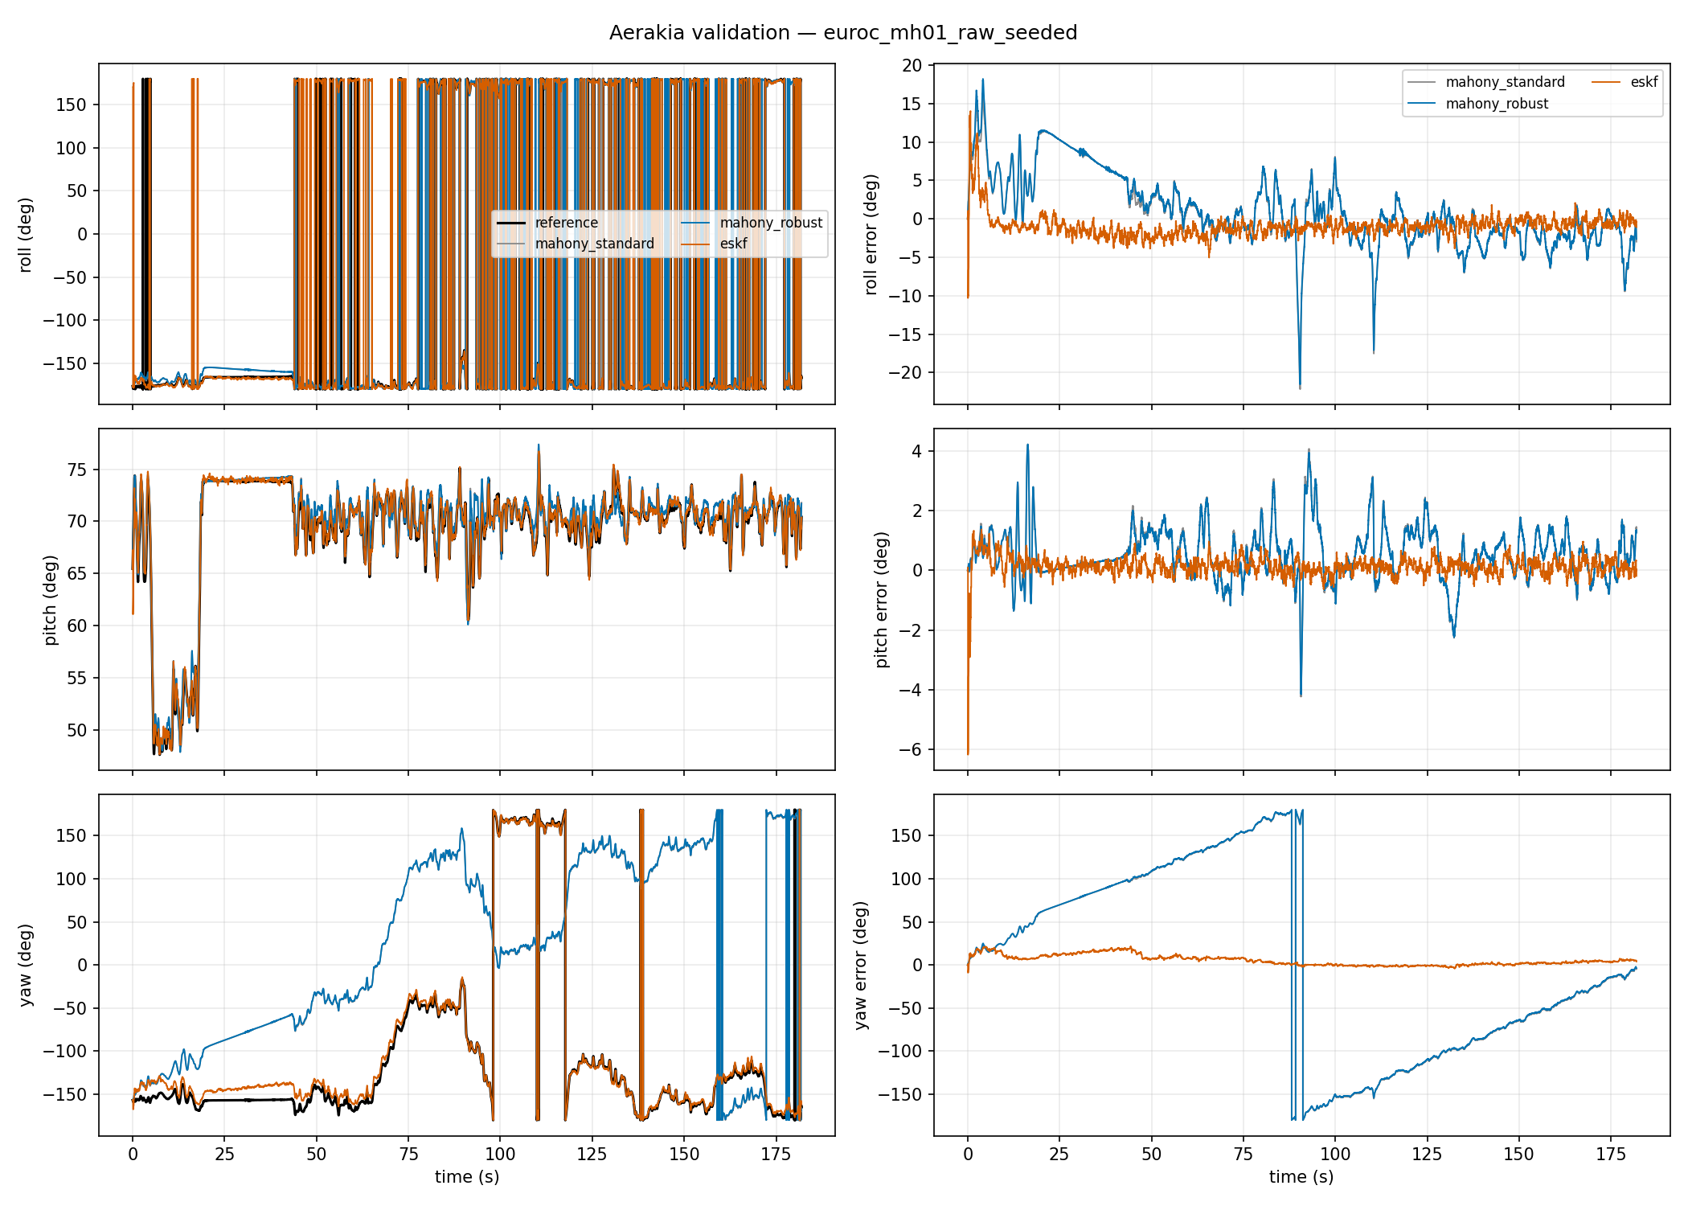
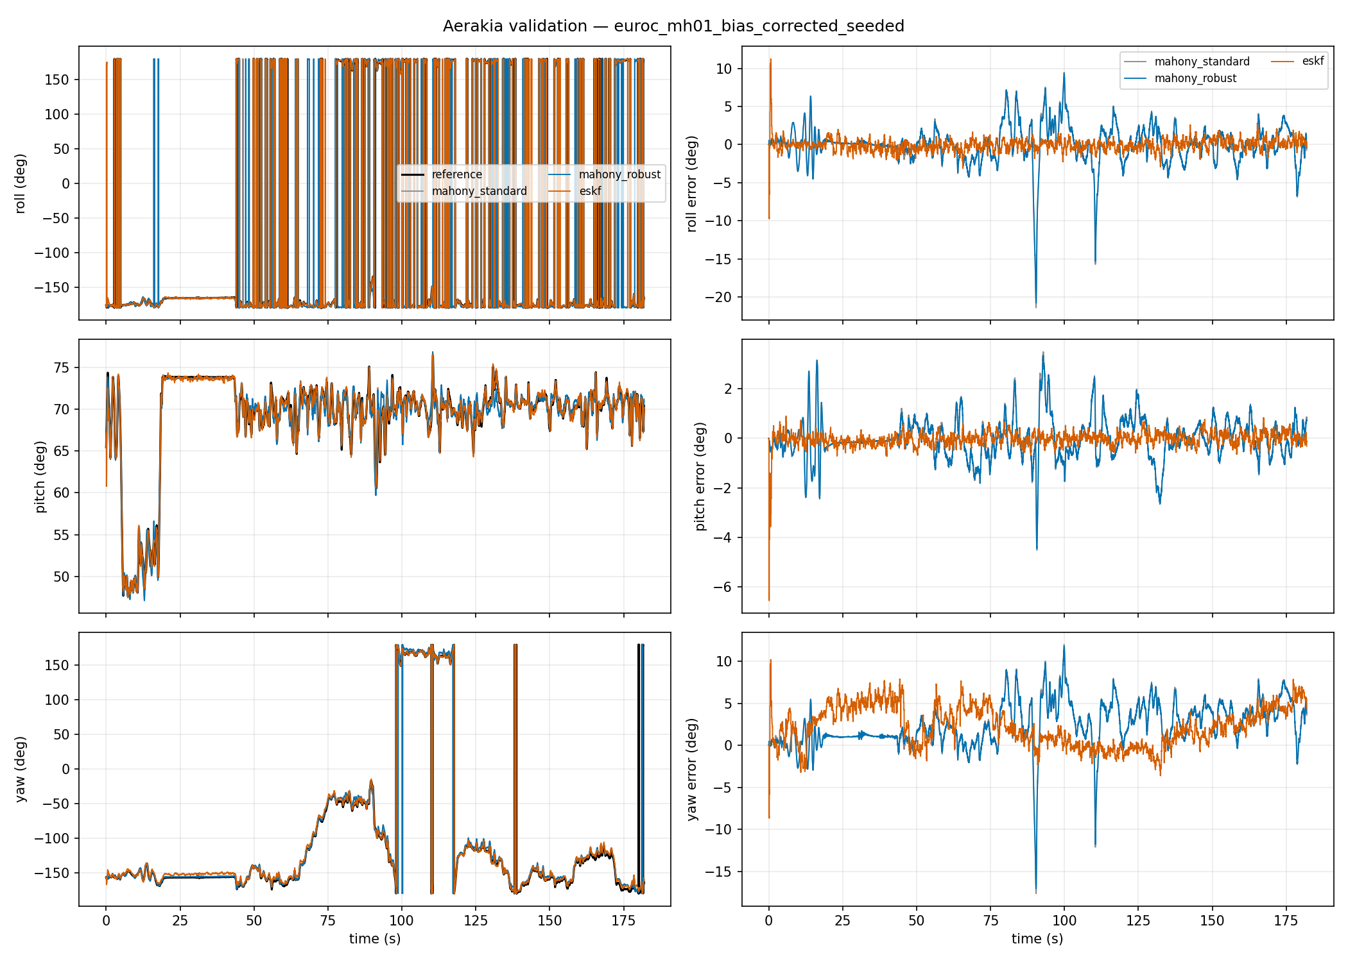
ATTITUDE TRACE COMPARISON
MH_01_easy：raw IMU seeded 误差下降 63%
8.80 deg -> 3.25 deg；位置 RMSE 保持 0.131 m。
优化前
偏置校正后
Aerakia optimization campaign | July 17-21, 2026
4
Notes:
[Sources]
Images: /home/clark/DevFiles/OneDev/cloud-restored-20260717/public-validation-data/euroc/MH_01_easy/aerakia_raw_seeded/report/attitude_comparison.png and /home/clark/DevFiles/OneDev/cloud-restored-20260717/public-validation-data/euroc/MH_01_easy/aerakia_bias_corrected/report/attitude_comparison.png. Metrics: aerakia-flight-algorithms/reports/aerakia-optimization-showcase/showcase-data.json.

Slide 5
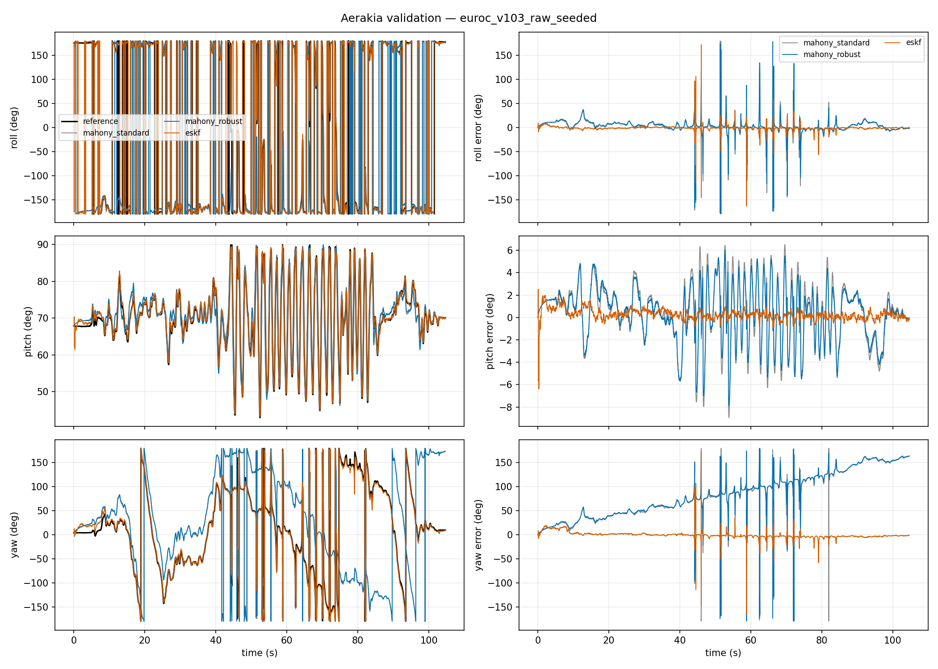
ATTITUDE TRACE COMPARISON
V1_03_difficult：raw IMU seeded 误差下降 43%
4.04 deg -> 2.32 deg；困难航段的收益仍然明确。
优化前
偏置校正后
Aerakia optimization campaign | July 17-21, 2026
5
Notes:
[Sources]
Images: /home/clark/DevFiles/OneDev/cloud-restored-20260717/public-validation-data/euroc/V1_03_difficult/aerakia_raw_seeded/report/attitude_comparison.png and /home/clark/DevFiles/OneDev/cloud-restored-20260717/public-validation-data/euroc/V1_03_difficult/aerakia_bias_corrected/report/attitude_comparison.png. Metrics: aerakia-flight-algorithms/reports/aerakia-optimization-showcase/showcase-data.json.

Slide 6
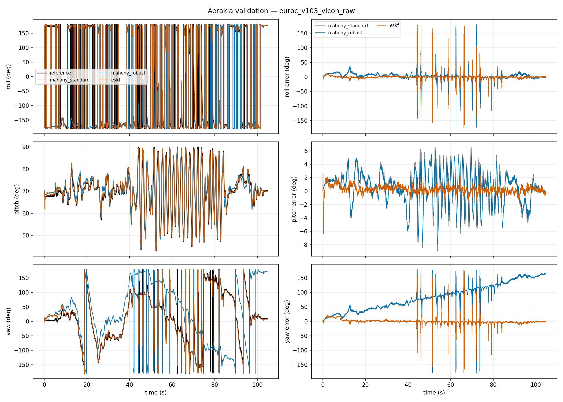
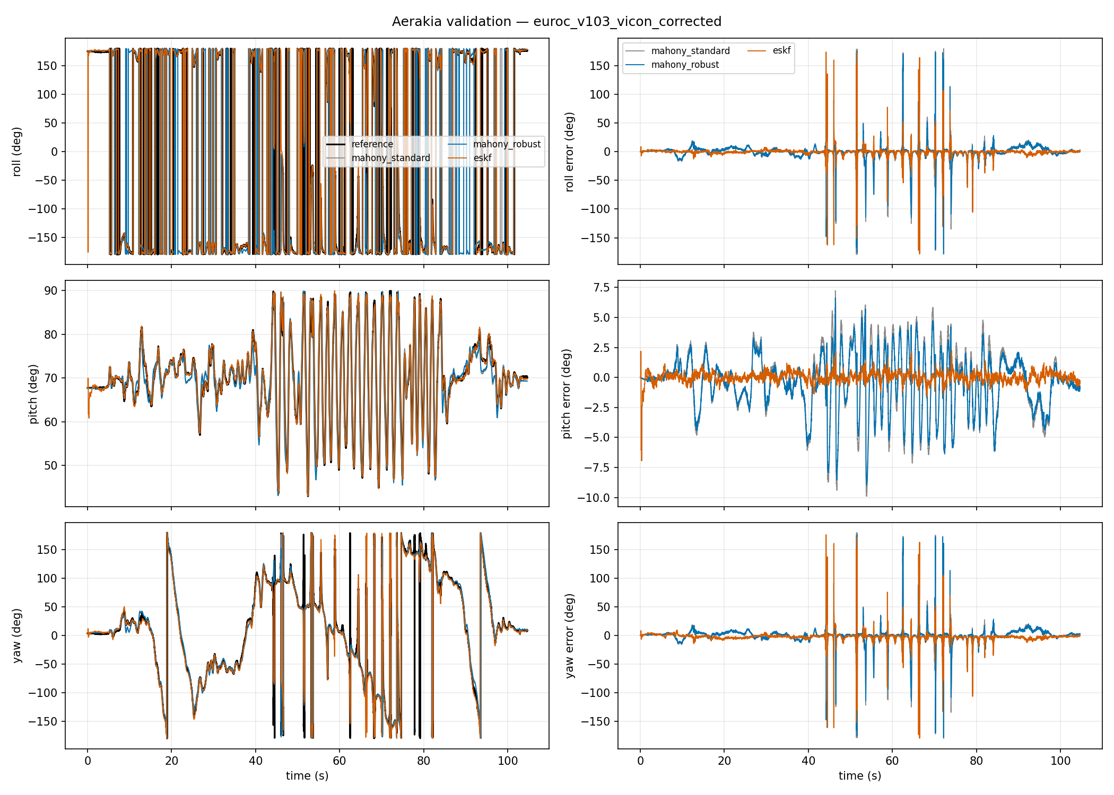
ATTITUDE TRACE COMPARISON
Vicon 链路：姿态误差下降 40%
4.10 deg -> 2.47 deg；不同姿态链路下结论仍成立。
优化前
偏置校正后
Aerakia optimization campaign | July 17-21, 2026
6
Notes:
[Sources]
Images: /home/clark/DevFiles/OneDev/cloud-restored-20260717/public-validation-data/euroc/V1_03_difficult/aerakia_vicon_raw_seeded/report/attitude_comparison.png and /home/clark/DevFiles/OneDev/cloud-restored-20260717/public-validation-data/euroc/V1_03_difficult/aerakia_vicon_bias_corrected/report/attitude_comparison.png. Metrics: aerakia-flight-algorithms/reports/aerakia-optimization-showcase/showcase-data.json.

Slide 7
COVERAGE AND NEXT GATES
覆盖已拓展，但不同数据集不应混成一张精度榜
不同传感器与真值边界保留在同一张展示中，但只作工况覆盖说明。
Blackbird aggressive UAV
独立动捕真值；synthetic GNSS
1.57 deg attitude RMSE; healthy 1.0
INSANE outdoor cold start
共享 dual-RTK heading/reference
1.53 deg yaw RMSE; alignment 11.49 s
UrbanNav 131 s outage
独立 SPAN-CPT navigation reference
healthy 1.0; aided position RMSE 6.52 m
IDF-DS fixed wing stress
PX4 compatibility / onboard estimate
3.24 deg attitude RMSE; 34 recoveries
下一步：把这三组配对测试固定为回归门槛；自动归档每次提交；继续以独立 A/B 证据决定默认配置。
Aerakia optimization campaign | July 17-21, 2026
7
Notes:
[Sources]
Sources: validation/public/blackbird_nyc_subway_winter_summary.json, insane_outdoor1_heading_summary.json, urbannav_hk_medium_urban_1_summary.json, idf_ds_summary.json.

