Slide 1
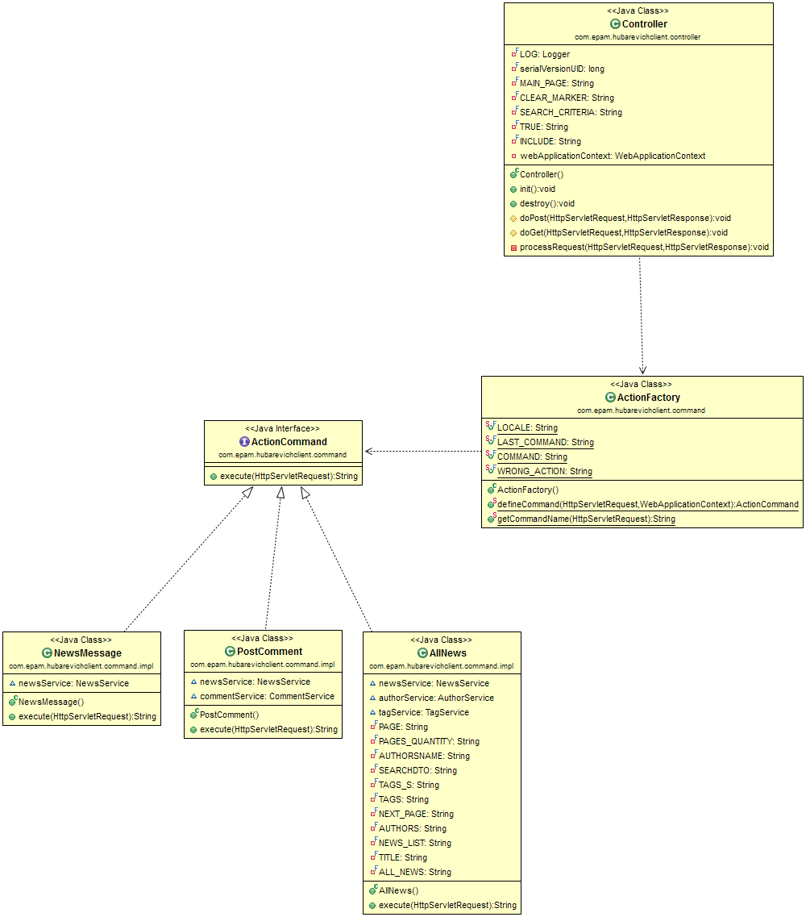
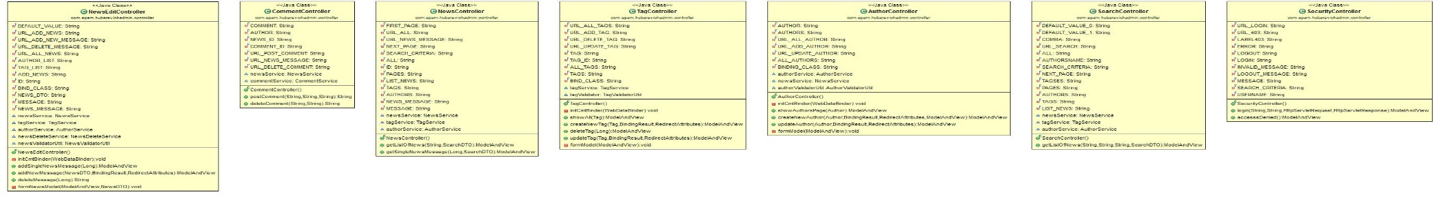
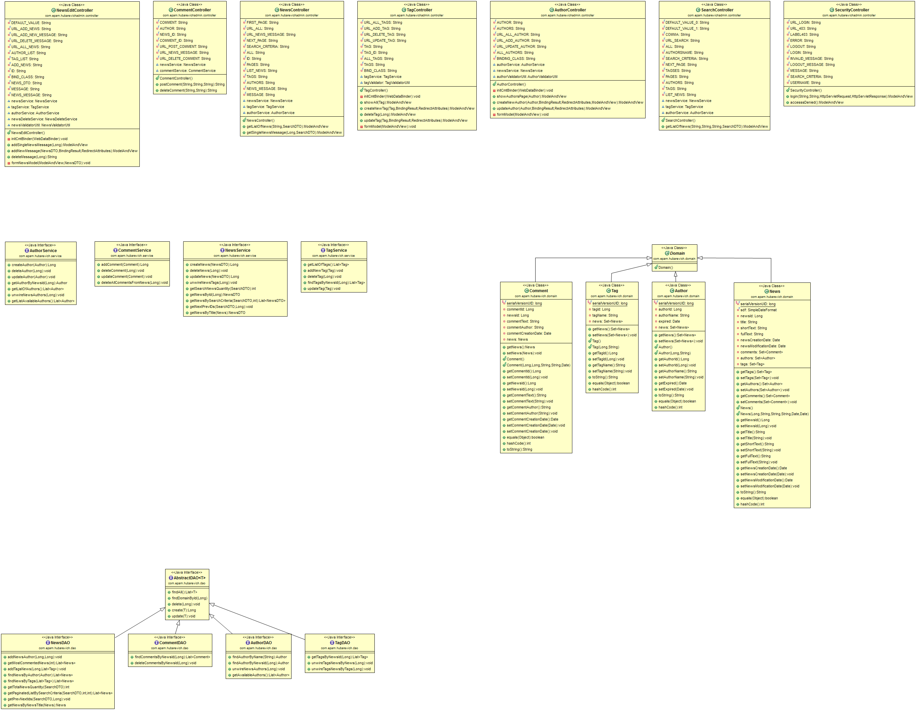

news-admin
news-client
Particular view
Particular view
Controller
dispatcher-servlet
+Dispatcher()
+dispatch():void
Controller
news-common
Model
Service
Domain
DAO

