Slide 1

Chapter 5
Probability
© McGraw Hill LLC. All rights reserved. No reproduction or distribution without the prior written consent of McGraw Hill LLC.

Slide 2
Chapter Learning Objectives
Chapter 5
L O 5.1: Describe the sample space of a random experiment.
L O 5.2: Distinguish among the three views of probability.
L O 5.3: Apply the definitions and rules of probability.
L O 5.4: Calculate odds from given probabilities.
L O 5.5: Determine when events are independent.
L O 5.6: Apply the concepts of probability to contingency tables.
L O 5.7: Interpret a tree diagram.
L O 5.8: Use Bayes’ Theorem to calculate revised probabilities.
L O 5.9: Apply counting rules to calculate possible event arrangements.

Slide 3
Probability
Chapter 5
Descriptive statistics allow us to describe a business process that we have already observed. But how will that process behave in the future?
The field of study called probability allows us to understand and quantify the uncertainty about the future. We use the rules of probability to bridge the gap between what we know now and what is unknown about the future.

Slide 4
Random Experiments
L O 5.1
A random experiment is an observational process whose results cannot be known in advance.
Example: when a customer enters a Lexus dealership, will the customer buy a car or not? How much will the customer spend?
The set of all possible outcomes (denoted S) is the sample space for the experiment.
Example: when Citibank makes a consumer loan, we might define a sample space with only two outcomes:
The sample space describing a Walmart customer’s payment method might have four outcomes:

Slide 5
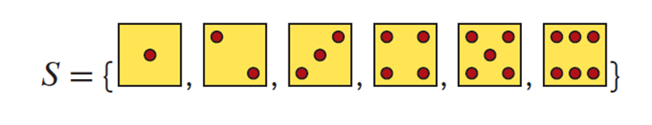
Sample Space 1
L O 5.1
The sample space to describe rolling a die has six outcomes:

Slide 6
Sample Space 2
L O 5.1
If the outcome of the experiment is a continuous measurement, the sample space cannot be listed, but it can be described by a rule. For example, the sample space for the length of a randomly chosen cell phone call would be:
The sample space to describe a randomly chosen student’s G P A would be:
Similarly, some discrete measurements are best described by a rule. For example, the sample space for the number of hits on a YouTube website on a given day is:

Slide 7
Event
L O 5.1
An event is any subset of outcomes in the sample space.
A simple event, or elementary event, is a single outcome.
A discrete sample space S consists of all the simple
events, denoted
A compound event consists of two or more simple events.

Slide 8

Probability 1
L O 5.2
The probability of an event is a number that measures the relative likelihood that the event will occur.
The probability of event A
must lie within
the interval from 0 to 1:
If
then the
If
then the event
event cannot occur.
is certain to occur.
Access the text alternative for slide images.

Slide 9

Probability 2
L O 5.2
In a discrete sample space, the probabilities of all simple events must sum to one:
For example, if on a shopping spree, the following percentages (on the left) were recorded for the four methods of payments. We can compute the equivalent probabilities which sum to 1.
credit card: | 32%
debit card: | 15%
cash: | 35%
check: | 18%
Sum = | 100%
P(credit card) = | .32
P(debit card) = | .15
P(cash) = | .35
P(check) = | .18
Sum = | 1.0
Probability

Slide 10
What is “Probability”
L O 5.2
There are three distinct ways of assigning probability. Each must be considered separately.
Approach | How Assigned? | Example
Empirical | Estimated from observed outcome frequency | There is a 3.2 percent chance of twins in a randomly chosen birth.
Classical | Known a priori by the nature of the experiment | There is a 50 percent chance of heads on a coin flip.
Subjective | Based on informed opinion or judgment | There is a 60 percent chance that Toronto will bid for the 2030 Winter Olympics.

Slide 11
Empirical Approach
L O 5.2
Empirical data are data that are collected through observations.
We assign probabilities by dividing frequency of observed outcomes (f) in our experimental sample space by the number of observations (n).
For example, to estimate the default rate on student loans:

Slide 12
Empirical Examples
L O 5.2

Slide 13
Law of Large Numbers 1
L O 5.2
Law of Large Numbers:
The law of large numbers states that as the number of trials of a random experiment increases, the average of the outcomes will approach the expected value.
As the sample size increases, there is an increased probability that any event (even an unlikely one) will occur.
Example: The odds that one ticket will win the lottery are low, yet the probability is high that someone will win the lottery because so many people buy lottery tickets.

Slide 14

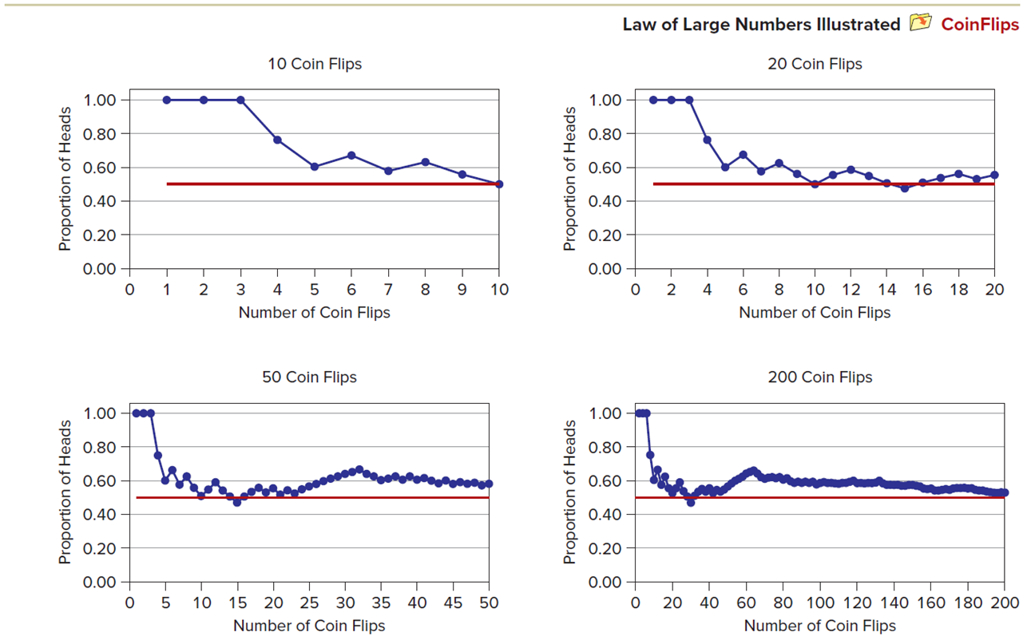
Law of Large Numbers 2
L O 5.2
Law of Large Numbers Illustrated
CoinFlips
Access the text alternative for slide images.

Slide 15
Classical Approach 1
L O 5.2
The classical approach is when we can use deduction
to determine
A priori refers to the process of assigning probabilities before the event is observed or the experiment is conducted. A priori probabilities are based on logic, not experience.
Example: flipping a coin or rolling a pair of dice. We can use deduction to determine the probability of an event.

Slide 16
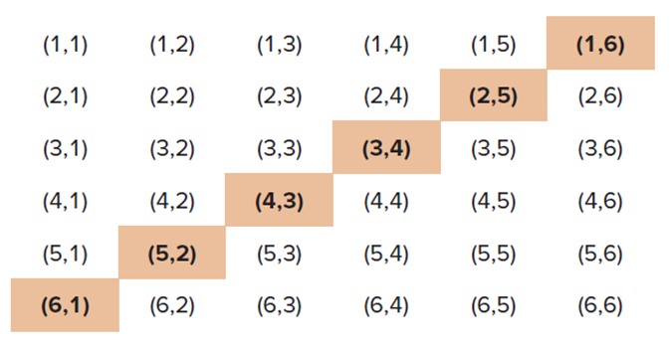
Classical Approach 2
L O 5.2
The sample space for the two-dice experiment shown previously. There are 36 possible outcomes. Rolling a seven is shown by the shaded outcomes below.
The probability is obtained a priori without actually doing an experiment.
Access the text alternative for slide images.

Slide 17
Subjective Approach
L O 5.2
A subjective probability reflects someone’s informed judgment about the likelihood of an event. It is used when there is no repeatable random experiment.
Examples:
What is the probability that Ford’s new supplier of plastic fasteners will be able to meet the September 23 shipment deadline?
What is the probability that a new truck product program will show a return on investment of at least 10 percent?
What is the probability that the price of Ford’s stock will rise within the next 30 days?

Slide 18
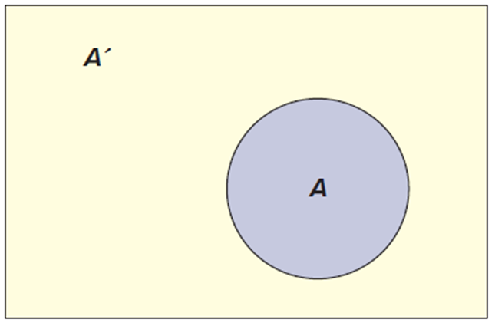
Complement of an Event
L O 5.3
The complement of an event A is denoted
and
consists of everything in the sample space S except event A, as illustrated in the Venn diagram.
Since A and
together comprise
the entire sample space, then:

Slide 19
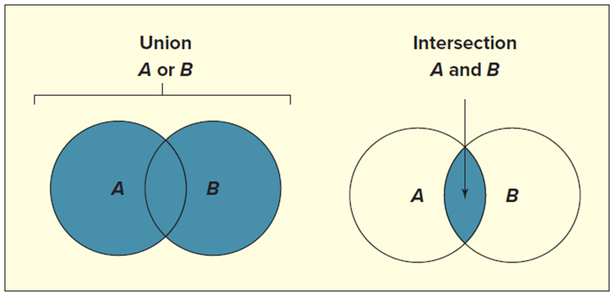
Union or Intersection?
L O 5.3
The union of two events consists of all outcomes in the sample space S that are contained either in event A or in event B or in both.
The union of A and B is sometimes denoted
The intersection of two events A and B is the event consisting of all outcomes in the sample space S that are contained in both event A
and event B. The intersection of A and B is denoted
The probability of
is called the joint probability
and is denoted
Access the text alternative for slide images.

Slide 20
General Law of Addition 1
L O 5.3
The general law of addition says that the probability of the union of two events A and B is the sum of their probabilities less the probability of their intersection.
General Law of Addition:
(5.6)
When you add the
together, you count the
twice.
So you have to subtract
to avoid overstating
the probability.

Slide 21
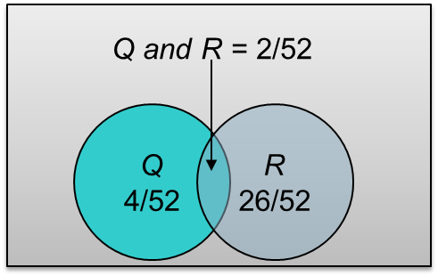
General Law of Addition 2
L O 5.3
For a standard deck of cards:
Queen:
(there are 4 queens in a deck).
Red:
(there are 26 red cards in a deck).
Queen and Red:
(there are 2 red queens in
a deck).
Therefore:
Queen or Red:
Access the text alternative for slide images.

Slide 22
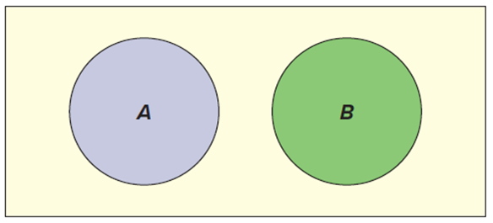
Mutually Exclusive Events
L O 5.3
Events A and B are mutually exclusive (or disjoint) if their intersection is the empty set (a set that contains no elements).
In other words, one event precludes the other from occurring.
The empty set is often called the null set and is denoted
Examples:
Customer age: A = under 21, B = over 65.
Purebred dog breed: A = border collie, B = golden retriever.
Business form: A = corporation, B = sole proprietorship.

Slide 23
Special Law of Addition
L O 5.3
If A and B are mutually exclusive events, then
and the general addition law can be simplified to the sum of the individual probabilities for A and B, the special law of addition.
Special Law of Addition:
(addition law for mutually exclusive events)
(5.8)
Example:
If we look at a person’s age, then
because these events do not overlap.

Slide 24
Collectively Exhaustive Events
L O 5.3
Events are collectively exhaustive if their union is the entire sample space S (that is, all the events that can possibly occur).
Two mutually exclusive, collectively exhaustive events are binary events.
A car repair either is covered by the warranty (A) or is not
covered by the warranty
There can be more than two mutually exclusive, collectively exhaustive events.
Google map gives you directions by car (C), public transit (P), walking (W), car hire (T), or bike (B).

Slide 25
Conditional Probability 1
L O 5.3
The probability of event A given that event B has occurred is a conditional probability, denoted
which is read “the probability of A given B.”
The conditional probability is the joint probability of A and B divided by the probability of B.

Slide 26
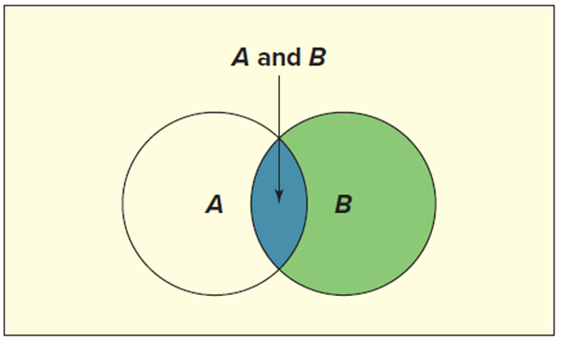
Conditional Probability 2
L O 5.3
The sample space is restricted to B, an event that we know has occurred (the green shaded circle).
The intersection,
is the part of B that is also in
A (the blue shaded area).
The ratio of the relative size of set
to set B is the
conditional probability
Access the text alternative for slide images.

Slide 27
Conditional Probability 3
L O 5.3
Of the population age 16 to 21 and not in college, 13.50 percent are unemployed, 29.05 percent are high school dropouts, and 5.32 percent are unemployed high school dropouts. What is the conditional probability that a member of this population is unemployed, given that the person is a high school dropout? To answer this question, define:
U = the event that the person is unemployed.
D = the event that the person is a high school dropout.
This "story problem" contains three facts:
So by formula 5.9, the conditional probability of an unemployed youth given that the person dropped out of high school is,

Slide 28
Conditional Probability 4
L O 5.3
The conditional probability of being unemployed is,
(18.31 percent). This is greater than
the unconditional probability of being unemployed
(13.50 percent). In other words, knowing
that someone is a high school dropout alters the probability that the person is unemployed.

Slide 29
General Law of Multiplication 1
L O 5.3
The general law of multiplication states that the probability of the intersection of two events A and B is:
General Law of Multiplication:
(5.10)

Slide 30
General Law of Multiplication 2
L O 5.3
Last year, 70 percent of new movies were available as video on demand (V O D) within 14 days of their release. Of those movies, 50 percent were released as T V pay-per-view (as opposed through a subscription streaming service). What is the joint probability that a new movie was available as V O D within 14 days of release tor T V pay-per-view? To answer this question, define:
V = the event that a new movie was available as V O D within 14 days of release.
T = the event that a new movie was available as T V pay-per-view.
This "story problem" contains two facts:
By formula 5.10, the joint probability that a new movie was available as V O D within 14 days of release and as T V pay-per-view is
Therefore, 35 percent of new movies last year were available as video on demand within 14 days of their release and as TV pay-per-view.

Slide 31
Odds of an Event 1
L O 5.4
Statisticians usually speak of probabilities rather than odds, but in sports and games of chance, we often hear odds quoted.
We define the odds in favor of an event A as the ratio of the probability that event A will occur to the probability that event A will not occur.
Its reciprocal is the odds against event A.
Odds in favor of A :
Odds against A :

Slide 32
Odds of an Event 2
L O 5.4
In horse racing and other sports, odds usually are quoted against winning. If the odds against event A are quoted as b to a, then the implied probability of event A is:
For example, if a racehorse has 4 to 1 odds against winning, this is equivalent to saying that the odds-makers assign the horse a 20 percent chance of winning:

Slide 33
Independent Events
L O 5.5
When
differs from
the events are dependent.
When knowing that event B has occurred does not affect the probability that event A will occur, then events A and B are independent.
If text messaging among high school students is independent of gender, this means that knowing whether a student is a male or female does not change the probability that the student uses text messaging.
Independent Events:
(5.11)
Event A is independent of event B if and only if

Slide 34
Special Law of Multiplication 1
L O 5.5
If A and B are independent events, we can simplify the general law of multiplication to show that the joint probability of events A and B is the product of their individual probabilities. Recall the general law of multiplication:
If A and B are independent, then we can substitute
for
The result is shown in formula 5.12, the special law
of multiplication.
Special Law of Multiplication:
If events A and B are independent, then:
(5.12)

Slide 35
Special Law of Multiplication 2
L O 5.5
Based on past data, the probability that a customer at a certain Noodles & Company restaurant will order a dessert (event D) with the meal is .08. The probability that a customer will order a bottled beverage (event B) is .14. The joint probability that a customer will order both a dessert and a bottled beverage is .0112. Is ordering a dessert independent of ordering a bottled beverage?
We see that
so D and B are independent
of each other. If we know that a customer has ordered a bottled beverage, does this information change the probability that the customer will also order a dessert? No, because the events are independent.

Slide 36
Special Law of Multiplication 3
L O 5.5
Redundancy can increase system reliability even when individual component reliability is low. For example, the NASA space shuttle has three flight computers. Suppose that they function independently but that each has an unacceptable .03
chance of failure (3 failures in 100 missions). Let
= event that
computer j fails. Then,
(presuming that failures are independent)
missions.

Slide 37
Special Law of Multiplication 4
L O 5.5
Triple redundancy can reduce the probability of computer failure to .000027 (27 failures in 1,000,000 missions). Of course, in practice, it is very difficult to have truly independent computers because they may share electrical buses or cables. On one shuttle mission, two of the three computers actually did fail, which proved the value of redundancy. Another example of space shuttle redundancy is the four independent fuel gauges that prevent the shuttle's main engines from shutting down too soon. Initial launch rules allowed the shuttle to fly as long as two of them were functional, but after the Challenger launch explosion, the rules were modified to require that 3 of 4 be functional, and they were modified again after the Columbia accident to require that all 4 be functional (see https://history.nasa.gov/sts511.html).

Slide 38
Contingency Tables
L O 5.6
A contingency table is a cross-tabulation of frequencies into rows and columns.
The intersection of each row and column is a cell that shows a count of data values that lie in each cell.
A contingency table with r rows and c columns has rc cells and is called an r × c table.

Slide 39
Marginal Probabilities
L O 5.6
The marginal probability of an event is a relative frequency that is found by dividing a row or column total by the total sample size.
Using the column totals, 280 out of 360 alumni were engaged at the lowest level. The marginal probability of a low
engagement level is
In other words,
about 77.78 percent of the M B A alumni were engaged at the lowest level.

Slide 40
Joint Probabilities
L O 5.6
A joint probability represents the intersection of two events.
The middle cell highlighted is the joint event that a graduate is from the
part-time M B A program
and is also engaged at a medium level
We can write this probability either as
Because 17 out of 360 alumni are in this category, we calculate the
joint probability as
There is less than a 5
percent chance that an M B A alumnus is both a graduate of the part-time program and engaged at a medium level.

Slide 41
Conditional Probabilities
L O 5.6
When we restrict ourselves to a single row or column (the condition), we can calculate conditional probabilities.
If we restrict ourselves to the 37 executive alumni in the third row, we can calculate the percent of M B A graduate that is engaged at a high level
given that the alumnus is an executive M B A
This conditional
probability may be written
There were 15 highly engaged
alumni out of 37 executive M B As, so
There is about a 40 percent chance that an executive M B A will be highly engaged.

Slide 42
Relative Frequencies
L O 5.6
To facilitate certain kinds of probability calculations, we
divide each cell frequency
by the total sample size
(n = 360) to get the relative frequencies.
The upper left-hand cell becomes
Each cell is a joint probability. The cells sum to 1.0000 because these are all the possible event combinations.

Slide 43
Tree Diagrams 1
L O 5.7
A tree diagram or decision tree helps to visualize all possible outcomes.
Start with a contingency table.
For example, this table gives expenses ratios by fund type for 21 bond funds and 23 stock funds.

Slide 44
Tree Diagrams 2
L O 5.7
The tree diagrams shows all events along with their marginal, condition, and joint probabilities.
To label the tree, we need to compute the conditional probabilities.

Slide 45
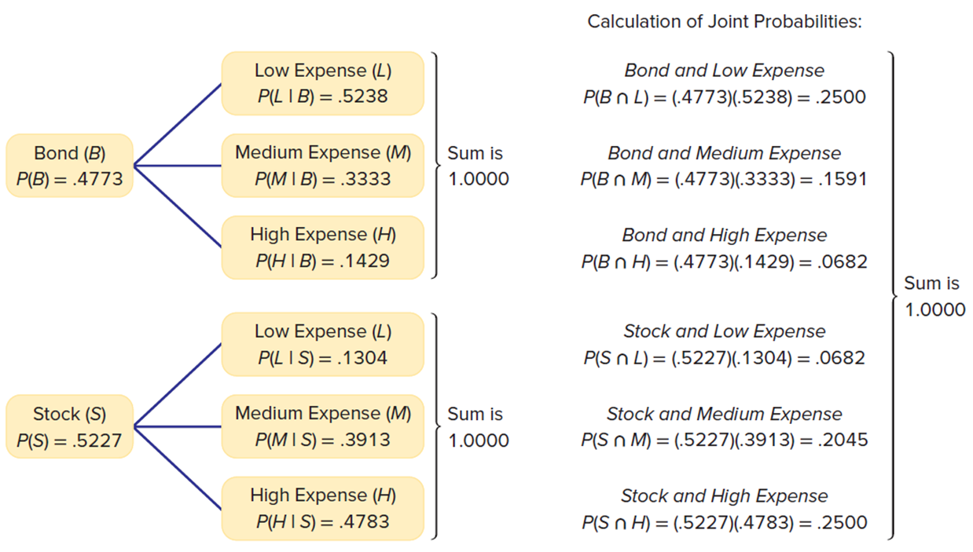
Tree Diagrams 3
L O 5.7
Tree Diagram for Fund Type and Expense Ratios:
BondFund
Access the text alternative for slide images.

Slide 46
Bayes’ Theorem 1
L O 5.8
An important theorem published by Thomas Bayes (1702 to 1761) provides a method of revising probabilities to reflect new information.
The prior (unconditional) probability of an event B is revised after event A has occurred to yield a posterior (conditional) probability.
Bayes’ formula:
In some situations,
is not given. The most useful
and common form of Bayes’ Theorem replaces
with an expanded formula:

Slide 47
Bayes’ Theorem 2
L O 5.8
A generalization of Bayes’ Theorem allows event B to have as many mutually exclusive and collectively
exhaustive categories as we wish
rather
than just the two dichotomous categories B and

Slide 48
Bayes’ Theorem Example 1
L O 5.8
Based on historical data, three hospital trauma centers have 50, 30, and 20 percent of the cases, respectively. The probability of a case resulting in a malpractice suit in each of the three hospitals is .001, .005, and .008, respectively. If a malpractice suit is filed, what is the probability that it originated in hospital 1? This problem is solved as follows. We define,
Event A = event that a malpractice suit is filed by a patient.
Event
= event that the patient was treated at trauma center

Slide 49
Bayes’ Theorem Example 2
L O 5.8
Applying formula 5.16, we can find
as follows:
The probability that the malpractice suit was filed in hospital 1 is .1389, or 13.89 percent. Although hospital 1 sees 50 percent of the trauma patients, it is expected to generate less than half the malpractice suits because the other two hospitals have a much higher incidence of malpractice suits.

Slide 50
Bayes’ Theorem Example 3
L O 5.8
There is nothing special about
In fact, it is easy to
calculate all the posterior probabilities at once by using a worksheet, as shown:
(probability that a malpractice lawsuit originated in hospital 1)
(probability that a malpractice lawsuit originated in hospital 2)
(probability that a malpractice lawsuit originated in hospital 3)

Slide 51
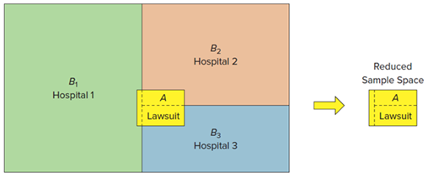
Bayes’ Theorem Example 4
L O 5.8
We could visualize this situation as shown. The initial sample space consists of three mutually exclusive and collectively exhaustive events
As indicated by their relative areas,
is 50 percent
of the sample space,
is 30 percent of the sample space,
is 20
percent of the sample space. But given that a malpractice case has been filed (event A), then the relevant sample space is reduced to that of event A.
The revised (posterior) probabilities are the relative areas within event A:
is the proportion of A that lies within
is the proportion of A that lies within
is the proportion of A that lies within
Access the text alternative for slide images.

Slide 52
Fundamental Rule of Counting 1
L O 5.9
If event A can occur in
ways and event B can occur in
ways, then events A and B can occur in
In general, m events can occur
ways.
Example:
How many unique stock keeping unit (S K U) labels can a chain of hardware stores create by using two letters (ranging from A A to Z Z) followed by four numbers (digits 0 through 9)?
A F1078: hex-head 6 cm bolts—box of 12.
R T4855: Lime-A-Way cleaner—16 ounce.
L L3119: Rust-Oleum Professional primer—gray 15 ounce.

Slide 53
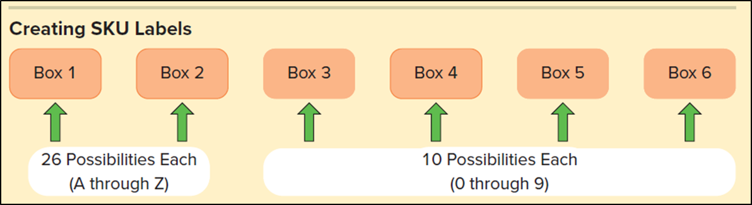
Fundamental Rule of Counting 2
L O 5.9
There are 26 ways (letters A through Z) to fill either the first or the second box. There are 10 ways (digits 0 through 9) to fill the third through sixth boxes. The number of unique inventory labels is therefore 26 × 26 × 10 × 10 × 10 × 10 = 6,760,000. Such a system should suffice for a moderately large retail store.
Access the text alternative for slide images.

Slide 54
Factorials
L O 5.9
The number of unique ways that n items can be arranged in a particular order is n factorial, the product of all integers from 1 to n.
Factorials are useful for counting the possible arrangements of any n items.
There are n ways to choose the first, n−1 ways to choose the second, and so on.
A home appliance service truck must make three stops (A, B, C). In how many ways could the three stops be arranged?

Slide 55
Permutations and Combinations 1
L O 5.9
A permutation is an arrangement of the r sample items in a particular order.
A combination is a collection of r items chosen at random without replacement from n items where the order of the selected items is not important.
Permutation
Combination

Slide 56
Permutations and Combinations 2
L O 5.9
Five home appliance customers (A, B, C, D, E) need service calls, but the field technician can service only three of them before noon.
Example 1 - Permutation: The order in which they are serviced is important (to the customers, anyway), so each possible arrangement of three service calls is different.
Example 2 – Combination: The customers don’t care when they are serviced as long as it’s before noon.

Slide 57
Chapter 5: Practice Problems

Slide 58
Questions
L O 5.2
Which kind of probability is it (empirical, classical, subjective)?
5.9: There is a 20 percent chance that a new stock offered in an initial public offering (I P O) will reach or exceed its target price on the first day.
5.10: There is a 25 percent chance that A T&T Wireless and Verizon will merge.
5.11: Commercial rocket launches have a 95 percent success rate.
5.12: The probability of rolling three sevens in a row with dice is .0046.

Slide 59
Question 17
L O 5.3
Are these characteristics of a student at your university mutually exclusive or not? Explain.
(a) A = works 20 hours or more, B = majoring in accounting.
(b) A = born in the United States, B = born in Canada.
(c) A = owns a Toyota, B = owns a Honda.

Slide 60
Question 25
L O 5.4
Currently Samsung ships 21.7 percent of the organic light-emitting diode (O L E D) displays in the world. Let S be the event that a randomly selected O L E D display was made by Samsung. Find:
(a)
(b)
(c) The odds in favor of event S.
(d) The odds against event S.

Slide 61
Question 32
L O 5.5
Which pairs of events are independent?
(a)
(b)
(c)

Slide 62
Question 40
L O 5.6
The contingency table below shows the results of a survey of video viewing habits by age. Find the following probabilities or percentages:
(a) Probability that a viewer is aged 18 to 34.
(b) Probability that a viewer prefers watching videos on a T V screen.
(c) Percentage of viewers who are 18 to 34 and prefer videos on a mobile or laptop device.
(d) Percentage of viewers aged 18 to 34 who prefer videos on a mobile or laptop device.
(e) Percentage of viewers who are 35 to 54 or prefer videos on a mobile or laptop device.
Viewer Age | Video Viewing Platform Preferred Mobile/Laptop Device | Video Viewing Platform Preferred TV Screen | Row Total
18 to 34 | 39 | 30 | 69
35 to 54 | 10 | 10 | 20
55+ | 3 | 8 | 11
Column Total | 52 | 48 | 100

Slide 63
Question 44
L O 5.6
This contingency table describes 200 business students. Find each probability and interpret it in words.
(a)
(b)
Gender | Major Accounting (A) | Major Economics (E) | Major Statistics (S) | Row Total
Female (F) | 44 | 30 | 24 | 98
Male (M) | 56 | 30 | 16 | 102
Column Total | 100 | 60 | 40 | 200
(c)
(d)
(e)
(f)
(g)
(h)

Slide 64
Question 47
L O 5.7
Of grocery shoppers who have a shopping cart, 70 percent pay
by credit/debit card
20 percent pay cash
and 10 percent pay by check
Of shoppers without
a shopping cart, 50 percent pay by credit/debit card
40 percent pay cash
and 10 percent pay by check
On Saturday morning, 80 percent of the shoppers
take a shopping cart
and 20 percent do not
(a) Sketch a tree based on these data.
(b) Calculate the probability of all joint probabilities (for example
(c) Verify that the joint probabilities sum to 1.

Slide 65
Question 49
L O 5.8
A drug test for athletes has a 5 percent false positive rate and a 10 percent false negative rate. Of the athletes tested, 4 percent have actually been using the prohibited drug. If an athlete tests positive, what is the probability that the athlete has actually been using the prohibited drug? Explain your reasoning clearly.

Slide 66
Question 64
L O 5.9
A real estate office has 10 sales agents. Each of four new customers must be assigned an agent.
(a) Find the number of agent arrangements where order is important.
(b) Find the number of agent arrangements where order is not important.
(c) Why is the number of combinations smaller than the number of permutations?

Slide 67
Chapter 5: Analytics in Action

Slide 68
Analytics in Action 1
Climate Change:
How can local governments, financial institutions, and businesses assess risks of climate change? Heat, rainfall, and flooding impact crop yields, costs of air-conditioning, construction plans, and even business location. Climate risks can affect credit ratings (for example, Moody's) when firms or governments seek to borrow for growth or capital improvements. Analytics firms (for example, 427mt.com and jupiterintel.com) are springing up to offer climate intelligence services for clients such as governments, pension funds, and banks. Some individual firms are beginning to train their in-house staff to improve forecasts of impacts of climate change. These tech start-ups seek to encourage data-driven preparation for climate change. (See The Economist 433, no. 9170 (November 23, 2019), pp. 68 to 69.)

Slide 69
Analytics in Action 2
Can Amazon Read Your Mind?
You go to Amazon.com to search for a Roomba robot vacuum for your apartment. Amazon returns over 3,000 results from your search (new, used, various vendors and models). But Amazon also recommends that you consider buying an iTouchless automatic stainless steel trashcan or Tossits car trash bags. How did it decide on these suggestions? The answer is that Amazon has a matrix (like an Excel pivot table) that keeps track of the frequency of copurchased items (for example, books, music, D V D s) for web shoppers. Probabilities derived from the cells in this contingency table are used to recommend products that are likely to be of interest to you, assuming that you are "like“ other buyers. While such predictions of your behavior are only probabilistic, even a modest chance of landing extra sales can make a difference in bottom-line profit. There are even more sophisticated logic engines that can track your web clicks. Is this an invasion of your privacy? Does it bother you to think that you may be predictable? Interestingly, many consumers don't seem to mind and actually find value in this kind of statistical information system.

Slide 70
End of Main Content
© McGraw Hill LLC. All rights reserved. No reproduction or distribution without the prior written consent of McGraw Hill LLC.

Slide 71
Accessibility Content: Text Alternatives for Images
71

Slide 72
Probability 1 – Text Alternative
Return to parent-slide containing images.
The first arrow points from the text labeled If P (A) = 0, then the event cannot occur to the text labeled 0 less than or equal to P (A) less than or equal to 1. The second arrow points from the text labeled If P (A) = 1, then the event is certain to occur to the text labeled 0 less than or equal to P (A) less than or equal to 1.
Return to parent-slide containing images.
72

Slide 73
Law of Large Numbers 2 – Text Alternative
Return to parent-slide containing images.
In all 4 graphs, the horizontal axis is labeled Number of coin flips and the vertical axis is labeled Proportion of Heads. The vertical axis ranges from 0 to 1 in increments of 0.2. Graph 1. 10 Coin flips. The horizontal axis ranges from 0 to 10 in increments of 1. The blue line begins at (1, 1), passes through (3, 1), (5, 0.6), (6, 0.7), (7, 0.6), (8, 0.6), and ends at (10, 0.5). The red horizontal line begins at (1, 0.5) and ends at (10, 0.5). Graph 2. 20 Coin flips. The horizontal axis ranges from 0 to 20 in increments of 2. The blue line begins at (1, 1), passes through (5, 0.6), (6, 0.7), (7, 0.6), (8, 0.62), (10, 0.5), (12, 0.6), (15, 0.5), (18, 0.6), and ends at (20, 0.59). The red horizontal line begins at (1, 0.5) and ends at (20, 0.5). Graph 3. 50 Coin flips. The horizontal axis ranges from 0 to 50 in increments of 5. The blue line begins at (1, 1), passes through (4, 1), (5, 0.6), (6, 0.7), (10, 0.5), (11, 0.6), (15, 0.5), (20, 0.55), (32, 0.7), and ends at (50, 0.6). The red horizontal line begins at (0, 0.5) and ends at (50, 0.5). Graph 4. 200 Coin flips. The horizontal axis ranges from 0 to 200 in increments of 20. The blue line begins at (0, 1), passes through (30, 0.45), (60, 0.65), and ends at (200, 0.5). The red horizontal line begins at (0, 0.5) and ends at (200, 0.5). All values are estimated.
Return to parent-slide containing images.
73

Slide 74
Classical Approach 2 – Text Alternative
Return to parent-slide containing images.
Row 1. (1, 1) (1, 2) (1, 3), (1, 4), (1, 5), (1, 6). Row 2. (2, 1), (2, 2), (2, 3), (2, 4), (2, 5), (2, 6). Row 3. (3, 1), (3, 2), (3, 3), (3, 4), (3, 5), (3, 6). Row 4. (4, 1), (4, 2), (4, 3), (4, 4), (4, 5), (4, 6). Row 5. (5, 1), (5, 2), (5, 3), (5, 4), (5, 5), (5, 6). Row 6. (6, 1), (6, 2), (6, 3), (6, 4), (6, 5), (6, 6). The outcomes that add to seven are shaded. There are 6 of them: (6, 1), (5, 2), (4, 3), (3, 4), (2, 5), and (1, 6).
Return to parent-slide containing images.
74

Slide 75
Union or Intersection? – Text Alternative
Return to parent-slide containing images.
The diagram shows 2 overlapping circles labeled A and B. For the union of A and B, 2 circles are shaded. For the intersection of A and B, the intersecting region is shaded.
Return to parent-slide containing images.
75

Slide 76
General Law of Addition 2 – Text Alternative
Return to parent-slide containing images.
The left circle is labeled Q 4÷52. The right circle is labeled R 26÷52. The intersecting region is labeled Q and R = 2÷52.
Return to parent-slide containing images.
76

Slide 77
Conditional Probability 2 – Text Alternative
Return to parent-slide containing images.
2 overlapping circles are inside a square. The left circle is labeled A. The right circle is labeled B. The intersecting region is labeled A and B.
Return to parent-slide containing images.
77

Slide 78
Tree Diagrams 3 – Text Alternative
Return to parent-slide containing images.
This tree diagram shows two different fund types: Bonds (probability = 0.4773) and stocks (probability = 0.5227). Each may have a low, medium, or high expense. If a bond is purchased, the probability of a low expense is 0.5238, the probability of a medium expense is 0.3333, and the probability of a high expense is 0.1429. If a stock is purchased, the probability of a low expense is 0.1304, the probability of a medium expense is 0.3913, and the probability of a high expense is 0.4783. To calculate the joint probabilities, we need to find the intersection (product of the probabilities) of each combination of fund type and expense ratio. The probability of bond and low expense is 0.4773 times 0.5238 = 0.2500. The probability of bond and medium expense is 0.4773 times 0.3333 = 0.1591. The probability of bond and high expense is 0.4773 times 0.1429 = 0.0682. The probability of stock and low expense is 0.5227 times 0.1304 = 0.0682. The probability of stock and medium expense is 0.5227 times 0.3913 = 0.2045. The probability of stock and high expense is 0.5227 times 0.4783 = 0.25. The sum of these six joint probabilities is 1.0000.
Return to parent-slide containing images.
78

Slide 79
Bayes’ Theorem Example 4 – Text Alternative
Return to parent-slide containing images.
A rectangle shows the left half as Hospital 1, the right upper corner as Hospital 2, and the bottom right corner as Hospital 3. A yellow rectangle labeled A Lawsuit is at the intersecting region of 3 hospitals. This yellow rectangle is the reduced sample space.
Return to parent-slide containing images.
79

Slide 80
Fundamental Rule of Counting 2 – Text Alternative
Return to parent-slide containing images.
Creating S K U labels. 6 boxes are shown. There are 26 possibilities (letters A through Z) to fill box 1 and box 2. There are 10 possibilities each (0 through 9) to fill boxes 3 through 6.
Return to parent-slide containing images.
80

