Slide 1

Chapter 6
Discrete Probability Distributions
© McGraw Hill LLC. All rights reserved. No reproduction or distribution without the prior written consent of McGraw Hill LLC.

Slide 2
Chapter Learning Objectives
Chapter 6
L O 6.1: Define a discrete random variable and its probability distribution.
L O 6.2: Solve problems using expected value and variance.
L O 6.3: Define and apply the uniform discrete model.
L O 6.4: Find binomial probabilities using tables, formulas, or Excel.
L O 6.5: Find Poisson probabilities using tables, formulas, or Excel.
L O 6.6: Use the Poisson approximation to the binomial (optional).
L O 6.7: Find hypergeometric probabilities using Excel.
L O 6.8: Use the binomial approximation to the hypergeometric (optional).
L O 6.9: Calculate geometric probabilities (optional).
L O 6.10: Apply rules for transformations of random variables (optional).

Slide 3
Discrete Probability Distributions 1
L O 6.1
A random variable is a function or rule that assigns a numerical value to each outcome in the sample space of a random experiment.
We use X when referring to a random variable in general, while specific values of X are shown in lowercase (for example, x₁).
A discrete random variable has a countable number of distinct values.
Some random variables have a clear upper limit (for example, number of absences in a class of 40 students), while others do not (for example, number of text messages you receive in a given hour).

Slide 4
Discrete Probability Distributions 2
L O 6.1
Decision Problem | Discrete Random Variable
Oxnard University has space in its MBA program for 65 new students. In the past, 75 percent of those who were admitted actually enrolled. The decision is made to admit 80 students. What is the probability that more than 65 admitted students will actually enroll? | X = number of admitted MBA students who actually enroll. (X = 0, 1, 2, . . . , 80)
On the late morning (9 to 12) work shift, L.L.Bean’s order processing center staff can handle up to 5 orders per minute. The mean arrival rate is 3.5 orders per minute. What is the probability that more than 5 orders will arrive in a given minute? | X = number of phone calls that arrive in a given minute at the L.L.Bean order processing center. (X = 0, 1, 2, . . .)
Rolled steel from a certain supplier averages 0.01 defect per linear meter. Toyota will reject a shipment of 500 linear meters if inspection reveals more than 10 defects. What is the probability that the order will be rejected? | X = number of defects in 500 meters of rolled steel. (X = 0, 1, 2, . . .)

Slide 5
Probability Distributions 1
L O 6.1
A discrete probability distribution assigns a probability to each value of a discrete random variable X. The distribution must follow the rules of probability defined in Chapter 5.
If X has n distinct values
then
(the probability for any given value of X)
(the sum over all values of X)

Slide 6
Probability Distributions 2
L O 6.1
Discrete probability distributions follow the rules of functions.
More than one sample space outcome can be assigned to the same number, but you cannot assign one outcome to two different numbers.
More than one random variable value can be assigned to the same probability, but one random variable value cannot have two different probabilities.
The probabilities must sum to 1.

Slide 7
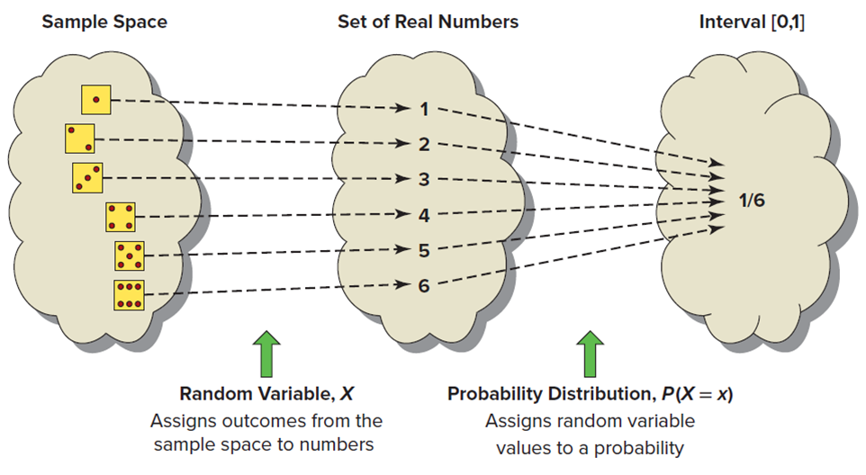
Probability Distributions 3
L O 6.1
This figure illustrates the relationship between the sample space, the random variable, and the probability distribution function for a simple experiment of rolling a die.
Access the text alternative for slide images.

Slide 8
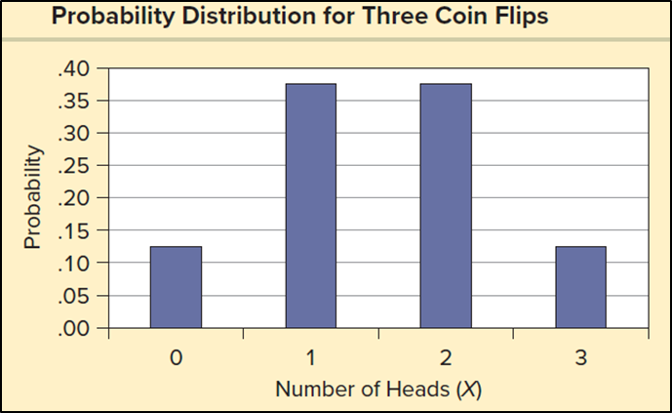
Example: Coin Flips
L O 6.1
When you flip a fair coin three times, the sample space has eight equally
likely simple events:
If X is the number of heads, then X is a random variable whose probability distribution is shown:
The values of X need not be equally likely. In this example, X = 1 and X = 2 are more likely than X = 0 or X = 3. However, the probabilities sum to 1, as in any probability distribution.
Access the text alternative for slide images.

Slide 9
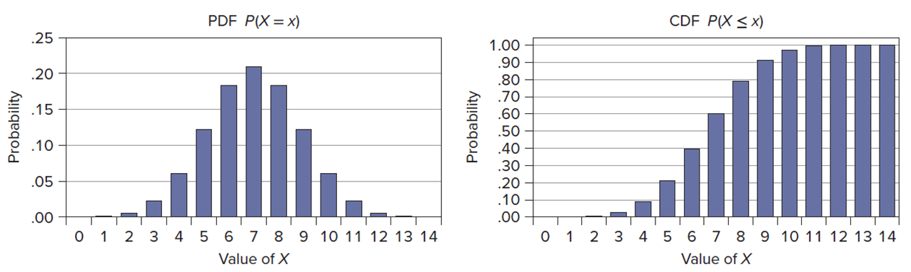
What is a P D F or a C D F?
L O 6.1
A probability distribution function (P D F) is a mathematical
function that shows the probability of each X-value,
A cumulative distribution function (C D F) is a mathematical
function that shows the cumulative sum of probabilities,
adding from the smallest to the largest X-value, gradually approaching unity.
Access the text alternative for slide images.

Slide 10
Expected Value
L O 6.2
The expected value
of a discrete random variable
is the sum of all X-values weighted by their respective probabilities.
It is a measure of center.
If there are N distinct values of X
the
expected value is,

Slide 11
Example: Service Calls 1
L O 6.2
The distribution of Sunday emergency service calls by Ace Appliance Repair is shown in Table 6.2. The probabilities sum to 1, as must be true for any probability distribution.

Slide 12
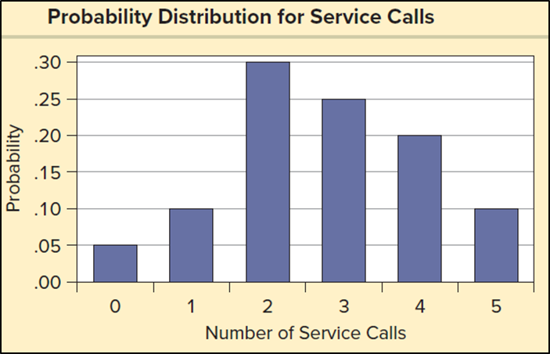
Example: Service Calls 2
L O 6.2
This particular probability distribution is not symmetric around the mean μ = 2.75.
However, the mean is still the balancing point, or fulcrum.
is an average and it does not have to be an
observable value.
Access the text alternative for slide images.

Slide 13
Variance and Standard Deviation
L O 6.2
The variance
of a discrete random variable is the
sum of the squared deviations about its expected value, weighted by the probability of each X-value. If there are N distinct values of X, the variance is:
We use either
to denote its variance.
The standard deviation is the square root of the variance and is denoted σ:

Slide 14
Example: Bed and Breakfast 1
L O 6.2
The Bay Street Inn is a seven-room bed-and-breakfast in the sunny California coastal city of Santa Theresa. Demand for rooms generally is strong during February, a prime month for tourists. However, experience shows that demand is quite variable. The probability distribution of room rentals during February is shown in below, where X = the number of rooms rented (X = 0, 1, 2, 3, 4, 5, 6, 7). The
worksheet shows the calculation of
 | .

Slide 15
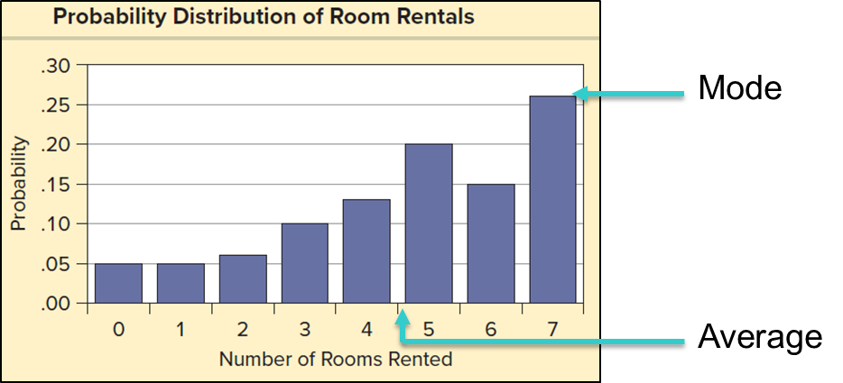
Example: Bed and Breakfast 2
L O 6.2
This distribution is skewed to the left and bimodal. The mode (most likely value) is 7 rooms rented, but the average is only 4.71 room rentals in February. The standard deviation of 2.06 indicates that there is considerable variation around the mean,
Access the text alternative for slide images.

Slide 16
Uniform Distribution
L O 6.3
The uniform distribution is one of the simplest discrete models. It describes a random variable with a finite number of consecutive integer values from a to b.
The entire distribution depends only on the two parameters a and b.
Each value is equally likely.

Slide 17
Characteristics of the Uniform Distribution
L O 6.3

Slide 18
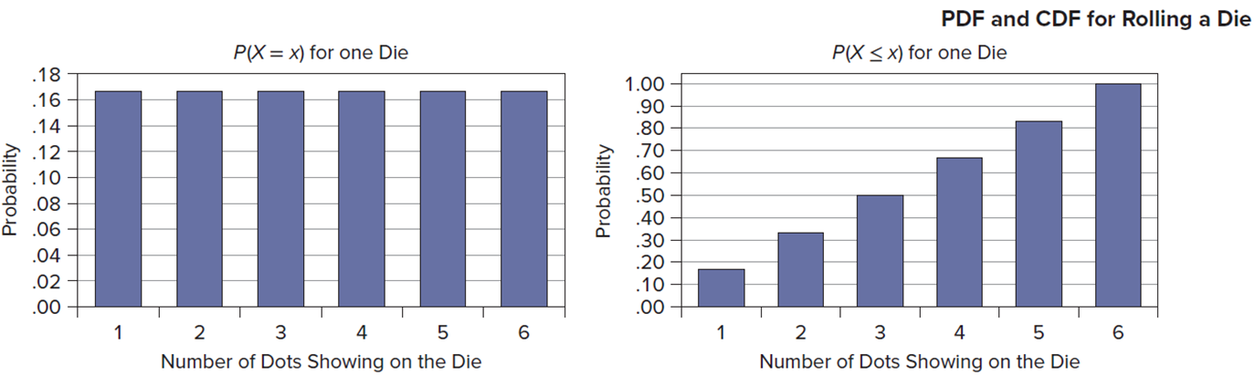
Example: Rolling a Die 1
L O 6.3
When you roll one die, the number of dots forms a uniform discrete random variable with six equally likely integer values 1, 2, 3, 4, 5, 6.
Access the text alternative for slide images.

Slide 19
Example: Rolling a Die 2
L O 6.3
The mean (3.5) must be halfway between 1 and 6, but there is no way you could anticipate the standard deviation without using a formula.
For this example, the mean and standard deviation are:

Slide 20
Bernoulli Experiments 1
L O 6.4
A random experiment that has only two outcomes is called a Bernoulli experiment.
To create a random variable, we arbitrarily call one outcome a “success” (denoted X = 1) and the other a “failure” (denoted X = 0).
The probability of success is denoted
The probability of failure is
so the probabilities sum to
1, that is,
The probability of success,
remains the same for each trial.

Slide 21
Bernoulli Experiments 2
L O 6.4
The examples in the table show that a success (X = 1) may in fact represent something undesirable but of main interest. Metallurgists look for signs of metal fatigue. Auditors look for expense voucher errors. Bank loan officers look for loan defaults. A success, then, is merely an event of interest.
Bernoulli Experiment | Possible Outcomes | Probability of “Success”
Flip a coin | 1 = heads. 0 = tails. | π = .50
Inspect a jet turbine blade | 1 = crack found. 0 = no crack found. | π = .001
Purchase a tank of gas | 1 = pay by credit card. 0 = do not pay by credit card. | π = .78
Do a mammogram test | 1 = positive test. 0 = negative test. | π = .0004

Slide 22
Binomial Distributions
L O 6.4
The binomial distribution arises when a Bernoulli experiment is repeated n times.
Each trial is independent so that the probability of success π remains constant on each trial.
In a binomial experiment, we are interested in X = the number of successes in n trials, so the binomial random variable X is the sum of n independent Bernoulli random variables:
The probability of a particular number of successes
is determined by parameters n and π.

Slide 23
Characteristics of the Binomial Distribution
L O 6.4

Slide 24
Example: Quick Oil Change Shop
L O 6.4
Consider a shop that specializes in quick oil changes. It is important to this type of business to ensure that a car’s service time is not considered “late” by the customer. We can define service times as being either late or not late and define the random variable X to be the number of cars that are late out of the total number of cars serviced. We assume that cars are independent of each other and the chance of a car being late stays the same for each car. Suppose
that historically
Suppose we would like to know the probability that exactly 2 of the next 12 cars serviced are late. In this case, n = 12, and we want to know

Slide 25
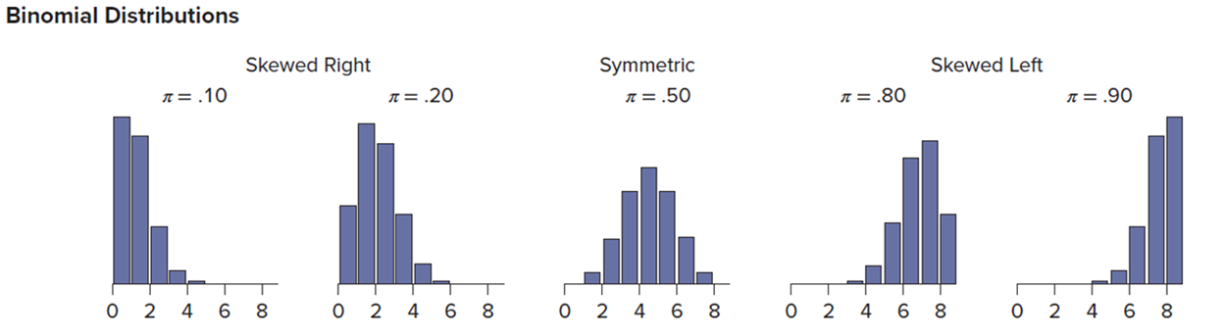
Binomial Shape
L O 6.4
A binomial distribution is skewed right if π < .50, skewed left if π < .50, and symmetric only if π = .50.
However, skewness decreases as n increases, regardless of the value of π.
Access the text alternative for slide images.

Slide 26
Recognizing Binomial Applications
L O 6.4
The binomial distribution has five main characteristics.
The number of trials (n) is fixed.
There are only two outcomes for each trial: success or failure.
The probability of success for each trial (π) remains constant.
The trials are independent of each other.
The random variable (X) is the number of successes out of n trials.
Even if you don’t know π, you may have a binomial experiment. In practice, the value of π would be estimated from experience.

Slide 27
Finding Binomial Probabilities
L O 6.4
One can use the binomial formula.
One can use the binomial tables in the appendix of the text.
One can use technology such as Excel. (Other technologies include some scientific calculators, MegaStat, Minitab, Python, etc.).

Slide 28
Example: Uninsured Patients 1
L O 6.4
On average, 20 percent of the emergency room patients at Greenwood General Hospital lack health insurance. In a random sample of four patients, what is the probability that two will be uninsured?
X = number of uninsured patients (“success”).
(20% chance that a given patient will be
uninsured).
(80%chance that a patient will be insured).
n = 4 patients.
The domain is X = 0, 1, 2, 3, 4 patients.

Slide 29
Example: Uninsured Patients 2
L O 6.4
The P D F is shown in the Table. We can calculate binomial probabilities by using Excel’s binomial formula =BINOM.DIST(x, n, π, cumulative), where cumulative is 0 (if you want a P D F) or 1 (if you want a C D F). We also can use a calculator to work it out from the mathematical formula with n = 4 and π = .20.
The probability that two will be uninsured is 0.1536 or 15.36%.

Slide 30

Compound Events 1
L O 6.4
A compound event is expressed using an inequality.
Consider the event that the sample of four patients will contain at most two uninsured patients.
The probability of this event would be expressed as
As shown previously, we can add the P D F
values.

Slide 31
Compound Events 2
L O 6.4
What is the probability that fewer than two patients have insurance?
What is the probability that no more than two patients have insurance?

Slide 32
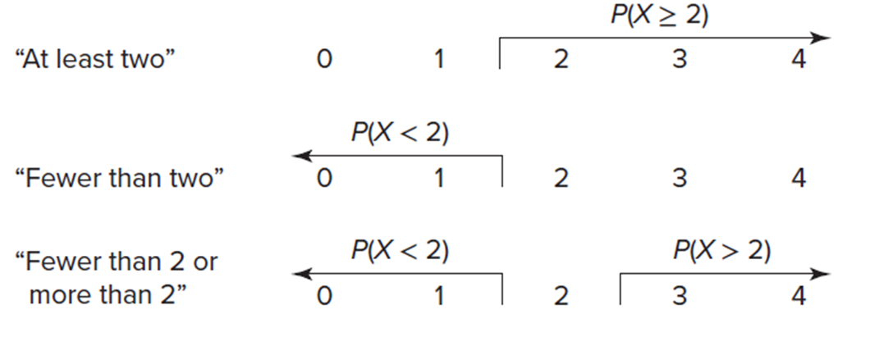
Compound Events 3
L O 6.4
To interpret phrases such as “more than” or “at least,” it is helpful to sketch a diagram:
Access the text alternative for slide images.

Slide 33
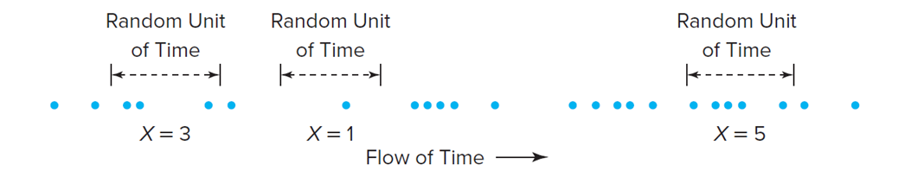
Poisson Distribution 1
L O 6.5
The Poisson distribution describes the number of occurrences within a randomly chosen unit of time (for example, minute, hour) or space (for example, square foot, linear mile).
The events must occur randomly and independently over a continuum of time or space.
We will call the continuum “time” because the most common Poisson application is modeling arrivals per unit of time.
Access the text alternative for slide images.

Slide 34

Poisson Distribution 2
L O 6.5
Each dot
is an occurrence of the event of interest.
Let X = the number of events per unit of time.
The value of X is a random variable that depends on when the unit of time is observed. The figure above shows that we could get X = 3 or X = 1 or X = 5 events, depending on where the randomly chosen unit of time happens to fall.
Access the text alternative for slide images.

Slide 35
Characteristics of the Poisson Distribution
L O 6.5
All characteristics of the Poisson model are determined by its mean λ, (lambda).
The constant e is approximately 2.71828.
The mean of the Poisson distribution is λ, and its standard deviation is the square root of the mean.
The simplicity of the Poisson formulas makes it an attractive model.
X has no obvious limit, that is, the number of events that can occur in a given unit of time is not bounded.
Poisson probabilities taper off toward zero as X increases, so the effective range is usually small.

Slide 36
Poisson Distribution
L O 6.5

Slide 37
Example: Coffee Shop Customers 1
L O 6.5
On Thursday morning between 9 a.m. and 10 a.m., customers arrive at a mean rate of 1.7 customers per minute at the campus coffee shop and enter the queue (if any) for a coffee. Using the
Poisson formulas with
the equations for the PDF, mean,
and standard deviation are:

Slide 38
Example: Credit Union Customers 2
L O 6.5
Suppose we would like to know the probability that exactly 3 customers will enter the queue for a coffee in a minute. Using λ = 1.7 and x = 3:
Alternatively, we could have calculated this using the Excel function =POISSON.DIST (3, 1.7, 0). The third parameter, 0, means that we want Excel to calculate

Slide 39
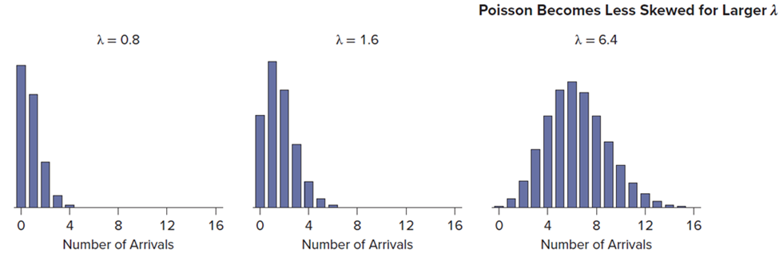
Recognizing Poisson Applications
L O 6.5
The Poisson distribution has four main characteristics.
An event of interest occurs randomly over time or space.
The average arrival rate (λ) remains constant.
The arrivals are independent of each other.
The random variable (X) is the number of events within an observed time interval.
Access the text alternative for slide images.

Slide 40
Compound Events 5
L O 6.5
Cumulative probabilities can be evaluated by summing individual X probabilities.
the probability that at most two customers will arrive in a given minute is the sum of probabilities for several events:
we could calculate this probability using Excel’s C D F function:

Slide 41
Compound Events 6
L O 6.5
We could then calculate the probability of at least three customers (the complementary event):
λ
Appendix B facilitates Poisson calculations. In this figure the highlighted probabilities are for the terms in the sum for
X | 1.6 | 1.7 | 1.8 | 1.9 | 2.0 | 2.1
0 | .2019 | .1827 | .1653 | .1496 | .1353 | .1225
1 | .3230 | .3106 | .2975 | .2842 | .2707 | .2572
2 | .2584 | .2640 | .2678 | .2700 | .2707 | .2700
3 | .1378 | .1496 | .1607 | .1710 | .1804 | .1890
4 | .0551 | .0636 | .0723 | .0812 | .0902 | .0992
5 | .0176 | .0216 | .0260 | .0309 | .0361 | .0417
6 | .0047 | .0061 | .0078 | .0098 | .0120 | .0146
7 | .0011 | .0015 | .0020 | .0027 | .0034 | .0044
8 | .0002 | .0003 | .0005 | .0006 | .0009 | .0011
9 | ­- | .0001 | .0001 | .0001 | .0002 | .0003
10 | - | - | - | - | - | .0001
11 | - | - | - | - | - | -

Slide 42
Finding Poisson Probabilities
L O 6.5
One can use the Poisson distribution formula.
One can use the Poisson tables in the appendix of the text.
Once can use technology such as Excel. (Other technologies include some scientific calculators, MegaStat, Minitab, Python, etc.).

Slide 43
Poisson Approximation to Binomial
L O 6.6
The Poisson distribution may be used to approximate a binomial by setting λ = nπ. This approximation is helpful when the binomial calculation is difficult (for example, when n is large).
The general rule for a good approximation is that n should be “large” and π should be “small.”
A common rule of thumb says the approximation is adequate if n ≥ 20 and π ≤ .05.

Slide 44
Hypergeometric Distribution
L O 6.7
The hypergeometric distribution is similar to the binomial except that sampling is without replacement from a finite population of N items.
The trials are not independent and the probability of success is not constant from trial to trial.
The hypergeometric distribution has three parameters:
N (the number of items in the population).
n (the number of items in the sample).
s (the number of successes in the population).
The hypergeometric distribution may be skewed right or left and
is symmetric only if
If the proportion of successes in the population is 50 percent.

Slide 45
Characteristics of the Hypergeometric Distribution
L O 6.7

Slide 46
Example: Damaged iPads 1
L O 6.7
In a shipment of 10 iPads, 2 are damaged and 8 are good. The receiving department at Best Buy tests a sample of 3 iPads at random to see if they are defective. The number of damaged iPads in the sample is a random variable X. The problem description is,
N = 10 (number of iPads in the shipment).
n = 3 (sample size drawn from the shipment).
s = 2 (number of damaged iPads in the shipment, that is, population “successes”).
N − s = 8 (number of nondamaged iPads in the shipment).
x = ? (number of damaged iPads in the sample, that is, sample “successes”).
n − x = ? (number of nondamaged iPads in the sample).

Slide 47
Example: Damaged iPads 2
L O 6.7
This is not a binomial problem because
is not constant.
What is the probability of getting a damaged iPod on the first draw from the sample?
What is the probability of getting a damaged iPod on the second draw?
(if the first iPod was undamaged).
(if the first iPod was damaged) or
What about on the third draw?
depending on what happened in the first two draws.

Slide 48
Example: Damaged iPads 3
L O 6.7
The only possible values of x are 0, 1, and 2 because there are only 2 damaged iPads in the population. The probabilities are,

Slide 49
Recognizing Hypergeometric Applications
L O 6.7
Look for a finite population (N) containing a known number of successes (s) and sampling without replacement (n items in the sample) where the probability of success is not constant for each sample item drawn.
Forty automobiles are to be inspected for California emissions compliance. Thirty-two are compliant, but 8 are not. A sample of 7 cars is chosen at random. What is the probability that all are compliant? At least 5?
A law enforcement agency must process 500 background checks for firearms purchasers. Fifty applicants are convicted felons. Through a computer error, 10 applicants are approved without a background check. What is the probability that none is a felon? At least two are?
A medical laboratory receives 40 blood specimens to check for H I V. Eight actually contain H I V. A worker is accidentally exposed to 5 specimens. What is the probability that none contained H I V?

Slide 50
Binomial Approximation to the Hypergeometric
L O 6.8
Both the binomial and hypergeometric involve samples of size n and treat X as the number of successes.
The binomial sample is with replacement while the hypergeometric sample is without replacement.
Rule of Thumb: If
it is safe to use the
binomial approximation to the hypergeometric, using
sample size n and success probability

Slide 51
Geometric Distribution
L3O 6.9
The geometric distribution describes the number of Bernoulli trials until the first success is observed.
X is the number of trials until the first success.
Ranges from
since we must have at least one
trial to obtain the first success. However, the number of trials is not fixed.
π is the constant probability of a success on each trial.

Slide 52
Characteristics of the Geometric Distribution
L O 6.9
Excel offers no geometric P D F or C D F.

Slide 53
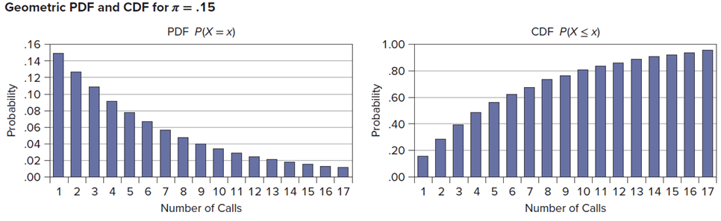
Example: Telefund Calling 1
L O 6.9
At Faber University, 15 percent of the alumni (the historical percentage) make a donation or pledge during the annual telefund.
What is the probability that the first donation will come within the first five calls?
To calculate this geometric probability, we would set
apply the P D F formula
and then sum the
probabilities:
Access the text alternative for slide images.

Slide 54
Example: Telefund Calling 2
L O 6.9
Then,
Alternately, we can use the C D F to get
The C D F is a much easier method when sums are required.

Slide 55
Example: Telefund Calling 3
L O 6.9
The expected number of phone calls until the first donation is,
On the average, we expect to call between 6 and 7 alumni until the first donation. However, the standard deviation is rather large:
The large standard deviation is a signal that it would be unwise to regard the mean as a good prediction of how many trials will be needed until the first donation.

Slide 56
Linear Transformation
L O 6.10
A linear transformation of a random variable X is performed by adding a constant, multiplying by a constant, or both.
Consider the random variable aX + b, where a and b are any
constants
Adding a constant shifts the mean but does not affect the standard deviation.
Multiplying by a constant affects both the mean and the standard deviation.
Rule 1:
(mean of a transformed variable)
Rule 2:
(standard deviation of a transformed variable)

Slide 57
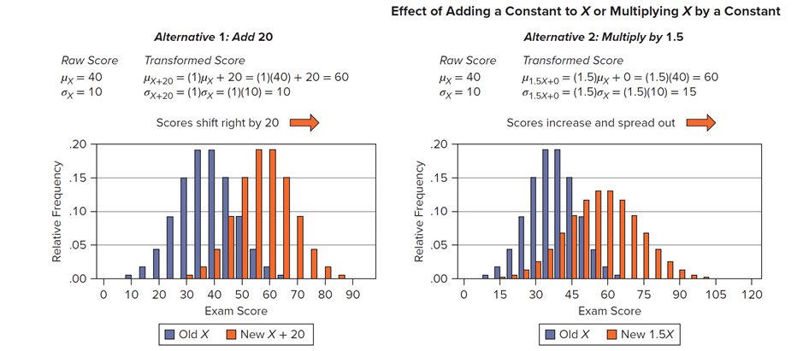
Example: Exam Scores 1
L O 6.10
Professor Hardtack gave a tough exam whose raw scores had μ = 40 and σ = 10, so he decided to raise the mean by 20 points. One way to increase the mean to 60 is to shift the curve by adding 20 points to every student’s score.
Rule 1 says that adding a constant to all X-values will shift the mean but will leave the standard deviation unchanged, as illustrated in the left-side graph using a = 1 and b = 20.
Access the text alternative for slide images.

Slide 58
Example: Exam Scores 2
L O 6.10
Alternatively, Professor Hardtack could multiply every exam score by 1.5, which also would accomplish the goal of raising the mean from 40 to 60. However, Rule 2 says that the standard deviation would rise from 10 to 15, thereby also increasing the dispersion. In other words, this policy would “spread out” the students’ exam scores. Some scores might even exceed 100, as illustrated in the right-side graph.
Access the text alternative for slide images.

Slide 59
Sums of Random Variables
L O 6.10
If we consider the sum of two independent random variables X and Y, given as X + Y, then:
Rule 3:
(mean of sum of two random variables X and Y)
Rule 4:
(standard deviation of sum if X and Y are independent)
Rule 3 says that the means can be added. Rule 4 says that the variances can be added if the variables are independent.
Note: This can be extended to the sum of any independent random variables.

Slide 60
Covariance
L O 6.10
If X and Y are not independent (that is, if X and Y are correlated), then we cannot use Rule 4 to find the standard deviation of their sum.
The covariance of two random variables, denoted
describes how the variables vary in
relation to each other.
We use both the covariance and the variances of X and Y to calculate the standard deviation of the sum of X and Y.
Rule 5:

Slide 61
Chapter 6: Practice Problems

Slide 62
Question 2
L O 6.1
On hot, sunny summer days, Jane rents inner tubes by the river that runs through her town. Based on her past experience, she has assigned the following probability distribution to the number of tubes she will rent on a randomly selected day.
(a) Find
(b) Find
(c) Find
(d) Find
(e) Which of the probability expressions in parts (a) to (d) is a value of the C D F?

Slide 63
Question 5
L O 6.2
On the midnight shift, the number of patients with head trauma in an emergency room has the probability distribution shown below.
(a) Calculate the mean and standard deviation.
(b) Describe the shape of this distribution.

Slide 64
Question 11
L O 6.3
The ages of Python programmers at SynFlex Corp. range from 20 to 60.
(a) If their ages are uniformly distributed, what would be the mean and standard deviation?
(b) What is the probability that a randomly selected programmer’s age is at least 40? At least 30?
Hint: Treat employee ages as integers.

Slide 65
Question 21
L O 6.4
Calculate each binomial probability:
(a) More than 10 successes in 16 trials with an 80 percent chance of success.
(b) At least 4 successes in 8 trials with a 40 percent chance of success.
(c) No more than 2 successes in 6 trials with a 20 percent chance of success.

Slide 66
Question 35
L O 6.5
Calculate each Poisson probability:
More than 10 arrivals with λ = 8.0.
(b) No more than 5 arrivals with λ = 4.0.
(c) At least 2 arrivals with λ = 5.0.

Slide 67
Question 42
L O 6.6
The probability of a manufacturing defect in an aluminum beverage can is .00002. If 100,000 cans are produced, find the approximate probability of:
(a) at least one defective can.
(b) two or more defective cans.
(c) Is the Poisson approximation justified?

Slide 68
Question 48
L O 6.7
A statistics textbook chapter contains 60 exercises, 6 of which are essay questions. A student is assigned 10 problems. Define X to be the number of essay questions the student receives.
(a) Use Excel to calculate the entire hypergeometric probability distribution for X.
(b) What is the probability that none of the questions are essay?
(c) That at least one is essay?
(d) That two or more are essay?
(e) Make an Excel graph of the P D F of the hypergeometric distribution and describe its appearance.

Slide 69
Question 52
L O 6.8
Two hundred employee travel expense reimbursement vouchers were filed last year in the finance department at Ramjac Corporation. Of these, 20 contained errors. A corporate auditor audits a sample of five vouchers. Let X be the number of incorrect vouchers in the sample.
(a) Justify the use of the binomial approximation.
(b) Find the probability that the sample contains no erroneous vouchers.
(c) Find the probability that the sample contains at least two erroneous vouchers.

Slide 70
Question 56
L O 6.9
In the Ardmore Hotel, 20 percent of the guests (the historical percentage) pay by American Express credit card.
(a) What is the expected number of guests until the next one pays by American Express credit card?
(b) What is the probability that the first guest to use an American Express credit card is within the first 10 to check out?

Slide 71
Question 61
L O 6.10
There are five accounting exams. Bob’s typical score on each exam is a random variable with a mean of 80 and a standard deviation of 5. His final grade is based on the sum of his exam scores.
(a) Find the mean and standard deviation of Bob’s point total assuming his performances on exams are independent of each other.
(b) By the Empirical Rule (see Chapter 4), would you expect that Bob would earn at least 450 points (the required total for an “A”)?

Slide 72
Chapter 6: Analytics in Action

Slide 73
Analytics in Action
Car Insurance, Risk, and Driverless Vehicles:
The car insurance industry estimates probabilities of vehicle accidents using big data sets of historical events. Insurance rates are based on expected values calculated using conditional probabilities on factors such as type of vehicle, age, income, and gender of driver, as well as geographic location. These all play a role in determining the risk of a traffic accident that causes vehicle damage, injury, or death. Because more than 90% of vehicle accidents are attributed to drivers, traditional risk assessment models place heavy weight on driver characteristics.
Artificial intelligence and analytics have now made driverless vehicles a reality. This transition from manned vehicles to autonomous vehicles will shift the bulk of the risk from the driver to the vehicle manufacturers and software designers. Liability in the case of damage, injury, or a fatality will now be shared between the vehicle owner and the A I software. Personal car insurance is being redefined to account for this shift and adapt to new technology.

Slide 74
End of Main Content
© McGraw Hill LLC. All rights reserved. No reproduction or distribution without the prior written consent of McGraw Hill LLC.

Slide 75
Accessibility Content: Text Alternatives for Images
75

Slide 76
Probability Distributions 3 – Text Alternative
Return to parent-slide containing images.
The set of real numbers are the values 1 through 6, and the probability of each value is 1/6. The random variable X assigns outcomes from the sample space to numbers, and the probability distribution P of X = lowercase x assigns random variable values to a probability.
Return to parent-slide containing images.
76

Slide 77
Example: Coin Flips – Text Alternative
Return to parent-slide containing images.
The horizontal axis is labeled Number of Heads X. It ranges from 0 to 3 in increments of 1. The vertical axis is labeled Probability. It ranges from 0 to 0.40 in increments of 0.05. The data is as follows. 0: 0.125. 1: 0.375. 2: 0.375. 3: 0.125. All values are estimated.
Return to parent-slide containing images.
77

Slide 78
What is a P D F or a C D F? – Text Alternative
Return to parent-slide containing images.
P D F, P (X = x). The horizontal axis is labeled Value of X. It ranges from 0 to 14 in increments of 1. The vertical axis is labeled Probability. It ranges from 0.00 to 0.25 in increments of 0.05. The data is as follows. 0: 0. 1: 0.01. 2: 0.02. 3: 0.03. 4: 0.06. 5: 0.12. 6: 0.18. 7: 0.21. 8: 0.18. 9: 0.12. 10: 0.06. 11: 0.03. 12: 0.02. 13: 0.01. 14: 1. C D F, P (X less than or equal to lowercase x). The horizontal axis is labeled Value of X. It ranges from 0 to 14 in increments of 1. The vertical axis is labeled Probability. It ranges from 0 to 1 in increments of 0.10. The data is as follows. 2: 0.001. 3: 0.002. 4: 0.10. 5: 0.20. 6: 0.40. 7: 0.60. 8: 0.80. 9: 0.90. 10: 0.99. 11: 1. 12: 1. 13: 1. 14: 1. All values are estimated.
Return to parent-slide containing images.
78

Slide 79
Example: Service Calls 2 – Text Alternative
Return to parent-slide containing images.
The horizontal axis is labeled Number of service calls. It ranges from 0 to 5 in increments of 1. The vertical axis is labeled Probability. It ranges from 0 to 0.30 in increments of 0.05. The data is as follows. 0: 0.05. 1: 0.10. 2: 0.30. 3: 0.25. 4: 0.20. 5: 0.10. All values are estimated.
Return to parent-slide containing images.
79

Slide 80
Example: Bed and Breakfast 2 – Text Alternative
Return to parent-slide containing images.
The horizontal axis is labeled Number of rooms rented. It ranges from 0 to 7 in increments of 1. The vertical axis is labeled Probability. It ranges from 0 to 0.30 in increments of 0.05. The data is as follows. 0: 0.05. 1: 0.05. 2: 0.06. 3: 0.10. 4: 0.12. 5: 0.20. 6: 0.15. 7: 0.26. The Average is 4.75 and the mode is 7 rooms. All values are estimated.
Return to parent-slide containing images.
80

Slide 81
Example: Rolling a Die 1 – Text Alternative
Return to parent-slide containing images.
P (X = lowercase x) for one die. The horizontal axis is labeled Number of dots showing on the die. It ranges from 1 to 6 in increments of 1. The vertical axis is labeled Probability. It ranges from 0 to 0.18 in increments of 0.02. The data is as follows. 1: 0.17. 2: 0.17. 3: 0.17. 4: 0.17. 5: 0.17. 6: 0.17. P D F and C D F for rolling a die. The horizontal axis is labeled Number of dots showing on the die. It ranges from 1 to 6 in increments of 1. The vertical axis is labeled Probability. It ranges from 0 to 1 in increments of 0.10. The data is as follows. 1: 0.15. 2: 0.32. 3: 0.50. 4: 0.65. 5: 0.85. 6: 1. All values are estimated.
Return to parent-slide containing images.
81

Slide 82
Binomial Shape – Text Alternative
Return to parent-slide containing images.
Skewed right. Pi = 0.10. The horizontal axis ranges from 0 to 8 in increments of 2. The bins are located at 0, 1, 2, 3, and 4. 3 bins are to the right of the maximum value. Pi = 0.20. The horizontal axis ranges from 0 to 8 in increments of 2. The bins are located at 0, 1, 2, 3, 4, 5, and 6. 4 bins are to the right of the maximum value. Symmetric. Pi = 0.50. The number of bins to the right and left of the maximum value are equal. Skewed left. Pi = 0.80. The horizontal axis ranges from 0 to 8 in increments of 2. The bins are located at 3, 4, 5, 6, 7, and 8. 4 bins are to the left of the maximum value. Pi = 0.90. The horizontal axis ranges from 0 to 8 in increments of 2. The bins are located at 4, 5, 6, 7, and 8. 4 bins are to the left of the maximum value.
Return to parent-slide containing images.
82

Slide 83
Compound Events 3 – Text Alternative
Return to parent-slide containing images.
At least two: Probability of X greater than or equal to 2. Fewer than two: Probability of X less than 2. Fewer than 2 or more than 2: Probability of X less than 2 and X greater than 2.
Return to parent-slide containing images.
83

Slide 84
Poisson Distribution 1 – Text Alternative
Return to parent-slide containing images.
The timeline is segmented into equal intervals. Each interval corresponds to a random unit of time. The x values marked from left to right below the intervals are 3, 1, and 5.
Return to parent-slide containing images.
84

Slide 85
Poisson Distribution 2 – Text Alternative
Return to parent-slide containing images.
The timeline is segmented into equal intervals. Each interval corresponds to a random unit of time. The x values marked from left to right below the intervals are 3, 1, and 5.
Return to parent-slide containing images.
85

Slide 86
Recognizing Poisson Applications – Text Alternative
Return to parent-slide containing images.
Lambda = 0.8. The horizontal axis labeled Number of arrivals ranges from 0 to 16 in increments of 4. The bins are located at 0, 1, 2, 3, and 4. 4 bins are the right of the maximum value. Lambda = 1.6. The horizontal axis labeled Number of arrivals ranges from 0 to 16 in increments of 4. The bins are located at 0, 1, 2, 3, 4, 5, and 6. 4 bins are the right of the maximum value. Lambda = 6.4. The horizontal axis labeled Number of arrivals ranges from 0 to 16 in increments of 4. The bins are located from 0 to 16. 5 bins are at the left and 9 bins are at the right of the maximum value.
Return to parent-slide containing images.
86

Slide 87
Example: Telefund Calling 1 – Text Alternative
Return to parent-slide containing images.
In both graphs, the horizontal axis is labeled Number of calls. It ranges from 1 to 17 in increments of 1. The vertical axis is labeled Probability. It ranges from 0 to 0.16 in increments of 0.02. The data is as follows. 1: 0.15. 2: 0.13. 3: 0.11. 4: 0.09. 5: 0.08. 6: 0.07. 7: 0.06. 8: 0.05. 9: 0.04. 10: 0.03. 11: 0.03. 12: 0.03. 13: 0.02. 14: 0.02. 15: 0.19. 16: 0.18. 17: 0.12. C D F, P (X less than or equal to lowercase x). The horizontal axis is labeled Number of calls. It ranges from 1 to 17 in increments of 1. The vertical axis is labeled Probability. It ranges from 0 to 1 in increments of 0.20. The data is as follows. 1: 0.18. 2: 0.30. 3: 0.40. 4: 0.50. 5: 0.58. 6: 0.61. 7: 065. 8: 0.78. 9: 0.78. 10: 0.80. 11: 0.81. 12: 0.82. 13: 0.85. 14: 0.85. 15: 0.9. 16: 0.95. 17: 0.99. All values are estimated.
Return to parent-slide containing images.
87

Slide 88
Example: Exam Scores 1 – Text Alternative
Return to parent-slide containing images.
Alternative 1: Add 20. Raw score. Mu sub x = 40. Transformed score: Mu sub x + 20 = (1) mu sub x + 20 = (1) (40) + 20 = 60. Raw score. Sigma sub x = 10. Transformed score: Sigma sub X + 20 = (1) sigma sub X = (1) (10) = 10. The bar graph plots relative frequency versus the exam score. The horizontal axis ranges from 0 to 90 in increments of 10 and the vertical axis ranges from 0 to 0.20 in increments of 0.05. The data is as follows. 10: 0.01. 20: 0.04. 30: 0.15. 40: 0.19. 50: 0.09. 60: 0.01. 65: 0.01. New X + 20. The exam scores shifts to the right by 20. Alternative 2: Multiply by 1.5. Raw score. Mu sub x = 40. Transformed score. Mu sub 1.5 x + 0 = (1.5) Mu sub x + 0 = (1.5) (40) = 60. Raw score: Sigma sub x = 10. Transformed score. Sigma sub 1.5 X + 0 = (1.5) Sigma sub x = (1.5) (10) = 15. The bar graph plots relative frequency versus the exam score. The horizontal axis ranges from 0 to 120 in increments of 15 and the vertical axis ranges from 0 to 0.20 in increments of 0.05. The data is as follows. Old X. 12: 0.01. 15: 0.02. 17: 0.04. 30: 0.15. 35: 0.19. 40: 0.19. 45: 0.15. 47: 0.09. 60: 0.01. 70: 0.01. New 1.5 X. The relative frequency of each exam score is multiplied by 1.5. The scores increase and spread out. All values are estimated.
Return to parent-slide containing images.
88

Slide 89
Example: Exam Scores 2 – Text Alternative
Return to parent-slide containing images.
Alternative 1: Add 20. Raw score. Mu sub x = 40. Transformed score: Mu sub x + 20 = (1) mu sub x + 20 = (1) (40) + 20 = 60. Raw score. Sigma sub x = 10. Transformed score: Sigma sub X + 20 = (1) sigma sub X = (1) (10) = 10. The bar graph plots relative frequency versus the exam score. The horizontal axis ranges from 0 to 90 in increments of 10 and the vertical axis ranges from 0 to 0.20 in increments of 0.05. The data is as follows. 10: 0.01. 20: 0.04. 30: 0.15. 40: 0.19. 50: 0.09. 60: 0.01. 65: 0.01. New X + 20. The exam scores shifts to the right by 20. Alternative 2: Multiply by 1.5. Raw score. Mu sub x = 40. Transformed score. Mu sub 1.5 x + 0 = (1.5) Mu sub x + 0 = (1.5) (40) = 60. Raw score: Sigma sub x = 10. Transformed score. Sigma sub 1.5 X + 0 = (1.5) Sigma sub x = (1.5) (10) = 15. The bar graph plots relative frequency versus the exam score. The horizontal axis ranges from 0 to 120 in increments of 15 and the vertical axis ranges from 0 to 0.20 in increments of 0.05. The data is as follows. Old X. 12: 0.01. 15: 0.02. 17: 0.04. 30: 0.15. 35: 0.19. 40: 0.19. 45: 0.15. 47: 0.09. 60: 0.01. 70: 0.01. New 1.5 X. The relative frequency of each exam score is multiplied by 1.5. The scores increase and spread out. All values are estimated.
Return to parent-slide containing images.
89

