Slide 1

Chapter 7
Continuous Probability Distributions
© McGraw Hill LLC. All rights reserved. No reproduction or distribution without the prior written consent of McGraw Hill LLC.

Slide 2
Chapter Learning Objectives
Chapter 7
L O 7.1: Define a continuous random variable.
L O 7.2: Calculate uniform probabilities.
L O 7.3: Know the form and parameters of the normal distribution.
L O 7.4: Find the normal probability for given z or x using tables or Excel.
L O 7.5: Solve for z or x for a given normal probability using tables or Excel.
L O 7.6: Use the normal approximation to a binomial or a Poisson.
L O 7.7: Find the exponential probability for a given x.
L O 7.8: Solve for x for a given exponential probability.
L O 7.9: Use the triangular distribution for “what-if” analysis (optional).

Slide 3
Continuous Random Variables 1
L O 7.1
A continuous random variable usually arises from measuring something such as the waiting time until the next customer arrives.
Unlike a discrete variable, a continuous random variable can have noninteger (decimal) values.
Probabilities are defined as areas under a curve called the probability density function (P D F).
Probabilities for a continuous random variable are
defined on intervals such as

Slide 4
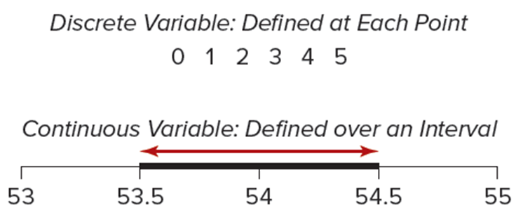
Continuous Random Variables 2
L O 7.1
The figure below illustrates the differences between discrete and continuous random variables.
Access the text alternative for slide images.

Slide 5
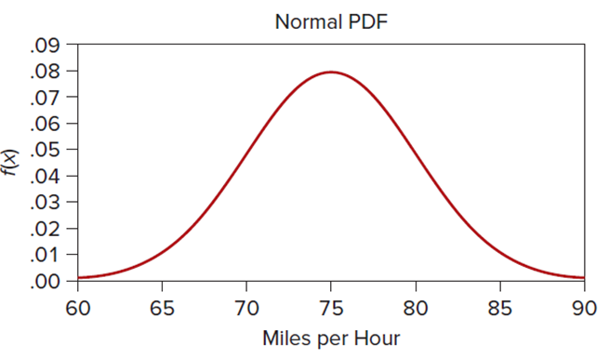
Probability Density Function (P D F)
L O 7.1
Continuous P D Fs:
Denoted by
Must be nonnegative.
Total area under curve = 1.
Mean, variance, and shape depend on the P D F parameters.
Reveals the shape of the distribution.
An example is the normal P D F.
Access the text alternative for slide images.

Slide 6
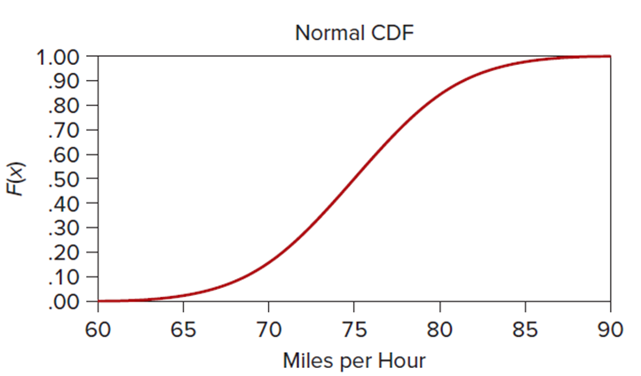
Cumulative Distribution Function
L O 7.1
Continuous C D Fs:
Denoted by
Shows
the cumulative proportion of scores.
Useful for finding probabilities.
An example is the normal C D F.
Access the text alternative for slide images.

Slide 7
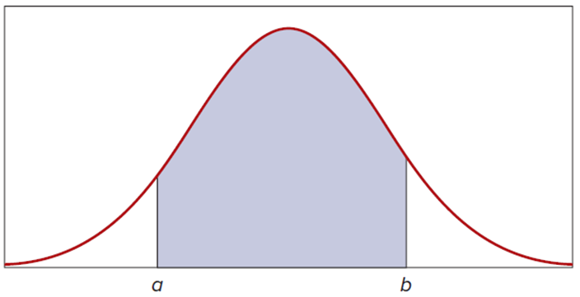
Probabilities as Areas
L O 7.1
Continuous probability functions:
Unlike discrete distributions, the probability at any single point is 0.
The entire area under any P D F, by definition, is set to 1.
The mean is the balance point of the distribution.
The area under the curve between a and b represents

Slide 8
Expected Value and Variance
L O 7.1
The mean and variance of a continuous random variable are
analogous to
for a discrete random variable,
except that the integral sign
replaces the summation sign
Integrals are taken over all X-values.
The mean is still the balancing point or fulcrum for the entire distribution, and the variance is still a measure of dispersion about the mean.

Slide 9
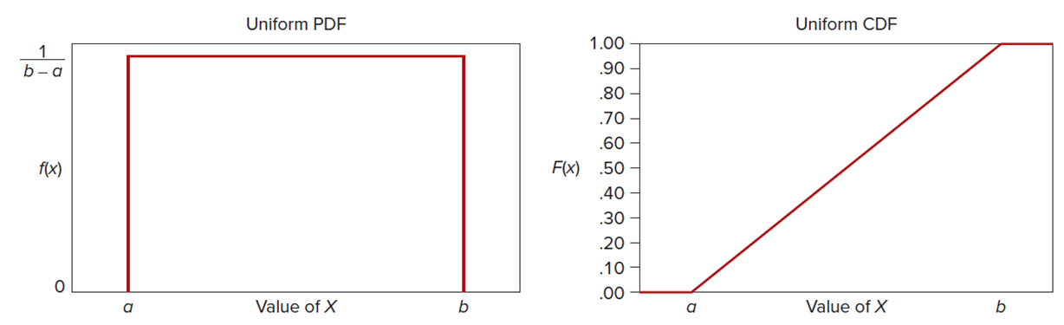
Uniform Continuous Distribution
L O 7.2
If X is a random variable that is uniformly distributed between a and b, its P D F has constant height, as shown.
The uniform continuous distribution is sometimes denoted
for short. Its mean and standard deviation are show.
The area under the curve is 1 by multiplying its base (b − a)
by its height
Access the text alternative for slide images.

Slide 10
Characteristics of the Uniform Distribution
L O 7.2

Slide 11
Example: Anesthesia Effectiveness 1
L O 7.2
An oral surgeon injects a painkiller prior to extracting a tooth. Given the varying characteristics of patients, the dentist views the time for anesthesia effectiveness as a uniform random variable that takes between 15 and 30 minutes. In short notation, we could say that X is
Setting a = 15 and b = 30, we obtain the
mean and standard deviation:

Slide 12
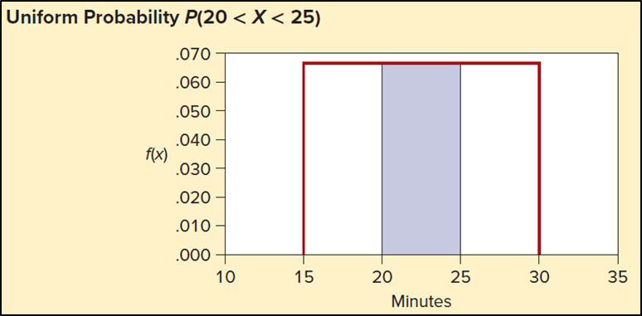
Example: Anesthesia Effectiveness 2
L O 7.2
An event probability is simply an interval width expressed as a proportion of the total. Thus, the probability of taking between c and d minutes is,
(area between c and d in a uniform model)
For example, the probability that the anesthetic takes between 20 and 25 minutes is,
Access the text alternative for slide images.

Slide 13
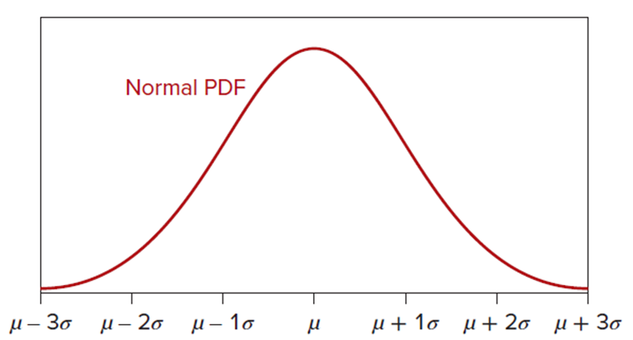
Normal Distribution
L O 7.3
Normal or Gaussian (or bell shaped) distribution.
Defined by two parameters,
Denoted by
Domain is
(continuous scale).
Almost all (99.7%) of the area under the normal curve is included in this interval:
The distribution is symmetric and unimodal about the mean.
Access the text alternative for slide images.

Slide 14
Characteristics of the Normal Distribution
L O 7.3

Slide 15
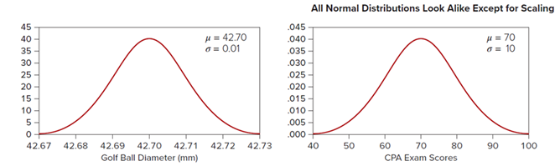
Normal Distribution 1
L O 7.3
All normal distributions have the same general shape, differing only in the axis scales.
The left chart shows the distribution of diameters of golf balls from a manufacturing process that produces normally distributed diameters with a mean diameter of μ = 42.70 mm and a standard deviation σ = 0.01 mm.
The right chart shows the distribution of scores on the C P A theory exam, assumed to be normal with a mean of μ = 70 and a standard deviation σ = 10.
Access the text alternative for slide images.

Slide 16
What is Normal?
L O 7.3
To be regarded as a candidate for normality, a random variable should:
Be measured on a continuous scale.
Possess a clear center.
Have only one peak (unimodal).
Exhibit tapering tails.
Be symmetric about the mean (equal tails).
Variables that might be expected to be normally distributed:
X = quantity of beverage in a 2-liter bottle of Diet Pepsi.
X = cockpit noise level in a Boeing 777 at the captain’s left ear during cruise.
X = diameter in millimeters of a manufactured steel ball bearing.

Slide 17
Standard Normal Distribution
L O 7.4
Since for every value of μ and σ, there is a different normal distribution, we can transform a normal random variable to a standard normal distribution with μ = 0 and σ = 1 using this formula:
(transformation of each x­-value to z-value)
If X is normally distributed, the standardized variable Z has a standard normal distribution.
Its mean is 0 and its standard deviation is 1.
The maximum height of
is at 0 (the mean) and its
points of inflection are at ± 1 (the standard deviation).

Slide 18
Characteristics of the Standard Normal Distribution
L O 7.4

Slide 19
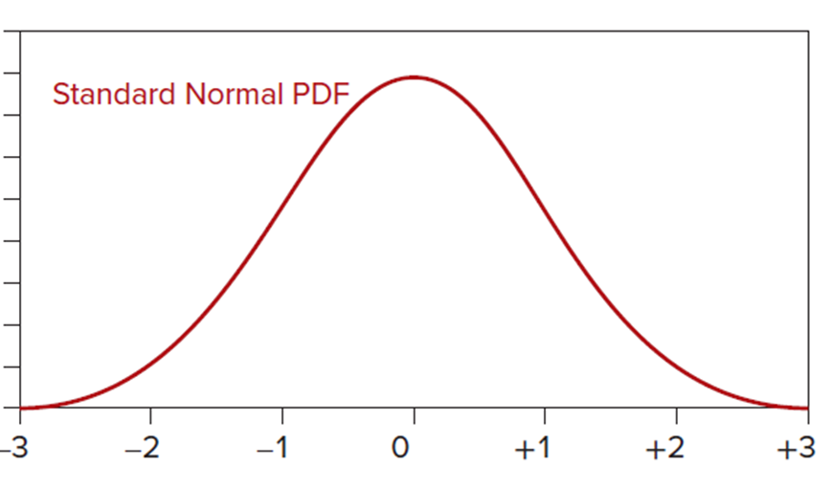
Normal Distribution 2
L O 7.4
Because every transformed normal distribution will look the same, we can use a common scale, usually labeled
from −3 to +3. Because
is a probability density
function, the entire area under the curve is 1.
Access the text alternative for slide images.

Slide 20
Normal Distribution 3
L O 7.4
Appendix C-1 allows you to find the area under the curve from 0 to z.
For example, to calculate
select
the row for z = 1.9 and the column for 0.06 (because 1.96 = 1.90 + 0.06).
This row and column are shaded. At the intersection of the shaded row and column, we see

Slide 21
Normal Distribution 4
L O 7.4
 |  |  |  |  |  |  | .

Slide 22
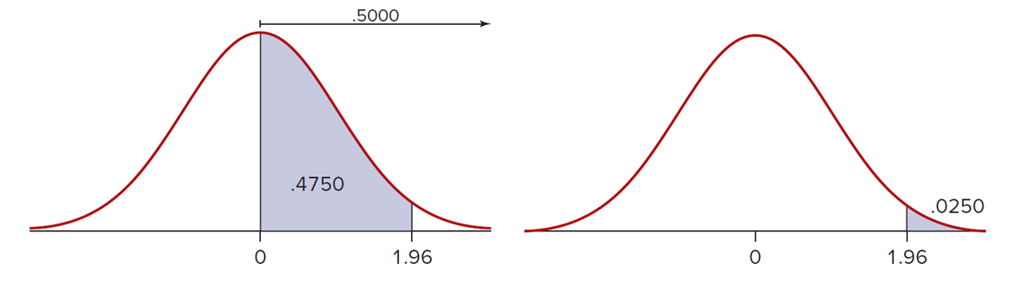
Normal Distribution 5
L O 7.4
This area is illustrated. Half the total area under the curve lies to the right of the mean. We can find a right-tail area by subtraction. For example,

Slide 23
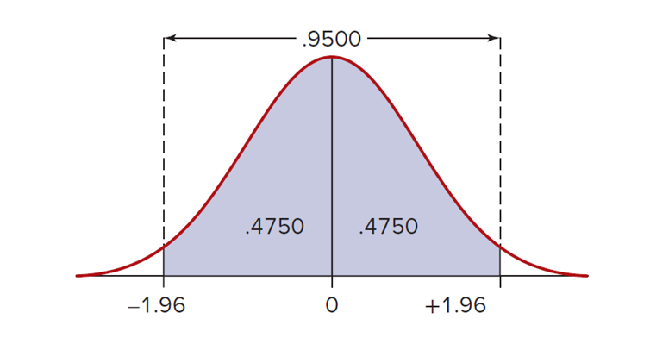
Normal Distribution 6
L O 7.4
Suppose we want a middle area such as
Because the normal distribution is symmetric, we also
know that
The interval −1.96 < Z < 1.96 encloses 95 percent of the area under the normal curve. This figure illustrates this calculation.

Slide 24
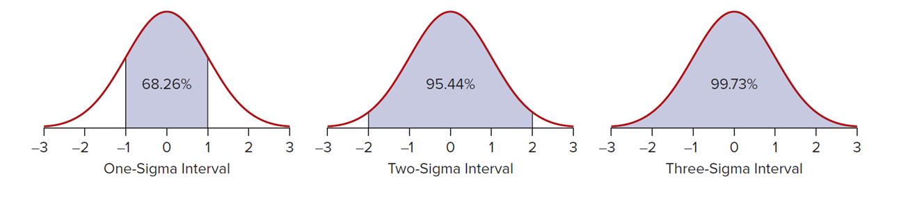
Normal Distribution 7
L O 7.4
Approximately 68% of the area under the curve is within +1σ.
Approximately 95% of the area under the curve is within +2σ.
Approximately 99.7% of the area under the curve is within +3σ.
Access the text alternative for slide images.

Slide 25
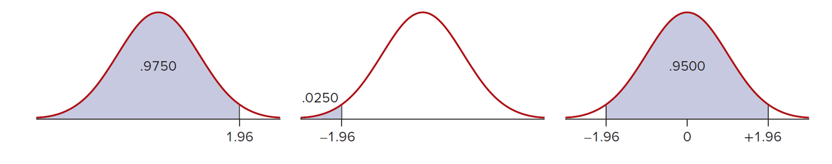
Normal Distribution 8
L O 7.4
Appendix C-1 allows you to find the area under the curve from 0 to z.
Appendix C-2 allows you to find the area under the curve from the left of z (similar to Excel).
Access the text alternative for slide images.

Slide 26
Finding Z for a Given Area 1
L O 7.5
Appendices C-1 and C-2 can be used to find the z-value corresponding to a given probability.
For example, what z-value defines the top 1% of a normal distribution?
This implies that 49% of the area lies between 0 and z which gives z = 2.33 by looking for an area of 0.4900 in Appendix C-1.

Slide 27
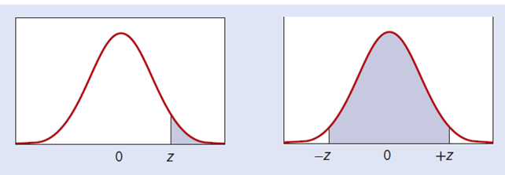
Finding Z for a Given Area 2
L O 7.5
We can find other important areas in the same way. Because we are often interested in the top 25 percent, 10 percent, 5 percent, 1 percent, etc., or the middle 50 percent, 90 percent, 95 percent, 99 percent, and so forth, it is convenient to record these important z-values for quick reference.
z | Right Tail Area | Middle Area
0.675 | .25 | .50
1.282 | .10 | .80
1.645 | .05 | .90
1.960 | .025 | .95
2.326 | .01 | .98
2.576 | .005 | .99
Access the text alternative for slide images.

Slide 28
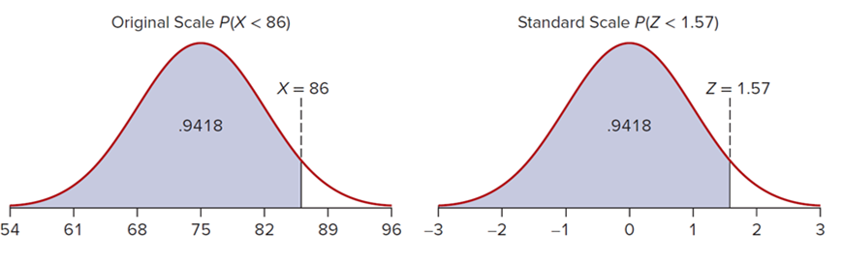
Finding Z for a Given Area 3
L O 7.5
John took an economics exam and scored 86 points. The class mean was 75 with a standard deviation of 7. What percentile is John
in? That is, what is
We need first to calculate John’s
standardized Z-score:
This says that John’s score is 1.57 standard deviations above the
mean. From Appendix C-2 we get
so John is approximately in the 94th percentile. That means that his score was better than 94 percent of the class.

Slide 29
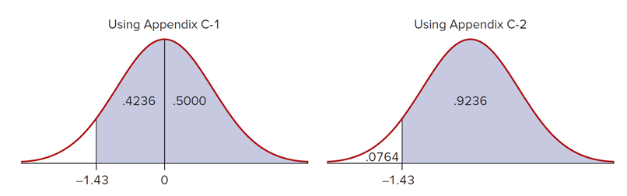
Finding Z for a Given Area 4
L O 7.5
On this exam, what is the probability that a randomly chosen test-taker would have a score of at least 65? We begin by standardizing:
Using Appendix C-1 we can calculate
= .4236 + .5000 = .9236, or 92.4%
Using Appendix C-2 we can calculate
= 1 − .0764 = .9236, or 92.4%.
Access the text alternative for slide images.

Slide 30
Finding X for a given area 1
L O 7.5
How can we find the various normal percentiles (5th, 10th, 25th, 75th, 90th, 95th, etc.) known as the inverse normal?
We simply turn the standardizing transformation around:

Slide 31
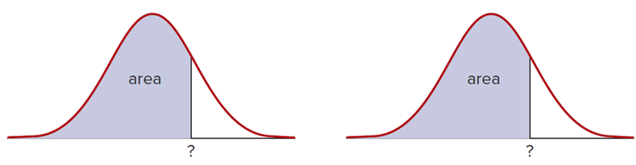
Finding X for a given area 2
L O 7.5
Syntax: | =NORM.INV(area, μ, σ) | =NORM.S.INV(area)
Example: | =NORM.INV(0.99,75,7) = 91.2844 | =NORM.S.INV(0.75) = 0.674490
What it does: | Value of x for given left-tail area. If μ = 75 and σ = 7, the 99th percentile for exam-takers is a score of 91.28 or 91 to the nearest integer. | Value of z corresponding to a given left-tail area. Here, the 75th percentile (third quartile) of a standard normal is z = 0.675.
Access the text alternative for slide images.

Slide 32
Example: Exam Scores
L O 7.5
John’s economics professor has decided that any student who scores below the 10th percentile must retake the exam. The exam
scores are normal with
What is the score that
would require a student to retake the exam?
We need to find the value of x that satisfies
The approximate z-score for the 10th percentile is z = −1.28.
The steps to solve the problem are:
Use Appendix C or Excel to find
Substitute the given information into
Solve for x to get
Students who score below 66 points on the economics exam will be required to retake the exam.

Slide 33
Example: Service Times 1
L O 7.5
After studying the process of changing oil, the shop’s manager has found that the distribution of service times, X, is normal with a mean μ = 28 minutes and a standard deviation σ = 5 minutes, that
This information can now be used to answer
questions about normal probabilities.
To answer these types of questions, it is helpful to follow a few basic steps.
Draw a picture and label the picture with the information you know.
Shade in the area that will answer your question.
Standardize the random variable.
Find the area by using one of the tables or Excel.

Slide 34
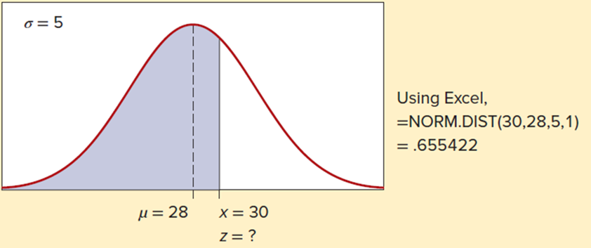
Example: Service Times 2
L O 7.5
Problem #1: What proportion of cars will be finished in less than half an hour?
Steps 1 and 2: Draw a picture and shade the area to the left of 30 minutes.
Step 3:
Step 4: Using Appendix C-2 or Excel we find that

Slide 35
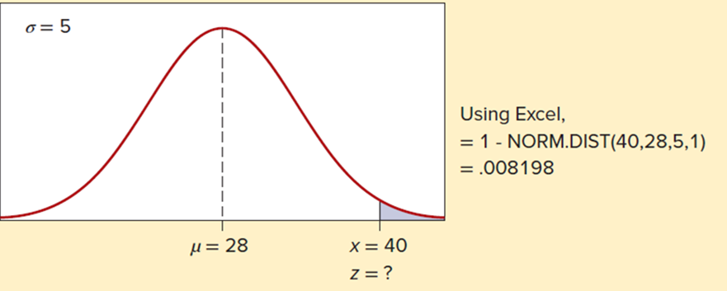
Example: Service Times 3
L O 7.5
Problem #2: What is the chance that a randomly selected car will take longer than 40 minutes to complete?
Steps 1 and 2: Draw a picture and shade the area to the right of 40 minutes.
Step 3:
Step 4: Using Appendix C-2 or Excel we find that

Slide 36
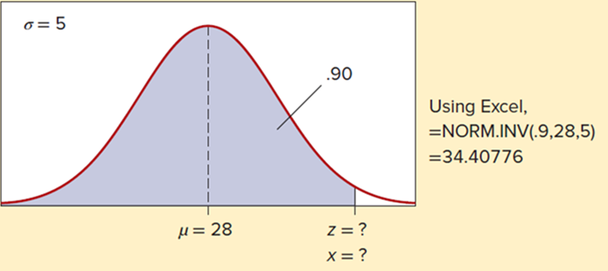
Example: Service Times 4
L O 7.5
Problem #3: What service time corresponds to the 90th percentile?
Steps 1 and 2: Draw a picture and shade the desired area.
In this case, steps 3 and 4 need to be reversed.
Step 3: Find z = 1.28 by using the tables or Excel.
Step 4:
Ninety percent of the cars will be finished in 34.4 minutes or less.

Slide 37
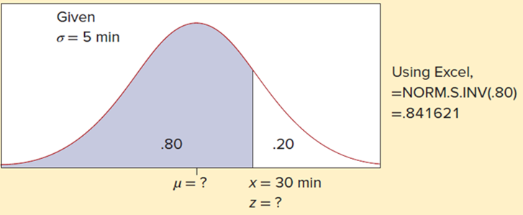
Example: Service Times 5
L O 7.5
Problem #4: The manager wants to be able to service 80 percent of the vehicles within 30 minutes. What must the mean service time be to accomplish this goal?
Steps 1 and 2: Draw a curve and shade the desired area.
Step 3: Use tables or Excel to Find z = 0.84 (approximately) for an upper tail area of .20 (lower tail area of .80).
Step 4:
The mean service time would have to be 25.8 minutes to ensure that 80 percent are serviced within 30 minutes.
Access the text alternative for slide images.

Slide 38
Normal Approximation to the Binomial 1
L O 7.6
Binomial probabilities can be difficult to calculate when n is large.
Use a normal approximation to the binomial distribution.
The logic of this approximation is that as n becomes large, the discrete binomial bars become more like a smooth, continuous, normal curve.

Slide 39
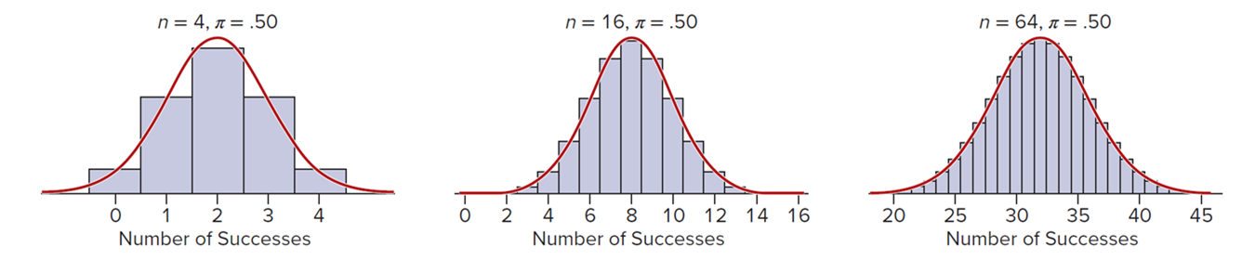
Normal Approximation to the Binomial 2
L O 7.6
This figure illustrates the idea for 4, 16, and 64 flips of a fair coin with X defined as the number of heads in n tries.
As sample size increases, it becomes easier to visualize a smooth, bell-shaped curve overlaid on the bars.
Binomial Approaches Normal as n Increases:
Access the text alternative for slide images.

Slide 40
Normal Approximation to the Binomial 3
L O 7.6
As a rule of thumb, when
it is safe to use the normal approximation to the binomial distribution.
In this case, the mean and standard deviation for the binomial distribution will be equal to the normal
respectively.

Slide 41
Example: Coin Flips 1
L O 7.6
What is the probability of more than 17 heads in 32 flips of a fair coin?
In binomial terms, this would be
which would be a tedious sum even if we had a table.
Could the normal approximation be used?
With n = 32 and
we clearly meet the
requirement that

Slide 42
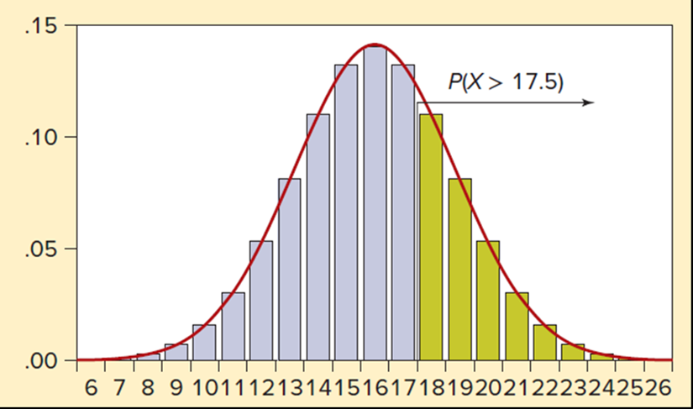
Example: Coin Flips 2
L O 7.6
When translating a discrete scale into a continuous scale, we must be careful about individual points. The event “more than 17” actually falls halfway between 17 and 18 on a discrete scale.

Slide 43
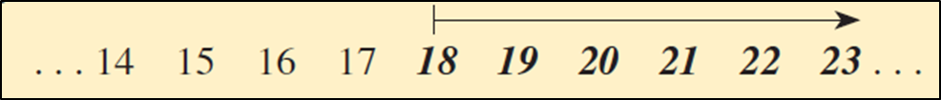
Example: Coin Flips 3
L O 7.6
You don’t need to draw the entire distribution. All you need is a little diagram (ignoring the low and high ends of the scale because they are not relevant) to show the event “more than 17” visually:
If you make a diagram like this, you can see the correct cutoff point. Because the cutoff point for “more than 17” is halfway
between 17 and 18, the normal approximation is
The 0.5 is an adjustment called the continuity correction. The normal parameters are,

Slide 44
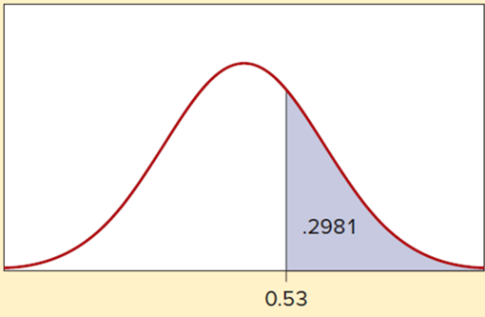
Example: Coin Flips 4
L O 7.6
We then perform the usual standardizing transformation with the continuity-corrected X-value:
From Appendix C-1 we find
Alternately, we could use Appendix C-2 to get
which, by the symmetry of the normal distribution, is
the same as

Slide 45
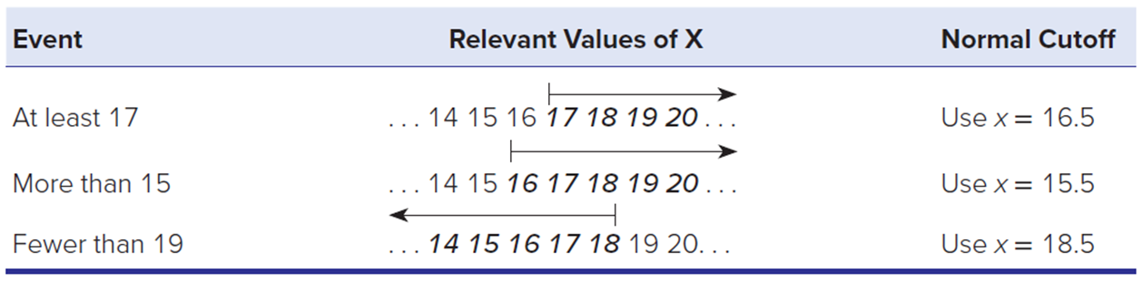
Normal Approximation to the Binomial 4
L O 7.6
To be sure you understand the continuity correction, consider the events in the table below.
We sketch a diagram to find the correct cutoff point to approximate a discrete model with a continuous one.
Access the text alternative for slide images.

Slide 46
Normal Approximation to the Poisson
L O 7.6
The normal approximation to the Poisson distribution
works best when
is large (for example, when
exceeds the values in Appendix B).
Set the normal
equal to the mean and standard
deviation for the Poisson distribution.

Slide 47

Example: Utility Bills 1
L O 7.6
On Wednesday between 10 a.m. and noon, customer billing inquiries arrive at a mean rate of 42 inquiries per hour at Consumers Energy.
What is the probability of receiving more than 50 calls?
The mean
is too large to use Appendix B.
Use the normal approximation.
We set:
The continuity-corrected cutoff point for
(halfway between 50 and 51):

Slide 48
Example: Utility Bills 2
L O 7.6
The standardized Z-value for the event “more than 50” is
Using Appendix C-2 we look up
which is the
same as
because the normal distribution is symmetric.
We can check the actual Poisson probability by using Excel’s cumulative function =POISSON.DIST(50, 42, 1) and subtracting from 1:
In this case, the normal approximation (.0951) comes fairly close to the Poisson result (.0975). Of course, if you have access to Excel, you don’t need the approximation at all.

Slide 49
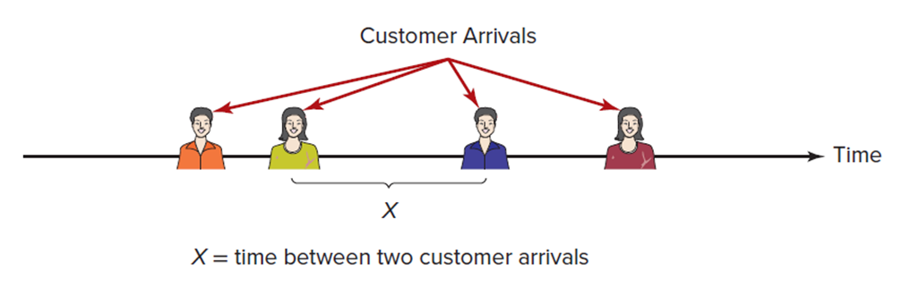
Exponential Distribution
L O 7.7
If events per unit of time follow a Poisson distribution, the time until the next event follows the exponential distribution.
The time until the next event is a continuous variable.
Access the text alternative for slide images.

Slide 50
Characteristics of the Exponential Distribution
L O 7.7

Slide 51
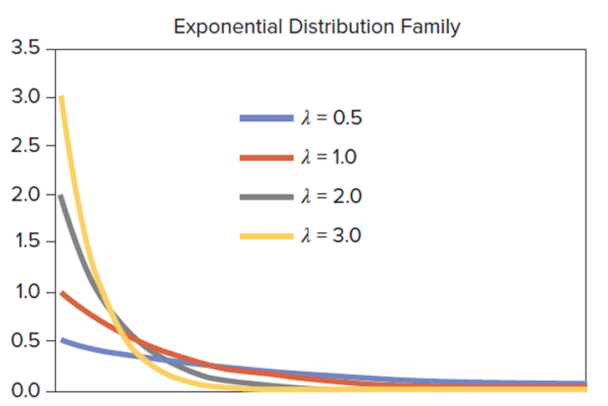
Exponential Distribution 1
L O 7.7
The exponential distribution has one parameter, the mean arrival rate λ.
Each value of λ gives a different P D F.
However, all curves in the exponential P D F family have the same shape.
The vertical axis intercept is always λ because inserting x = 0 in the P D F formula gives
Access the text alternative for slide images.

Slide 52
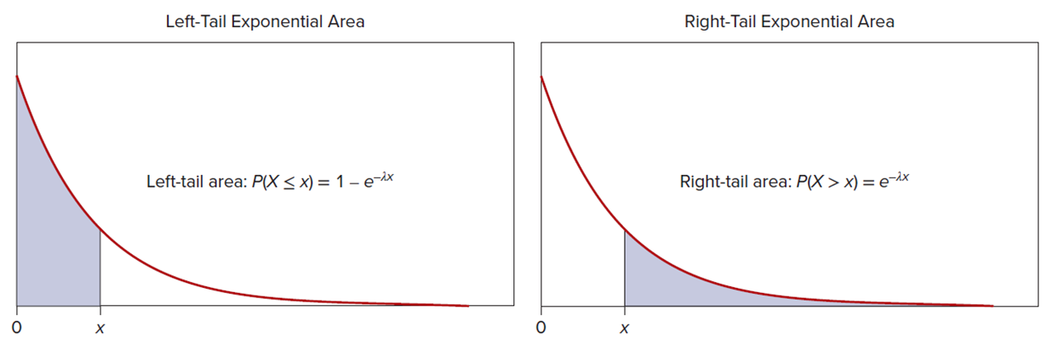
Exponential Distribution 2
L O 7.7
The exponential probability density function approaches zero as x increases and is right-skewed.
We usually are not interested in the height of the function
but rather in areas under the curve.
The probability of waiting more than x units of time until the next
arrival is
while the probability of waiting x units of time or
less is
Access the text alternative for slide images.

Slide 53
Example: Customer Waiting Time 1
L O 7.7
Between 2 p.m. and 4 p.m. on Wednesday, patient insurance inquiries arrive at Blue Choice insurance at a mean rate of 2.2 calls per minute.
What is the probability of waiting more than 30 seconds for the next call?
We set λ = 2.2 events per minute and x = 0.50 minute.
Note that we must convert 30 seconds to 0.50 minute because λ is expressed in minutes, and the units of measurement must be the same. We have:

Slide 54
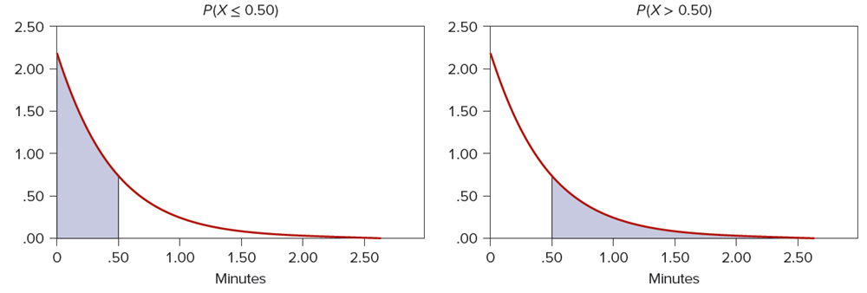
Example: Customer Waiting Time 2
L O 7.7
There is about a 33 percent chance of waiting more than 30 seconds before the next call arrives. Because x = 0.50 is a point
that has no area in a continuous model,
refer to the same event.
The probability that 30 seconds or less (0.50 minute) will be needed before the next call arrives is,
Access the text alternative for slide images.

Slide 55
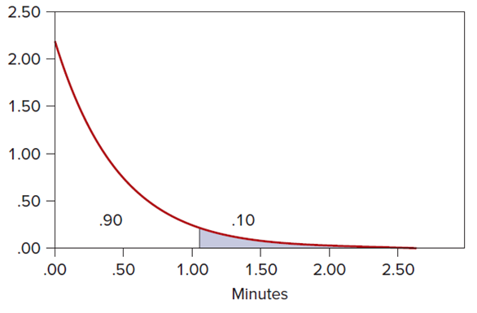
Inverse Exponential 1
L O 7.8
We can use the exponential area formula in reverse.
If the mean arrival rate is 2.2 calls per minute, we want the 90th percentile for waiting time (the top 10 percent of waiting time).
We want to find the x-value that defines the upper 10 percent.

Slide 56
Inverse Exponential 2
L O 7.8
Because
we set
the right-tail area to .10, take the natural logarithm of both sides, and solve for x:
We conclude that 90 percent of the calls will arrive within 1.0466 minutes (or 62.8 seconds).

Slide 57
Mean Time Between Events
L O 7.8
Exponential waiting times are often described in terms of the mean time between events (M T B E) rather than in terms of Poisson
arrivals per unit of time. In other words, we might be given
M T B E
mean time between events (units of time per event)
mean events per unit of time (events per unit of time)
For example, if the mean time between patient arrivals in an
emergency room is 20 minutes, then
arrival per
We could work a problem using either hours or minutes, as long as we
are careful to make sure that x and λ are expressed in the same
units when we calculate
For example,
is the same as

Slide 58
Example: Flat Panel Displays
L O 7.8
The NexGenCo color flat-panel display in an aircraft cockpit has a mean time between failures (M T B F) of 22,500 flight hours. What is the probability of a failure within the next 10,000 flight hours?
Because 22,500 hours per failure implies
failure
per hour, we calculate:
There is a 35.88 percent chance of failure within the next 10,000 hours of flight. This assumes that failures follow the Poisson model.

Slide 59
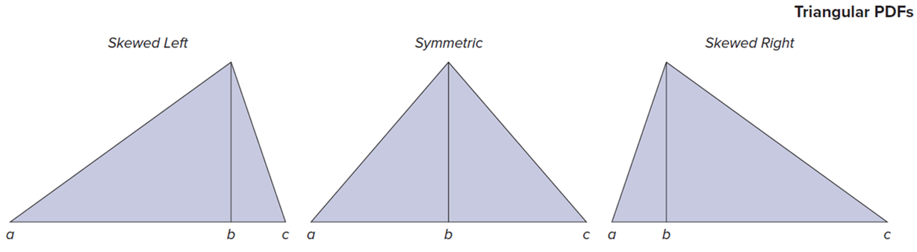
Triangular Distribution 2
L O 7.9
The triangular distribution is a way of thinking about variation that corresponds rather well to what-if analysis in business.
It is not surprising that business analysts are attracted to the triangular model.
Its finite range and simple form are more understandable than a normal distribution.
Access the text alternative for slide images.

Slide 60
Triangular Distribution 1
L O 7.9
Characteristics of the triangular distribution:
Can be symmetric or skewed.
X values must lie within the interval
It has a mode or “peak.” The peak is reminiscent of a normal, which also has a single maximum.
It does not go on forever because its X values are confined by a and c.
The triangular distribution is sometimes denoted.

Slide 61
Characteristics of the Triangular Distribution
L O 7.9

Slide 62
Example: Anesthesia Effectiveness 3
L O 7.9
An oral surgeon injects a painkiller prior to extracting a tooth. Given the varying characteristics of patients, the dentist views the time for anesthesia effectiveness as a triangular random variable that takes between 15 minutes and 30 minutes, with 20 minutes as the most likely time. Setting a = 15, b = 20, and c = 30, we obtain.

Slide 63
Example: Anesthesia Effectiveness 4
L O 7.9
Using the cumulative distribution function or C D F, we can calculate the probability of taking less than x minutes:
For example, the probability that the anesthetic takes less than 25 minutes is,

Slide 64
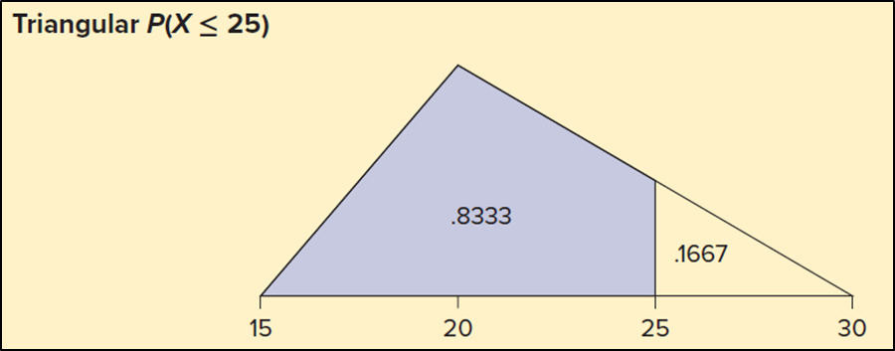
Example: Anesthesia Effectiveness 5
L O 7.9
We are finding the small triangle’s area
and then subtracting from 1.
In contrast, assuming a uniform distribution with parameters
a = 15 and b = 30 would yield
Why is it different? Because the triangular, with mode 20, has more probability on the low end, making it more likely that a patient will be fully anesthetized within 25 minutes.

Slide 65
Chapter 7: Practice Problems

Slide 66
Question 2
L O 7.1
It is Saturday morning at Starbucks. Is each random variable discrete (D) or continuous (C)?
a. Temperature of the coffee served to a randomly chosen customer.
b. Number of customers who order only coffee with no food.
c. Waiting time before a randomly chosen customer is handed the order.

Slide 67
Question 8
L O 7.2
Assume the weight of a randomly chosen American passenger car is a uniformly distributed random variable ranging from 2,500 pounds to 4,500 pounds.
a. What is the mean weight of a randomly chosen vehicle?
b. The standard deviation?
c. What is the probability that a vehicle will weigh less than 3,000 pounds?
d. More than 4,000 pounds?
e. Between 3,000 and 4,000 pounds?

Slide 68
Question 14
L O 7.3
Discuss why you would or would not expect each of the following variables to be normally distributed. Hint: Would you expect a single central mode and tapering tails? Would the distribution be roughly symmetric? Would one tail be longer than the other?
a. Shoe sizes of adult males.
b. Years of higher education of 30-year-old employed women.
c. Days from mailing home utility bills to receipt of payment.
d. Time to process insurance claims for residential fire damage.

Slide 69
Question 19
L O 7.4
Find the standard normal area for each of the following. Sketch the normal curve and shade in the area represented below.
a.
b.
c.
d.

Slide 70
Question 26
L O 7.5
High school students across the nation compete in a financial capability challenge each year by taking a National Financial Capability Challenge Exam. Students who score in the top 20 percent are recognized publicly for their achievement by the Department of the Treasury. Assuming a normal distribution, how many standard deviations above the mean does a student have to score to be publicly recognized?

Slide 71
Question 32
L O 7.5
The weight of a miniature Tootsie Roll is normally distributed with a mean of 3.30 grams and standard deviation of 0.13 gram.
a. Within what weight range will the middle 95 percent of all miniature Tootsie Rolls fall?
b. What is the probability that a randomly chosen miniature Tootsie Roll will weigh more than 3.50 grams?
Data are from a project by M B A student Henry Scussel.

Slide 72
Question 51
L O 7.5
A study found that the mean waiting time to see a physician at an outpatient clinic was 40 minutes with a standard deviation of 28 minutes. Use Excel to find each probability.
a. What is the probability of more than an hour’s wait?
b. Less than 20 minutes?
c. At least 10 minutes.

Slide 73
Question 55
L O 7.6
The probability is .90 that a vending machine in the Oxnard University Student Center will dispense the desired item when correct change is inserted. If 200 customers try the machine, what is the approximate normal probability that:
a. At least 175 will receive the desired item?
b. That fewer than 190 will receive the desired item?
Explain.

Slide 74
Question 58
L O 7.6
The average defect rate on a 2010 Volkswagen vehicle was reported to be 1.35 defects per vehicle. Suppose that we inspect 100 Volkswagen vehicles at random.
a. What is the approximate normal probability of finding at least 150 defects?
b. Of finding fewer than 100 defects?
c. Use Excel to calculate the actual Poisson probabilities.
How close were your approximations?

Slide 75
Question 62
L O 7.7
Between 11 p.m. and midnight on Thursday night, Mystery Pizza gets an average of 4.2 telephone orders per hour. Find the probability that:
a. At least 30 minutes will elapse before the next telephone order;
b. Less than 15 minutes will elapse; and
c. Between 15 and 30 minutes will elapse.

Slide 76
Question 68
L O 7.8
The shoplifting sensor at a certain Best Buy exit gives an alarm 0.5 times a minute.
a. Find the median waiting time until the next alarm.
b. Find the first quartile of waiting time before the next alarm.
c. Find the 30th percentile of waiting time until the next alarm.

Slide 77
Question 71
L O 7.9
Suppose that the distribution of order sizes (in dollars) at L.L.Bean has a distribution that is T(0, 25, 75).
a. Find the mean.
b. Find the standard deviation.
c. Find the probability that an order will be less than $25.
d. Sketch the distribution and shade the area for the event in part (c).

Slide 78
End of Main Content
© McGraw Hill LLC. All rights reserved. No reproduction or distribution without the prior written consent of McGraw Hill LLC.

Slide 79
Accessibility Content: Text Alternatives for Images
79

Slide 80
Continuous Random Variables 2 – Text Alternative
Return to parent-slide containing images.
Discrete variable: Defined at each point. 0, 1, 2, 3, 4, and 5. Continuous variable: Defined over an interval. An interval from 53 to 55. The numbers from 53.5 to 54.5 are highlighted.
Return to parent-slide containing images.
80

Slide 81
Probability Density Function (P D F) – Text Alternative
Return to parent-slide containing images.
The horizontal axis is labeled Miles per hour. It ranges from 60 to 90 in increments of 5. The vertical axis is labeled f (x). It ranges from 0 to 0.09 in increments of 0.01. The graph shows a normal distribution curve that begins at (60, 0), reaches the peak at (75, 0.08), and ends at (90, 0). All values are estimated.
Return to parent-slide containing images.
81

Slide 82
Cumulative Distribution Function – Text Alternative
Return to parent-slide containing images.
The horizontal axis is labeled Miles per hour. It ranges from 60 to 90 in increments of 5. The vertical axis is labeled uppercase F (x). It ranges from 0 to 1 in increments of 0.10. The graph shows a curve that begins at (60, 0), goes up with decreasing steepness, and ends at (90, 1). All values are estimated.
Return to parent-slide containing images.
82

Slide 83
Uniform Continuous Distribution – Text Alternative
Return to parent-slide containing images.
Uniform P D F. The graph plots f of x versus Value of X. 2 points a and b are marked on the horizontal axis. Point 1 over b minus a is marked at the top of the vertical axis. A line begins at (a, 0), passes through (a, 1 over b minus a), (b, 1 over b minus a), and ends at (b, 0). Uniform C D F. The graph plots uppercase F of x versus Value of X. 2 points a and b are marked on the horizontal axis. The vertical axis ranges from 0 to 1 in increments of 0.10. The line begins at (0, 0), passes through (a, 0), (b, 1), and ends at the top right. All values are estimated.
Return to parent-slide containing images.
83

Slide 84
Example: Anesthesia Effectiveness 2 – Text Alternative
Return to parent-slide containing images.
The horizontal axis is labeled Minutes. It ranges from 10 to 35 in increments of 5. The vertical axis is labeled f (x). It ranges from 0 to 0.070 in increments of 0.010. Uniform density curve from 15 to 30 minutes with the region from 20 to 25 minutes shaded.
Return to parent-slide containing images.
84

Slide 85
Normal Distribution – Text Alternative
Return to parent-slide containing images.
The labels on the horizontal axis from left to right: mu minus 3 sigma, mu minus 2 sigma, mu minus 1 sigma, mu, mu + 1 sigma, mu + 2 sigma, and mu + 3 sigma. The graph shows a normal distribution curve with peak at mu.
Return to parent-slide containing images.
85

Slide 86
Normal Distribution 1 – Text Alternative
Return to parent-slide containing images.
Left graph. The horizontal axis is labeled Golf ball diameter in millimeters. It ranges from 42.67 to 42.73 in increments of 0.01. The vertical axis ranges from 0 to 45 in increments of 5. The graph shows a normal distribution curve with mean mu = 42.70 and sigma = 0.01. Right graph. The horizontal axis is labeled C P A Exam scores. It ranges from 40 to 100 in increments of 10. The vertical axis ranges from 0 to 0.045 in increments of 0.005. The graph shows a normal distribution curve with mean mu = 70 and sigma = 10.
Return to parent-slide containing images.
86

Slide 87
Normal Distribution 2 – Text Alternative
Return to parent-slide containing images.
The horizontal axis ranges from negative 3 to + 3 in increments of 1. The normal distribution curve begins at (negative 3, 0), reaches the peak at 0, and ends at (3, 0).
Return to parent-slide containing images.
87

Slide 88
Normal Distribution 7 – Text Alternative
Return to parent-slide containing images.
The first shows that an area of 68.26% falls within one standard deviation of the mean. The second shows that an area of 95.44% falls within two standard deviations of the mean. The third shows that an area of 99.73% falls within three standard deviations of the mean.
Return to parent-slide containing images.
88

Slide 89
Normal Distribution 8 – Text Alternative
Return to parent-slide containing images.
The first one shows a standard normal curve in which everything below positive 1.96 is shaded. The area is 0.9750. The second shows everything below negative 1.96 shaded. This area is 0.0250. The third shows everything between negative and positive 1.96 shaded. This area is 0.9500.
Return to parent-slide containing images.
89

Slide 90
Finding Z for a Given Area 2 – Text Alternative
Return to parent-slide containing images.
Normal curve 1. 0 is marked at center and z is marked near the right end of the horizontal axis. The region to the right of z is shaded. Normal curve 2. Negative z is marked near the left end, 0 is marked at the center, and + z is marked at the right end of the horizontal axis. The region between negative z and + z is shaded.
Return to parent-slide containing images.
90

Slide 91
Finding Z for a Given Area 4 – Text Alternative
Return to parent-slide containing images.
The first one is in the original scale with mean 75 and standard deviation 7. The area below X = 86 is shaded. The area is 0.9418.The second one is on a standardized scale and the area below z = 1.57 is shaded. This area is 0.9418.
Return to parent-slide containing images.
91

Slide 92
Finding X for a given area 2 – Text Alternative
Return to parent-slide containing images.
A question mark is marked near the right end of the horizontal axis. The regions to the left of the question mark are shaded in both curves.
Return to parent-slide containing images.
92

Slide 93
Example: Service Times 5 – Text Alternative
Return to parent-slide containing images.
Normal curve with mu unknown and sigma = 5 minutes. Starting from the left 80% of the curve is shaded. The x-value is x = 30 minutes and z = unknown. Using Excel = N O R M, dot, S, dot, I N V (0.80) = 0.841621.
Return to parent-slide containing images.

Slide 94
Normal Approximation to the Binomial 2 – Text Alternative
Return to parent-slide containing images.
The first histogram is a binomial distribution with n = 4 and pi = 0.50. There are just 5 bars, and they are perfectly symmetric. The number of successes ranges from 0 to 4. The second histogram uses n = 16 and pi = 0.50. The bars are narrower and more closely approximate the normal curve. The third histogram uses n = 64 and pi = 0.50. The bars are now even narrower and even more closely approximate the normal distribution.
Return to parent-slide containing images.
94

Slide 95
Normal Approximation to the Binomial 4 – Text Alternative
Return to parent-slide containing images.
The row entries are as follows. Row 1. Event: At least 17. Relevant values of X: …14, 15, 16, 17, 18, 19, 20… An arrow points to the right from 17. Normal cutoff: Use x = 16.5. Row 2. Event: More than 15. Relevant values of X: …14, 15, 16, 17, 18, 19, 20… An arrow points to the right from 16. Normal cutoff: Use X = 15.5. Row 3. Event: Fewer than 19. Relevant values of X: …14, 15, 16, 17, 18, 19, 20… An arrow points to the left from 18. Normal cutoff: Use X = 18.5.
Return to parent-slide containing images.
95

Slide 96
Exponential Distribution – Text Alternative
Return to parent-slide containing images.
A diagram representing the concept of ‘Customer Arrivals’ over time. Four icons symbolizing customers are arranged sequentially along a horizontal line labeled ‘Time’. Arrows point towards each customer icon, indicating their respective arrival times. The time interval between two consecutive customer arrivals is denoted by ‘X’.
Return to parent-slide containing images.
96

Slide 97
Exponential Distribution 1 – Text Alternative
Return to parent-slide containing images.
All four graphs begin at the specified value of lambda on the vertical axis and decrease exponentially approaching the horizontal axis asymptotically from above.
Return to parent-slide containing images.
97

Slide 98
Exponential Distribution 2 – Text Alternative
Return to parent-slide containing images.
The first image represents the left-tail area of an exponential distribution. The shaded region, which extends from 0 to x, represents the probability P of capital X greater than or equal to small X which equals 1 minus e power minus lambda small X. The second image depicts the right-tail area of an exponential distribution. The shaded region, starting from the value x and extending to the right, represents the probability p of capital X lesser than or equal to X equals 1 minus 2 power of minus lambda multiplied by small X.
Return to parent-slide containing images.
98

Slide 99
Example: Customer Waiting Time 2 – Text Alternative
Return to parent-slide containing images.
In both graphs, the horizontal axis is labeled Minutes. It ranges from 0 to 2.50 in increments of 0.50. The vertical axis ranges from 0.00 to 2.50 in increments of 0.50. P of X less than or equal to 0.50. In the exponential curve, the region to the left of 0.50 is shaded. P of X greater than 0.50. In the exponential curve, the region to the right of 0.50 is shaded.
Return to parent-slide containing images.
99

Slide 100
Triangular Distribution 2 – Text Alternative
Return to parent-slide containing images.
A skewed left triangular P D F graph has a height that is above a value that is toward the right side of the length of the base. A symmetric triangular P D F graph has a height that is directly centered over the length of the base. A skewed right triangular P D F graph has a height that is toward the left side of the length of the base.
Return to parent-slide containing images.
100

