Slide 1

Chapter 8
Sampling Distributions and Estimation
© McGraw Hill LLC. All rights reserved. No reproduction or distribution without the prior written consent of McGraw Hill LLC.

Slide 2
Chapter Learning Objectives
Chapter 8
L O 8.1: Define a sampling distribution.
L O 8.2: Explain the desirable properties of estimators.
L O 8.3: State and apply the Central Limit Theorem for a mean.
L O 8.4: Explain how sample size affects the standard error.
L O 8.5: Construct a confidence interval for a population mean using z.
L O 8.6: Know when and how to use Student’s t instead of z to estimate a mean.
L O 8.7: Construct a confidence interval for a population proportion.
L O 8.8: Know how to modify confidence intervals when the population is finite.
L O 8.9: Calculate sample size to estimate a mean.
L O 8.10: Calculate sample size to estimate a proportion.
L O 8.11: Construct a confidence interval for a variance (optional).

Slide 3
Sampling Distributions
L O 8.1
The value of a sample statistic, calculated from a random sample, will vary depending on which population items happen to be included in the sample.
Some samples may represent the population well, while other samples could differ greatly from the population (particularly if the sample size is small).
This sampling variation can easily be illustrated by selecting random samples from a large population.

Slide 4
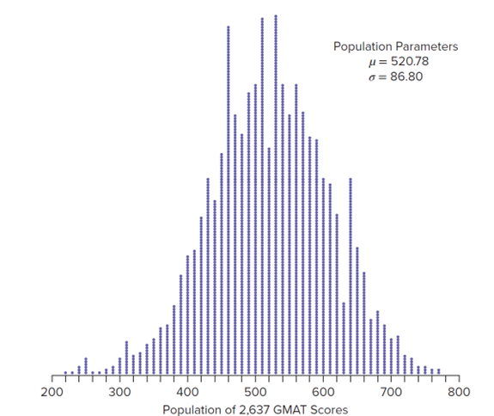
Sampling and Estimation 1
L O 8.1
Consider sampling from a large population of G M A T scores for M B A applicants. The population parameters are μ = 520.78 and σ = 86.80.
The figure below shows a dot plot of the entire population.
Access the text alternative for slide images.

Slide 5
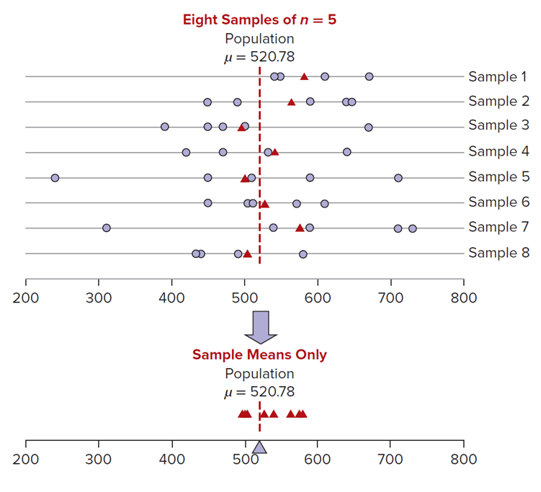
Sampling and Estimation 2
L O 8.1
This figure shows several random samples of n = 5 from this population.
The individual items that happen to be included in the samples vary.
While sampling variation is inevitable, there is a tendency for the sample means to be close to the population mean (μ = 520.78) shown as a dashed line.
Access the text alternative for slide images.

Slide 6
Sampling and Estimation 3
L O 8.1
In larger samples, the sample means would tend to be even closer to μ.
A probability distribution that describes the values of a sample statistic calculated from all possible sample of size n is called a sampling distribution.
This chapter explains how to use the sampling distribution of a statistic to estimate unknown population parameters, taking into account four factors.
Sample variation (uncontrollable).
Population variation (uncontrollable).
Sample size (controllable).
Desired confidence in the estimate (controllable).

Slide 7
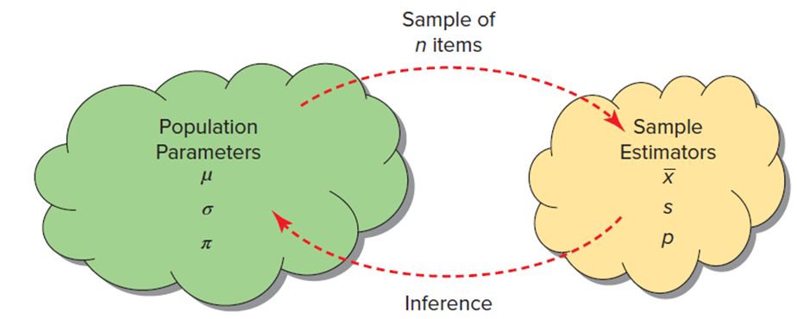
Estimators 1
L O 8.2
An estimator is a statistic calculated from a sample to estimate the value of a population parameter.
An estimate is the value of the estimator in a particular sample.
We usually denote a population parameter by a lowercase Greek letter (For example, μ, σ, or π). The corresponding sample estimator is usually a Roman letter
Access the text alternative for slide images.

Slide 8
Estimators 2
L O 8.2

Slide 9
Sampling Error
L O 8.2
The sampling error is the difference between the statistic and the corresponding population parameter.
Sampling error exists because different samples
will yield different values for
depending on
which population items happen to be included in the sample.

Slide 10
Properties of Estimators 1
L O 8.2
The bias is the difference between the expected value (that is, the average value) of the estimator and the true parameter. For the mean:
An estimator is unbiased if its expected value is the
parameter being estimated. We say
is an unbiased
estimate of μ because
There can be sampling error in a particular sample, but an unbiased estimator neither overstates nor understates the true parameter on average.

Slide 11
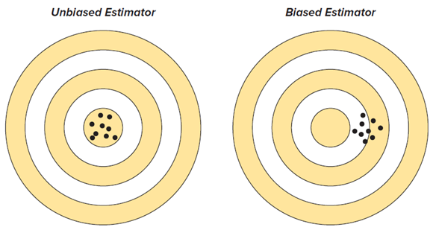
Properties of Estimators 2
L O 8.2
An expert whose rifle sights are correctly aligned will produce a target pattern like the one on the left.
The same expert shooting a rifle with misaligned sights might produce the pattern on the right.
Both targets show sampling variation, but the unbiased estimator is correctly aimed.
An unbiased estimator avoids systematic error.
Access the text alternative for slide images.

Slide 12
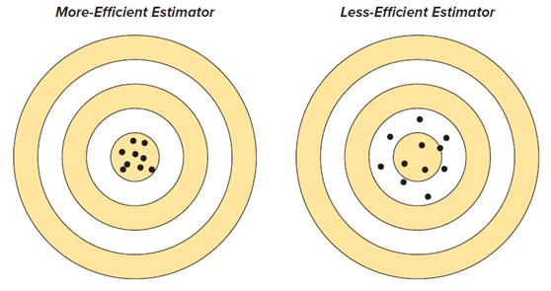
Efficiency 1
L O 8.2
Efficiency refers to the variance of the estimator’s sampling distribution.
Smaller variance means a more efficient estimator. Among all unbiased estimators, we prefer the minimum variance estimator, referred to as M V U E (minimum variance unbiased estimator).
The figure shows two unbiased estimators. Both patterns are centered on the bull’s-eye, but the estimator on the left has less variation. A more efficient estimator is closer on average to the true value of the parameter.
Access the text alternative for slide images.

Slide 13
Efficiency 2
L O 8.2
You cannot assess efficiency from one sample, but it can be studied either mathematically or by simulation.
Statisticians have proved that, for a normal distribution,
are minimum variance estimators of
respectively (that is, no other estimators can have smaller variance).
Similarly, the sample proportion p is an M V U E of the population proportion π.

Slide 14
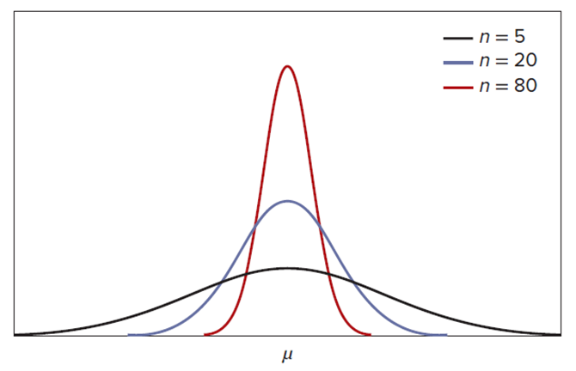
Consistency
L O 8.2
A consistent estimator converges toward the parameter being estimated as the sample size increases.
That is, the sampling distribution variation decreases around the true parameter value, as illustrated.
The figure illustrates the importance of a large sample because in a large sample your estimated mean is likely to be closer to μ.

Slide 15
Central Limit Theorem
L O 8.3
Consider the sample mean
used to estimate the
population mean μ.
Our objective is to use the sampling distribution of
​to say something about the population that we
are studying.

Slide 16
Standard Error of the Mean 1
L O 8.4
To describe the sampling distribution, we need to know the mean, variance, and shape of the distribution.
is a random variable whose value will change
whenever we take a different sample.
As long as our samples are random samples, the only type of error we will have in our estimating process is sampling error.
The sampling error of the sample mean is described by its standard deviation. This value has a special name, the standard error of the mean.

Slide 17
Standard Error of the Mean 2
L O 8.4
Standard error of the mean decreases as the sample size increases.
(standard error of the mean)
If the average spending by a salon customer for a facial treatment is μ = $80.00 with standard deviation σ = $10.00, then the standard error of the mean for a random sample of 20 facial treatments is much smaller than $10:

Slide 18
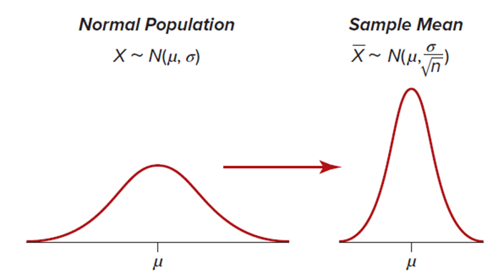
Standard Error of the Mean 3
L O 8.4
If the population is normal, the sample mean has a normal distribution centered at μ, with a standard error
As the sample size n increases, the distribution
of the sample means converges to the population mean
μ as the standard error of the mean,
gets smaller.
Access the text alternative for slide images.

Slide 19
Central Limit Theorem 1
L O 8.3
However, the population may not have a normal distribution, or we may simply not know what the population distribution looks like.
What can we do in these circumstances? We can rely on one of the most fundamental laws of statistics, the Central Limit Theorem.
Central Limit Theorem for a Mean.
If a random sample of size n is drawn from a population with mean μ and standard deviation σ, the distribution of the sample mean
approaches a normal distribution with mean μ and standard
deviation
as the sample size increases.

Slide 20
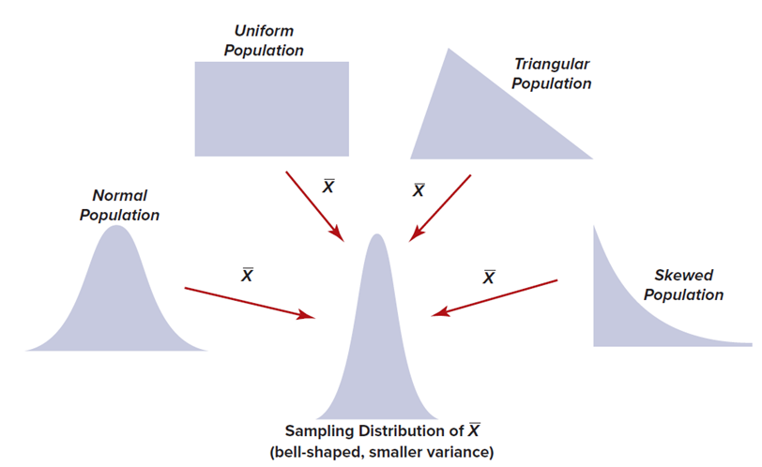
Central Limit Theorem 2
L O 8.3
The Central Limit Theorem (C L T) is a powerful result that allows
us to approximate the shape of the sampling distribution of
when we don’t know what the population distribution looks like.
Even if your population is not normal, by the C L T, if the sample size is large enough, the sample mean will have approximately a normal distribution.
Access the text alternative for slide images.

Slide 21
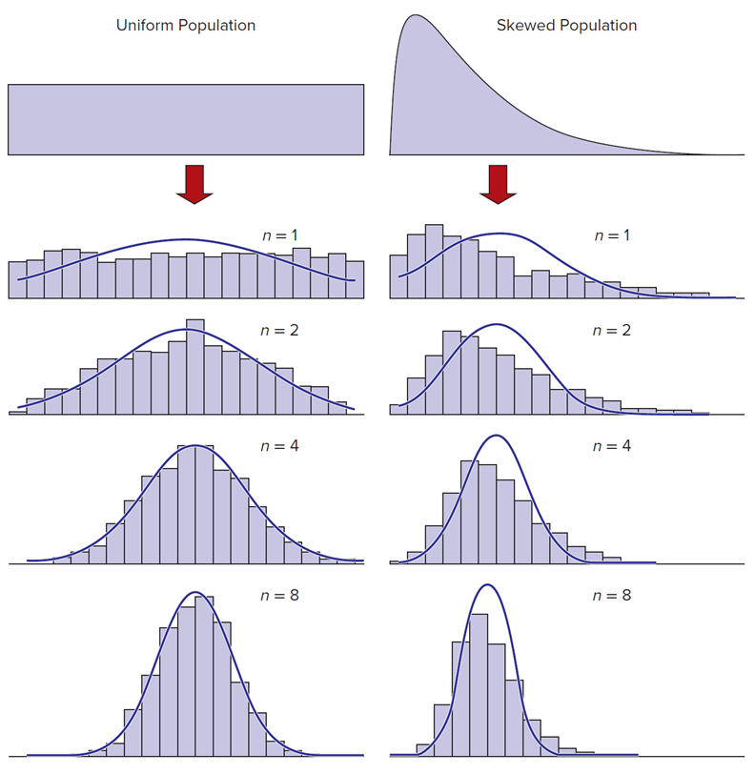
Central Limit Theorem 3
L O 8.3
A rule of thumb often used is that n ≥ 30 is required to assume a normal distribution for the sample mean, but a much smaller n can suffice for symmetric populations.
Access the text alternative for slide images.

Slide 22
Range of Sample Means 1
L O 8.3
The Central Limit Theorem permits us to define an interval within which the sample means are expected to fall. As long as the sample size n is large enough, we can use the normal distribution regardless of the population shape.
Expected Range of Sample Means:
where
is the standard error of the mean
(8.5)

Slide 23
Range of Sample Means 2
L O 8.3
If we know μ and σ, the C L T allows us to predict the range of sample means for samples of size n, when the z-values for the standard normal distribution are used.
90% Interval
95% Interval
99% Interval

Slide 24
Example: Bottle Filling 1
L O 8.3
The amount of liquid in a half-liter (500 ml) bottle of Diet Coke is normally distributed with
μ = 505 ml.
σ = 1.2 ml.
Because the population is normal, the sample mean
will be a
normally distributed random variable for any sample size.
If we sample a single bottle (that is, n = 1) and measure its fill, the sample “mean” is just X, which should lie within the ranges shown in the table.
It appears that the company has set the mean far enough above 500 ml that essentially all bottles contain at least the advertised half-liter quantity. If we increase the sample size to n = 4 bottles, we expect the sample means to lie within a narrower range.

Slide 25
Example: Bottle Filling 2
L O 8.4
Expected 95 Percent Range of the Sample Means.
If this experiment were repeated a large number of times, we would expect that the sample means would lie within the limits shown above.
For example, if we took 1,000 samples and computed the mean for each sample, we would expect that approximately 950 of the sample means would lie within the 95 percent limits.
But we don’t really take 1,000 samples (except in a computer simulation). We actually take only one sample.

Slide 26
Confidence Intervals 1
L O 8.5
A sample mean
calculated from a random sample
is a point estimate of the unknown population
mean μ.
We construct a confidence interval for the unknown mean
μ by adding and subtracting a margin of error from
the mean of our random sample.
Confidence Interval for a Mean μ with known σ:
where
is the standard error of the mean
(8.6)

Slide 27
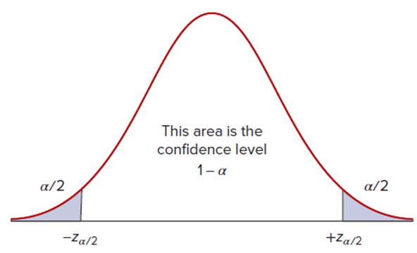
Confidence Intervals 2
L O 8.5
If samples are drawn from a normal population (or if the sample is
large enough that
is approximately normal by the Central Limit
Theorem) and
is known, then the margin of error is calculated
using the standard normal distribution.
The value
is determined by the desired level of confidence,
which we call
Because the sampling distribution is symmetric,
is the area in
each tail of the normal distribution.
Access the text alternative for slide images.

Slide 28
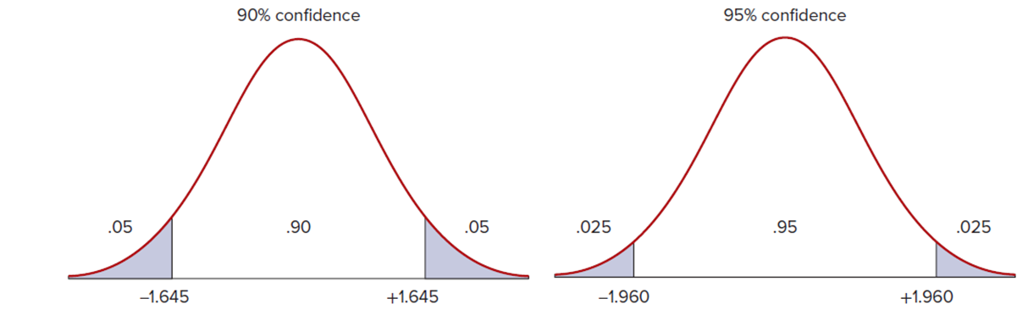
Confidence Intervals 3
L O 8.5
The middle area shows the confidence level.
The remaining area is divided into two symmetrical tails,
each having area equal to
The value of
will depend on the level of confidence
desired.
90 Percent and 95 Percent Confidence Levels Compared.
Access the text alternative for slide images.

Slide 29
Choosing a Confidence Level
L O 8.5
A higher confidence level leads to a wider confidence interval.
Greater confidence implies loss of precision (that is, greater margin of error).
95% confidence is most often used.
This table shows several common confidence levels and their associated z-values.

Slide 30
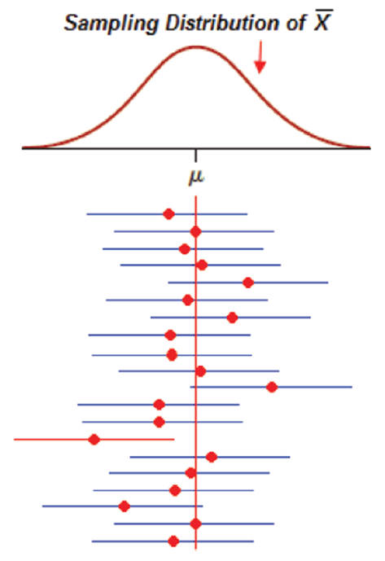
Interpretation
L O 8.5
A confidence interval either does or does not contain μ.
The confidence level quantifies the risk.
Out of 100 confidence intervals, approximately 95% may contain μ, while approximately 5% might not contain μ when constructing 95% confidence intervals.
Note that one interval does not contain μ.
Sampling Distribution of
Access the text alternative for slide images.

Slide 31
When Can We Assume Normality
L O 8.5
If σ is known and the population is normal, then we can safely use the formula to compute the confidence interval.
If σ is known and we do not know whether the population is normal, a common rule of thumb is that n ≥ 30 is sufficient to use the formula as long as the distribution is approximately symmetric with no outliers.
Larger n may be needed to assume normality if you are sampling from a strongly skewed population or one with outliers.

Slide 32
Student’s t Distribution 1
L O 8.6
In situations where the population is normal but its standard deviation σ is unknown, the Student’s t distribution should be used instead of the normal z distribution.
Confidence Interval for a Mean μ with Unknown σ:
where
is the estimated standard error of the mean
(8.8)

Slide 33
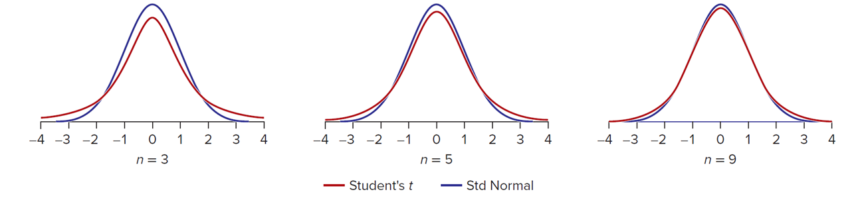
Student’s t Distribution 2
L O 8.6
The t distributions are symmetric and shaped very much like the standard normal distribution, except they are somewhat less peaked and have thicker tails.
Note that the t distributions are a class of distributions, each of which is dependent on the size of the sample we are using.
The tails of the distributions change as the sample size increases.
Comparison of Normal and Student’s t.
Access the text alternative for slide images.

Slide 34
Degrees of Freedom
L O 8.6
Knowing the sample size allows us to calculate a parameter called degrees of freedom (sometimes abbreviated df or d.f.).
d.f. = n − 1 (degrees freedom for a confidence interval for μ).
For large degrees of freedom, the t distribution approaches the shape of the normal distribution.
However, in small samples, the difference is important.

Slide 35
Comparison of z and t
L O 8.6
For very small samples, t-values differ substantially from the normal. As the degrees of freedom increase, the t-values approach the normal z-values.
For example, for n = 31, the degrees of freedom, d.f. = 31 − 1 = 30.
So for a 90 percent confidence interval, we would use t = 1.697, which is only slightly larger than z = 1.645.

Slide 36
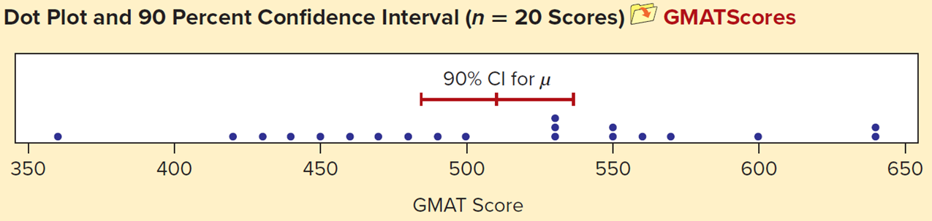
Example: G M A T Scores 1
L O 8.6
Consider a random sample of G M A T scores submitted by 20 applicants to an M B A program.
We will construct a 90 percent confidence interval for the mean G M A T score of all M B A applicants.
530 | 450 | 600 | 570 | 360
550 | 640 | 490 | 460 | 550
480 | 440 | 530 | 470 | 560
500 | 430 | 640 | 420 | 530
Dot Plot and 90 Percent Confidence Interval (n = 20 Scores)
G M A TScores
Access the text alternative for slide images.

Slide 37
Example: G M A T Scores 2
L O 8.6
Because the population standard deviation σ is unknown, we will use the Student’s t for our confidence interval with 19 degrees of freedom:
d.f. = n − 1 = 20 − 1 = 19 (degrees of freedom for n = 20).
For a 90 percent confidence interval, we consult
Appendix D and find

Slide 38
Example: G M A T Scores 3
L O 8.6

Slide 39
Example: G M A T Scores 4
L O 8.6
The 90 percent confidence interval is,
We are 90 percent confident that the true mean G M A T
score is within the interval
If we wanted a narrower interval with the same level of confidence, we would need a larger sample size.

Slide 40
Confidence Interval Width
L O 8.6
Confidence interval width reflects:
the sample size.
the confidence level.
the standard deviation.
To obtain a narrower interval and more precision:
increase the sample size, or,
lower the confidence level (For example, from 90% to 80% confidence).

Slide 41
Student’s t Distribution
L O 8.6
Must the Population Be Normal?
The t distribution assumes a normal population. While this assumption is often in doubt, simulation studies have shown that confidence intervals using Student's t are reliable as long as the population is not badly skewed and if the sample size is not too small (see Chapter 8 McGraw Hill Connect ® supplements for simulation demonstrations).
Can I Ever Use z Instead of t ?
In large samples, z and t give similar results. But a conservative statistician always uses the t distribution for confidence intervals when σ is unknown because using z would underestimate the margin of error. Because t tables are easy to use (or we can get t-values from Excel), there isn't much justification for using z when σ is unknown.

Slide 42
Confidence Interval for a Proportion 1
L O 8.7
Proportions occur frequently in surveys and sampling, most often expressed as percents.
For example, firms often track the proportion of customers who say they are likely to recommend the company to a friend or colleague.
Analysts also must account for sampling error to determine how reliable their estimate is.

Slide 43
Confidence Interval for a Proportion 2
L O 8.7
The Central Limit Theorem (C L T) applies to a sample proportion because a proportion is just a mean of data whose only values are 0 or 1.
Central Limit Theorem for a Proportion:
As sample size increases, the distribution of the sample
proportion
approaches a normal distribution with mean
and standard error σ_{p} where

Slide 44
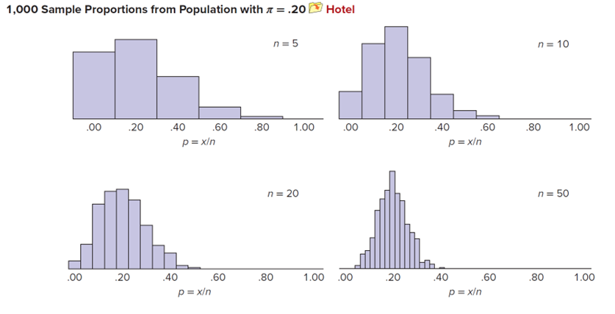
Confidence Interval for a Proportion 3
L O 8.7
The distribution of a sample proportion
is symmetric if
π = .50 and regardless of π, approaches symmetry as n increases.
If we could actually take repeated samples, we could empirically study
the sampling distribution of
This can be done in a computer
simulation. This image shows histograms of 1,000 sample proportions of various sample sizes taken from a population with π = .20.
1,000 Sample Proportions from Population with π = .20
Hotel
Access the text alternative for slide images.

Slide 45
When is it Safe to Assume Normality of p? 1
L O 8.7
The statistic
may be assumed normally distributed
when the sample is “large.” How large must n be?
The sample proportion
may be assumed normal if both
The sample proportion
may be assumed normal when
the sample has at least 10 “successes” and at least 10 “failures,” that is, when x ≥ 10 and n − x ≥ 10.
good alternative rule is to require

Slide 46
When is it Safe to Assume Normality of p? 2
L O 8.7
The table shows that a very large sample may be needed to assume normality of the sample proportion when π differs greatly from .50.
If your sample is too small to assume a normal distribution for p, you would need to construct a confidence interval using the binomial distribution.
π | n
.50 | 20
.40 or .60 | 25
.30 or .70 | 33
.20 or .80 | .50
.10 or .90 | 100
.05 or .95 | 200
.02 or .98 | 500
.01 or .99 | 1,000
.005 or .995 | 2,000
.002 or .998 | 5,000
.001 or .999 | 10,000

Slide 47
Confidence Interval for π
L O 8.7
Confidence Interval for π :
(8.11)
The table shows
values for common confidence
levels.

Slide 48
Example: Auditing 1
L O 8.7
A sample of 75 retail in-store purchases showed that 24 were paid in cash. The sample proportion is,
(proportion of in-store cash transactions)
We can assume that p is normally
because np and
exceed 10. That is,
and
The 95 percent confidence interval is
constructing a confidence interval, we use p instead of π in our rule of thumb to test
whether n is large enough to assure normality because π is unknown. The test is therefore equivalent to asking if x ≥ 10 and n − x ≥ 10.

Slide 49
Example: Auditing 2
L O 8.7
We cannot know with certainty whether the true
proportion lies within the interval
Either it does or it does not. And it is true that different samples could yield different intervals.
But we can say that, on average, 95 percent of the intervals constructed in this way would contain the true population proportion π.
Therefore, we are 95 percent confident that the true proportion π is between .214 and .426.

Slide 50
Reducing the Margin of Error
L O 8.7
The width of the confidence interval for π depends on.
Sample size.
Confidence level.
Sample proportion p.
We cannot do anything about p because it is calculated from the sample. If we want a narrower interval (that is, improved precision), we could either increase the sample size or reduce the confidence level (for example, from 95 percent to 90 percent).

Slide 51
Rule of Three
L O 8.7
If in n independent trials no events occur, the upper 95 percent
confidence bound is approximately
For example, if no medical complications arise in 17 prenatal fetal surgeries, the upper bound on such complications is
roughly
or about 18 percent.
This rule is sometimes used when limited data are available.
This rule is especially useful because the formula for the
standard error
breaks down when p = 0.
The rule of three is a conservative approach.

Slide 52
Estimating From Finite Populations 1
L O 8.8
If the sample size n is less than 5 percent of the population and we are sampling without replacement, then we consider the size of the population to be effectively infinite.
When we will take samples without replacement where n is greater than 5 percent of the population, our margin of error on the interval estimate is actually less than when the sample size is “small” relative to the population size.
As we sample more of the population, we get more precise estimates. We need to account for the fact that we are sampling a larger percentage of the population.

Slide 53
Estimating From Finite Populations 2
L O 8.8
The finite population correction factor (F P C F) reduces the margin of error and provides a more precise interval estimate.
Finite Population Correction Factor:
is the finite population correction factor (F P C F).
(8.12)
Where
N = the number of items in the population.
n = the number of items in the sample.

Slide 54
Estimating From Finite Populations 3
L O 8.8
Confidence Intervals for Finite Populations:
estimating μ with known σ
(8.13)
estimating μ with unknown σ
(8.14)
estimating π
(8.15)

Slide 55
Example: Streeling Pharmaceutical 1
L O 8.8
Streeling Pharmaceutical has a staff of 1,000 employees. The human resources department sent a survey to a random sample of 75 employees to estimate the average number of hours per week its employees use the company’s on-site exercise facility.
The sample results showed
hours and
s = 0.83 hour. Because more than 5 percent of the
population was sampled
a finite
population correction is suggested. The F P C F would be,

Slide 56
Example: Streeling Pharmaceutical 2
L O 8.8
The 95 percent confidence interval estimate, with
(d.f. = 74), would be,
If the F P C F had been omitted, the confidence interval would have been:
In this example, the F P C F narrowed the confidence interval only slightly, by reducing the margin of error from ±0.191 to ±0.184. Because it reduces the margin of error, using the F P C F is desirable, even when its benefit is modest.

Slide 57
Sample Size to Estimate μ
L O 8.9
Suppose we wish to estimate a population mean with a maximum allowable margin of error of ± E. What sample size is required?
(sample size to estimate μ)
Always round n to the next higher integer to be conservative.
A Myth:
Many people believe that when the population is large, you need a larger sample to obtain a given level of precision in the estimate. This is incorrect. For a given level of precision, it is only the sample size that matters, even if the population is a million or a billion. This is apparent from the confidence interval formula, which includes n but not N.

Slide 58
How to Estimate σ? 1
L O 8.9
Method 1: Take a Preliminary Sample:
Take a small preliminary sample and use the sample estimate s in place of σ. This method is common, though its logic is somewhat circular (that is, we must take a sample to plan a sample).
Method 2: Assume Uniform Population:
Estimate upper and lower limits a and b and set
For example, we might guess the weight of a light-duty truck to range from 1,500
pounds to 3,500 pounds, implying a standard deviation of
Because a uniform distribution has no
central tendency, the actual σ is probably smaller than our guess, so we get a larger n than necessary (a conservative result).

Slide 59
How to Estimate σ? 2
L O 8.9
Method 3: Assume Normal Population:
Estimate upper and lower bounds a and b, and set
This assumes
normality with most of the data within
so the estimated range is
For example, we might guess the weight of a light truck to range from 1,500
pounds to 3,500 pounds, implying
Recent
research suggests that this method may not be conservative enough (see Related
Reading).
Method 4: Poisson Arrivals:
In the special case when
is a Poisson arrival rate, then
For example, if you think the arrival rate is about 20 customers per hour, then you
would estimate

Slide 60
Sample Size for a Proportion
L O 8.10
Suppose we wish to estimate a population proportion with a precision (maximum error) of ± E. What sample size is required?
Since
is a number between 0 and 1, the allowable error
E is also between 0 and 1.
Always round n to the next higher integer.

Slide 61
How to Estimate π
L O 8.10
Method 1: Assume That π = .50:
This method is conservative and ensures the desired precision. It is therefore a sound choice and is often used. However, the sample may end up being larger than necessary.
Method 2: Take a Preliminary Sample:
Take a small preliminary sample and insert p into the sample size formula in place of π. This method is appropriate if π is believed to differ greatly from .50, as is often the case, though its logic is somewhat circular (that is, we must take a sample to plane our sample).
Method 3: Use a Prior Sample or Historical Data:
A reasonable approach, but how often are such data available? And might π have changed enough to make it a questionable assumption?

Slide 62
Example: A T M Withdrawals 1
L O 8.10
A university credit union wants to know the proportion of cash withdrawals that exceed $50 at its ATM located in the student union building. With an error of ± 2 percent and a confidence level of 95 percent, how large a sample is needed to estimate the proportion of withdrawals exceeding $50? The z-value for 95 percent confidence is z = 1.960. Using E = 0.02 and assuming
conservatively that
the required sample size is,

Slide 63
Example: A T M Withdrawals 2
L O 8.10
We would need to examine n = 2,401 withdrawals to estimate π within ± 2 percent and with 95 percent confidence. In this case, last year’s proportion of A T M withdrawals over $50 was 27 percent. If we had used this estimate of π in our calculation, the required sample size would be,
(rounded to next higher integer)
We would need to examine n = 1,893 withdrawals to estimate π within ± 0.02. The required sample size is smaller than when we make the conservative assumption π = .50.

Slide 64
Confidence Interval For A Population Variance, σ^{power2}
L O 8.11
If the population is normal, then the sample variance
follows
the chi-square distribution
with degrees of freedom d.f. = n − 1.
Lower
and upper
tail percentiles for the chi-square
distribution can be found using Appendix E.
Using the sample variance
the confidence interval for the
variance is computed from the following relationship.
To obtain a confidence interval for the standard deviation σ, just take the square root of the interval bounds.

Slide 65
Example: Pizza Delivery 1
L O 8.11
On a particular Friday night, the charges for 40 pizza delivery orders from Mama Frida’s Pizza showed a
mean of
with a sample variance
Construct a 95% confidence interval for the population variance for the charges.
The sample data were nearly symmetric (median $24.98) with no outliers. Normality of the prices will be assumed. From Appendix E, using 39 degrees of freedom (d.f. = n − 1 = 40 − 1 = 39), we obtain bounds for the 95 percent middle area.

Slide 66
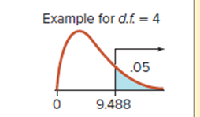
Example: Pizza Delivery 2
L O 8.11
Chi-Square Values for 95 Percent Confidence with d.f. = 39
CHI-SQUARE CRITICAL VALUES:
This table shows the critical values of chi-square for each desired tail area and degrees of freedom (d.f.).
Area in Upper Tail
Access the text alternative for slide images.

Slide 67
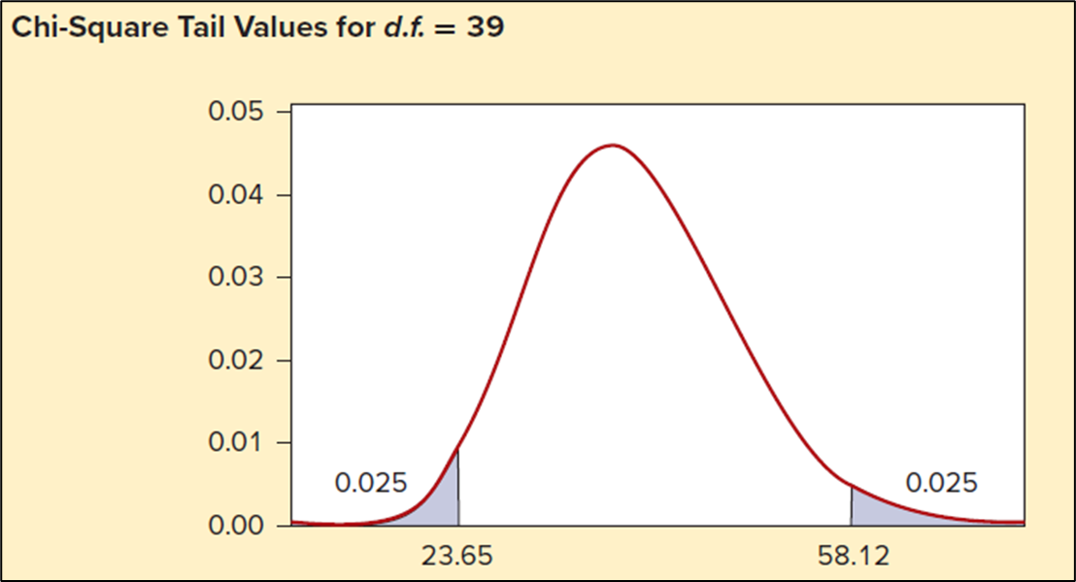
Example: Pizza Delivery 3
L O 8.11
Chi-Square Tail Values for d.f. = 39:

Slide 68
Example: Pizza Delivery 4
L O 8.11
The 95 percent confidence interval for the population
variance
is,
Lower bound:
Upper bound:
With 95 percent confidence, we believe that
If you want a confidence interval for
the standard deviation, just take the square root of the
interval bounds. In this example, that would give

Slide 69
Assumption of Normality
L O 8.11
The methods described for confidence interval estimation of the variance and standard deviation depend on the population having a normal distribution.
If the population does not have a normal distribution, then the confidence interval should not be considered accurate.
In such a case, the best alternative is to look for software that can calculate a bootstrap estimate of

Slide 70
Chapter 8: Practice Problems

Slide 71
Question 3
L O 8.3
The diameter of bushings turned out by a manufacturing process is a normally distributed random variable with a mean of 4.035 mm and a standard deviation of 0.005 ml. A sample of 25 bushings is taken once an hour.
a. Within what interval should 95 percent of the bushing diameters fall?
b. Within what interval should 95 percent of the sample means fall?
c. What conclusion would you reach if you saw a sample mean of 4.020? A sample mean of 4.055?

Slide 72
Question 11
L O 8.5
Use the sample information
to
calculate the following confidence intervals for μ assuming the sample is from a normal population:
a. 90 percent confidence;
b. 95 percent confidence;
c. 99 percent confidence.
d. Describe how the intervals change as you increase the confidence level.

Slide 73
Question 23
L O 8.6
A sample of 21 minivan electrical warranty repairs for “loose, not attached” wires (one of several electrical failure categories the dealership mechanic can select) showed a mean repair cost of $45.66 with a standard deviation of $27.79.
a. Construct a 95 percent confidence interval for the true mean repair cost.
b. How could the confidence interval be made narrower?

Slide 74
Question 35
L O 8.7
From a list of stock mutual funds, 52 funds were selected at random. Of the funds chosen, it was found that 19 required a minimum initial investment under $1,000.
a. Construct a 90 percent confidence interval for the true proportion requiring an initial investment under $1,000.
b. May normality of p be assumed? Explain.

Slide 75
Question 41
L O 8.8
A random survey of 500 students was conducted from a population of 2,300 students to estimate the proportion who had part-time jobs. The sample showed that 245 had part-time jobs. Calculate the 90 percent confidence interval for the true proportion of students who had part-time jobs.

Slide 76
Question 46
L O 8.9
Analysis showed that the mean arrival rate for vehicles at a certain Shell station on Friday afternoon last year was 4.5 vehicles per minute. How large a sample would be needed to estimate this year’s mean arrival rate with 98 percent confidence and an error of ±0.5?

Slide 77
Question 54
L O 8.10
How large a sample size would be needed to estimate the percentage of wireless routers in San Francisco that use data encryption, with an error of ±2 percent and 95 percent confidence?

Slide 78
Question 59
L O 8.11
Find the 90 percent confidence interval for the standard deviation of gasoline mileage mpg for these 16 San Francisco commuters driving hybrid gas–electric vehicles.
38.8 | 48.9 | 28.5 | 40.0 | 38.8 | 29.2 | 29.1 | 38.5
34.4 | 46.1 | 51.8 | 30.7 | 36.9 | 25.6 | 42.7 | 38.3

Slide 79
Chapter 8: Analytics in Action

Slide 80
Analytics in Action
Margin of Error in the Era of Big Data:
We want estimates of parameters from sample data to be both unbiased and efficient (see Figures 8.4 and 8.5). We expect big data to lead to more efficient estimates because sampling error decreases as the sample size increases. In the era of big data, the margin of error around an estimate of a population parameter can be very small, which means the estimates can be very precise. But if you recall from Chapter 2, sampling error is not the only type of error in sampling.
Quality of data is as important as quantity of data. Selection bias, response error, and interviewer error are not a function of sample size. When large amounts of non-random data are collected, bias can be systemic, and conclusions from big data can be misleading. Precise estimates with small margins of error cannot correct for systemic bias.
For example, data and statistics collected by police departments are dependent on where police are deployed. Crimes committed in neighborhoods without a consistent police presence might not be tracked as closely or be included in crime statistics data sets. Witness accounts may reflect ethnic or racial bias. Such factors may lead to poor quality data and biased conclusions about crime despite precise estimates.

Slide 81
End of Main Content
© McGraw Hill LLC. All rights reserved. No reproduction or distribution without the prior written consent of McGraw Hill LLC.

Slide 82
Accessibility Content: Text Alternatives for Images
82

Slide 83
Sampling and Estimation 1 – Text Alternative
Return to parent-slide containing images.
A histogram. The horizontal axis ranges from 300 to 800 in increments of 100. The histogram is symmetric. The minimum value is 220 and the maximum value is 780. The mean value is 520. The population parameters are mu = 520.78 and sigma = 86.80.
Return to parent-slide containing images.
83

Slide 84
Sampling and Estimation 2 – Text Alternative
Return to parent-slide containing images.
The horizontal axis ranges from 200 to 800 in increments of 100. 4 dots are plotted for each of the 8 samples. Most of the dots are concentrated between 420 and 700. A vertical dashed line is at mu = 520.78.
Return to parent-slide containing images.
84

Slide 85
Estimators 1 – Text Alternative
Return to parent-slide containing images.
The sample estimators estimate the sample of n items from the population parameters. The population parameters are represented by mu, sigma, and pi. The parameters of the sample estimators are x bar, s, and p.
Return to parent-slide containing images.
85

Slide 86
Properties of Estimators 2 – Text Alternative
Return to parent-slide containing images.
2 Images of a dart board showing an unbiased estimator where the darts hit bull's-eye and a biased estimator where the darts tend to miss bull's-eye.
Return to parent-slide containing images.
86

Slide 87
Efficiency 1 – Text Alternative
Return to parent-slide containing images.
The dart board illustration shows a more efficient estimator where the darts consistently hit bull's-eye and a less efficient estimator where the darts center around bull's-eye, but are spread out.
Return to parent-slide containing images.
87

Slide 88
Standard Error of the Mean 3 – Text Alternative
Return to parent-slide containing images.
Normal population. X is approximately N (mu, sigma). Normal curve with mean mu and standard deviation sigma is wide and not tall. Sample Mean. X is approximately N (mu, sigma over square root of n). The normal curve of the sample means is tall and narrow.
Return to parent-slide containing images.
88

Slide 89
Central Limit Theorem 2 – Text Alternative
Return to parent-slide containing images.
Despite the shape of the population such as Normal population, Uniform population, Triangular population, and Skewed population, the sampling distribution of the x-bar will become bell-shaped and have a smaller variance.
Return to parent-slide containing images.
89

Slide 90
Central Limit Theorem 3 – Text Alternative
Return to parent-slide containing images.
This illustration shows uniform and skewed right populations. Four sampling distributions are shown below with samples of size n = 1, then n = 2, then n = 4, and then n = 8 showing that as n increases the distribution of x bar normalizes and the standard deviation decreases.
Return to parent-slide containing images.
90

Slide 91
Confidence Intervals 2 – Text Alternative
Return to parent-slide containing images.
Normal curve with the tails shaded. The tail areas are each alpha divided by 2. The middle area is the confidence level 1 minus alpha. The critical values are negative and positive z sub alpha divided by 2.
Return to parent-slide containing images.
91

Slide 92
Confidence Intervals 3 – Text Alternative
Return to parent-slide containing images.
90% confidence means the middle 90% of the curve is labeled leaving 0.05 shaded areas in each tail. The critical value on the horizontal axis for these tail regions is positive and negative 1.645. 95% confidence means the middle 95% of the curve is shaded leaving 0.025 shaded areas in each tail. The critical value on the horizontal axis for these tail regions is positive and negative 1.960.
Return to parent-slide containing images.
92

Slide 93
Interpretation – Text Alternative
Return to parent-slide containing images.
A red dot indicates the center of each confidence interval. A vertical line is drawn at mu. Some of the sample means are above mu and some are below. All 20 confidence intervals except for one span the vertical line, illustrating that all but one capture the unknown population mean.
Return to parent-slide containing images.
93

Slide 94
Student’s t Distribution 2 – Text Alternative
Return to parent-slide containing images.
In the first graph, the standard normal curve is compared with a t distribution with n = 3. The t distribution is shorter and wider, but not by much. The middle graph compares a normal curve with a t distribution with n = 5. The t distribution is shorter and wider, but only barely. In the third graph, a normal curve is compared with a t distribution with n = 9. The t distribution is shorter and wider, but the difference is barely noticeable.
Return to parent-slide containing images.
94

Slide 95
Example: G M A T Scores 1 – Text Alternative
Return to parent-slide containing images.
The horizontal axis is labeled G M A T score. It ranges from 350 to 650 in increments of 50. 20 points are plotted at 530, 550 480, 500, 450, 640, 440, 430, 600, 490, 530, 640, 570, 460, 470, 420, 360, 550, 560, and 530.
Return to parent-slide containing images.
95

Slide 96
Confidence Interval for a Proportion 3 – Text Alternative
Return to parent-slide containing images.
1,000 sample proportions from the population with pi = 0.20. In all 4 histograms, the horizontal axis is labeled p = x over n. It ranges from .00 to 1.00 in increments of 0.20. Histogram 1. There are 5 bins with width = 0.20. Histogram 2. There are 10 bins with width = 0.10. Histogram 3. There are 20 bins with a width = 0.4. Histogram 4. There are 50 bins with width = 0.1.
Return to parent-slide containing images.
96

Slide 97
Example: Pizza Delivery 2 – Text Alternative
Return to parent-slide containing images.
The graph has a shaded region on the right tail. The beginning of this shaded region is marked at 9.488 on the horizontal axis. An arrow extends from this point, stretching rightward into the tail of the distribution, with the shaded tail region labeled as 0.05.
Return to parent-slide containing images.
97

