Slide 1
MSU General PowerPoint Template
This file is a blank template to help you create a university-related presentation. A few starter slides have been included for your convenience.
There are five sets of slide layouts available for you to use from the “Layout” menu:
Standard blue background with logo.
Blue background without logo.
White backgrounds.
Blue bottom/blue background
Blue bottom/white background
(The last two are legacy layouts that were previously available from University Communications.)

Slide 2
This slide contains ready-made utility elements you can copy onto other slides if needed to help with visibility.
DELETE THIS SLIDE WHEN YOU’RE DONE.
Semi-transparent box to go behind other text on busy backgrounds.
Background gradient. Expand its size to fit needed area. Adjust shading using the “Format Shape” tools.

Slide 3

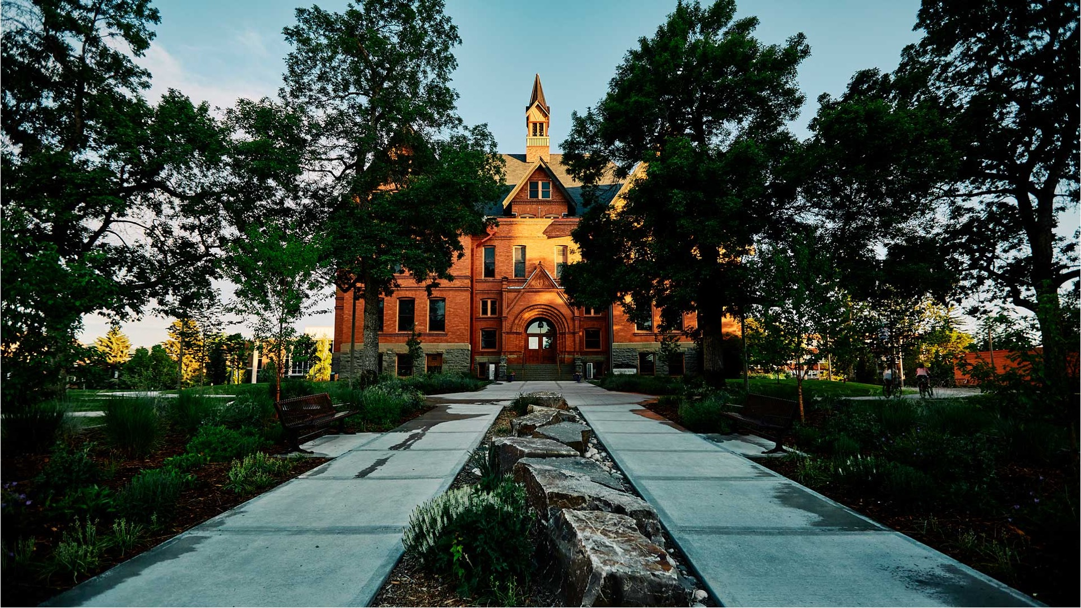

Montana State University Template
Insert Subtitle

Slide 4
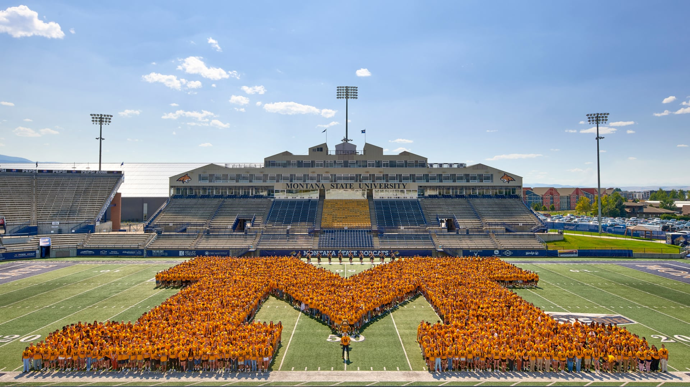
Notes:
On Aug. 19, 2025, MSU gathered its incoming first-year students in Bobcat Stadium for the traditional M Photo.

