Slide 1
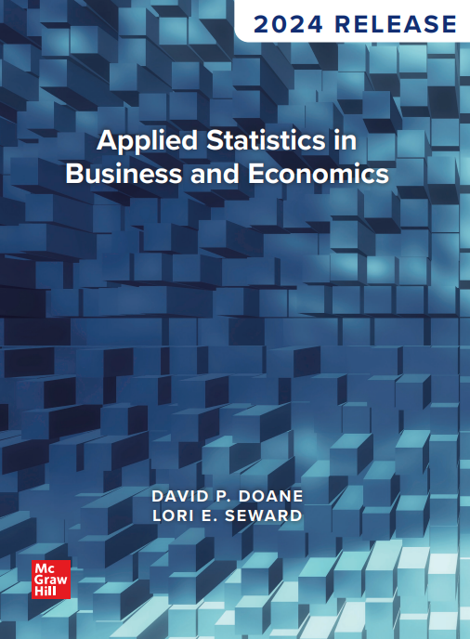
Chapter 1
Overview of Statistics
© McGraw Hill LLC. All rights reserved. No reproduction or distribution without the prior written consent of McGraw Hill LLC.

Slide 2
Chapter Learning Objectives
Chapter 1
L O 1.1: Define statistics and explain some of its uses.
L O 1.2: List reasons for a business student to study statistics.
L O 1.3: Explain the uses of statistics in business.
L O 1.4: State the common challenges facing business professionals using statistics.
L O 1.5: List and explain common statistical pitfalls.

Slide 3
Why Study Statistics? 1
Chapter 1
Increasingly, companies are using statistical analysis (business analytics) to support decision making, recognize anomalies that require tactical action, or gain strategic insight to align business processes with business objectives.
Businesses that combine managerial judgment with statistical analysis are more successful.

Slide 4
What is Statistics? 1
L O 1.1
Statistics may be thought of as a collection of methodologies to summarize, draw valid conclusions, and make predictions from empirical measurements. Statistics helps us organize and present information and extract meaning from raw data.
Plural or Singular?
Statistics | The science of collecting, organizing, analyzing, interpreting, and presenting data.
Statistic | A single measure, reported as a number, used to summarize a sample data set.

Slide 5
What is Statistics? 2
L O 1.1
For the height of students, a graduation gown manufacturer may need to know the average height for the length of the gowns or an architect may need to know the maximum height to design the height of the doorways of the classrooms. Both the average and the maximum are examples of statistics.
There are two primary kinds of statistics.
Descriptive statistics refers to the collection, presentation, and summary of data (either using charts and graphs or using numerical summary).
Inferential statistics refers to the generalizing from a sample to a population, estimating unknown population parameters, drawing conclusions, and making decisions.

Slide 6
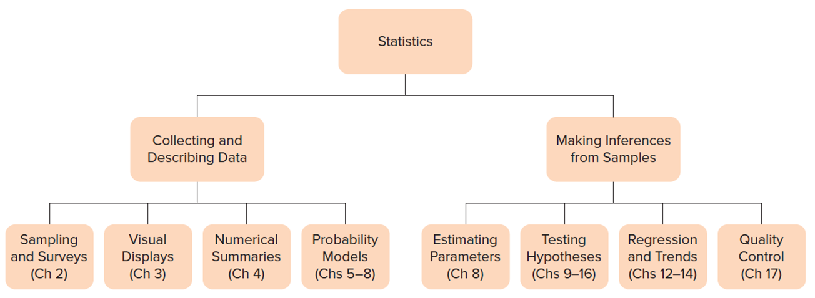
What is Statistics? 3
L O 1.1
Figure 1.1: Overview of Statistics.
Access the text alternative for slide images.

Slide 7
What is Statistics? 4
L O 1.1
What is Business Analytics?
Analytics is a broad field that uses statistics, mathematics, and computational tools to extract information from data. Analytics tools fall into three categories: descriptive, predictive, and prescriptive. This terminology derived from the questions we are trying to answer.
What happened? Businesses use descriptive analytics tools to analyze historical data and help them identify trends and patterns.
What is likely to happen next? Businesses use predictive analytics tools to predict probabilities of future events and help them forecast consumer behavior.
What actions do we take to achieve our goals? Businesses use prescriptive analytics tools to help them make decisions on how to achieve objectives within real-world constraints.

Slide 8
Why Study Statistics? 2
L O 1.2
Knowing statistics will make you a better consumer of other people’s data analyses.
You should know enough to handle everyday data problems, to feel confident that others cannot deceive you with spurious arguments, and to know when you’ve reached the limits of your expertise.

Slide 9
Why Study Statistics? 3
L O 1.2
Statistical knowledge gives companies a competitive advantage against organizations that cannot understand their internal or external market data.
Mastery of basic statistics gives an individual manager a competitive advantage as one works one’s way through the promotion process, or when one moves to a new employer.

Slide 10
Why Study Statistics? 4
L O 1.2
Communication:
Understanding the language of statistics facilitates communication and improves problem solving.
Computer Skills:
The use of spreadsheets for data analysis and word processors or presentation software for reports improves upon your existing skills.

Slide 11
Why Study Statistics? 5
L O 1.2
Information Management:
Statistics helps summarize small and large amounts of information (data) and reveal underlying relationships.
Technical Literacy:
Career opportunities are in growth industries propelled by advanced technology. The use of statistical software increases your technical literacy.

Slide 12
Why Study Statistics? 6
L O 1.2
Process Improvement:
Large firms have formal systems for continuous quality improvement. Statistics helps firms oversee their suppliers, monitor their internal operations, and identify problems. Quality improvement goes far beyond statistics, but every college graduate is expected to know enough statistics to understand its role in quality improvement.

Slide 13
Applying Statistics in Business 1
L O 1.3
Auditing:
The firm has learned that some invoices are being paid incorrectly, but it doesn’t know how widespread the problem is. A sample of invoices can be used to estimate the proportion of incorrectly paid invoices.

Slide 14
Applying Statistics in Business 2
L O 1.3
Marketing:
Many companies use Customer Relationship Management (C R M) to analyze customer data from multiple sources. With statistical and analytics tools such as correlation and data mining, they identify specific needs of different customer groups, and this helps them market their products and services more effectively.

Slide 15
Applying Statistics in Business 3
L O 1.3
Health Care:
Evaluate incoming patients using a 42-item physical and mental assessment questionnaire.
Quality Improvement:
Initiate a triple inspection program, setting penalties for workers who produce poor-quality output.

Slide 16
Applying Statistics in Business 4
L O 1.3
Purchasing:
A food producer purchases plastic containers for packaging its product. Inspection of the most recent shipment of 500 containers found that 3 of the containers were defective. The supplier’s historical defect rate is .005. Has the defect rate really risen or is this simply a “bad” batch?

Slide 17
Applying Statistics in Business 5
L O 1.3
Medicine:
Determine whether a new drug is really better than the placebo or if the difference is due to chance.
Operations Management:
Manage inventory by forecasting consumer demand.
Product Warranty:
Determine the average dollar cost of engine warranty claims on a new hybrid engine.

Slide 18
Statistical Challenges
L O 1.4
The ideal data analyst (business professionals using statistics) should possess these characteristics:
Is technically current (For example, software-wise).
Communicates well.
Is proactive.
Has a broad outlook.
Is flexible.
Meets deadlines.
Focuses on the main problem.
Knows their limitations and is willing to ask for help.
Can deal with imperfect information.
Has professional integrity.

Slide 19
Imperfect Data and Practical Constraints
L O 1.4
You will face constraints on the type and quality of data you can collect.
State any assumptions and limitations and use generally accepted statistical tests to detect unusual data points or to deal with missing data.
Constraint Examples:
Automobile tests can’t use human subjects (too risky).
Telephone surveys can’t ask a female respondent whether she has had an abortion (sensitive question).
We can’t test everyone for COVID (the world is not a laboratory).

Slide 20
Business Ethics
L O 1.4
Some broad ethical responsibilities of business include the following:
Treating customers in a fair and honest manner.
Complying with laws that prohibit discrimination.
Ensuring that products and services meet safety regulations.
Advertising in a factual and informative manner.
Encouraging employees to ask questions and voice concerns about the company’s business practices.
Being responsible for accurately reporting information to management.

Slide 21
Upholding Ethical Standards
L O 1.4
Ethical standards for the data analyst:
Know and follow accepted procedures.
Maintain data integrity.
Carry out accurate calculations.
Report procedures faithfully.
Protect confidential information.
Cite sources.
Acknowledge sources of financial support.

Slide 22
Working in Teams
L O 1.4
Business activity is often handled in teams. Today, technical experts spend much of their time in meetings, discussing project milestones, preparing team reports, and arguing about methodology.
Questions teams face.
What is the best way to organize the team?
What communication channels will the team use?
How can the team’s resources best be utilized?
What is the role of the team leader?
Do we need a subcommittee?

Slide 23
Using Consultants
L O 1.4
Hire consultants at the beginning of the project, when your team lacks certain skills or when an unbiased or informed view is needed.
Some companies expect their employees to be able to interpret the results of a statistical analysis, even if it was completed by an outside consultant.

Slide 24
Communicating with Numbers 1
L O 1.4
Numbers have meaning only when communicated in the context of a certain situation.
Presentation should be such that managers will quickly understand the information they need to use in order to make good decisions.

Slide 25
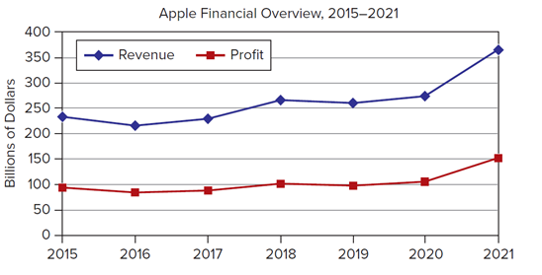
Communicating with Numbers 2
L O 1.4
Compare Table 1.1 and Figure 1.2. Which is more helpful in understanding Apple’s recent financial performance?
Table 1.1: Apple Revenue and Profit, 2015 to 2021 (Billions).
Year | 2015 | 2016 | 2017 | 2018 | 2019 | 2020 | 2021
Revenue | 233.7 | 215.6 | 229.2 | 265.6 | 260.2 | 274.5 | 365.8
Profit | 93.6 | 84.3 | 88.2 | 101.8 | 98.4 | 105.0 | 152.8
Source: www.macrotrends.net.
Figure 1.2: Apple Revenue and Profit, 2015 to 2021 (Billions).
Apple
Access the text alternative for slide images.

Slide 26
Critical Thinking
L O 1.5
Statistics is an essential part of critical thinking because it allows us to test an idea against empirical evidence.
Empirical data represent data collected through observation and experiments.
Statistical tools are used to compare prior ideas with empirical data, but pitfalls do occur.

Slide 27
Logical Pitfalls 1
L O 1.5
Logical pitfalls abound in both the data collection process and the reasoning process.
Pitfall 1: Conclusions from small samples.
Be careful about making generalizations from small samples (For example, a group of 10 patients who showed improvement).

Slide 28
Logical Pitfalls 2
L O 1.5
Pitfall 2: Conclusions from nonrandom samples.
Be careful about making generalizations from retrospective studies of special groups (For example, studying vaccine-related complications must also include those who have no complications).

Slide 29
Logical Pitfalls 3
L O 1.5
Pitfall 3: Conclusions from rare events.
Be careful about drawing strong inferences from events that are not surprising when looking at the entire population (For example, winning the lottery).
Pitfall 4: Poor survey methods.
Be careful about using poor sampling methods or vaguely worded questions (For example, an anonymous survey or quiz may provide better insight).

Slide 30
Logical Pitfalls 4
L O 1.5
Pitfall 5: Assuming a causal link.
Be careful about drawing conclusions when no cause-and-effect link exists (For example, teams who play in named ballparks (Citi Field for the N Y Mets) tend to lose more games than they win. Actually, it is the players and managers who determine whether a team wins).

Slide 31
Logical Pitfalls 5
L O 1.5
Pitfall 6: Generalization to individuals.
Avoid reading too much into statistical generalizations (For example, men are taller than women). Yes, but only in a statistical sense. Men are taller on average, but many women are taller than many men.

Slide 32
Logical Pitfalls 6
L O 1.5
Pitfall 7: Unconscious bias.
Be careful about unconsciously or subtly allowing bias to color handling of data (For example, heart disease in men versus women). Symptoms in men are more obvious than in women.
Pitfall 8: Significance versus importance.
Statistically significant effects may lack practical importance (For example, Austrian military recruits born in the spring average 0.6 cm taller than those born in the fall). Would anyone notice this difference?

Slide 33
Chapter 1: Practice Problems

Slide 34
Question 2
L O 1.3
Give an example of how statistics might be useful to the person in the scenario.
a. A personnel executive is examining job turnover in different restaurants in a fast-food chain.
b. An intranet manager is studying email usage rates by employees in different job classifications.
c. A retirement planner is studying mutual fund performance for six different types of asset portfolios.

Slide 35
Question 6
L O 1.4
The U S Public Interest Research Group Education Fund (U S P I R G) recently published a report titled The Campus Credit Card Trap: A Survey of College Students about Credit Card Marketing. You can find this report and more information about campus credit card marketing at The Campus Credit Card Trap. Read this report and then answer the following questions about how statistics plays a role in resolving ethical dilemmas.
a. What is the perceived ethical issue highlighted in this report?
b. How did U S P I R G conduct its study to collect information and data?
c. What broad categories did its survey address?
d. Did the survey data verify that the issue was a real, instead of a perceived, ethical problem?
e. Do you agree with the study’s assessment of the issue? Why or why not?
f. Based on the results of the survey, is the issue widespread? Explain.
g. Describe the report’s suggested solutions to confront unethical business practices.

Slide 36
Which Fallacy, if Any, do You See?
L O 1.5
Question 8:
Recently, the same five winning numbers (4, 21, 23, 34, 39) came up both on Monday and on Wednesday in the North Carolina Lottery. “That’s so unlikely that it must be rigged,” said Mary.
Question 9:
A National Health Interview Survey conducted by the U S Centers for Disease Control and Prevention reported that using a cell phone instead of a landline appeared to double a person’s chances of binge drinking. “I guess I’d better give up my cell phone,” said Bob.

Slide 37
Chapter 1: Analytics in Action

Slide 38
Analytics in Action 1
L O 1.1
Using Analytics to Improve Business:
Descriptive Analytics: Google Analytics provides a wide range of metrics for companies that want to better understand how their websites operate. This type of descriptive analytics allows companies to see, for example, loading time for their pages in different browsers and on different devices; how much time a viewer spends on the page; and the number of visits per hour, day, or week. In addition, companies can see performance measures such as bounce rate or click-through rale. Bounce rate shows the percentage of viewers who leave the site after viewing only the homepage. Click through rate is the percentage of viewers who click on the ad when they view it on a webpage. Both of these metrics are important for evaluating the effectiveness of a web design.
Predictive Analytics: In 2015, Oracle acquired Datalogix (now called Oracle Advertising), a company that analyzes consumer purchasing behavior to help its customers design the most effective digital marketing campaigns. The acquisition of Datalogix strengthened the tools Oracle provides as part of its data cloud offerings. Predictive analytics has been the key to Datalogix's success. Dr Pepper is one of its happy customers. When Dr Pepper wanted to increase sales, it turned to Datalogix for help in designing a successful Facebook advertising campaign. Through the use of analytics, Datalogix showed that by targeting Facebook users who purchased carbonated beverages and those who purchased Dr Pepper products in particular, Dr Pepper was able to increase its sales by 1.5 percent. And for every $1 spent on advertising, Dr Pepper saw a $3 increase in revenue.

Slide 39
Analytics in Action 2
L O 1.1
Prescriptive Analytics: Hotel rooms and airplane seats are perishable, just like apples and lettuce. When a room or seat is not booked, the company has lost the ability to earn revenue for that night or flight. Setting the right price for the right customer on the right day is complicated. Hotels and airlines feed large data sets into mathematical algorithms that choose the optimal pricing scheme to maximize the revenue for that room or seat. This practice is called revenue management and is an example of prescriptive analytics. When large data sets are analyzed along with system constraints, companies can quickly simulate many different outcomes related to a wide variety of decisions. This allows the decision makers to choose a set of actions that will result in the best outcome for the company and its customers.

Slide 40
Analytics in Action 3
L O 1.2
Can Big Data Predict Airfares?
When you book an airline ticket online, does it annoy you when the next day you find a cheaper fare on exactly the same flight? Or do you congratulate yourself when you get a "good" fare followed by a price rise? Ticket price variation can be predicted, even though there is some uncertainty in the actual price you end up paying. KAYAK, a subsidiary of Priceline.com, is a travel planning website and mobile app used by millions of people every day to help forecast prices on airfares as well as hotels and rental cars. How does KAYAK predict airfare variation? It uses big data. Each day, KAYAK’s analysts process over a billion online queries to forecast whether an airfare will go up or down. The mathematical models they use also provide a statistical confidence in their prediction so you can make decisions on when to purchase your airline ticket. If you travel a lot and take the time to use services such as KAYAK, you could save money. (See www.kayak.com/price-trend-explanation.)

Slide 41
Analytics in Action 4
L O 1.4
Ethical Issues in Artificial Intelligence:
Predictions from machine learning (M L) and artificial intelligence (A I) face major concerns about reproducibility, potential bias, transparency, and causality. For example, if a mortgage loan is denied because the A N N predicts a high probability of default, how can the bank explain its decision to a customer? If a medicine is predicted to be effective in treating a disease but the causal mechanism is not explicit, should the medicine be prescribed? Was the training data somehow biased (For example, by race or gender)? Deep ethical problems arise when A l is used to make decisions that affect people. People are demanding that A l explain its methods more clearly.
Will Google’s A I search engines (For example. BERT) ingest biases from web data sources that it scans without human direction? Online digitized information is likely to reflect common gender stereotypes, racial profiles, or posts by hate groups and bots.
Other search engines (For example, Siri, Alexa) face the same issues. This is a challenge, but also a source of business opportunity that creates demand for statistical expertise in improving these search engines and the reliability of data sources.
A I decisions may require ethical judgments. For example, in self-driving vehicles, which of several bad options is best when a crash is unavoidable? Faced with a choice of sacrificing one life to save several, what should A I do?
Sources: See David.J. Hand, "Dark Data," Significance 17, no. 3 (June 2020), pp. 34-37; S U Noble, Algorithms of Oppression: How Search Engines Reinforce Racism (New York: N Y U Press, 2018).

Slide 42
End of Main Content
© McGraw Hill LLC. All rights reserved. No reproduction or distribution without the prior written consent of McGraw Hill LLC.

Slide 43
Accessibility Content: Text Alternatives for Images
43

Slide 44
What is Statistics? 3 – Text Alternative
Return to parent-slide containing images.
Statistics is divided into two parts: collecting and describing data and making inferences from samples. Collecting and describing data is covered in Chapters 2 through 8. Chapter 2 is about sampling and surveys. Chapter 3 covers visual displays. Chapter 4 covers numerical summaries. Chapters 5 through 8 cover probability models. Making inferences from samples is covered in Chapters 8 through 17. Chapter 8 covers estimating parameters. Chapters 9 to 16 cover testing hypotheses. Chapters 12 to 14 cover regression and trends, and Chapter 17 covers quality control.
Return to parent-slide containing images.

Slide 45
Communicating with Numbers 2 – Text Alternative
Return to parent-slide containing images.
The horizontal axis ranges from 2015 to 2021 in increments of 1. The vertical axis is labeled Billions of Dollars. It ranges from 0 to 400 in increments of 50. The curve labeled Revenue begins at (2015, 240), passes through (2016, 210), (2017, 230), (2018, 260), (2019, 260), and (2020, 265), and ends at (2021, 360). The curve labeled Profit begins at (2015, 100), passes through (2016, 90), (2017, 90), (2018, 100), and (2019, 100), and ends at (2021, 150). All values are estimated.
Return to parent-slide containing images.

