Slide 1

Chapter 2
Data Collection
© McGraw Hill LLC. All rights reserved. No reproduction or distribution without the prior written consent of McGraw Hill LLC.

Slide 2
Chapter Learning Objectives
Chapter 2
L O 2.1: Use basic terminology for describing data and samples.
L O 2.2: Explain the difference between numerical and categorical data.
L O 2.3: Explain the difference between time series and cross-sectional data.
L O 2.4: Recognize levels of measurement in data and ways of coding data.
L O 2.5: Recognize a Likert scale and know how to use it.
L O 2.6: Use the correct terminology for samples and populations.
L O 2.7: Explain the common sampling methods and how to implement them.
L O 2.8: Find everyday print or electronic data sources.
L O 2.9: Describe basic elements of survey types, survey designs, and response scales.

Slide 3
Variables and Data 1
L O 2.1
Data Terminology:
Observation: a single member of a collection of items that we want to study, such as a person, firm, or region.
Variable: a characteristic of the subject or individual, such as an employee’s income or an invoice amount.
Data set: consists of all the values of all of the variables for all of the observations we have chosen to observe.

Slide 4
Variables and Data 2
L O 2.1
A data set may consist of many variables.
The questions that can be explored and the analytical techniques that can be used will depend upon the data type and the number of variables.
This textbook covers:
univariate data sets (one variable).
bivariate data sets (two variables).
multivariate data sets (more than two variables).

Slide 5
Variables and Data 3
L O 2.1
Table 2.2: Number of Variables and Typical Tasks.
Data Set | Variables | Example | Typical Tasks
Univariate | One | Income | Histograms, basic statistics
Bivariate | Two | Income, Age | Scatter plots, correlation
Multivariate | More than two | Income, Age, Gender | Regression modeling

Slide 6
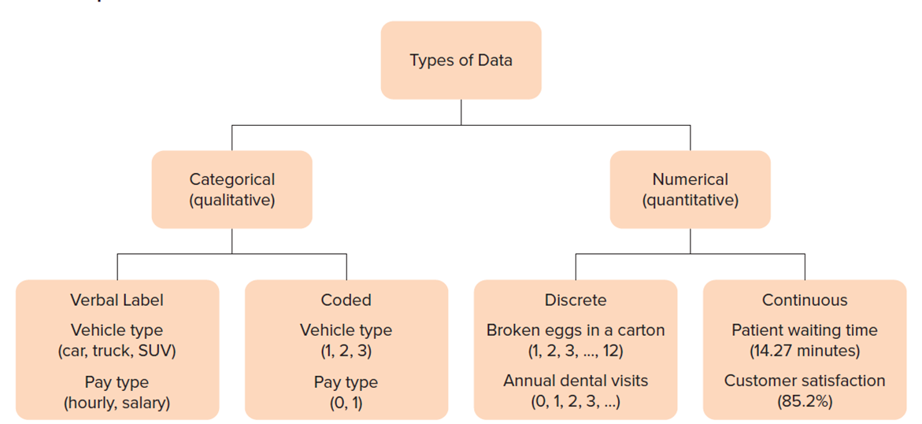
Categorical and Numerical Data
L O 2.2
Figure 2.1: Data Types and Examples.
Access the text alternative for slide images.

Slide 7
Time Series Data
L O 2.3
Each observation in the sample represents a different equally spaced point in time (For example, years, months, days).
The periodicity is the time between observations (annual, quarterly, monthly, weekly, daily, hourly, and so on).
Examples:
Macroeconomics:
National Income.
Economic indicators.
Monetary data.
Microeconomics:
Sales.
Market share.
Inventory turnover.

Slide 8
Cross-Sectional Data 1
L O 2.3
Each observation represents a different individual unit (For example, person) at the same point in time (For example, monthly VISA balances).
For cross-sectional data, we are interested in:
Variation among observations.
Example: accounts receivable in 20 Subway franchises.
Relationships.
Example: whether accounts receivable are related to sales volume in 20 Subway franchises as shown in Figure 2.2.
We can combine the two data types to get pooled cross-sectional and time series data.

Slide 9
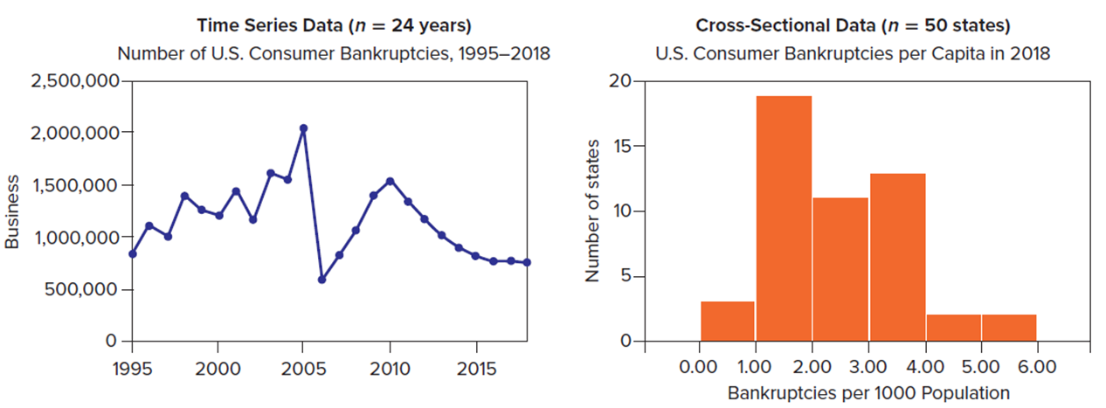
Cross-Sectional Data 2
L O 2.3
Figure 2.2: Examples of Time Series versus Cross-Sectional Data.
Source: American Bankruptcy Institute (www.abiworld.org).
Access the text alternative for slide images.

Slide 10
What type of data (categorical, discrete numerical, or continuous numerical) is each of the following
a. Length of a TV commercial.
b. Number of peanuts in a can of Planter’s Mixed Nuts.
c. Occupation of a mortgage applicant.
d. Flight time from London Heathrow to Chicago O’Hare.
e. The fat grams you ate for lunch yesterday.
f. The name of the airline with the cheapest fare from New York to London.

Slide 11
Which type of data (cross-sectional or time series) is each variable?
a. Scores of 50 students on a midterm accounting exam last semester.
. Bob’s scores on 10 weekly accounting quizzes last semester.
c. Average score by all takers of the state’s CPA exam for each of the last 10 years.
d. Number of years of accounting work experience for each of the 15 partners in a CPA firm.
e. Dividends per share paid by General Electric common stock for the last 20 quarters.
f.Latest price/earnings ratios of 10 stocks in Bob’s retirement portfolio.

Slide 12
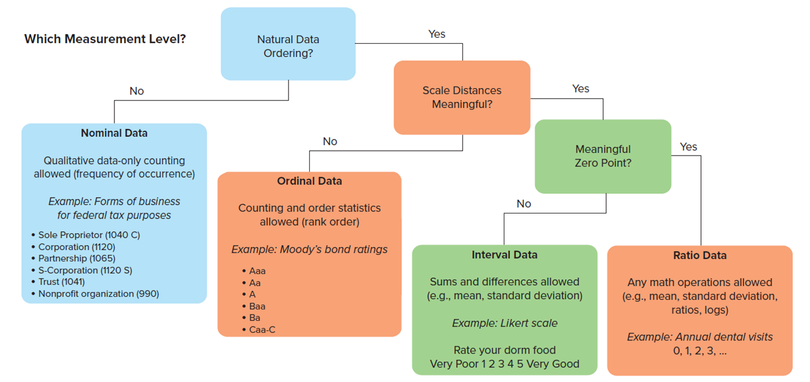
Levels of Measurement 1
L O 2.4
Figure 2.3: Determining the Measurement Level.
Access the text alternative for slide images.

Slide 13
Levels of Measurement 2
L O 2.4
Level of Measurement | Characteristics | Example
Nominal | Categories only | Eye color (blue, brown, green, etc.)
Ordinal | Rank has meaning. No clear meaning to distance | Rarely, never
Interval | Distance has meaning | Temperature (57° Celsius)
Ratio | Meaningful zero exists | Accounts payable ($21.7 million)

Slide 14
Nominal Measurement
L O 2.4
Nominal data merely identifies a category.
Nominal data are qualitative, attribute, categorical or classification data, and can be coded numerically (For example, 1 = Apple, 2 = Samsung, 3 = Dell, 4 = H P).
The only mathematical operations are counting or simple statistics (For example, the mode).
Example:
Did you file an insurance claim last month?
Yes.
No.

Slide 15
Ordinal Measurement
L O 2.4
Ordinal data codes can be ranked (For example, 1 = Frequently, 2 = Sometimes, 3 = Rarely, 4 = Never).
Distance between data codes is not meaningful (For example, distance between 1 and 2, or between 2 and 3, or between 3 and 4 lacks meaning).
Many useful statistical tests exist for ordinal data, which are especially useful in social science, marketing, and human resource research.
Example:
How often do you use Microsoft Access?
Frequently.
Sometimes.
Rarely.
Never.

Slide 16
Interval Measurement
L O 2.4
Interval data can be ranked, but can also have meaningful intervals between scale points (For example, difference between 60°F and 70°F is same as difference between 20°F and 30°F).
Since intervals between numbers represent distances, mathematical operations can be performed (For example, average).
Zero point of interval scales is arbitrary, so ratios are not meaningful (For example, 60°F is not twice as warm as 30°F).
Example:
What was the temperature yesterday? (in Fahrenheit).

Slide 17
Ratio Measurement
L O 2.4
Ratio data have all properties of nominal, ordinal, and interval data types and also possess a meaningful zero (absence of quantity being measured).
Because of this zero point, ratios of data values are meaningful (For example, $20 million profit is twice as much as $10 million).
Zero does not have to be observable in the data; it is an absolute reference point.
Example:
How much did the book weigh?

Slide 18
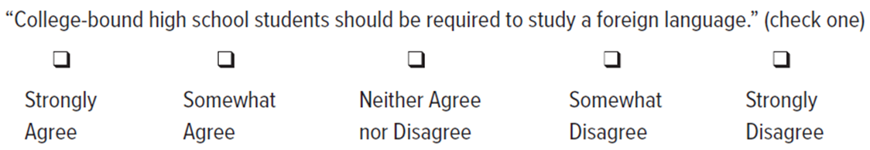
Likert Scales 1
L O 2.5
A special case of interval data frequently used in survey research.
The coarseness of a Likert scale refers to the number of scale points (typically 5 or 7).
Access the text alternative for slide images.

Slide 19
Likert Scales 2
L O 2.5
A neutral midpoint (“Neither Agree nor Disagree”) is allowed if we use an odd number of scale points (usually 5 or 7). Occasionally, surveys may omit the neutral midpoint to force the respondent to “lean” one way or another. Likert data are coded numerically, but any equally spaced values will work.
Likert Coding: 1 to 5 scale | Likert Coding: −2 to +2 scale
5 = Will help a lot | +2 = Will help a lot
4 = Will help a little | +1 = Will help a little
3 = No effect on investment climate | 0 = No effect on investment climate
2 = Will hurt a little | −1 = Will hurt a little
1 = Will hurt a lot | −2 = Will hurt a lot

Slide 20
Levels of Measurement
L O 2.4
Use the following procedure to recognize data types:
Question | If “Yes”
Q1. Is there a meaningful zero point? | Ratio data (statistical operations are allowed).
Q2. Are intervals between scale points meaningful? | Interval data (common statistics allowed, For example, means and standard deviations).
Q3. Do scale points represent rankings? | Ordinal data (restricted to certain nonparametric statistical tests).
Q4. Are there discrete categories? | Nominal data (only counting allowed, For example, finding the mode).

Slide 21
Sampling Concepts 1
L O 2.6
Population or Sample?
Population:
All of the items that we are interested in. May be either finite (For example, all of the passengers on a particular plane) or effectively infinite (For example, all of the Cokes produced in an ongoing bottling process).
Sample:
A subset of the population that we will actually analyze.

Slide 22
Sampling Concepts 2
L O 2.6
Sample or Census?
A sample involves looking only at some items selected from the population.
A census is an examination of all items in a defined population.
Why can’t the United States Census survey every person in the population?
mobility, undocumented workers, budget constraints, incomplete responses, etc.

Slide 23
Sampling Concepts 3
L O 2.6
Table 2.4: Sample or Census?
When a Sample May Be Preferred | When a Census May Be Preferred
Infinite Population | Small Population
Population is of indefinite size (an assembly line can keep producing cars). | Population is small or the effort of data collection is small.
Destructive Testing | Large Sample Size
The act of measurement may destroy or devalue the item (battery life, vehicle crash tests). | If the required sample size approaches the population size, we might as well go ahead and take a census.
Timely Results | Database Exists
Sampling may yield more timely results (checking vegetables for salmonella contamination). | If data are in a database, we can examine all the cases.
Accuracy | Legal Requirements
Instead of spreading resources thinly to attempt a census, budget might be better spent to improve sampling. | Banks must count all the cash in bank teller drawers at the end of each business day.
Cost
Even if a census is feasible, the cost, in either time or money, may exceed our budget.
Sensitive Information
Sexual harassment might best be studied by selected in-depth employee interviews.

Slide 24
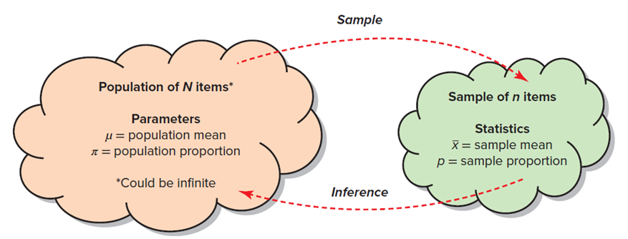
Sampling Concepts 4
L O 2.6
Parameter or Statistic?
Parameter:
A measurement or characteristic of the population (For example, a mean or proportion). Usually unknown because we can rarely observe the entire population. Usually (but not always) represented by a Greek letter (For example, μ or π).
Statistic:
A numerical value calculated from a sample (For example, a mean or proportion). Usually (but not always) represented by a Roman letter
Figure 2.4: Population versus Sample.
Access the text alternative for slide images.

Slide 25
Sampling Concepts 5
L O 2.6
From a sample of n items, chosen from a population, we compute statistics that can be used as estimates of parameters found in the population.
To avoid confusion, we use different symbols for each parameter and its corresponding statistic.
Thus, the population mean is denoted by μ (the lowercase
Greek letter mu) while the sample mean is
The population proportion is denoted π (the lowercase
Greek letter pi), while the sample proportion is p.

Slide 26
Sampling Concepts 6
L O 2.6
Target Population:
The population must be carefully specified and the sample must be drawn scientifically so that the sample is representative.
The target population is the population we are interested in (For example, U.S. gasoline pump prices).
The sampling frame is the group from which we take the sample (For example, 115,000 stations).
The frame should not differ from the target population.

Slide 27
Sampling Methods
L O 2.7
Random Sampling Methods:
Simple Random Sample | Use random numbers to select items from a list.
Systematic Sample | Select every kayth item from a list or sequence.
Stratified Sample | Select randomly within defined strata (For example, by age).
Cluster Sample | Select random geographical regions (For example, zip codes).

Slide 28
Simple Random Sample
L O 2.7
We denote the population size by N and the sample size by n.
In a simple random sample, every item in the population of N items has the same chance of being chosen in the sample of n items.
A physical experiment to accomplish this would be to write each of the N data values on a poker chip, and then to draw n chips from a bowl after stirring it thoroughly.

Slide 29
With or Without Replacement 1
L O 2.7
With the advent of technology, random samples can easily be generated.
Sampling without replacement – once an item has been selected to be included in a sample, it is not considered for the sample again.
Sampling with replacement – The item could show up more than once.

Slide 30
With or Without Replacement 2
L O 2.7
When should we worry about sampling without replacement?
Only when the population is finite and the sample size is close to the population size.
Note:
A common criterion is that a finite population is effectively infinite if the sample is less than 5 percent of
the population
An equivalent statement is that a population is effectively infinite when it is at least 20 times as large as the sample

Slide 31
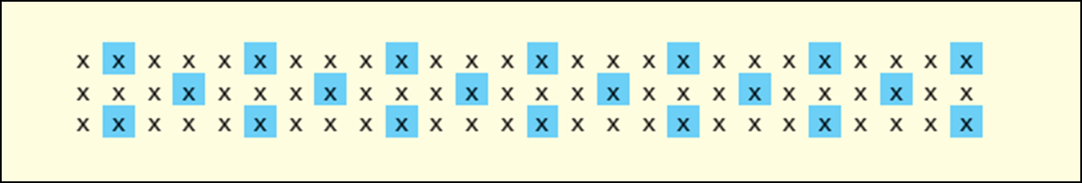
Systematic Sampling
L O 2.7
Sample by choosing every kayth item from a list, starting from form a randomly chosen entry on the list.
For example, starting at item 2 (see below), we sample every 4 items to obtain a sample of n = 20 items from a list of N = 78 items.
Note that
(periodicity).

Slide 32
Stratified Sampling
L O 2.7
Utilizes prior information about the population.
Applicable when the population can be divided into relatively homogeneous subgroups of known size (strata).
A simple random sample of the desired size is taken within each stratum.
Alternatively, a random sample of the whole population could be taken, and then individual strata estimates could be combined using appropriate weights.
Examples: Gender, Race, etc.

Slide 33
Cluster Sampling 1
L O 2.7
Strata consist of geographical regions.
One-stage cluster sampling – sample consists of all elements in each of k randomly chosen subregions (clusters).
Two-stage cluster sampling – first choose k subregions (clusters), then choose a random sample of elements within each cluster.

Slide 34
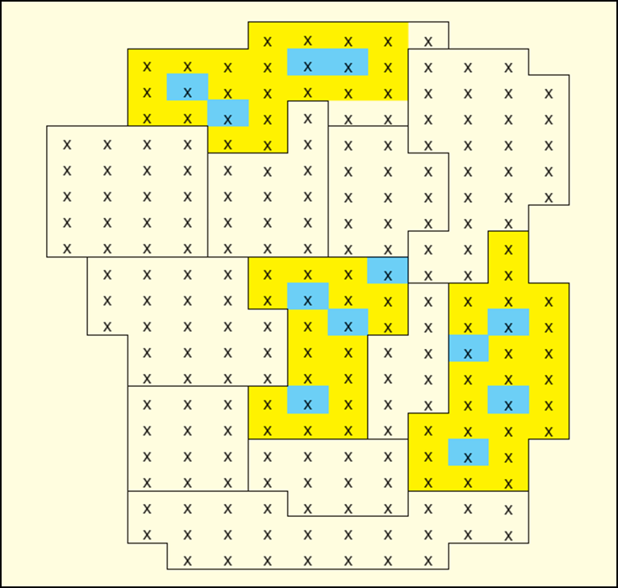
Cluster Sampling 2
L O 2.7
Cluster Sample:
Here is an example of 4 elements sampled from each of 3 randomly chosen clusters (two-stage cluster sampling).
Figure 2.7:
Two-Stage Cluster Sampling: Randomly choose three clusters, then randomly choose four items in each cluster.

Slide 35
Non-Random Sampling Methods
L O 2.7
Sample Type | Explanation | Example
Judgment Sample | Use expert knowledge to choose “typical” items. | Which employees to interview.
Convenience Sample | Use a sample that happens to be available. | Ask coworkers’ opinions at lunch.
Focus Groups | In-depth dialog with a representative panel of individuals. | iPod users.

Slide 36
Judgment Sample
L O 2.7
A non-probability sampling method that relies on the expertise of the sampler to choose items that are representative of the population.
Can be affected by subconscious bias (that is, non-randomness in the choice).
Quota sampling is a special kind of judgment sampling, in which the interviewer chooses a certain number of people in each category.

Slide 37
Convenience Sample
L O 2.7
Take advantage of whatever sample is available at that moment. A quick way to sample.
Example:
A newspaper reporter doing a story on perceived airport security might interview co-workers who travel frequently.

Slide 38
Focus Groups
L O 2.7
A panel of individuals chosen to be representative of a wider population, formed for open-ended discussion and idea gathering.
Although not a random sampling method, focus groups are widely used, both in business and in social science research, for the insights they can yield beyond “just numbers”.

Slide 39
Other Data Collection Methods
L O 2.7
Businesses now have many other methods for collecting data with the use of technology.
Point-of-sale (P O S) systems can collect real-time data on purchases at retail or convenience stores, restaurants, and gas stations.
Your customer loyalty accounts (using your phone number of email) offer better deals but also build a profile of your purchasing behavior.

Slide 40
Sample Size
L O 2.7
The necessary sample size for a reliable estimate of a parameter depends on the inherent variability of the quantity being measured and the desired precision of the estimate.
For example, the caffeine content of Red Bull is fairly consistent because each can is filled at the factory, so a small sample size would suffice to estimate the mean.
In contrast, the amount of caffeine in an individually brewed cup of Bigelow Raspberry Royale tea varies widely because people let it steep for varying lengths of time.
The purposes of the investigation, the costs of sampling, the budget, and time constraints also are taken into account in deciding on sample size.

Slide 41
Sources of Error or Bias 1
L O 2.7
In sampling, the word bias refers to a systematic tendency to over- or underestimate a population parameter of interest.
The word error generally refers to problems in sample methodology.
No matter how careful you are when conducting a survey, you will encounter potential sources of error.

Slide 42
Sources of Error or Bias 2
L O 2.7
Source of Error | Characteristics
Nonresponse bias | Respondents differ from non-respondents
Selection bias | Self-selected respondents are atypical
Response error | Respondents give false information
Coverage error | Incorrect specification of frame or population
Measurement error | Unclear survey instrument wording
Interviewer error | Responses influenced by interviewer
Sampling error | Random and unavoidable

Slide 43
Data Sources
L O 2.8
One goal of a statistics course is to help you learn where to find data that might be needed. Fortunately, many excellent sources are widely available. Some sources are given in the following table.
Type of Data | Examples
U.S. job-related data | U.S. Bureau of Labor Statistics
U.S. economic data | Economic Report of the President
Periodicals | Economist, Bloomberg Businessweek, Fortune, Forbes
Indexes | The New York Times, The Wall Street Journal
Databases | Compustat, Citibase, U.S. Census
World data | C I A World Factbook
Web | Wikipedia, Google, Yahoo!, M S N

Slide 44
Web Data Sources
L O 2.8
Source | Website
Bureau of Economic Analysis | www.bea.gov
Bureau of Justice Statistics | www.bjs.gov
Bureau of Labor Statistics | www.bls.gov
Central Intelligence Agency | www.cia.gov
Economic Report of the President | www.gpo.gov/erp
Environmental Protection Agency | www.epa.gov
Federal Reserve System | www.federalreserve.gov
Food and Drug Administration | www.fda.gov
National Center for Education Statistics | nces.ed.gov
National Center for Health Statistics | www.cdc.gov/nchs
U.S. Census Bureau | www.census.gov
U.S. Federal Statistics | www.usa.gov/statistics
World Bank | www.worldbank.org
World Demographics | www.demographia.com
World Health Organization | www.who.int/en

Slide 45
Steps of Survey Research
L O 2.9
Step 1: State the goals of the research.
Step 2: Develop the budget (time, money, staff).
Step 3: Create a research design (target population, frame, sample size).
Step 4: Choose a survey type and method of administration.
Step 5: Design a data collection instrument (questionnaire).
Step 6: Pre-test the survey instrument and revise as needed.
Step 7: Administer the survey (follow up if needed).
Step 8: Code the data and perform analysis.

Slide 46
Questionnaire Design
L O 2.9
Use a lot of white space in layout.
Begin with short, clear instructions.
State the survey purpose.
Assure anonymity.
Instruct on how to submit the completed survey.
Break survey into naturally occurring sections.
Let respondents bypass sections that are not applicable.
Pre-test and revise as needed.
Keep as short as possible.
Types of Questions:
Open-ended.
Fill-in-the-blank.
Ranked choices.
Pictograms.
Likert scale.

Slide 47
Surveys
L O 2.9
Survey Validity and Reliability:
Surveys are often called instruments because they are thought of as a measurement tool. As a measurement tool, researchers want the survey to be both valid and reliable. A valid survey is one that measures what the researcher wants to measure. Are the questions worded in such a way that the responses provide information about what the researcher wants to know? A reliable survey is one that is consistent. In other words, over time will the responses from similar respondents stay the same?

Slide 48
Question Wording 1
L O 2.9
The way a question is asked has a profound influence on the response. For example:
Shall state taxes be cut?
Shall state taxes be cut, if it means reducing highway maintenance?
Shall state taxes be cut, if it means firing teachers and police?
Make sure you have covered all the possibilities.
For example: Are you married?
Yes.
No.
How old is your father?
35 to 45.
45 to 55.
55 to 65.
65 or older.
How would a widow respond (missing option)? What if the father is deceased or is 45 years old (overlapping classes)?

Slide 49
Question Wording 2
L O 2.9
Responses are usually coded numerically (For example, 1 = male, 2 = female).
Missing values are typically denoted by special characters (For example, blank, “dot.” or “*”).
Discard questionnaires that are flawed or missing many responses.
Watch for multiple responses or inconsistent replies.
Follow up if necessary and always document your data-coding decisions.

Slide 50
Chapter 2: Practice Problems

Slide 51
Question 2
L O 2.2
What type of data (categorical, discrete numerical, or continuous numerical) is each of the following variables? If there is any ambiguity, explain why the answer is unclear.
a. Length of a TV commercial.
b. Number of peanuts in a can of Planter’s Mixed Nuts.
c. Occupation of a mortgage applicant.
d. Flight time from London Heathrow to Chicago O’Hare.

Slide 52
Question 5
L O 2.3
Which type of data (cross-sectional or time series) is each variable?
a. Scores of 50 students on a midterm accounting exam last semester.
b. Bob’s scores on 10 weekly accounting quizzes last semester.
c. Average score by all takers of the state’s C P A exam for each of the last 10 years.
d. Number of years of accounting work experience for each of the 15 partners in a C P A firm.

Slide 53
Question 9
L O 2.4
Which measurement level (nominal, ordinal, interval, ratio) is each of the following variables? Explain.
a. Number of hits in Game 1 of the next World Series.
b. Field position of a randomly chosen baseball player (catcher, pitcher, etc.).
c. Temperature on opening day (Celsius).
d. Salary of a randomly chosen American League pitcher.
e. Freeway traffic on opening day (light, medium, heavy).

Slide 54
Question 15
L O 2.6
Would you use a sample or a census to measure each of the following? Why?
a. The model years of the cars driven by each of your five closest friends.
b. The model years of the cars driven by each student in your statistics class.
c. The model years of the cars driven by each student in your university.

Slide 55
Question 19
L O 2.7
Suppose you want to know the ages of moviegoers who attend a theater’s last showing on a Friday night. What kind of sample is it if you:
(a) survey the first 20 persons to emerge from the theater.
(b) survey every 10th person to emerge from the theater.
(c) survey everyone who looks under age 12?

Slide 56
Question 24
L O 2.7
What sources of error might you encounter if you want to know:
(a) about the dating habits of college men, so you go to a dorm meeting and ask students how many dates they have had in the last year;
(b) how often people attend religious services, so you stand outside a particular church on Sunday and ask entering individuals how often they attend;
(c) how often people eat at McDonald’s, so you stand outside a particular McDonald’s and ask entering customers how often they eat at McDonald’s?

Slide 57
Question 26
L O 2.9
What kind of survey (mail, telephone, interview, web, direct observation) would you recommend that a small laundry and dry cleaning business use for each of the following purposes, and why?
a. To estimate the proportion of customers preferring opening hours at 7 a.m. instead of 8 a.m.
b. To estimate the proportion of customers who have only laundry and no dry cleaning.
c. To estimate the proportion of residents in the same zip code who spend more than $20 a month on dry cleaning.

Slide 58
Chapter 2: Analytics in Action

Slide 59
Analytics in Action
Too Much Randomness?
Spotify recently altered its "shuffle" feature because it was perceived by some to be "too random." Its research suggested that customers might respond better when songs by favorite artists were positioned more evenly along a playlist. Do you agree?
There are other reasons to depart from pure random sampling. For example, you would not expect the same song to be played twice in a row. But should it be allowed to play again with only one intervening song? Two? Three? How much can we "tweak“ a random algorithm without defeating its purpose? Research shows that humans try to perceive patterns even in random sequences. Might "tweaking" give rise to a different type of customer complaint?

Slide 60
End of Main Content
© McGraw Hill LLC. All rights reserved. No reproduction or distribution without the prior written consent of McGraw Hill LLC.

Slide 61
Accessibility Content: Text Alternatives for Images
61

Slide 62
Categorical and Numerical Data – Text Alternative
Return to parent-slide containing images.
There are 2 types of data. They are Categorical or qualitative and Numerical or quantitative data. Categorical data can have a verbal label or be coded. Some of the examples of Verbal label are vehicle types and pay type. The vehicle types include car, truck, and S U V and the pay type includes hourly and salary. In coded data, the vehicle types are coded as 1, 2, and 3 and the pay types are 0 and 1. Numerical or quantitative data is divided into discrete data and continuous data. Some of the examples of discrete data are broken eggs in a carton 1, 2, 3, … 12 and annual dental visits 0, 1, 2, 3… Some of the examples of the continuous data are patient waiting time 14.27 minutes and customer satisfaction 85.2%.
Return to parent-slide containing images.
62

Slide 63
Cross-Sectional Data 2 – Text Alternative
Return to parent-slide containing images.
Time series data, n = 24 years. Number of U.S. consumer Bankruptcies, 19 95 to 2018. The graph plots Business versus years. The horizontal axis ranges from 19 95 to 2015 in increments of 5. The vertical axis is labeled Business. It ranges from 0 to 2,500,000 in increments of 500,000. The curve begins at (19 95, 900,000), passes through (19 96, 1,100,000), (19 98, 1,000,000), (2000, 1,200,000), (2002, 1,500,000), (2003, 1,100,000), (2004, 1,500,000), (2005, 2,100,000), (2006, 500,000), (2010, 1,600,000), (2012, 1,000,000), (2015, 900,000), and ends at (2020, 700,000). All values are estimated. Cross-sectional data, n = 50 states. The U.S. Consumer Bankruptcies per capita in 2018. The graph plots the Number of states versus Bankruptcies per 1000 population. The horizontal axis is labeled Bankruptcies per 1000 population. It ranges from 0 to 6 in increments of 1. The vertical axis is labeled Number of States. It ranges from 0 to 20 in increments of 5. The data is as follows. 0 to 1: 3. 1 to 2: 19. 2 to 3: 11. 3 to 4: 13. 4 to 5: 2. 5 to 6: 2. All values are estimated.
Return to parent-slide containing images.
63

Slide 64
Levels of Measurement 1 – Text Alternative
Return to parent-slide containing images.
Step 1. Natural data ordering? If yes, go to step 2 else go to step 1a. Step 1a. Nominal data. Qualitative data only counting allowed, frequency of occurrence. Example: Forms of business for federal tax purposes. Sole proprietor 1040 C. Corporation 1120. Partnership 1065. S-Corporation 1120 S. Trust 1041. Nonprofit organization 990. Step 2. Are scale distances meaningful? If yes, go to step 3, else go to step 2a. Step 2a. Counting and order statistics allowed, rank order. Example: Moody’s bond ratings. Uppercase A lowercase a lowercase a. Uppercase A lowercase a. Uppercase A. Uppercase B lowercase a lowercase a. B a. Uppercase C lowercase a lowercase a- Uppercase C. Step 3. Meaningful zero point? If yes, go to step 3a else go to step 3b. Step 3a. Ratio data. Any math operations allowed. For example, mean, standard deviation, ratios, logs. Example: Annual dental visits 0, 1, 2, 3… Step 3b. Interval data. Sums and differences allowed. For example, mean, and standard deviation. Example: Likert scale. Rate your dorm food. Very poor 1 2 3 4 5 Very good.
Return to parent-slide containing images.
64

Slide 65
Likert Scales 1 – Text Alternative
Return to parent-slide containing images.
For the first image: College-bound high school students should be required to study a foreign language, check one. Below this, there is a continuum from strongly agree to strongly disagree.
For the second image: Likert, using discrete scale points: Very Poor 1 2 3 4 5 6 7 Very Good. Likert, using a slider. A slider is from Very Poor to Very Good.
Return to parent-slide containing images.
65

Slide 66
Sampling Concepts 4 – Text Alternative
Return to parent-slide containing images.
The mean mu and proportion pi of the population are called parameters. The mean x-bar and proportion p of the sample are called statistics. The population can be infinite in size. The sample from the population of N items makes inferences about the population.
Return to parent-slide containing images.

