Slide 1

Chapter 3
Describing Data Visually
© McGraw Hill LLC. All rights reserved. No reproduction or distribution without the prior written consent of McGraw Hill LLC.

Slide 2
Chapter Learning Objectives
Chapter 3
L O 3.1: Make a stem-and-leaf or dot plot.
L O 3.2: Create a frequency distribution for a data set.
L O 3.3: Make a histogram with appropriate bins.
L O 3.4: Identify skewness, modal classes, and outliers in a histogram.
L O 3.5: Make an effective line chart.
L O 3.6: Make and interpret a scatter plot.
L O 3.7: Make an effective column chart or bar chart.
L O 3.8: Make an effective pie chart.
L O 3.9: Make simple tables and pivot tables.
L O 3.10: Recognize deceptive graphing techniques.

Slide 3
Describing Data Visually 1
Chapter 3
In this chapter, you will see how visual displays can provide insight into the characteristics of a data set without using mathematics.
The type of graph you use to display your data is dependent on the type of data you have. Some charts are better suited for quantitative data, while others are better for displaying categorical data.
This chapter explains several basic types of charts, offers guidelines on when to use them, advises you how to make them effective, and warns of ways that charts can be deceptive.

Slide 4
Describing Data Visually 2
Chapter 3
Look at the data and visualize how they were collected and measured.
Visual (charts and graphs) provides insight into characteristics of a data set without using mathematics.
Numerical (statistics or tables) provides insight into characteristics of a data set using mathematics.
This chapter explains several basic types of charts, offers guidelines on when to use them, advises you how to make them effective, and warns of ways that charts can be deceptive.

Slide 5
Preliminary Assessment
Chapter 3
Begin with univariate data (a set of n observations on one variable) and consider the following.
Characteristic | Interpretation
Measurement | What are the units of measurement (For example, dollars)? Are the data values integers or continuous? Any missing observations? Any concerns with accuracy or sampling methods?
Center | Where are the data values concentrated? What seem to be typical or middle data values?
Variability | How much dispersion is there in the data? How spread out are the data values? Are there unusual values?
Shape | Are the data values distributed symmetrically? Skewed? Sharply peaked? Flat? Bimodal?

Slide 6
Stem-and-Leaf Plot 1
L O 3.1
The stem-and-leaf plot is a tool of exploratory data analysis (E D A) that seeks to reveal essential data features in an intuitive way.
A stem-and-leaf plot is basically a frequency tally, except that we use digits instead of tally marks.
For two-digit or three-digit integer data, the stem is the tens digit of the data, and the leaf is the ones digit.

Slide 7
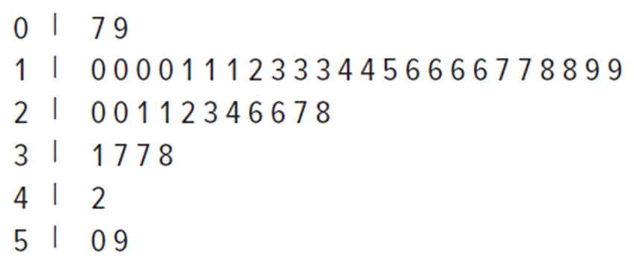
Stem-and-Leaf Plot 2
L O 3.1
For the 44 P/E ratios, the stem-and-leaf plot is given below.
The data values in the fourth stem are 31, 37, 37, 38.
We always use equally spaced stems (even if some stems are empty).
Access the text alternative for slide images.

Slide 8
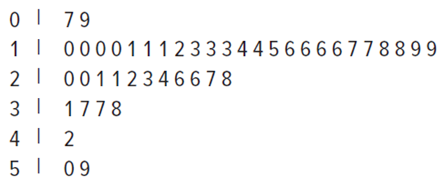
Stem-and-Leaf Plot 3
L O 3.1
The stem-and-leaf can reveal central tendency (24 of the 44 P/E ratios were in the 10 to 19 stem) as well as dispersion (the range is from 7 to 59).
In this illustration, the leaf digits have been sorted, although this is not necessary.
The stem-and-leaf has the advantage that we can retrieve the raw data by concatenating a stem digit with each of its leaf digits. For example, the last stem has data values 50 and 59.
Access the text alternative for slide images.

Slide 9
Dot Plots 1
L O 3.1
A dot plot is the simplest graphical display of n individual values of numerical data.
Easy to understand.
It reveals dispersion, central tendency, and the shape of the distribution.

Slide 10
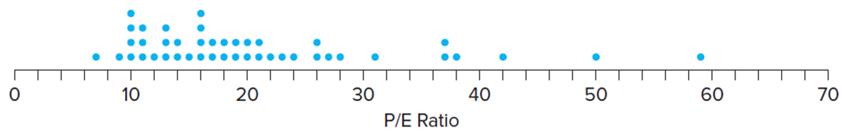
Dot Plots 2
L O 3.1
Steps in Making a Dot Plot:
Make a scale that covers the data range.
Mark the axes and label them.
Plot each data value as a dot above the scale at its approximate location.
If more than one data value lies at about the same axis location, the dots are stacked vertically.
Access the text alternative for slide images.

Slide 11
Dot Plots 3
L O 3.1
The range is from 7 to 59.
All but a few data values lie between 10 and 25.
A typical “middle” data value would be around 17 or 18.
The data are not symmetric due to a few large P/E ratios.
Access the text alternative for slide images.

Slide 12
Frequency Distribution 1
L O 3.2
Frequency Distribution:
A tabulation of n data values into k classes called bins, based on values of the data. The bin limits are cutoff points that define each bin. Bins generally have equal interval widths, and their limits cannot overlap.
Basic Steps:
Sort the data in ascending order.
Choose the number of bins.
Set the bin limits.
Put the data values in the appropriate bin.
Create the table.

Slide 13
Frequency Distribution 2
L O 3.2
Step 1: Sort the data in ascending order.
Find the smallest and largest data values.
Sorted Price/Earnings Ratios
7 | 9 | 10 | 10 | 10 | 10 | 11 | 11 | 11 | 12 | 13
13 | 13 | 14 | 14 | 15 | 16 | 16 | 16 | 16 | 17 | 17
18 | 18 | 19 | 19 | 20 | 20 | 21 | 21 | 22 | 23 | 24
26 | 26 | 27 | 28 | 31 | 37 | 37 | 38 | 42 | 50 | 59

Slide 14
Frequency Distribution 3
L O 3.2
Step 2: Choose the number of bins.
We expect the number of bins, k, to be much smaller than the sample size, n.
Sturges’ Rule: Every time we double the sample size, we should add one bin.
Sample Size (n) | Suggested Number of Bins (k)
16 | 5
32 | 6
64 | 7
128 | 8
256 | 9
512 | 10
1,024 | 11

Slide 15
Frequency Distribution 4
L O 3.2
Step 3: Set bin limits.
Find the appropriate width by dividing the data range by the number of bins:
Using the example on the previous slide our calculation would be:
To obtain “nice” limits, we could round the bin width up to 10 and choose bin limits of 0, 10, 20, 30, 40, 50, and 60.

Slide 16
Frequency Distribution 5
L O 3.2
Step 4: Prepare a Table of Frequencies.
You can choose to show only the absolute frequencies, or counts, for each bin.
You could also include the relative frequencies and cumulative frequencies.

Slide 17
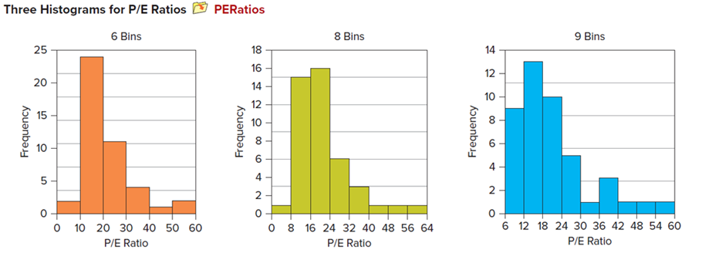
Histograms 1
L O 3.3
A histogram is a graphical representation of a frequency distribution.
A histogram is a column chart.
Y-axis shows frequency within each bin.
X-axis ticks shows end points of each bin.
Three Histograms for P/E Ratios
PERatios
Access the text alternative for slide images.

Slide 18
Histograms 2
L O 3.3
Choosing the number of bins and bin limits in creating histograms requires judgment.
One can use software programs to create histograms with different bins. These include software such as:
Excel.
MegaStat.
Minitab.
Python.

Slide 19
Histograms 3
L O 3.4
A histogram may suggest the shape of the population.
It is influenced by the number of bins and bin limits.
Skewness – indicated by the direction of the longer tail of the histogram.
Left-skewed – (negatively skewed) a longer left tail.
Right-skewed – (positively skewed) a longer right tail.
Symmetric – both tail areas are the same.

Slide 20
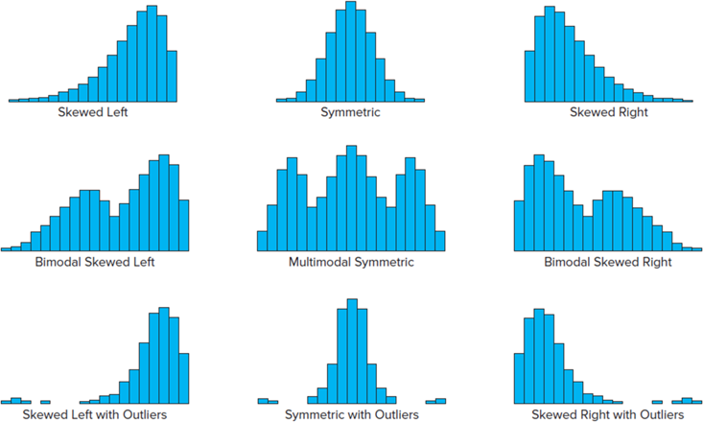
Histograms 4
L O 3.4
Prototype Distribution Shapes:
Access the text alternative for slide images.

Slide 21
Histograms 5
L O 3.4
An outlier is an extreme value that is far enough from the majority of the data that it probably arose from a different cause or is due to measurement error.
We will define outliers more precisely in the next chapter.
For now, think of outliers as unusual points located in the histogram tails.

Slide 22
Tips for Effective Frequency Distributions
L O 3.4
Check Sturges’ Rule first, but only as a suggestion for the number of bins.
Choose an appropriate bin width.
Choose bin limits that are multiples of the bin width.
Make sure that the range is covered, and add bins if necessary.
Skewed data may require more bins to reveal sufficient detail.

Slide 23
Frequency Polygons and Ogive 1
L O 3.4
A frequency polygon is a line graph that connects the midpoints of the histogram intervals, plus extra intervals at the beginning and end so that the line will touch the X-axis.
It serves the same purpose as a histogram but is attractive when you need to compare two data sets (since more than one frequency polygon can be plotted on the same scale).
An ogive (pronounced “oh-jive”) is a line graph of the cumulative frequencies.
It is useful for finding percentiles or in comparing the shape of the sample with a known benchmark such as the normal distribution (that you will be seeing in the next chapter).

Slide 24
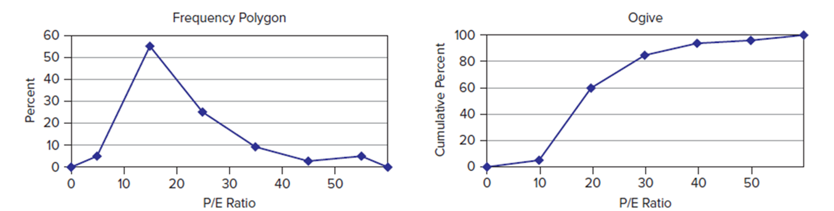
Frequency Polygons and Ogive 2
L O 3.4
Frequency Polygon and Ogive
PERatios
Access the text alternative for slide images.

Slide 25
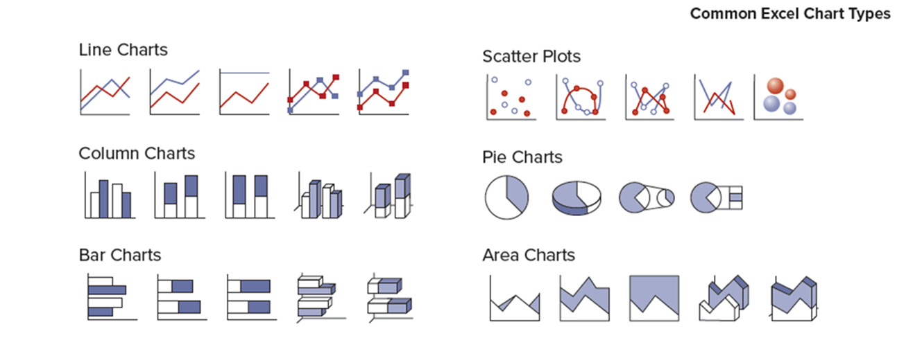
Effective Excel Charts
Excel has a variety of different kinds of charts.
You can find them on the “Insert” tab.
Access the text alternative for slide images.

Slide 26
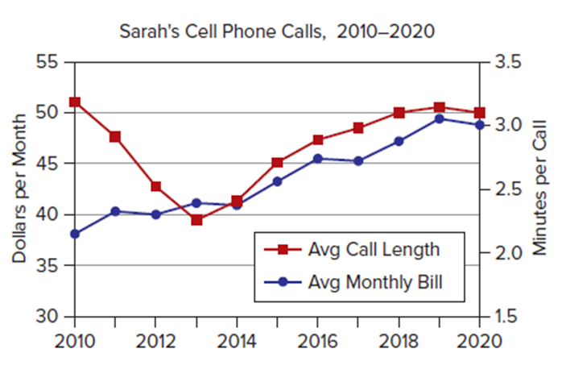
Line Charts
L O 3.5
Line charts are used to display a time series, to spot trends, or to compare time periods.
They can display several variables at once.
Access the text alternative for slide images.

Slide 27
Log Scales 1
L O 3.5
Arithmetic scale – distances on the Y-axis are proportional to the magnitude of the variable being displayed.
Logarithmic scale – (ratio scale) equal distances represent equal ratios.
Use a log scale for the vertical axis when data vary over a wide range, say, by more than an order of magnitude.
This will reveal more detail for smaller data values.

Slide 28
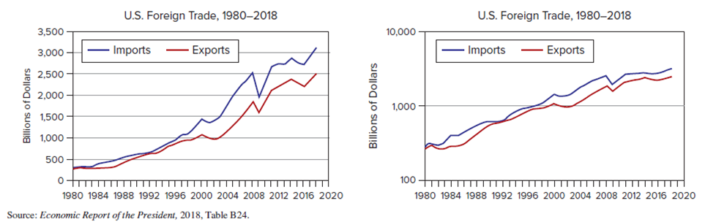
Log Scales 2
L O 3.5
A log scale is useful for time series data that might be expected to grow at a compound annual percentage rate (For example, G D P, the national debt, or your future income). It reveals whether the quantity is growing at an.
Increasing percent (concave upward),
Constant percent (straight line), or
Declining percent (concave downward).
Comparison of Arithmetic and Log Scales
USTrade
Access the text alternative for slide images.

Slide 29
Tips for Effective Line Charts
L O 3.5
Line charts are used for time series data (never for cross-sectional data).
The numerical variable is shown on the Y-axis, while the time units go on the X-axis with time increasing from left to right. Business audiences expect this rule to be followed.
Except for log scales, use a zero origin on the Y-axis unless more detail is needed. The zero-origin rule is mandatory for a corporate annual report or investor stock prospectus.
To avoid graph clutter, numerical labels usually are omitted on a line chart, especially when the data cover many time periods. Use gridlines to help the reader read data values.
Data markers (squares, triangles, circles) are helpful. But when the series has many data values or when many variables are being displayed, they clutter the graph.

Slide 30
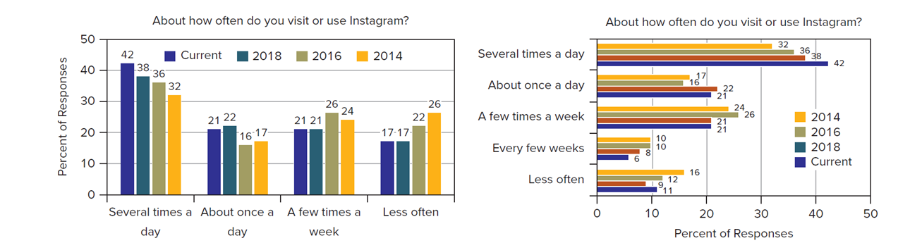
Column and Bar Charts
L O 3.6
A column chart is a vertical display of the data.
A bar chart is a horizontal display of the data.
Same Data Displayed Two Ways
Instagram
Source: Adapted from Pew Research Center.
Access the text alternative for slide images.

Slide 31
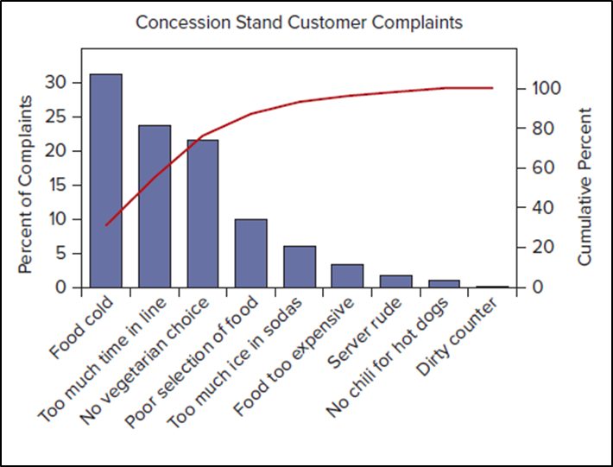
Pareto Charts
L O 3.6
Special type of column chart commonly used in quality management to display the frequency of defects or errors of different types.
Categories are displayed in descending order of frequency.
Focus on significant few (that is, few categories that account for most defects or errors).
Access the text alternative for slide images.

Slide 32
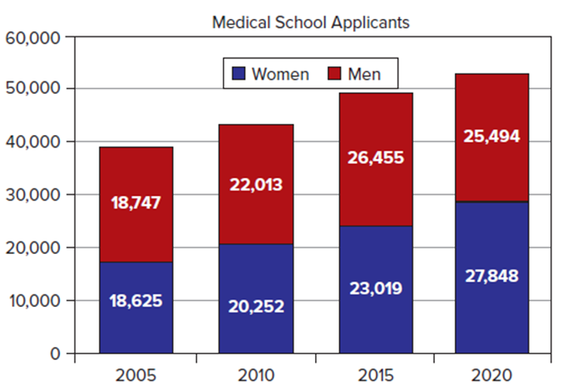
Stacked Column Chart
L O 3.6
Bar height with the sum of several subtotals. Areas may be compared by color to show patterns in the subgroups and total.
Access the text alternative for slide images.

Slide 33
Tips for Effective Bar and Column Charts
L O 3.6
The numerical variable of interest usually is shown with vertical bars on the Y-axis.
If the quantity displayed is a time series, the category labels (For example, years) are displayed on the horizontal X-axis with time increasing from left to right.
The height or length of each bar should be proportional to the quantity displayed. This is easy because most software packages default to a zero origin on a bar graph.
Add numerical values at the top of each bar, unless they would impair legibility.
Bar scale position is harder to read on 3D charts; 2D charts are preferred.

Slide 34
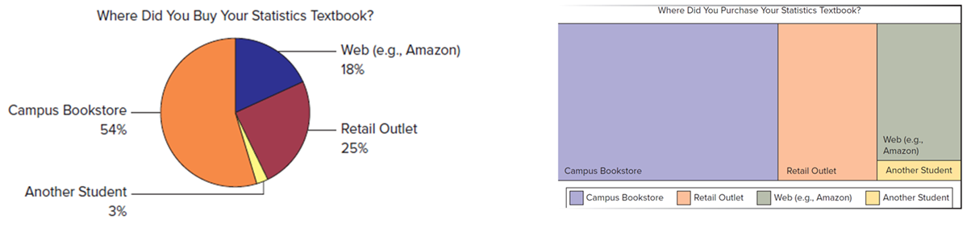
Pie Charts 1
L O 3.7
A pie chart can only convey a general idea of the data.
Pie charts should be used to portray data which sum to a total (For example, percent market shares).
A pie chart should only have a few (that is, 2 to 5) slices, each slice can be labeled with data values or percents.
An alternative to display parts of a whole is Excel’s hierarchy chart.
Access the text alternative for slide images.

Slide 35
Pie Charts 2
L O 3.7
Common Pie Chart Errors:
Pie charts can only convey a general idea of the data values.
Pie charts are ineffective when they have too many slices.
Pie chart data must represent parts of a whole (For example, percent market share).

Slide 36
Scatter Plots 1
L O 3.8
Scatter plots can convey patterns in data pairs that would not be apparent from a table.
A scatter plot is a starting point for bivariate data analysis in which we investigate the association and relationship between two quantitative variables.

Slide 37
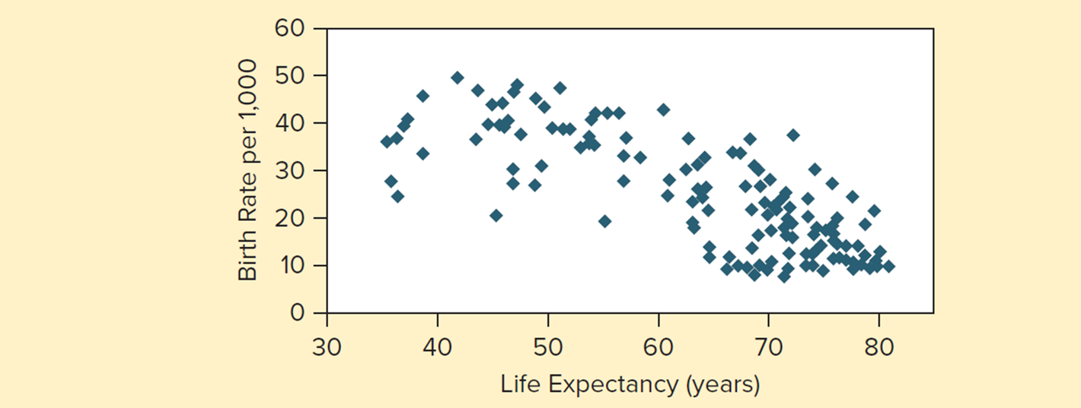
Scatter Plots 2
L O 3.8
Figure 3.11 shows a scatter plot with life expectancy on the X-axis and birth rates on the Y-axis. In this illustration, there seems to be an association between X and Y. That is, nations with higher birth rates tend to have lower life expectancy (and vice versa). No cause-and-effect relationship is implied because, in this example, both variables could be influenced by a third variable that is not mentioned (For example, G D P per capita).
Scatter Plot of Birth Rates and Life Expectancy (n = 153 nations)
BirthLife
Figure: 3.11
Access the text alternative for slide images.

Slide 38
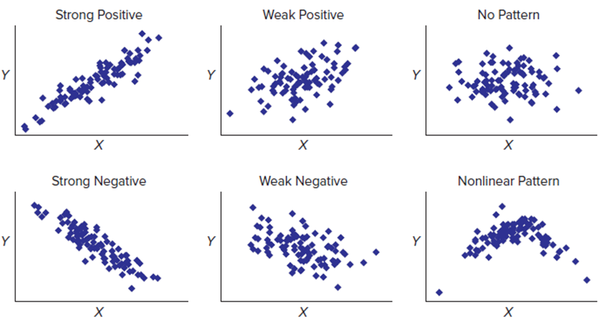
Scatter Plots 3
L O 3.8
The figure below shows some scatter plot patterns similar to those that you might observe when you have a sample of (X, Y) data pairs.
A scatter plot can convey patterns in data pairs that would not be apparent from a table.
Access the text alternative for slide images.

Slide 39
Tables 1
L O 3.9
Tables are the simplest form of data display.
By arranging numbers in rows and columns, their meaning can be enhanced so it can be understood at a glance.
Arrangement of data is in rows and columns to enhance meaning.
The data can be viewed by focusing on the time pattern (down the columns) or by comparing the variables (across the rows).

Slide 40
Tables 2
L O 3.9
X Y Bank Inc. Earning Summary (millions of dollars).
 | Year 2020 | Year 2019 | Year 2018 | Year 2017 | Year 2016
Net interest income | 2,306 | 2,025 | 1,805 | 1,772 | 1,652
Provision for credit losses | 2 | 77 | 237 | 138 | 28
Noninterest income | 1,046 | 1,069 | 1,174 | 1,052 | 842
Noninterest expense | 1,821 | 1,748 | 1,915 | 1,815 | 1,586
Provision for income taxes | 307 | 518 | 178 | 244 | 292
Net income | 1,185 | 735 | 462 | 530 | 586

Slide 41
Tips for Effective Tables
L O 3.9
Keep the table simple, consistent with its purpose.
For presentations, round off to three or four significant digits (For example, 142 rather than 142.213).
Physical table layout should guide the eye toward the comparison you wish to emphasize. Spaces or shading may be used to separate rows or columns. Use lines sparingly.
Within a column, use a consistent number of decimal digits. Right-justify or decimal-align the data unless all field widths are the same within the column.

Slide 42
Pivot Tables 1
L O 3.9
Pivot tables can be created in Excel.
The row and column variables must be either categorical or discrete numerical, and the variable for the table cells must be numerical.
After the table is created you can change the table by dragging variable names from the list specified in your data matrix.

Slide 43
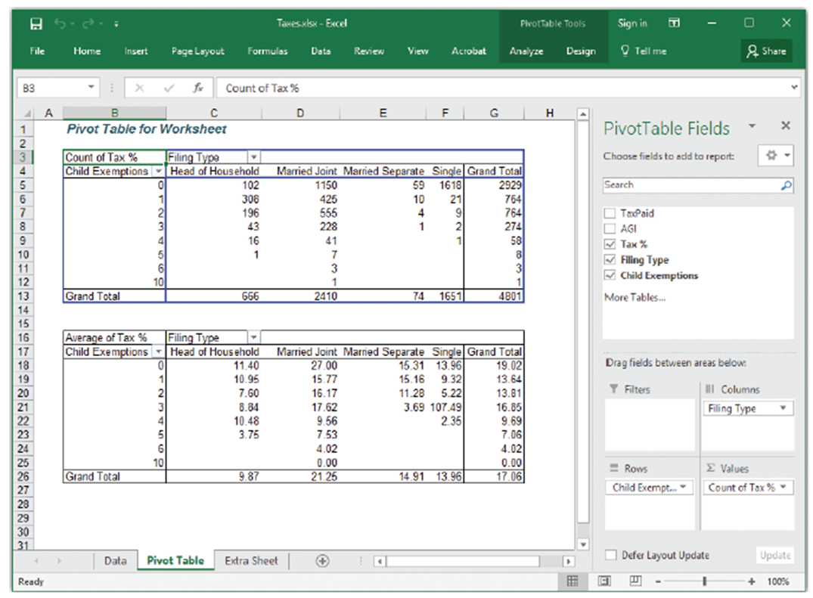
Pivot Tables 2
L O 3.9
Access the text alternative for slide images.

Slide 44
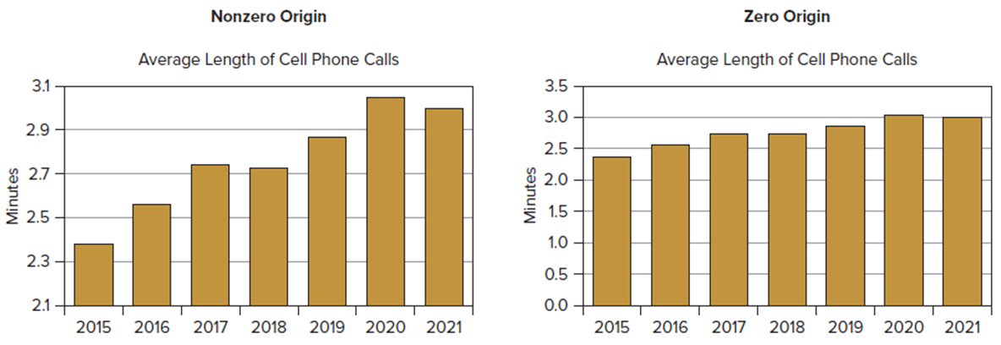
Deceptive Graphs 1
L O 3.10
Error 1: Nonzero origin.
A nonzero origin will exaggerate the trend.
Look at the axis in these two graphs.
Access the text alternative for slide images.

Slide 45
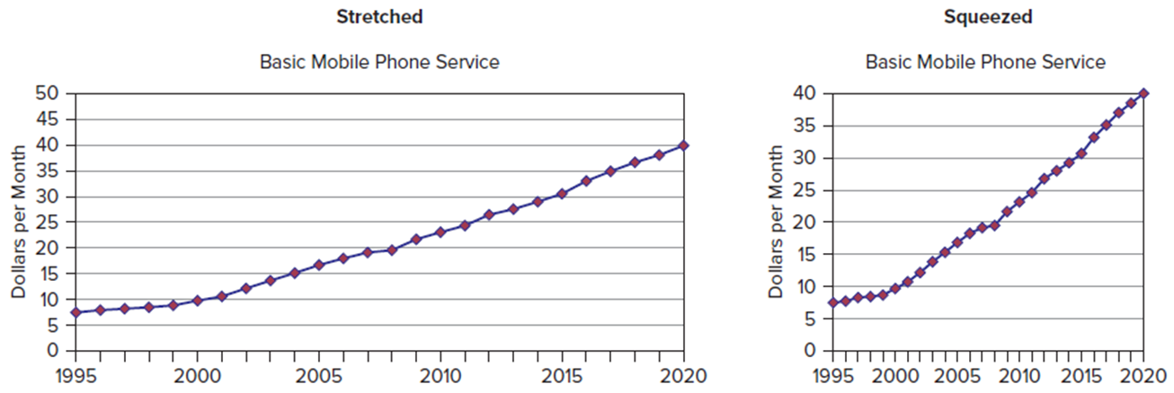
Deceptive Graphs 2
L O 3.10
Error 2: Elastic graph proportions.
Keep the aspect ratio (width/height) below 2.00 so as not to exaggerate the graph. By default, Excel uses an aspect ratio of 1.68.
Access the text alternative for slide images.

Slide 46
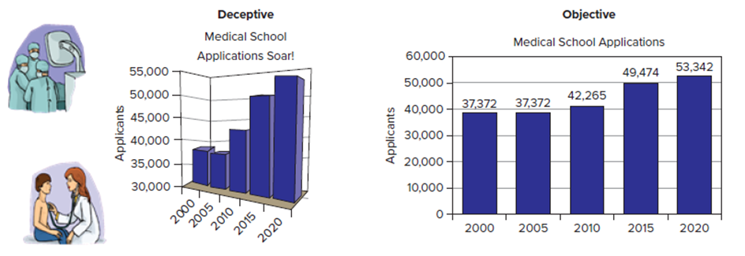
Deceptive Graphs 3
L O 3.10
Error 3: Dramatic titles, distracting art, and perplexing depth.
A title should be short but adequate for the purpose.
Avoid images that can distract the reader or impart an emotional slant.
A 3-D chart introduces further ambiguity in reading the bar height.
Access the text alternative for slide images.

Slide 47
Deceptive Graphs 4
L O 3.10
Error 4: Unclear definitions or scales.
Missing or unclear units of measurement can render a chart useless.
Gridlines help the viewer compare magnitudes but are often omitted to avoid graph clutter.
For maximum clarity in a bar graph, label each bar with its numerical value.
Error 5: Vague Sources.
Vague sources like “Department of Commerce” may indicate that the author lost the citation, didn’t know the data source, or mixed data from several sources.
Scientific publications insist on complete source citations.

Slide 48
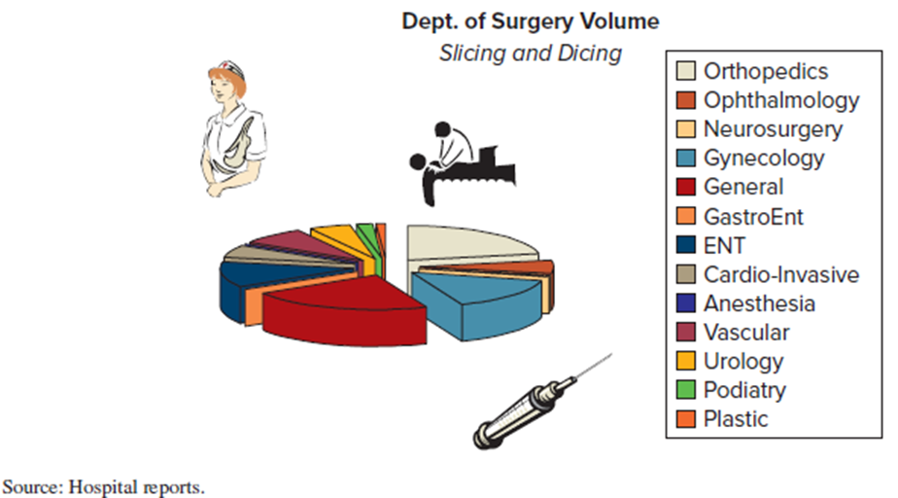
Deceptive Graphs 5
L O 3.10
Error 6: Complex graphs.
Complicated visual displays make the reader work harder.
Keep your main objective in mind.
Source: Hospital reports.
Access the text alternative for slide images.

Slide 49
Deceptive Graphs 6
L O 3.10
Error 7: Estimated data.
In a spirit of zeal to include the “latest” figures, the last few data points in a time series are often estimated. At a minimum, estimated points should be noted.

Slide 50
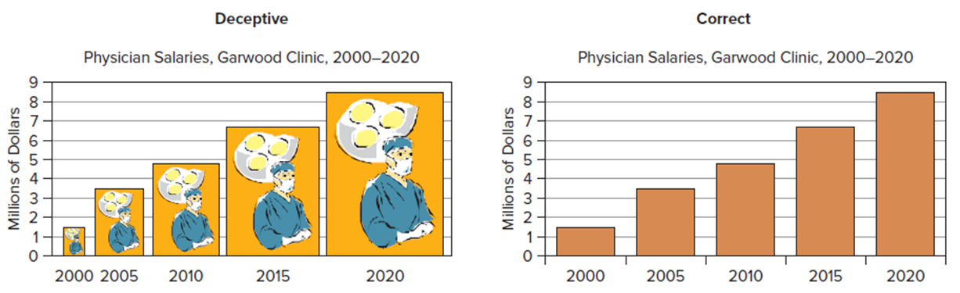
Deceptive Graphs 7
L O 3.10
Error 8: Area Trick.
One of the most pernicious visual tricks is simultaneously enlarging the width of the bars as their height increases, so the bar area misstates the true proportion. Like replacing graph bars with figures like human beings, coins, or gas pumps.
Access the text alternative for slide images.

Slide 51
Chapter 3: Practice Problems

Slide 52

Question 2
L O 3.1
a. Make a stem-and-leaf plot for the number of defects per 100 vehicles for these 32 brands.
b. Make a dot plot of the defects data.
c. Describe these two displays (center, variability, and shape).
Defects per 100 Vehicles (alphabetical by brand)
JDPower
Brand | Defects | Brand | Defects | Brand | Defects
Acura | 86 | Hyundai | 102 | MINI | 133
Audi | 111 | Infiniti | 107 | Mitsubishi | 146
BMW | 113 | Jaguar | 130 | Nissan | 111
Buick | 114 | Jeep | 129 | Porsche | 83
Cadillac | 111 | Kia | 126 | Ram | 110
Chevrolet | 111 | Land Rover | 170 | Scion | 114
Chrysler | 122 | Lexus | 88 | Subaru | 121
Dodge | 130 | Lincoln | 106 | Toyota | 117
Ford | 93 | Mazda | 114 | Volkswagen | 135
GMC | 126 | Mercedes-Benz | 87 | Volvo | 109
Honda | 95 | Mercury | 113
Source: J.D. Power and Associates 2010 Initial Quality StudyTM.

Slide 53
Question 8
L O 3.2, 3, 4
a. Make a frequency distribution for the annual compensation of 40 randomly chosen C E Os (millions of dollars).
b. Describe the shape of the histogram.
c. Identify any unusual values.
5.33 | 18.3 | 24.55 | 9.08 | 12.22 | 5.52 | 2.01 | 3.81
192.92 | 17.83 | 23.77 | 8.7 | 11.15 | 4.87 | 1.72 | 3.72
66.08 | 15.41 | 22.59 | 6.75 | 9.97 | 4.83 | 1.29 | 3.72
28.09 | 12.32 | 19.55 | 5.55 | 9.19 | 3.83 | 0.79 | 2.79
34.91 | 13.95 | 20.77 | 6.47 | 9.63 | 4.47 | 1.01 | 3.07
*File C E O Comp40

Slide 54
Question 11
L O 3.5
a. Use Excel to prepare a line chart to display the data on housing starts. Modify the colors, fonts, etc., to make the display effective.
b. Describe the pattern, if any.
U.S. Housing Starts (thousands), 2000 to 20 20
Housing
Year | Starts | Year | Starts | Year | Starts
2000 | 1,573 | 2007 | 1,342 | 2014 | 1,000
2001 | 1,601 | 2008 | 900 | 2015 | 1,107
2002 | 1,710 | 2009 | 554 | 2016 | 1,178
2003 | 1,854 | 2010 | 586 | 2017 | 1,209
2004 | 1,950 | 2011 | 612 | 2018 | 1,250
2005 | 2,073 | 2012 | 784 | 2019 | 1,267
2006 | 1,812 | 2013 | 928 | 2020 | 1,366
Source: https://fred.stlouisfed.org

Slide 55
Question 15
L O 3.6
a. Use Excel to make a scatter plot of the data for bottles water sales for 10 weeks, placing Price on the X-axis and Units Sold on the Y-axis. Add titles and modify the default colors, fonts, etc., as you judge appropriate to make the scatter plot effective.
b. Describe the relationship (if any) between X and Y.
Unit Price | Units Sold
1.15 | 186
0.94 | 216
1.04 | 173
1.05 | 182
1.08 | 183
1.33 | 150
0.99 | 190
1.25 | 165
1.16 | 190
1.11 | 201

Slide 56
Question 19
L O 3.7
a. Use Excel to prepare a line chart to display the following gasoline price data. Modify the default colors, fonts, etc., to make the display effective.
b. Change it to a 2-D column chart. Modify the display if necessary to make the display attractive.
c. Do you prefer the line chart or bar chart? Why?
Average U.S. Retail Price of Gasoline (dollars per gallon)
GasPrice
Year | Price | Year | Price | Year | Price
1965 | 0.31 | 1985 | 1.20 | 2005 | 2.30
1970 | 0.36 | 1990 | 1.16 | 2010 | 3.02
1975 | 0.57 | 1995 | 1.15 | 2015 | 2.33
1980 | 1.25 | 2000 | 1.51 | 2020 | 1.77
Source: www.fueleconomy.gov and eia.doe.gov. Pre-19 80 prices are for unleaded gas.

Slide 57
Question 22
L O 3.8
a. Use Excel to prepare a 2-D pie chart for these web-surfing data. Modify the default colors, fonts, etc., as you judge appropriate to make the display effective.
b. Right-click the chart area, select “chart type”, and change to a bar chart.
c. Right-click the chart area, select “chart type”, and change to a hierarchy chart. Which do you prefer? Why?
Are You Concerned about Being Tracked While Web Surfing?
Privacy
Level of Concern | Percent
Very concerned | 68
Somewhat concerned | 23
Not very concerned | 9
Total | 100

Slide 58
Chapter 3: Analytics in Action

Slide 59
Analytics in Action 1
Vail Resorts Epic Pass:
When Vail Resorts was conducting market research for its new season ski pass, the Epic Pass, it surveyed its guests to determine which features of a season pass were most important. Features of a season pass include the number of days of skiing allowed (limited versus unlimited), the number of resorts included on the pass, the number of blackout dates (all holidays, some holidays, or no blackouts), and the price of the pass.
A market survey was sent to a random sample of Vail Resorts guests. Vail received 1,930 responses. The respondents were sorted into groups based on the number of ski vacations they typically take each year. A summary of the responses is displayed in the clustered column chart below. The chart clearly shows that the feature considered most important to all three groups was the price of the pass. Determining the right price of the pass was critical in order to create a valuable product that a skier would purchase. An analytics tool called conjoint analysis was used to summarize additional data from subsequent surveys. The Epic Pass was priced at $579 after this further analysis. Charts can be effective communication tools by allowing the analyst to compare and summarize information from many different groups and across different variables. Decision makers can then see in a snapshot the areas on which to focus.

Slide 60
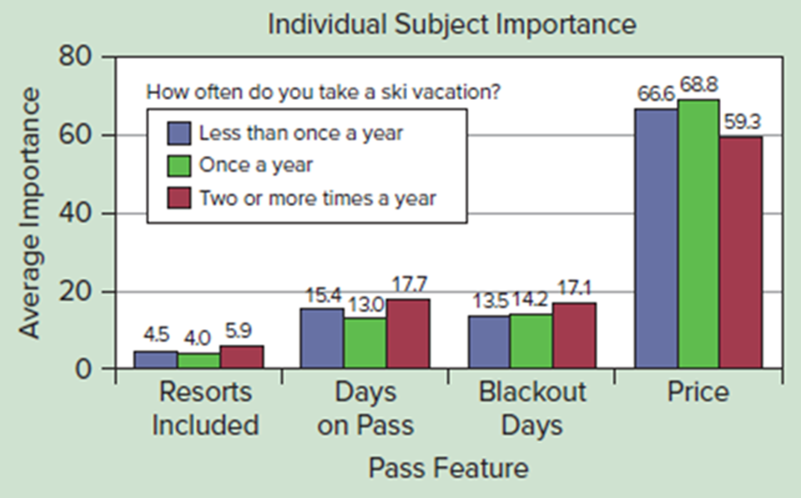
Analytics in Action 2
Access the text alternative for slide images.

Slide 61
End of Main Content
© McGraw Hill LLC. All rights reserved. No reproduction or distribution without the prior written consent of McGraw Hill LLC.

Slide 62
Accessibility Content: Text Alternatives for Images
62

Slide 63
Stem-and-Leaf Plot 2 – Text Alternative
Return to parent-slide containing images.
A stem-and-leaf plot representing 44 Price-to-Earnings (P/E) ratios. The ‘stem’ values range from 0 to 5, each corresponding to a set of ‘leaf’ values. For a stem of 0, the leaf values are 7 and 9. For a stem of 1, the leaf values are 0, 0, 0, 1, 1, 1, 2, 3, 3, 3, 4, 4, 5, 6, 6, 6, 6, 7, 7, 8, 8, 9, 9. For a stem of 2, the leaf values are 0, 0, 1, 1, 2, 3, 4, 6, 6, 7, 8. For a stem of 3, the leaf values are 1, 7, 7, 8. For a stem of 4, the only leaf value is 2. Lastly, for a stem of 5, the leaf values are 0 and 9.
Return to parent-slide containing images.

Slide 64
Stem-and-Leaf Plot 3 – Text Alternative
Return to parent-slide containing images.
A stem-and-leaf plot representing 44 Price-to-Earnings (P/E) ratios. The ‘stem’ values range from 0 to 5, each corresponding to a set of ‘leaf’ values. For a stem of 0, the leaf values are 7 and 9. For a stem of 1, the leaf values are 0, 0, 0, 1, 1, 1, 2, 3, 3, 3, 4, 4, 5, 6, 6, 6, 6, 7, 7, 8, 8, 9, 9. For a stem of 2, the leaf values are 0, 0, 1, 1, 2, 3, 4, 6, 6, 7, 8. For a stem of 3, the leaf values are 1, 7, 7, 8. For a stem of 4, the only leaf value is 2. Lastly, for a stem of 5, the leaf values are 0 and 9.
Return to parent-slide containing images.

Slide 65
Dot Plots 2 – Text Alternative
Return to parent-slide containing images.
A dot plot represents the Price-to-Earnings (P/E) ratios. The X-axis of the plot ranges from 0 to 70, with increments of 10. Each dot on the plot corresponds to a P/E ratio. The majority of the dots, indicating the most common P/E ratios, are clustered between the values of 10 and 30.
Return to parent-slide containing images.

Slide 66
Dot Plots 3 – Text Alternative
Return to parent-slide containing images.
A dot plot represents the Price-to-Earnings (P/E) ratios. The X-axis of the plot ranges from 0 to 70, with increments of 10. Each dot on the plot corresponds to a P/E ratio. The majority of the dots, indicating the most common P/E ratios, are clustered between the values of 10 and 30.
Return to parent-slide containing images.

Slide 67
Histograms 1 – Text Alternative
Return to parent-slide containing images.
Three histograms, each plotting the frequency of Price-to-Earnings (P/E) ratios. The first histogram has a frequency range of 0 to 25, with increments of 5, and a P/E ratio range of 0 to 60, with increments of 10. This histogram is divided into 6 bins. The trend of the graph ascends to a maximum frequency of 24 for the P/E ratio range of 10 to 20, and then descends gently. The second histogram plots a frequency range of 0 to 18 against a P/E ratio range of 0 to 64, with increments of 8. This histogram is divided into 8 bins. The graph shows an ascending trend, peaking at a frequency of 16 for the P/E ratio range of 16 to 24, and then descends gently. The third histogram plots a frequency range of 0 to 14, with increments of 2, against a P/E ratio range of 6 to 60, with increments of 6. This histogram is divided into 9 bins. The graph also shows an ascending trend, with a maximum frequency of 13 for the P/E ratio range of 12 to 18, and then descends gently. Please note that all values are approximations.
Return to parent-slide containing images.

Slide 68
Histograms 4 – Text Alternative
Return to parent-slide containing images.
A chart displays nine distinct types of histograms, each representing a different data distribution. The types are as follows: Skewed Left: This histogram shows a distribution where most of the data falls to the right, with the tail of the distribution extending to the left. Symmetric: This histogram shows a distribution where the data is evenly distributed around the mean, creating a bell-shaped curve. Skewed Right: This histogram shows a distribution where most of the data falls to the left, with the tail of the distribution extending to the right. Bimodal Skewed Left: This histogram shows a distribution with two peaks that is skewed to the left. Multimodal Symmetric: This histogram shows a distribution with more than two peaks, and the data is symmetrically distributed around the mean. Bimodal Skewed Right: This histogram shows a distribution with two peaks that is skewed to the right. Skewed Left with Outliers: This histogram shows a skewed left distribution with additional outlier data points. Symmetric with Outliers: This histogram shows a symmetric distribution with additional outlier data points. Skewed Right with Outliers: This histogram shows a skewed right distribution with additional outlier data points.
Return to parent-slide containing images.

Slide 69
Frequency Polygons and Ogive 2 – Text Alternative
Return to parent-slide containing images.
Two line graphs, each plotting percent against Price-to-Earnings (P/E) ratios. The first graph on the left is a frequency polygon. The percent ranges from 0 to 60 with increments of 10, and the P/E ratio ranges from 0 to 50 with increments of 10. The graph shows a curve that starts at the point (0,0), ascends to a maximum at the point (15, 55), then gently descends to the point (25, 23), and continues descending until it reaches the point (50, 2). The second graph on the right is an ogive, or cumulative frequency graph. It plots cumulative percent, which ranges from 0 to 100 with increments of 20, against the P/E ratio, which ranges from 0 to 50 with increments of 10. The graph shows a curve that begins at the point (0, 0), and ascends until it peaks at the point (50, 100). Please note that all values are approximations.
Return to parent-slide containing images.

Slide 70
Effective Excel Charts – Text Alternative
Return to parent-slide containing images.
A chart is composed of six sets, each showcasing different types of charts. The first set, titled ‘Line Charts’, displays five distinct models. The second set, ‘Scatter Plots’, also presents five unique models. Similarly, the third set features ‘Column Charts’ with five different models. The fourth set, ‘Pie Charts’, differs slightly by offering four unique models. The fifth set, ‘Bar Charts’, returns to the pattern with five distinct models. Lastly, the sixth set, ‘Area Charts’, concludes the collection with five different models.
Return to parent-slide containing images.

Slide 71
Line Charts – Text Alternative
Return to parent-slide containing images.
A line graph titled “Sarah’s Cell Phone Calls” spans the years 2010 to 2020. It plots two variables: dollars per month and minutes per call. The left Y-axis represents the average monthly bill, ranging from $30 to $55 in increments of $5. The right Y-axis represents the average call length, ranging from 1.5 to 3.5 minutes in increments of 0.5 minutes. The X-axis represents the years from 2010 to 2020 in increments of 2 years. The graph displays two curves: one for the average call length and another for the average monthly bill. The average call length curve starts at 3.0 minutes in 2010, decreases to 2.5 minutes by 2014, and then gradually increases back to 3.0 minutes by 2020. The average monthly bill curve starts at $38 in 2010 and steadily increases to $48 by 2020. Please note that all values are approximations.
Return to parent-slide containing images.

Slide 72
Log Scales 2 – Text Alternative
Return to parent-slide containing images.
A line graph plots the value of imports and exports in billions of dollars against the years from 1980 to 2020. The Y-axis ranges from 0 to 3,500 billion dollars in increments of 500, while the X-axis represents the years in increments of 4 years. The graph displays two fluctuating trend curves for imports and exports: The import curve starts at 350 billion dollars in 1980, increases to 2,000 billion dollars by 2008, remains steady until 2012, and then rises to 3,100 billion dollars by 2018. The export curve begins at 350 billion dollars in 1980, increases to 1,500 billion dollars by 2008, and then rises to 2,500 billion dollars by 2018. Please note that all values are approximations. The graph also includes a zoomed-in portion on the right for a more detailed view of specific data points.
Return to parent-slide containing images.

Slide 73
Column and Bar Charts – Text Alternative
Return to parent-slide containing images.
The left bar graph plots the percentage of responses, ranging from 0 to 50 in increments of 10, against four parameters: ‘several times a day’, ‘about once a day’, ‘a few times a week’, and ‘less often’. This is done for the years 2014, 2016, 2018, and the current year.
The data for each parameter is as follows:
‘Several times a day’: Current: 42%, 2018: 38%, 2016: 36%, 2014: 32%.
‘About once a day’: Current: 21%, 2018: 22%, 2016: 16%, 2014: 17%.
‘A few times a week’: Current: 21%, 2018: 21%, 2016: 26%, 2014: 24%.
‘Less often’: Current: 17%, 2018: 17%, 2016: 22%, 2014: 26%.
The right horizontal bar graph plots the same parameters against the percentage of responses for the same years. The data for each parameter is as follows:
‘Several times a day’: Current: 42%, 2018: 38%, 2016: 36%, 2014: 32%.
‘About once a day’: Current: 21%, 2018: 22%, 2016: 16%, 2014: 17%.
‘A few times a week’: Current: 21%, 2018: 21%, 2016: 26%, 2014: 24%.
‘Every few weeks’: Current: 6%, 2018: 8%, 2016: 10%, 2014: 10%.
‘Less often’: Current: 11%, 2018: 9%, 2016: 12%, 2014: 16%.
Return to parent-slide containing images.

Slide 74
Pareto Charts – Text Alternative
Return to parent-slide containing images.
A Pareto chart titled ‘Concession Stand Customer Complaints’. The chart plots the percent of complaints, which ranges from 0 to 30 with increments of 5, on the left Y-axis. The cumulative percent, which ranges from 0 to 100 with increments of 20, is plotted on the right Y-axis. These percentages are plotted against nine different parameters related to customer complaints. The parameters, in descending order of complaints, are as follows: Food cold, Too much time in line, No vegetarian choice, Poor selection of food, Too much ice in sodas, Food too expensive, Server rude, No chili for hot dogs, and Dirty counter. The graph shows a curve that starts at 10% complaints, ascends gently till it reaches 23%, peaks at 28%, and then descends gently. Please note that all values are approximations.
Return to parent-slide containing images.

Slide 75
Stacked Column Chart – Text Alternative
Return to parent-slide containing images.
A stacked column chart titled ‘Medical School Applicants’. The chart plots the number of applicants, which ranges from 0 to 60,000 with increments of 10,000, on the Y-axis. The X-axis represents the years from 2005 to 2020, with increments of 5 years. The chart is divided into two sections for women and men. The data represented in the chart is as follows: In 2005, there were 18,625 women and 18,747 men applicants. In 2010, the number of women applicants increased to 20,252, and the number of men applicants rose to 22,013. By 2015, the number of women applicants grew to 23,019, while the number of men applicants reached 26,455. In 2020, the number of women applicants peaked at 27,848, whereas the number of men applicants slightly decreased to 25,494.
Return to parent-slide containing images.

Slide 76
Pie Charts 1 – Text Alternative
Return to parent-slide containing images.
A description of two charts. The first is a pie chart divided into four sections, each representing a different category. The sections are as follows: Web: This section accounts for 18% of the pie chart. Retail Outlet: This section makes up 25% of the pie chart. Another Student: This is the smallest section, accounting for only 3% of the pie chart. Campus Bookstore: This is the largest section, making up 54% of the pie chart. To the right of the pie chart is a hierarchy chart created in Excel. This chart is made up of rectangles of varying sizes, each representing one of the categories from the pie chart. The size of each rectangle corresponds to the percentage that each category represents in the pie chart. The largest rectangle represents the Campus Bookstore, followed by smaller rectangles for the Retail Outlet, Web, and Another Student categories.
Return to parent-slide containing images.

Slide 77
Scatter Plots 2 – Text Alternative
Return to parent-slide containing images.
A scatter plot that plots the birth rate per 1,000, which ranges from 0 to 60 with increments of 10, against life expectancy in years, which ranges from 30 to 80 with increments of 10. The graph shows clusters of data points between a birth rate of 5 to 25 and a life expectancy ranging from 62 to 78 years. Please note that all values are approximations.
Return to parent-slide containing images.

Slide 78
Scatter Plots 3 – Text Alternative
Return to parent-slide containing images.
A chart displays six different types of scatter plots, each representing a unique correlation pattern between two variables:
Strong Positive: This scatter plot shows a clear upward trend, indicating a strong positive correlation between the two variables.
Weak Positive: This scatter plot shows a slight upward trend, indicating a weak positive correlation between the two variables.
No Pattern: This scatter plot shows no discernible trend, indicating no correlation between the two variables.
Strong Negative: This scatter plot shows a clear downward trend, indicating a strong negative correlation between the two variables.
Weak Negative: This scatter plot shows a slight downward trend, indicating a weak negative correlation between the two variables.
Nonlinear Pattern: This scatter plot shows a curve or irregular pattern, indicating a nonlinear relationship between the two variables.
Return to parent-slide containing images.

Slide 79
Pivot Tables 2 – Text Alternative
Return to parent-slide containing images.
A spreadsheet displayed as a pivot table with seven columns and 26 rows. The spreadsheet contains two tables. The first table at the top has six columns. The column headers are titled ‘Child Exemptions’, ‘Head of Household’, ‘Married Joint’, ‘Married Separate’, ‘Single’, and ‘Grand Total’. The first two columns of this table represent the ‘Count of tax%’ and ‘Filing Type’. The first column of this table lists the number of items, while the remaining columns contain numerical values. The second table also has six columns with the same headers as the first table. However, in this table, the first two columns represent the ‘Average of tax%’ and ‘Filing Type’. Similar to the first table, the first column of this table lists the number of items, while the remaining columns contain numerical values.
Return to parent-slide containing images.

Slide 80
Deceptive Graphs 1 – Text Alternative
Return to parent-slide containing images.
Two bar graphs titled ‘Nonzero Origin’ and ‘Zero Origin’, both plotting the average length of cell phone calls. The first graph on the left, ‘Nonzero Origin’, plots minutes ranging from 2.1 to 3.1 with increments of 0.2 against the years from 2015 to 2021 with increments of 1 year. The graph shows an ascending trend, with the maximum average call length of 3.0 minutes occurring in the year 2020. The second graph on the right, ‘Zero Origin’, plots minutes ranging from 0.0 to 3.5 with increments of 0.5 against the same years as the first graph. This graph also shows a gentle ascending trend, with the maximum average call length again occurring in the year 2020 with 3 minutes. Please note that all values are approximations.
Return to parent-slide containing images.

Slide 81
Deceptive Graphs 2 – Text Alternative
Return to parent-slide containing images.
Two line graphs. The first graph on the left, titled ‘Stretched’, plots the dollars per month, which ranges from 0 to 50 with increments of 5, against the years from 19 95 to 2020 with increments of 5 years. The graph shows an ascending trend with the following values: (19 95, 7.5), (2000, 10), (2005, 18), (2010, 22), (2015, 30), and (2020, 40). Please note that all values are approximations. The second graph on the right, titled ‘Squeezed’, presents the same data as the first graph but in a contracted and zoomed view.
Return to parent-slide containing images.

Slide 82
Deceptive Graphs 3 – Text Alternative
Return to parent-slide containing images.
Two bar graphs, one titled ‘Deceptive’ on the left and the other titled ‘Objective’ on the right. The right graph, titled ‘Medical School Applications’, plots the number of applicants, which ranges from 0 to 60,000 with increments of 10,000, against the years from 2000 to 2020 with increments of 5 years. The graph shows the following data:
In 2000, there were 37,372 applicants.
In 2005, the number of applicants was 37,372.
In 2010, the number of applicants increased to 42,265.
In 2015, the number of applicants rose to 49,474.
In 2020, the number of applicants peaked at 53,342.
The left graph shows the same data but without proper values. It also includes two distracting images, making the chart hard to read. Additionally, the chart is presented in a 3-dimensional view, which can distort the perception of the data.
Return to parent-slide containing images.

Slide 83
Deceptive Graphs 5 – Text Alternative
Return to parent-slide containing images.
A complex pie chart that is somewhat deceptive in its presentation. The chart is divided into 13 sections, each presumably representing a different category. However, the chart does not provide any values for these sections, making it difficult to interpret the data accurately. The chart is presented in a 3-dimensional format. While this can make the chart visually appealing, it can also distort the perception of the data and make it harder to compare the different sections accurately. In addition, the chart includes three unrelated medical images. These images do not appear to provide any relevant information and may distract from the data being presented. Accompanying the chart is a table with a color gradient corresponding to the 13 sections of the pie chart.
Return to parent-slide containing images.

Slide 84
Deceptive Graphs 7 – Text Alternative
Return to parent-slide containing images.
Two bar graphs, one titled ‘Deceptive’ and the other titled ‘Correct’, both plotting physician salaries in millions of dollars against the years from 2000 to 2020 with increments of 5 years. The Correct graph on the right plots the millions of dollars, which ranges from 0 to 9, showing an ascending trend over the years. This graph provides a clear and straightforward representation of the data. The Deceptive graph on the left, however, plots the same data but with a range of 0 to 9 million dollars with increments of 1. This graph also shows an ascending trend. However, it includes an illustration of a healthcare professional within the bar graph. The size of the illustration increases with the height of the bars.
Return to parent-slide containing images.

Slide 85
Analytics in Action 2 – Text Alternative
Return to parent-slide containing images.
A bar graph titled ‘Individual Subject Importance’. The graph plots the average importance, which ranges from 0 to 80 with increments of 20, against four pass features: ‘Resorts Included’, ‘Days on Pass’, ‘Blackout Days’, and ‘Price’. These features are evaluated for three categories: ‘Less than once a year’, ‘Once a year’, and ‘Two or more times a year’. The data represented in the graph is as follows:
Resorts Included: For ‘Less than once a year’, the importance is 4.5. For ‘Once a year’, it’s 4.0, and for ‘Two or more times a year’, it’s 5.9.
Days on Pass: For ‘Less than once a year’, the importance is 15.4. For ‘Once a year’, it’s 13.0, and for ‘Two or more times a year’, it’s 17.7.
Blackout Days: For ‘Less than once a year’, the importance is 13.5. For ‘Once a year’, it’s 14.2, and for ‘Two or more times a year’, it’s 17.1.
Price: For ‘Less than once a year’, the importance is 66.6. For ‘Once a year’, it’s 68.8, and for ‘Two or more times a year’, it’s 59.3.
Return to parent-slide containing images.

