Slide 1

Chapter 4
Descriptive Statistics
© McGraw Hill LLC. All rights reserved. No reproduction or distribution without the prior written consent of McGraw Hill LLC.

Slide 2
Learning Objectives
Chapter 4
L O 4.1: Explain the concepts of center, variability, and shape.
L O 4.2: Calculate and interpret common measures of center.
L O 4.3: Calculate and interpret common measures of variability.
L O 4.4: Apply Chebyshev’s theorem.
L O 4.5: Apply the Empirical Rule and recognize outliers.
L O 4.6: Transform a data set into standardized values.
L O 4.7: Calculate quartiles and other percentiles.
L O 4.8: Make and interpret box plots.
L O 4.9: Calculate and interpret a correlation coefficient and covariance.
L O 4.10: Calculate the mean and standard deviation from grouped data.
L O 4.11: Assess skewness and kurtosis in a sample.

Slide 3
Numerical Description 1
L3O 4.1
This chapter explains numerical descriptions of data. While visual displays of data can answer many questions, a more detailed numerical description is often needed.
We are interested in three key characteristics:
Characteristic | Interpretation
Center | Where are the data values concentrated? What seem to be typical or middle data values? Is there central tendency?
Variability | How much dispersion is there in the data? How spread out are the data values? Are there unusual values?
Shape | Are the data values distributed symmetrically? Skewed? Sharply peaked? Flat? Bimodal?

Slide 4

Numerical Description 2
L O 4.1
Every year, J.D. Power and Associates issues its initial vehicle quality ratings. These ratings are of interest to consumers, dealers, and manufacturers. Table 4.2 shows defect rates tor 33 vehicle brands for model year 2022. Reported defect rates are based on a sample of vehicles within each brand. Numerical statistics can be used to summarize a data set like this.
Table 4.2:
Defects per 100 Vehicles
J D Power
Brand | Defects | Brand | Defects | Brand | Defects
Acura | 192 | G M C | 162 | Mazda | 180
Alfa Romeo | 211 | Honda | 183 | Mercedes-Benz | 189
Audi | 239 | Hyundai | 185 | MINI | 168
B M W | 165 | Infiniti | 204 | Mitsubishi | 226
Buick | 139 | Jaguar | 210 | Nissan | 167
Cadillac | 163 | Jeep | 199 | Porsche | 200
Chevrolet | 147 | Kia | 156 | Ram | 186
Chrysler | 265 | Land Rover | 193 | Subaru | 191
Dodge | 143 | Lexus | 157 | Toyota | 172
Ford | 167 | Lincoln | 167 | Volkswagen | 230
Genesis | 156 | Maserati | 255 | Volvo | 256
Source: J.D. Power and Associates 2022 Initial Quality Study™. Ratings arc intended for educational purposes only and should not be used as a guide to consumer decisions. Tesla and Polestar brands are not shown because they did not meet the J.D. Power study criteria.

Slide 5
Numerical Data Example 1
L O 4.1
The underlying measurement scale is continuous (For example, if 4 defects were found in 3 vehicles, the defect rate would be 1.333333, or 133 defects per 100 vehicles).
Defect rates would vary from year to year and perhaps even within a given model year, so the timing of the study could affect the results.
A good first step is to sort the data, as shown.
Brand | Defects | Brand | Defects | Brand | Defects
Buick | 139 | Nissan | 167 | Jeep | 199
Dodge | 143 | MINI | 168 | Porsche | 200
Chevrolet | 147 | Toyota | 172 | Infiniti | 204
Genesis | 156 | Mazda | 180 | Jaguar | 210
Kia | 156 | Honda | 183 | Alfa Romeo | 211
Lexus | 157 | Hyundai | 185 | Mitsubishi | 226
G M C | 162 | Ram | 186 | Volkswagen | 230
Cadillac | 163 | Mercedes-Benz | 189 | Audi | 239
B M W | 165 | Subaru | 191 | Maserati | 255
Ford | 167 | Acura | 192 | Volvo | 256
Lincoln | 167 | Land Rover | 193 | Chrysler | 265

Slide 6
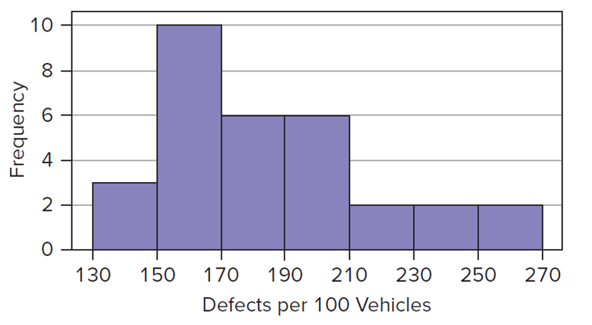
Numerical Data Example 2
L O 4.1
The sorted data reveal a wide range of data values, from 139 (Buick) to 265 (Chrysler). This suggests a high degree of variability.
The next visual step is a histogram. The modal class (largest frequency) between 150 and 170 reveals the center. The shape of the histogram is right-skewed (most data on the left, longer right tail).
Access the text alternative for slide images.

Slide 7
Measures of Center
L O 4.2
Table 4.4:
Six Measures of Center.
*R offers equivalent functions mean(x), median(x), and trimmed mean mean(x,trim=p%) but not the others on this list. See Appendix J for a side-by-side list of R and Excel functions.

Slide 8
Mean
L O 4.2
The most familiar statistical measure of center is the mean.
It is the sum of the data values divided by the number of data items.
For a population we denote it μ, while for a sample we
call it
(population definition)
(sample definition)

Slide 9
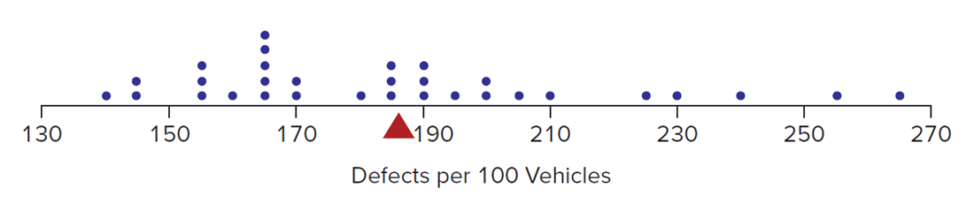
Characteristics of the Mean
L O 4.2
The arithmetic mean is the “average” with which most of us are familiar.
The mean is affected by every sample item.
It is the balancing point or fulcrum in a distribution if we view the X-axis as a lever arm and represent each data item as a physical weight,
Access the text alternative for slide images.

Slide 10
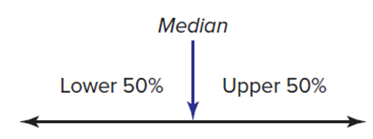
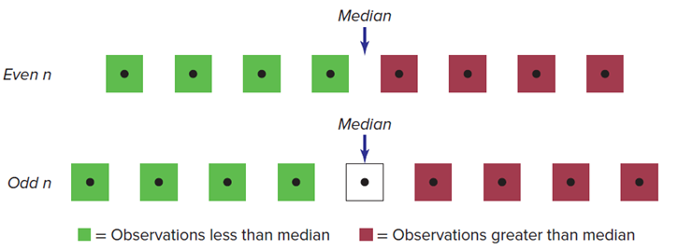
Median
L O 4.2
The median is the 50th percentile or midpoint of a sample data set. It separates the upper and lower halves.
The median is the middle observation in the sorted array if n is odd, but the average of the two middle observations if n is even.
Access the text alternative for slide images.

Slide 11
Mode
L O 4.2
The mode is the most frequently occurring data value.
There may be multiple modes or no mode.
The mode is most useful for discrete or categorical data with only a few distinct data values. For continuous data or data with a wide range, the mode is rarely useful.
139 | 143 | 147 | 156 | 156 | 157 | 162 | 163 | 165 | 167 | 167
167 | 168 | 172 | 180 | 183 | 185 | 186 | 189 | 191 | 192 | 193
199 | 200 | 204 | 210 | 211 | 226 | 230 | 239 | 255 | 256 | 265

Slide 12
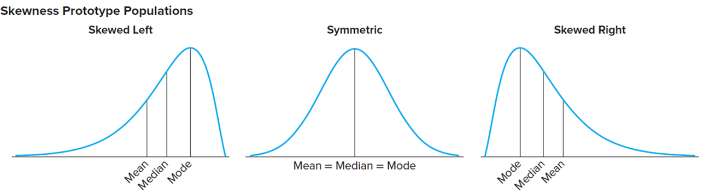
Shape 1
L O 4.2
Compare the mean and median or look at the histogram to determine degree of skewness.
Access the text alternative for slide images.

Slide 13
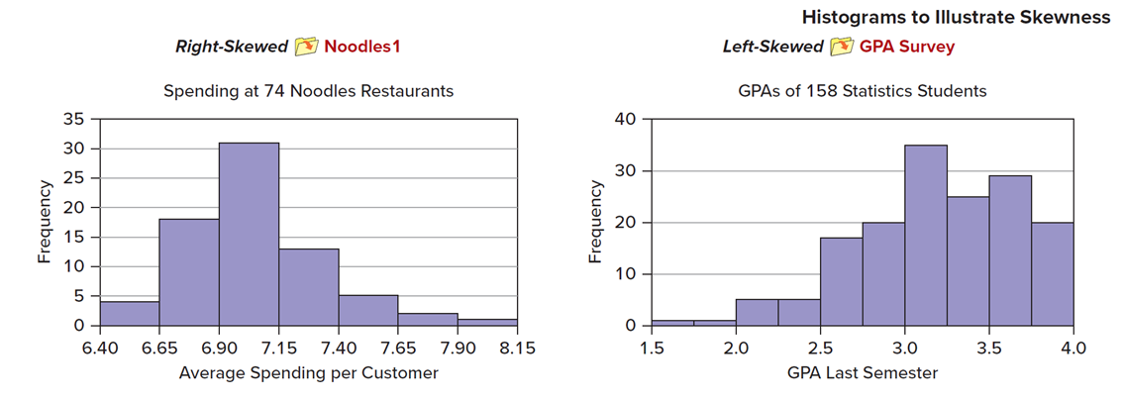
Shape 2
L O 4.2
Distribution's Shape | Histogram Appearance | Statistics
Skewed left (negative skewness) | The longer tail of histogram points left (a few low values but most data on right) | Mean < Median
Symmetric | Tails of the histogram are balanced (low/high values offset) | Mean ≈ Median
Skewed right (positive skewness) | The longer tail of the histogram points right (most data on left but a few high values) | Mean > Median
Access the text alternative for slide images.

Slide 14
Geometric Mean
L O 4.1
The geometric mean (denoted G) is a multiplicative average, obtained by multiplying the data values and then taking the nth root of the product.
For example, the geometric mean for the J.D. Power quality data is,

Slide 15
Growth Rates
L O 4.2
We can use a variation on the geometric mean to find the average growth rate for a time series of n periods.
For example, from 2011 to 2015, JetBlue Airlines’ revenues grew as shown.
The average growth rate is given by taking the geometric mean of the n − 1 ratios of each year’s revenue to the preceding year.
The average growth rate is 9.2% per year.
Year | Revenue
2011 | 4,504
2012 | 4,982
2013 | 5,441
2014 | 5,817
2015 | 6,416

Slide 16
Midrange
L O 4.2
The midrange is the point halfway between the lowest and highest values of X. It is easy to calculate but is not a robust measure of central tendency because it is sensitive to extreme data values.
For the J.D. Power data:

Slide 17
Trimmed Mean
L O 4.2
The trimmed mean is calculated like any other mean, except that the highest and lowest k percent of the observations in the sorted data array are removed.
The trimmed mean mitigates the effects of extreme high values on either end.
For a 5 percent trimmed mean for the J.D. Power data (n = 33), we would remove only one observation from each end because .05 × 33 = 1.65 = 1 (truncated to the next lower integer) and then take the average of the middle 31 observations.

Slide 18
Measures of Central Tendency
L O 4.2
Excel’s measures of center for the J.D. Power data:
Mean: | =AVERAGE(Data) | = 188.58
Median: | =MEDIAN(Data) | = 185
Mode: | =MODE.SNGL(Data) | = 167
Geo Mean: | =GEOMEAN(Data) | = 185.89
Midrange: | =(MIN(Data)+MAX(Data))/2 | = 202
5% Trim Mean: | =TRIMMEAN(Data,0.10) | = 187.71

Slide 19
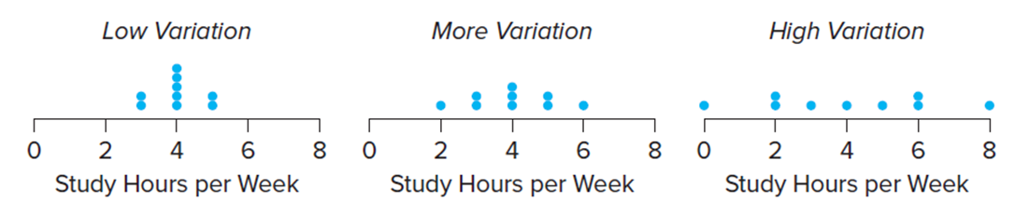
Measures of Variability 1
L O 4.3
Variation is the “spread” of data points about the center of the distribution in a sample.
Consider possible sample distributions of study time spent by several college students taking an economics class:
Each diagram has the same mean, but they differ in dispersion around the mean.
Access the text alternative for slide images.

Slide 20
Measures of Variability 2
L O 4.2
Five Measures of Variability for a Sample:

Slide 21
Range
L O 4.3
The range is the difference between the largest and smallest observations:
For the J.D. Power data, the range is
Although it is easy to calculate, a drawback of the range is that it only considers the two extreme data values.

Slide 22
Variance
L O 4.3
The population variance (denoted
is the
lowercase Greek letter “sigma”) is defined as the sum of squared deviations from the mean divided by the population size. If we have a sample (that is, most of the
time), we replace
to get the sample variance
Population Variance
Sample Variance

Slide 23
Standard Deviation 1
L O 4.3
The standard deviation is defined as the square root of the variance. The units of measurement for the standard deviation is same as the units of the variable.
Population Standard Deviation
Sample Standard Deviation
In describing variability, we most often use the standard deviation. The standard deviation is a single number that helps us understand how individual values in a data set vary from the mean.

Slide 24
Standard Deviation 2
L O 4.3
Standard Deviation Used to Compare Risks:
"Generally speaking, the standard deviation is how much an investment's returns have varied historically from its average. The statistical measure is usually computed using monthly returns for the most recent three-year period. Standard deviation can be useful when comparing the investment risk of various mutual funds. If two funds have similar average returns but different standard deviations, the fund with the higher standard deviation is the more volatile of the two."
Source: T. Rowe Price Investor, September 2009, p. 8.

Slide 25
Coefficient of Variation
L O 4.3
We use the Coefficient of Variation (C V) to compare dispersion in data sets with dissimilar units of measurement (For example, kilograms and ounces) or dissimilar means (for example, home prices in two different cities).
The C V is the standard deviation expressed as a percent of the mean.
In some data sets, the standard deviation can exceed the mean, so the C V can exceed 100%.
This can happen in skewed data sets, especially if there are outliers.

Slide 26
Mean Absolute Deviation
L O 4.3
This mean absolute deviation (M A D) reveals the average distance from the center. Absolute values must be used; otherwise, the deviations around the mean would sum to zero.
The M A D is appealing because of its simple, concrete interpretation. Using the lever analogy, the M A D tells us what the average distance is from an individual data point to the fulcrum.

Slide 27
Chebyshev’s Theorem
L O 4.4
For any population with mean μ and standard deviation σ, the percentage of observations that lie within k standard deviations of the mean must be at least
k = 2
at least 75.0% will lie within μ ± 2σ.
k = 3
at least 88.9% will lie within μ ± 3σ.
k = 4
at least 93.8% will lie within μ ± 4σ.
Although applicable to any data set, these limits tend to be rather wide.

Slide 28
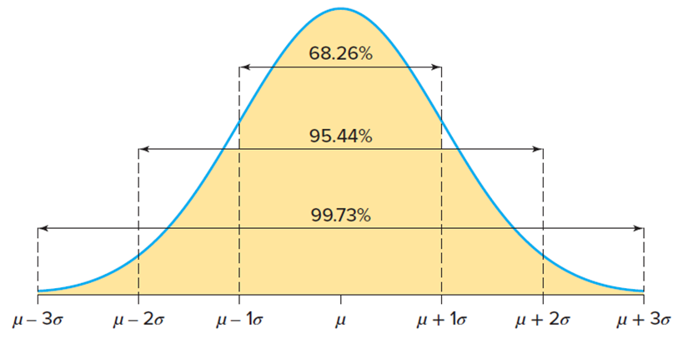
Empirical Rule 1
L O 4.5
The normal distribution is symmetric and is also known as the bell-shaped curve.
The Empirical Rule states that for data from a normal distribution, we expect the interval μ ± kσ to contain a known percentage of data.
k = 1
68.26% will lie within μ ± 1σ.
k = 2
95.44% will lie within μ ± 2σ.
k = 3
99.73% will lie within μ ± 3σ.
Access the text alternative for slide images.

Slide 29

Empirical Rule 2
L O 4.5
For example, suppose that 80 students take an exam. How many students will score within 2 standard deviations of the mean? Assuming that exam scores follow a normal or bell-shaped curve, we might be willing to rely on the Empirical Rule, which predicts that 95.44% × 80, or approximately 76 students, will score within 2 standard deviations from the mean. Because a normal distribution is symmetric about the mean, we expect that about 2 students will score more than 2 standard deviations above the mean and 2 below the mean.
Access the text alternative for slide images.

Slide 30
Standardized Data
L O 4.6
A general approach to identifying unusual observations is to redefine each observation in terms of its distance from the mean in standard deviations to obtain standardized data.
We get the standardized value (called a z-score) by transforming each value of the observed data:
A negative z value means the observation is to the left of the mean.
for a population
for a sample
A positive z means the observation is to the right of the mean.

Slide 31
Unusual Observations
L O 4.6
Outlier – beyond three standard deviations from the mean.
Unusual – beyond two standard deviations from the mean.

Slide 32
Estimating Sigma
L O 4.6
For a normal distribution, the range of values is almost 6 s (from μ − 3 s to μ + 3 s).
If you know the range
you can estimate
the standard deviation as
Useful for approximating the standard deviation when only the range R is known.
This estimate depends on the assumption of normality.

Slide 33
Percentiles 1
L O 4.7
There are different ways to divide data into groups.
Percentiles | 100 Groups
Deciles | 10 Groups
Quintiles | 5 Groups
Quartiles | 4 Groups
For example, you score in the 83rd percentile on a standardized test. That means that 83% of the test-takers scored below you.

Slide 34
Percentiles 2
L O 4.7
Percentiles generally have to be interpolated between two data values. For example, suppose you want the 95th percentile for a sample of n = 73 items. Because .95 × 73 = 69.35, you would have to interpolate between the 69th and 70th observations (that is, between x₆₉ and x₇₀) to obtain the 95th percentile.
Percentiles can be used in employee merit evaluation and salary benchmarking.
The number of groups depends on the task at hand and the sample size, but quartiles deserve special attention because they are meaningful even for fairly small samples.

Slide 35
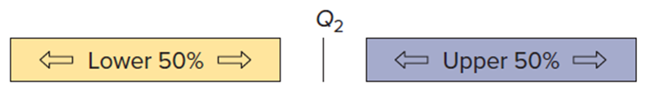
Quartiles 1
L O 4.7
The quartiles
are scale points that
divide the sorted data into four groups of approximately equal size, that is, the 25th, 50th, and 75th percentiles, respectively.
The second quartile
is the median. Because equal
numbers of data values lie below and above the median, it is an important indicator of center.
Access the text alternative for slide images.

Slide 36
Quartiles 2
L O 4.7
The first and third quartiles
indicate center
because they define the boundaries for the middle 50
percent of the data. But
also indicate
variability because the interquartile range
(denoted I Q R) measures the degree of spread in the data (the middle 50 percent).
Access the text alternative for slide images.

Slide 37
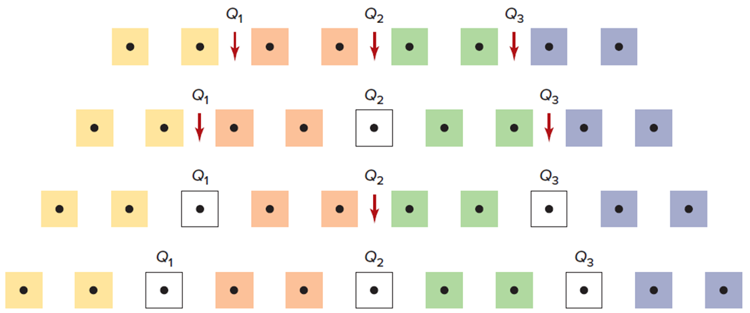
Quartiles 3
L O 4.7
Conceptually, the first quartile
is the median of the data values
below
and the third quartile
is the median of the data values
above
Depending on n, the quartiles
may be
members of the data set or may lie between two of the sorted data values.
Access the text alternative for slide images.

Slide 38
Methods of Medians 1
L O 4.7
For small data sets, find quartiles using method of medians:
Step 1: Sort the observations.
Step 2: Find the median
Step 3: Find the median of the data values that lie below
Step 4: Find the median of the data values that lie above

Slide 39
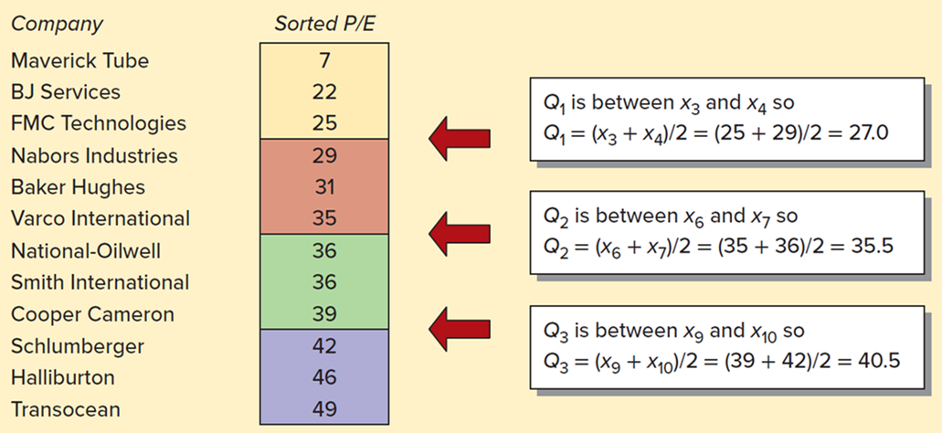
Methods of Medians 2
L O 4.7
A financial analyst has a portfolio of 12 energy equipment stocks. She has data on their recent price/earnings (P/E) ratios. To find the
quartiles, she sorts the data, finds
(the median) halfway between the
middle two data values, and then finds
(medians of the lower
and upper halves, respectively).
Figure 4.7: Method of Medians.
Access the text alternative for slide images.

Slide 40
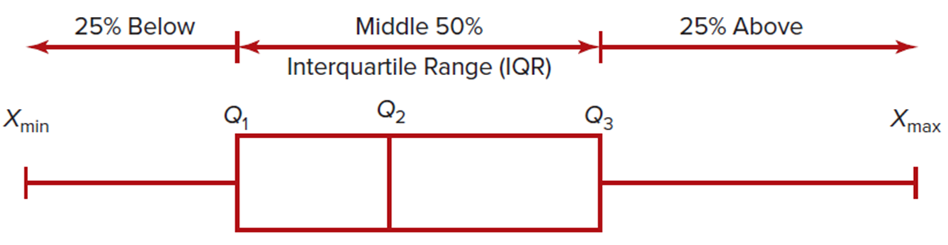
Box Plots 1
L O 4.8
A useful tool of exploratory data analysis (E D A) is the box plot (also called a box-and-whisker plot) based on the five-number summary:
The box plot is visually displayed like this:
Access the text alternative for slide images.

Slide 41
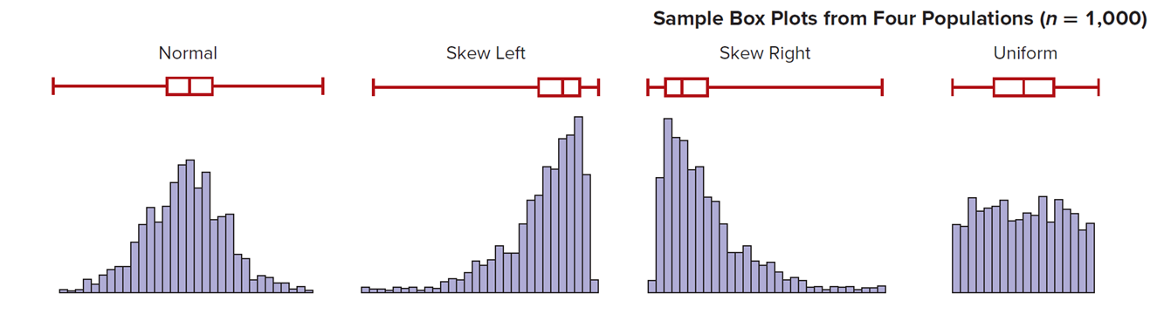
Box Plots 2
L O 4.8
A box plot shows variability and shape.
Access the text alternative for slide images.

Slide 42
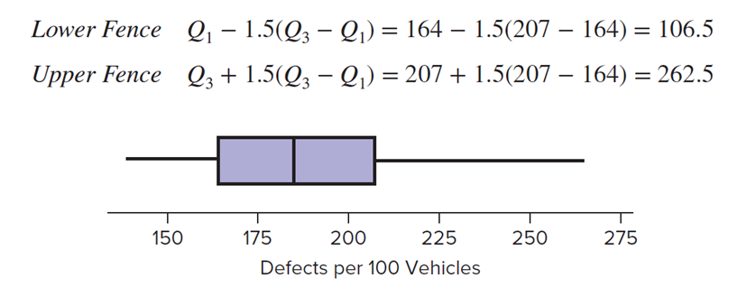
Box Plots 3
L O 4.8
We can use the quartiles to identify unusual data points. The idea is
to detect data values that are far below
or far above
The fences are based on the interquartile range (I Q R).
Lower Fence
Upper Fence
For the J.D. Power data
the fences are,
Access the text alternative for slide images.

Slide 43
Box Plots 4
L O 4.8
Quartiles can be used to define an additional measure of center that has the advantage of not being influenced by outliers. The midhinge is the average of the first and third quartiles:
The midhinge is always exactly halfway between
while the median
can be anywhere within the “box,” which
suggests a new way to describe skewness:
Skewed right (longer right tail)
Symmetric (tails roughly equal)
Skewed left (longer left tail)

Slide 44
Covariance
L O 4.9
The covariance of two random variables X and Y
measures the degree to which the values of X and Y change together.
Population covariance:
Sample covariance:
The units of measurement for the covariance are unpredictable because the magnitude and/or units of measurement of X and Y may differ. For this reason, analysts generally work with the correlation coefficient, which is a standardized value of the covariance that ensures a range between −1 and +1.

Slide 45
Correlation Coefficient 1
L O 4.9
Conceptually, a correlation coefficient is the covariance divided by the product of the standard deviations (denoted
for a population or
for a sample).
For a population, the correlation coefficient is indicated by the lowercase Greek letter ρ (rho), while for a sample we use the lowercase Roman letter r.
Population correlation coefficient:
Sample correlation coefficient:

Slide 46
Correlation Coefficient 2
L O 4.9
The sample correlation coefficient is a statistic that describes the degree of linearity between paired observations on two quantitative variables X and Y.
The range of r is −1 ≤ r ≤ + 1.
When r is near 0, there is little or no linear relationship between X and Y.
An r value near +1 indicates a strong positive relationship.
An r value near −1 indicates a strong negative relationship.

Slide 47
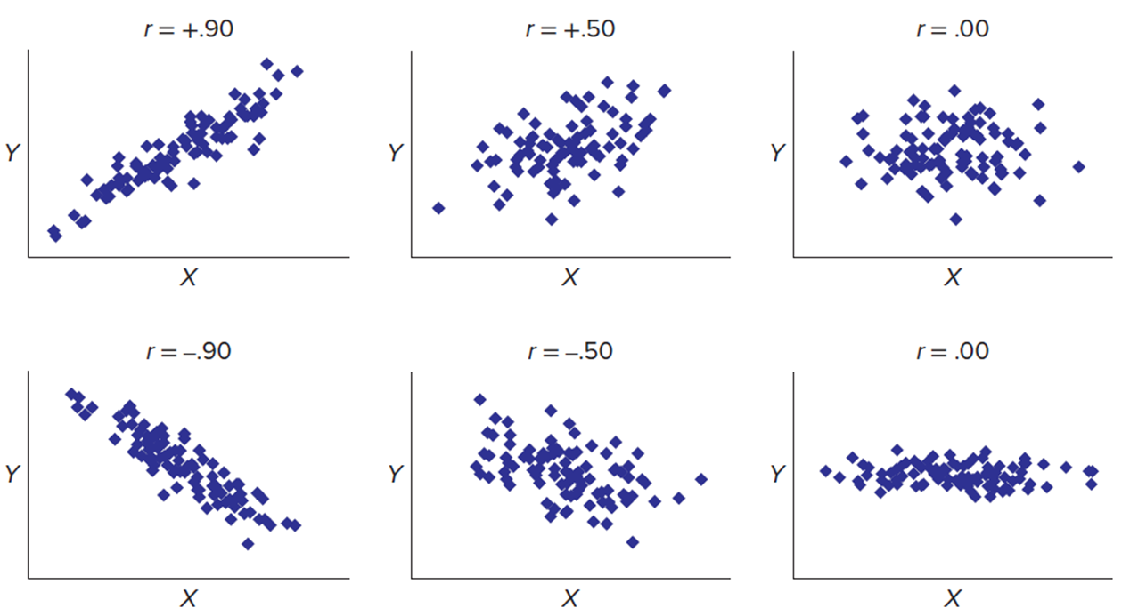
Correlation Coefficient 3
L O 4.9
Access the text alternative for slide images.

Slide 48
Weighted Mean
L O 4.10
The weighted mean is a sum that assigns each data value a
weight
that represents a fraction of the total (that is,
the k weights must sum to 1).
For example, your instructor might give a weight of 30 percent to homework, 20 percent to the midterm exam, 40 percent to the final exam, and 10 percent to a term project (so that .30 + .20 + .40 + .10 = 1.00). Suppose your scores on these were 85, 68, 78, and 90. Your weighted average for the course would be,

Slide 49
Group Mean
L O 4.10
We can apply the idea of a weighted mean when we must work with observations that have been grouped.
Each interval j has a midpoint
and a frequency
we
calculate the estimated mean by multiplying the midpoint of each class by its class frequency, taking the sum over all k classes, and dividing by sample size n.

Slide 50
Group Standard Deviation
L O 4.10
We then estimate the standard deviation by subtracting the estimated mean from each class midpoint, squaring the difference, multiplying by the class frequency, taking the sum over all classes to obtain the sum of squared deviations about the mean, dividing by n − 1, and taking the square root. Avoid the common mistake of “rounding off” the mean before subtracting it from each midpoint.

Slide 51
Grouped Data
L O 4.10
Worksheet for Grouped Cholesterol Medication Data (n = 47)
RxPrice

Slide 52
Skewness 1
L O 4.11
In a general way, skewness (as shown in Figure 4.28) may be judged by looking at the sample histogram, or by comparing the mean and median.
However, this comparison is imprecise and does not take account of sample size.
When more precision is needed, we look at the sample’s skewness coefficient:

Slide 53
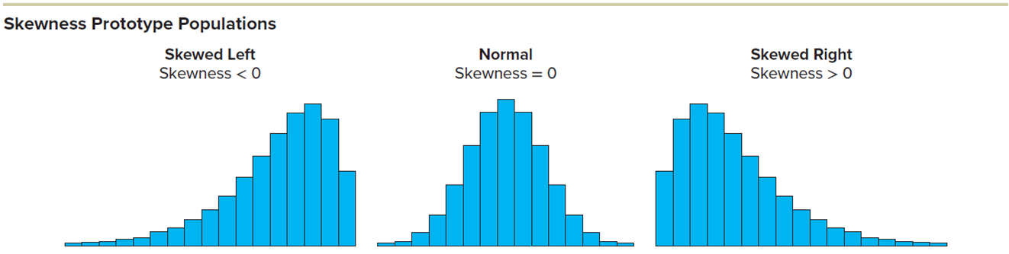
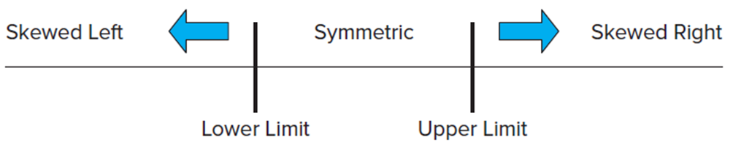
Skewness 2
L O 4.11
Access the text alternative for slide images.

Slide 54
Skewness 3
L O 4.11
The skewness coefficient can be obtained from Excel’s Tools > Data Analysis > Descriptive Statistics or by the function =SKEW(Data).
An alternative measure of skewness is the Pearson 2
skewness coefficient
where m is the
sample median:
This intuitively attractive statistic is easy to calculate using just three common descriptive statistics. It expresses the difference between the mean and median in terms of standard deviations.

Slide 55
Kurtosis 1
L O 4.11
Kurtosis refers to the relative length of the tails and the degree of concentration in the center.
A normal bell-shaped population is called mesokurtic and serves as a benchmark.
A population that is flatter than a normal population (that is, has heavier tails) is called platykurtic, while one that is more sharply peaked than a normal population (that is, has thinner tails) is leptokurtic.
Kurtosis is not the same thing as variability, although the two are easily confused.

Slide 56
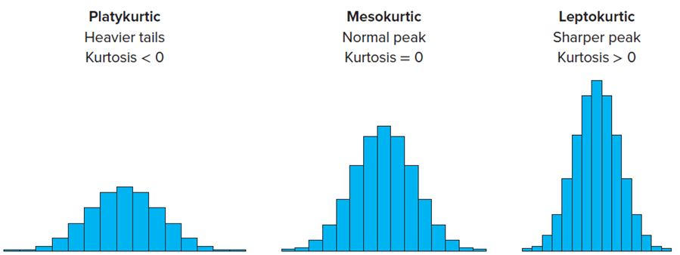
Kurtosis 2
L O 4.11
A histogram is an unreliable guide to kurtosis because its scale and axis proportions may vary, so a numerical statistic is needed:
Access the text alternative for slide images.

Slide 57
Kurtosis 1
L O 4.11
The skewness coefficient can be obtained from Excel’s Tools > Data Analysis > Descriptive Statistics or by the function =KURT(Data).
The degree of skewness or kurtosis must be judged using a table that takes account of the sample size (For example, Tables 4.18 and 4.19 in the textbook).

Slide 58
Chapter 4: Practice Problems

Slide 59
Question 1
L O 4.2
a. For each data set, find the mean, median, and mode.
b. Discuss anything about the data that affects the usefulness of each statistic as a measure of center.
Annual campus health center visits (12 students)
0, 0, 0, 0, 0, 1, 2, 3, 3, 5, 5, 15
Red Rocks ticket prices (9 concerts)
40, 60, 65, 71, 72, 75, 76, 78, 98
Sodium grams in canned soup (8 varieties)
225, 255, 295, 302, 304, 337, 351, 366

Slide 60
Question 12
L O 4.2
a. For each data set, find the median, midrange, and geometric mean.
b. Are they reasonable measures of central tendency?
Vehicle speeds on highway I-5 (9 vehicles)
42, 55, 65, 67, 68, 75, 76, 78, 94
Sodium grams in canned soup (8 varieties)
225, 255, 295, 302, 304, 337, 351, 366
Annual campus health center visits (12 students)
0, 0, 0, 0, 0, 1, 2, 3, 3, 5, 5, 15

Slide 61
Question 22
L O 4.3
For each data set:
(a) Find the mean.
(b) Find the standard deviation, treating the data as a sample.
(c) Find the standard deviation, treating the data as a population.
(d) What does this exercise show about the two formulas?
Data Set A: 6, 7, 8
Data Set B: 4, 5, 6, 7, 8, 9, 10
Data Set C: 1, 2, 3, 4, 5, 6, 7, 8, 9, 10, 11, 12, 13

Slide 62
Question 30
L O 4.4, 5
(a) By Chebyshev’s Theorem, at least how many students in a class of 200 would score within the range
(b) By the Empirical Rule, how many students in a class of 200 would score within the range
(c) What assumption is required in order to apply the Empirical Rule?

Slide 63
Question 32
L O 4.6
The mean monthly rent of students at Oxnard University is $875 with a standard deviation of $219.
(a) John’s rent is $1,325. What is his standardized z-score?
(b) Is John’s rent an outlier?
(c) How high would the rent have to be to qualify as an outlier?

Slide 64
Question 41
L O 4.8
In 2007, total compensation (in thousands of dollars) for 40 randomly chosen C E O’s ranged from 790 to 192,920, with
quartiles
(a) Sketch a simple box plot (5-number summary without fences) using a nicely scaled X-axis.
(b) Describe its shape (skewed left, symmetric, skewed right).

Slide 65
Question 46
L O 4.7, 8
Citibank recorded the number of customers to use a downtown A T M during the noon hour on 32 consecutive workdays.
(a) Use Excel to find the quartiles. What do they tell you?
(b) Find the midhinge. What does it tell you?
(c) Make a box plot and interpret it. Citibank File.
25 | 37 | 23 | 26 | 30 | 40 | 25 | 26
39 | 32 | 21 | 26 | 19 | 27 | 32 | 25
18 | 26 | 34 | 18 | 31 | 35 | 21 | 33
33 | 9 | 16 | 32 | 35 | 42 | 15 | 24

Slide 66
Question 49
L O 4.9
Closing prices of two stocks are recorded for 50 trading days. The sample standard deviation of stock X is 4.638, and the sample standard deviation of stock Y is 9.084. The sample covariance is −36.111.
(a) Calculate the sample correlation coefficient.
(b) Describe the relationship between prices of these two stocks.

Slide 67
Question 52
L O 4.10
Estimate the mean from this table of grouped data and frequencies.
From |  | To | f
0 | < | 20 | 5
20 | < | 40 | 12
40 | < | 60 | 18
60 | < | 80 | 9
 |  | Total | 44

Slide 68
Chapter 4: Analytics in Action

Slide 69
Analytics in Action 1
Future Job Titles:
The terms “data science” and “analytics” cover a lot of territory, but they rest on basic stuff that you are learning in this chapter: organizing and describing data succinctly to reveal their essential properties and potential relevance to specific problems or decisions. Here are some job titles you may soon encounter (for more ideas, see www.datasciencecentral.com).
Data Analyst:
The data analyst “scrubs” and analyzes data looking for potential bias or concerns about their quality. Then the data are examined to reveal the structure and essential features. This is a career starting point for many newly trained individuals.

Slide 70
Analytics in Action 2
Information Security Analyst:
Cyberattacks have brought applications in cybersecurity to the forefront of data analytics. The goal is to identify threats and predict their severity, using real-time data. Artificial intelligence and machine learning will play a role here. Collecting data underlies it all.
Data Engineer:
Innovative companies are constantly introducing new products and services. The focus of data engineering is on linking data science to the creation of business value, preventing problems, and working with teams to troubleshoot and find solutions for problems that have been identified from data about a company's products and services.

Slide 71
Analytics in Action 3
A l Product Manager:
Oversight is needed for the training and rollout of artificial intelligence systems. Particular attention is recently being paid to potential bias in training and monitoring A I performance. For example, Germany's Ethics Commission has now called for regulation of algorithmic systems (Significance, December 2019, p. 4) that are being proposed or adopted. Jobs will exist for individuals who become skilled in machine learning and A l.
A l Architect:
Professionals are needed to design the frameworks for A l systems. This is a high-level task, but recruitment will come from the ranks of those who have gained experience starting from the bottom. Mastering basic statistics is critical.

Slide 72
Analytics in Action 4
Measuring Volatility:
Investors make decisions based on many factors, including the volatility of a stock's price. We might measure volatility by calculating the mean and variance (or standard deviation) of historical prices of a stock over a certain time period. The coefficient of variation would provide a unit-free measure of "historic volatility" that could be used to compare volatility among different stocks. However, stock prices may violate some assumptions (for example, normality) and may not be predictive of the future. Because an investor's objective is to predict the future (For example, pricing of stock options), more complex methods are required.

Slide 73
Analytics in Action 5
The Black Sholes method of option contract pricing incorporates additional variables, such as contract strike price, current stock price, time to expiration, and volatility. It requires complex mathematical calculations (after all, its developers earned a Nobel Prize). A powerful statistical tool called the V I X Index has been introduced to measure the market's expectation of future volatility. It is calculated in real-time base on S&P 500 stock prices. Calculating the V I X also entails complex algebra and statistics. While you may enjoy doing Internet research on your own to understand these terms, you had better plan on taking classes in finance if you intend to become an active investor. Your basic training in statistics provides a good starting point.

Slide 74
End of Main Content
© McGraw Hill LLC. All rights reserved. No reproduction or distribution without the prior written consent of McGraw Hill LLC.

Slide 75
Accessibility Content: Text Alternatives for Images
75

Slide 76
Numerical Data Example 2 – Text Alternative
Return to parent-slide containing images.
A histogram that plots the frequency of defects per 100 vehicles. The frequency ranges from 0 to 10 with increments of 2. The graph exhibits a right-skewed trend, indicating that there are more vehicles with a lower number of defects. The highest frequency of 10 is observed in the range of 150 to 170 defects. Please note that all values are approximations.
Return to parent-slide containing images.

Slide 77
Characteristics of the Mean – Text Alternative
Return to parent-slide containing images.
A dot plot represents the number of defects per 100 vehicles. The x-axis of the plot ranges from 130 to 270, with increments of 20. Each dot on the plot corresponds to a specific number of defects. The majority of the dots, indicating the most common number of defects, are clustered between the values of 150 and 170. Please note that all values are approximations.
Return to parent-slide containing images.

Slide 78
Median – Text Alternative
Return to parent-slide containing images.
For the first image, an illustration of a double-headed arrow, representing a range. The left end of the arrow is labeled ‘Lower 50%’, indicating the bottom half of the data set. The right end is labeled ‘Upper 50%’, representing the top half of the data set. At the center of the arrow, pointing downwards, is a label reading ‘Median’, marking the middle value of the data set.
For the second image, two rows of icons representing data observations and their relation to the median value. In the first row, titled ‘Even n’, there are 4 green grid icons representing observations that are less than the median, and 4 red grid icons representing observations that are greater than the median. Between these two groups of icons, there is a downward arrow labeled ‘median’. The second row follows a similar pattern. It also has 4 green grid icons for observations less than the median and 4 red grid icons for observations greater than the median. However, in this row, the median is represented by a white icon placed between the two groups of observations.
Return to parent-slide containing images.

Slide 79
Shape 1 – Text Alternative
Return to parent-slide containing images.
Three types of normal distribution curves: skewed left, symmetric, and skewed right. Skewed Left: In this distribution, the median is at the center, the mean is to the left of the median, and the mode is to the right of the median. This indicates that there are a few exceptionally small values in the data set. Symmetric: In this distribution, the mean, median, and mode all lie on the same line. This indicates that the data is evenly distributed on both sides of the mean. Skewed Right: In this distribution, the median is at the center, the mode is to the left of the median, and the mean is to the right of the median.
Return to parent-slide containing images.

Slide 80
Shape 2 – Text Alternative
Return to parent-slide containing images.
Two histograms, each showing a different trend. The first histogram on the left, titled ‘Spending at 74 Noodles Restaurants’, plots the frequency, which ranges from 0 to 35 with increments of 5, against the average spending per customer, which ranges from 6.40 to 8.15 with increments of 0.25. The graph shows a right-skewed trend, indicating that most customers spend less with a few spending more. The second histogram on the right, titled ‘G P A’s of 158 Statistics Students’, plots the frequency, which ranges from 0 to 40 with increments of 10, against the G P A last semester, which ranges from 1.5 to 4.0 with increments of 0.5. The graph shows a left-skewed trend, indicating that most students have high G P A’s with a few having lower G P A’s.
Return to parent-slide containing images.

Slide 81
Measures of Variability 1 – Text Alternative
Return to parent-slide containing images.
Three dot plots, each representing study hours per week which ranges from 0 to 8 with increments of 2. The plots are categorized into low variation, more variation, and high variation. Low Variation: In this dot plot, most of the values are compacted around 4 hours. This indicates that most students study around 4 hours per week, with very little variation. More Variation: This dot plot shows values ranging between 2 to 6 hours. This indicates a wider spread in the number of hours students study per week. High Variation: This dot plot shows the widest range of values, from 0 to 8 hours. This indicates a high variation in the number of hours students study per week.
Return to parent-slide containing images.

Slide 82
Empirical Rule 1 – Text Alternative
Return to parent-slide containing images.
A symmetrical normal distribution curve with three standard deviation (σ) values. The base of the curve ranges from the mean (μ) minus 3σ to μ plus 3σ. The values plotted are as follows:
For k = 1, approximately 68.26% of values will lie within μ ± σ.
For k = 2, approximately 95.44% of values will lie within μ ± 2σ.
For k = 3, approximately 99.73% of values will lie within μ ± 3σ.
Return to parent-slide containing images.

Slide 83
Empirical Rule 2 – Text Alternative
Return to parent-slide containing images.
A symmetrical normal distribution curve with three standard deviation (σ) values. The base of the curve ranges from the mean (μ) minus 3σ to μ plus 3σ. The values plotted are as follows:
For k = 1, approximately 68.26% of values will lie within μ ± σ.
For k = 2, approximately 95.44% of values will lie within μ ± 2σ.
For k = 3, approximately 99.73% of values will lie within μ ± 3σ.
Return to parent-slide containing images.

Slide 84
Quartiles 1 – Text Alternative
Return to parent-slide containing images.
For the first image, three quartiles, denoted by Q1, Q2, and Q3. They divide a rank-ordered data set into four equal parts: Q1 (First Quartile): Also known as the lower quartile, Q1 is the median of the lower half of the data set. It separates the lowest 25% of the data from the rest. Q2 (Second Quartile): Q2 is the median of the entire data set. It separates the data into two halves. Half the scores are greater than or equal to this value and half are less. Q3 (Third Quartile): Also known as the upper quartile, Q3 is the median of the upper half of the data set. It separates the highest 25% of the data from the rest.
For the second image, the second quartile (Q2) is also known as the median. It divides the data set into two halves. The lower half falls below the median and constitutes the lower 50% of the data set, while the upper half is above the median and constitutes the upper 50% of the data set.
Return to parent-slide containing images.

Slide 85
Quartiles 2 – Text Alternative
Return to parent-slide containing images.
Two quartiles, denoted by Q1 and Q3. Q1 (First Quartile): Also known as the lower quartile, Q1 is the median of the lower half of the data set. It separates the lowest 25% of the data from the middle 50%. Q3 (Third Quartile): Also known as the upper quartile, Q3 is the median of the upper half of the data set. It separates the middle 50% of the data from the highest 25%.
Return to parent-slide containing images.

Slide 86
Quartiles 3 – Text Alternative
Return to parent-slide containing images.
Four rows, each depicting a different quartile distribution. The first row displays eight data points, with the first, second, and third quartiles (Q1, Q2, and Q3) positioned between specific data values. The second row shows a distribution of nine data points, with the quartiles similarly placed. The third row presents ten data points with the quartiles marked between successive data values. The fourth and final row illustrates a set of eleven data points, with the quartiles located between specific points.
Return to parent-slide containing images.

Slide 87
Methods of Medians 2 – Text Alternative
Return to parent-slide containing images.
A financial analyst analyzes a portfolio of 12 energy equipment stocks, with data on their recent price/earnings (P/E) ratios. The data is sorted to find the quartiles. The median (Q2) is found halfway between the middle two data values, and then Q1 and Q3 are found as the medians of the lower and upper halves, respectively. The sorted P/E ratios for the companies are as follows: Maverick Tube (7), B J Services (22), F M C Technologies (25), Nabors Industries (29), Baker Hughes (31), Varco International (35), National-Oilwell (36), Smith International (36), Cooper Cameron (39), Schlumberger (42), Halliburton (46), and Transocean (49). The first quartile (Q1) is calculated as the average of the third and fourth values (27.0), the second quartile (Q2) as the average of the sixth and seventh values (35.5), and the third quartile (Q3) as the average of the ninth and tenth values (40.5).
Return to parent-slide containing images.

Slide 88
Box Plots 1 – Text Alternative
Return to parent-slide containing images.
A box plot represents the first quartile (Q1), the second quartile (Q2 or median), and the third quartile (Q3). The Q1 marks the value below which 25% of the data falls, the Q2 represents the middle value or the 50% mark also known as the Interquartile Range (I Q R), and the Q3 marks the value above which 25% of the data falls. These quartiles are plotted on a scale that extends from the minimum data value (X minimum) to the maximum data value (X maximum).
Return to parent-slide containing images.

Slide 89
Box Plots 2 – Text Alternative
Return to parent-slide containing images.
A box plot represents four different data distributions, each with its own variability and shape. The shapes correspond to four types of distributions: Normal, Skew Left, Skew Right, and Uniform. These sample box plots are derived from four distinct populations, each with a sample size of 1,000.
Return to parent-slide containing images.

Slide 90
Box Plots 3 – Text Alternative
Return to parent-slide containing images.
A calculation of the lower and upper fences of a data set. The lower fence is calculated as Q1 minus 1.5 times the interquartile range (Q3 − Q1), resulting in a value of 106.5. The upper fence is calculated as Q3 plus 1.5 times the interquartile range, resulting in a value of 262.5. A graph titled ‘Defects per 100 Vehicles’ is presented, with a scale ranging from 150 to 275 on the y-axis.
Return to parent-slide containing images.

Slide 91
Correlation Coefficient 3 – Text Alternative
Return to parent-slide containing images.
Six scatter plots are presented, each illustrating a different correlation coefficient value. The correlation coefficients represented are r = 0.90, r = 0.50, r = 0.0, r = −0.90, r = −0.50, and r = 0.0. Each plot visualizes the relationship between two variables, with the correlation coefficient.
Return to parent-slide containing images.

Slide 92
Skewness 2 – Text Alternative
Return to parent-slide containing images.
For the first image, three histograms are presented under the title ‘Skewness Prototype Populations’, each illustrating a different type of skewness. The first histogram is skewed to the left, indicating a skewness value less than 0. The second histogram shows a normal distribution, where the skewness equals 0. The third histogram is skewed to the right, indicating a skewness value greater than 0. The base scale of the histograms labels the left of the symmetric as ‘Skewed Left’ and the right of the symmetric as ‘Skewed Right’.
For the second image, an illustration of a range scale. The center part of the scale is labeled ‘Symmetric’. To the left of the ‘Symmetric’ section, it’s labeled as ‘Skewed Left’, indicating a distribution that tails off to the left. To the right, it’s labeled as ‘Skewed Right’, indicating a distribution that tails off to the right. Within the ‘Symmetric’ section, there are two vertical lines marking the boundaries of this section. The line on the left is titled ‘Lower Limit’, and the line on the right is titled ‘Upper Limit’.
Return to parent-slide containing images.

Slide 93
Kurtosis 2 – Text Alternative
Return to parent-slide containing images.
Three histograms are presented, each representing a different type of kurtosis. The first histogram is labeled ‘Platykurtic’, characterized by heavier tails and a kurtosis value less than 0. The second histogram is ‘Mesokurtic’, depicting a normal peak with a kurtosis value equal to 0. The third histogram is ‘Leptokurtic’, featuring a sharper peak with a kurtosis value greater than 0.
Return to parent-slide containing images.

