Slide 1
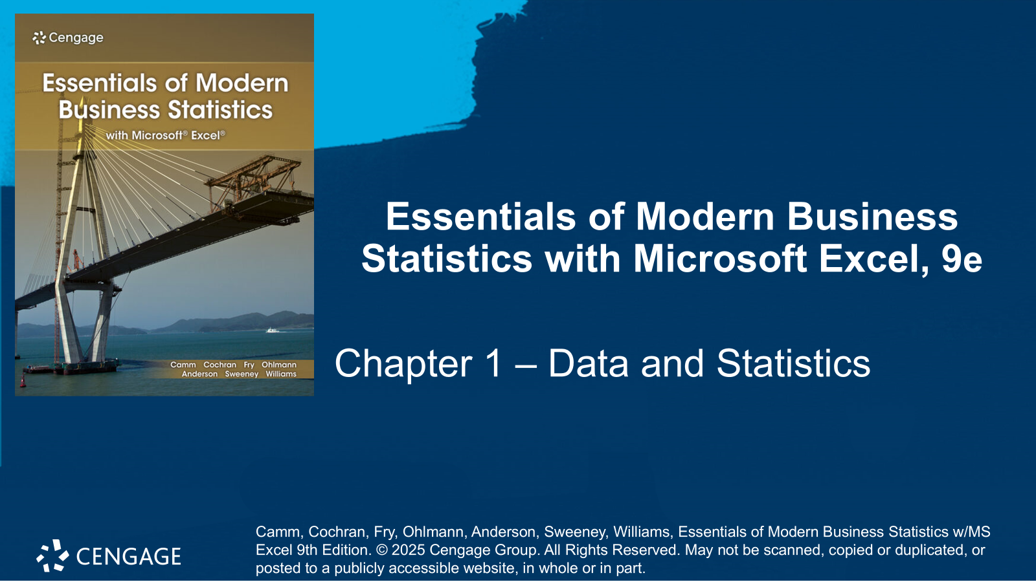

Slide 2
Chapter Contents
1.1 Applications in Business and Economics
1.2 Data
1.3 Data Sources
1.4 Descriptive Statistics
1.5 Statistical Inference
1.6 Statistical Analysis Using Microsoft Excel
1.7 Analytics
1.8 Big Data and Data Mining
1.9 Ethical Guidelines for Statistical Practice
Summary

Slide 3
Chapter Objectives
After completing this chapter, you will be able to:
LO 1-1 Identify the elements, variables, and observations in a data set.
LO 1-2 Identify categorical, quantitative, cross-sectional, and time-series data and their scale of measurement.
LO 1-3 Identify and create descriptive statistics of a data set.
LO 1-4 Distinguish between a population and a sample and identify the population being studied.
LO 1-5 Distinguish between data generated from a survey versus an experiment and when each is appropriate.
LO 1-6 Describe the data and sources of data that might be needed to answer a question.
LO 1-7 Make an inference based on descriptive statistics.

Slide 4
Introduction
The term statistics refers to numerical facts such as averages, medians, percentages, and maximums that help us understand a variety of business and economic situations.
Statistics can also refer to the art and science of collecting, analyzing, presenting, and interpreting data.
In this text, we emphasize the use of statistics for business and economic decision-making.
Section 1.1 begins by introducing applications of statistics in business and economics.
In Section 1.2, we define the term data and introduce the concept of a data set and how it is characterized.
Section 1.3 discusses how data can be obtained from existing sources or through surveys and experimental studies designed to obtain new data.
Sections 1.4 and 1.5 describe the uses of data in developing descriptive statistics and making statistical inferences.
The chapter closes with miscellaneous introductory topics in statistics.

Slide 5
1.1 Applications in Business and Economics
Accounting: public accounting firms use statistical sampling procedures when conducting audits for their clients.
Economics: economists use statistical information in making forecasts about the future of the economy or some aspect of it.
Finance: financial advisors use price/earnings ratios and dividend yields to guide their investment advice.
Marketing: electronic point-of-sale scanners at retail checkout counters are used to collect data for a variety of marketing research applications.
Production: a variety of statistical quality control charts are used to monitor the output of a production process.
Information Systems: a variety of statistical information helps administrators assess the performance of computer networks.

Slide 6
1.2 Data
Data are the facts and figures collected, analyzed, and summarized for presentation and interpretation.
Elements are the entities on which data are collected.
A variable is a characteristic of interest for the elements.
A data set consists of all the data collected for a particular study.
The total number of data values in a complete data set is the number of elements multiplied by the number of variables.
An observation is the set of measurements obtained for a particular element.
A data set with n elements contains n observations.

Slide 7
1.2 Data Set for 60 Nations in the World Trade Organization
DATAfile: nations
Shown here are the first five nations out of 60 (rows) of a table including several variables (columns.)
Observation #1 (Armenia) contains the measurements: Member; 4,267; B+; and Stable.
Observation #2 (Australia) contains the measurements: Member; 51,812; AAA; and Negative.
And so on.
Nation | WTO Status | Per Capita GDP (S) |  | Fitch Rating | Fitch Outlook
Armenia | Member | 4,267 |  | B+ | Stable
Australia | Member | 51,812 |  | AAA | Negative
Austria | Member | 48,328 |  | AA+ | Stable
Azerbaijan | Observer | 4,214 |  | BB+ | Stable
Bahrain | Member | 28,608 |  | B+ | Stable

Slide 8
1.2 Nominal and Ordinal Scales of Measurement
Nominal scale: the data are labels or names used to identify an attribute of the element.
Example: the WTO Status variable in the Nations table has a nominal scale of measurement because it uses the data “Member” and “Observer” are labels used to identify the status category for a nation.
Note: a numeric code may also be used. For example, we could use the label “1” to identify a “Member” status category and “2” to identify an “Observer” status category.
Ordinal scale: the data have the properties of nominal data, and the order or rank of the data is meaningful.
Example: the Fitch Rating variable in the Nations table has ordinal data because the labels, which range from AAA to F, are rank-ordered by credit rating.
Note: ordinal data can also be recorded by a numerical code, such as a student’s class rank in school.

Slide 9
1.2 Interval and Ratio Scales of Measurement
Interval scale: the data have the properties of ordinal data, and the interval between observations is expressed in terms of a fixed unit of measure. Data with an interval scale of measurement are always numerical.
Example: College admission SAT scores have an interval scale of measurement.
Note: the difference between the values of a variable with an interval scale of measurement are always meaningful.
Ratio scale: the data have the properties of interval data, and the ratio of two values is meaningful.
Example: variables such as distance, height, weight, and time use the ratio scale of measurement.
Note: the ratio scale of measurement requires that a zero value be included to indicate that nothing exists for the variable at the zero point.

Slide 10
1.2 Categorical and Quantitative Data
Data can be further classified as categorical or quantitative.
The statistical analysis that is appropriate depends on whether the data for the variable are categorical or quantitative.
Categorical Data
Quantitative Data
A categorical variable is a variable with categorical data.
Statistical analyses are rather limited.
We can summarize categorical data by:
counting the number of observations in each category
computing the proportion of the observations in each category
A quantitative variable is a variable with quantitative data.
Quantitative data indicate how many or how much and are always numerical.
Ordinary arithmetic operations are meaningful for quantitative data.
More alternatives for statistical analysis are available when the data are quantitative.

Slide 11
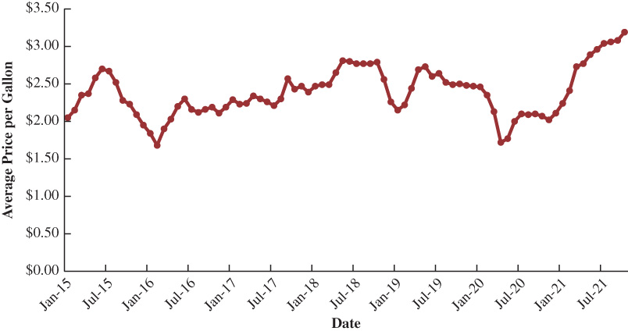
1.2 Cross-Sectional and Time Series Data
Cross-sectional data are collected at the same or approximately the same point in time.
Example: The data in the previously shown Nations data file are cross-sectional because they describe the five variables for the 60 WTO nations at the same point in time.
Time series data are instead collected over several time periods.
Graphs of time series data, such as the U.S. average price per gallon of regular gasoline between 2015 and 2021 shown to the right, help understand:
what happened in the past
identify any trends over time
project future levels for the time series

Slide 12
1.3 Data Sources
Data can be obtained
from existing sources
by conducting an observational study, or
by conducting an experiment.
In some cases, data needed for a particular application already exist.
The most important categories of existing data sources and related examples are:
Internal company records
Business database services
Government agencies
Industry associations
Special-interest organizations
Internet

Slide 13
1.3 Statistical Studies
Observational Study
Experiment
In an observational study, no attempt is made to control or influence the variables of interest.
Examples:
Recording data on demographics and shopping habits of a random group of Walmart customers.
Recording CEO gender and return on equity (ROE) for a sample of Fortune 500 companies to investigate the relationship between CEO gender and company performance.
Surveys and public opinion polls.
Because an experiment is conducted under controlled conditions, its data can provide more information compared to data obtained from existing sources or observational studies.
In experiments, first, a variable of interest is identified, and then one or more other variables are identified and controlled. The collected data are then analyzed to investigate how they influence the variable of interest.
Example – a pharmaceutical company administers different dosages of a new drug to groups of randomly selected individuals and monitors how they are affected by it.

Slide 14
1.3 Considerations on Data Acquisition
Time Requirement
Searching for information can be time-consuming.
Information may no longer be useful by the time it is available.
Cost of Acquisition
Organizations often charge for information even when it is not their primary business activity.
Data Errors
Using any data that happen to be available.
Data acquired with little care can lead to misleading information.

Slide 15
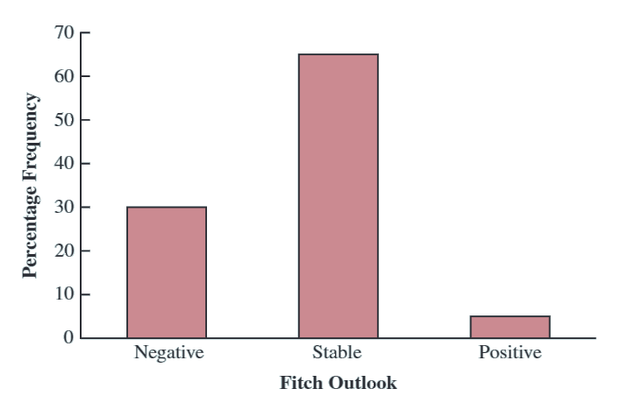
1.4 Descriptive Statistics
Most of the statistical information in publications consists of data that are summarized and presented in a form that is easy to understand.
Such summaries of data, which may be tabular, graphical, or numerical, are referred to as descriptive statistics.
Examples:
The variable Fitch Outlook in the WTO Nations table can be summarized as a table or bar chart.
Numerical descriptive statistics such as the mean (or average.)
Fitch Outlook | Frequency | Percent Frequency (%)
Positive | 3 | 5.0
Stable | 39 | 65.0
Negative | 18 | 30.0

Slide 16
1.5 Statistical Inference
When the collection of information about a large group of elements (individuals, companies, voters, households, products, customers, and so on) is not feasible because of time, cost, and other considerations, data can be collected from only a small portion of the group.
Formally, we use the following definitions of the larger and smaller groups of elements:
Population: the set of all elements of interest in a particular study
Sample: a subset of the population
We also formally define the following statistical processes:
Statistical inference: the process of using data obtained from a sample to make estimates and test hypotheses about the characteristics of a population
Census: the process of collecting data for the entire population
Sample survey: a process of collecting data for a sample

Slide 17
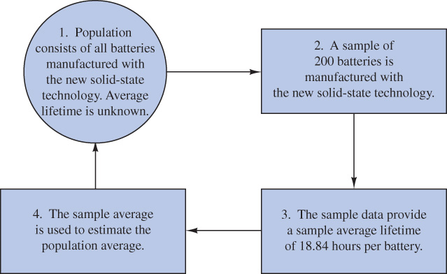
1.5 The Rogers Industries Example
DATAfile: rogers
Rogers Industries has developed a new solid-state lithium battery that should last longer and be safer to use.
Researchers want to evaluate the advantages of the new battery using statistical inference.
The sample average battery life of 18.84 hours can be used as an estimate (inference) of the population average.

Slide 18
1.6 Statistical Analysis Using Microsoft Excel
Because statistical analysis typically involves working with large amounts of data, computer software is frequently used to conduct the analysis.
This book shows how statistical analysis can be performed using Microsoft Excel.
This book is about statistics; it is not a book about spreadsheets. Our focus is on showing the appropriate statistical procedures for
Collecting, analyzing, presenting, and interpreting data.
Because Excel is widely available in business organizations, you can expect to put the knowledge gained here to use in the setting where you currently, or soon will, work.
If, in the process of studying this material, you become more proficient with Excel, so much the better.
We begin most sections with an application scenario in which a statistical procedure is useful.
After showing what the statistical procedure is and how it is used, we turn to showing how to implement the procedure using Excel.

Slide 19
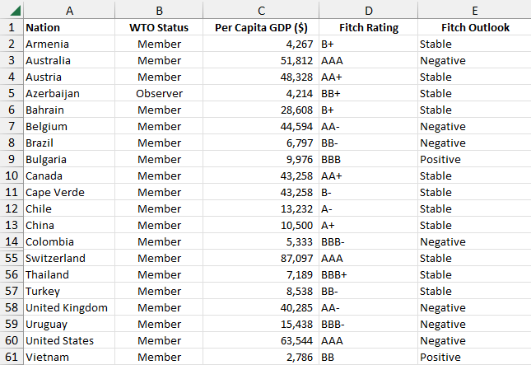
1.6 Excel: Data Sets and Worksheets
The figure below shows an Excel worksheet for the data set about the 60 nations participating in the World Trade Organization, shown in Section 1.2.
Row 1 and column A contain labels;
cells B1:E1 contain the variable names;
cells A2:A61 contain the observation names; and
cells B2:E61 contain the collected data.
Because displaying a worksheet with this many rows on a single page of a textbook is not practical, we will hide selected rows to conserve space.
In the example, we have hidden rows 15 through 54 to conserve space.

Slide 20
1.6 Excel: Statistical Analysis
To separate the discussion of a statistical procedure from the discussion of using Excel to implement the procedure, the material discussed using Excel will usually be set apart in sections with green headings, such as the one for this slide.
In using Excel for statistical analysis, the following four tasks may be needed, but not necessarily all of them:
Enter/Access Data (always needed): Select cell locations for the data and enter the data along with appropriate labels or open an existing Excel file such as one of the files that accompany the text.
Enter Functions and Formulas: Select cell locations, enter Excel functions and formulas, and provide descriptive labels to identify the results.
Apply Tools: Use Excel’s tools for data analysis and presentation.
Editing Options: Edit the results to better identify the output or to create a different type of presentation.

Slide 21
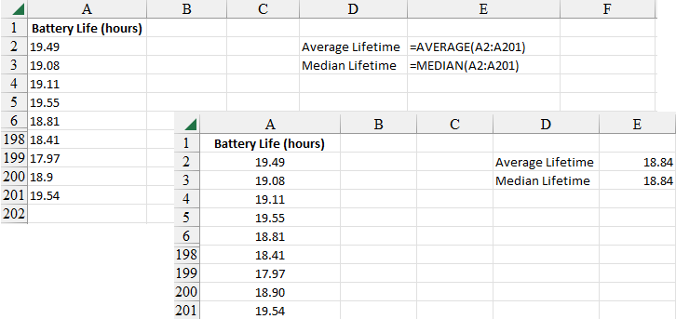
1.6 Excel: AVERAGE and MEDIAN Functions
The two shown worksheets describe how to use Excel’s functions AVERAGE and MEDIAN to compute the average and median lifetime for the 200 batteries included in the DATAfile rogers.
The value worksheet in the foreground displays the data for the problem and shows the results of the analysis.
The formula worksheet in the background displays the Excel formula used to compute the average lifetime.
The following tasks are shown:
Enter/Access Data. Open file rogers.
Enter Functions and Formulas. Entered in cells E2 and E3.

Slide 22
1.7 Analytics
Analytics is the scientific process of transforming data into insight for making better decisions.
Analytics is now generally thought to comprise three broad categories of techniques:
Descriptive analytics describes what has happened in the past.
Examples – data queries, reports, descriptive statistics, data visualization, data dashboards, and basic what-if spreadsheet models
Predictive analytics uses models constructed from past data to predict the future or to assess the impact of one variable on another
Examples – linear regression, time series analysis, forecasting models, and simulation.
Prescriptive analytics yield the best course of action.
Examples – optimization models and decision analysis

Slide 23
1.8 Big Data and Data Mining
Big data are larger and more complex data sets that cannot be managed, processed, or analyzed with commonly available software in a reasonable amount of time.
Analysts often define big data by referring to the Four V’s:
Volume: the amount of available data; velocity: the speed at which data is collected and processed; variety: refers to different data types; veracity: refers to the reliability of the data generated.
Data warehousing is the process of capturing, storing, and maintaining data.
Computing power and data collection tools have reached the point where it is now feasible to store and retrieve extremely large quantities of data in seconds.
Data mining methods help develop useful decision-making information from large databases.
Analysts use a combination of automated procedures to “mine the data” and convert it into useful information.
The most effective data mining procedures are multiple regression, logistic regression, and machine learning, which discover relationships in the data and predict future outcomes.

Slide 24
1.9 Ethical Guidelines for Statistical Practice
In a statistical study, unethical behavior can take a variety of forms including:
Improper sampling
Inappropriate analysis of the data
Development of misleading graphs
Use of inappropriate summary statistics
Biased interpretation of the statistical results
One should strive to be fair, thorough, objective, and neutral in collecting, analyzing, and presenting data.
Consumers of statistics should also be aware of the possibility of unethical behavior by others.
The American Statistical Association developed a report on “Ethical Guidelines for Statistical Practice” that contains guidelines organized into 8 topic areas of professionalism and responsibilities that address the major stakeholders of statistical analysis and research.

Slide 25
Summary
Statistics is the art and science of collecting, analyzing, presenting, and interpreting data.
Data consists of the facts and figures that are collected and analyzed.
The four scales of measurement used to obtain data on a particular variable include nominal, ordinal, interval, and ratio.
For purposes of statistical analysis, data can be classified as categorical or quantitative.
Categorical data use labels or names to identify an attribute of each element and use either the nominal or ordinal scale of measurement.
Quantitative data are numeric values that indicate how much or how many and use either the interval or ratio scale of measurement.
Descriptive statistics are the tabular, graphical, and numerical methods used to summarize data. The process of statistical inference uses data obtained from a sample to make estimates or test hypotheses about the characteristics of a population.
The last sections of the chapter introduced analytics, big data, data mining, the role of computers in statistical analysis, and a summary of ethical guidelines for statistical practice.

