Slide 1
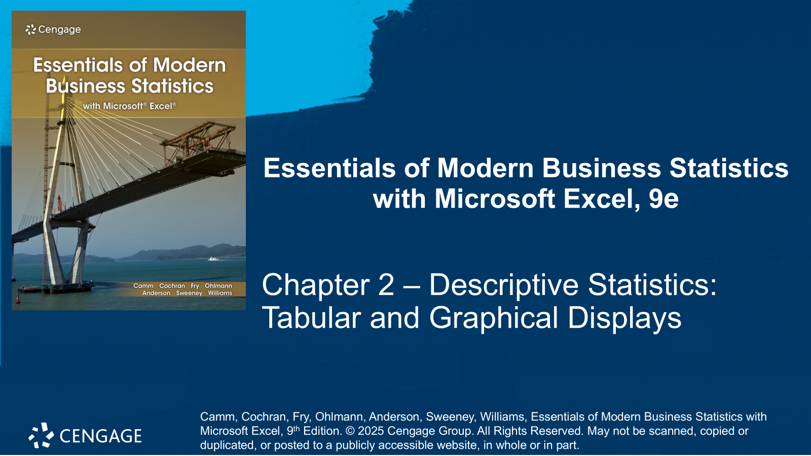

Slide 2
Chapter Contents
2.1 Summarizing Data for a Categorical Variable
2.2 Summarizing Data for a Quantitative Variable
2.3 Summarizing Data for Two Variables Using Tables
2.4 Summarizing Data for Two Variables Using Graphical Displays
2.5 Visualizing Geospatial Data
2.6 Data Visualization: Best Practices in Creating Effective Graphical Displays
Summary

Slide 3
Chapter Objectives (1 of 2)
After completing this chapter, you will be able to:
LO 2-1 Construct and interpret frequency, relative frequency, and percent frequency distributions for categorical data.
LO 2-2 Construct and interpret bar graphs and pie charts for categorical data.
LO 2-3 Construct and interpret frequency, relative frequency, and percent frequency distributions for quantitative data.
LO 2-4 Construct and interpret cumulative frequency, cumulative relative frequency, and cumulative percent distributions for quantitative data.
LO 2-5 Construct and interpret dot plots, histograms, and stem-and-leaf displays for quantitative data.
LO 2-6 Interpret the shape of a distribution of data and identify positive skewness, negative skewness, and symmetric distributions.

Slide 4
Chapter Objectives (2 of 2)
LO 2-7 Construct and interpret crosstabulations to summarize data for two variables.
LO 2-8 Construct and interpret a scatter diagram for two quantitative variables.
LO 2-9 Identify and explain Simpson’s paradox from a crosstabulation.
LO 2-10 Construct and interpret side-by-side and stacked bar charts.
LO 2-11 Create and interpret choropleth maps and cartograms for applications to geospatial data.
LO 2-12 Apply concepts of data-ink ratio and decluttering to improve table and chart designs.

Slide 5
Introduction
This chapter introduces tabular and graphical displays for summarizing both categorical and quantitative data.
We first discuss tabular and graphical displays to summarize the data for a single variable.
This is followed by a discussion of the use of tabular and graphical displays to summarize the data for two variables to reveal the relationship between the two variables.
We also introduce several specialized graphical displays used for geospatial data to create maps based on data.
Data visualization is a term often used to describe graphical displays to summarize and present information about a data set.
The last section of this chapter introduces data visualization and provides guidelines for creating effective graphical displays.
Statistical software packages provide extensive capabilities for summarizing data and preparing visual presentations.

Slide 6
2.1 Summarizing Data for a Categorical Variable
A frequency distribution is a tabular summary of data showing the number (frequency) of observations in each of several non-overlapping categories or classes.
Example DATAfile: softdrink
To develop a frequency distribution for the sample of 50 soft drink purchases, we count the number of times each soft drink appears.
The frequency distribution highlights Coca-Cola as the leader, followed by Pepsi, Diet Coke, Dr. Pepper, and Sprite.
 | Soft Drink | Frequency
 | Coca-Cola | 19
 | Diet Coke | 8
 | Dr. Pepper | 5
 | Pepsi | 13
 | Sprite | 5
 | Total | 50

Slide 7
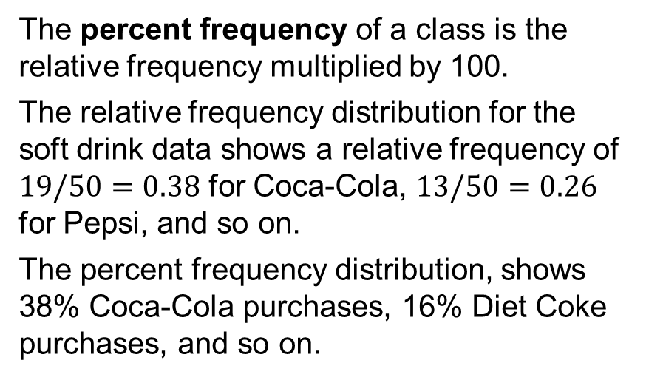
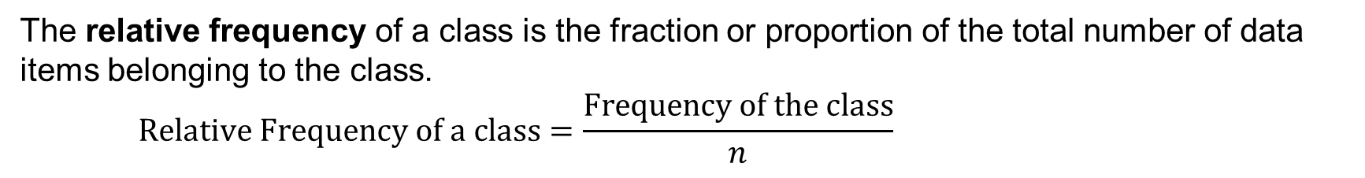
2.1 Relative Frequency and Percent Frequency Distributions
The relative frequency of a class is the fraction or proportion of the total number of data items belonging to the class.
$$\text{Relative} \text{Frequency} \text{of} \text{a} \text{class}=\frac{\text{Frequency} \text{of} \text{the} \text{class}}{n}$$
The percent frequency of a class is the relative frequency multiplied by 100.
The relative frequency distribution for the soft drink data shows a relative frequency of $19/50=0.38$ for Coca-Cola, $13/50=0.26$ for Pepsi, and so on.
The percent frequency distribution, shows 38% Coca-Cola purchases, 16% Diet Coke purchases, and so on.
 | Soft Drink | Relative Frequency | Percent Frequency
 | Coca-Cola | 0.38 | 38
 | Diet Coke | 0.16 | 16
 | Dr. Pepper | 0.10 | 10
 | Pepsi | 0.26 | 26
 | Sprite | 0.10 | 10
 | Total | 1.00 | 100

Slide 8
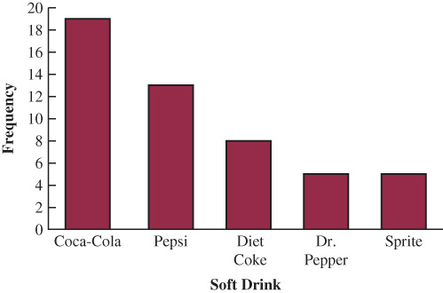
2.1 Bar Chart
A bar chart is a graphical display for depicting categorical data summarized in a frequency, relative frequency, or percent frequency distribution.
On one axis (usually the horizontal axis), we specify the labels used for the classes (categories).
A frequency, relative frequency, or percent frequency scale is used for the other axis (usually the vertical axis).
Using a bar of fixed width, drawn above each class label, we extend the height appropriately.
The bars are separated to emphasize the fact that each class is a separate category.
In this example, the bars are also sorted.

Slide 9
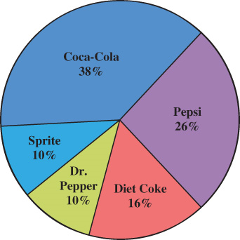
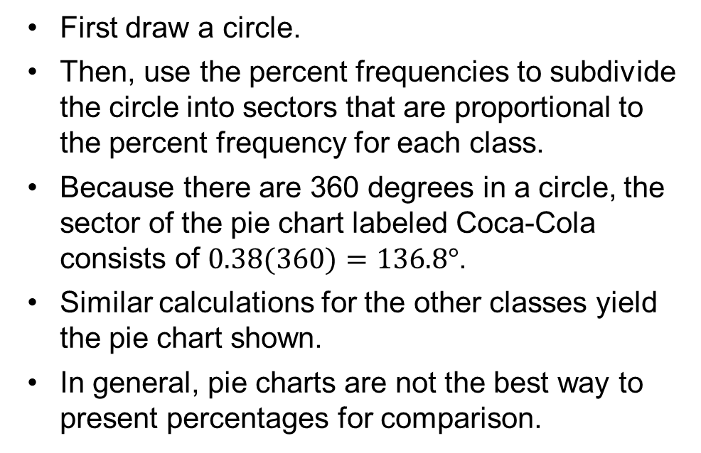
2.1 Pie Chart
The pie chart provides another graphical display for presenting relative frequency and percent frequency distributions for categorical data
First draw a circle.
Then, use the percent frequencies to subdivide the circle into sectors that are proportional to the percent frequency for each class.
Because there are 360 degrees in a circle, the sector of the pie chart labeled Coca-Cola consists of $0.38(360)=136.8°$.
Similar calculations for the other classes yield the pie chart shown.
In general, pie charts are not the best way to present percentages for comparison.

Slide 10
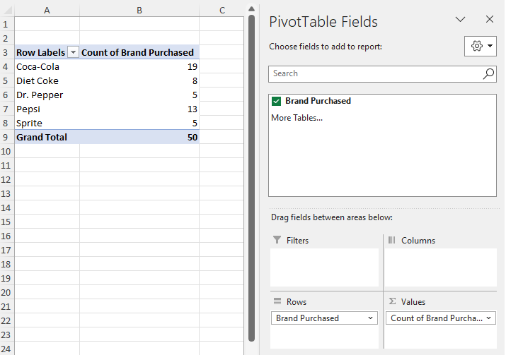
2.1 Excel: Construct a Frequency Distribution
We can use Excel’s Recommended PivotTables tool to construct a frequency distribution for the sample of 50 soft drink purchases.
Enter/Access Data: Open the file softdrink.
Apply Tools: To build a Pivot Table:
Step 1. Select any cell in the dataset.
Step 2. Click the Insert tab on the Ribbon.
Step 3. In the Tables group, click Recommended PivotTables.
Step 4. Click OK.

Slide 11
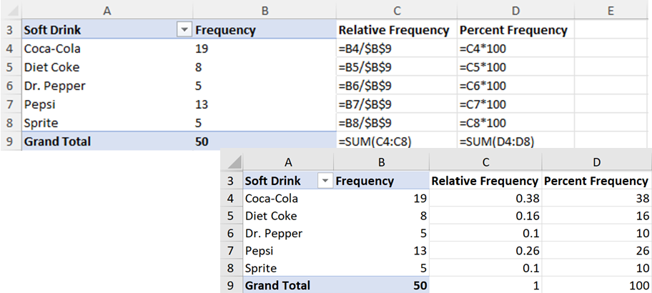
2.1 Excel: Construct Relative and Percent Frequency Distributions
To compute the relative frequency for Coca-Cola, we entered the formula =B4/$B$9 in cell C4. Copying cell C4 to cells C5:C8 computes the remaining relative frequencies.
To compute the percent frequency for Coca- Cola, we entered the formula =C4*100 in cell
D4 and copied it to cells D5:D8 to compute the remaining percent frequencies.
The totals are computed by entering SUM(C4:C8) in cell C9 and copying it to cell D9.

Slide 12
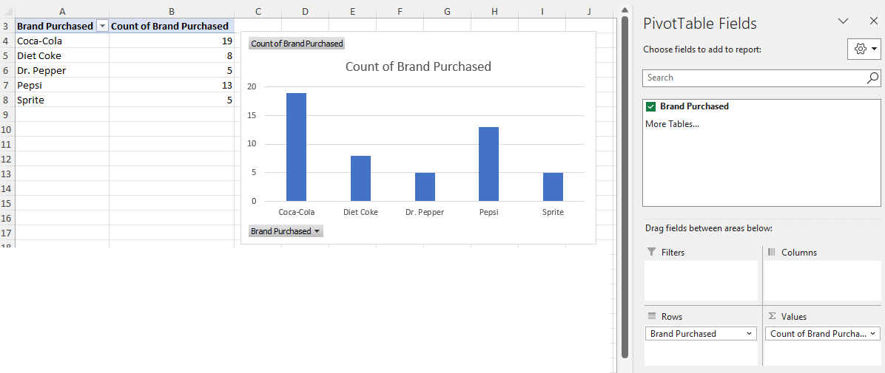
2.1 Excel: Construct a Bar Chart
Enter/Access Data: Open the file softdrink.
Apply Tools: the following steps describe how to use Excel’s Recommended Charts tool to construct a bar chart.
Step 1: Select any cell in the data set.
Step 2: Click the Insert tab on the Ribbon.
Step 3: In the Charts group, click Recommended Charts; a preview showing the bar chart appears.
Step 4: Click OK; the bar chart will appear in a new worksheet. See notes for editing options.
Notes:
You can easily edit the bar chart to display a different chart title and add axis titles.
For instance, suppose you would like to create a sorted bar chart to use “BarChart of Soft Drink Purchases” as the chart title, to use “Soft Drink” for the horizontal axist title and to use “Frequency” for the vertical axis title.
Step 1. Click the Chart Title and replace it with Bar Chart of Soft Drink Purchases.
Step 2. Click the Chart Elements button
Step 3. When the list of chart elements appears: Select the check box for Axis Titles (creates placeholders for the axis titles.)
Step 4. Click the horizontal Axis Title placeholder and replace it with Soft Drink.
Step 5. Click the vertical Axis Title placeholder and replace it with Frequency.
Step 6. Right-click on any of the bars in the chart, select Sort, and click Sort Largest to Smaller.

Slide 13
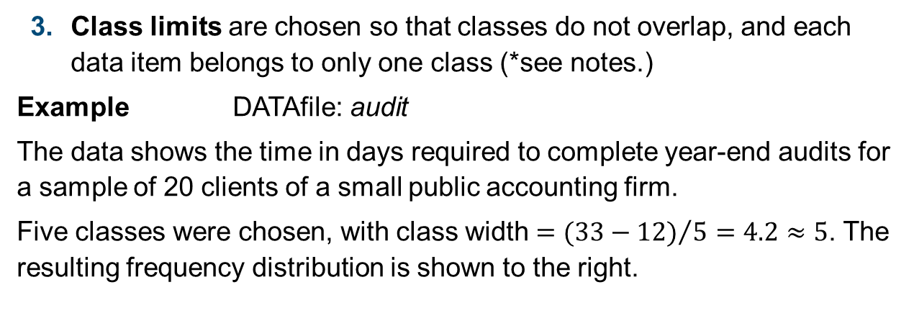
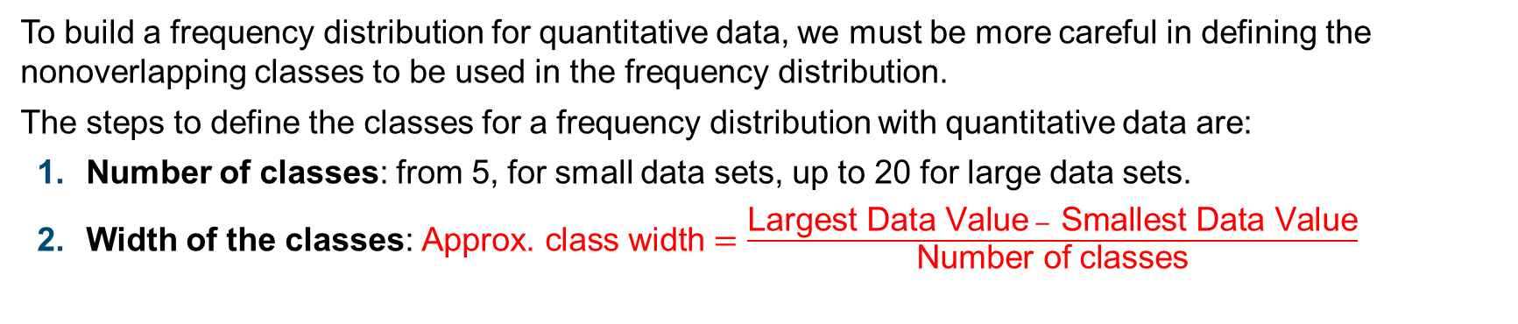
2.2 Summarizing Data for a Quantitative Variable
To build a frequency distribution for quantitative data, we must be more careful in defining the nonoverlapping classes to be used in the frequency distribution.
The steps to define the classes for a frequency distribution with quantitative data are:
Number of classes: from 5, for small data sets, up to 20 for large data sets.
Width of the classes: $\text{Approx}\text{.} \text{class} \text{width}=\frac{\text{Largest} \text{Data} \text{Value} − \text{Smallest} \text{Data} \text{Value}}{\text{Number} \text{of} \text{classes}}$
Class limits are chosen so that classes do not overlap, and each data item belongs to only one class (*see notes.)
Example DATAfile: audit
The data shows the time in days required to complete year-end audits for a sample of 20 clients of a small public accounting firm.
Five classes were chosen, with class width $={(33−12)}/5=4.2≈5$. The resulting frequency distribution is shown to the right.
Audit Time (days) | Frequency
10-14 | 4
15-19 | 8
20-24 | 5
25-29 | 2
30-34 | 1
Total | 20
Notes:
*Note: the appropriate values for the class limits with quantitative data depend on the level of accuracy of the data. For instance, with the audit time data, the limits used were integer values. If the data were rounded to the nearest tenth of a day (e.g., 12.3, 14.4, and so on), then the limits would be stated in tenths of days. For instance, the first class would be 10.0–14.9. If the data were recorded to the nearest hundredth of a day (e.g., 12.34, 14.45, and so on), the limits would be stated in hundredths of days. For instance, the first class would be 10.00–14.99.

Slide 14
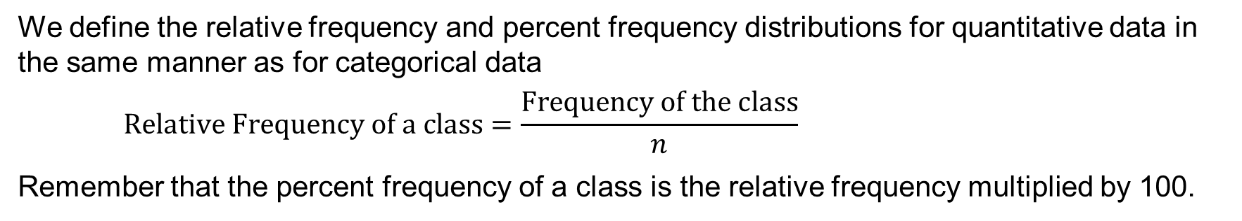
2.2 Relative Frequency and Percent Frequency Distributions for a Quantitative Variable
We define the relative frequency and percent frequency distributions for quantitative data in the same manner as for categorical data
$$\text{Relative} \text{Frequency} \text{of} \text{a} \text{class}=\frac{\text{Frequency} \text{of} \text{the} \text{class}}{n}$$
Remember that the percent frequency of a class is the relative frequency multiplied by 100.
Based on the class frequencies for the 20 audit times, the table shows the relative frequency distribution and percent frequency distribution (*see notes.)
Note that 40% of the audits required between 15 and 19 days, and only 5% of the audits required 30 or more days.
Audit Time (days) | Relative Frequency | Percent Frequency
10-14 | 0.20 | 20
15-19 | 0.40 | 40
20-24 | 0.25 | 25
25-29 | 0.10 | 10
30-34 | 0.05 | 5
Total | 1.00 | 100
Notes:
*Note: in some applications, we want to know the midpoints of the classes in a frequency distribution for quantitative data. The class midpoint is the value halfway between the lower and upper-class limits. For the audit time data, the five class midpoints are 12, 17, 22, 27, and 32.

Slide 15
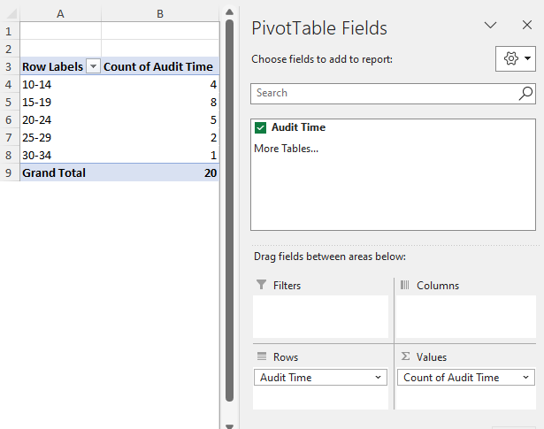
2.2 Excel: Construct a Frequency Distribution
Enter/Access Data: Open the file audit.
Apply Tools: The following steps describe how to construct a frequency distribution for the audit time data.
Step 1. Select any cell in the data set.
Step 2. Click the Insert tab.
Step 3. In the Tables group, click PivotTable.
Step 4. Click OK on the Create PivotTable dialog box.
Step 5. In the PivotTable Fields task pane: drag Audit Time to the Rows area; drag Audit Time to the Values area.
Step 6. Click on Sum of Audit Time in the Values area.
Step 7. Select Value Field Settings ... from the options.
Step 8. When the Value Field Settings dialog box appears, choose Count under Summarize value field by; Click OK.
See notes for grouping the data as shown to the right.
Notes:
To group the rows containing the audit times, followi these steps.
Step 1. Right-click cell A4 in the PivotTable or any other cell containing an audit time.
Step 2. Choose Group from the list of options that appears.
Step 3. When the Grouping dialog box appears
Enter 10 in the Starting at: box
Enter 34 in the Ending at: box
Enter 5 in the By: box
Click OK.

Slide 16
2.2 Cumulative Distributions
A cumulative frequency distribution shows the number of items with values less than or equal to the upper limit of each class (*see notes.)
A cumulative relative frequency distribution shows the proportion of items with values less than or equal to the upper limit of each class.
A cumulative percent frequency distribution shows the percentage of items with values less than or equal to the upper limit of each class.
The distributions in the table show that 85% of the audits were completed in 24 days or less, 95% of the audits were completed in 29 days or less, and so on.
Audit Time (days) | Cumulative Frequency | Cumulative Relative Frequency | Cumulative Percent Frequency
Less than or equal to 14 | 4 | 0.20 | 20
Less than or equal to 19 | 12 | 0.60 | 60
Less than or equal to 24 | 17 | 0.85 | 85
Less than or equal to 29 | 19 | 0.95 | 95
Less than or equal to 34 | 20 | 1.00 | 100
Notes:
*Note: the last entry in a cumulative frequency distribution always equals the total number of observations. The last entry in a cumulative relative frequency distribution always equals 1.00 and the last entry in a cumulative percent frequency distribution always equals 100.

Slide 17
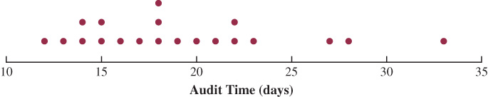
2.2 Dot Plot
The Dot Plot is one of the simplest graphical summaries of quantitative data.
A horizontal axis shows the range for the data, and each data value is represented by a dot placed above the axis.
Dot plots show the details of the data and are useful for comparing the distribution of the data for two or more variables.
The dot plot for the audit time data is shown below.
The three dots located above 18 on the horizontal axis indicate that an audit time of 18 days occurred three times.

Slide 18
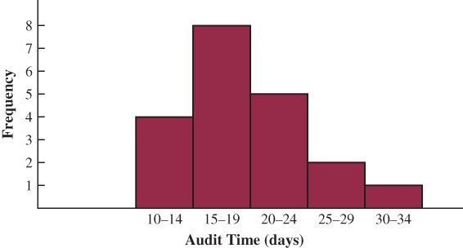
2.2 Histogram
The histogram is a common graphical display that can be prepared for quantitative data previously summarized in a frequency, relative frequency, or percent frequency distribution.
The variable of interest is placed on the horizontal axis.
A rectangle is drawn above each class interval with its height corresponding to the interval’s frequency, relative frequency, or percent frequency.
Unlike a bar graph, a histogram has no natural separation between rectangles of adjacent classes (*see notes.)
The histogram for the audit time data is shown.
Note that the class of 15–19 days shows the greatest frequency with 8 audits.
The class of 30-34 days shows the lowest frequency with only 1 audit.
Notes:
*Note: A bar chart and a histogram are essentially the same thing; both are graphical presentations of the data in a frequency distribution. A histogram is just a bar chart with no separation between bars. For some discrete quantitative data, a separation between bars is also appropriate. Consider, for example, the number of classes in which a college student is enrolled. The data may only assume integer values. Intermediate values such as 1.5, 2.73, and so on are not possible. With continuous quantitative data, however, such as the audit times, a separation between bars is not appropriate.

Slide 19
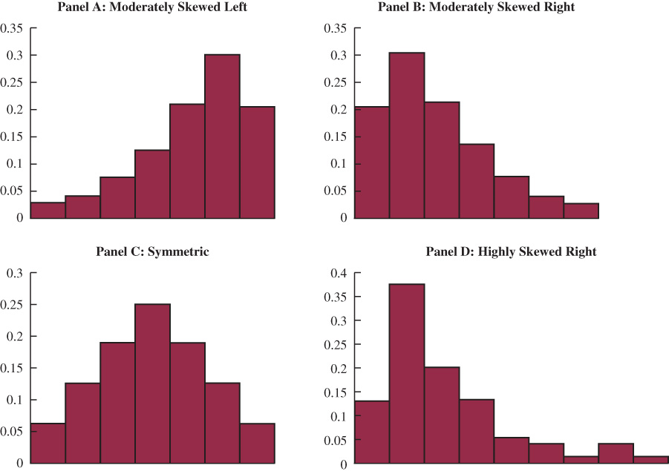
2.2 Histograms Showing Differing Levels of Skewness

Slide 20
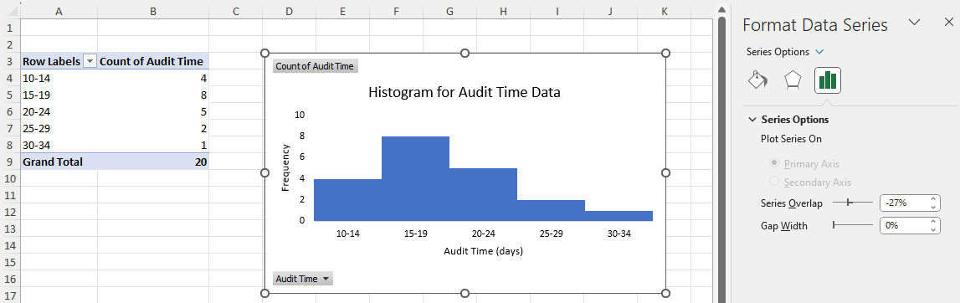
2.2 Excel: Construct a Histogram
Apply Tools: The following steps describe how to use Excel’s Recommended Charts tool to construct a histogram for the audit time data.
Step 1. Select any cell in the PivotTable report Step 2. Click the Insert tab on the Ribbon Step 3. In the Charts group, click Recommended Charts Step 4. Click OK
Editing Options: In addition to removing the gaps between the bars, see the notes for additional edits.
Notes:
To use “Histogram for Audit Time Data” as the chart title and insert “Audit Time (days)”for the horizontal axis title and “Frequency” for the vertical axis title, follow these steps.
Step 1. Right-click any bar in the chart and choose Format Data Series ... from the list of options that appears,
Step 2. When the Format Data Series task pane appears. Click Series Options to display the options. Set the Gap Width to 0. Click the Close button at the top right of the task pane.
Step 3. Click the Chart Title and replace it with Histogram for Audit Time Data.
Step 4. Click the Chart Elements button.
Step 5. When the list of chart elements appears: Select the check box for Axis Titles (creates placeholders for the axis titles)Deselect the check box for LegendDeselect the check box for Gridlines. Step 6. Click the horizontal Axis Title placeholder and replace it with Audit Time (days)Step 7. Click the vertical Axis Title placeholder and replace it with Frequency.

Slide 21
2.2 Stem-and-Leaf Display
A stem-and-leaf display shows both the rank order and shape of a distribution of data.
It is similar to a histogram on its side, but it has the advantage of showing the actual values.
The leading digits of each data item are arranged to the left of a vertical line.
To the right of the vertical line, we record the last digit for each item in rank order.
Each line (row) in the display is referred to as a stem.
Each digit on a stem is a leaf.
Example DATAfile: aptitudetest
The data indicate the number of questions answered correctly in a 150-question aptitude test given to 50 individuals recently interviewed for a position.
Stem-and-leaf displays for data with more than three digits are possible.
6 | 8 | 9
7 | 2 | 3 | 3 | 5 | 6 | 6
8 | 0 | 1 | 1 | 2 | 3 | 4 | 5 | 6
9 | 1 | 2 | 2 | 2 | 4 | 5 | 5 | 6 | 7 | 8 | 8
10 | 0 | 0 | 2 | 4 | 6 | 6 | 6 | 7 | 8
11 | 2 | 3 | 5 | 5 | 8 | 9 | 9
12 | 4 | 6 | 7 | 8
13 | 2 | 4
14 | 1

Slide 22
2.3 Summarizing Data for Two Variables Using Tables
Consider Zagat’s review of 300 restaurants in the Los Angeles area. The data set includes measurements on quality rating and typical meal price (DATAfile: restaurant.)
A crosstabulation of the data is shown below, where:
the Quality Rating, a categorical variable with categories good, very good, and excellent, is shown in the left margin, and its frequency distribution in the right margin.
the Meal Price, a quantitative variable ranging from $10 to $49 and grouped into four classes, is shown in the top margin, and its frequency distribution in the bottom margin.
the cells in the body of the table provide the counts for all the combinations of Quality Rating and Meal Price.
 |  | Meal Price
Quality Rating | $10-19 | $20-29 | $30-39 | $40-49 | Total
Good | 42 | 40 | 2 | 0 | 84
Very Good | 34 | 64 | 46 | 6 | 150
Excellent | 2 | 14 | 28 | 22 | 66
TotaI | 78 | 118 | 76 | 28 | 300

Slide 23
2.3 Crosstabulation: Row Percentages
Converting the entries in a crosstabulation into row percentages or column percentages can provide more insight into the relationship between the two variables.
For row percentages, the results of dividing each frequency in the crosstabulation by its corresponding row total are shown in the table below.
Each row in the table is a percent frequency distribution of meal price for one of the quality rating categories.
Of the restaurants with the lowest quality rating (good), 50% have low meal prices.
Of the restaurants with an excellent quality rating, most are in the $30-$39 and $40-$49 higher price ranges.
 |  | Meal Price
Quality Rating | $10-19 | $20-29 | $30-39 | $40-49 | Total
Good | 50.0% | 47.6% | 2.4% | 0.0% | 100.0%
Very Good | 22.7% | 42.7% | 30.6% | 4.0% | 100.0%
Excellent | 3.0% | 21.2% | 42.4% | 33.4% | 100.0%

Slide 24
2.3 Crosstabulation: Column Percentages
For column percentages, the results of dividing each frequency in the crosstabulation by its corresponding column total are shown in the table below.
Each column in the table is a percent frequency distribution of quality rating for one of the classes of meal prices.
Only 2.6% of restaurants with low ($10-19) meal prices have an excellent quality rating.
As meal price increases, percent frequency distribution shifts toward higher quality ratings.
 |  | Meal Price
Quality Rating | $10-19 | $20-29 | $30-39 | $40-49
Good | 53.8% | 33.9% | 2.6% | 0.0%
Very Good | 43.6% | 54.2% | 60.5% | 21.4%
Excellent | 2.6% | 11.9% | 36.8% | 78.6%
TotaI | 100.0% | 100.0% | 100.0% | 100.0%

Slide 25
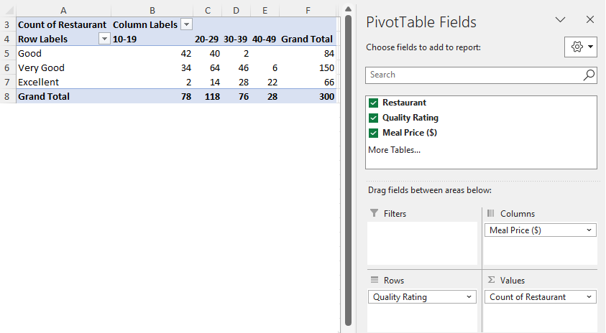
2.3 Excel: Construct a Crosstabulation with PivotTable
Enter/Access Data: Open the file restaurant.
Apply Tools: The following steps describe how to use Excel’s PivotTable tool to construct a crosstabulation of quality ratings and meal prices.
Step 1. Select any cell in the data set and click the Insert tab.
Step 2. In the Tables group click PivotTable. When the Create PivotTable dialog box appears, click OK.
Step 3. In the PivotTable Fields task pane, drag Quality Rating to the Rows area, drag Meal Price to the Columns area, and drag Restaurant to the Values area.
Step 4. See notes to change the displayed sums into counts.
Notes:
To change the displayed values from sums to counts, follow these steps:
Click on Sum of Restaurant in the Values area.
Select Value Field Settings ... from the list of options that appears.
SWhen the Value Field Settings dialog box appears, under Summarize value field by, choose Count.
Click OK.

Slide 26
2.3 An Analysis of Two Judges’ Verdicts
Judges Ron Luckett and Dennis Kendall presided over cases in Common Pleas Court and Municipal Court during the past three years. Some of the rendered verdicts were appealed.
A crosstabulation for a total of 275 appealed verdicts was developed based upon two variables: the Judge (Luckett or Kendall), and the verdict (upheld or reversed.)
The crosstabulation of the results, along with the column percentages in parentheses next to each value, shows that Judge Kendall has been doing the better job because of the greater percentage (88% vs. 86%) of upheld verdicts.
 | Judge
Verdict | Luckett | Kendall | Total
Upheld | 129 (86%) | 110 (88%) | 239
Reversed | 21 (14%) | 15 (12%) | 36
TotaI (%) | 150 (100%) | 125 (100%) | 275

Slide 27
2.3 Simpson’s Paradox
However, when the results are disaggregated by type of Court (Common Pleas vs. Municipal Court) into two, a separate crosstabulation for each Judge, a different picture emerges:
Judge Luckett leads Judge Kendall in Common Pleas Court upheld verdicts, 91% to 90%.
Judge Luckett also leads Judge Kendall in Municipal Court upheld verdicts, 85% to 80%.
The reversal of conclusions based on aggregate and disaggregated data is called Simpson’s Paradox.
 | Judge Luckett | Judge Luckett |  |  |  | Judge Kendall | Judge Kendall
Verdict | Common Pleas | Municipal Court | Total |  | Verdict | Common Pleas | Municipal Court | Total
Upheld | 29 (91%) | 100 (85%) | 129 |  | Upheld | 90 (90%) | 20 (80%) | 110
Reversed | 3 (9%) | 18 (15%) | 21 |  | Reversed | 10 (10%) | 5 (20%) | 15
TotaI (%) | 32 (100%) | 118 (100%) | 150 |  | TotaI (%) | 100 (100%) | 25 (100%) | 125

Slide 28
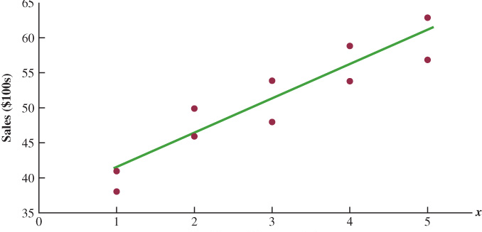
2.4 Summarizing Data for Two Variables Using Graphical Displays
A scatter diagram is a graphical presentation of the relationship between two quantitative variables.
A trendline is a line that provides an approximation of the relationship.
Example DATAfile: Electronics
The horizontal axis (x) shows the number of commercials; the vertical axis (y), sales for an electronic store in San Francisco.
The relationship between the number of commercials and sales does not form a perfectly straight line. However, the general pattern of the points and the trendline suggest that the overall relationship is positive.

Slide 29
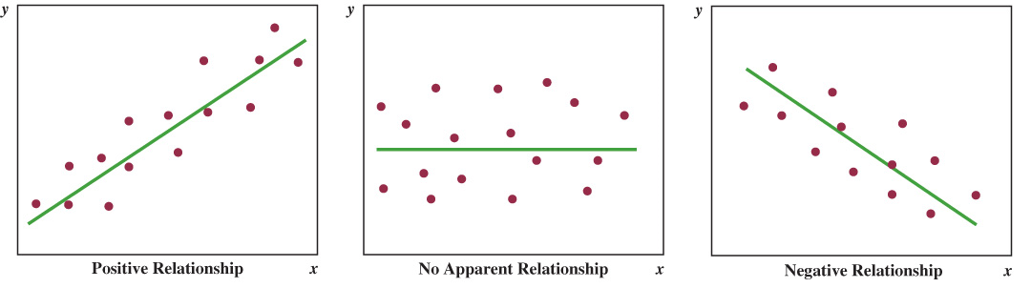
2.4 Types of Relationships Depicted by Scatter Diagrams

Slide 30
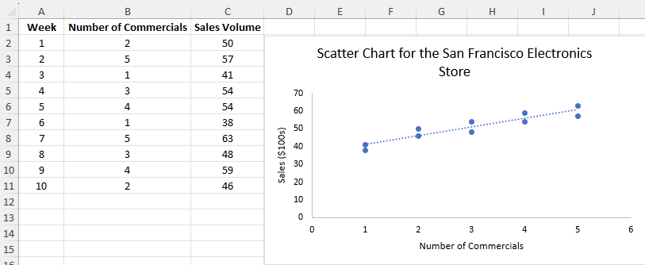
2.4 Excel: Construct a Scatter Diagram
Enter/Access Data: Open the file electronics.
Apply Tools: The following steps describe how to construct a scatter diagram.
Step 1. Select cells B1:C11.
Step 2. Click the Insert tab.
Step 3. In the Charts group, click Insert Scatter (X,Y) or Bubble Chart.
Step 4. When the list of scatter diagram subtypes appears, click Scatter.
Editing Options: You can easily add a chart title, axis titles, and a trendline to obtain the scatter diagram shown to the right.
See notes for instructions on how to do it.
Notes:
Step 1. Click the Chart Title and replace it with Scatter Chart for the San Francisco Electronics Store
Step 2. Click the Chart Elements button (located next to the top-right corner of the chart)
Step 3. When the list of chart elements appears:
Select the check box for Axis Titles (creates placeholders for the axis titles)
Deselect the check box for Gridlines (to remove the gridlines from the chart)
Select the check box for Trendline
Step 4. Click the horizontal Axis Title placeholder and replace it with Number of Commercials
Step 5. Click the vertical Axis Title placeholder and replace it with Sales ($100s)

Slide 31
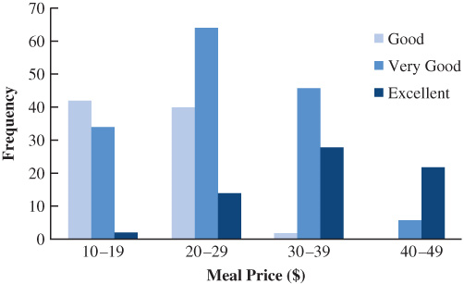
2.4 Side-by-Side Bar Chart
A side-by-side bar chart is a graphical display for depicting multiple bar charts on the same display.
We can use a side-by-side bar chart to represent the column percentages of the Zagat’s restaurant reviews.
Each cluster of bars represents one of the four classes of meal prices.
Each bar within a cluster represents one of the three quality rating categories.
The chart makes even more apparent the shift toward higher quality ratings as the meal prices increase.

Slide 32
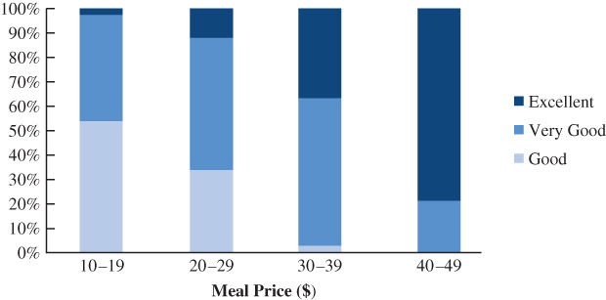
2.4 Stacked Bar Chart
We can also use a stacked bar chart to compare two variables on the same display.
In a stacked bar chart, each bar is broken into rectangular segments of a different color showing the relative frequency of each class in a manner similar to a pie chart.
We can also use a stacked bar chart to represent the column percentages of the Zagat’s restaurant reviews.
Note that, because percentage frequencies are displayed, all bars are of the same height, extending to the 100% mark (*see notes.)
The stacked bar chart shows even more clearly the shift toward higher quality ratings as meal prices increase.
Notes:
*Note: a stacked bar chart can also be used to display frequencies rather than percentage frequencies. In this case, the different color segments of each bar represent the contribution to the total for that bar, rather than the percentage contribution.

Slide 33
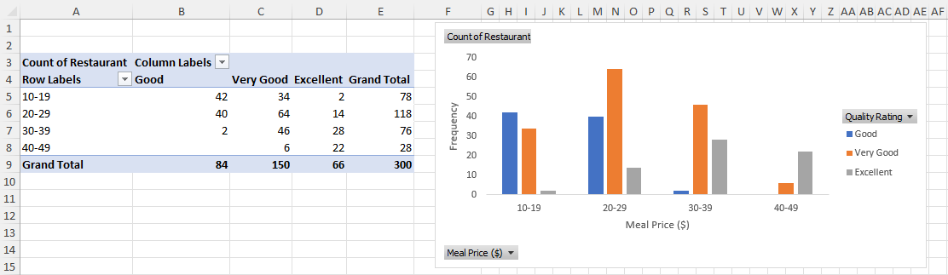
2.4 Excel: Construct a Side-by-Side Bar Chart
Apply Tools: The following steps describe how to use Excel’s Recommended Charts tool to construct a side-by-side bar chart for the restaurant data using the PivotTable output.
Step 1. Select any cell in the PivotTable report Step 5. Click the Design tab
Step 2. Click the Insert tab Step 6. In the Data group, click Switch
Step 3. In the Charts group, click Recommended Charts Row/Column to display Meal
Step 4. Click OK Price ($) on the horizontal axis
Editing Options: See the notes for additional edits on bar colors and axis labels.
Notes:
Step 1. Click the Chart Elements button (located next to the top-right corner of the chart)
Step 2. When the list of chart elements appears:
Select the check box for Axis Titles (creates placeholder for the axis titles)
Deselect the check box for Gridlines
Step 3. Click the horizontal Axis Title placeholder and replace it with Meal Price ($)
Step 4. Click the vertical Axis Title placeholder and replace it with Frequency

Slide 34
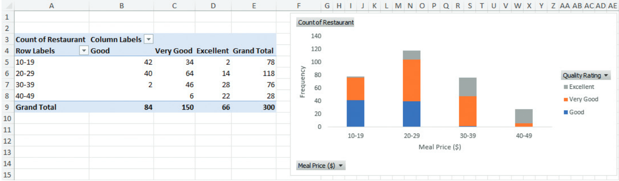
2.4 Excel: Construct a Stacked Bar Chart
You can easily change the side-by-side bar chart to a stacked bar chart using the following steps.
Step 5. Click on the bar chart.
Click the Design tab on the Ribbon. In the Type group, click Change Chart Type.
Step 6. When the Change Chart Type dialog box appears:
Select the Stacked Columns option. Click OK.

Slide 35
2.5 Visualizing Geospatial Data
Geospatial data include information on the geographic location of each record.
Displaying geospatial data on a map can help discover patterns that would have been otherwise difficult to interpret.
There are two general types of geographic visualization:
Choropleth maps
Cartograms

Slide 36
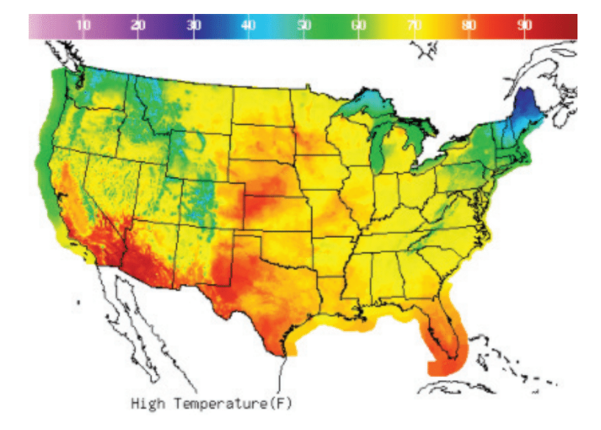
2.5 Choropleth Maps
Weather map example
A choropleth map is a geographic visualization that uses shades of color, different colors, or symbols to indicate the values of a quantitative or categorical variable associated with a geographic region or area.
Example:
A weather map uses color to depict the daily high temperature, with warmer colors (on the red end of the spectrum) representing higher temperatures and cooler colors (on the purple end of the spectrum) representing lower temperatures.

Slide 37
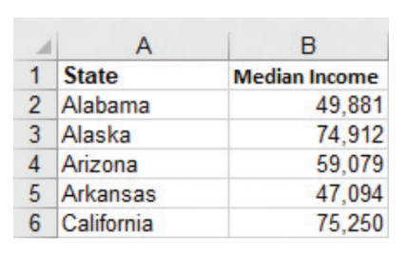
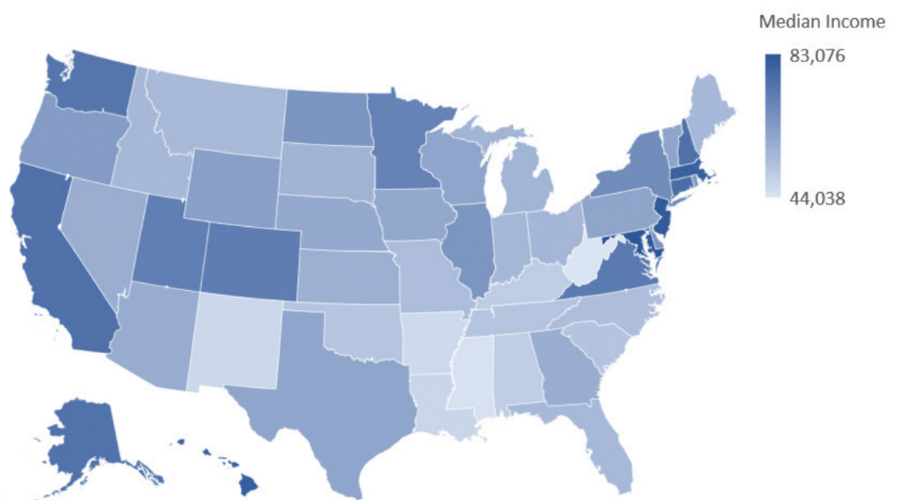
2.5 Excel: Construct a State-Level Data Choropleth Map
Choropleth map of the United States displaying median income by state
A portion of data in DATAfile IncomeByState
To build the choropleth map to the left, follow these steps:
Step 1. Select cells A1:B51
Step 2 .Click the Insert tab on the Ribbon
Step 3. In the Charts group, click the Maps button
Step 4. Select Filled Map

Slide 38
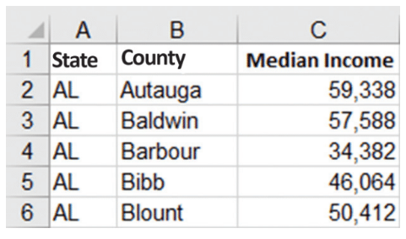
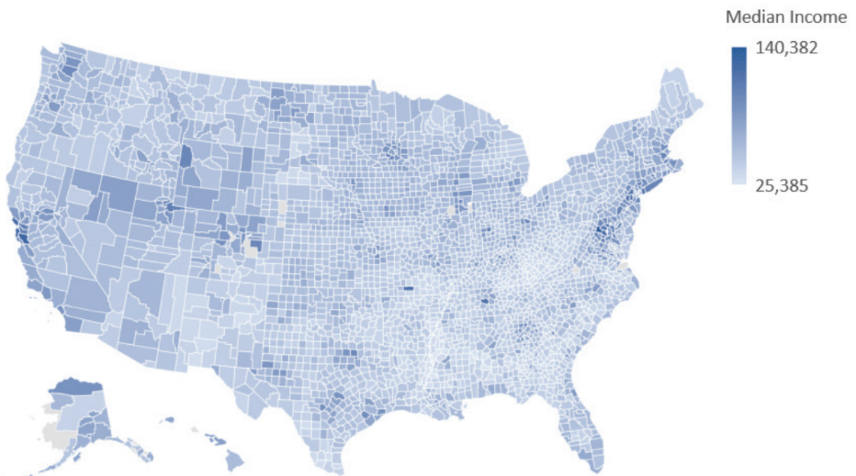
2.5 Excel: Construct a County-Level Data Choropleth Map
Choropleth map of the United States displaying median income by county
A portion of data in DATAfile IncomeByCounty
To build the choropleth map to the left, follow these steps:
Step 1. Select cells A1:C3148
Step 2. Click the Insert tab on the Ribbon
Step 3. In the Charts group, click the Maps button
Step 4. Select Filled Map

Slide 39
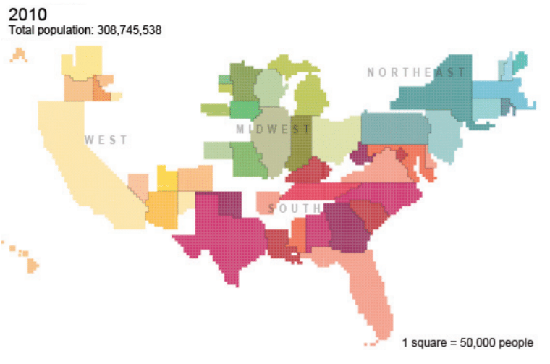
2.5 Cartograms
Cartogram of the United States displaying state population
A cartogram is a map-like diagram that uses geographic positioning but purposefully represents map regions that do not necessarily correspond to land area.
Example:
In the cartogram of the United States to the left, each state’s area has been modified to make it proportional to the state’s population.

Slide 40
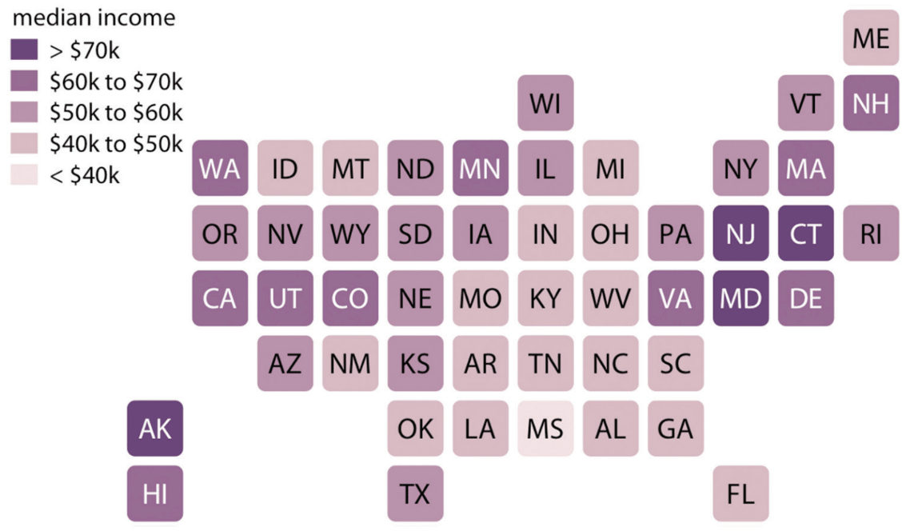
2.5 Equal-Area Cartograms
Equal-area cartogram of the United States displaying median income by state.
A potential weakness of a cartogram is that the sizing of the regions may distort enough to render the relative geographic positioning meaningless and the standard area-based geography unrecognizable.
An equal-area cartogram provides a balanced visual representation of each state while still maintaining fidelity to relative geographic positioning.

Slide 41
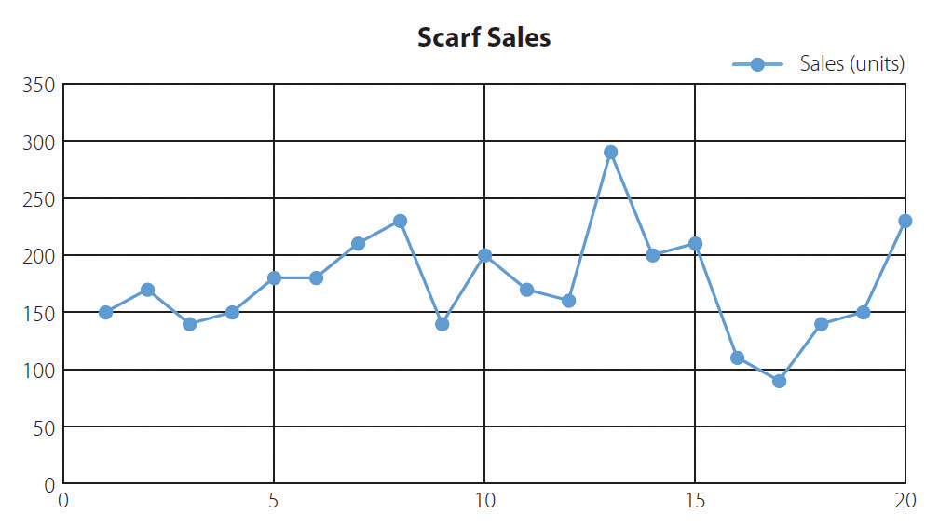
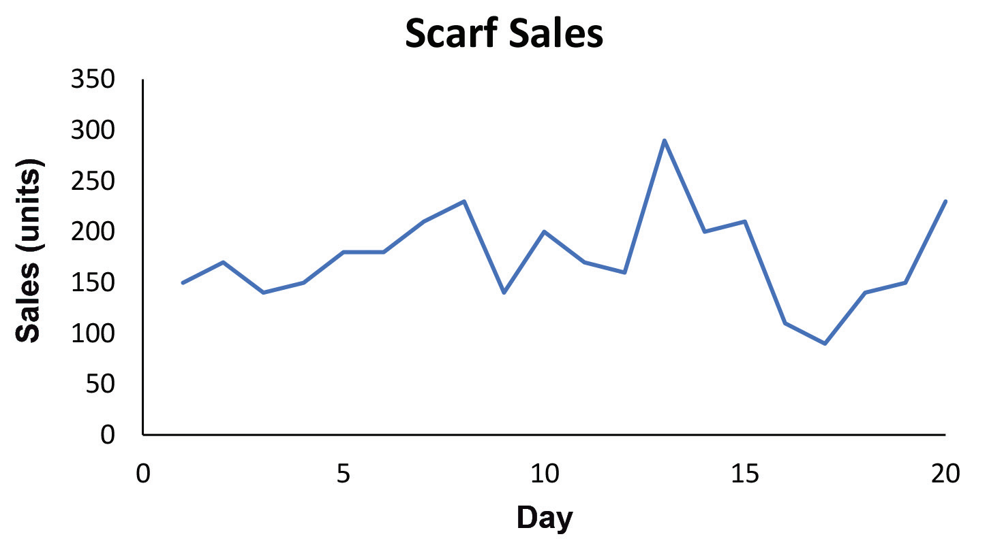
2.6 Data-Ink Ratio
The data-ink ratio measures the proportion of ink used in a table or chart that is necessary to convey the meaning to the audience.
Overuse of non-data-ink increases cognitive load without conveying additional information.
Low Data-Ink Ratio Chart
High Data-Ink Ratio Chart

Slide 42
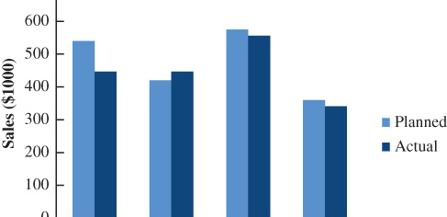
2.6 Best Practices in Creating Effective Graphical Displays
Data visualization is the use of graphical displays to summarize and present data.
The goal of data visualization is to communicate, as effectively and clearly as possible, the key information about the data.
The side-by-side bar chart of the planned versus actual sales data by sales region in the United States for Gustin Chemical is a good example of an effective graphical display.
The chart is an effective graphical display because it follows these guidelines:
It displays a clear and concise title.
It keeps the display simple, yet informative.
Each axis is clearly labeled, and units are provided.
The two colors used are distinct, and a legend is provided to explain their use.

Slide 43
2.6 Summary of Graphical Displays Used to Show the Distribution of Data
Bar Chart: used to show the frequency distribution and relative frequency distribution for categorical data
Pie Chart: used to show the relative frequency and percent frequency for categorical data. A pie chart is generally not preferred to the use of a bar chart
Dot Plot: used to show the distribution of quantitative data over the entire range of the data
Histogram: used to show the frequency distribution for quantitative data over a set of class intervals
Stem-and-Leaf Display: used to show both the rank order and shape of the distribution for quantitative data

Slide 44
2.6 Summary of Graphical Displays Used to Make Comparisons and Show Relationships
To Make Comparisons
To Show Relationships
Side-by-Side Bar Chart: used to compare two variables
Stacked Bar Charts: used to compare the relative frequency or percent frequency of two categorical variables
Scatter diagram: used to show the relationship between two quantitative variables
Trendline: used to approximate the relationship of data in a scatter diagram

Slide 45
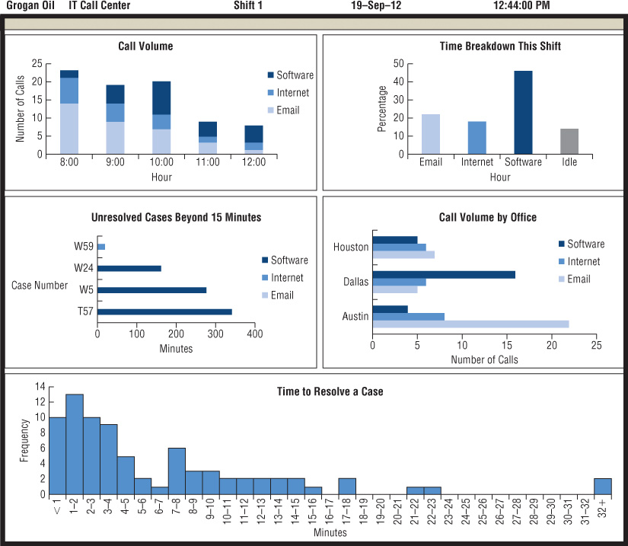
2.6 Data Dashboards
A data dashboard is a widely used data visualization tool that organizes and presents key performance indicators (KPIs) used to monitor an organization or process.
A data dashboard provides timely summary information that is easy to read, understand, and interpret.
Additional guidelines for data dashboards include:
Minimize the need for screen scrolling.
Avoid unnecessary use of color or 3D displays.
Use borders between charts to improve readability.

Slide 46
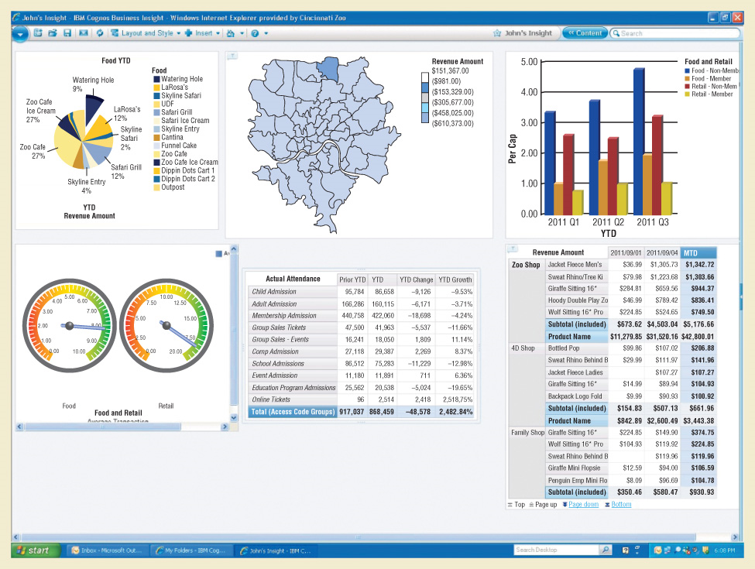
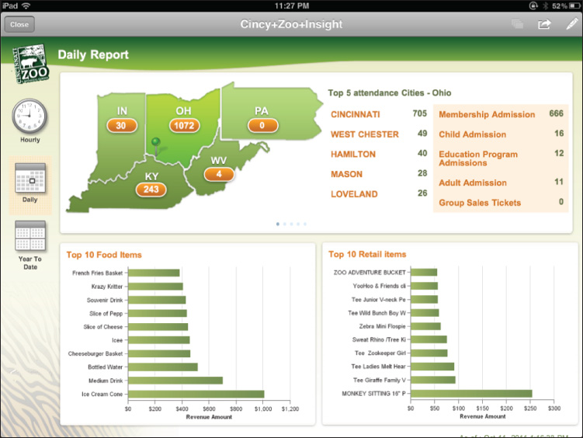
2.6 Data Visualization in Practice
Cincinnati Zoo Data Dashboard
Botanical Garden Data Dashboard

Slide 47
Summary
Even a modest set of data is often difficult to interpret in the form in which it is gathered.
Tabular and graphical displays can be used to summarize and present data so that patterns are revealed and the data are more easily interpreted.
We described tabular and graphical displays to summarize the data for:
a single categorical variable
a single quantitative variable
two variables, categorical or quantitative
two quantitative variables
We discussed guidelines for creating effective graphical displays and how to choose the most appropriate type of display.
We showed how choropleth maps and cartograms can be used to display geospatial data.
We introduced how data dashboards can be used to monitor a company’s performance in a manner that is easy to read, understand, and interpret.

Slide 48
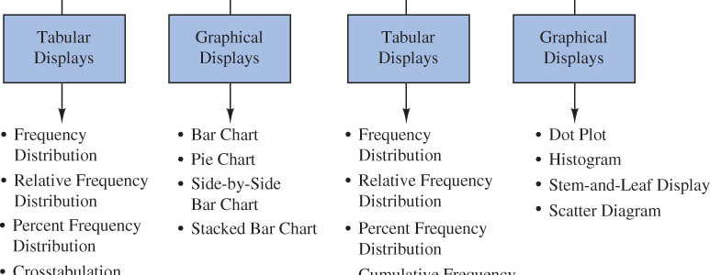
A Summary of Tabular and Graphical Displays of Data

