Slide 1
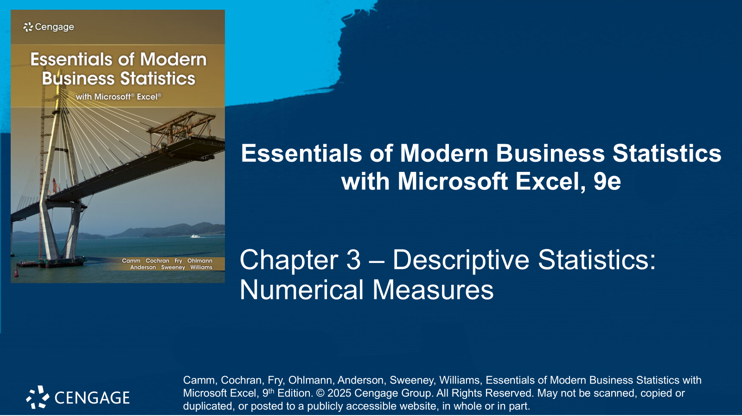

Slide 2
Chapter Contents
3.1 Measures of Location
3.2 Measures of Variability
3.3 Measures of Distribution Shape, Relative Location, and Detecting Outliers
3.4 Five-Number Summaries and Box Plots
3.5 Measures of Association Between Two Variables
3.6 Data Dashboards: Adding Numerical Measures to Improve Effectiveness
Summary

Slide 3
Chapter Objectives (1 of 2)
After completing this chapter, you will be able to:
LO 3-1 Calculate and interpret measures of location for quantitative data such as the mean, weighted mean, median, geometric mean, and mode.
LO 3-2 Calculate and interpret percentiles and quartiles for quantitative data.
LO 3-3 Calculate and interpret measures of variability for quantitative data such as the range, interquartile range, variance, standard deviation, and coefficient of variation.
LO 3-4 Calculate and interpret z-scores for quantitative data.

Slide 4
Chapter Objectives (2 of 2)
LO 3-5 Apply and interpret Chebyshev’s theorem and the empirical rule to quantitative data.
LO 3-6 Identify outliers in a set of quantitative data.
LO 3-7 Calculate and interpret a five-number summary for a set of quantitative data.
LO 3-8 Construct and interpret a boxplot.
LO 3-9 Calculate and interpret the covariance and the correlation coefficient for two quantitative variables.

Slide 5
Introduction
In this chapter, we develop numerical summary measures for data sets consisting of a single variable.
When a data set contains more than one variable, the same numerical measures can be computed separately for each variable. However, in the two-variable case, we will also develop measures of the relationship between the variables.
If the measures are computed for data from a sample, they are called sample statistics.
If the measures are computed for data from a population, they are called population parameters.
A sample statistic is referred to as the point estimator of the corresponding population parameter.
Statistical software packages and spreadsheets can be used to develop the descriptive statistics presented in this chapter.

Slide 6
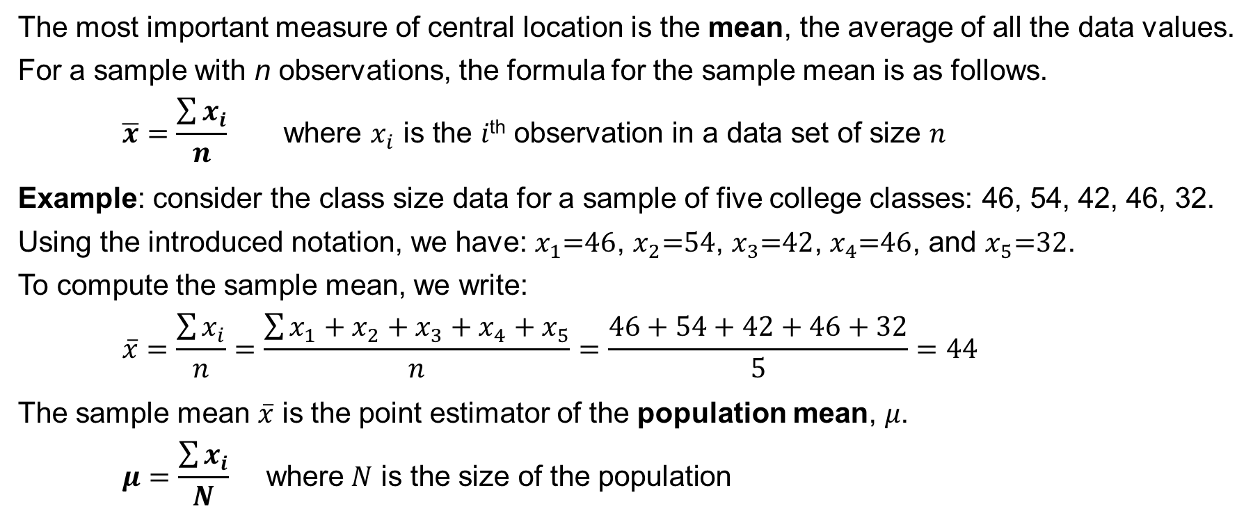
3.1 Measures of Location
The most important measure of central location is the mean, the average of all the data values.
For a sample with n observations, the formula for the sample mean is as follows.
$$\overline{x}=\frac{\sum{x_{i}}}{n} \text{where} x_{i} \text{is} \text{the} i\text{th} \text{observation} \text{in} \text{a} \text{data} \text{set} \text{of} \text{size} n$$
Example: consider the class size data for a sample of five college classes: 46, 54, 42, 46, 32.
Using the introduced notation, we have: $x_{1}\text{=46}$, $x_{2}\text{=}\text{54}$, $x_{3}\text{=4}\text{2}$, $x_{4}\text{=46}$, and $x_{5}\text{=}\text{32}$.
To compute the sample mean, we write:
$$\overline{x}=\frac{\sum{x_{i}}}{n}=\frac{\sum{x_{1}+x_{2}+x_{3}+x_{4}+x_{5}}}{n}=\frac{46+54+42+46+32}{5}=44$$
The sample mean $\overline{x}$ is the point estimator of the population mean, 𝜇.
$$μ=\frac{\sum{x_{i}}}{N} \text{where} N \text{is} \text{the} \text{size} \text{of} \text{the} \text{population}$$

Slide 7
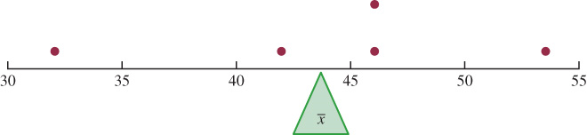
3.1 The Mean as the Center of Balance for the Dot Plot
If you view the horizontal axis of the dot plot as a long narrow board in which each of the dots has the same fixed weight, the mean is the fulcrum (or pivot point) that balances the dot plot.
This is how a see-saw on a playground works; the only difference is that the see-saw is pivoted in the middle so that as one end goes up, the other end goes down.
In the dot plot, we are locating the pivot point based on the location of the dots.

Slide 8
3.1 Median
The median is the value in the middle of a data set when data are arranged in ascending order.
To compute the median, first arrange the data in ascending order (smallest to largest value.)
If n is odd, the median is the middle value.
If n is even, the median is the average of the two middle values.
Example: consider the starting monthly salary for 12 business graduates.
First, we arrange the data in ascending order:
5710 5755 5850 5880 5880 5890 5920 5940 5950 6050 6130 6325
Because $n=12$ is even, the median is the average of the 6th and 7th (middle) values.
$$Median={\left(5890+5920\right)}/2=5905$$
Because the mean is influenced by extremely small and large data values, the median is the preferred measure of central location to report annual income and property value data.

Slide 9
3.1 Mode
The mode of a data set is the value that occurs with the greatest frequency.
Example: consider again the starting monthly salary for 12 business graduates.
5710 5755 5850 5880 5880 5890 5920 5940 5950 6050 6130 6325
$5,880 is the mode because it is the only monthly starting salary that occurs more than once.
It may happen that the greatest frequency occurs at two or more different values.
In these instances, more than one mode exists.
In the presence of multiple modes, we define the following two cases:
If the data have exactly two modes, the data are said to be bimodal.
If the data have more than two modes, the data are said to be multimodal.

Slide 10
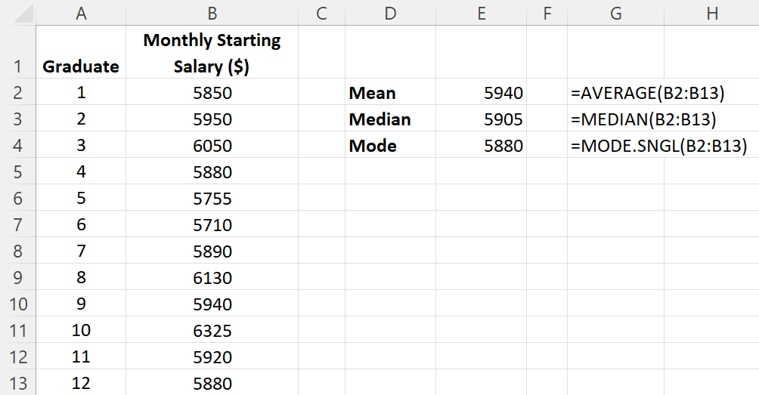
3.1 Excel: Compute Mean, Median, and Mode
Enter/Access Data: Open the file startingsalaries. Data and labels are in cells A1:B13.
Enter Functions and Formulas: The following functions can be used to compute mean, median, and mode:
Mean =AVERAGE(B2:B13)
Median =MEDIAN(B2:B13)
Mode =MODE.SINGL(B2:B13)

Slide 11
3.1 Weighted Mean
In the formula for the mean, each data is given equal importance or weight.
In those instances where the mean is computed by giving each observation a weight that reflects its relative importance, we can calculate the weighted mean instead.
For a sample with n observations and weights $w_{i}$, the formula for the weighted mean is
$$\overline{x}=\frac{\sum{w_{i}x_{i}}}{\sum{w_{i}}}$$
Purchase | Cost per Pound ($) | Weight (lbs)
1 | 3.00 | 1200
2 | 3.40 | 500
3 | 2.80 | 2750
4 | 2.90 | 1000
5 | 3.25 | 800
Example: calculate the weighted mean for a sample
of five purchases of raw materials listed to the right.
$$\overline{x}=\frac{\sum{w_{i}x_{i}}}{\sum{w_{i}}}=$$
$$\frac{1,200\left(3.00\right)+500\left(3.40\right)+2,750\left(2.80\right)+1,000\left(2.95\right)+800(3.25)}{1,200+500+2,750+1,000+800}=\frac{18,500}{6,250}=\$2.96$$

Slide 12
3.1 Geometric Mean
The geometric mean is a measure of central location calculated by finding the $n$th root of the product of $n$ values.
The general formula for the geometric mean, denoted ${\overline{x}}_{g}$, follows.
$${\overline{x}}_{g}=\sqrt[n]{\left(x_{1}\right)\left(x_{2}\right)…\left(x_{n}\right)}={\left[\left(x_{1}\right)\left(x_{2}\right)…\left(x_{n}\right)\right]}^{1/n}$$
The geometric mean is often used in analyzing growth rates in financial data (where using the arithmetic mean will provide misleading results.)
It should be applied any time you want to determine the mean rate of change over several successive periods (be it years, quarters, weeks, etc.)
Other common applications include changes in populations of species, crop yields, pollution levels, and birth and death rates.

Slide 13
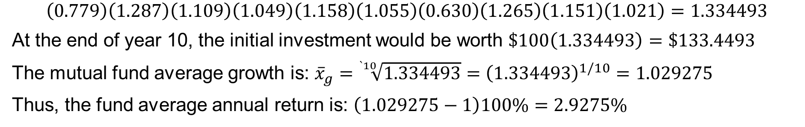
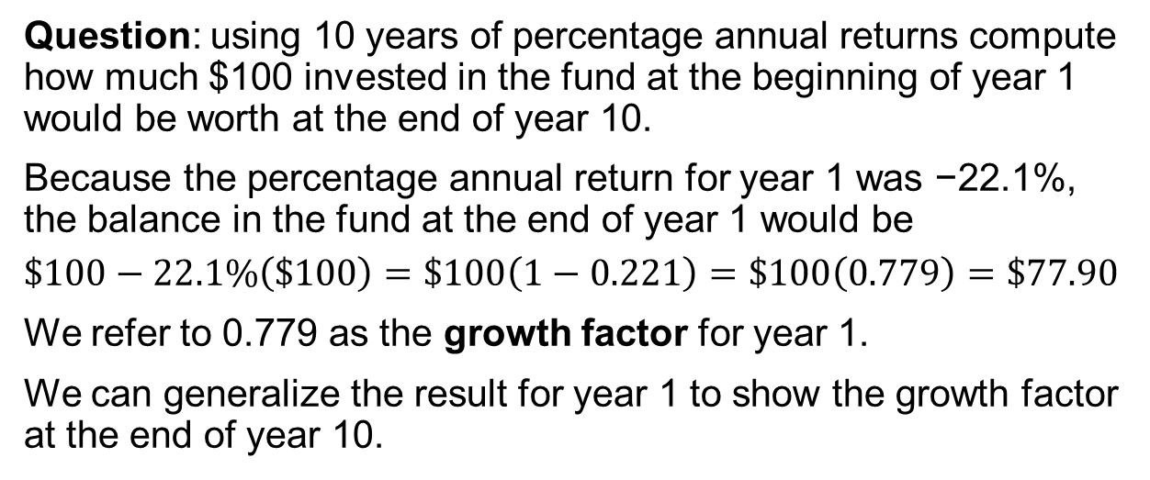
3.1 An Application of the Geometric Mean
Question: using 10 years of percentage annual returns compute how much $100 invested in the fund at the beginning of year 1 would be worth at the end of year 10.
Because the percentage annual return for year 1 was −22.1%, the balance in the fund at the end of year 1 would be
$$\$100−22.1\%\left(\$100\right)=\$100\left(1−0.221\right)=\$100\left(0.779\right)=\$77.90$$
We refer to 0.779 as the growth factor for year 1.
We can generalize the result for year 1 to show the growth factor at the end of year 10.
Year | Return (%) | Growth Factor
1 | -22.1 | 0.779
2 | 28.7 | 1.287
3 | 10.9 | 1.109
4 | 4.9 | 1.049
5 | 15.8 | 1.158
6 | 5.5 | 1.055
7 | -37.0 | 0.630
8 | 26.5 | 1.265
9 | 15.1 | 1.151
10 | 2.1 | 1.021
$$\left(0.779\right)\left(1.287\right)\left(1.109\right)\left(1.049\right)\left(1.158\right)\left(1.055\right)\left(0.630\right)\left(1.265\right)\left(1.151\right)\left(1.021\right)=1.334493$$
At the end of year 10, the initial investment would be worth $\$100\left(1.334493\right)=\$133.4493$
The mutual fund average growth is: ${\overline{x}}_{g}=\sqrt[`10]{1.334493}={\left(1.334493\right)}^{1/10}=1.029275$
Thus, the fund average annual return is: $\left(1.029275−1\right)100\%=2.9275\%$

Slide 14
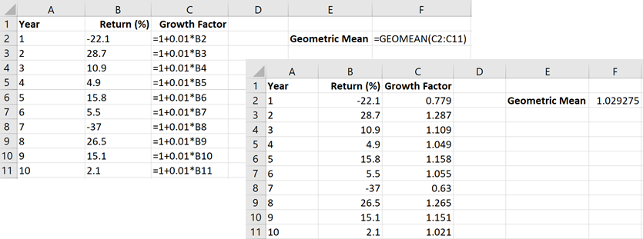
3.1 Excel: Compute Geometric Mean
Enter/Access Data: Open the file mutualfund. Data and labels are in cells A1:B11.
Enter Functions and Formulas: To compute the growth factor, enter =1+0.01*B2 in cell C2 and copy it down to cell C11.
Then, enter =GEOMEAN(C2:C11) in cell F2.

Slide 15
3.1 Percentile
A percentile provides information about how the data are spread over the interval from the smallest value to the largest value.
Admission test scores for colleges and universities are frequently reported in terms of percentiles.
The 𝑝th percentile of a data set is a value such that at least p percent of the items take on this value or less and at least ($100–p$) percent of the items take on this value or more.
To calculate the 𝑝th percentile of a data set, we must first arrange the data in ascending order so that the smallest value in the data set is in position 1, the next one in position 2, and so on.
The location of the 𝑝th percentile, denoted $L_{p}$, is computed using the following equation:
$$L_{p}=\frac{p}{100}\left(n+1\right)$$
Now, we are ready to calculate the 𝑝th percentile. Let us do that with an example.

Slide 16
3.1 An Application of the Percentile
Compute the 80th percentile for the sample of 12 business graduates’ starting salaries.
With the data arranged in ascending order, we indicate the position of each observation directly below its value.
 | 5710 | 5755 | 5850 | 5880 | 5880 | 5890 | 5920 | 5940 | 5950 | 6050 | 6130 | 6325
Position | 1 | 2 | 3 | 4 | 5 | 6 | 7 | 8 | 9 | 10 | 11 | 12
The location of the 80th percentile is
$$L_{80}=\frac{p}{100}\left(n+1\right)=\frac{80}{100}\left(12+1\right)=10.4$$
The interpretation of $L_{80}=10.4$ is that the 80th percentile is 40% of the way between the values in position 10 and 11.
$$\text{80}\text{th} \text{percentile}=6050+0.4\left(6130−6050\right)=6050+0.4\left(80\right)=6082$$

Slide 17
3.1 Quartile
Quartiles are specific percentiles that divide the data set into four parts, with each part containing approximately 25% of the observations. Quartiles are defined as follows:
$Q_{1}=$ first quartile, or 25th percentile
$Q_{2}=$ second quartile, or 50th percentile (also the median)
$Q_{3}=$ third quartile, or 75th percentile
The procedure for computing percentiles can be also used to compute quartiles. Let us calculate $Q_{1}$ and $Q_{3}$ for the sample of 12 business graduates’ starting salaries.
First, we calculate the locations
$$L_{25}=\frac{25}{100}\left(12+1\right)=3.25 \text{and} L_{75}=\frac{75}{100}\left(12+1\right)=9.75$$
The calculations of $Q_{1}$ and $Q_{3}$ follow:
$Q_{1}=5850+0.25\left(5880−5850\right)=5857.5 Q_{3}=5950+0.75\left(6050−5950\right)=6025$

Slide 18
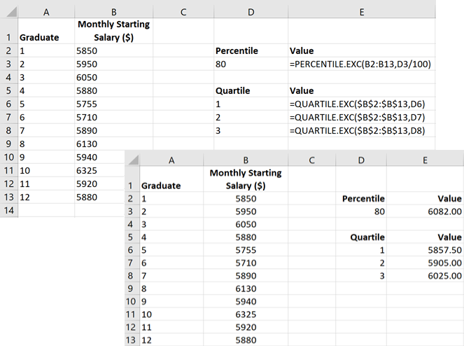
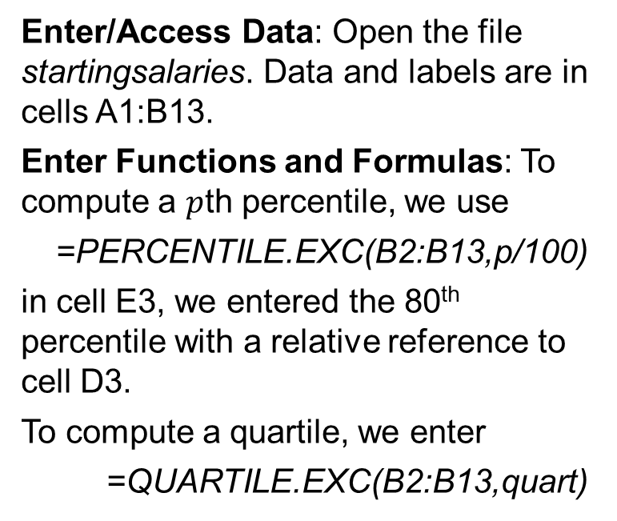
3.1 Excel: Compute Percentiles and Quartiles
Enter/Access Data: Open the file startingsalaries. Data and labels are in cells A1:B13.
Enter Functions and Formulas: To compute a $p$th percentile, we use
=PERCENTILE.EXC(B2:B13,p/100)
in cell E3, we entered the 80th percentile with a relative reference to cell D3.
To compute a quartile, we enter
=QUARTILE.EXC(B2:B13,quart)
in cells E6:E8, where quart = 1,2, or 3, with references to the quartile numbers in cells D6:D8.

Slide 19
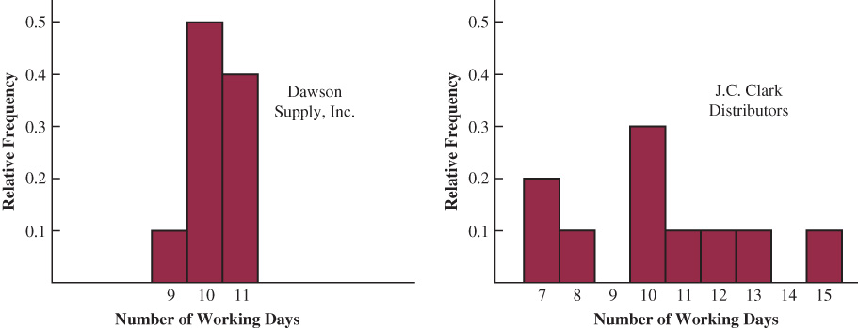
3.2 Measures of Variability
It is desirable to consider measures of variability (dispersion), as well as measures of location.
Consider the histograms for the number of days required to fill orders for two suppliers.
Although the mean number of days is 10 for both suppliers and the supplier to the right can fill some orders in as little as 7 to 8 days, while the supplier to the left has a lower dispersion and demonstrates a higher degree of reliability in terms of making deliveries on schedule.

Slide 20
3.2 Range and Interquartile Range
Range
Interquartile Range
The range is the simplest measure of variability, and it is defined as
$$\text{Range}\text{ = }\text{Largest} \text{Value}\text{ – }\text{Smallest} \text{Value}$$
For the example of the business graduates’ starting salaries, the range is
$$\text{6325}−\text{5710}=\text{615}$$
However, the range sensitivity to extreme data values makes it a poor choice to measure the dispersion in a data set.
The interquartile range (IQR) overcomes the dependency on extreme values considering the range for the middle 50% of the data.
The interquartile range is calculated as the difference between the third quartile, $Q_{3}$, and the first quartile, $Q_{1}$.
$$IQR\text{ = }Q_{3}\text{ –}Q_{1}$$
For the example of the business graduates’ starting salaries, the IQR is
$$\text{6025}−\text{5857.5}=\text{167.5}$$

Slide 21
3.2 Variance
The variance is a measure of variability that utilizes all the data.
The variance is based on the difference between the value of each observation ($x_{i}$) and the mean ($\overline{x}$for a sample, $μ$ for a population.)
The difference between each $x_{i}$ and the mean is called a deviation about the mean.
In the computation of the variance, the deviations about the mean are squared.
Population Variance
Sample Variance (*see notes)
$$σ^{2}=\frac{\sum{{\left(x_{i}−μ\right)}^{2}}}{N}$$
Where N is the population size.
$$s^{2}=\frac{\sum{{\left(x_{i}−\overline{x}\right)}^{2}}}{n−1}$$
Where n is the sample size.
Notes:
*Note: although a detailed explanation is beyond the scope of this text, it can be shown that if the sum of the squared deviations about the sample mean is divided by $n−1$, and not n, the resulting sample variance provides an unbiased estimate of the population variance.

Slide 22
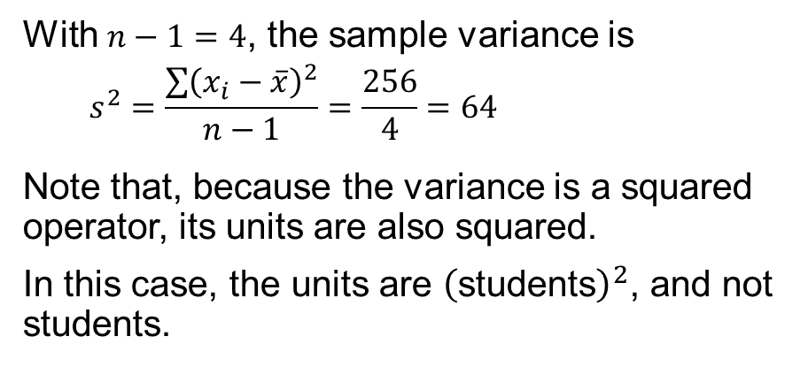
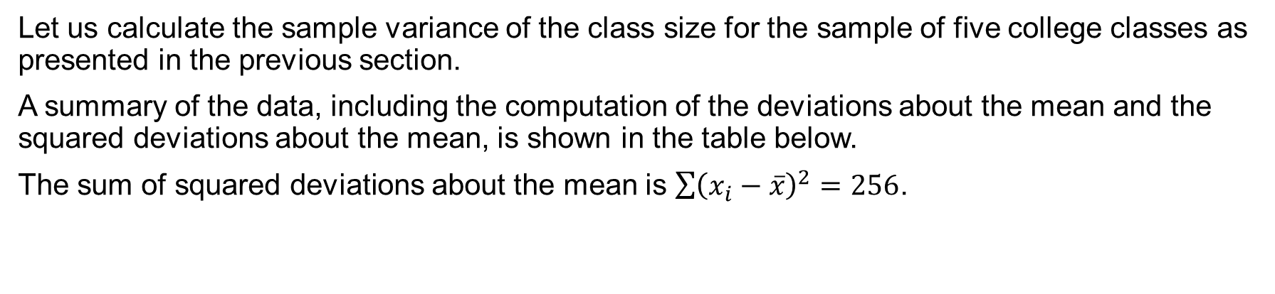
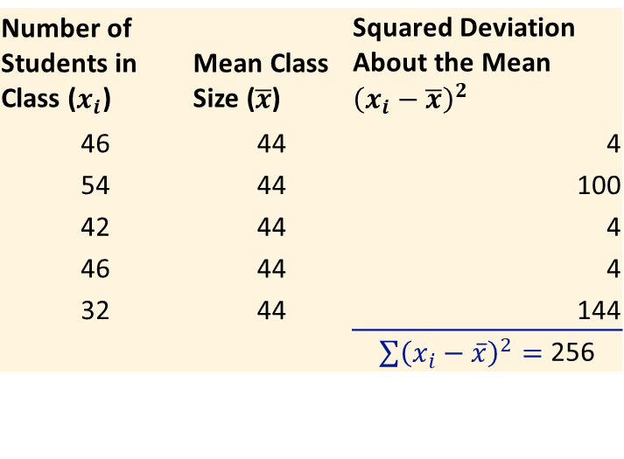
3.2 A Calculation of the Sample Variance
Let us calculate the sample variance of the class size for the sample of five college classes as presented in the previous section.
A summary of the data, including the computation of the deviations about the mean and the squared deviations about the mean, is shown in the table below.
The sum of squared deviations about the mean is $\sum{{\left(x_{i}−\overline{x}\right)}^{2}}=256$.
With $n−1=4$, the sample variance is
$$s^{2}=\frac{\sum{{\left(x_{i}−\overline{x}\right)}^{2}}}{n−1}=\frac{256}{4}=64$$
Note that, because the variance is a squared operator, its units are also squared.
In this case, the units are ${\left(\text{students}\right)}^{2}$, and not students.
Number of Students in Class ($x_{i}$) | Mean Class Size ($\overline{x}$) | Squared Deviation About the Mean ${\left(x_{i}−\overline{x}\right)}^{2}$
46 | 44 | 4
54 | 44 | 100
42 | 44 | 4
46 | 44 | 4
32 | 44 | 144
 |  | $\sum{{\left(x_{i}−\overline{x}\right)}^{2}}=$ 256

Slide 23
3.2 Standard Deviation
The standard deviation is defined to be the positive square root of the variance.
Sample standard deviation: $s=\sqrt{s^{2}}$
Population standard deviation: $σ=\sqrt{σ^{2}}$
In the previous example, we calculated the sample variance of the class size for the sample of five college classes as $s^{2}=64$.
Thus, the sample standard deviation of the class size is
$s=\sqrt{64}=8$ students
Because the standard deviation is the square root of the variance, the units of the variance, ${\left(\text{students}\right)}^{2}$, are converted to students in the standard deviation.
Thus, the standard deviation is more easily compared to the mean and other statistics that are measured in the same units as the original data.

Slide 24
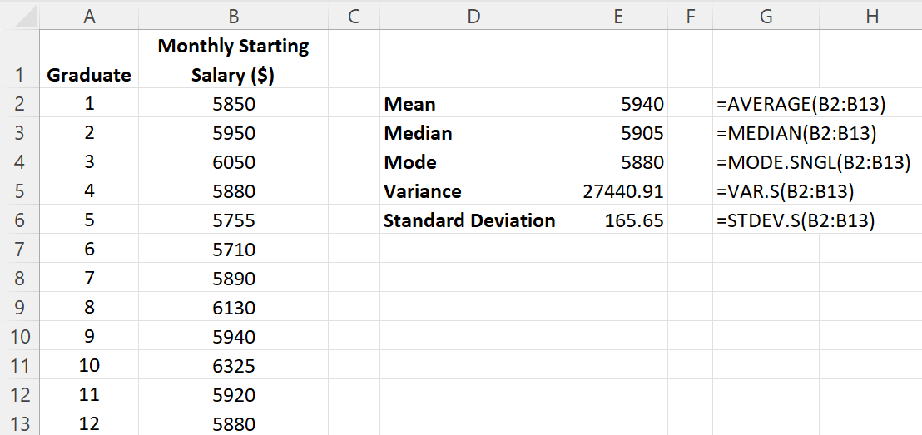
3.2 Excel: Compute Sample Variance and Sample Standard Deviation
Enter/Access Data: Open the file startingsalaries. Data are in cells B2:B13.
Enter Functions and Formulas: The following functions can be used to compute sample variance and sample standard deviation:
Variance
=VAR.S(B2:B13)
Standard Deviation
=STDEV.S(B2:B13)

Slide 25
3.2 Coefficient of Variation
The coefficient of variation, usually expressed as a percentage, measures how large the standard deviation is relative to the mean.
$$\left(\frac{\text{Standard} \text{Deviation}}{\text{Mean}}×100\right)\%$$
For the class size of the sample of five college classes, we found a sample mean of 44 and a sample standard deviation of 8.
The coefficient of variation is
$$\left(\frac{8}{44}×100\right)\%=18.2\%$$
In words, the coefficient of variation tells us that the sample standard deviation is 18.2% of the value of the sample mean.

Slide 26
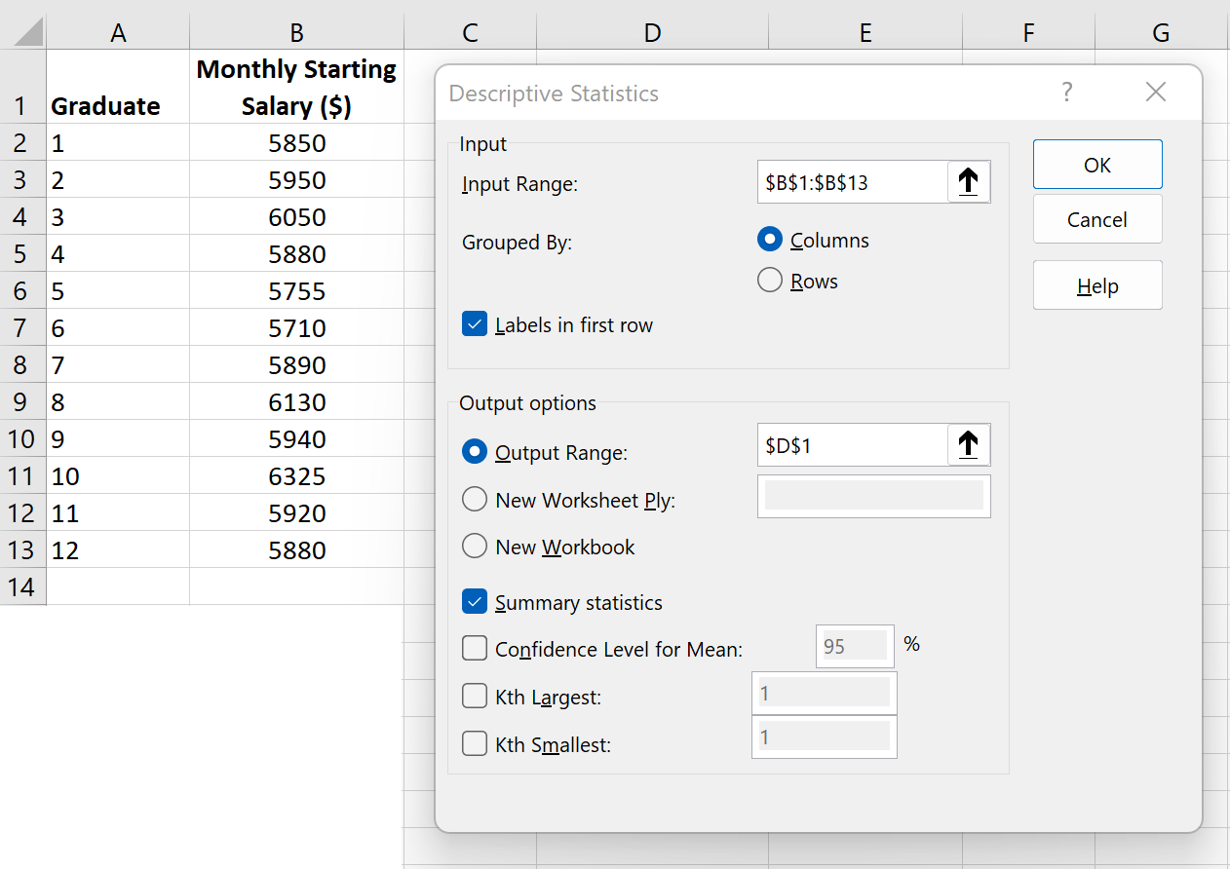
3.2 Excel’s Descriptive Statistics Tool: dialog Box
The Descriptive Statistics tools, allows the user to compute a variety of descriptive statistics at once.
Enter/Access Data: Open the file startingsalaries.
Apply Tools: The following steps describe how to produce Excel’s dialog box (shown to the right) for the Descriptive Statistics tool.
Step 1. Click the Data tab on the Ribbon
Step 2. In the Analysis group, click Data Analysis.
Step 3. Choose Descriptive Statistics from the list of Analysis Tools.
Click OK.

Slide 27
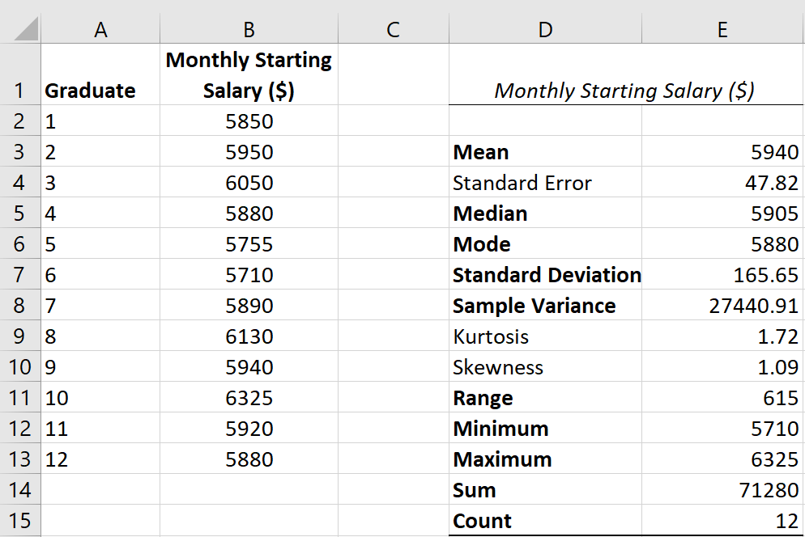
3.2 Excel’s Descriptive Statistics Tool: Results
Step 4. When the Descriptive Statistics dialog box appears (see previous slide):
Enter B1:B13 in the Input Range: box
Select Columns in the Grouped By: area
Select the check box for Labels in First Row
Select Output Range: in the Output options area
Enter D1 in the Output Range: box
Select the check box for Summary Statistics
Click OK

Slide 28
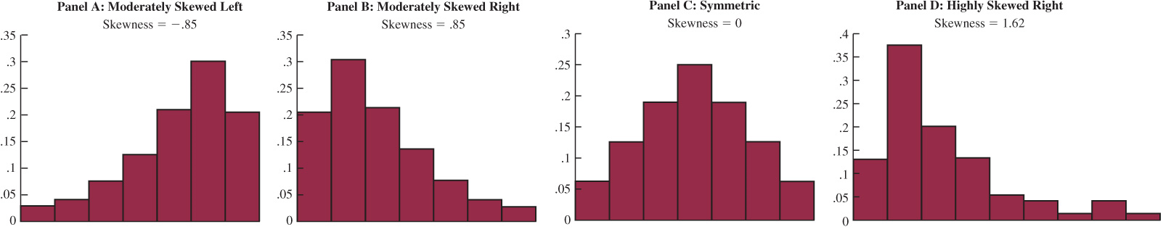
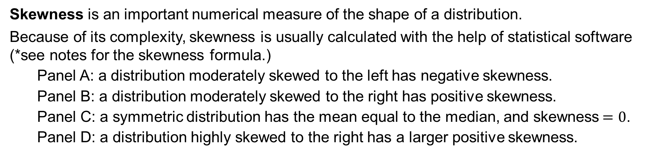
3.3 Measures of Distribution Shape
Skewness is an important numerical measure of the shape of a distribution.
Because of its complexity, skewness is usually calculated with the help of statistical software (*see notes for the skewness formula.)
Panel A: a distribution moderately skewed to the left has negative skewness.
Panel B: a distribution moderately skewed to the right has positive skewness.
Panel C: a symmetric distribution has the mean equal to the median, and skewness$=0$.
Panel D: a distribution highly skewed to the right has a larger positive skewness.
Notes:
*Note: $skewness=\frac{n}{(n−1)(n−2)}\sum{{\left(\frac{x_{i}−\overline{x}}{s}\right)}^{3}}$

Slide 29
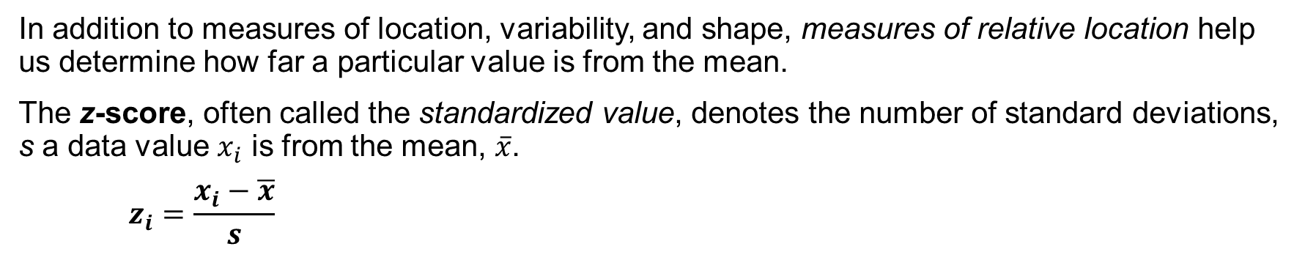
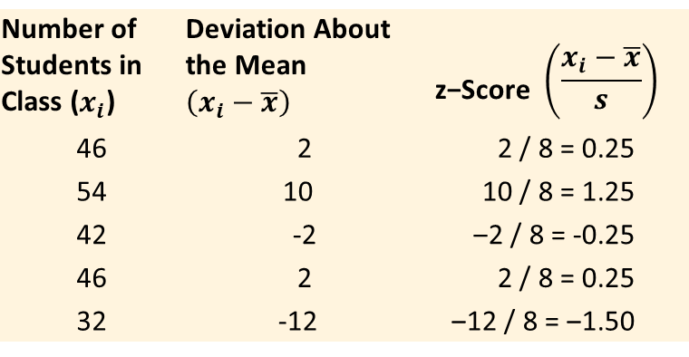
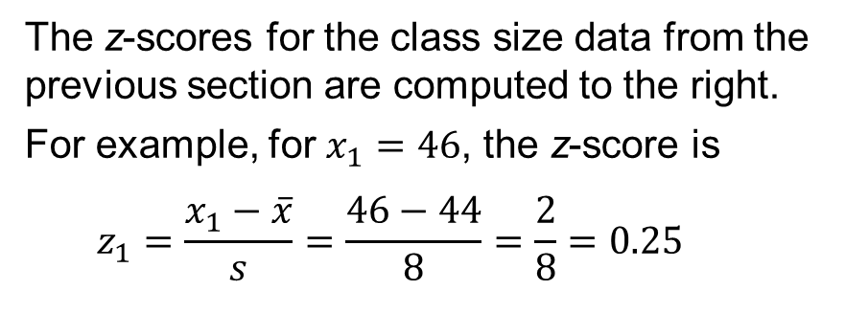
3.3 z-Scores
In addition to measures of location, variability, and shape, measures of relative location help us determine how far a particular value is from the mean.
The z-score, often called the standardized value, denotes the number of standard deviations, s a data value $x_{i}$ is from the mean, $\overline{x}$.
$$z_{i}=\frac{x_{i}−\overline{x}}{s}$$
Number of Students in Class ($x_{i}$) | Deviation About the Mean $\left(x_{i}−\overline{x}\right)$ | $$\text{z}\text{−}\text{Score} \left(\frac{x_{i}−\overline{x}}{s}\right)$$
46 | 2 | 2 / 8 = 0.25
54 | 10 | 10 / 8 = 1.25
42 | -2 | ‒2 / 8 = -0.25
46 | 2 | 2 / 8 = 0.25
32 | -12 | ‒12 / 8 = ‒1.50
The z-scores for the class size data from the previous section are computed to the right.
For example, for $x_{1}=46$, the z-score is
$$z_{1}=\frac{x_{1}−\overline{x}}{s}=\frac{46−44}{8}=\frac{2}{8}=0.25$$

Slide 30
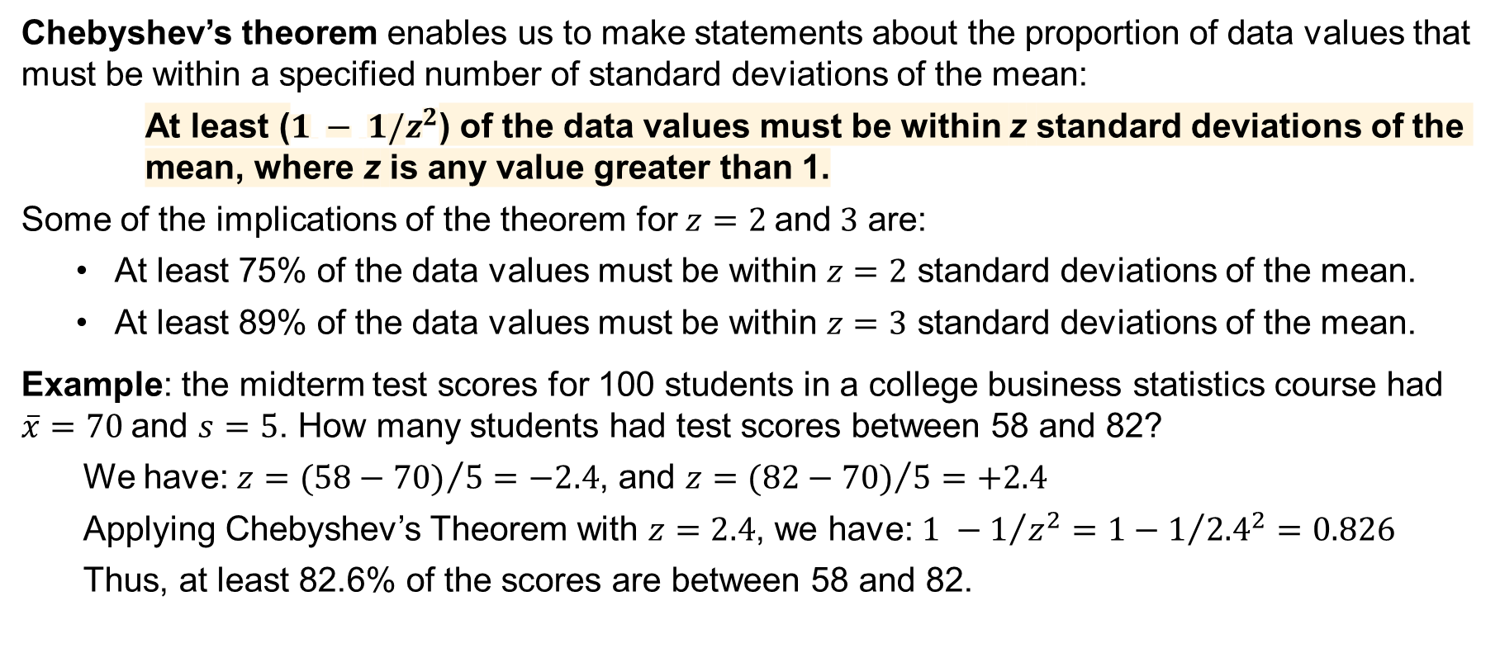
3.3 Chebyshev’s Theorem
Chebyshev’s theorem enables us to make statements about the proportion of data values that must be within a specified number of standard deviations of the mean:
At least ($1 − 1/z^{2}$) of the data values must be within z standard deviations of the mean, where z is any value greater than 1.
Some of the implications of the theorem for $z=2 \text{and} 3$ are:
At least 75% of the data values must be within $z=2$ standard deviations of the mean.
At least 89% of the data values must be within $z=3$ standard deviations of the mean.
Example: the midterm test scores for 100 students in a college business statistics course had $\overline{x}=70$and $s=5$. How many students had test scores between 58 and 82?
We have: $z={(58−70)}/5=−2.4$, and $z={(82−70)}/5=+2.4$
Applying Chebyshev’s Theorem with $z=2.4$, we have: $1 −1/{z^{2}}=1−1/{{2.4}^{2}=0.826}$
Thus, at least 82.6% of the scores are between 58 and 82.

Slide 31
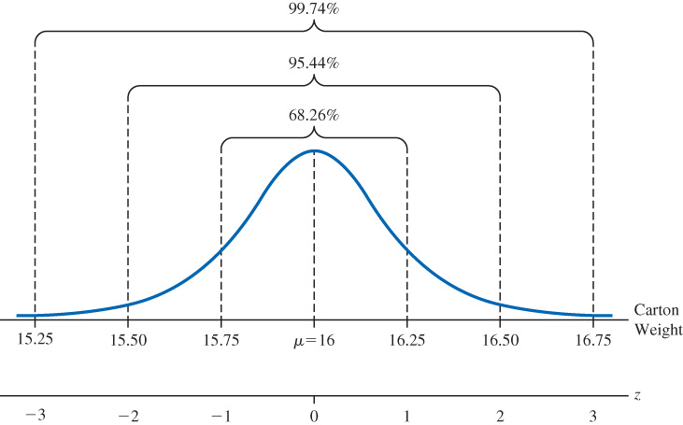
3.3 Empirical Rule
When the data are believed to approximate a symmetric bell-shaped distribution, the empirical rule can be used to determine the percentage of data values that must be within a specified number of standard deviations of the mean.
For data having a bell-shaped distribution:
~68% of the data values will be within one
standard deviation of the mean.
~95% of the data values will be within two
standard deviations of the mean.
Almost all of the data values (~99.7%) will be within
three standard deviations of the mean.
The empirical rule is based on the normal
distribution, which we will cover in Chapter 6.

Slide 32
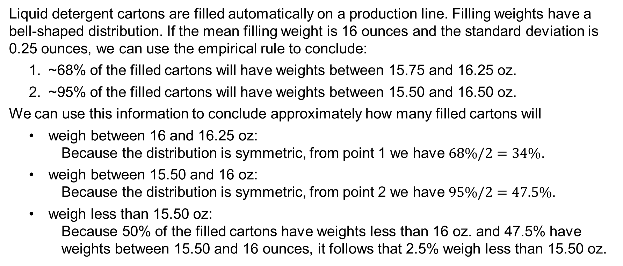
3.3 An Application of the Empirical Rule
Liquid detergent cartons are filled automatically on a production line. Filling weights have a bell-shaped distribution. If the mean filling weight is 16 ounces and the standard deviation is 0.25 ounces, we can use the empirical rule to conclude:
~68% of the filled cartons will have weights between 15.75 and 16.25 oz.
~95% of the filled cartons will have weights between 15.50 and 16.50 oz.
We can use this information to conclude approximately how many filled cartons will
weigh between 16 and 16.25 oz:
Because the distribution is symmetric, from point 1 we have $68\%/2=34\%$.
weigh between 15.50 and 16 oz:
Because the distribution is symmetric, from point 2 we have $95\%/2=47.5\%$.
weigh less than 15.50 oz:
Because 50% of the filled cartons have weights less than 16 oz. and 47.5% have weights between 15.50 and 16 ounces, it follows that 2.5% weigh less than 15.50 oz.

Slide 33
3.3 Detecting Outliers with z-Scores
An outlier is an unusually small or unusually large value in a data set. Care should be taken when handling outliers, as they might be:
• an incorrectly recorded data value
• a data value that was incorrectly included in the data set
• a correctly recorded data value that belongs in the data set
A data value with a z-score less than -3 or greater than +3 might be considered an outlier.
For this example, refer to the starting monthly salary for the 12 business graduates, with mean, x = 5940, and standard deviation, s = 165.65.
The smallest value in the data set, 5710, has z = (5710 - 5940)/156.65 = - 1.39, and the largest value in the data set, 6325, has z = (6325 - 5940)/156.65 = 2.32.
Because all the values are within three standard deviations of the mean (z-scores within +3), we conclude that there is no evidence of outliers.

Slide 34
3.3 Alternative Method for Detecting Outliers
Another approach to identifying outliers is based upon the values of the first and third quartiles ($Q_{1}$ and $Q_{3}$) and the interquartile range (IQR).
For this example, refer to the starting monthly salary for the 12 business graduates.
To use this method, we first compute the following lower and upper limits:
Lower Limit $=Q_{1}−1.5\left(IQR\right)=5857.5−1.5\left(167.5\right)=5606.25$
Upper Limit $=Q_{3}+1.5\left(IQR\right)=6025+1.5\left(167.5\right)=6276.25$
Looking at the starting monthly salary for the 12 business graduates, we see that:
There are no starting salaries lower than the Lower Limit = 5606.25.
There is one starting salary, 6325, that is greater than the Upper Limit = 6276.25.
Thus, using this alternate approach, 6325 is considered to be an outlier.

Slide 35
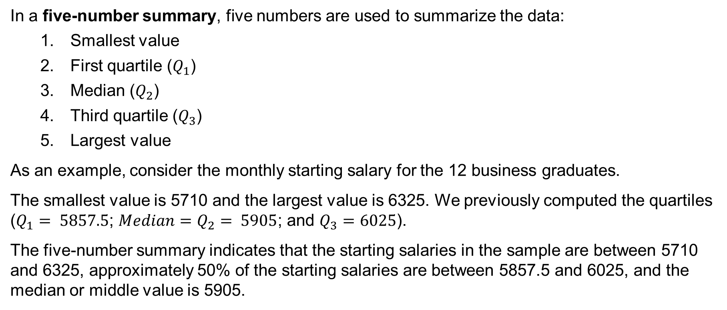
3.4 Five-Number Summaries and Boxplots
In a five-number summary, five numbers are used to summarize the data:
Smallest value
First quartile ($Q_{1}$)
Median ($Q_{2}$)
Third quartile ($Q_{3}$)
Largest value
As an example, consider the monthly starting salary for the 12 business graduates.
The smallest value is 5710 and the largest value is 6325. We previously computed the quartiles ($Q_{1}= 5857.5$; $Median=Q_{2}= 5905$; and $Q_{3}=6025$).
The five-number summary indicates that the starting salaries in the sample are between 5710 and 6325, approximately 50% of the starting salaries are between 5857.5 and 6025, and the median or middle value is 5905.

Slide 36
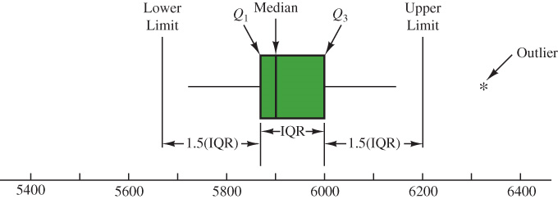
3.4 Boxplot
A boxplot is a graphical display of data based on a five-number summary.
The steps used to construct the boxplot for the monthly starting salary data are:
Draw a box between $Q_{1}= 5857.5$ and $Q_{3}=6025$.
Draw a vertical line in the box at the location of the median, $Q_{2}= 5905$.
Using $IQR=167.5$, compute the lower and upper limits for detecting outliers (note that the limits are usually not drawn.)
Extend horizontal lines (whiskers) away from the box and up to the smallest and largest values that lie within the limits.
Use a small asterisk (*) to represent outliers.

Slide 37
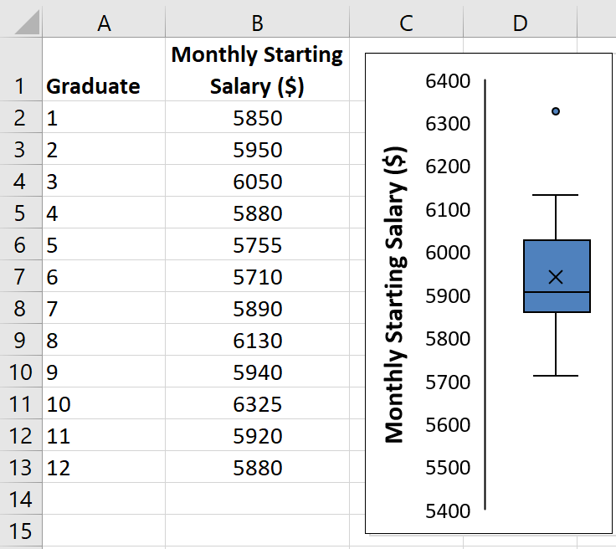
3.4 Excel: Construct a Boxplot
We can use Excel’s Insert Statistic Chart to construct a boxplot of the monthly starting salary data as outlined below.
Enter/Access Data: Open the file startingsalaries. The data are in cells B2:B13.
Apply Tools: The following steps describe how to use Excel’s Insert Statistic Chart to construct a box plot.
Step 1. Select cells B2:B13
Step 2. Click the Insert tab on the Ribbon
Step 3. In the Charts group, click Insert Statistic Chart and then click Box and Whisker to create the boxplot in Excel.
Editing Options: See notes for details.
Notes:
Step 1. Click on Chart Title and press the Delete key
Step 2. Click on the 1 below the horizontal axis and press the Delete key
Step 3. Click on the Chart Elements button
Step 4. When the list of chart elements appears:
Deselect Gridlines to remove the horizontal gridlines from the chart
Click Axis Titles to create placeholders for the axis titles
Click on the horizontal Axis Title and press the Delete key
Click on the vertical Axis Title placeholder and replace it with Monthly Starting Salary ($)

Slide 38
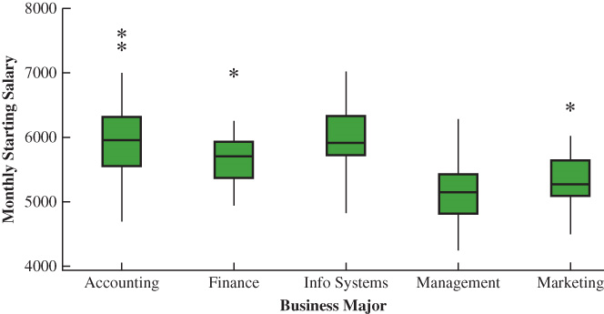
3.4 A Comparative Analysis Using Boxplots
Boxplots can be used to provide a graphical summary of two or more groups and facilitate visual comparisons among the groups.
As an application, consider the major and starting salary data for a new sample of 111 recent business school graduates (DATAfile: MajorSalaries.)
Note that the boxplots for each major have been drawn vertically, as is often the case.
A comparative analysis of the boxplots reveals:
Accounting has the higher salaries, management and marketing the lower.
Based on the median, Accounting and Information Systems have the highest median salaries, followed by Finance.
High salary outliers exist for accounting, finance, and marketing majors.

Slide 39
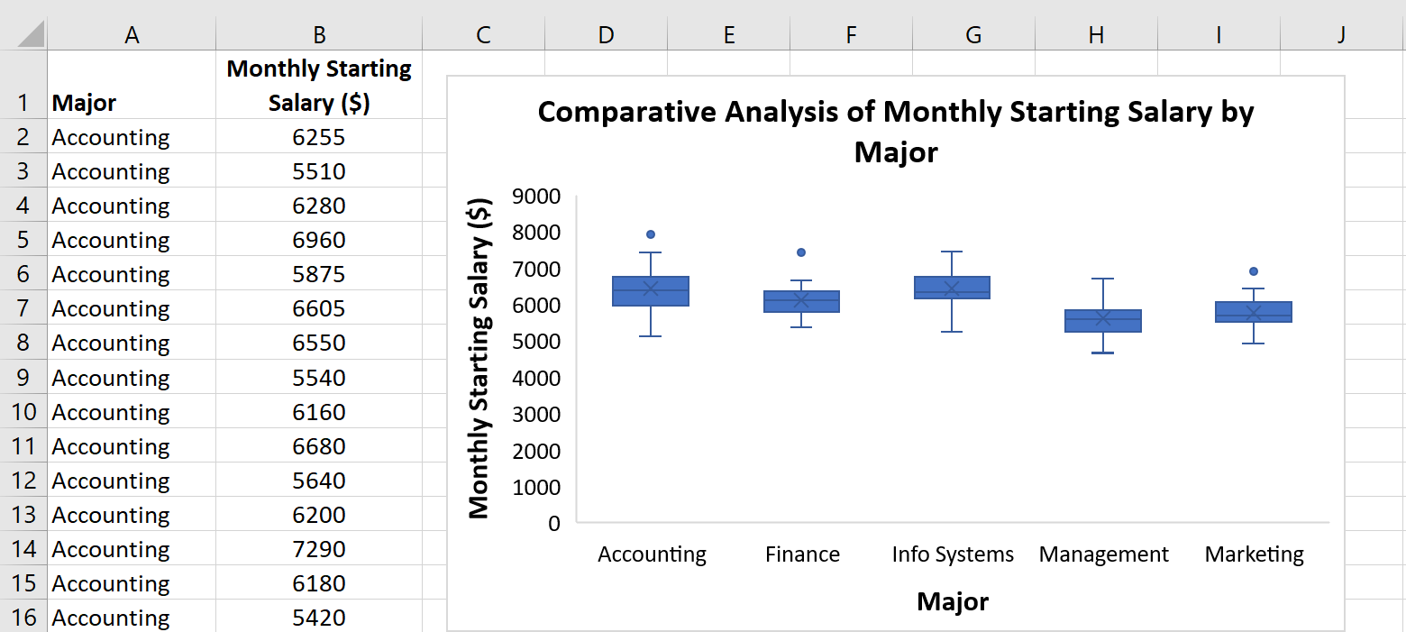
3.4 Excel: Construct a Comparative Analysis Using Boxplots
Use Steps 1-4, as shown for the “Construct a Boxplot” slide, applied to the DATAfile majorsalaries. Data and labels are in cells A1:B112. See notes for Editing Options.
Notes:
Step 1. Click on Chart Title and replace it with Comparative Analysis of Monthly Starting Salary by Major
Step 2. To put the majors in alphabetical order from left to right
Select cells in the data set (A2:B112)
Select the Data tab on the Ribbon
Select Sort from the Sort & Filter group
From the Sort by drop-down menu in the Sort dialog box, select Major
From the Order drop-down menu in the Sort dialog box, select A to Z
Click OK
Step 3. Select the chart by clicking anywhere on the chart.
Click on the Chart Elements button
Step 4. When the list of chart elements appears
Deselect Gridlines to remove the horizontal gridlines from the chart
Click Axis Titles to create placeholders for the axis titles
Editing Options:
Click on the horizontal Axis Title placeholder and replace it with Major
Click on the vertical Axis Title placeholder and replace it with Monthly Starting Salary ($)

Slide 40
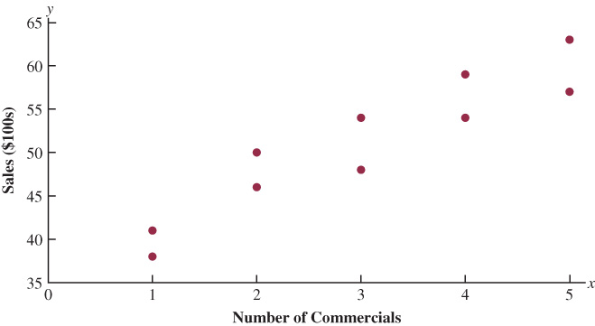
3.5 Measures of Association Between Two Variables
Often a manager or decision-maker is interested in the relationship between two variables.
Covariance and correlation coefficient are two descriptive measures of the linear association between two variables.
DATAfile: Electronics
As an application, we consider a sample of $n=10$ weekly data for an electronics store in San Francisco.
The scatter diagram to the right suggests a positive and linear relationship between the number of weekend television commercials and the sales (in $100s) at the store during the following week.

Slide 41
3.5 Covariance
For a sample of size n with observations $\left(x_{i},y_{i}\right)\text{, }\text{and} i=1…n$, the sample covariance is defined as
$$s_{xy}=\frac{\sum{\left(x_{i}−\overline{x}\right)\left(y_{i}−\overline{y}\right)}}{n−1}$$
$$x_{i}$$ | $$y_{i}$$ | $$\left(x_{i}−\overline{x}\right)$$ | $$\left(y_{i}−\overline{y}\right)$$ | $$\left(x_{i}−\overline{x}\right)\left(y_{i}−\overline{y}\right)$$
2 | 50 | -1 | -1 | 1
5 | 57 | 2 | 6 | 12
1 | 41 | -2 | -10 | 20
3 | 54 | 0 | 3 | 0
4 | 54 | 1 | 3 | 3
1 | 38 | -2 | -13 | 26
5 | 63 | 2 | 12 | 24
3 | 48 | 0 | -3 | 0
4 | 59 | 1 | 8 | 8
2 | 46 | -1 | -5 | 5
30 | 510 | 0 | 0 | 99
The table to the right shows the detailed calculations for the sample covariance of the electronics store data:
$$s_{xy}=\frac{\sum{\left(x_{i}−\overline{x}\right)\left(y_{i}−\overline{y}\right)}}{n−1}=\frac{99}{9}=11$$
The population covariance for a population of size N is
$$σ_{xy}=\frac{\sum{\left(x_{i}−μ_{x}\right)\left(y_{i}−μ_{y}\right)}}{N}$$

Slide 42
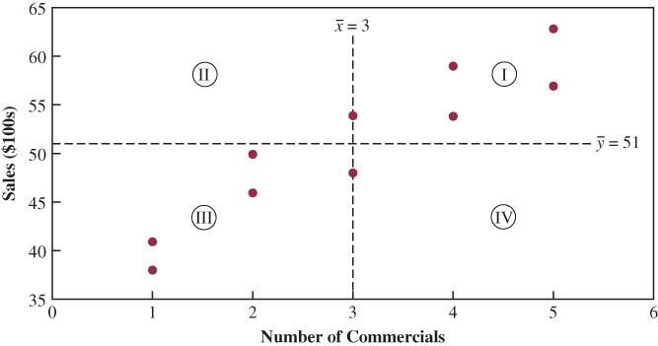
3.5 Interpretation of Sample Covariance
The figure shown to the right is the scatter diagram for the electronics store data, in which two dashed lines, a vertical line at $\overline{x}=3$, and a horizontal line at $\overline{y}=51$, dissect the diagram into four quadrants, labeled from I to IV.
Because the covariance is related to the $\left(x_{i}−\overline{x}\right)\left(y_{i}−\overline{y}\right)$ term, it follows that quadrants:
I and III have a positive contribution to the covariance, because $\left(x_{i}−\overline{x}\right)$ and $\left(y_{i}−\overline{y}\right)$ have the same sign.
II and IV have a negative contribution to the covariance, because $\left(x_{i}−\overline{x}\right)$ and $\left(y_{i}−\overline{y}\right)$ have opposite sign.
The scatter diagram for the electronics store data shows that none of the data appear in quadrants II or IV. Thus, $s_{xy}$ is positive.

Slide 43
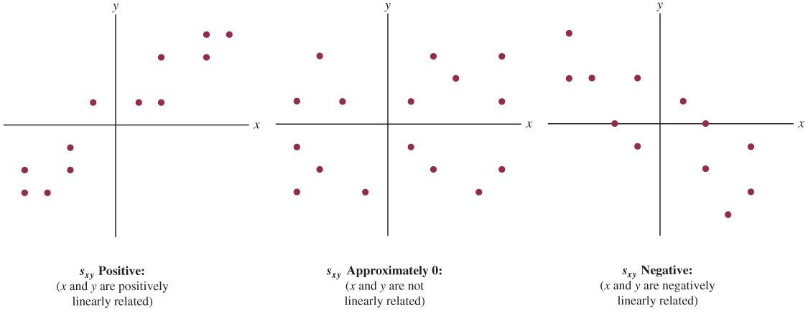
3.5 Relationship Between Pattern and Covariance

Slide 44
3.5 Correlation Coefficient
The correlation coefficient is a measure of the relationship between x and y that is not affected by the units of measurement.
The Pearson product moment correlation coefficient is defined as
Sample Data
Population Data
$$r_{xy}=\frac{s_{xy}}{s_{x}s_{y}}$$
Where
$r_{xy}=$ sample correlation coefficient
$s_{xy}=$ sample covariance
$s_{x}=$ sample standard deviation of x
$s_{y}=$ sample standard deviation of y
$$ρ_{xy}=\frac{σ_{xy}}{σ_{x}σ_{y}}$$
Where
$ρ_{xy}=$ population correlation coefficient
$σ_{xy}=$ population covariance
$σ_{x}=$ population standard deviation for x
$σ_{y}=$ population standard deviation for y

Slide 45
3.5 Interpretation of the Correlation Coefficient
Let us now compute the sample correlation coefficient for the San Francisco electronics store.
$$s_{x}^{2}=\sqrt{\frac{\sum{{\left(x_{i}−\overline{x}\right)}^{2}}}{n−1}}=\sqrt{\frac{20}{9}}=1.49 s_{y}^{2}=\sqrt{\frac{\sum{{\left(y_{i}−\overline{y}\right)}^{2}}}{n−1}}=\sqrt{\frac{566}{9}}=7.93$$
We already know that $s_{xy}=11$. Thus, the sample correlation coefficient is
$$r_{xy}=\frac{s_{xy}}{s_{x}s_{y}}=\frac{11}{(1.49)(7.93)}=0.93$$
The correlation coefficient is always between −1 and +1.
The sign of the correlation coefficient matches the direction of the association.
The closer to +1, the stronger the positive linear association between x and y.
The closer to −1, the stronger the negative linear association between x and y.
The closer to 0, the weaker the linear association between x and y.

Slide 46
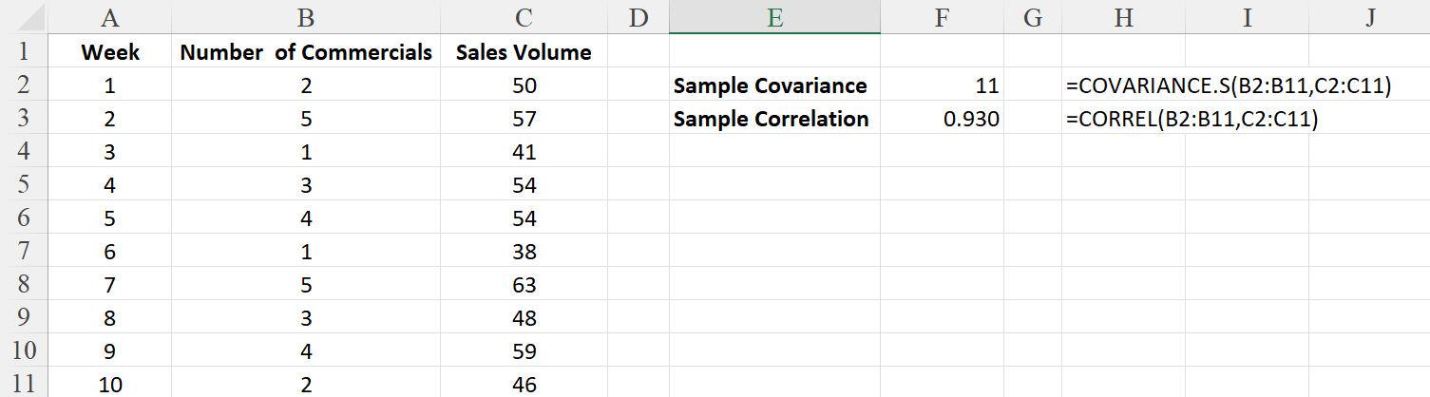
3.5 Excel: Compute the Sample Covariance and Sample Correlation Coefficient
Enter/Access Data: Open the file electronics. The data are in cells B2:C11.
Enter Functions and Formulas: To compute the sample covariance in cell F2, we enter
=COVARIANCE.S(B2:B11,C2:C11)
To compute the sample correlation coefficient in cell F3, we enter
=CORREL(B2:B11,C2:C11)

Slide 47
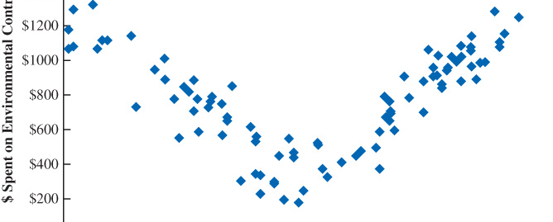
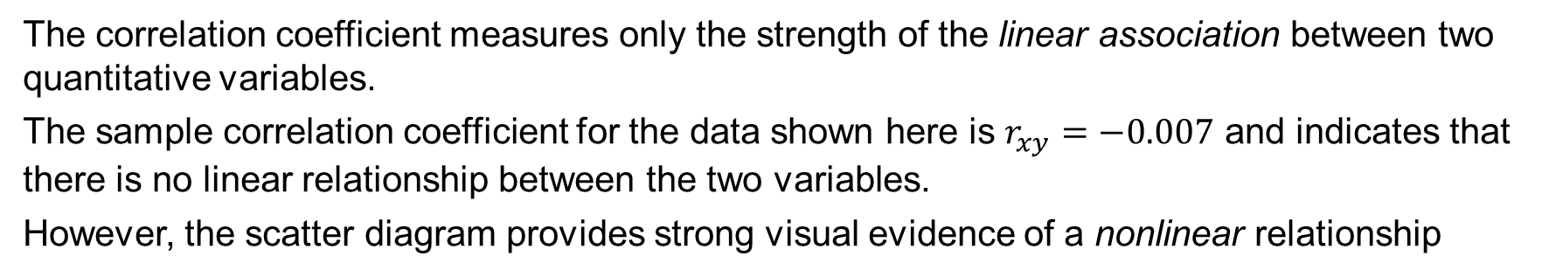
3.5 A Note on Linear Association
The correlation coefficient measures only the strength of the linear association between two quantitative variables.
The sample correlation coefficient for the data shown here is $r_{xy}=−0.007$ and indicates that there is no linear relationship between the two variables.
However, the scatter diagram provides strong visual evidence of a nonlinear relationship

Slide 48
3.6 Data Dashboards
Data dashboards = set of visual displays that organize and present data
Monitor the performance of a company or organization
Must be easy to read, understand, and interpret
Includes both graphical displays and numerical measures
The choice of graphs and tables depends on the nature of the data set and purpose for which it is being gathered.

Slide 49
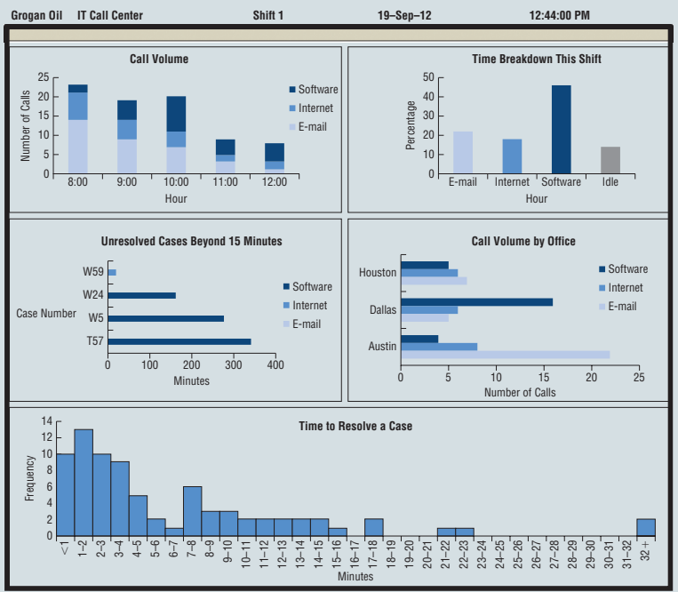
3.6 Data Dashboard with Graphical Displays

Slide 50
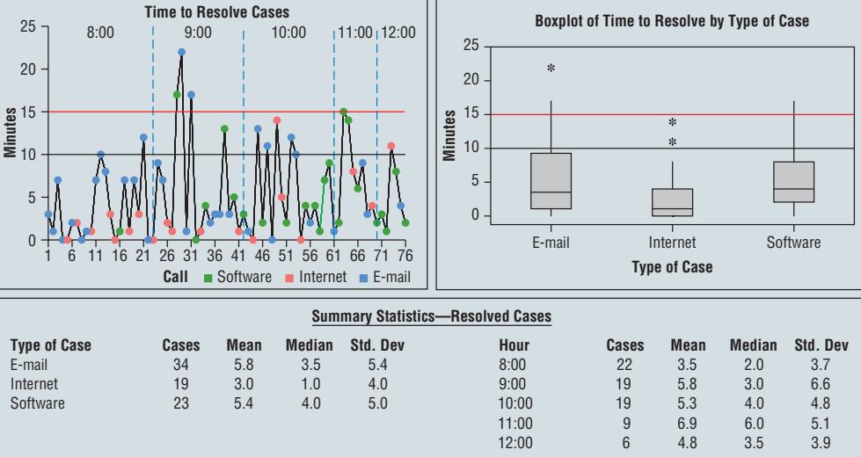
3.6 Data Dashboard with Summary Statistics

Slide 51
Summary
In this chapter, we introduced descriptive statistics that can be used to summarize the location, variability, and shape of the distribution.
Numerical values obtained for a sample are called sample statistics.
Numerical values obtained for a population are called population parameters.
We defined the mean, median, mode, weighted mean, geometric mean, percentiles, and quartiles as measures of location.
Next, we presented the range, interquartile range, variance, standard deviation, and coefficient of variation as measures of variability or dispersion.
We introduced skewness as a measure of the shape of the distribution, described how the mean and standard deviation are used to provide more information about data distribution (Chebyshev’s theorem and the empirical rule), and to identify outliers.
Finally, we introduced covariance and the correlation coefficient as measures of association between two variables.

