Slide 1
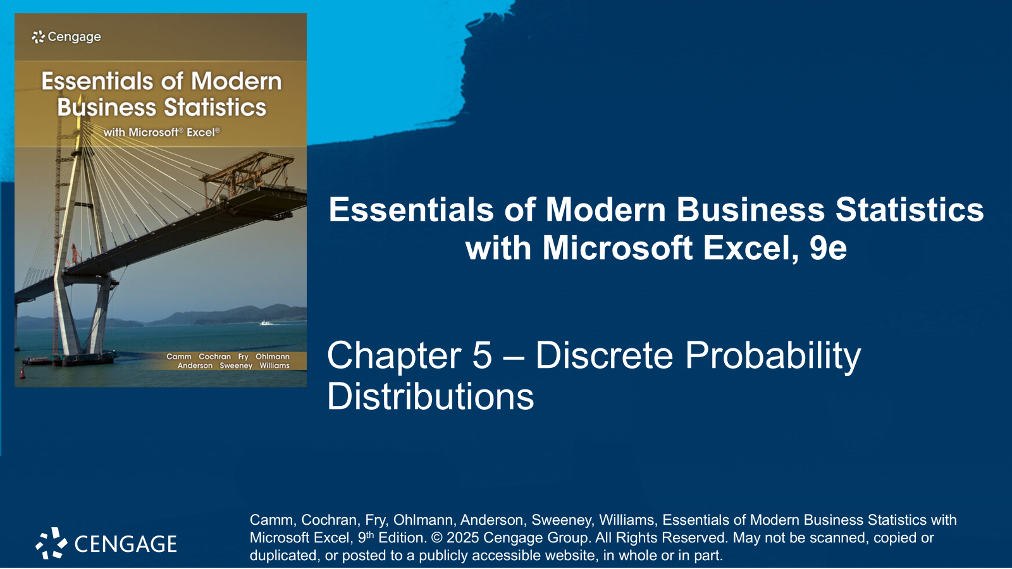

Slide 2
Chapter Contents
5.1 Random Variables
5.2 Developing Discrete Probability Distributions
5.3 Expected Value and Variance
5.4 Bivariate Distributions, Covariance, and Financial Portfolios
5.5 Binomial Probability Distribution
5.6 Poisson Probability Distribution
5.7 Hypergeometric Probability Distribution
Summary

Slide 3
Chapter Objectives (1 of 2)
After completing this chapter, you will be able to:
LO 5-1 Define and identify discrete and continuous random variables.
LO 5-2 Develop, graph, and interpret valid probability distributions for discrete random variables.
LO 5-3 Calculate and interpret the expected value, variance, and standard deviation for discrete random variables.
LO 5-4 Develop and interpret the bivariate probability distribution for two discrete random variables.
LO 5-5 Calculate and interpret the covariance and correlation coefficient for two discrete random variables.
LO 5-6 Calculate and interpret the expected value and variance of a linear combination of two random variables.

Slide 4
Chapter Objectives (2 of 2)
LO 5-7 Identify and use the binomial probability function to compute the probability of a specified number of successes out of a given number of trials.
LO 5-8 Calculate and interpret the expected value, variance, and standard deviation for binomial experiments.
LO 5-9 Identify and use the Poisson probability function to compute the probability of a specified number of occurrences over a given interval.
LO 5-10 Calculate and interpret the expected value, variance, and standard deviation for Poisson experiments.
LO 5-11 Identify and use the hypergeometric probability function to compute the probability of a specified number of successes out of a given number of trials.
LO 5-12 Calculate and interpret the expected value, variance, and standard deviation for hypergeometric experiments.

Slide 5
Introduction
In this chapter, we extend the study of probability by introducing the concepts of random variables and probability distributions.
Random variables and probability distributions are models for populations of data.
The values of random variables represent the values of the data, and the probability distribution provides either the probability of each data value or a rule for computing the probability of each data value or a set of data values
The focus of this chapter is on probability distributions for discrete data, that is, discrete probabil­ity distributions.
We will introduce two types of discrete probability distributions.
A table with one column for the values of the random variable and a second column for the asso­ciated probabilities.
Three types of mathematical functions that represent a probability distribution: the binomial, Poisson, and hypergeometric distribution.

Slide 6
5.1 Random Variables
A random variable is a numerical description of the outcome of an experiment.
A discrete random variable may assume either a finite number of values or an infinite sequence of values.
Random Experiment | Random Variable (x) | Possible Values for the Random Variable
Flip a coin | Face of coin showing | 1 if heads; 0 if tails
Roll a die | Number of dots showing on top of die | 1, 2, 3, 4, 5, 6
Contact five customers | Number of customers who place an order | 0, 1, 2, 3, 4, 5
Operate a health care clinic for one day | Number of patients who arrive | 0, 1, 2, 3, …
Offer a customer the choice of two products | Product chosen by customer | 0 if none; 1 if choose product A; 2 if choose product B

Slide 7
5.1 Examples of Continuous Random Variables
A continuous random variable may assume any numerical value in an interval or collection of intervals (*see notes.)
Random Experiment | Random Variable (x) | Possible Values for the Random Variable
Customer visits a web page | Time customer spends on web page in minutes | x ≥ 0
Fill a soft drink can (max capacity = 12.1 ounces) | Number of ounces | 0 ≤ x ≤ 12.1
Test a new chemical process | Temperature when the desired reaction takes place (min temperature = 150°F; max temperature = 212°F) | 150 ≤ x ≤ 212
Invest $10,000 in the stock market | Value of investment after one year | x ≥ 0
Notes:
*Note: One way to determine whether a random variable is discrete or continuous is to think of the values of the random variable as points on a line segment. Choose two points representing values of the random variable. If the entire line segment between the two points also represents possible values for the random variable, then the random variable is continuous.

Slide 8
5.2 Developing Discrete Probability Distributions
The probability distribution for a random variable describes how probabilities are distributed over the values of the random variable.
We can describe a discrete probability distribution with a table, graph, or formula.
The Two Types of Discrete Probability Distributions
Probability Function
The probability function, denoted by f(x), defines the probability distribution by providing the probability for each value of the random variable.
The required conditions for a discrete probability function are:
$$f\left(x\right)≥0 \text{and} \sum{f\left(x\right)=1}$$
Uses the rules of assigning probabilities to experimental outcomes to determine probabilities for each value of the random variable.
Uses a special mathematical formula to compute the probabilities for each value of the random variable.

Slide 9
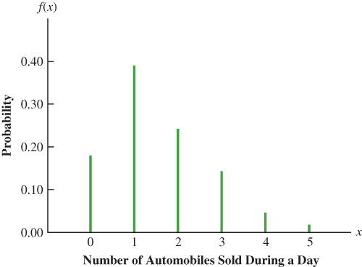
5.2 Empirical Discrete Distribution
There are three methods for assigning probabilities to random variables: classical method, subjective method, and relative frequency method.
The use of the relative frequency method to develop discrete probability distributions leads to an empirical discrete distribution.
Example: Number of automobiles sold during a day at DiCarlo Motors.
The table to the right shows the number of automobiles sold at DiCarlo over the past 300 days.
We define the random variable of interest as:
$x$ = the number of automobiles sold during a day.
We can use the relative frequencies to represent graphically the empirical discrete distribution for $x$.
x | # of days | f(x)
0 | 54 | 54 / 300 = 0.18
1 | 117 | 117 / 300 = 0.39
2 | 72 | 72 / 300 = 0.24
3 | 42 | 42 / 300 = 0.14
4 | 12 | 12 / 300 = 0.04
5 | 3 | 3 / 300 = 0.01
 | 300 | Total 1.00

Slide 10
5.2 Probability Distribution Given by a Formula
In addition to tables and graphs, a formula that gives the probability function, $f(x)$, for every value of x is often used to describe the probability distributions.
Typical discrete probability distributions specified by formulas are the discrete-uniform, binomial, Poisson, and hypergeometric distributions.
The discrete uniform probability distribution is the simplest example of a discrete probability distribution given by a formula.
The discrete uniform probability function is
$$f\left(x\right)= \frac{1}{n}$$
Where: n = the number of values the random variable may assume
An example of a discrete uniform probability distribution is provided by the experiment of rolling a die, in which $n=6$ equally likely outcomes, the random variable $x$ is represented by the number of dots on the upward face of the die, and $f\left(x\right)=1/n=1/6$.

Slide 11
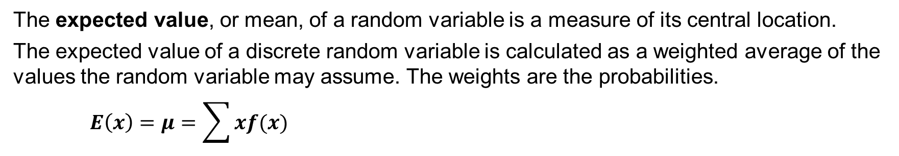
5.3 Expected Value and Variance
The expected value, or mean, of a random variable is a measure of its central location.
The expected value of a discrete random variable is calculated as a weighted average of the values the random variable may assume. The weights are the probabilities.
$$E\left(x\right)=μ=\sum{xf(x)}$$
x | f(x) | xf(x)
0 | 0.18 | 0(0.18) = 0.00
1 | 0.39 | 1(0.39) = 0.39
2 | 0.24 | 2(0.24) = 0.48
3 | 0.14 | 3(0.14) = 0.42
4 | 0.04 | 4(0.04) = 0.16
5 | 0.01 | 5(0.01) = 0.05
 |  | E(x) = 1.50
The expected value for the DiCarlo Motors example is
$E\left(x\right)=\sum{xf(x)}=1.50$ automobiles (*see notes)
Although sales from 0 to 5 automobiles are possible on any one day, over time DiCarlo can anticipate selling an average of 1.50 automobiles per day, or 30(1.50) = 45 automobiles per month.
Notes:
*Note: the expected value does not have to be a value the random variable can assume.

Slide 12
5.3 Variance and Standard Deviation
The variance summarizes the variability in the values of a random variable (*see notes.)
The variance of a discrete random variable is calculated as
$$Var\left(x\right)=σ^{2}=\sum{{(x−μ)}^{2}f(x)}$$
For the DiCarlo Motors example, variance and standard deviation are calculated as
$$Var\left(x\right)=\sum{{\left(x−μ\right)}^{2}f\left(x\right)=1.25}$$
$σ=\sqrt{Var(x)}=\sqrt{1.25}=1.118$ automobiles
Because the standard deviation is measured in the same units as the random variable, it is often preferred in describing the variability of a random vari­able.
x | x − μ | (x − μ)² | f(x) | (x − μ)² f(x)
0 | 0 − 1.5 = −1.50 | 2.25 | 0.18 | 2.25(0.18) = 0.4050
1 | 1 − 1.5 = −0.50 | 0.25 | 0.39 | 0.25(0.39) = 0.0975
2 | 2 − 1.5 = 0.50 | 0.25 | 0.24 | 0.25(0.24) = 0.0600
3 | 3 − 1.5 = 1.50 | 2.25 | 0.14 | 2.25(0.14) = 0.3150
4 | 4 − 1.5 = 2.50 | 6.25 | 0.04 | 6.25(0.04) = 0.2500
5 | 5 − 1.5 = 3.50 | 12.25 | 0.01 | 12.25(0.01) = 0.1225
 |  |  |  | σ² =1.2500
Notes:
*Note: the variance is a weighted average of the squared deviations of a random variable from its mean. The weights are the probabilities.

Slide 13
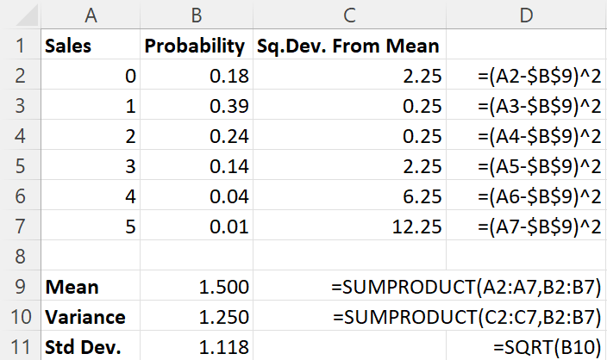
5.3 Excel: Compute the Expected Value, Variance, and Standard Deviation
An easier way to compute the expected value, variance, and standard deviation of a discrete probability distribution is to use Excel’s SUMPRODUCT function.
Enter/Access Data: Enter the values for the random variable and the corresponding probabilities in cells A1:B7, properly labeled.
Enter Functions and Formulas: In cell B9, the SUMPRODUCT function multiplies each value in one range by the corresponding value in another range and sums the products.
We compute square deviations from the mean in cells C2:C7. The SUMPRODUCT function is then used again in cell B10 for the variance.
The SQRT function in cell B11 computes the standard deviation.

Slide 14
5.4 Bivariate Probability Distributions, Covariance, and Financial Portfolios
A bivariate probability distribution is a probability distribution involving two random variables.
The outcomes of a bivariate experiment consist of the values of two random variables.
Examples of bivariate experiments:
Rolling a pair of dice and recording the number for each die.
Recording the percentage gain for a stock fund and a bond fund over a period of time.
When dealing with bivariate probability distributions, we are often interested in the relationship between the two random variables.
In this section, we introduce bivariate distributions and show how the covariance and correlation coefficient can be used as a measure of linear association between the random variables.
We shall also see how bivariate probability distributions can be used to construct and analyze financial portfolios.

Slide 15
5.4 A Bivariate Experiment for DiCarlo Motors
Suppose we consider the bivariate experiment of observing a day of operations at DiCarlo Motors and recording the number of cars sold daily at the DiCarlo Motors automobile dealerships in Saratoga and Geneva, New York.
Let us define, $x=$ the number of cars sold at the Geneva dealership, and $y=$ the number of cars sold at the Saratoga dealership.
The table shows the number of cars sold (frequencies) at each of the dealerships over a 300-day period.
 |  |  | Saratoga Dealership
Geneva Dealership | 0 | 1 | 2 | 3 | 4 | 5 | Total
0 | 21 | 30 | 24 | 9 | 2 | 0 | 86
1 | 21 | 36 | 33 | 18 | 2 | 1 | 111
2 | 9 | 42 | 9 | 12 | 3 | 2 | 77
3 | 3 | 9 | 6 | 3 | 5 | 0 | 26
Total | 54 | 117 | 72 | 42 | 12 | 3 | 300

Slide 16
5.4 A Bivariate Empirical Discrete Probability Distribution for DiCarlo Motors
If we divide all the frequencies by the 300 observations, we develop a bivariate empirical discrete probability distribution for automobile sales at the two DiCarlo dealerships.
The probabilities in the lower and right margins provide the marginal distributions for the DiCarlo Motors Saratoga and Geneva dealerships, respectively.
The probabilities in the table provide the bivariate probability distribution for sales at both dealerships.
 |  |  | Saratoga Dealership
Geneva Dealership | 0 | 1 | 2 | 3 | 4 | 5 | Total
0 | 0.0700 | 0.1000 | 0.0800 | 0.0300 | 0.0067 | 0.0000 | 0.2867
1 | 0.0700 | 0.1200 | 0.1100 | 0.0600 | 0.0067 | 0.0033 | 0.3700
2 | 0.0300 | 0.1400 | 0.0300 | 0.0400 | 0.0100 | 0.0067 | 0.2567
3 | 0.0100 | 0.0300 | 0.0200 | 0.0100 | 0.0167 | 0.0000 | 0.0867
Total | 0.1800 | 0.3900 | 0.2400 | 0.1400 | 0.0400 | 0.0100 | 1.0000

Slide 17
5.4 Probability Distribution for Total Daily Sales at DiCarlo Motors
Let us define the total sales at DiCarlo Motors as: $s=x+y$.
From the bivariate probability distribution, we see that: $f\left(\text{s}\text{=0}\right)=0.0700$, $f\left(\text{s}\text{=1}\right)=0.0700+0.1000=0.1700$, $f\left(\text{s}\text{=}2\right)=0.0300+0.1200+0.0800=0.2300$, and so on.
The table to the right shows the complete probability distribution, along with the computation of the expected value and variance of total daily sales at DiCarlo Motors:
$E\left(s\right)=2.6433$
$Var\left(s\right)=2.3895$
s | f(s) | s f(s) | s − E(s) | [s − E(s)]² | [s − E(s)]² f(s)
0 | 0.0700 | 0.0000 | -2.6433 | 6.9872 | 0.4891
1 | 0.1700 | 0.1700 | -1.6433 | 2.7005 | 0.4591
2 | 0.2300 | 0.4600 | -0.6433 | 0.4139 | 0.0952
3 | 0.2900 | 0.8700 | 0.3567 | 0.1272 | 0.0369
4 | 0.1267 | 0.5067 | 1.3567 | 1.8405 | 0.2331
5 | 0.0667 | 0.3333 | 2.3567 | 5.5539 | 0.3703
6 | 0.0233 | 0.1400 | 3.3567 | 11.2672 | 0.2629
7 | 0.0233 | 0.1633 | 4.3567 | 18.9805 | 0.4429
8 | 0.0000 | 0.0000 | 5.3567 | 28.6939 | 0.0000
 |  | E(s) = 2.6433 |  |  | Var(s) = 2.3895

Slide 18
5.4 Expected Value and Variance of Daily Sales at the Geneva Dealership
With bivariate probability distributions, we often want to better understand the relationship existing between the two random variables by calculating the covariance and/or correlation coefficient as measures of association between two random variables.
To calculate the covariance, we need $Var(x)$, $Var(y)$, and $Var(s=x+y)$.
We have already computed the last two. Calculations of daily sales at the Geneva dealership follow:
$E\left(x\right)=1.1435$
$Var\left(x\right)=0.8696$
$$σ\left(x\right)=\sqrt{0.8696}=0.9325$$
x | f(x) | x f(x) | x − E(x) | [x − E(x)]² | [x − E(x)]² f(x)
0 | 0.2867 | 0.0000 | -1.1435 | 1.3076 | 0.3748
1 | 0.3700 | 0.3700 | -0.1435 | 0.0206 | 0.0076
2 | 0.2567 | 0.5134 | 0.8565 | 0.7336 | 0.1883
3 | 0.0867 | 0.2601 | 1.8565 | 3.4466 | 0.2988
 |  | E(x) = 1.1435 |  |  | Var(x) = 0.8696

Slide 19
5.4 Covariance and Correlation at DiCarlo Motors
The formula to compute the covariance between the random variables $x$ and $y$ is
$σ_{xy}={\left[Var\left(x+y\right)−Var\left(x\right)−Var(y)\right]}/2$ $={\left(2.3895−0.8696−1.25\right)}/2=0.1350$
The covariance of 0.1350 indicates that daily sales at DiCarlo’s two dealerships have a pos­itive relationship, but it is not suitable to get a sense of the strength of such relationship.
To assess the strength of a relationship, we use the correlation coefficient between x and y
$$ρ_{xy}=\frac{σ_{xy}}{σ_{x}σ_{y}}=\frac{0.1350}{(0.9325)(1.118)}=0.1295$$
A correlation coefficient of .1295 indicates that there is a weak positive relationship between the random variables representing daily sales at the two DiCarlo dealerships.
If the correlation coefficient had equaled zero, we would have concluded that daily sales at the two dealerships were independent.

Slide 20
5.4 Financial Applications
A financial advisor is considering a financial portfolio for the coming year and for each of the four economic scenarios has developed a probability distribu­tion showing:
x = the percent return for investing in a large-­cap stock fund the percent return
y = the percent return for investing in a long-term government bond fund
The bivariate probability distribution for x and y is simply a list with a separate row for each experimental outcome (economic scenario.)
Economic Scenario | Probability f(x, y) | Large-Cap Stock Fund (x) | Long-Term Government Bond Fund (y)
Recession | 0.10 | −40 | 30
Weak Growth | 0.25 | 5 | 5
Stable Growth | 0.50 | 15 | 4
Strong Growth | 0.15 | 30 | 2

Slide 21
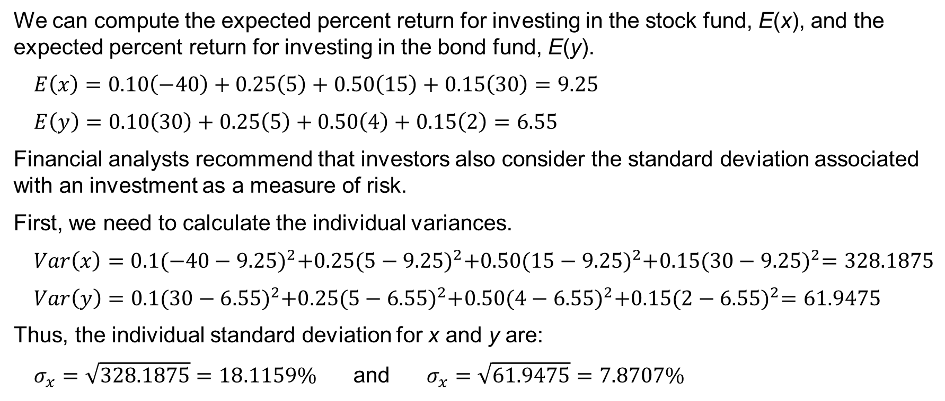
5.4 Return and Risk of the Individual Funds
We can compute the expected percent return for investing in the stock fund, E(x), and the expected percent return for investing in the bond fund, E(y).
$E\left(x\right)=0.10\left(−40\right)+0.25\left(5\right)+0.50\left(15\right)+0.15\left(30\right)=9.25$
$E\left(y\right)=0.10\left(30\right)+0.25\left(5\right)+0.50\left(4\right)+0.15\left(2\right)=6.55$
Financial analysts recommend that investors also consider the standard deviation associated with an investment as a measure of risk.
First, we need to calculate the individual variances.
$Var\left(x\right)=0.1{(−40−9.25)}^{2}+0.25{(5−9.25)}^{2}+0.50{(15−9.25)}^{2}+0.15{(30−9.25)}^{2}=328.1875$
$Var\left(y\right)=0.1{(30−6.55)}^{2}+0.25{(5−6.55)}^{2}+0.50{(4−6.55)}^{2}+0.15{(2−6.55)}^{2}=61.9475$
Thus, the individual standard deviation for x and y are:
$σ_{x}=\sqrt{328.1875}=18.1159\%$ and $σ_{x}=\sqrt{61.9475}=7.8707\%$

Slide 22
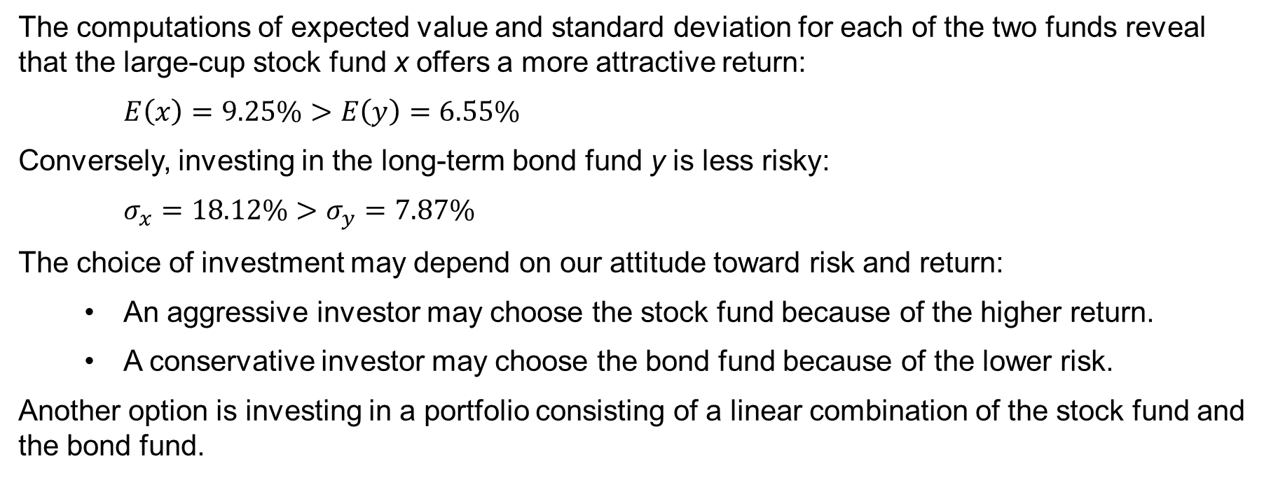
5.4 A Financial Portfolio of a Stock Fund and a Bond Fund
The computations of expected value and standard deviation for each of the two funds reveal that the large-cup stock fund x offers a more attractive return:
$E\left(x\right)=9.25\%>E\left(y\right)=6.55\%$
Conversely, investing in the long-term bond fund y is less risky:
$σ_{x}=18.12\%>σ_{y}=7.87\%$
The choice of investment may depend on our attitude toward risk and return:
An aggressive investor may choose the stock fund because of the higher return.
A conservative investor may choose the bond fund because of the lower risk.
Another option is investing in a portfolio consisting of a linear combination of the stock fund and the bond fund.

Slide 23
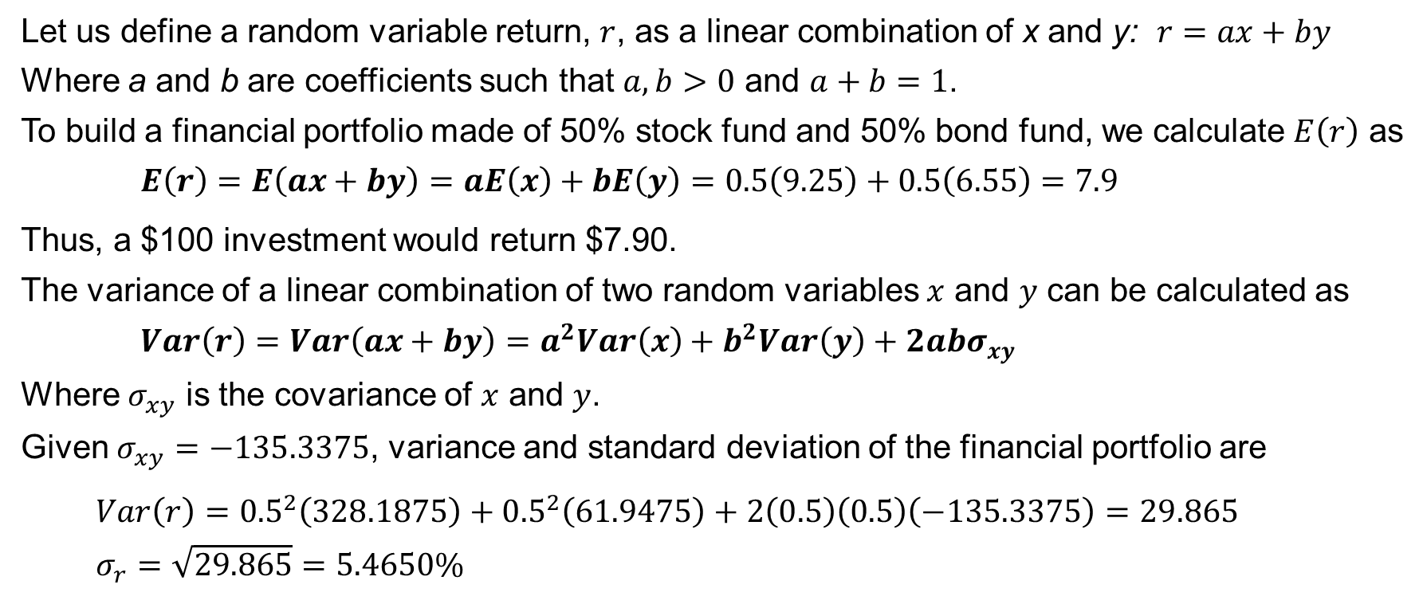
5.4 Properties of the Linear Combination of x and y
Let us define a random variable return, $r$, as a linear combination of x and y: $r=ax+by$
Where a and b are coefficients such that $a,b>0$ and $a+b=1$.
To build a financial portfolio made of 50% stock fund and 50% bond fund, we calculate $E\left(r\right)$ as
$$E\left(r\right)=E\left(ax+by\right)=aE\left(x\right)+bE\left(y\right)=0.5\left(9.25\right)+0.5\left(6.55\right)=7.9$$
Thus, a $100 investment would return $7.90.
The variance of a linear combination of two random variables $x$ and $y$ can be calculated as
$Var\left(r\right)=Var\left(ax+by\right)=a^{2}Var\left(x\right)+b^{2}Var\left(y\right)+2abσ_{xy}$
Where $σ_{xy}$ is the covariance of $x$ and $y$.
Given $σ_{xy}=−135.3375$, variance and standard deviation of the financial portfolio are
$Var\left(r\right)={0.5}^{2}\left(328.1875\right)+{0.5}^{2}\left(61.9475\right)+2\left(0.5\right)\left(0.5\right)\left(−135.3375\right)=29.865$
$σ_{r}=\sqrt{29.865}=5.4650\%$

Slide 24
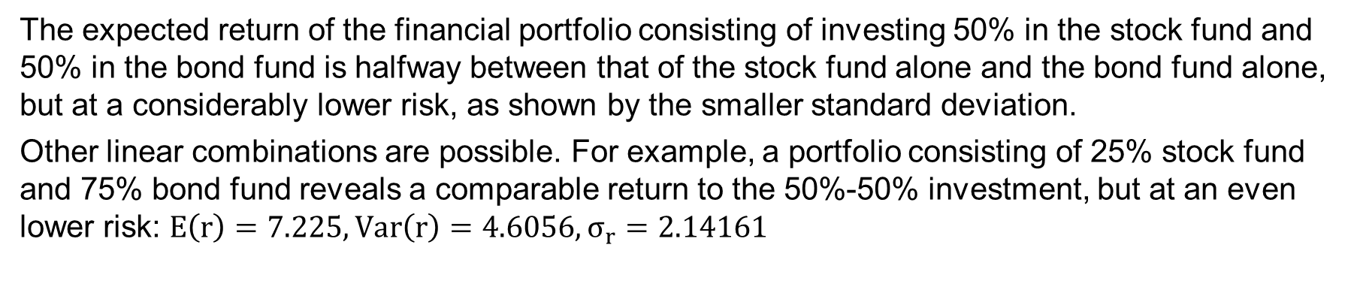
5.4 Risk and Return for the Three Financial Alternatives
The expected return of the financial portfolio consisting of investing 50% in the stock fund and 50% in the bond fund is halfway between that of the stock fund alone and the bond fund alone, but at a considerably lower risk, as shown by the smaller standard deviation.
Other linear combinations are possible. For example, a portfolio consisting of 25% stock fund and 75% bond fund reveals a comparable return to the 50%-50% investment, but at an even lower risk: $E\left(r\right)=7.225, Var\left(r\right)=4.6056, σ_{r}=2.14161$
Investment Alternative | Expected Return (%) | Variance of Return | Standard Deviation of Return (%)
100% in Stock Fund | 9.25 | 328.1875 | 18.1159
100% in Bond Fund | 6.55 | 61.9475 | 7.8707
Portfolio (50% in stock fund, 50% in bond fund) | 7.90 | 29.8650 | 5.4650

Slide 25
5.5 Binomial Probability Distribution
A binomial experiment exhibits the following four properties.
The experiment consists of a sequence of n identical trials.
Two outcomes, success and failure, are possible in each trial.
The probability of a success, denoted by p, and the probability of a failure, denoted by 1 – p, do not change from trial to trial (the stationarity assumption. *See notes.)
The trials are independent.
If properties 2-4 are present, we say the trials are generated by a Bernoulli process.
In a binomial experiment, our interest is in the number x of successes occurring in the n trials.
Because the number of successes is finite, x is a discrete random variable.
The probability distribution associated with this random variable is called the binomial probability distribution, and it is described by the binomial probability function.
Notes:
*Note: the stationarity assumption (property 3) should not be confused with the independence of the trials (property 4).
Consider the binomial experiment of an insurance salesperson visiting 10 randomly selected families. We define a success if the salesperson closes the sale of insurance with a family, and a failure if he does not. From past experience we know that the salesperson closes on an insurance in 10% of the family visits. In other words, p = 0.10. The stationarity assumption requires that the probability of a success (selling the insurance) remains the same over each trial (a family visit). In other words, if a salesperson got tired and lost interest in selling insurance, the probability of a success would decrease, and that would violate the stationarity assumption. The independence of the trials regards the decision of each family of whether to purchase or not the insurance.

Slide 26
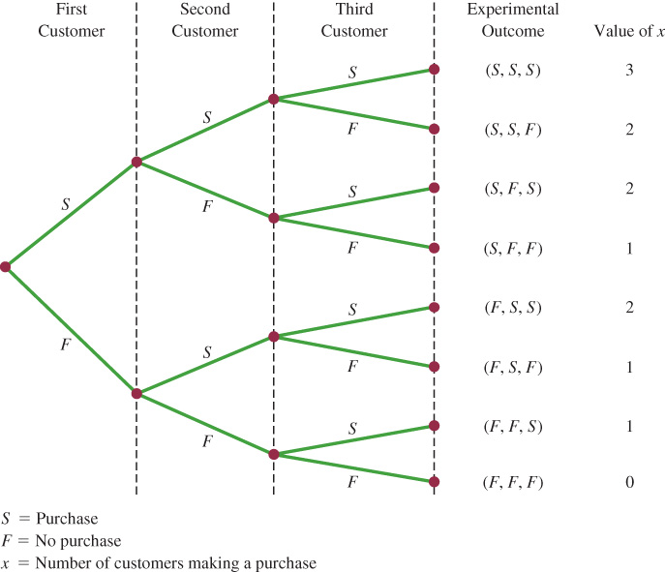
5.5 Martin Clothing Store Problem
On the basis of past experience, the store manager at the Martin Clothing store estimates the probability that any one customer will make a purchase to be 0.30.
What is the probability that two of the next three
customers will make a purchase?
The tree diagram to the right shows that the
experiment has eight possible outcomes.
The requirements for a binomial experiment are met:
Three identical trials, one for each customer
entering the store
Two outcomes: S = purchase, F = no purchase
Purchase: p = 0.30; no purchase: 1 – p = 0.70
Each purchase decision is independent

Slide 27
5.5 The Binomial Probability Function
The binomial probability function determines the probability of observing $x$ successes in $n$ trials in a binomial experiment.
$$f(x)=\left({n \atop x}\right)p^{x}{\left(1−p\right)}^{n−x}$$
Where:
$x$ = the number of successes
$p$ = the probability of a success in one trial
$n$ = the number of trials
𝑓(𝑥) = the probability of x successes in n trials
$$\left({n \atop x}\right)=\frac{n!}{x!\left(n−x\right)!} \text{(}\text{the} \text{number} \text{of} \text{experimental} \text{outcomes} \text{providing} \text{x} \text{successes} \text{in} \text{n} \text{trials}\text{)}$$
Table 5 of Appendix B gives the probability of $x$ successes in $n$ trials for a bi­nomial experiment with varying values of the probability of success, p (*see notes.)
Notes:
*Note: to Use a table of binomial probabilities we must specify the values of n, p, and x for the binomial experiment of interest. For example, to obtain the probability of x = 3 successes in a binomial experiment with n = 10 and p = 0.40, first, scroll down the leftmost column until you find the group for n = 10. Second, in the column next to it, locate x = 3 from the available rows. Third, move along the row for n = 10 and x = 3 until you reach the column corresponding to p = 0.40. The answer is 0.2150.

Slide 28
5.5 The Binomial Probability Calculation for the Martin Clothing Store Problem
The binomial probability function is the product of two factors:
1. The number of experimental outcomes providing exactly $x$ successes in $n$ trials:
$$\left({n \atop x}\right)=\frac{n!}{x!\left(n−x\right)!}$$
2. The probability of a particular sequence of trial outcomes with $x$ successes in $n$ trials:
$$p^{x}{(1−p)}^{n−x}$$
Thus, the probability that two ($x=2$) of the next three ($n=3$) customers will make a purchase at the Martin Clothing Store is
$$f\left(x\right)=\left({3 \atop 2}\right){0.30}^{2}{\left(1−0.30\right)}^{3−2}=\left(\frac{3!}{2!1!}\right){0.30}^{2}{\left(0.70\right)}^{1}=3(0.063)=0.189$$

Slide 29
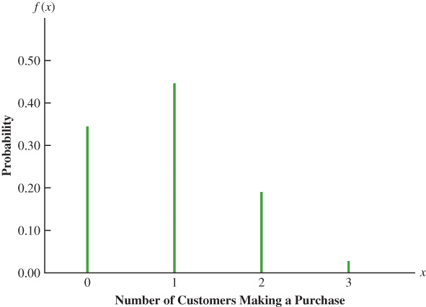
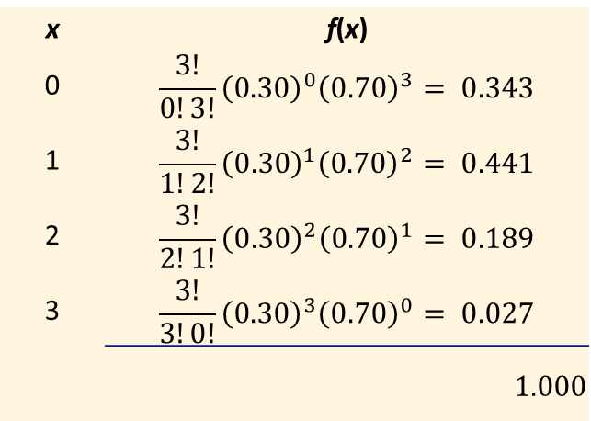
5.5 The Binomial Probability Distribution for the Martin Clothing Store Problem
If we repeat the calculation of the previous slide for the probability that the number of customers making a purchase is either 0, 1, or 3, we obtain the probability distribution.
The probability distribution may also be displayed with a graph, in which the height of a bar is proportional to the probability for a given value of $x$.
x | f(x)
0 | $$\frac{3!}{0!3!}{\left(0.30\right)}^{0}{\left(0.70\right)}^{3}= 0.343$$
1 | $$\frac{3!}{1!2!}{\left(0.30\right)}^{1}{\left(0.70\right)}^{2}= 0.441$$
2 | $$\frac{3!}{2!1!}{\left(0.30\right)}^{2}{\left(0.70\right)}^{1}= 0.189$$
3 | $$\frac{3!}{3!0!}{\left(0.30\right)}^{3}{\left(0.70\right)}^{0}= 0.027$$
 | $1.000$

Slide 30
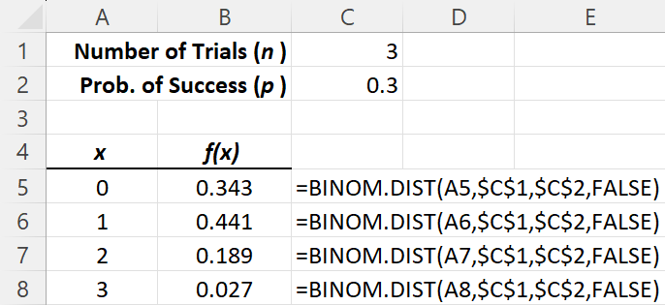
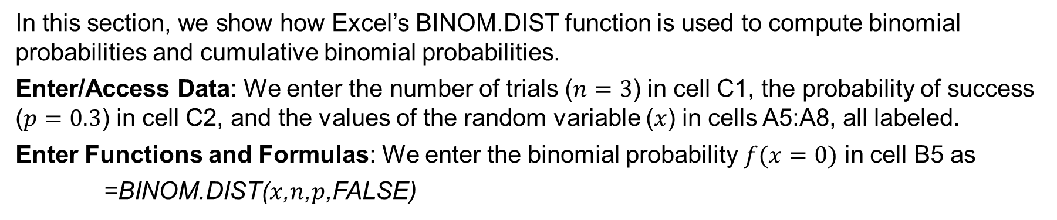
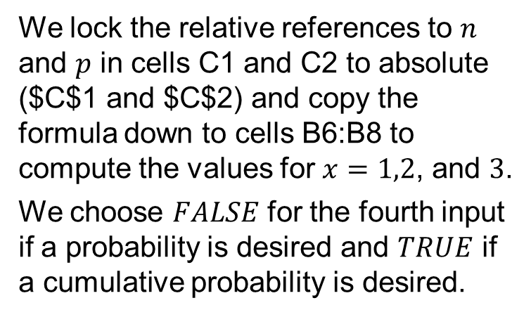
5.5 Excel: Computing Binomial Probabilities
In this section, we show how Excel’s BINOM.DIST function is used to compute binomial probabilities and cumulative binomial probabilities.
Enter/Access Data: We enter the number of trials ($n=3$) in cell C1, the probability of success ($p=0.3$) in cell C2, and the values of the random variable ($x$) in cells A5:A8, all labeled.
Enter Functions and Formulas: We enter the binomial probability $f(x=0)$ in cell B5 as
=BINOM.DIST($x$,$n$,$p$,FALSE)
We lock the relative references to $n$ and $p$ in cells C1 and C2 to absolute ($C$1 and $C$2) and copy the formula down to cells B6:B8 to compute the values for $x=1,2$, and $3$.
We choose $FALSE$ for the fourth input if a probability is desired and $TRUE$ if a cumulative probability is desired.

Slide 31
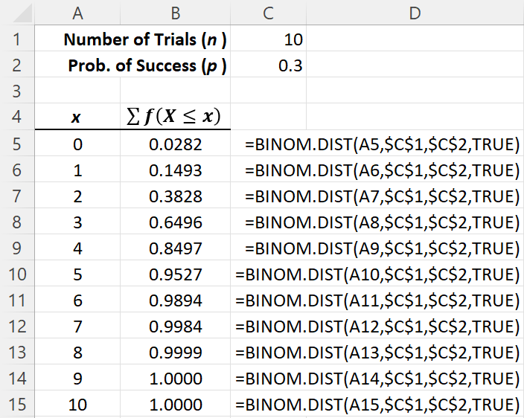
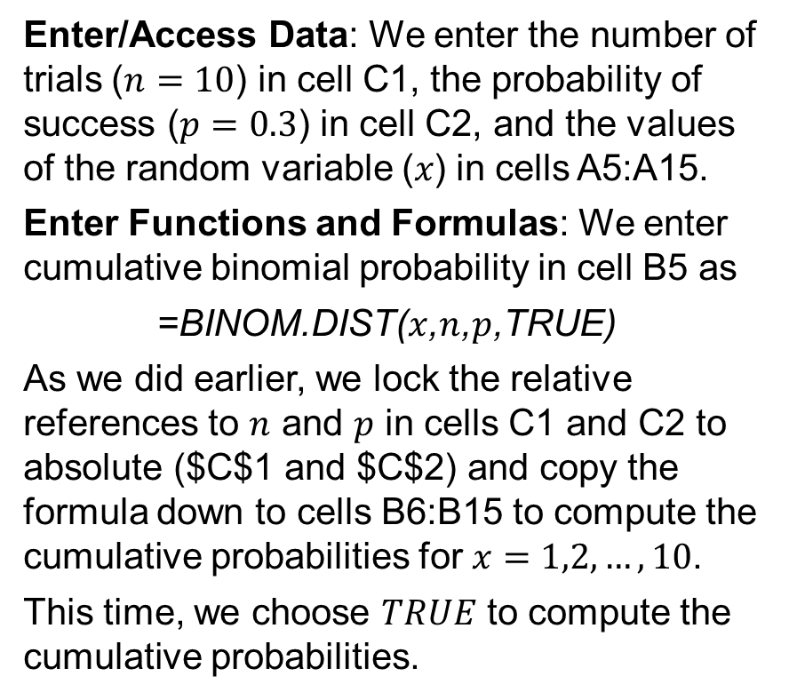
5.5 Excel: Computing Cumulative Binomial Probabilities
Enter/Access Data: We enter the number of trials ($n=10$) in cell C1, the probability of success ($p=0.3$) in cell C2, and the values of the random variable (𝑥) in cells A5:A15.
Enter Functions and Formulas: We enter cumulative binomial probability in cell B5 as
=BINOM.DIST($x$,$n$,$p$,TRUE)
As we did earlier, we lock the relative references to $n$ and $p$ in cells C1 and C2 to absolute ($C$1 and $C$2) and copy the formula down to cells B6:B15 to compute the cumulative probabilities for $x=1,2,…,10$.
This time, we choose $TRUE$ to compute the cumulative probabilities.

Slide 32
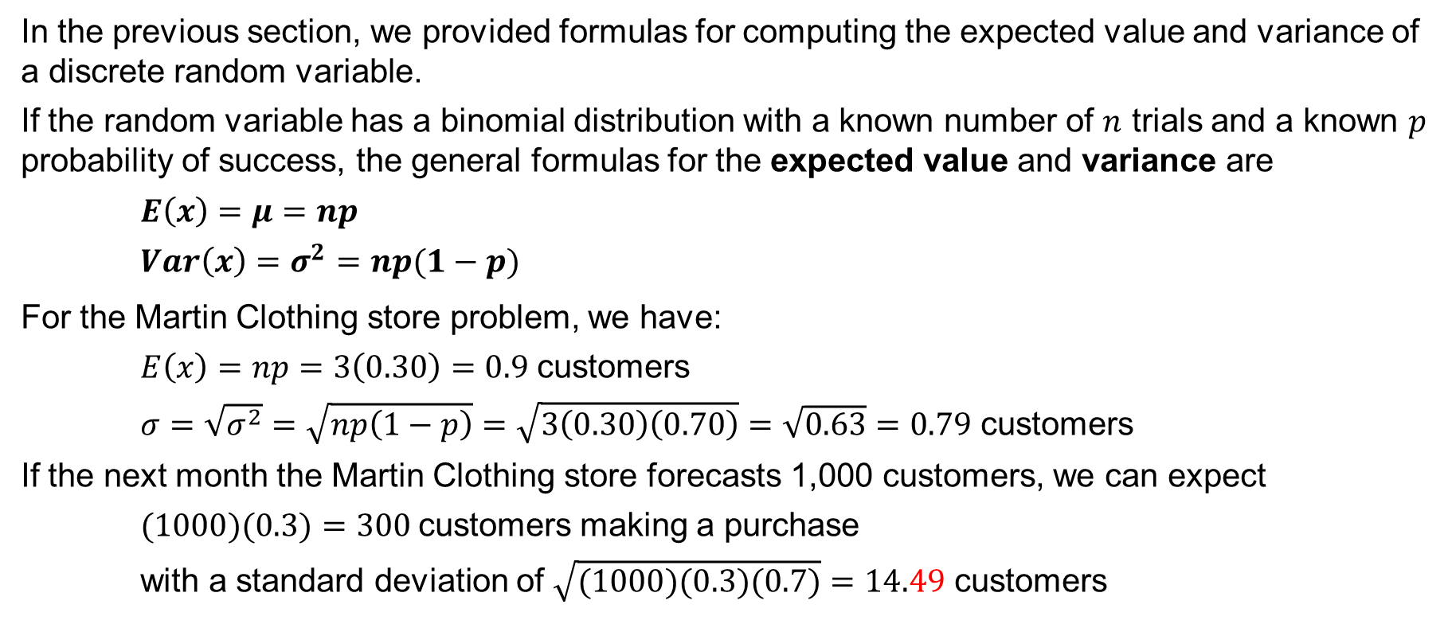
5.5 Properties of the Binomial Distribution
In the previous section, we provided formulas for computing the expected value and variance of a discrete random variable.
If the random variable has a bi­nomial distribution with a known number of $n$ trials and a known $p$ probability of success, the general formulas for the expected value and variance are
$E\left(x\right)=μ=np$
$Var\left(x\right)=σ^{2}=np(1−p)$
For the Martin Clothing store problem, we have:
$E\left(x\right)=np=3\left(0.30\right)=0.9$ customers
$σ=\sqrt{σ^{2}}=\sqrt{np\left(1−p\right)}=\sqrt{3\left(0.30\right)\left(0.70\right)}=\sqrt{0.63}=0.79$ customers
If the next month the Martin Clothing store forecasts 1,000 customers, we can expect
$(1000)(0.3)=300$customers making a purchase
with a standard deviation of $\sqrt{(1000)(0.3)(0.7)}=14.49$ customers

Slide 33
5.6 Poisson Probability Distribution
A Poisson Probability Distribution describes x, the number of occurrences over a specified interval of time or space, if the following two properties of a Poisson experiment are respected.
The probability of an occurrence is the same for any two intervals of equal length.
The occurrence or nonoccurrence in any interval is independent of the occur­rence or nonoccurrence in any other interval.
The Poisson probability function is described by the following equation
$$f\left(x\right)=\frac{μ^{x}e^{−μ}}{x!}$$
Where:
x = a discrete random variable describing the number of occurrences over an interval.
f(x) = the probability of x occurrences in an interval
μ = expected value or mean number of occurrences in an interval
Also, in a Poisson probability distribution, $σ^{2}\text{=} μ$ (the variance is equal to the mean.)

Slide 34
5.6 An Application of the Poisson Probability Distribution
An analysis of historical data shows that patients arrive at the emergency room of a large hospital on weekend mornings at the average rate $μ=10$ over a 15-minute interval.
What is the probability of exactly $x=5$ arrivals in 15 minutes on a weekend morning?
In a Poisson experiment, we have
$$f\left(5\right)=\frac{μ^{x}e^{−μ}}{x!}=\frac{{10}^{5}e^{−10}}{5!}=0.0378$$
What if we want to know the probability of exactly $x=1$ arrival over a 3-minute interval?
We observe that, on average, over a 3-minute interval, we have $μ=\left({10}/{15}\right)\left(3\right)=2$. Thus, the probability of one arrival over a 3-minute period is
$$f\left(1\right)=\frac{μ^{x}e^{−μ}}{x!}=\frac{2^{1}e^{−2}}{1!}=0.2707$$
The probability of observing 5 arrivals over a 15-minute period is not the same as observing 1 arrival over a 3-minute period.

Slide 35
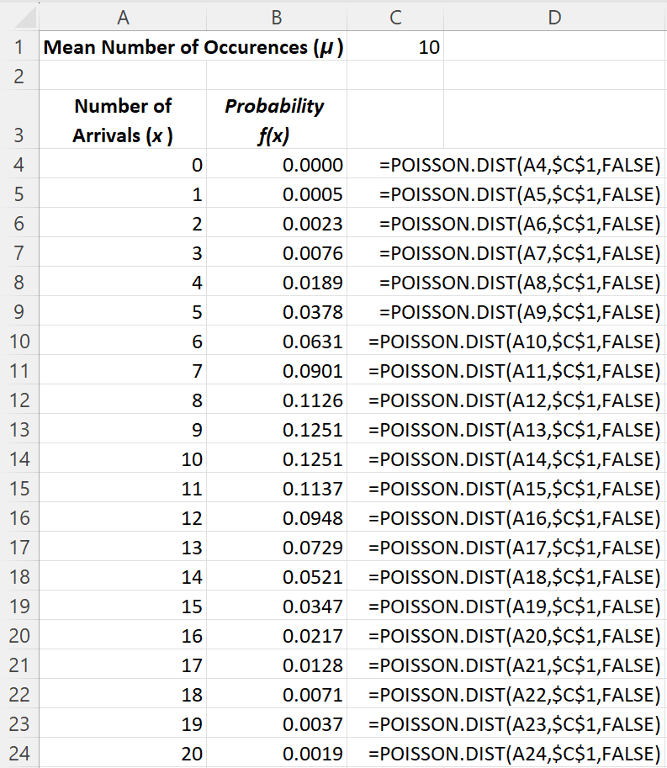
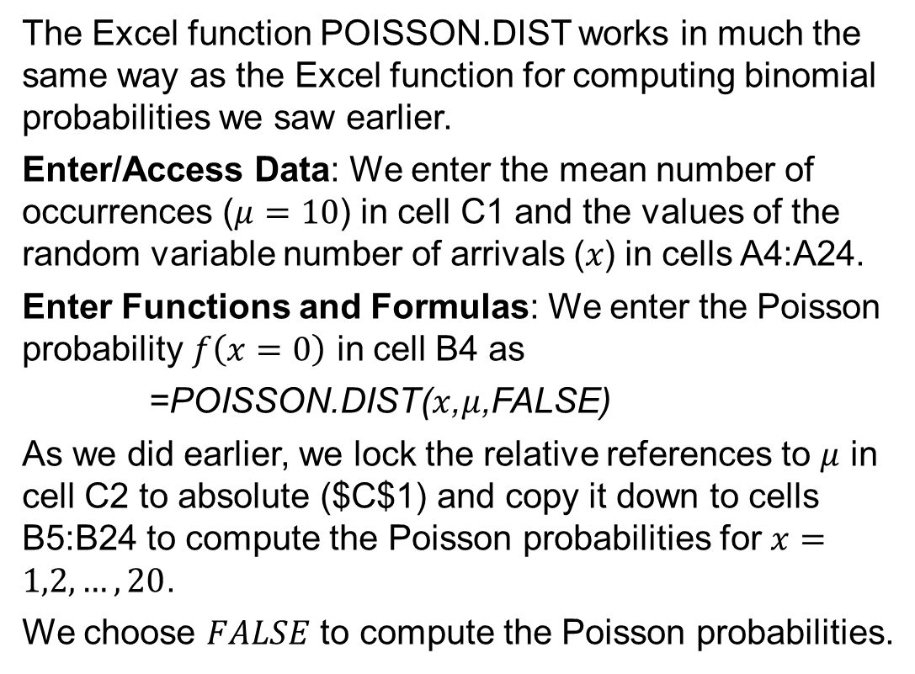
5.6 Excel: Computing Poisson Probabilities
The Excel function POISSON.DIST works in much the same way as the Excel function for computing binomial probabilities we saw earlier.
Enter/Access Data: We enter the mean number of occurrences ($μ=10$) in cell C1 and the values of the random variable number of arrivals (𝑥) in cells A4:A24.
Enter Functions and Formulas: We enter the Poisson probability $f\left(x=0\right)$ in cell B4 as
=POISSON.DIST($x$,$μ$,FALSE)
As we did earlier, we lock the relative references to $μ$ in cell C2 to absolute ($C$1) and copy it down to cells B5:B24 to compute the Poisson probabilities for $x=1,2,…,20$.
We choose $FALSE$ to compute the Poisson probabilities.

Slide 36
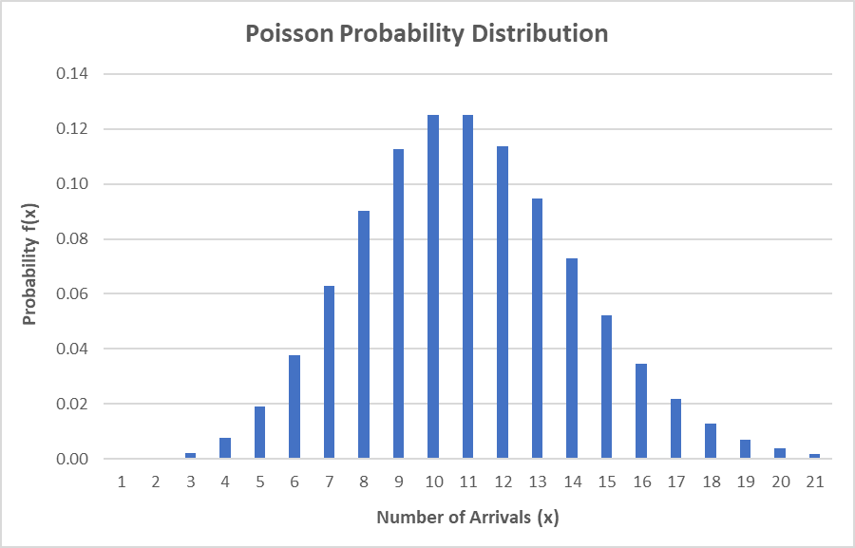
5.6 Displaying Chart of Poisson Probability Distribution
We can also use Excel’s chart tools to develop a graph of the Poisson probability distribution of arrivals using the probability values computed in the previous slide.
The chart gives a nice graphical presentation of the probabilities for the various number of arrival possibilities in a 15-minute interval.
We can see that the most likely number of arrivals is 10 or 11 and that the probabilities fall off smoothly for smaller and larger values.

Slide 37
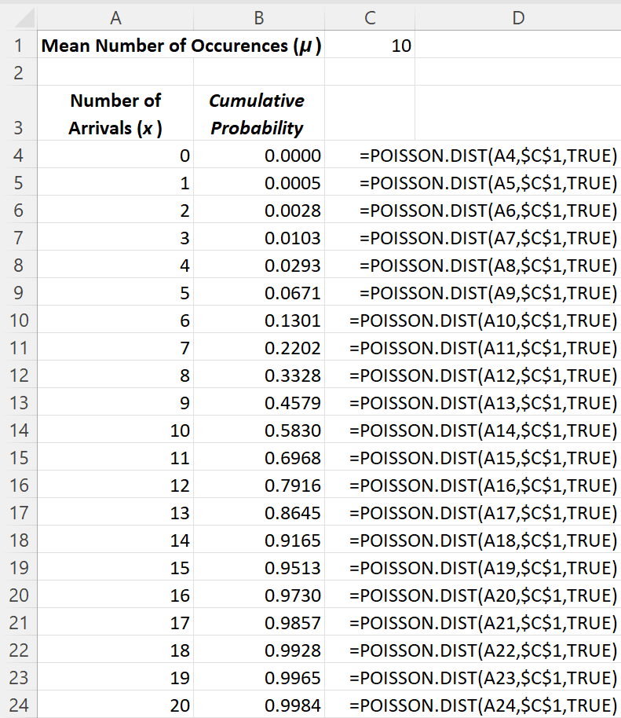
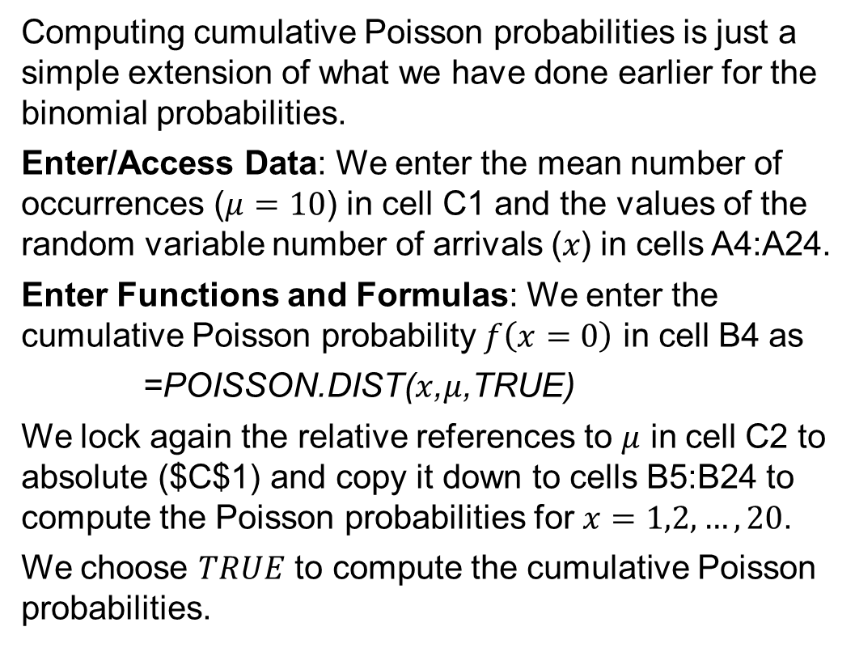
5.6 Excel: Computing Cumulative Poisson Probabilities
Computing cumulative Poisson probabilities is just a simple extension of what we have done earlier for the binomial probabilities.
Enter/Access Data: We enter the mean number of occurrences ($μ=10$) in cell C1 and the values of the random variable number of arrivals (𝑥) in cells A4:A24.
Enter Functions and Formulas: We enter the cumulative Poisson probability $f\left(x=0\right)$ in cell B4 as
=POISSON.DIST($x$,$μ$,TRUE)
We lock again the relative references to $μ$ in cell C2 to absolute ($C$1) and copy it down to cells B5:B24 to compute the Poisson probabilities for $x=1,2,…,20$.
We choose $TRUE$ to compute the cumulative Poisson probabilities.

Slide 38
5.6 Properties of the Poisson Probability Distribution
Because there is no stated upper limit for the number of occurrences, the Poisson probability function $f(x)$ is applicable for values $x=0,1,2,…$ without limit.
In practical applications, $x$ will eventually become large enough so that $f(x)$ becomes approximately zero and the probability of any larger values of $x$ negligible.
A Poisson probability distribution has the variance equal to the mean:
$$μ=σ^{2}$$
Probabilities can be calculated using a Poisson probability table (Table 7, Appendix B of the textbook).
For example, to obtain the probability of $x=5$ arrivals over a 15-minute period when $μ=10$ using the table, follow these two steps:
Scroll down the leftmost column until you find $x=5$
Move along the row for $x=5$ until you reach the column corresponding to $μ=10$.
The answer is 0.0378. As shown before, if using $x=1$ and $μ=2$, we get 0.2707 (*see notes.)
Notes:
*Note: remember that a Poisson probability distribution has the variance equal to the mean. Therefore,, over a 15-minute interval, we have 𝜇=10, the standard deviation, $σ=\sqrt{σ^{2}}=\sqrt{10}=3.16$, and a coefficient of variation of $100×\left(3.16/10\right)\%=31.6\%$ . But over a 3-minute interval, we have 𝜇=2 and $σ=\sqrt{σ^{2}}=\sqrt{2}=1.41$, and a much larger coefficient of variation of $100×\left(1.41/2\right)\%=70.7\%$. That’s the reason why the probabilities are also very different.

Slide 39
5.7 Hypergeometric Probability Distribution
The hypergeometric probability distribution is closely related to the binomial distribution, but it differs in two key respects:
The trials are not independent.
The probability of success changes from trial to trial.
The hypergeometric probability function is described by the following equation:
$$f(x)=\frac{\left({r \atop x}\right)\left({N−r \atop n−x}\right)}{\left({N \atop n}\right)} \text{for} 0≤x≤r$$
Where: x = the number of successes
n = the number of trials
𝑓(𝑥) = the probability of x successes in n trials
N = the number of elements in the population
r = the number of elements in the population labeled success

Slide 40
5.7 Hypergeometric Probability Function
The hypergeometric probability function, introduced in the previous slide, is used to compute the probability that in a random selection of n elements, selected without replacement, we obtain x elements labeled success and n − x elements labeled failure.
For this outcome to occur, we must obtain x successes from the r successes in the population and n − x failures from the N − r failures.
The hypergeometric probability function, f(x), the probability of obtaining x successes in n trials, shown in the previous slide, is made of the following three components:
$$\left({r \atop x}\right)=\text{the} \text{number} \text{of} \text{ways} \text{that} \text{x} \text{successes} \text{can} \text{be} \text{selected} \text{from} \text{r} \text{successes} \text{in} \text{the} \text{population}$$
$$\left({N−r \atop n−x}\right)=\text{the} \text{number} \text{of} \text{ways} \text{that} n−x \text{failures} \text{can} \text{be} \text{selected} \text{from} \text{a} \text{total} \text{of} N−r \text{failures}$$
$$\left({N \atop n}\right)=\text{the} \text{number} \text{of} \text{ways} \text{n} \text{elements} \text{can} \text{be} \text{selected} \text{from} \text{a} \text{population} \text{of} \text{size} \text{N}$$

Slide 41
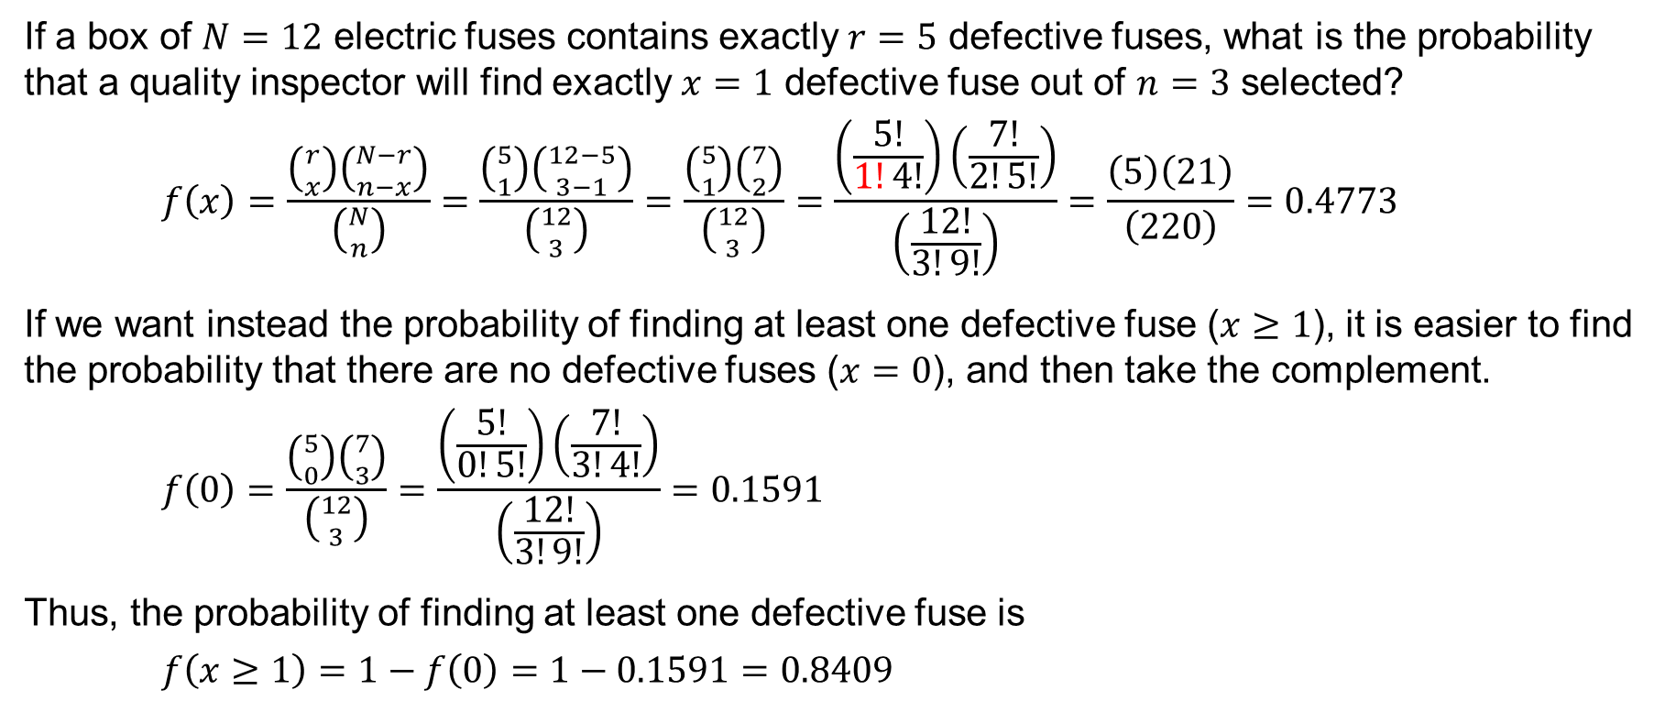
5.7 An Application of the Hypergeometric Distribution
If a box of $N=12$ electric fuses contains exactly $r=5$ defective fuses, what is the probability that a quality inspector will find exactly $x=1$ defective fuse out of $n=3$ selected?
$$f\left(x\right)=\frac{\left({r \atop x}\right)\left({N−r \atop n−x}\right)}{\left({N \atop n}\right)}=\frac{\left({5 \atop 1}\right)\left({12−5 \atop 3−1}\right)}{\left({12 \atop 3}\right)}=\frac{\left({5 \atop 1}\right)\left({7 \atop 2}\right)}{\left({12 \atop 3}\right)}=\frac{\left(\frac{5!}{1!4!}\right)\left(\frac{7!}{2!5!}\right)}{\left(\frac{12!}{3!9!}\right)}=\frac{\left(5\right)\left(21\right)}{\left(220\right)}=0.4773$$
If we want instead the probability of finding at least one defective fuse ($x≥1$), it is easier to find the probability that there are no defective fuses ($x=0$), and then take the complement.
$$f\left(0\right)=\frac{\left({5 \atop 0}\right)\left({7 \atop 3}\right)}{\left({12 \atop 3}\right)}=\frac{\left(\frac{5!}{0!5!}\right)\left(\frac{7!}{3!4!}\right)}{\left(\frac{12!}{3!9!}\right)}=0.1591$$
Thus, the probability of finding at least one defective fuse is
$$f\left(x≥1\right)=1−f\left(0\right)=1−0.1591=0.8409$$

Slide 42
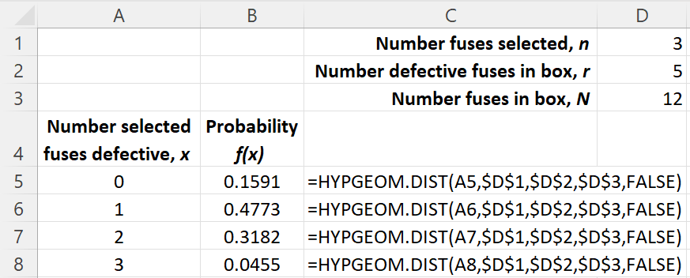
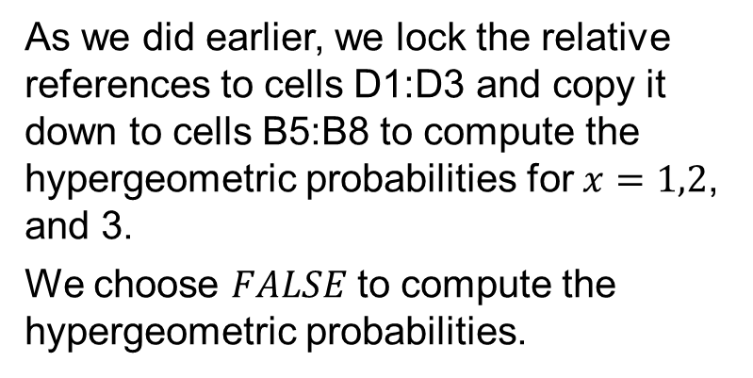
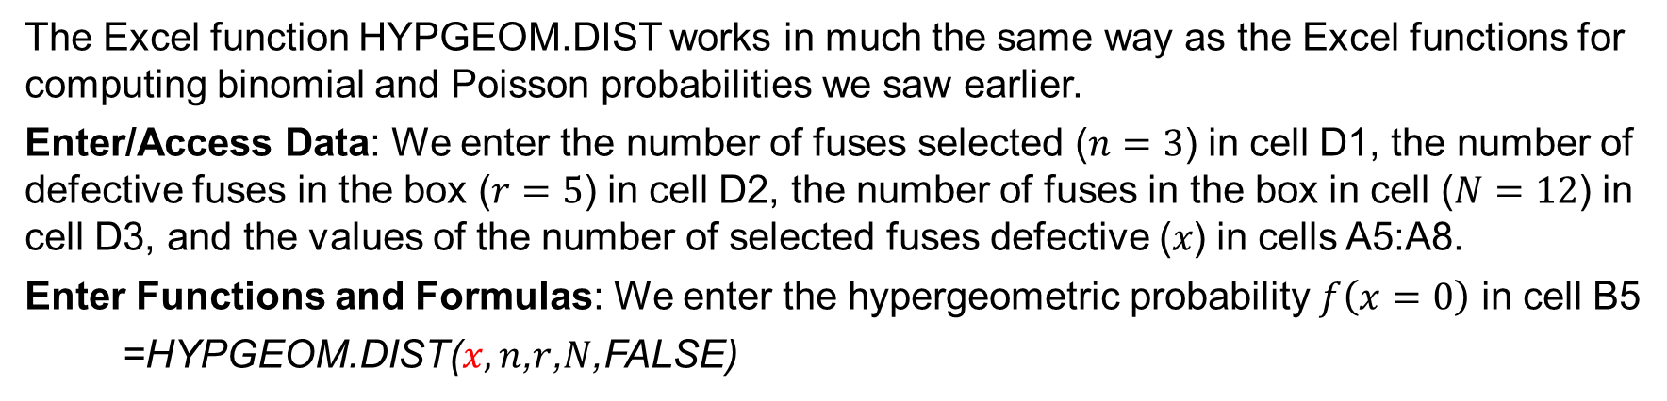
5.7 Excel: Computing Hypergeometric Probabilities
The Excel function HYPGEOM.DIST works in much the same way as the Excel functions for computing binomial and Poisson probabilities we saw earlier.
Enter/Access Data: We enter the number of fuses selected ($n=3$) in cell D1, the number of defective fuses in the box ($r=5$) in cell D2, the number of fuses in the box in cell ($N=12$) in cell D3, and the values of the number of selected fuses defective (𝑥) in cells A5:A8.
Enter Functions and Formulas: We enter the hypergeometric probability $f\left(x=0\right)$ in cell B5
=HYPGEOM.DIST($x,n$,$r$,$N$,FALSE)
As we did earlier, we lock the relative references to cells D1:D3 and copy it down to cells B5:B8 to compute the hypergeometric probabilities for $x=1,2$, and 3.
We choose 𝐹𝐴𝐿𝑆𝐸 to compute the hypergeometric probabilities.

Slide 43
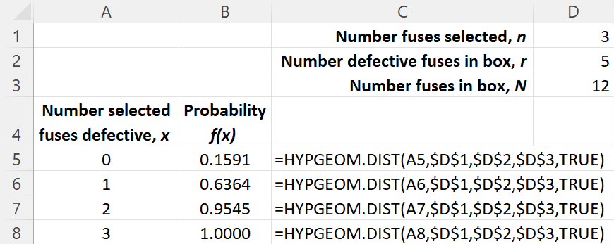
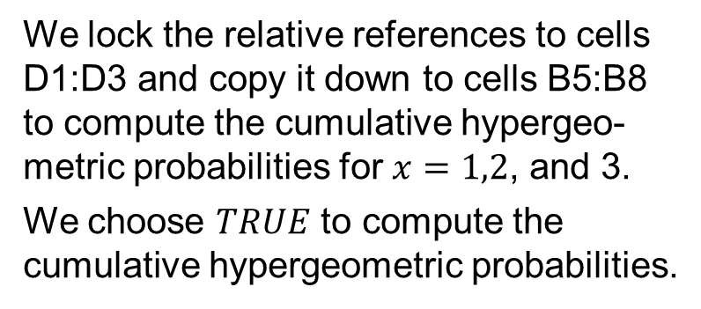
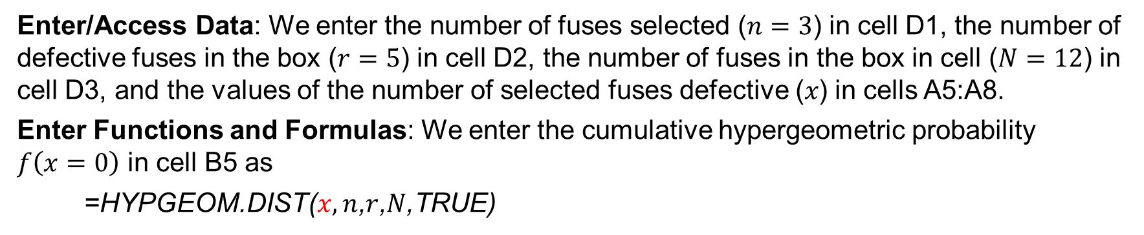
5.7 Excel: Computing Cumulative Hypergeometric Probabilities
Enter/Access Data: We enter the number of fuses selected ($n=3$) in cell D1, the number of defective fuses in the box ($r=5$) in cell D2, the number of fuses in the box in cell ($N=12$) in cell D3, and the values of the number of selected fuses defective (𝑥) in cells A5:A8.
Enter Functions and Formulas: We enter the cumulative hypergeometric probability $f\left(x=0\right)$ in cell B5 as
=HYPGEOM.DIST($x,n$,$r$,$N$,TRUE)
We lock the relative references to cells D1:D3 and copy it down to cells B5:B8 to compute the cumulative hypergeo-metric probabilities for $x=1,2$, and 3.
We choose $TRUE$ to compute the cumulative hypergeometric probabilities.

Slide 44
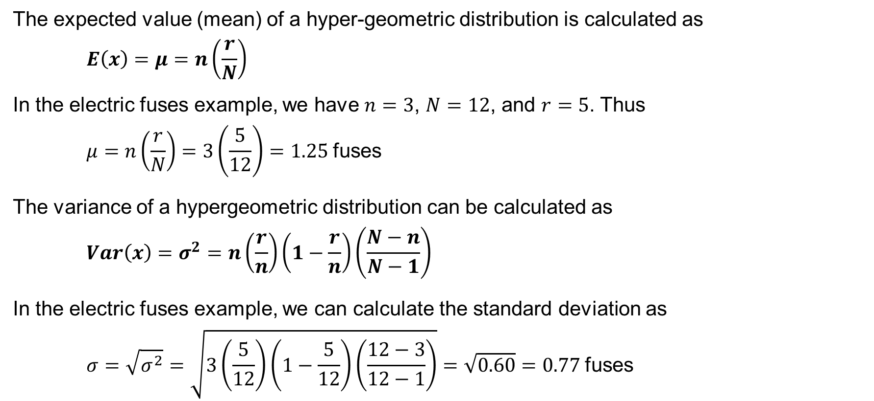
5.7 Properties of the Hypergeometric Distribution
The expected value (mean) of a hyper-geometric distribution is calculated as
$$E\left(x\right)=μ=n\left(\frac{r}{N}\right)$$
In the electric fuses example, we have $n=3$, $N=12$, and $r=5$. Thus
$$μ=n\left(\frac{r}{N}\right)=3\left(\frac{5}{12}\right)=1.25 \text{fuses}$$
The variance of a hypergeometric distribution can be calculated as
$$Var\left(x\right)=σ^{2}=n\left(\frac{r}{n}\right)\left(1−\frac{r}{n}\right)\left(\frac{N−n}{N−1}\right)$$
In the electric fuses example, we can calculate the standard deviation as
$$σ=\sqrt{σ^{2}}=\sqrt{3\left(\frac{5}{12}\right)\left(1−\frac{5}{12}\right)\left(\frac{12−3}{12−1}\right)}=\sqrt{0.60}=0.77 \text{fuses}$$

Slide 45
Summary
A random variable provides a numerical description of the outcome of an experiment.
For any discrete random variable, the probability distribution defined by a probability function provides the probability associated with each value of the random variable.
We introduced two types of discrete probability distributions:
A table consisting of the values of the random variable and associated probabilities.
A mathematical function that provides the probabilities for the random variable.
We described a probability distribution with the expected value, a measure of central location, and the variance and standard deviation as measures of variability.
We showed how to compute the covariance and correlation coefficient as measures of a bivariate relationship, and how bivariate distributions involving market returns on financial assets can be used to create financial portfolios.
Finally, we introduced three discrete probability distributions that are described by a mathematical function: the binomial, Poisson, and hypergeometric distributions.

