Slide 1
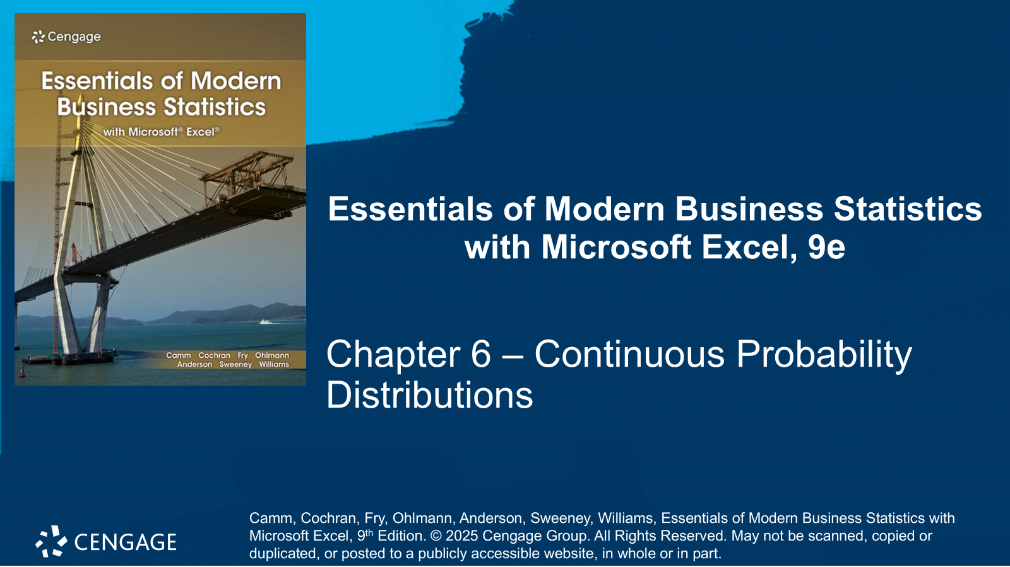

Slide 2
Chapter Contents
6.1 Uniform Probability Distribution
6.2 Normal Probability Distribution
6.3 Exponential Probability Distribution
Summary

Slide 3
Chapter Objectives (1 of 2)
After completing this chapter, you will be able to:
LO 6-1 Define, graph, and interpret the probability density function for a random variable that has a uniform probability distribution.
LO 6-2 Calculate and interpret the probability a random variable that has a uniform probability distribution assumes a value within a specified interval.
LO 6-3 Calculate and interpret the expected value, variance, and standard deviation for a random variable that has a uniform probability distribution.
LO 6-4 Graph the probability density function for a random variable that has a normal, or standard normal, probability distribution.
LO 6-5 Calculate and interpret the probability a random variable that has a normal (or standard normal) probability distribution assumes a value within a specified interval.

Slide 4
Chapter Objectives (2 of 2)
LO 6-6 Find and interpret the value of the random variable (or z value) corresponding to a specified probability for a normal (or standard normal) probability distribution.
LO 6-7 Calculate and interpret the probability a random variable that has an exponential probability distribution assumes a value within a specified interval.
LO 6-8 Define, graph, and interpret the probability density function for a random variable that has an exponential probability distribution function.

Slide 5
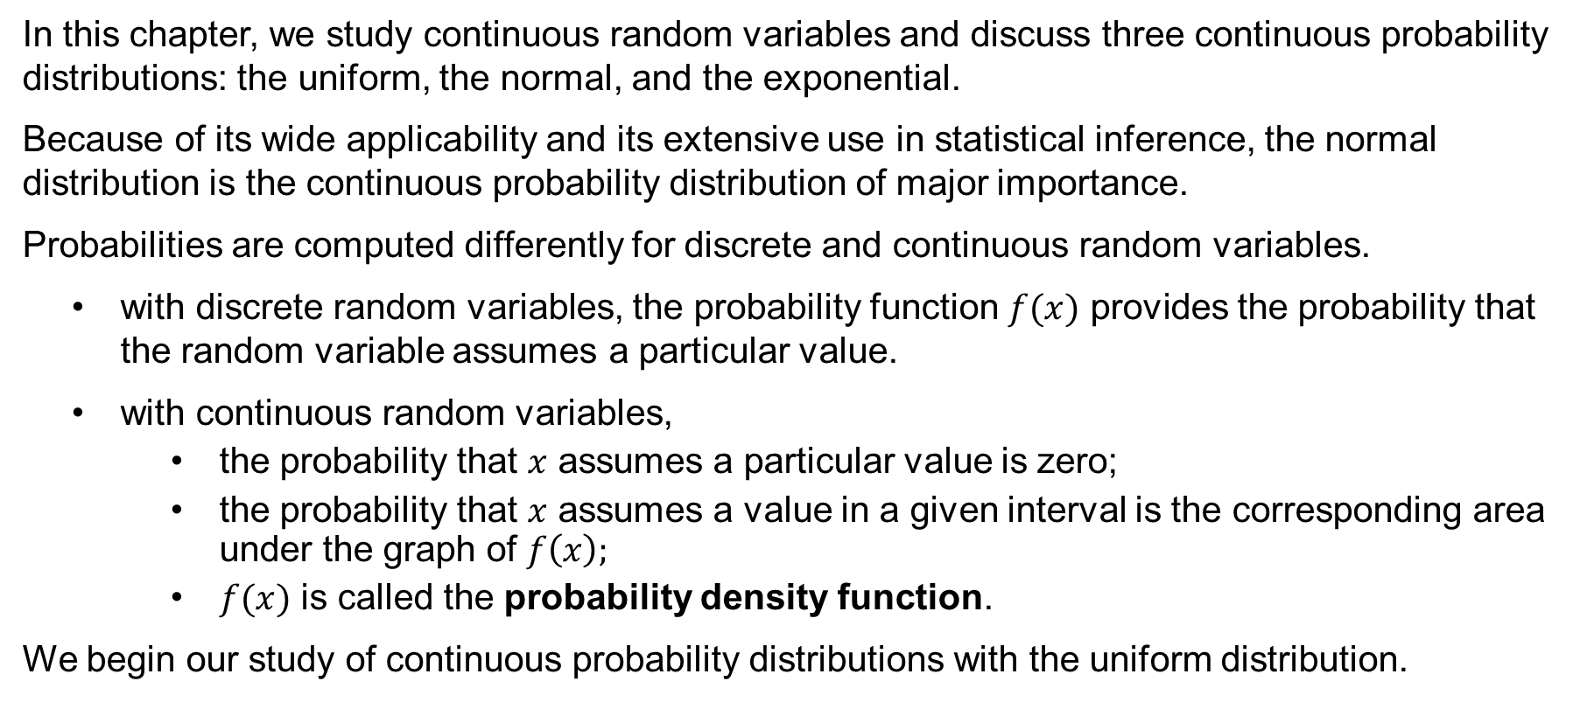
Introduction
In this chapter, we study continuous random variables and discuss three continuous probability distributions: the uniform, the normal, and the exponential.
Because of its wide applica­bility and its extensive use in statistical inference, the normal distribution is the continuous probability distribution of major importance.
Probabilities are computed differently for discrete and continuous random variables.
with discrete random variables, the probability function $f(x)$ provides the probability that the random variable assumes a particular value.
with continuous random variables,
the probability that $x$ assumes a particular value is zero;
the probability that $x$ assumes a value in a given interval is the corresponding area under the graph of $f\left(x\right);$
$f(x)$ is called the probability density function.
We begin our study of continuous probability distributions with the uniform distribution.

Slide 6
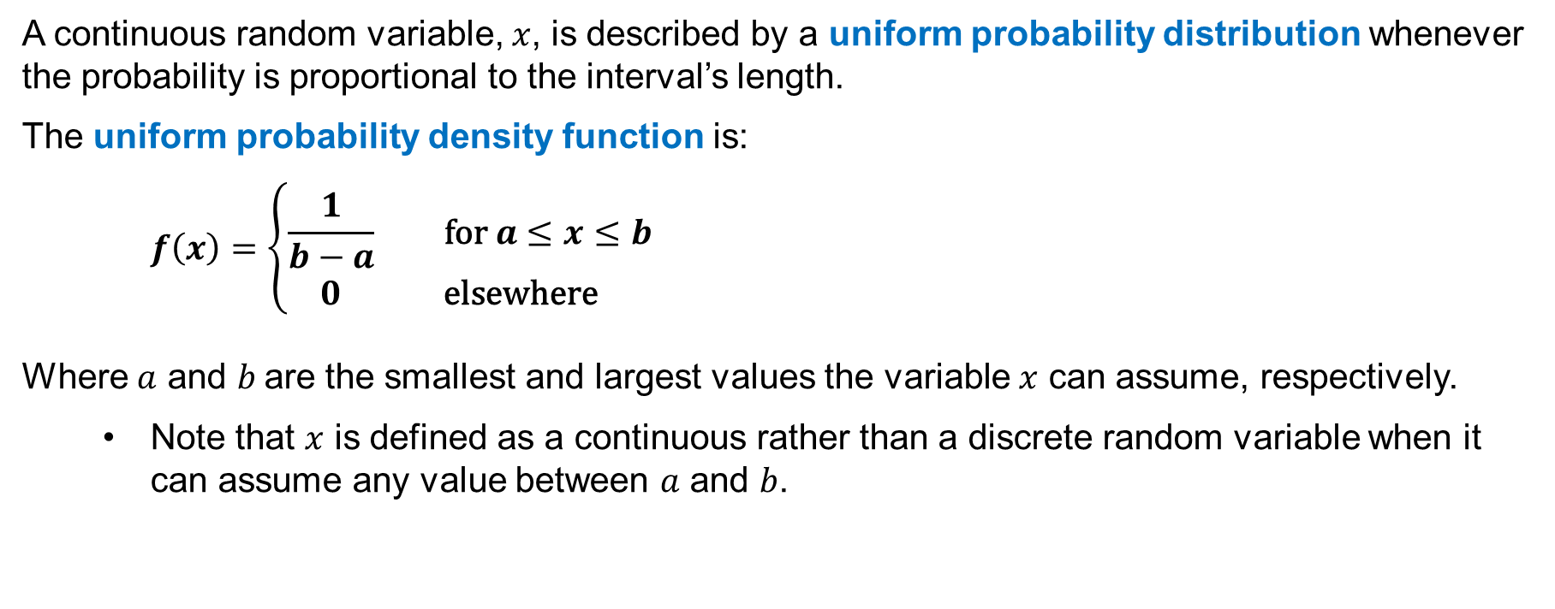
6.1 Uniform Probability Distribution
A continuous random variable, $x$, is described by a uniform probability distribution whenever the probability is proportional to the interval’s length.
The uniform probability density function is:
$$f\left(x\right)=\left\{\begin{aligned}\frac{1}{b−a} \text{for} a≤x≤b \\ 0 \text{elsewhere} \end{aligned}\right.$$
Where $a$ and $b$are the smallest and largest values the variable $x$ can assume, respectively.
Note that $x$ is defined as a continuous rather than a discrete random variable when it can assume any value between $a$ and $b$.

Slide 7
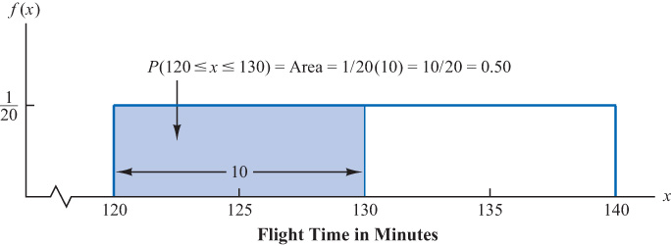
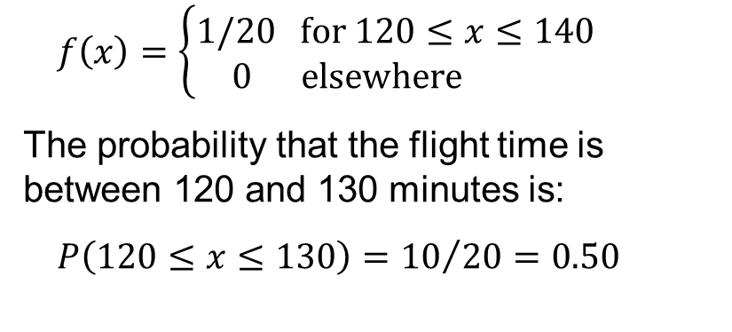
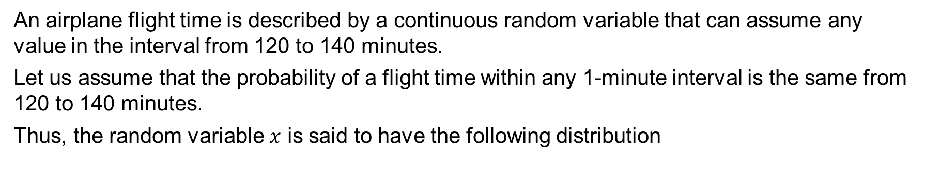
6.1 Area as a Measure of Probability
An airplane flight time is described by a continuous random variable that can assume any value in the interval from 120 to 140 minutes.
Let us assume that the probability of a flight time within any 1­-minute in­terval is the same from 120 to 140 minutes.
Thus, the random variable $x$ is said to have the following distribution
$$f\left(x\right)=\left\{\begin{aligned}1/20 \text{for} 120≤x≤140 \\ 0 \text{elsewhere} \end{aligned}\right.$$
The probability that the flight time is between 120 and 130 minutes is:
$$P\left(120≤x≤130\right)={10}/{20}=0.50$$

Slide 8
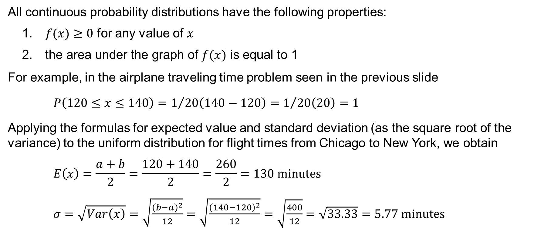
6.1 Properties of a Uniform Probability Distribution
All continuous probability distributions have the following properties:
$f(x)≥0$ for any value of $x$
the area under the graph of $f(x)$ is equal to 1
For example, in the airplane traveling time problem seen in the previous slide
$P\left(120≤x≤140\right)=1/{20\left(140−120\right)}=1/{20\left(20\right)}=1$
Applying the formulas for expected value and standard deviation (as the square root of the variance) to the uniform distribution for flight times from Chicago to New York, we obtain
$$E\left(x\right)=\frac{a+b}{2}=\frac{120+140}{2}=\frac{260}{2}=130 \text{minutes}$$
$σ=\sqrt{Var\left(x\right)}=\sqrt{\frac{{\left(b−a\right)}^{2}}{12}}=\sqrt{\frac{{\left(140−120\right)}^{2}}{12}}=\sqrt{\frac{400}{12}}=\sqrt{33.33}=5.77 \text{minutes}$

Slide 9
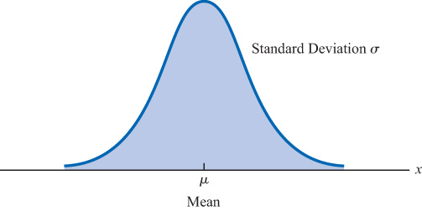
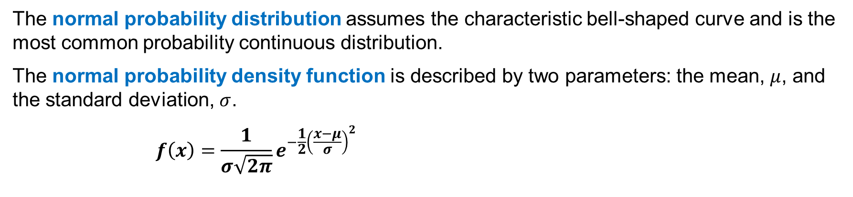
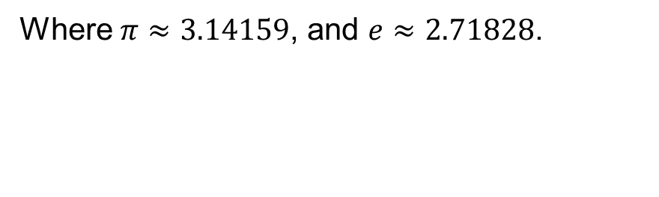
6.2 Normal Probability Distribution
The normal probability distribution assumes the characteristic bell-shaped curve and is the most common probability continuous distribution.
The normal probability density function is described by two parameters: the mean, $μ$, and the standard deviation, $σ$.
$$f\left(x\right)=\frac{1}{σ\sqrt{2π}}e^{−\frac{1}{2}{\left(\frac{x−μ}{σ}\right)}^{2}}$$
Where $π≈3.14159$, and $e≈2.71828$.
Notes:
*Note: Abraham de Moivre, a French mathematician, derived the normal distribution and published the results in The Doctrine of Chances, 1733..

Slide 10
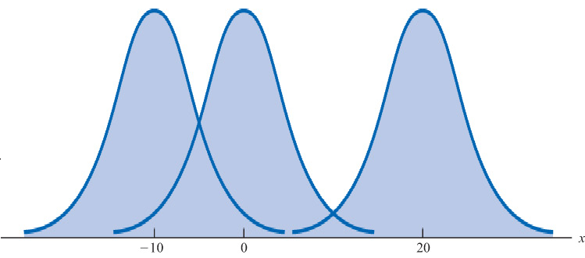
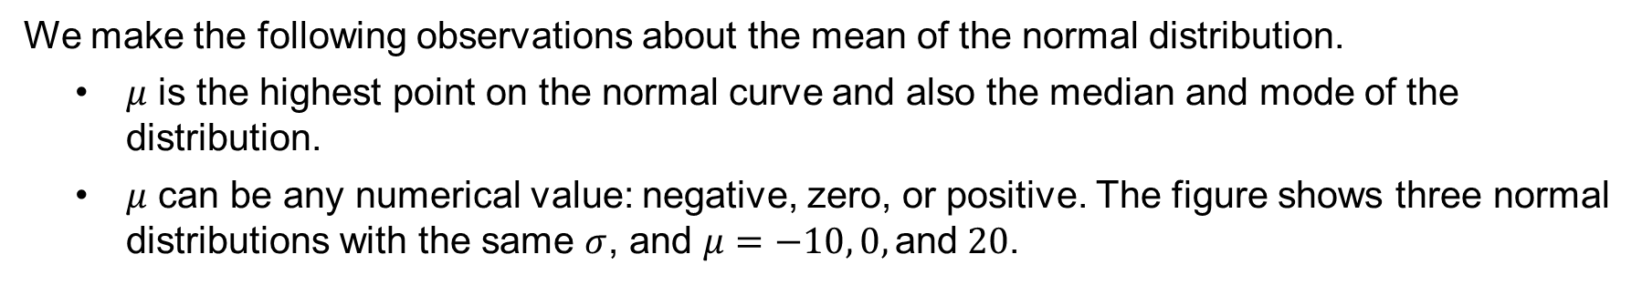
6.2 The Mean of the Normal Distribution
We make the following observations about the mean of the normal distribution.
$μ$ is the highest point on the normal curve and also the median and mode of the distribution.
$μ$ can be any numerical value: negative, zero, or posi­tive. The figure shows three normal distributions with the same $σ$, and $μ=−10, 0, \text{and} 20$.
The normal curve is symmetric, with both areas to the left and to the right of the mean equal to 0.5.
The tails of the normal curve extend indefinitely in both directions, and theoret­ically never touch the horizontal axis.

Slide 11
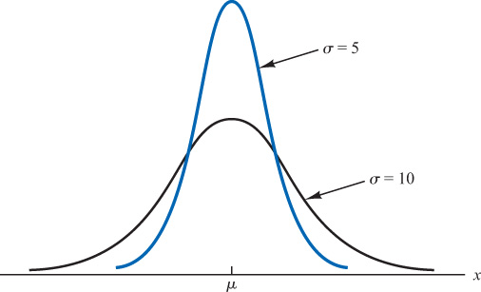
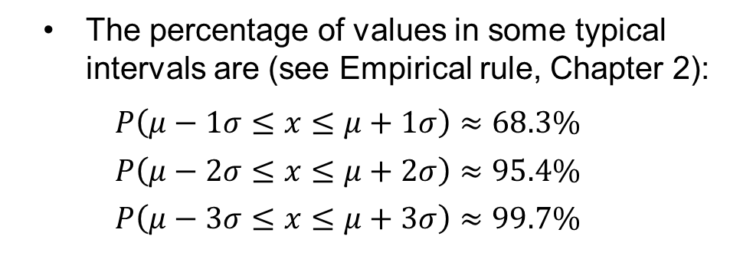
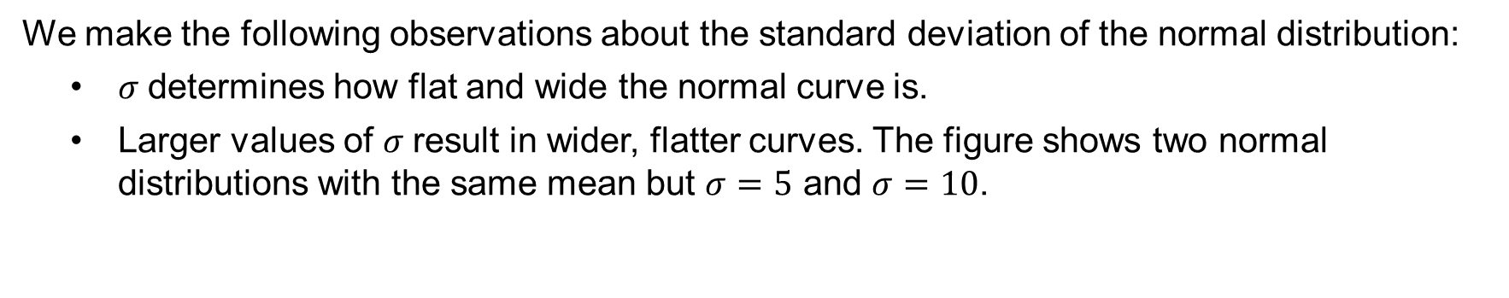
6.2 The Spread of the Normal Distribution
We make the following observations about the standard deviation of the normal distribution:
$σ$determines how flat and wide the normal curve is.
Larger values of $σ$result in wider, flatter curves. The figure shows two normal distributions with the same mean but $σ=5$ and $σ=10$.
The percentage of values in some typical intervals are (see Empirical rule, Chapter 2):
$$P\left(μ−1σ≤x≤μ+1σ\right)≈68.3\%$$
$$P\left(μ−2σ≤x≤μ+2σ\right)≈95.4\%$$
$$P\left(μ−3σ≤x≤μ+3σ\right)≈99.7\%$$

Slide 12
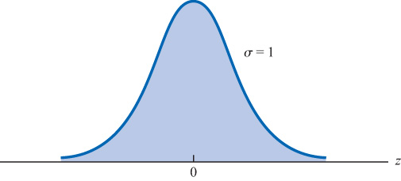
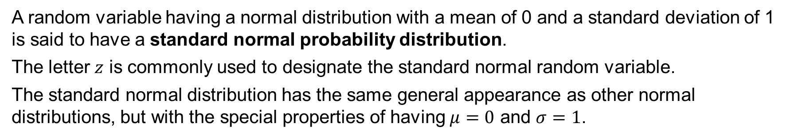
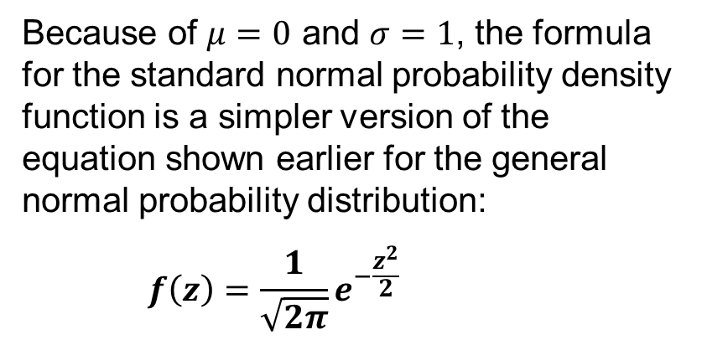
6.2 Standard Normal Probability Distribution
A random variable having a normal distribution with a mean of 0 and a standard deviation of 1 is said to have a standard normal probability distribution.
The letter $z$ is commonly used to designate the standard normal random variable.
The standard normal distribution has the same general appearance as other normal distributions, but with the special properties of having $μ=0$ and $σ=1$.
Because of $μ=0$ and $σ=1$, the formula for the standard normal probability density function is a simpler version of the equation shown earlier for the general normal probability distribution:
$$f\left(z\right)=\frac{1}{\sqrt{2π}}e^{−\frac{z^{2}}{2}}$$

Slide 13
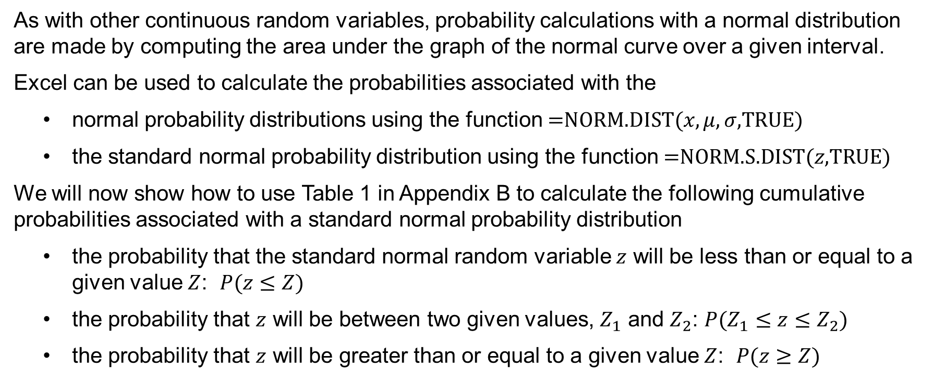
6.2 Probability Calculations with the Normal Distribution
As with other continuous random variables, probability calculations with a nor­mal distribution are made by computing the area under the graph of the normal curve over a given interval.
Excel can be used to calculate the probabilities associated with the
normal probability distributions using the function $\text{=}\text{NORM}\text{.}\text{DIST}\text{(}x,μ,σ\text{,}\text{TRUE}\text{)}$
the standard normal probabil­ity distribution using the function $\text{=}\text{NORM}\text{.}\text{S}\text{.}\text{DIST}\text{(}z\text{,}\text{TRUE}\text{)}$
We will now show how to use Table 1 in Appendix B to calculate the following cumulative probabilities associated with a stan­dard normal probability distribution
the probability that the standard normal random variable $z$ will be less than or equal to a given value $Z$: $P(z≤Z)$
the probability that $z$ will be between two given values, $Z_{1}$ and $Z_{2}$: $P(Z_{1}≤z≤Z_{2})$
the probability that $z$ will be greater than or equal to a given value $Z$: $P(z≥Z)$

Slide 14
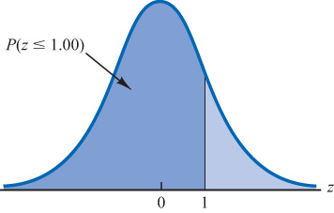
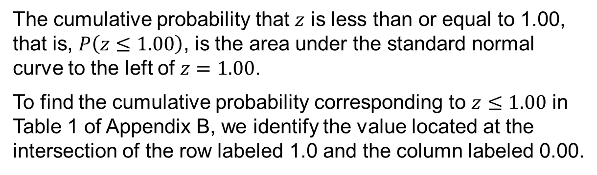
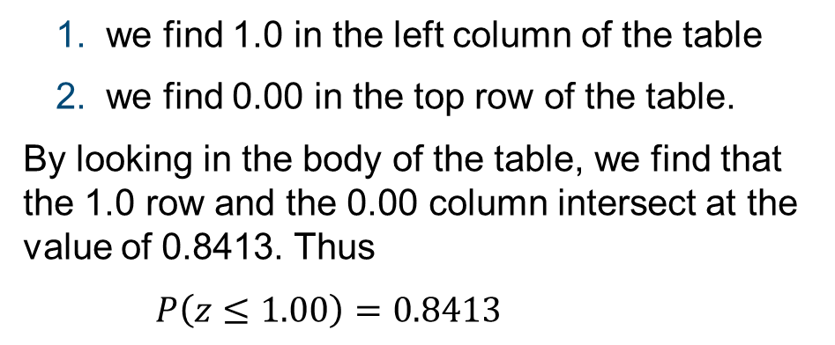
6.2 Cumulative Probability for $P(z≤1.00)$
The cumulative probability that $z$ is less than or equal to 1.00, that is, $P\left(z≤1.00\right)$, is the area under the standard normal curve to the left of $z=1.00$.
To find the cumulative probability correspond­ing to $z≤1.00$ in Table 1 of Appendix B, we identify the value located at the intersection of the row labeled 1.0 and the column labeled 0.00.
we find 1.0 in the left column of the table
we find 0.00 in the top row of the table.
By looking in the body of the table, we find that the 1.0 row and the 0.00 column intersect at the value of 0.8413. Thus
$P\left(z≤1.00\right)=0.8413$
z | 0.00 | 0.01 | 0.02 | … | 0.09
⋮ | ⋮ | ⋮ | ⋮ |  | ⋮
0.9 | 0.8159 | 0.8186 | 0.8212 | … | 0.8389
1.0 | 0.8413 | 0.8438 | 0.8461 | … | 0.8621
1.1 | 0.8643 | 0.8665 | 0.8686 | … | 0.8830
⋮ | ⋮ | ⋮ | ⋮ |  | ⋮

Slide 15
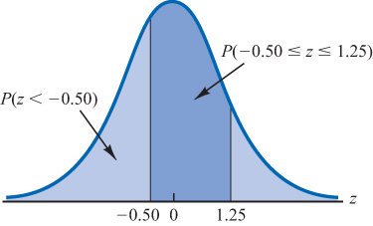
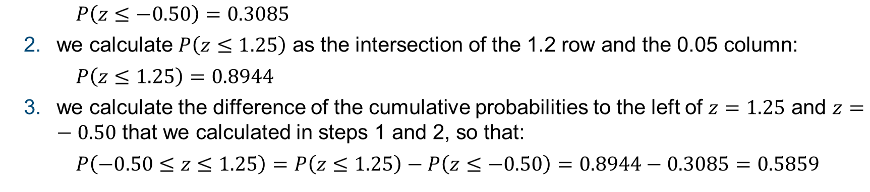
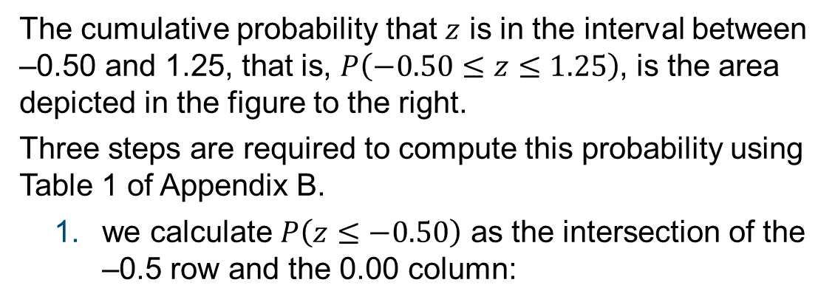
6.2 Cumulative Probability for $P(−0.50≤z≤1.25)$
The cumulative probability that $z$ is in the interval between –0.50 and 1.25, that is, $P\left(−0.50≤z≤1.25\right)$, is the area depicted in the figure to the right.
Three steps are required to compute this probability using Table 1 of Appendix B.
we calculate $P\left(z≤−0.50\right)$ as the intersection of the –0.5 row and the 0.00 column:
$P\left(z≤−0.50\right)=0.3085$
we calculate $P\left(z≤1.25\right)$ as the intersection of the 1.2 row and the 0.05 column:
$P\left(z≤1.25\right)=0.8944$
we calculate the difference of the cumulative probabilities to the left of $z=1.25$ and $z=−0.50$ that we calculated in steps 1 and 2, so that:
$$P\left(−0.50≤z≤1.25\right)=P\left(z≤1.25\right)−P\left(z≤−0.50\right)=0.8944−0.3085=0.5859$$

Slide 16
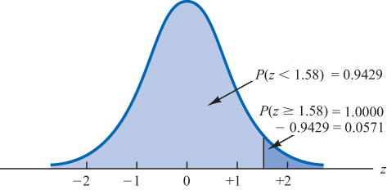
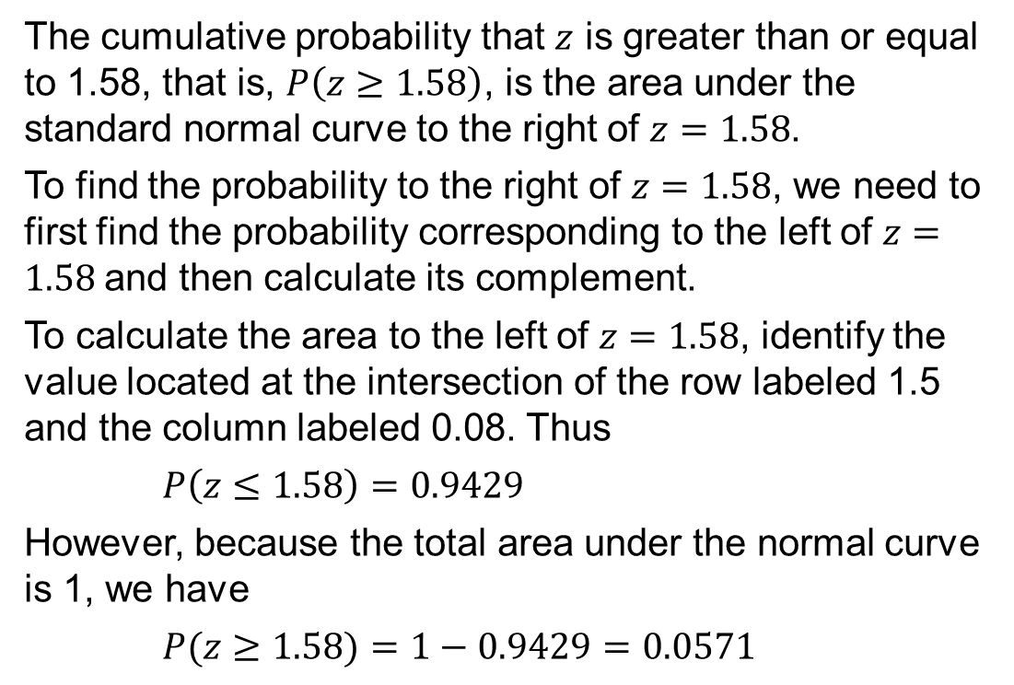
6.2 Cumulative Probability for $P(z≥1.58)$
The cumulative probability that $z$ is greater than or equal to 1.58, that is, $P\left(z≥1.58\right)$, is the area under the standard normal curve to the right of $z=1.58$.
To find the probability to the right of $z=1.58$, we need to first find the probability corresponding to the left of $z=1.58$and then calculate its complement.
To calculate the area to the left of $z=1.58$, identify the value located at the intersection of the row labeled 1.5 and the column labeled 0.08. Thus
$P\left(z≤1.58\right)=0.9429$
However, because the total area under the normal curve is 1, we have
$P(z≥1.58)=1−0.9429=0.0571$
z | 0.00 | 0.01 | … | 0.08 | 0.09
⋮ | ⋮ | ⋮ |  | ⋮ | ⋮
1.4 | 0.9192 | 0.9207 | … | 0.9306 | 0.9319
1.5 | 0.9332 | 0.9345 | … | 0.9429 | 0.9441
1.6 | 0.9452 | 0.9463 | … | 0.9535 | 0.9545
⋮ | ⋮ | ⋮ |  | ⋮ | ⋮

Slide 17
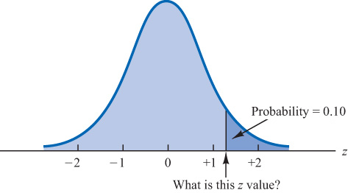
6.2 Find Z Such That $P\left(z≥z^{∗}\right)=0.10$
We want to find a $z^{∗}$ value such that the probability of obtaining a larger $z$ value is 0.10. That is
$P\left(z≥z^{∗}\right)=0.10$
In this inverse problem, we need to find the $z$ value that corresponds to a given probability.
However, the standard normal probability table gives the area under the curve to the left of a particular $z$ value.
Thus, we use again the complement rule to find a $z^{∗}$ value such that
$P\left(z≤z^{∗}\right)=1−P\left(z≥z^{∗}\right)=1−0.10=0.90$
Table 1 of Appendix B shows the closest probability to 0.9000 to be 0.8997, corresponding to the 1.2 row and the 0.08 column. That is, $z^{∗}=1.28$ (*see notes.)
z | 0.00 | 0.01 | … | 0.08 | 0.09
⋮ | ⋮ | ⋮ |  | ⋮ | ⋮
1.1 | 0.8643 | 0.8665 | … | 0.8810 | 0.8830
1.2 | 0.8849 | 0.8869 | … | 0.8997 | 0.9015
1.3 | 0.9032 | 0.9049 | … | 0.9162 | 0.9177
⋮ | ⋮ | ⋮ |  | ⋮ | ⋮
Notes:
*Note: we could use interpolation in the body of the table to get a better approximation of the $z^{∗}$ value that corresponds to an area of 0.9000. Doing so to provide one more decimal place of accuracy would yield a z value of 1.282. Alternatively, we can also use Excel: =NORM.S.INV(0.90)=1.281552.
However, in most practical situations, sufficient accuracy is obtained by simply using the table value closest to the desired probability.

Slide 18
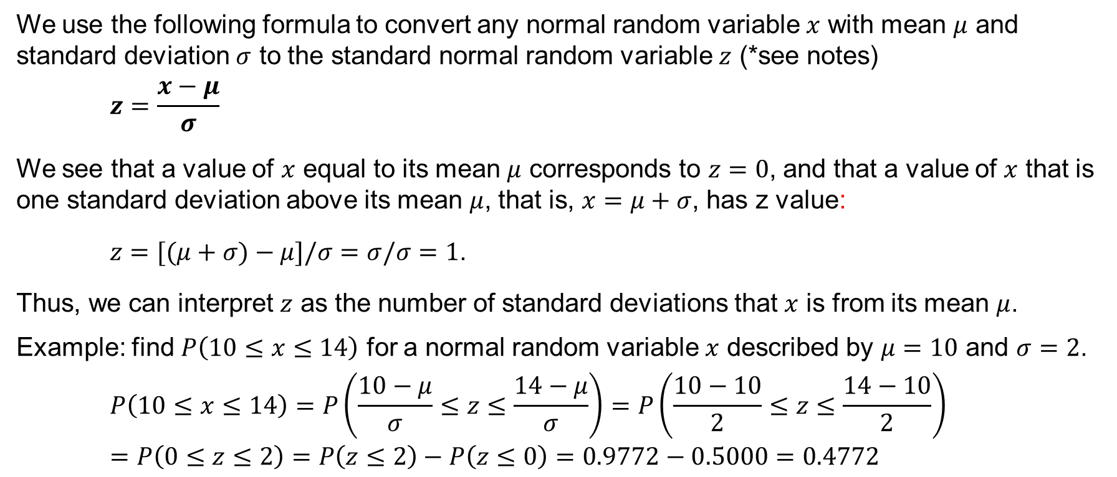
6.2 Computing Probabilities for Any Normal Curve
We use the following formula to convert any normal random variable $x$ with mean $μ$ and standard deviation $σ$ to the standard normal random variable $z$ (*see notes)
$$z=\frac{x−μ}{σ}$$
We see that a value of $x$ equal to its mean $μ$ corresponds to $z=0$, and that a value of $x$ that is one standard deviation above its mean $μ$, that is, $x=μ+σ$, has z value:
$z=[(μ+σ)−μ]/σ=σ/σ=1$.
Thus, we can interpret $z$ as the number of standard deviations that $x$ is from its mean $μ$.
Example: find $P\left(10≤x≤14\right)$ for a normal random variable $x$ described by $μ=10$ and $σ=2$.
$$P\left(10≤x≤14\right)=P\left(\frac{10−μ}{σ}≤z≤\frac{14−μ}{σ}\right)=P\left(\frac{10−10}{2}≤z≤\frac{14−10}{2}\right)=P\left(0≤z≤2\right)=P\left(z≤2\right)−P\left(z≤0\right)=0.9772−0.5000=0.4772$$
Notes:
*Note: the formula for the standard normal random variable is similar to the formula we introduced in Chapter 3 for computing z-scores for a data set.

Slide 19
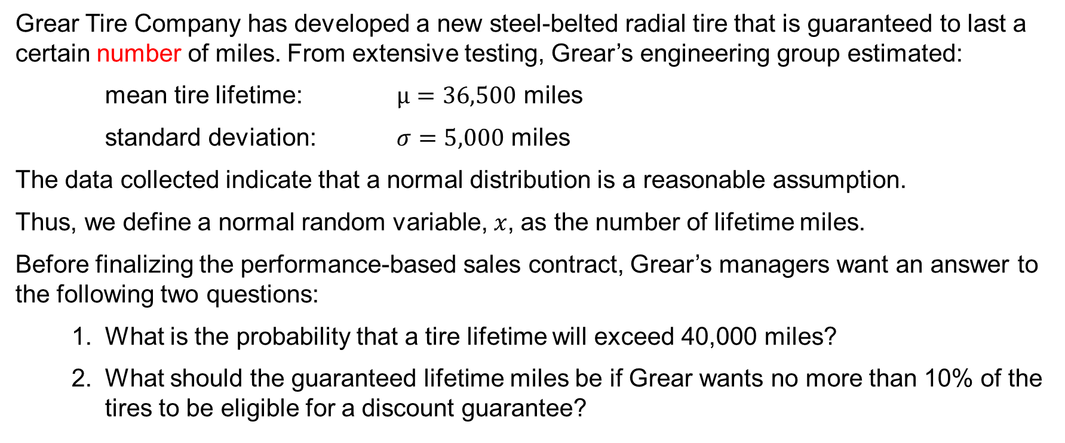
6.2 Grear Tire Company Problem
Grear Tire Company has developed a new steel-belted radial tire that is guaranteed to last a certain number of miles. From extensive testing, Grear’s engineering group estimated:
mean tire lifetime: $μ=36,500$ miles
standard deviation: $σ=5,000$ miles
The data collected indicate that a normal distribution is a reasonable assumption.
Thus, we define a normal random variable, $x$, as the number of lifetime miles.
Before finalizing the performance-based sales contract, Grear’s managers want an answer to the following two questions:
What is the probability that a tire lifetime will exceed 40,000 miles?
What should the guaranteed lifetime miles be if Grear wants no more than 10% of the tires to be eligible for a discount guarantee?

Slide 20
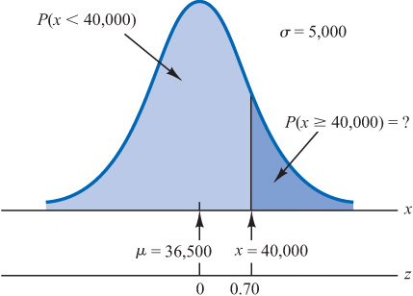
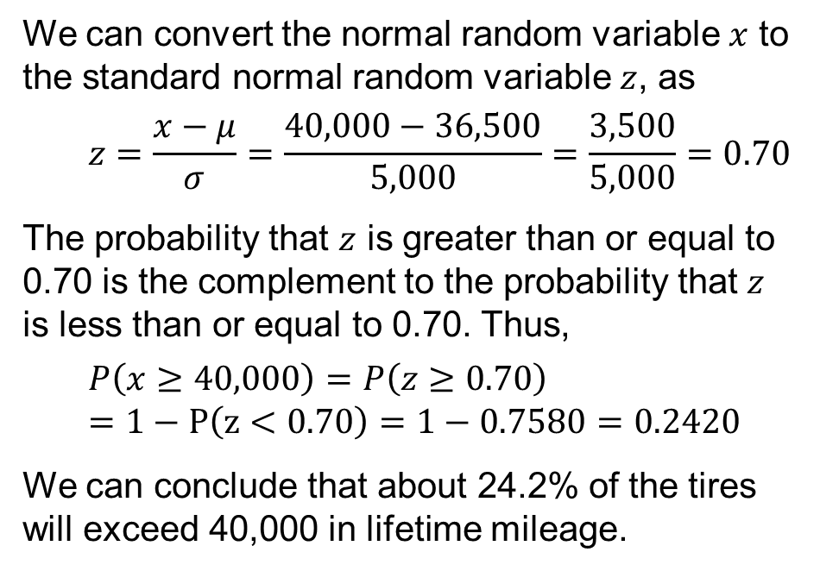
6.2 Probability Lifetime Exceeds 40,000 Miles
As depicted by the darker area in the figure, we need to find $P\left(x≥40,000\right)$.
We can convert the normal random variable $x$ to the standard normal random variable $z$, as
$$z=\frac{x−μ}{σ}=\frac{40,000−36,500}{5,000}=\frac{3,500}{5,000}=0.70$$
The probability that $z$ is greater than or equal to 0.70 is the complement to the probability that $z$ is less than or equal to 0.70. Thus,
$$P\left(x≥40,000\right)=P\left(z≥0.70\right)=1−P\left(z<0.70\right)=1−0.7580=0.2420$$
We can conclude that about 24.2% of the tires will exceed 40,000 in lifetime mileage.

Slide 21
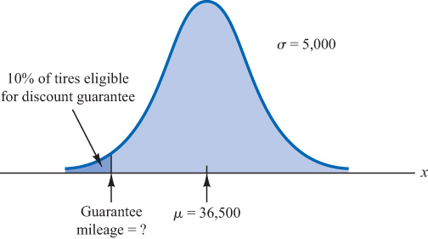
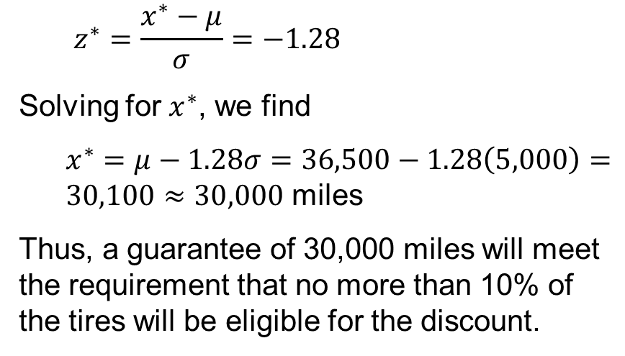
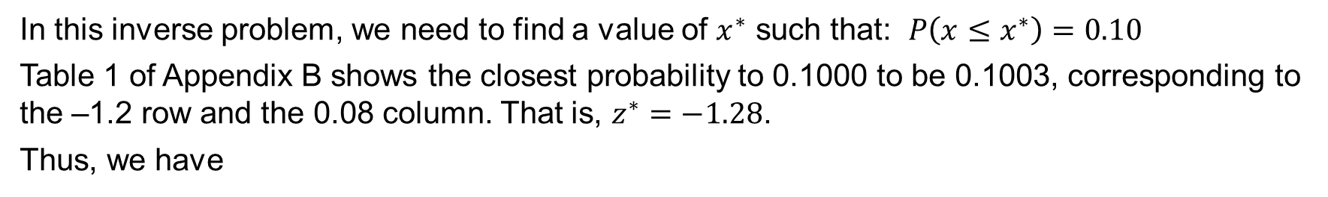
6.2 Great Tire Guaranteed Mileage
In this inverse problem, we need to find a value of $x^{∗}$ such that: $P\left(x≤x^{∗}\right)=0.10$
Table 1 of Appendix B shows the closest probability to 0.1000 to be 0.1003, corresponding to the –1.2 row and the 0.08 column. That is, $z^{∗}=−1.28$.
Thus, we have
$$z^{∗}=\frac{x^{∗}−μ}{σ}=−1.28$$
Solving for $x^{∗}$, we find
$x^{∗}=μ−1.28σ=36,500−1.28\left(5,000\right)=30,100≈30,000$ miles
Thus, a guarantee of 30,000 miles will meet the requirement that no more than 10% of the tires will be eligible for the discount.

Slide 22
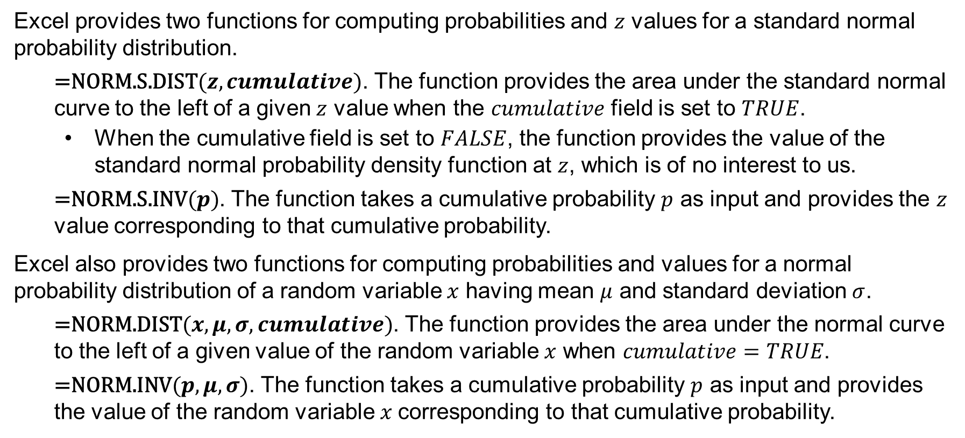
6.2 Excel’s Normal Probability Functions
Excel provides two functions for computing probabilities and $z$ values for a standard normal probability distribution.
$\text{=}\text{NORM}\text{.}\text{S}\text{.}\text{DIST}(z,cumulative)$. The function provides the area under the standard normal curve to the left of a given $z$ value when the $cumulative$ field is set to $TRUE$.
When the cumulative field is set to $FALSE$, the function provides the value of the standard normal probability density function at $z$, which is of no interest to us.
$\text{=}\text{NORM}\text{.}\text{S}\text{.}\text{INV}(p)$. The function takes a cumulative probability $p$ as input and provides the $z$ value corresponding to that cumulative probability.
Excel also provides two functions for computing probabilities and values for a normal probability distribution of a random variable $x$ having mean $μ$ and standard deviation $σ$.
$\text{=}\text{NORM}\text{.}\text{DIST}(x,μ,σ,cumulative)$. The function provides the area under the normal curve to the left of a given value of the random variable $x$ when $cumulative=TRUE$.
$\text{=}\text{NORM}\text{.}\text{INV}(p,μ,σ)$. The function takes a cumulative probability $p$ as input and provides the value of the random variable $x$corresponding to that cumulative probability.

Slide 23
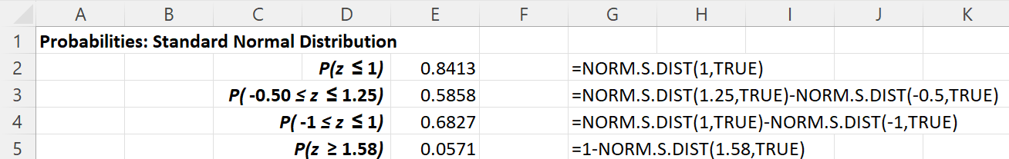
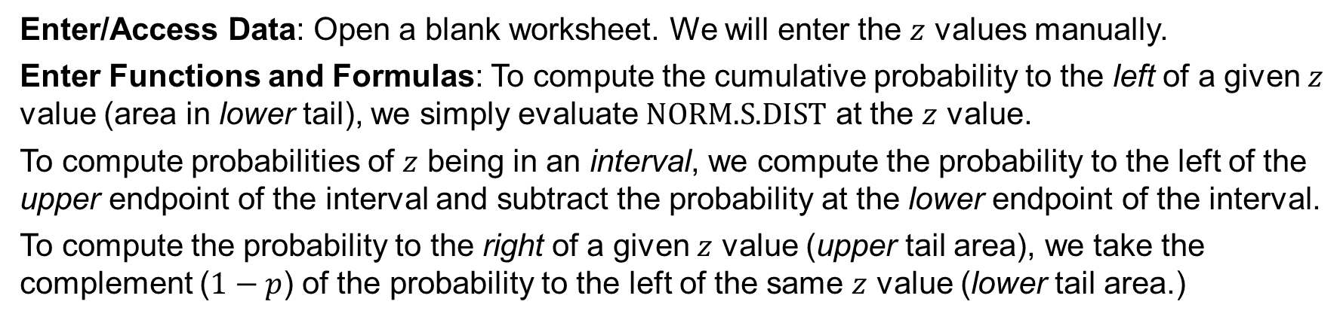
6.2 Excel: Computing Probabilities for the Standard Normal Distribution
Enter/Access Data: Open a blank worksheet. We will enter the $z$ values manually.
Enter Functions and Formulas: To compute the cumulative probability to the left of a given $z$ value (area in lower tail), we simply evaluate $\text{NORM}\text{.}\text{S}\text{.}\text{DIST}$ at the $z$ value.
To compute probabilities of $z$ being in an interval, we compute the probability to the left of the upper endpoint of the interval and subtract the probability at the lower endpoint of the interval.
To compute the probability to the right of a given $z$ value (upper tail area), we take the complement ($1−p$) of the probability to the left of the same $z$ value (lower tail area.)

Slide 24
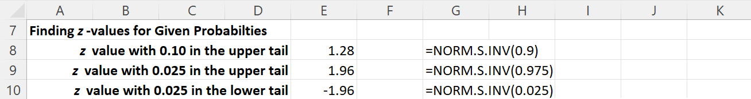
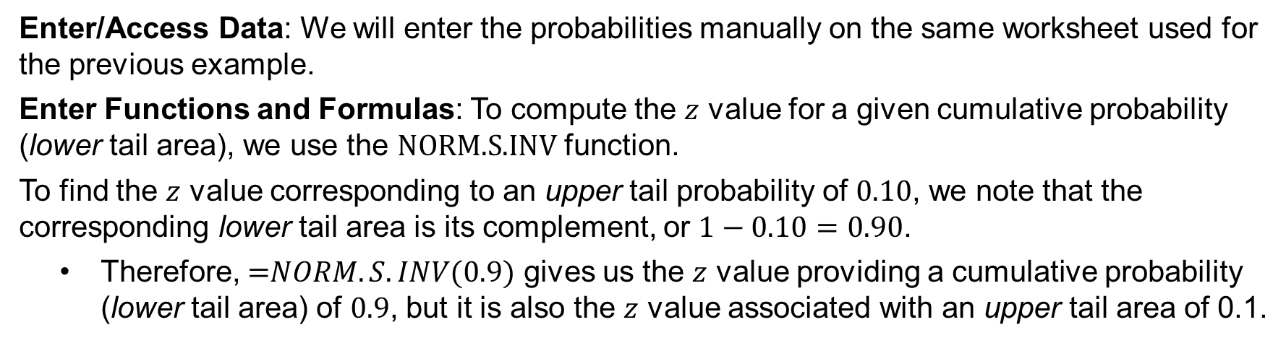

6.2 Excel: Computing $z$ Values for the Standard Normal Distribution
Enter/Access Data: We will enter the probabilities manually on the same worksheet used for the previous example.
Enter Functions and Formulas: To compute the $z$ value for a given cumulative probability (lower tail area), we use the $\text{NORM}\text{.}\text{S}\text{.}\text{INV}$ function.
To find the $z$ value corresponding to an upper tail probability of $0.10$, we note that the corresponding lower tail area is its complement, or $1−0.10=0.90$.
Therefore, $\text{=}NORM.S.INV(0.9)$ gives us the $z$ value providing a cumulative probability (lower tail area) of $0.9$, but it is also the $z$ value associated with an upper tail area of 0.1.

Slide 25
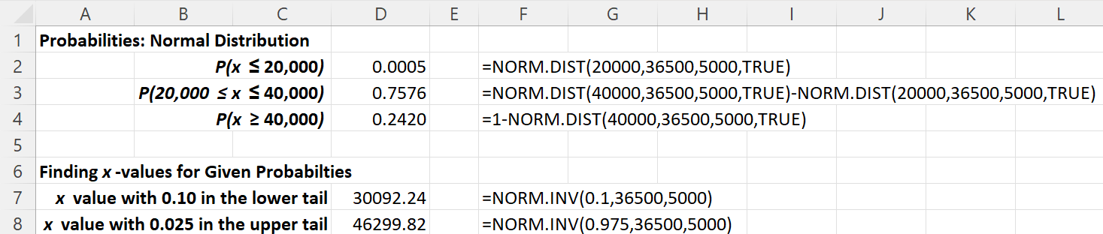
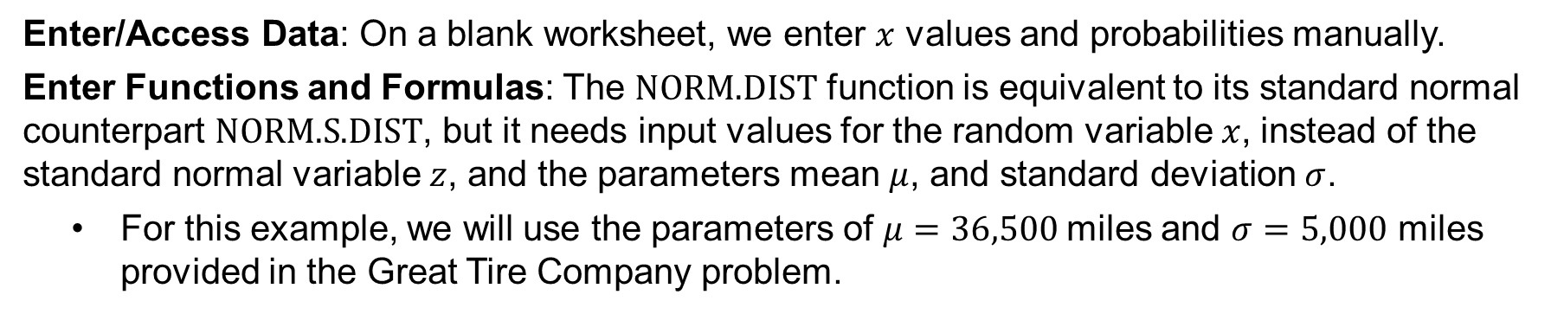

6.2 Excel: Computing Probabilities and $x$ Values for the Normal Distribution
Enter/Access Data: On a blank worksheet, we enter $x$ values and probabilities manually.
Enter Functions and Formulas: The $\text{NORM}\text{.}\text{DIST}$ function is equivalent to its standard normal counterpart $\text{NORM}\text{.}\text{S}\text{.}\text{DIST}$, but it needs input values for the random variable $x$, instead of the standard normal variable $z$, and the parameters mean $μ$, and standard deviation $σ$.
For this example, we will use the parameters of $μ=36,500$miles and $σ=5,000$ miles provided in the Great Tire Company problem.

Slide 26
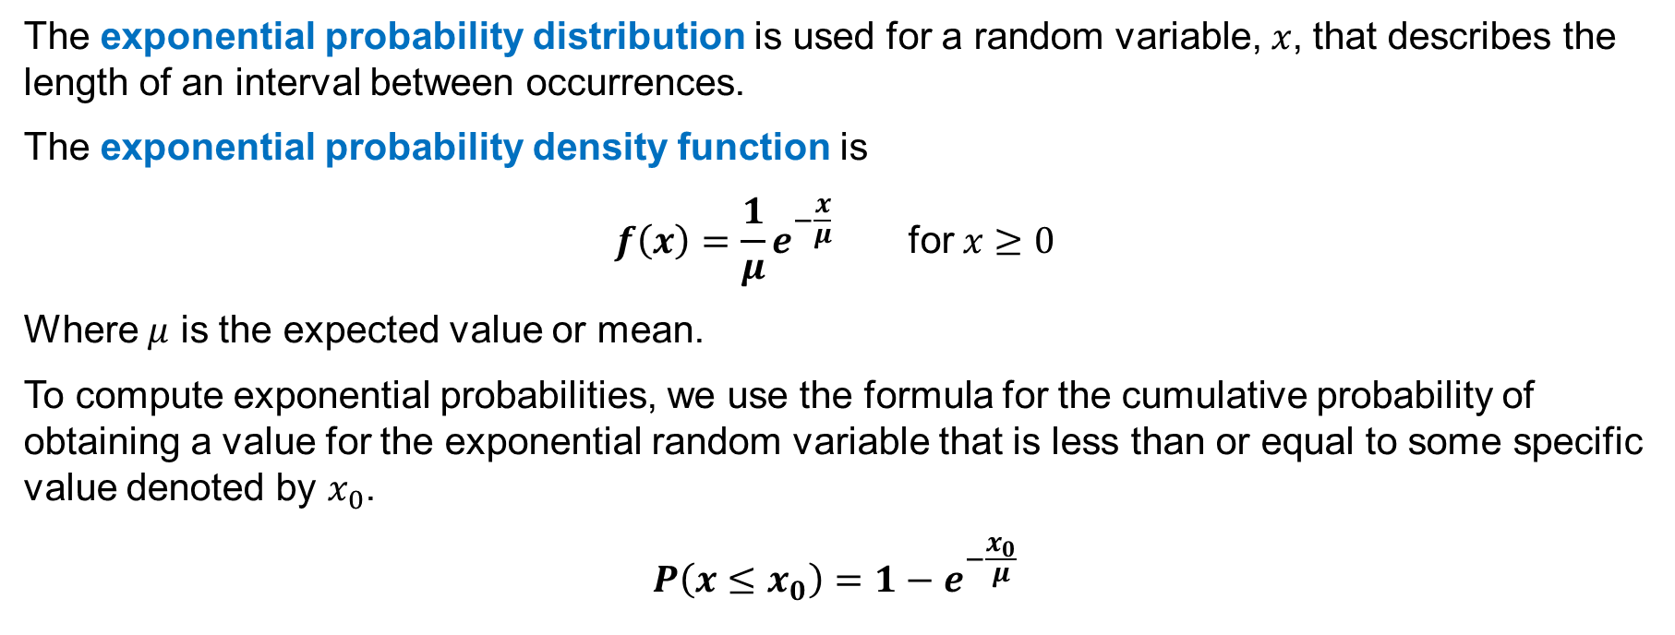
6.3 Exponential Probability Distribution
The exponential probability distribution is used for a random variable, $x$, that describes the length of an interval between occurrences.
The exponential probability density function is
$$f\left(x\right)=\frac{1}{μ}e^{−\frac{x}{μ}} \text{for} x≥0$$
Where $μ$ is the expected value or mean.
To compute exponential probabilities, we use the formula for the cumulative probability of obtaining a value for the exponential random variable that is less than or equal to some specific value denoted by $x_{0}$.
$$P\left(x≤x_{0}\right)=1−e^{−\frac{x_{0}}{μ}}$$

Slide 27
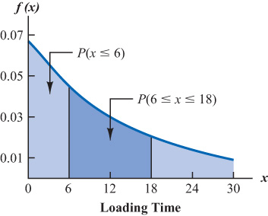
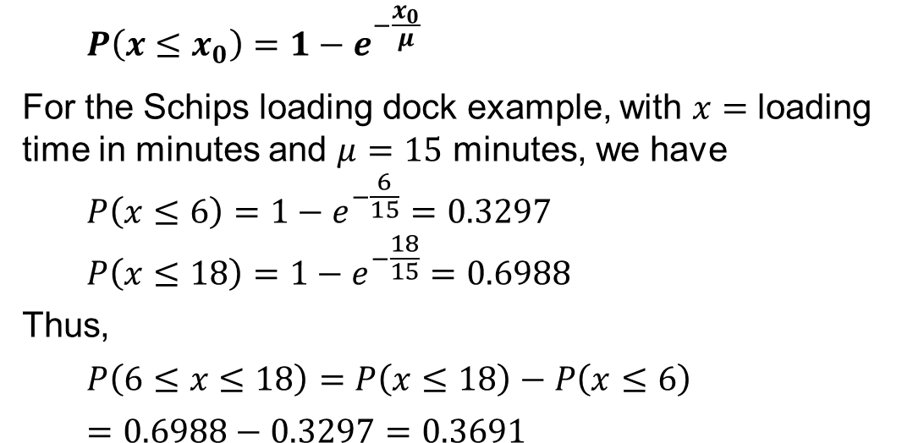

6.3 Exponential Distribution: Cumulative Probability
To compute exponential probabilities, we use the formula for the cumulative probability of obtaining a value for the exponential random variable that is less than or equal to some specific value denoted by $x_{0}$.
$$P\left(x≤x_{0}\right)=1−e^{−\frac{x_{0}}{μ}}$$
For the Schips loading dock example, with $x=$ loading time in minutes and $μ=15$ minutes, we have
$$P\left(x≤6\right)=1−e^{−\frac{6}{15}}=0.3297$$
$$P\left(x≤18\right)=1−e^{−\frac{18}{15}}=0.6988$$
Thus,
$$P\left(6≤x≤18\right)=P\left(x≤18\right)−P\left(x≤6\right)$$
$$=0.6988−0.3297=0.3691$$

Slide 28
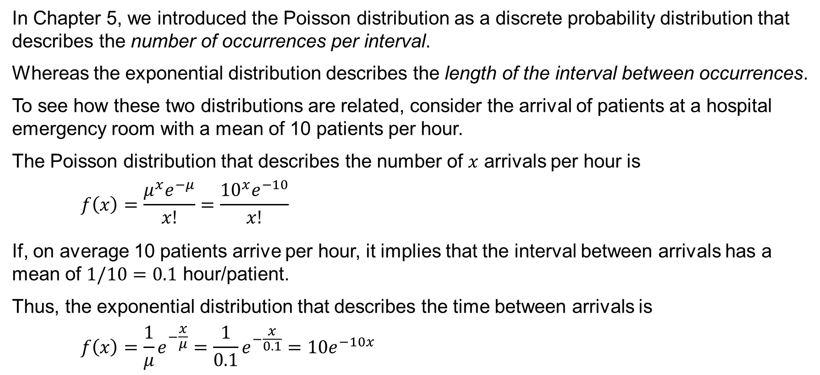
6.3 Poisson vs. Exponential Distributions
In Chapter 5, we introduced the Poisson distribution as a discrete probability distribution that describes the number of occurrences per interval.
Whereas the exponential distribution describes the length of the interval between occurrences.
To see how these two distributions are related, consider the arrival of patients at a hospital emergency room with a mean of 10 patients per hour.
The Poisson distribution that describes the number of $x$ arrivals per hour is
$$f\left(x\right)=\frac{μ^{x}e^{−μ}}{x!}=\frac{{10}^{x}e^{−10}}{x!}$$
If, on average 10 patients arrive per hour, it implies that the interval between arrivals has a mean of $1/10=0.1$ hour/patient.
Thus, the exponential distribution that describes the time between arrivals is
$$f\left(x\right)=\frac{1}{μ}e^{−\frac{x}{μ}}=\frac{1}{0.1}e^{−\frac{x}{0.1}}=10e^{−10x}$$

Slide 29
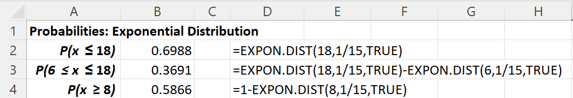
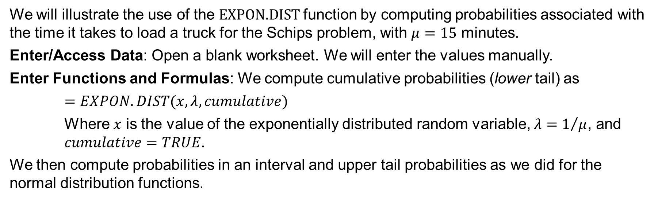
6.2 Excel: Computing Exponential Probabilities
We will illustrate the use of the $\text{EXPON}\text{.}\text{DIST}$function by computing probabilities associated with the time it takes to load a truck for the Schips problem, with $μ=15$ minutes.
Enter/Access Data: Open a blank worksheet. We will enter the values manually.
Enter Functions and Formulas: We compute cumulative probabilities (lower tail) as
$=EXPON.DIST(x, λ,cumulative)$
Where $x$ is the value of the exponentially distributed random variable, $λ=1/μ$, and $cumulative=TRUE$.
We then compute probabilities in an interval and upper tail probabilities as we did for the normal distribution functions.

Slide 30
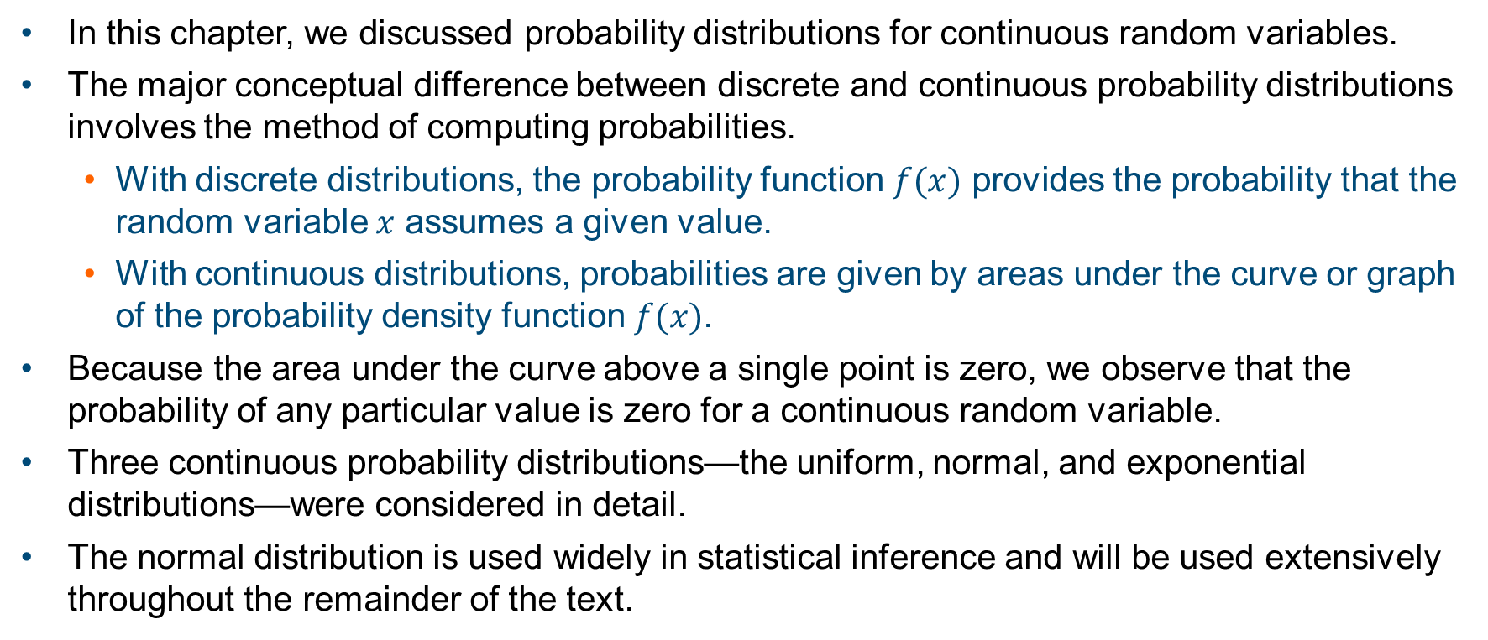
Summary
In this chapter, we discussed probability distributions for continuous random variables.
The major conceptual difference between discrete and continuous probability distributions involves the method of computing probabilities.
With discrete distributions, the probability function $f(x)$ provides the probability that the random variable $x$ assumes a given value.
With continuous distributions, probabilities are given by areas under the curve or graph of the prob­ability density function $f(x)$.
Because the area under the curve above a single point is zero, we observe that the probability of any particular value is zero for a continuous random variable.
Three continuous probability distributions—the uniform, normal, and exponential distributions—were considered in detail.
The normal distribution is used widely in statistical inference and will be used extensively throughout the remainder of the text.

