Slide 1


Slide 2
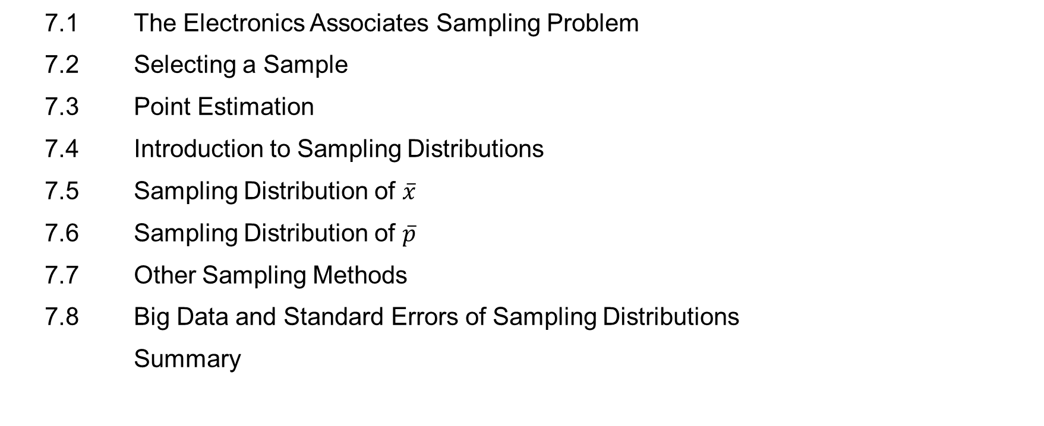
Chapter Contents
7.1 The Electronics Associates Sampling Problem
7.2 Selecting a Sample
7.3 Point Estimation
7.4 Introduction to Sampling Distributions
7.5 Sampling Distribution of $\overline{x}$
7.6 Sampling Distribution of $\overline{p}$
7.7 Other Sampling Methods
7.8 Big Data and Standard Errors of Sampling Distributions
Summary

Slide 3
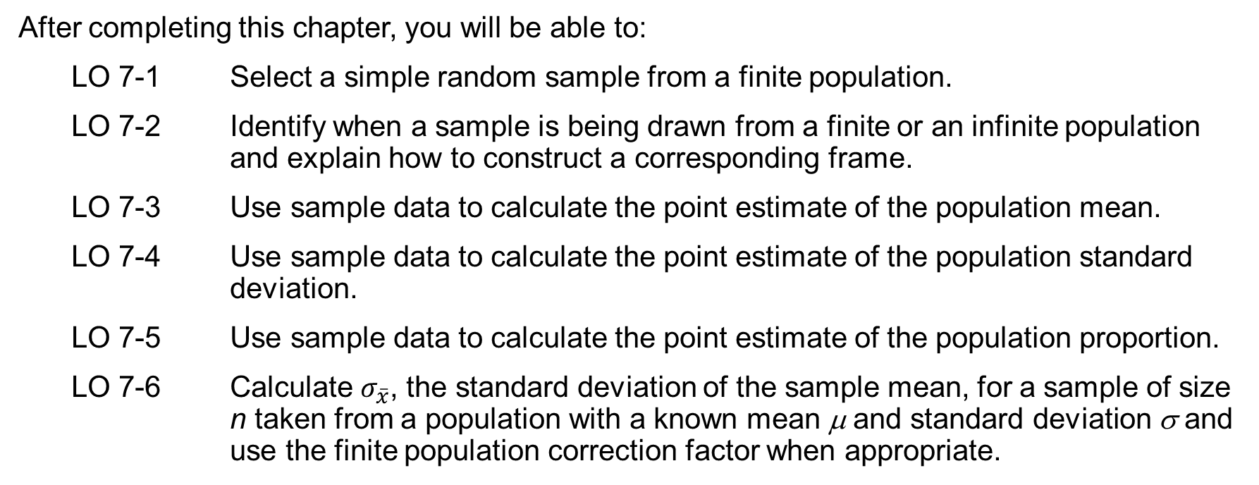
Chapter Objectives (1 of 2)
After completing this chapter, you will be able to:
LO 7-1 Select a simple random sample from a finite population.
LO 7-2 Identify when a sample is being drawn from a finite or an infinite population and explain how to construct a corresponding frame.
LO 7-3 Use sample data to calculate the point estimate of the population mean.
LO 7-4 Use sample data to calculate the point estimate of the population standard deviation.
LO 7-5 Use sample data to calculate the point estimate of the population proportion.
LO 7-6 Calculate $σ_{\overline{x}}$, the standard deviation of the sample mean, for a sample of size n taken from a population with a known mean μ and standard deviation σ and use the finite population correction factor when appropriate.

Slide 4
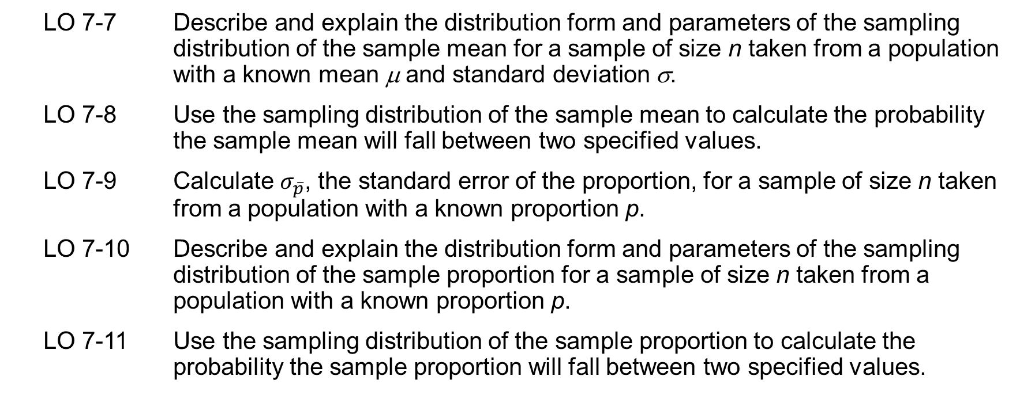
Chapter Objectives (2 of 2)
LO 7-7 Describe and explain the distribution form and parameters of the sampling distribution of the sample mean for a sample of size n taken from a population with a known mean μ and standard deviation σ.
LO 7-8 Use the sampling distribution of the sample mean to calculate the probability the sample mean will fall between two specified values.
LO 7-9 Calculate $σ_{\overline{p}}$, the standard error of the proportion, for a sample of size n taken from a population with a known proportion p.
LO 7-10 Describe and explain the distribution form and parameters of the sampling distribution of the sample proportion for a sample of size n taken from a population with a known proportion p.
LO 7-11 Use the sampling distribution of the sample proportion to calculate the probability the sample proportion will fall between two specified values.

Slide 5
Introduction
In this chapter, we show how simple random sampling is used to select a sample from either a finite population or an infinite population (a process.)
We then show how data obtained from a sample can be used to compute estimates of:
a population mean from a sample mean
a population proportion from a sample proportion
With estimates obtained from sample statistics, some estimation error is expected. This chapter provides the basis for determining how large that error might be.
In addition, we introduce the important concept of a sampling distribution, which will allow us to make statements about how close the sample estimates are to the corresponding population parameters.
The last two sections discuss some alternatives to simple random sampling that are often employed in practice and the ramifications of large samples on sampling distributions.

Slide 6
Introduction to Sampling
In Chapter 1, we presented the following definitions:
An element is the entity on which data are collected.
A population is a collection of all the elements of interest.
A sample is a subset of the population.
Sampling is the process of collecting data to answer a research question about a population.
Two important terms used in sampling are:
The sampled population is the population from which the sample is drawn.
A frame is a list of the elements that the sample will be selected from.
Because the sample contains only a portion of the population, results provide only estimates of the values of the population characteristics.
With proper sampling methods, the sample results can provide “good” estimates of the population characteristics.

Slide 7
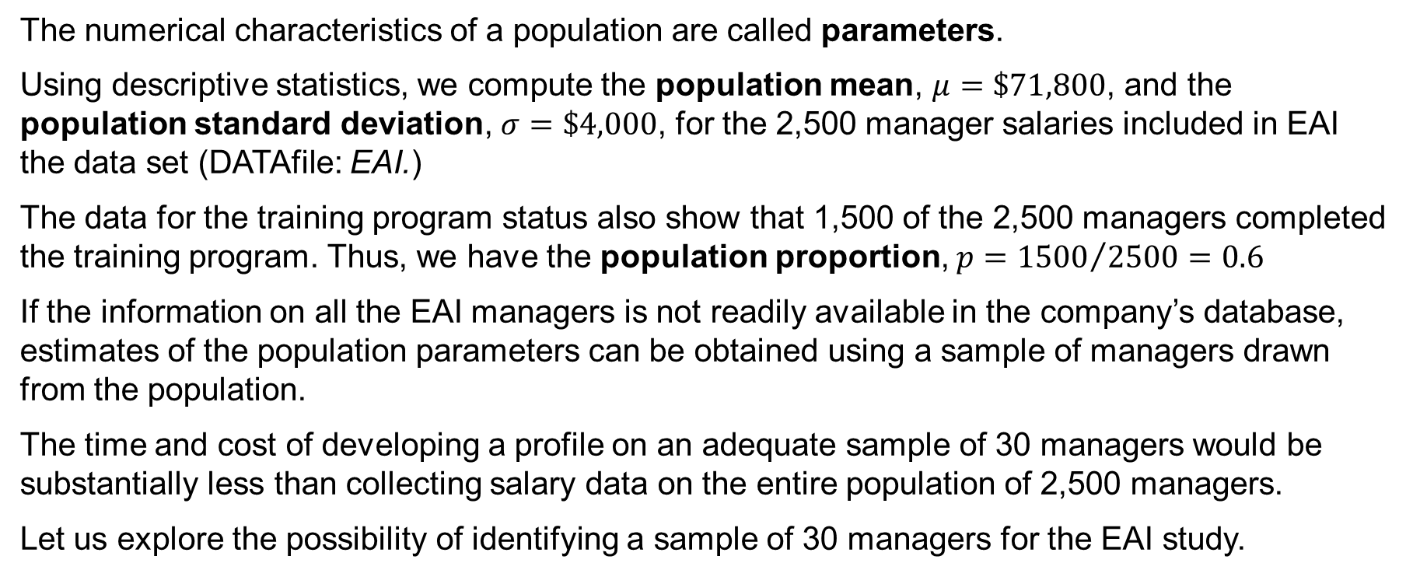
7.1 The Electronics Associates Sampling Problem
The numerical characteristics of a population are called parameters.
Using descriptive statistics, we compute the population mean, $μ=\$71,800$, and the population standard deviation, $σ=\$4,000$, for the 2,500 manager salaries included in EAI the data set (DATAfile: EAI.)
The data for the training program status also show that 1,500 of the 2,500 managers completed the training program. Thus, we have the population proportion, $p={1500}/{2500}=0.6$
If the information on all the EAI managers is not readily available in the company’s database, estimates of the population parameters can be obtained using a sample of managers drawn from the population.
The time and cost of developing a profile on an adequate sample of 30 managers would be substantially less than collecting salary data on the entire population of 2,500 managers.
Let us explore the possibility of identifying a sample of 30 managers for the EAI study.

Slide 8
7.2 Selecting a Sample
A simple random sample of size n is selected from a finite population of size N so that each possible sample of size n has the same probability of being selected.
Replacing each sampled element before selecting subsequent elements is called sampling with replacement. An element can appear in the sample more than once.
Sampling without replacement is the procedure used most often.
In large sampling projects, computer-generated random numbers are often used to automate the sample selection process.
To select a simple random sample from the finite population of EAI managers, follow this procedure:
Step 1: Assign a random number to each of the 2,500 managers.
The random numbers generated by Excel’s RAND function follow a uniform probability distribution between 0 and 1.
Step 2: Select the 30 applicants corresponding to the 30 smallest random numbers.

Slide 9
7.2 Sampling from an Infinite Population
Sometimes we want to select a sample but find that it is not possible to obtain a list of all elements in the population. As a result, we cannot construct a frame for the population.
When a frame is not available, such as in the case of an infinite population, we cannot use the random number selection procedure previously outlined (*see notes for details.)
To select a sample from an infinite population, we must still follow a random procedure in order to make valid statistical inferences about the population.
A random sample of size n is selected from an infinite population so that
each element selected comes from the same population
each element is selected independently
An ongoing process often generates an infinite population because there is no upper limit on the number of units it can create.
Examples of ongoing processes include parts manufactured on a production line and transactions occurring at a bank
Notes:
Note: In this section we have been careful to define two types of samples: a simple random sample from a finite population and a random sample from an infinite population. In the re­mainder of the text, we will generally refer to both of these as either a random sample or simply a sample. We will not make a distinction of the sample being a “simple” random sample unless it is necessary for the exercise or discussion.

Slide 10
7.3 Point Estimation
Manager Number | Annual Salary (S) | Management Training Program | Manager Number | Annual Salary (S) | Management Training Program
1 | 69,094.30 | Yes | 16 | 71,766.00 | Yes
2 | 73,263.90 | Yes | 17 | 72,541.30 | No
3 | 69,643.50 | Yes | 18 | 64,980.00 | Yes
4 | 69,894.90 | Yes | 19 | 71,932.60 | Yes
5 | 67,621.60 | No | 20 | 72,973.00 | Yes
6 | 75,924.00 | Yes | 21 | 65,120.90 | Yes
7 | 69,092.30 | Yes | 22 | 71,753.00 | Yes
8 | 71,404.40 | Yes | 23 | 74,391.80 | No
9 | 70,957.70 | Yes | 24 | 70,164.20 | No
10 | 75,109.70 | Yes | 25 | 72,973.60 | No
11 | 65,922.60 | Yes | 26 | 70,241.30 | No
12 | 77,268.40 | No | 27 | 72,793.90 | No
13 | 75,688.80 | Yes | 28 | 70,979.40 | Yes
14 | 71,564.70 | No | 29 | 75,860.90 | Yes
15 | 76,188.20 | No | 30 | 77,309.10 | No
A sample statistic that estimates the value of a population parameter is called a point estimator.
In point estimation, the value of a sample statistic is the point estimate of a population.
The annual salaries and training program status for a simple random sample of 30 EAI Managers are reported in the table to the right.
Note: different random numbers would have identified a different sample.

Slide 11
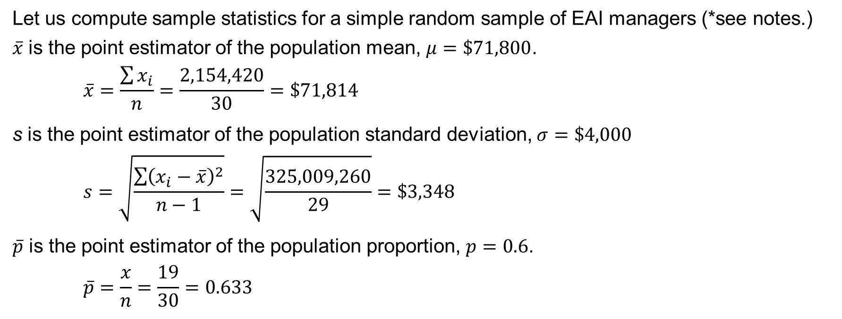
7.3 Point Estimation for the EAI Managers Example
Let us compute sample statistics for a simple random sample of EAI managers (*see notes.)
$\overline{x}$ is the point estimator of the population mean, $μ=\$71,800$.
$$\overline{x}=\frac{\sum{x_{i}}}{n}=\frac{2,154,420}{30}=\$71,814$$
s is the point estimator of the population standard deviation, $σ=\$4,000$
$$s=\sqrt{\frac{\sum{{\left(x_{i}−\overline{x}\right)}^{2}}}{n−1}}=\sqrt{\frac{325,009,260}{29}}=\$3,348$$
$\overline{p}$ is the point estimator of the population proportion, $p=0.6$.
$$\overline{p}=\frac{x}{n}=\frac{19}{30}=0.633$$
Notes:
*Note: a different sample would have resulted in different point estimates.

Slide 12
7.3 Practical Advice
The subject matter of most of the rest of the book is concerned with statistical inference.
In statistical inference, the subject of most of the rest of the book, we use a sample statistic as a point estimator of a population parameter.
The target population is the population we want to make inferences about.
The sampled population is the population from which the sample is actually taken.
In the EAI example, we drew a simple random sample from the sampled population of 2,500 managers to make point estimates of parameters of an identical target population.
However, it is not always easy to obtain a close correspondence between the sampled and target populations as we did in the EAI example.
Whenever a sample is used to make inferences about a population, we should make sure that the targeted population and the sampled population are in close agreement, or we cannot guarantee that the sample is representative of the target population.

Slide 13
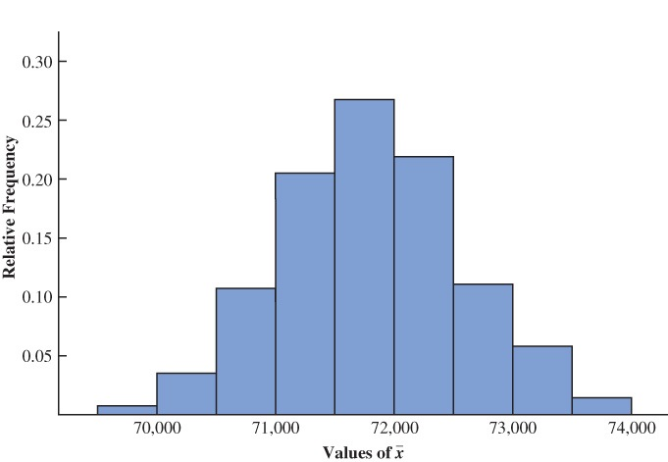
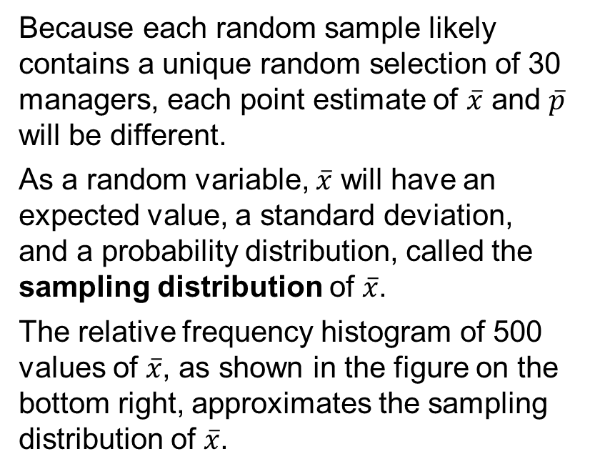
7.4 Introduction to Sampling Distributions
Suppose we repeat the process of selecting a simple random sample of 30 EAI managers over and over again, each time computing the values of $\overline{x}$ and $\overline{p}$.
Because each random sample likely contains a unique random selection of 30 managers, each point estimate of $\overline{x}$ and $\overline{p}$ will be different.
As a random variable, $\overline{x}$ will have an expected value, a standard deviation, and a probability distribution, called the sampling distribution of $\overline{x}$.
The relative frequency histogram of 500 values of $\overline{x}$, as shown in the figure on the bottom right, approximates the sampling distribution of $\overline{x}$.

Slide 14
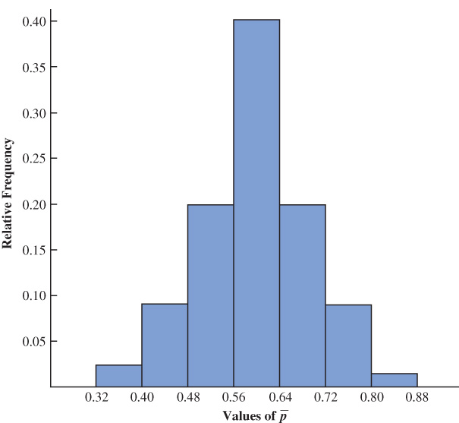
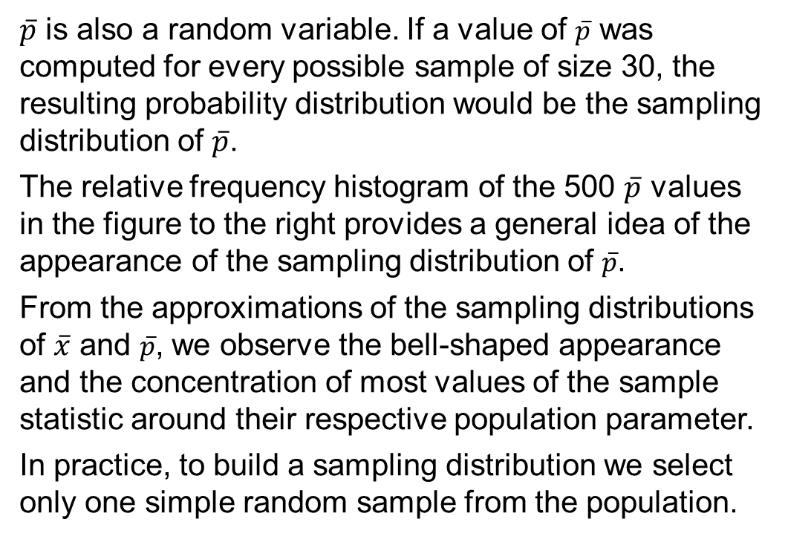
7.4 Approximation of a Sampling Distribution
$\overline{p}$ is also a random variable. If a value of $\overline{p}$ was computed for every possible sample of size 30, the resulting probability distribution would be the sampling distribution of $\overline{p}$.
The relative frequency histogram of the 500 $\overline{p}$ values in the figure to the right provides a general idea of the appearance of the sampling distribution of $\overline{p}$.
From the approximations of the sampling distributions of $\overline{x}$ and $\overline{p}$, we observe the bell-shaped appearance and the concentration of most values of the sample statistic around their respective population parameter.
In practice, to build a sampling distribution we select only one simple random sample from the population.

Slide 15
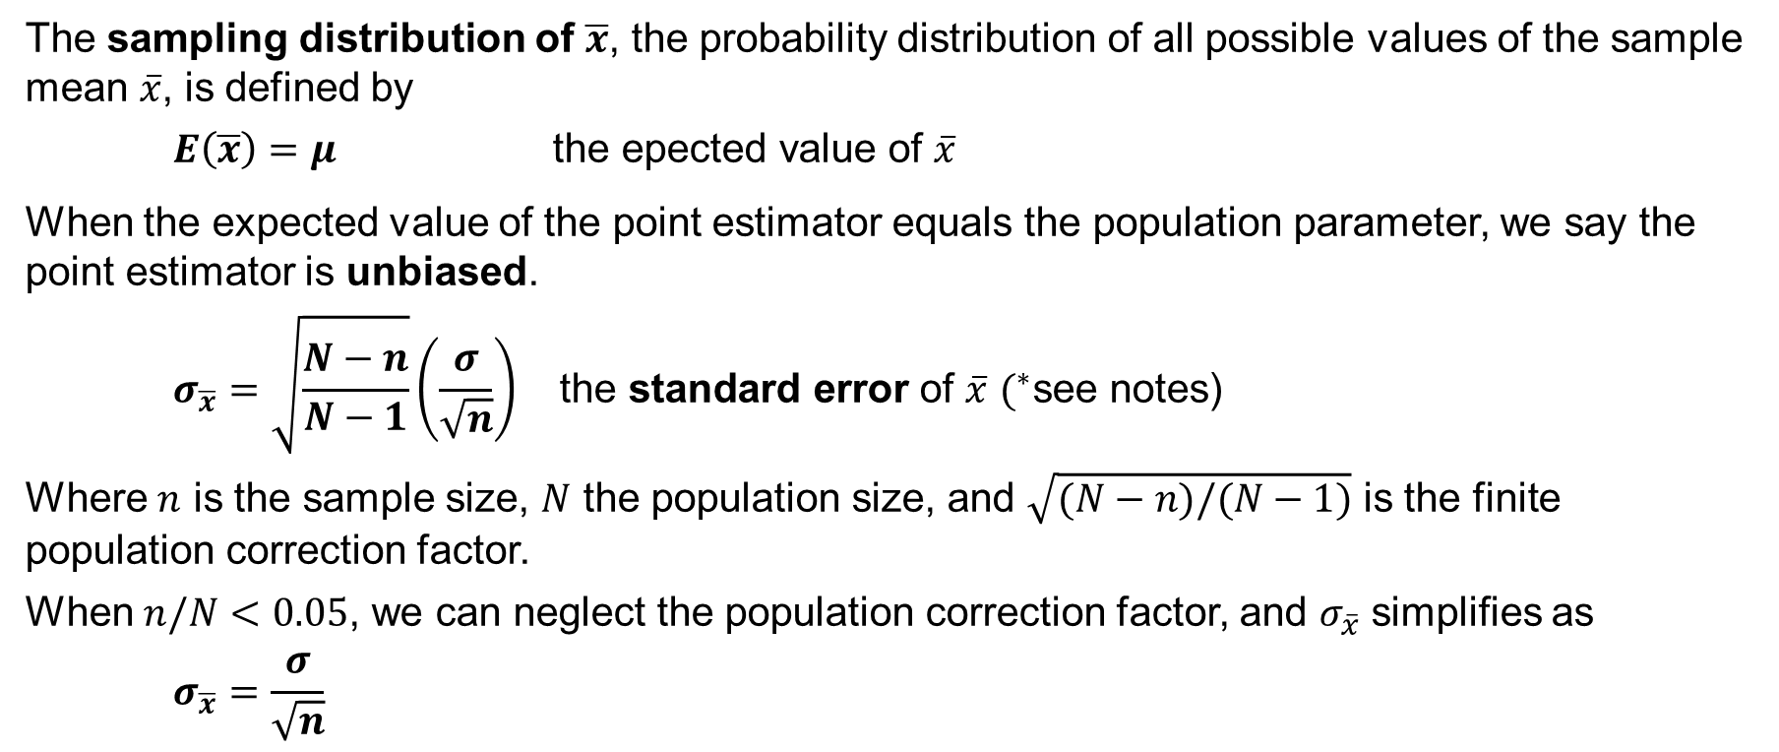
7.5 Sampling Distribution of $\overline{x}$
The sampling distribution of $\overline{x}$, the probability distribution of all possible values of the sample mean $\overline{x}$, is defined by
$$E\left(\overline{x}\right)=μ \text{the} \text{epected} \text{value} \text{of} \overline{x}$$
When the expected value of the point estimator equals the population parameter, we say the point estimator is unbiased.
$$σ_{\overline{x}}=\sqrt{\frac{N−n}{N−1}}\left(\frac{σ}{\sqrt{n}}\right) \text{the} \text{standard} \text{error} \text{of} \overline{x} (^{∗}\text{see} \text{notes}\text{)}$$
Where $n$ is the sample size, $N$ the population size, and $\sqrt{(N−n)/(N−1)}$ is the finite population correction factor.
When $n/N<0.05$, we can neglect the population correction factor, and $σ_{\overline{x}}$ simplifies as
$$σ_{\overline{x}}=\frac{σ}{\sqrt{n}}$$
Notes:
*Note: :We refer to the standard deviation of $\overline{x}$, $σ_{\overline{x}}$, as the standard error of the mean. In general, the term standard error refers to the standard deviation of a point estimator. Later we will see that the value of the standard error of the mean is helpful in determining how far the sample mean is from the population mean.

Slide 16
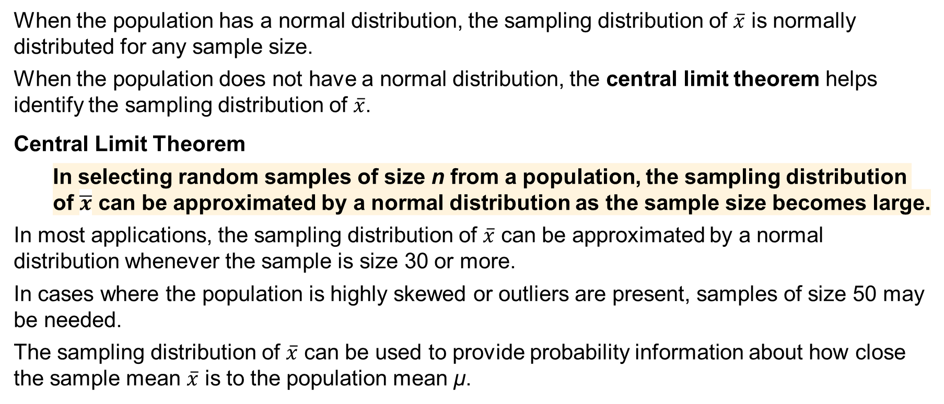
7.5 Form of the Sampling Distribution of $\overline{x}$
When the population has a normal distribution, the sampling distribution of $\overline{x}$ is normally distributed for any sample size.
When the population does not have a normal distribution, the central limit theorem helps identify the sampling distribution of $\overline{x}$.
Central Limit Theorem
In selecting random samples of size n from a population, the sampling distribution of $\overline{x}$ can be approximated by a normal distribution as the sample size becomes large.
In most applications, the sampling distribution of $\overline{x}$ can be approximated by a normal distribution whenever the sample is size 30 or more.
In cases where the population is highly skewed or outliers are present, samples of size 50 may be needed.
The sampling distribution of $\overline{x}$ can be used to provide probability information about how close the sample mean $\overline{x}$ is to the population mean μ.

Slide 17
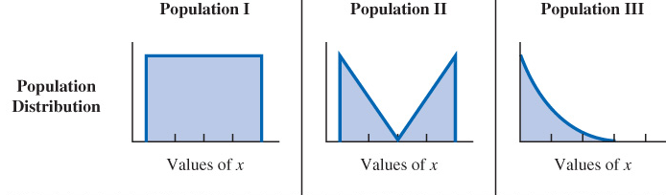
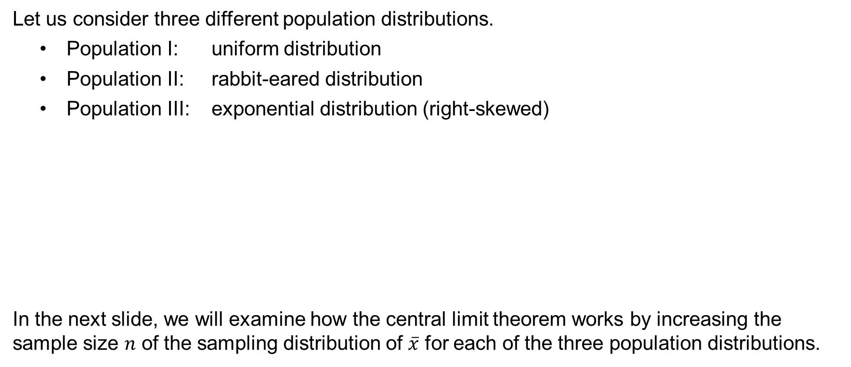
7.5 Sampling from Different Population Distributions
Let us consider three different population distributions.
Population I: uniform distribution
Population II: rabbit-eared distribution
Population III: exponential distribution (right-skewed)
In the next slide, we will examine how the central limit theorem works by increasing the sample size $n$ of the sampling distribution of $\overline{x}$ for each of the three population distributions.

Slide 18
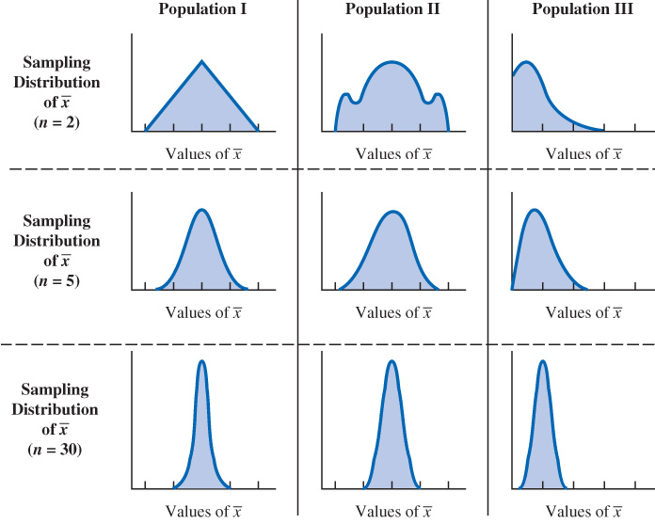
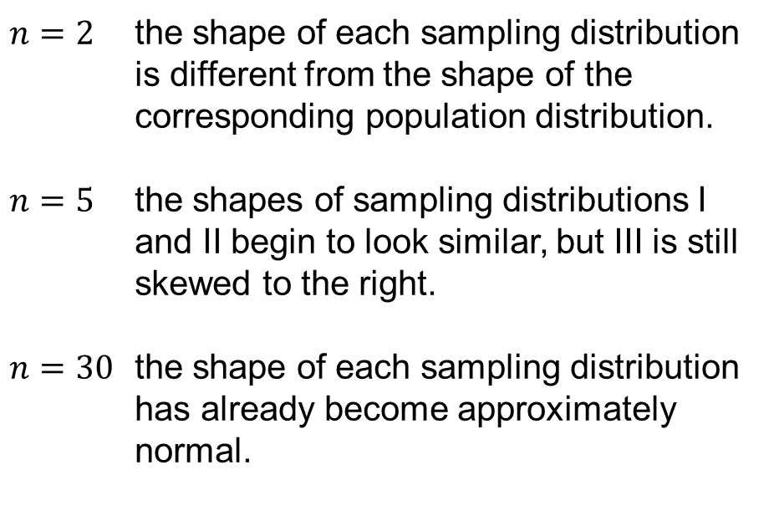
7.5 Illustration of the Central Limit Theorem
The three panels shows what happens to the sampling distribution of $\overline{x}$ for the three population distributions introduced in the previous slide when the sample size $n$ is increased.
$n=2$ the shape of each sampling distribution is different from the shape of the corresponding population distribution.
$n=5$ the shapes of sampling distributions I and II begin to look similar, but III is still skewed to the right.
$n=30$ the shape of each sampling distribution has already become approximately normal.

Slide 19
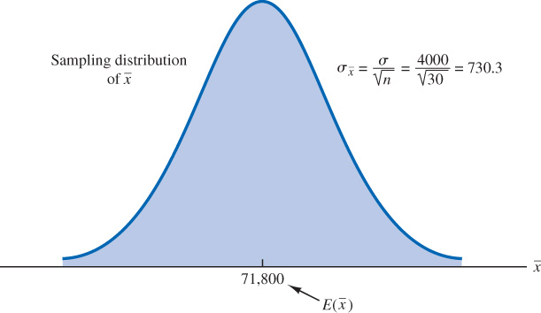
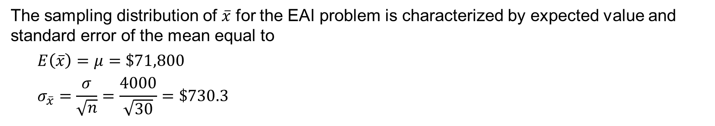
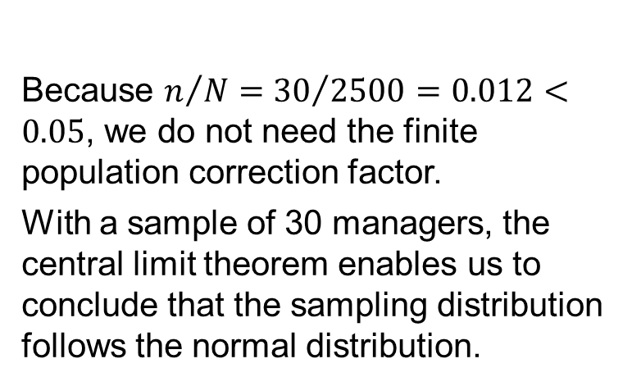
7.5 Sampling Distribution of $\overline{x}$ for the EAI Problem
The sampling distribution of $\overline{x}$ for the EAI problem is characterized by expected value and standard error of the mean equal to
$$E\left(\overline{x}\right)=μ=\$71,800$$
$$σ_{\overline{x}}=\frac{σ}{\sqrt{n}}=\frac{4000}{\sqrt{30}}=\$730.3$$
Because $n/N={30}/{2500}=0.012<0.05$, we do not need the finite population correction factor.
With a sample of 30 managers, the central limit theorem enables us to conclude that the sampling distribution follows the normal distribution.

Slide 20
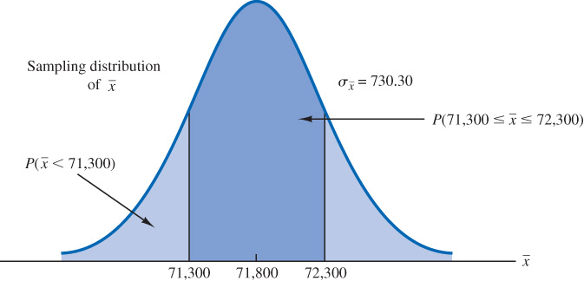
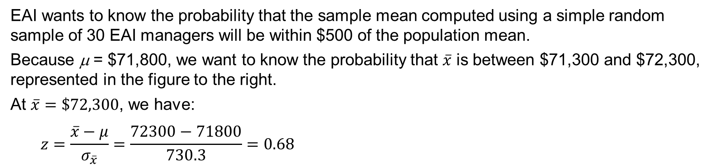
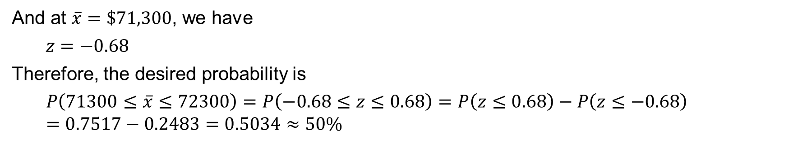
7.5 Application of the Sampling Distribution of $\overline{x}$
EAI wants to know the probability that the sample mean computed using a simple random sample of 30 EAI managers will be within $500 of the population mean.
Because μ = $71,800, we want to know the probability that $\overline{x}$ is between $71,300 and $72,300, represented in the figure to the right.
At $\overline{x}=\$72,300$, we have:
$$z=\frac{\overline{x}−μ}{σ_{\overline{x}}}=\frac{72300−71800}{730.3}=0.68$$
And at $\overline{x}=\$71,300$, we have
$$z=−0.68$$
Therefore, the desired probability is
$$P\left(71300≤\overline{x}≤72300\right)=P\left(−0.68≤z≤0.68\right)=P\left(z≤0.68\right)−P\left(z≤−0.68\right)=0.7517−0.2483=0.5034≈50\%$$

Slide 21
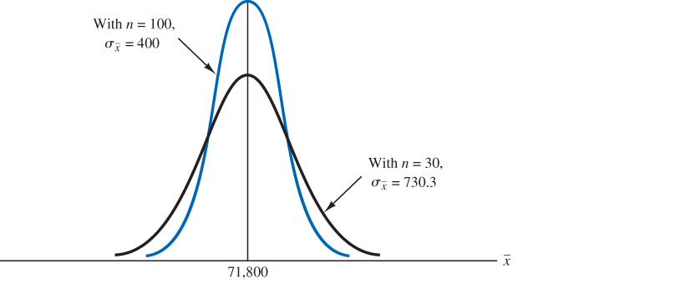
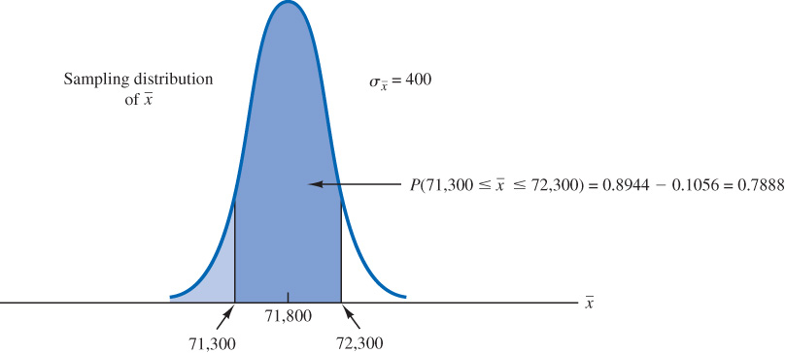

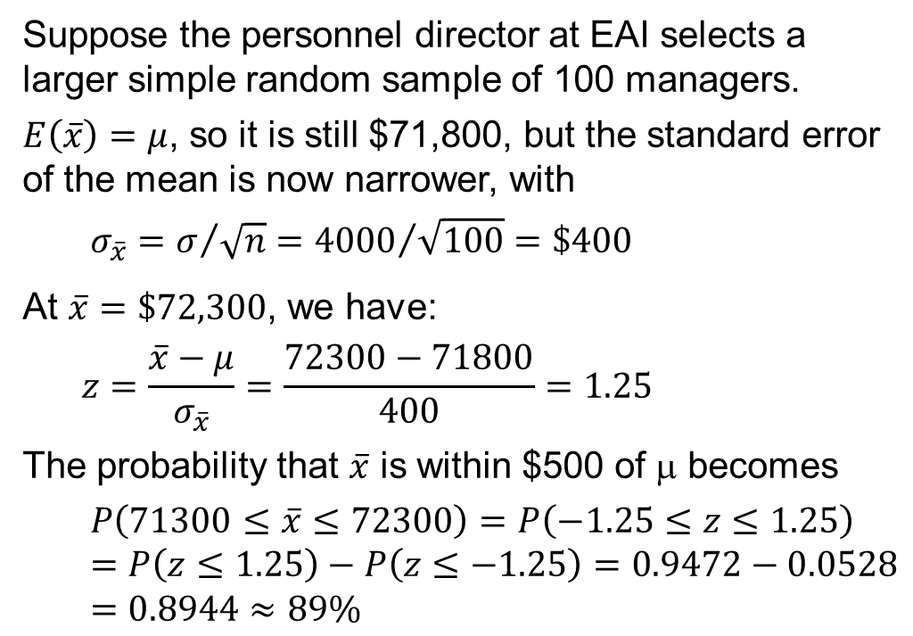
7.5 Relationship Between the Sample Size and the Sampling Distribution of $\overline{x}$
Suppose the personnel director at EAI selects a larger simple random sample of 100 managers.
$E\left(\overline{x}\right)=μ$, so it is still $71,800, but the standard error of the mean is now narrower, with
$$σ_{\overline{x}}=σ/{\sqrt{n}}={4000}/{\sqrt{100}}=\$400$$
At $\overline{x}=\$72,300$, we have:
$$z=\frac{\overline{x}−μ}{σ_{\overline{x}}}=\frac{72300−71800}{400}=1.25$$
The probability that $\overline{x}$ is within $500 of μ becomes
$$P\left(71300≤\overline{x}≤72300\right)=P\left(−1.25≤z≤1.25\right)=P\left(z≤1.25\right)−P\left(z≤−1.25\right)=0.9472−0.0528=0.8944≈89\%$$

Slide 22
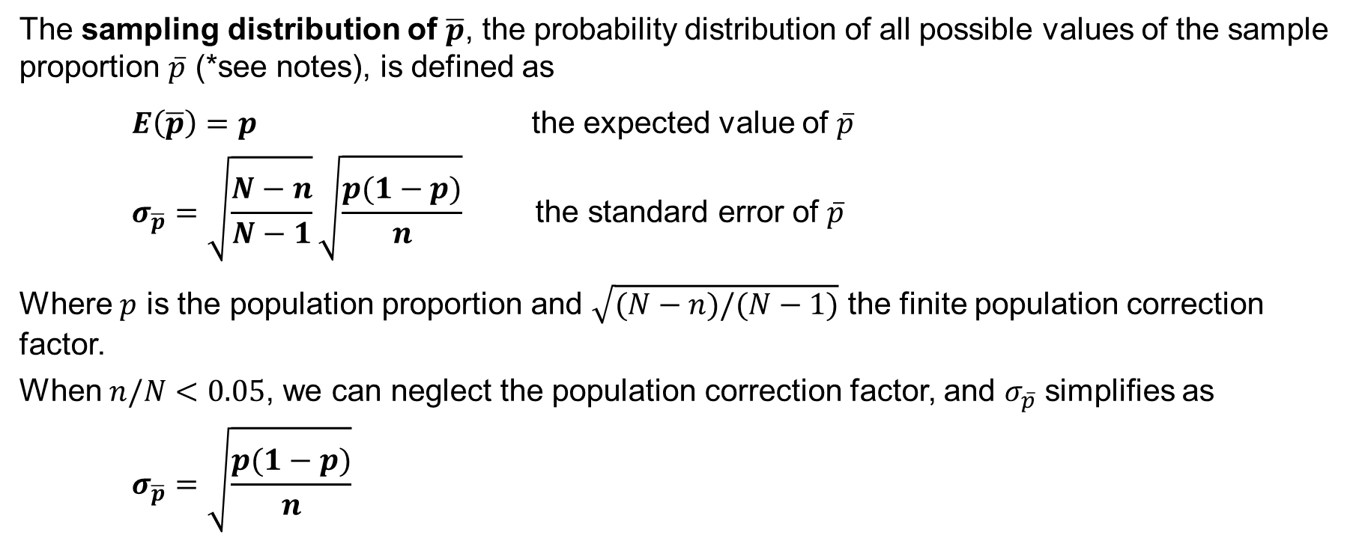
7.6 Sampling Distribution of $\overline{p}$
The sampling distribution of $\overline{p}$, the probability distribution of all possible values of the sample proportion $\overline{p}$ (*see notes), is defined as
$E\left(\overline{p}\right)=p$ the expected value of $\overline{p}$
$$σ_{\overline{p}}=\sqrt{\frac{N−n}{N−1}}\sqrt{\frac{p(1−p)}{n}} \text{the} \text{standard} \text{error} \text{of} \overline{p}$$
Where $p$ is the population proportion and $\sqrt{(N−n)/(N−1)}$ the finite population correction factor.
When $n/N<0.05$, we can neglect the population correction factor, and $σ_{\overline{p}}$ simplifies as
$$σ_{\overline{p}}=\sqrt{\frac{p(1−p)}{n}}$$
Notes:
*Note: $\overline{p}=x/n$ is the sample proportion, the point estimator of the population proportion $p$, with $x$ the number of elements in the sample that possess the characteristic of interest.

Slide 23
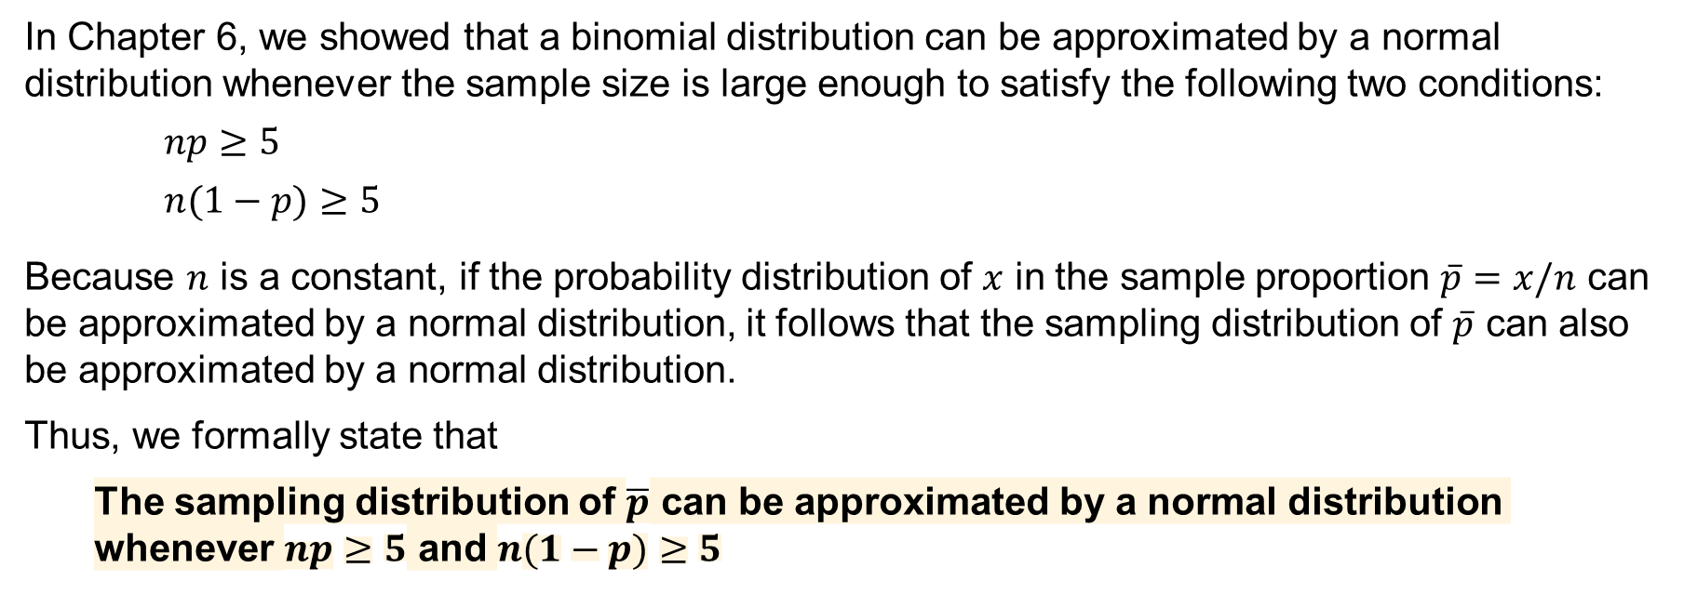
7.6 Form of the Sampling Distribution of $\overline{p}$
In Chapter 6, we showed that a binomial distribution can be approximated by a normal distribution whenever the sample size is large enough to satisfy the following two conditions:
$$np≥5$$
$$n(1−p)≥5$$
Because $n$ is a constant, if the probability distribution of $x$ in the sample proportion $\overline{p}=x/n$ can be approximated by a normal distribution, it follows that the sampling distribution of $\overline{p}$ can also be approximated by a normal distribution.
Thus, we formally state that
The sampling distribution of $\overline{p}$ can be approximated by a normal distribution whenever $np≥5$ and $n(1−p)≥5$

Slide 24
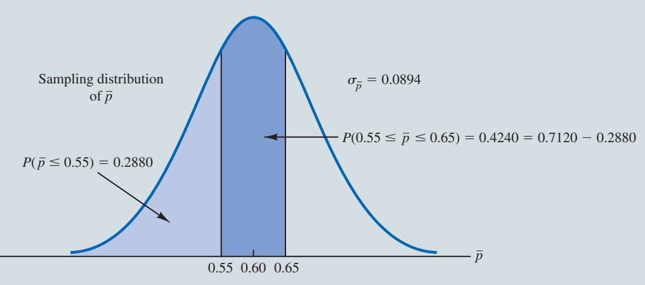
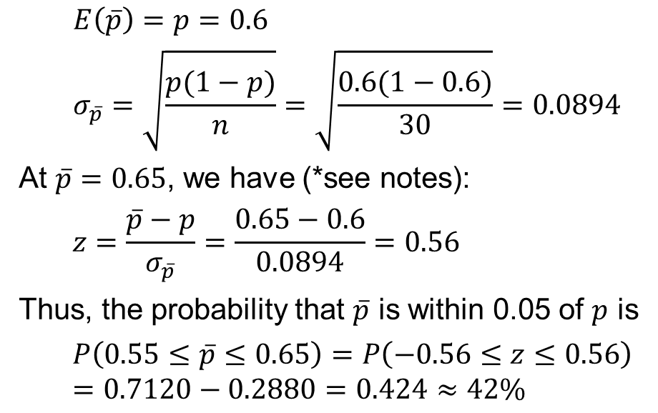
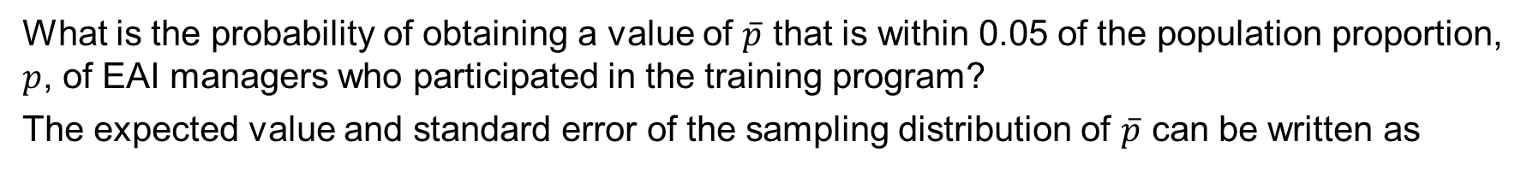
7.6 Practical Value of the Sampling Distribution of $\overline{p}$
What is the probability of obtaining a value of $\overline{p}$ that is within 0.05 of the population proportion, $p$, of EAI managers who participated in the training program?
The expected value and standard error of the sampling distribution of $\overline{p}$ can be written as
$$E\left(\overline{p}\right)=p=0.6$$
$$σ_{\overline{p}}=\sqrt{\frac{p(1−p)}{n}}=\sqrt{\frac{0.6(1−0.6)}{30}}=0.0894$$
At $\overline{p}=0.65$, we have (*see notes):
$$z=\frac{\overline{p}−p}{σ_{\overline{p}}}=\frac{0.65−0.6}{0.0894}=0.56$$
Thus, the probability that $\overline{p}$ is within 0.05 of $p$ is
$$P\left(0.55≤\overline{p}≤0.65\right)=P\left(−0.56≤z≤0.56\right)=0.7120−0.2880=0.424≈42\%$$
Notes:
Note: We can approximate the binomial distribution of $\overline{p}=x/n$ with a normal distribution because $np=30\left(0.6\right)=18>5$ and $n(1−p)=30\left(1−0.6\right)=12>5$.

Slide 25
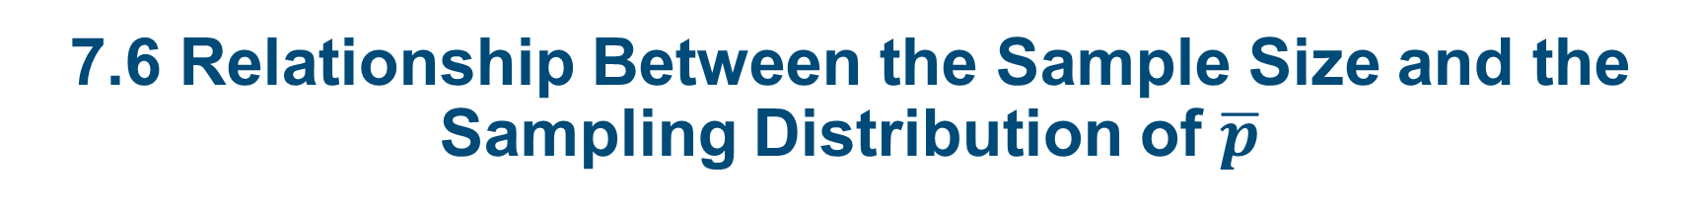
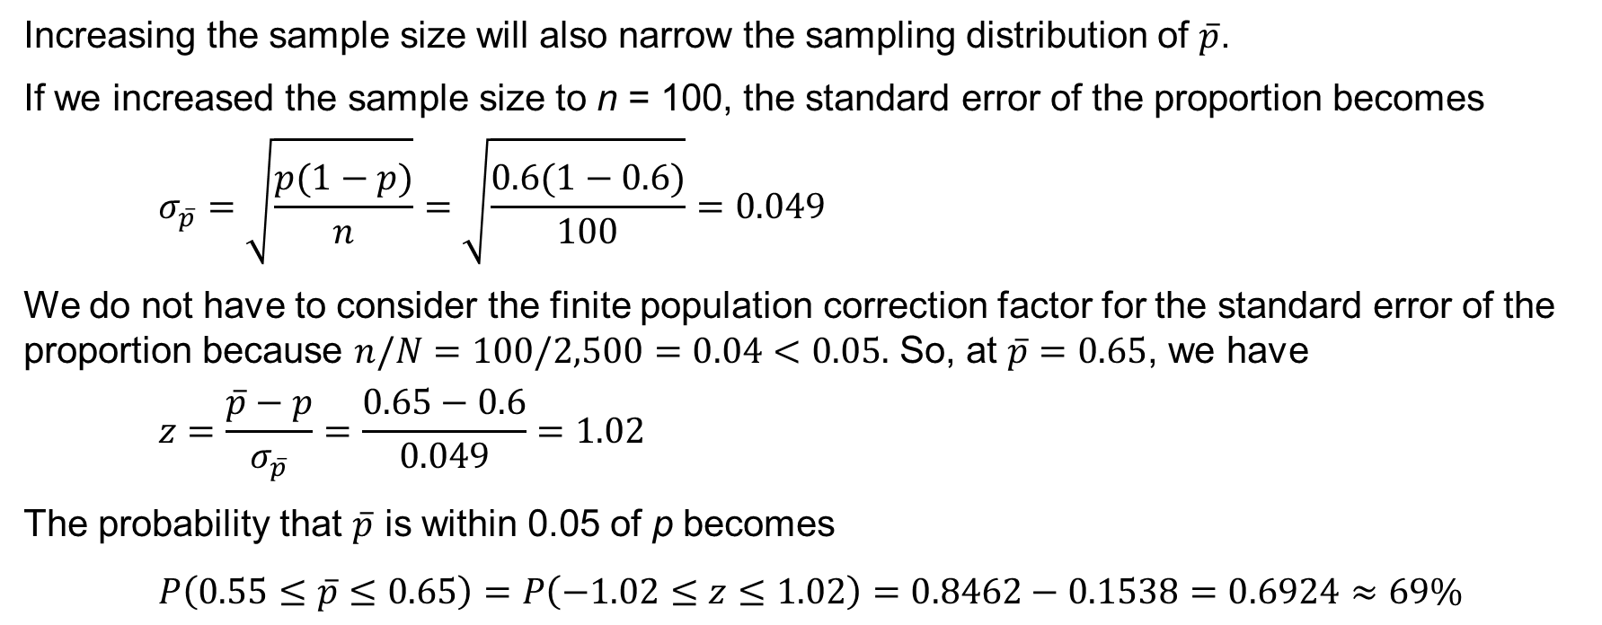
7.6 Relationship Between the Sample Size and the Sampling Distribution of $\overline{p}$
Increasing the sample size will also narrow the sampling distribution of $\overline{p}$.
If we increased the sample size to n = 100, the standard error of the proportion becomes
$$σ_{\overline{p}}=\sqrt{\frac{p(1−p)}{n}}=\sqrt{\frac{0.6(1−0.6)}{100}}=0.049$$
We do not have to consider the finite population correction factor for the standard error of the proportion because $n/N=100/2,500=0.04<0.05.$ So, at $\overline{p}=0.65$, we have
$$z=\frac{\overline{p}−p}{σ_{\overline{p}}}=\frac{0.65−0.6}{0.049}=1.02$$
The probability that $\overline{p}$ is within 0.05 of p becomes
$$P\left(0.55≤\overline{p}≤0.65\right)=P\left(−1.02≤z≤1.02\right)=0.8462−0.1538=0.6924≈69\%$$

Slide 26
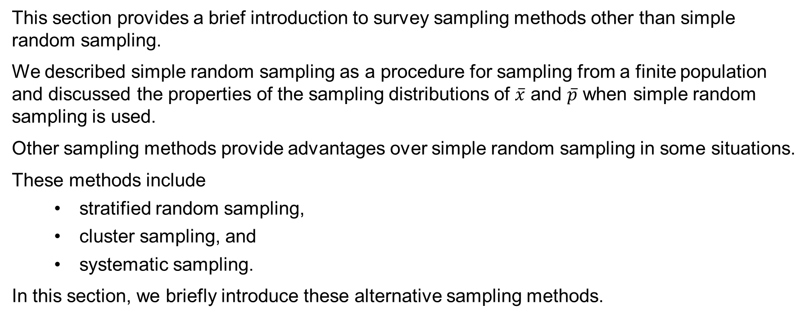
7.7 Other Sampling Methods
This section provides a brief introduction to survey sampling methods other than simple random sampling.
We described simple random sampling as a procedure for sampling from a finite population and discussed the properties of the sampling distributions of $\overline{x}$ and $\overline{p}$ when simple random sampling is used.
Other sampling methods provide advantages over simple random sampling in some situations.
These methods include
stratified random sampling,
cluster sampling, and
systematic sampling.
In this section, we briefly introduce these alternative sampling methods.

Slide 27
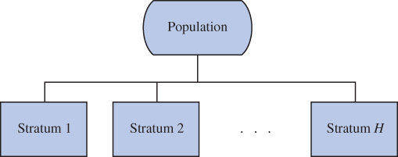
7.7 Stratified Random Sampling
The population is first divided into groups of elements called strata.
Each element in the population must belong to one and only one stratum.
Best results are obtained when the elements within each stratum are as much alike as possible (i.e. a homogeneous group.)
A simple random sample is then taken from each stratum. Formulas are used (i.e., weighted average) for combining the stratum sample results into one population parameter estimate.
Advantage: if the strata are homogeneous, this method may provide results just as precise as those of simple random sampling by using a smaller total sample size.
Disadvantage: may require a larger total sample size than simple random sampling.
Example: the basis for forming the strata might be department, location, age, industry type, etc.

Slide 28
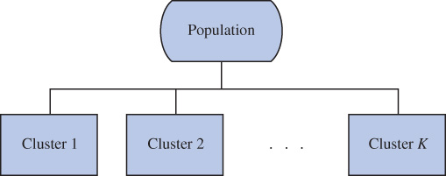
7.7 Cluster Sampling
The population is first divided into separate groups of elements called clusters.
Ideally, each cluster is a representative small-scale version of the population (i.e. heterogeneous group).
A simple random sample of the clusters is then taken.
All elements within each sampled (chosen) cluster form the sample.
Advantage: the close proximity of elements can be cost effective (i.e. many sample observations can be obtained in a short time).
Disadvantage: this method generally requires a larger total sample size than simple or stratified random sampling.
Example: typical in area sampling, with clusters being well-defined geographical areas.

Slide 29
7.7 Systematic Sampling
If a sample size of n is desired from a population containing N elements, we might sample one element for every N/n elements in the population.
We randomly select one of the first N/n elements from the population list.
We then select every N/n^{th} element that follows in the population list.
This method has the properties of a simple random sample, especially if the list of the population elements is a random ordering.
Advantage: the sample usually will be easier to identify than it would be if simple random sampling were used.
Example: selecting every 100th listing in a telephone book after the first randomly selected listing.

Slide 30
7.7 Nonprobability Sampling Methods
Convenience Sampling
Judgment Sampling
Items are included in the sample without known probabilities of being selected.
The sample is identified primarily by convenience.
It is a nonprobability sampling technique.
Advantage: sample selection and data collection are relatively easy.
Disadvantage: it is impossible to determine how representative of the population the sample is (*see notes.)
Example: a professor conducting research might use student volunteers to constitute a sample.
The person most knowledgeable on the subject of the study selects elements of the population that they feel as most representative of the population.
It is a nonprobability sampling technique.
Advantage: it is a relatively easy way of selecting a sample.
Disadvantage: the quality of the sample results depends on the judgment of the person selecting the sample (*see notes.)
Example: a reporter might sample three or four senators, judging them as reflecting the general opinion of the senate.
Notes:
*Note: We recommend using probability sampling methods when sampling from finite populations: simple random sampling, stratified random sampling, cluster sampling, or systematic sampling. For these methods, formulas are available for eval­uating the “goodness” of the sample results in terms of the closeness of the results to the population parameters being estimated. An evaluation of the goodness cannot be made with convenience or judgment sampling. Thus, great care should be taken in interpreting the results based on nonprob­ability sampling methods.

Slide 31
7.8 Practical Advice: Big Data and Errors in Sampling
The purpose of collecting a sample is to make inferences and answer research questions about a population.
Therefore, it is important that the sample look like, or be representative of, the population being investigated.
In practice, individual samples always, to varying degrees, fail to be perfectly representative of the populations from which they have been taken.
There are two general reasons a sample may fail to be representative of the population of interest:
sampling error
nonsampling error

Slide 32
7.8 Sampling Error
Sampling error is the natural deviation of the sample from the population that results from random sampling.
On average, random samples will be representative of the population from which they are collected.
However, the random collection of sample data does not ensure that every single sample will be perfectly representative of the population of interest.
Because the standard error of the sampling distribution of a sample statistic becomes smaller as the size of the sample increases, we can limit the impact of sampling error by collecting larger sample sizes.

Slide 33
7.8 Nonsampling Error
Deviations of the sample from the population that occur for reasons other than random sampling are referred to as nonsampling error.
Types of nonsampling error may include:
Coverage error may occur when the research objective and the population from which the sample is to be drawn are not aligned.
Nonresponse error may occur in surveys when some segments of the population are either more or less likely to respond to the survey mechanism.
Measurement error may result from the incorrect measurement of the population characteristic of interest.
Interviewer error may be caused by introducing a bias toward positive or negative responses during a telephone or in-person survey.
Processing error may be introduced during data recording and preparation.

Slide 34
7.8 Big Data and Sampling Error
Big data is defined as any set of data that is too large or too complex to be handled by standard data-processing techniques and typical desktop software.
The Four V’s are the four attributes that characterize the processes that generate big data:
Volume – the amount of data generated
Variety – the diversity in types and structures of data generated
Veracity – the reliability of the data generated
Velocity – the speed at which the data are generated
The large structural dimension of a data set may present the following challenges:
Tall data – a data set has so many observations that make traditional statistical inference obsolete.
Wide data – a data set has so many variables that render infeasible their simultaneous consideration.

Slide 35
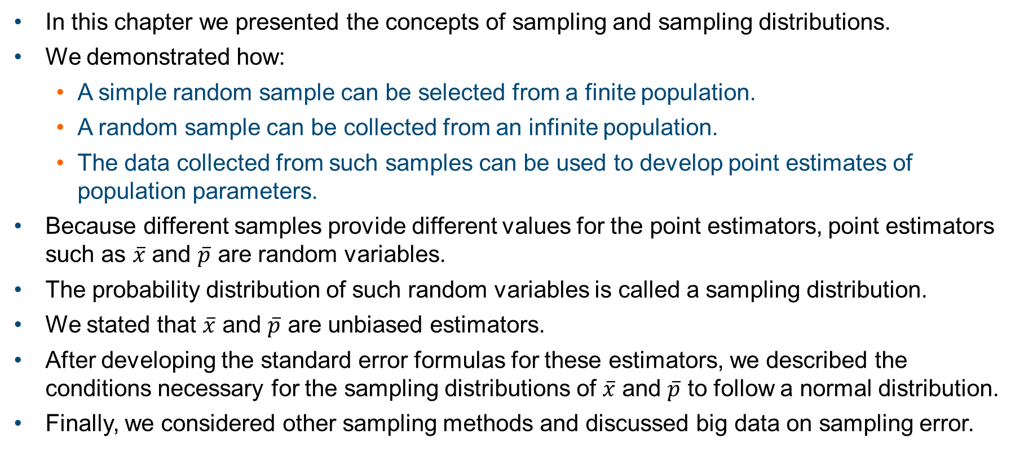
Summary
In this chapter we presented the concepts of sampling and sampling distributions.
We demonstrated how:
A simple random sample can be selected from a finite population.
A random sample can be collected from an infinite population.
The data collected from such samples can be used to develop point estimates of population parameters.
Because different samples provide different values for the point estimators, point estimators such as $\overline{x}$ and $\overline{p}$ are random variables.
The probability distribution of such random variables is called a sampling distribution.
We stated that $\overline{x}$ and $\overline{p}$ are unbiased estimators.
After developing the standard error formulas for these estimators, we described the conditions necessary for the sampling distributions of $\overline{x}$ and $\overline{p}$ to follow a normal distribution.
Finally, we considered other sampling methods and discussed big data on sampling error.

