Slide 1
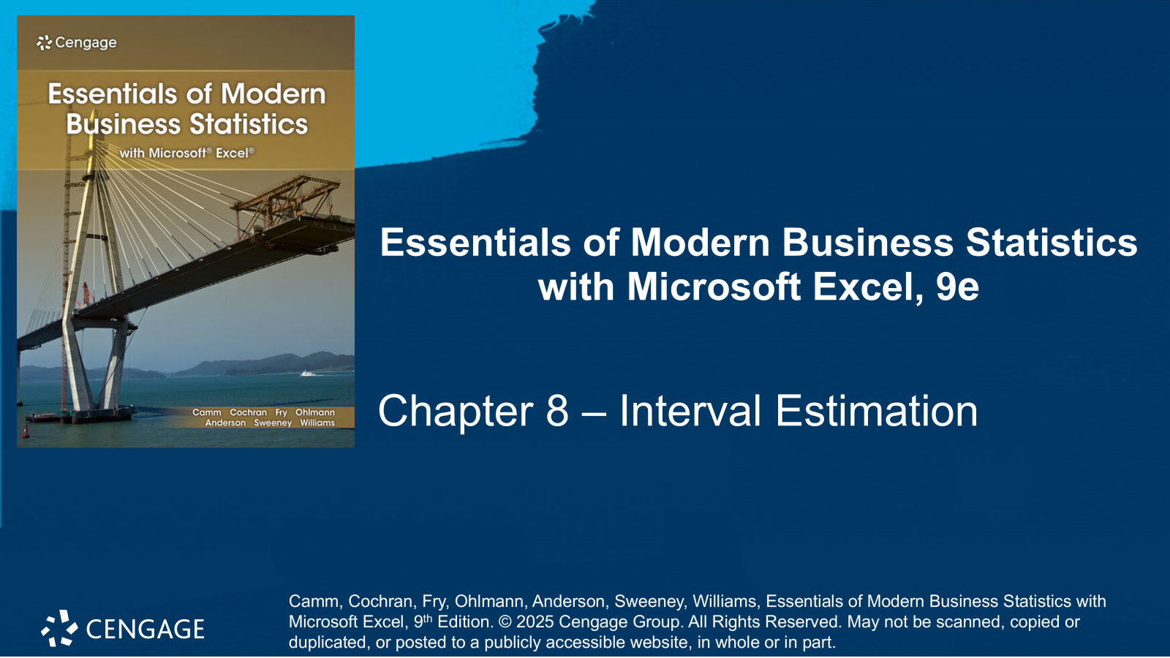

Slide 2
Chapter Contents
8.1 Population Mean: σ Known
8.2 Population Mean: σ Unknown
8.3 Determining the Sample Size
8.4 Population Proportion
8.5 Practical Advice: Big Data and Confidence Intervals
Summary

Slide 3
Chapter Objectives (1 of 2)
After completing this chapter, you will be able to:
LO 8-1 Calculate and interpret the margin of error and the interval estimate at a given level of confidence for a mean when the population standard deviation σ is known.
LO 8-2 Describe and explain the distribution form and parameters of the sampling distribution of the sample mean in the cases when the population standard deviation σ is unknown.
LO 8-3 Calculate and interpret the margin of error and the interval estimate at a given level of confidence for a mean when the population standard deviation σ is unknown.

Slide 4
Chapter Objectives (2 of 2)
LO 8-4 Determine the sample size necessary to provide an interval estimate of the mean at a desired margin of error at a specified confidence level.
LO 8-5 Calculate and interpret the margin of error, and the interval estimate at a given level of confidence for a proportion.
LO 8-6 Determine the sample size necessary to provide an interval estimate of the proportion at a desired margin of error at a specified confidence level.

Slide 5
Introduction
A point estimator is a sample statistic used to estimate a population parameter.
The sample mean $\overline{x}$ is a point estimator of the population mean μ
The sample proportion $\overline{p}$ is a point estimator of the population proportion p
An interval estimate is computed by adding and subtracting a value, called the margin of error, to the point estimate. The general form of an interval estimate is:
Point estimate ± Margin of error
The general form of an interval estimate of a population mean is:
$\overline{x}$± Margin of error
And the general form of an interval estimate of a population proportion is:
$\overline{p}$ ± Margin of error
The sampling distributions of $\overline{x}$ and $\overline{p}$ play key roles in computing these interval estimates.

Slide 6
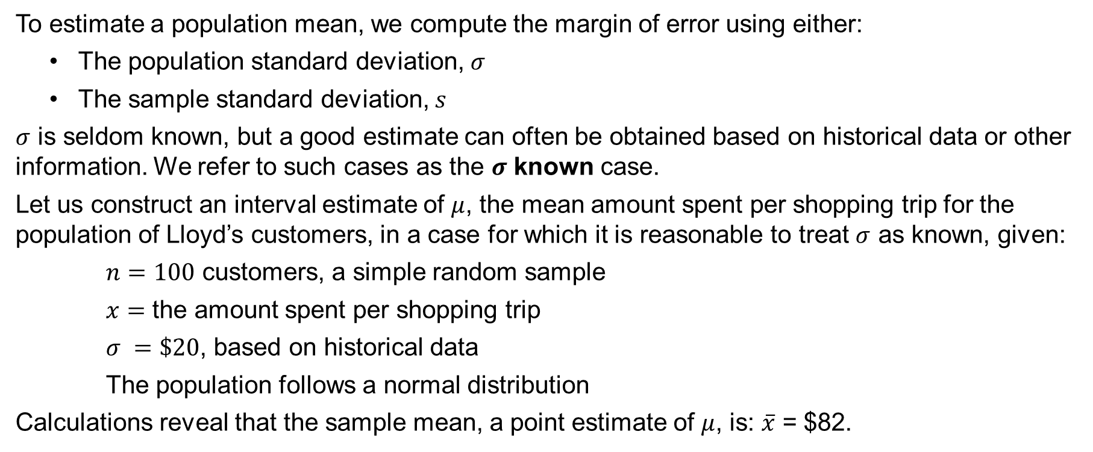
8.1 Population Mean: σ Known
To estimate a population mean, we compute the margin of error using either:
The population standard deviation, $σ$
The sample standard deviation, $s$
$σ$ is seldom known, but a good estimate can often be obtained based on historical data or other information. We refer to such cases as the $σ$ known case.
Let us construct an interval estimate of $μ$, the mean amount spent per shopping trip for the population of Lloyd’s customers, in a case for which it is reasonable to treat $σ$ as known, given:
$n=100$ customers, a simple random sample
$x=$ the amount spent per shopping trip
$σ =\$20$, based on historical data
The population follows a normal distribution
Calculations reveal that the sample mean, a point estimate of $μ$, is: $\overline{x}$ = $82.

Slide 7
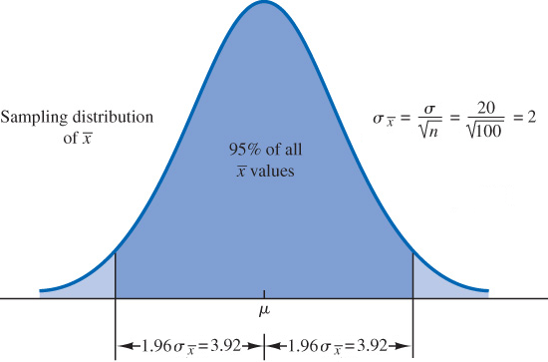
8.1 Sampling Distribution for the Sample Mean
We can conclude that the sampling distribution of $\overline{x}$ follows a normal distribution with a standard error of
$$σ_{\overline{x}}=\frac{σ}{\sqrt{n}}=\frac{\$20}{\sqrt{100}}=2$$
This sampling distribution, shown to the right, depicts how values of $\overline{x}$ are distributed around the population mean, μ.
It follows that 95% of the values of the normally distributed $\overline{x}$ random variable falls within $±1.96σ_{\overline{x}}$ standard deviations of the mean, or within
$$±1.96σ_{\overline{x}}=±1.96\left(2\right)=±3.92$$

Slide 8
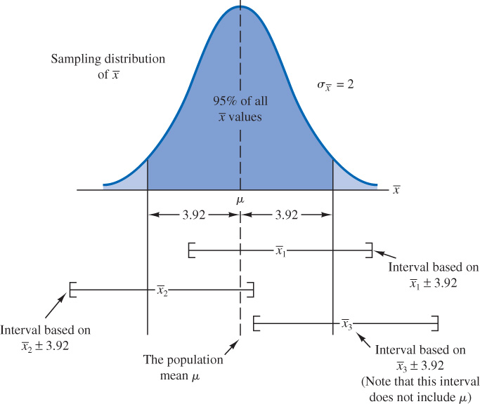
8.1 The Confidence Level
Let us set the margin of error equal to 3.92 and compute the interval estimate of μ using $\overline{x}±3.92$.
The figure shows what could happen if we took three separate samples of 100 Lloyd’s customers and built an interval estimate for each of them.
The first two intervals, built around the sample means ${\overline{x}}_{1}$ and ${\overline{x}}_{2}$, include the population mean, μ, but the third one, ${\overline{x}}_{3}$, does not.
It turns out that 95% of all intervals formed by subtracting 3.92 from $\overline{x}$ and adding 3.92 to $\overline{x}$ will include the population mean, μ.
We call an interval built around $\overline{x}$ a confidence interval established at the 95% confidence level.

Slide 9
8.1 Margin of Error and the Interval Estimate
An interval estimate of the population mean $μ$, for the $σ$ known case, can be written as
$$\overline{x}±z_{α/2}\frac{σ}{\sqrt{n}}$$
Where, $1−α$ is the confidence coefficient, and $z_{α/2}$ the $z$ value providing an area of $α/2$ in the upper tail of the standard normal probability distribution.
To construct a 95% confidence interval for the Lloyd’s example, we observe that, $1−α=0.95$.
Thus, we have
$α/2={\left(1−0.95\right)}/2={0.05}/2=0.025$, and $z_{α/2}=1.96$.
With, $\overline{x}=82$, $σ=20$, and $n=100$, we obtain
$$82±1.96\frac{20}{\sqrt{100}}=82±3.92$$

Slide 10
8.1 Commonly Used Confidence Levels
In the calculation of the previous slide, we concluded that we are 95% confident the mean amount spent per shopping trip at Lloyd’s is between
$82−3.92=\$78.08$ and $82+3.92=\$85.92$
Other confidence levels such as 90% and 99% may also be considered. The table shows the $z_{α/2}$ for 90%, 95%, and 99% confidence levels.
For example, at a 90% confidence level, $z_{α/2}=1.645$, and the confidence interval becomes
$$82±1.645\frac{20}{\sqrt{100}}=82±3.29$$
Or between
$82−3.29=\$78.71$ and $82+3.29=\$85.29$
Confidence Level | α | α/2 | z_{α/2}
90% | 0.10 | 0.05 | 1.645
95% | 0.05 | 0.025 | 1.960
99% | 0.01 | 0.005 | 2.576

Slide 11
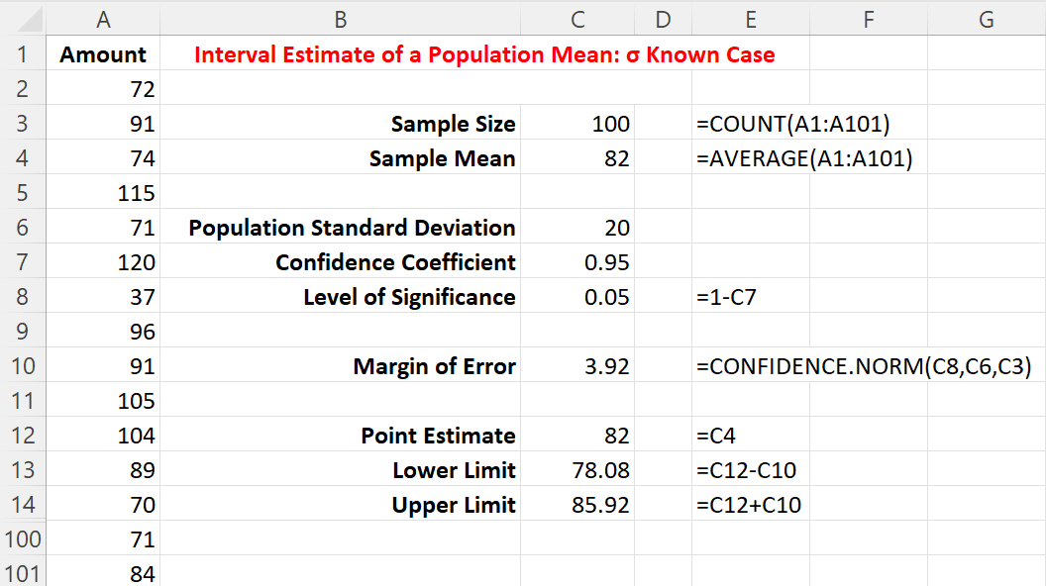
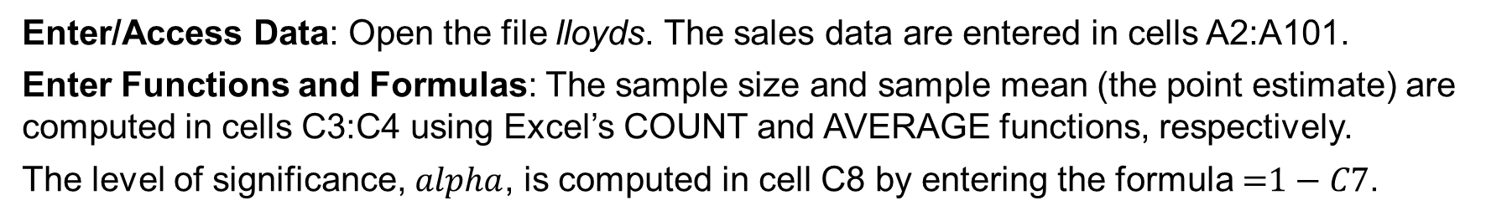
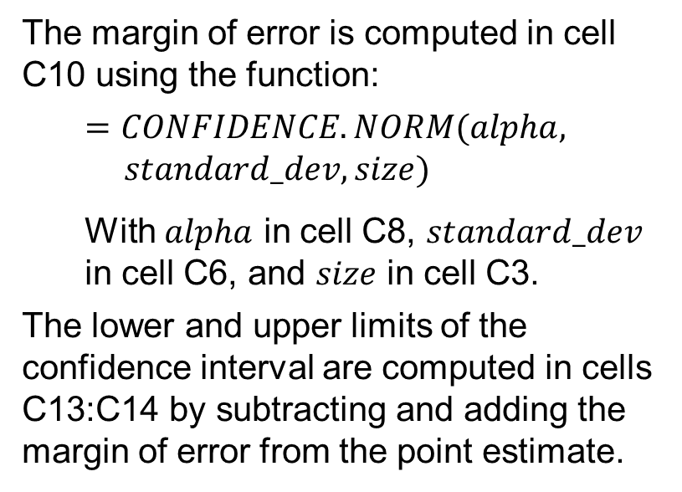
8.1 Excel: Construct a 95% Confidence Interval
Enter/Access Data: Open the file lloyds. The sales data are entered in cells A2:A101.
Enter Functions and Formulas: The sample size and sample mean (the point estimate) are computed in cells C3:C4 using Excel’s COUNT and AVERAGE functions, respectively.
The level of significance, $alpha$, is computed in cell C8 by entering the formula $\text{=}1−C7$.
The margin of error is computed in cell C10 using the function:
$$=CONFIDENCE.NORM(alpha,$$
$$standard_dev,size)$$
With $alpha$ in cell C8, $standard_dev$ in cell C6, and $size$ in cell C3.
The lower and upper limits of the confidence interval are computed in cells C13:C14 by subtracting and adding the margin of error from the point estimate.

Slide 12
8.1 Practical Advice
Adequate Sample Size
The sampling distribution of $\overline{x}$ is normal if the underlying population distribution is normal; otherwise, a sample size of n ≥ 30 is required.
If the population distribution is highly skewed or contains outliers, a sample size of 50 or more is recommended.
If the population is not normally distributed but is roughly symmetric, a sample size as small as 15 will suffice.
If the population is believed to be at least approximately normal, a sample size of less than 15 can be used.
For small sample sizes, a histogram of the sample data should be built to learn about the shape of the population distribution.

Slide 13
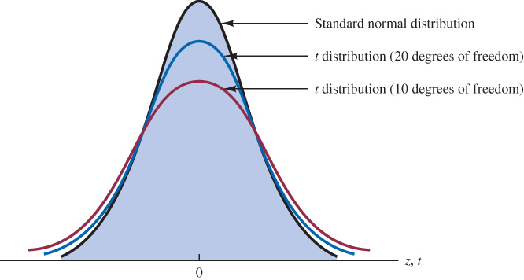
8.2 Population Mean: σ Unknown
The t Distribution
If an estimate of the population standard deviation, σ, cannot be developed prior to sampling, we use the sample standard deviation, s, instead.
This is referred to as the σ unknown case, with the interval estimate of μ based on the t distribution, a family of similar probability distributions depending on a parameter called the degrees of freedom.
A t distribution with more degrees of freedom has
less dispersion.
As the degrees of freedom increase, the difference
between the t distribution and the standard normal
probability distribution becomes smaller.
For more than 100 degrees of freedom, the standard
normal z value provides a good approximation to
the t value (*see notes for additional details.)
Notes:
Note: If the degrees of freedom exceed 100, the infinite degrees of freedom row of Table 2 in Appendix B can be used to approximate the actual t value; in other words, for more than 100 degrees of freedom, the standard normal z value provides a good approximation to the t value.

Slide 14
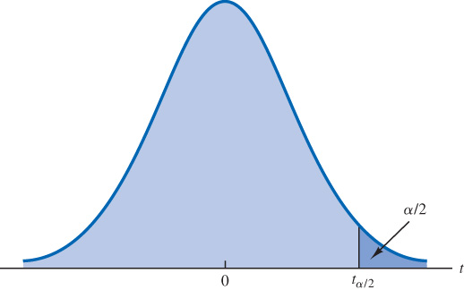
8.2 Interval Estimate of μ: σ Unknown
An interval estimate of the population mean $μ$, for the $σ$ unknown case, can be written as
$$\overline{x}±t_{α/2}\frac{s}{\sqrt{n}}$$
Where s is the sample standard deviation, $1−α$ is the confidence coefficient, and $t_{α/2}$ the t value providing an area of α/2 in the upper tail of a t distribution with $n−1$ degrees of freedom (*see the notes for details.)
As an application, consider the estimate of the mean credit card debt, $σ$ unknown case, for the population of U.S. households (DATAfile: NewBalance.)
The data consists of the household credit card debt, $x$, for a simple random sample of $n=70$ households.
Sample calculations reveal a sample mean $\overline{x}=\$9,312$, and a sample standard deviation, $s=\$4,007$.
Notes:
Note: degrees of freedom refer to the number of independent pieces of information (data points) that go in the computation of the sample standard deviation, s, and with the nth data point being “locked” by the computations of the sample mean, $\overline{x}$, needed for the computation of s.

Slide 15
8.2 Estimate of the Population Mean Credit Card Balance
With 95% confidence and $n−1=69$ degrees of freedom, Table 2 in Appendix B can be used to obtain $t_{0.025}=1.995$. We want the t value in the row with 69 degrees of freedom, and the column corresponding to 0.025 in the upper tail.
Area in upper tail | 0.20 | 0.10 | 0.05 | 0.025 | 0.01 | 0.005
t Value ($df=69$) | .847 | 1.294 | 1.667 | 1.995 | 2.382 | 2.649
Alternatively, the Excel equation =T.INV(1−0.025,69) will also generate the value 1.995.
We can now compute an interval estimate of the population mean credit card balance as:
$$9312±1.995\frac{4007}{\sqrt{70}} \text{or} 9312±955$$
Where $9,312 is the point estimate of the population mean and $955 the margin of error.
Thus, we are 95% confident that the mean credit card balance for the population of all households is between $9312−955=\$8,357$ and $9312+955=\$10,267$.

Slide 16
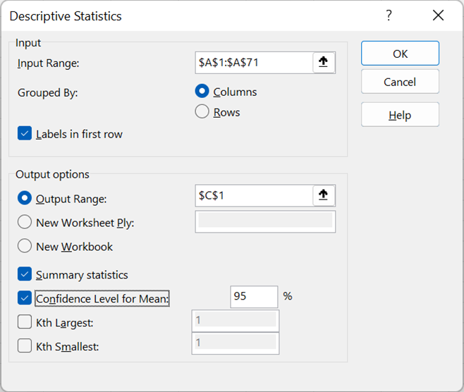
8.2 Excel: Compute a 95% Margin or Error Using the Descriptive Statistics Tool
Enter/Access Data: Open the file newbalance.
Apply Tools: Follow these steps in the Descriptive Statistics dialog box.
Step 1. Click the Data tab on the Ribbon
Step 2. In the Analyze group, click Data Analysis
Step 3. Choose Descriptive Statistics from the list of Analysis Tools
Step 4. In the Descriptive Statistics dialog box:
Enter A1:A71 in the Input Range: box
Select the check box for Labels in First Row
In the Output Options area:
Select Output Range: and enter C1
Select the check box for Summary Statistics Select the check box for Confidence Level for Mean: and enter 95
Click OK

Slide 17
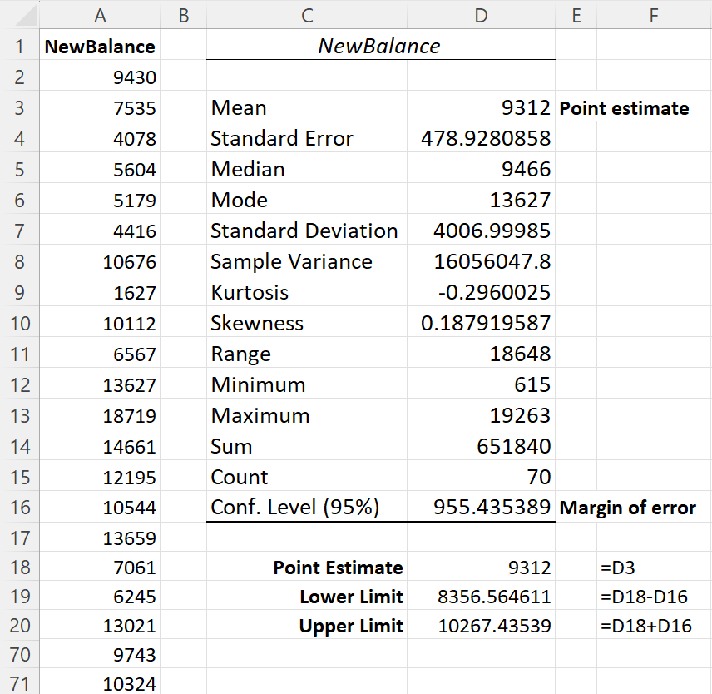
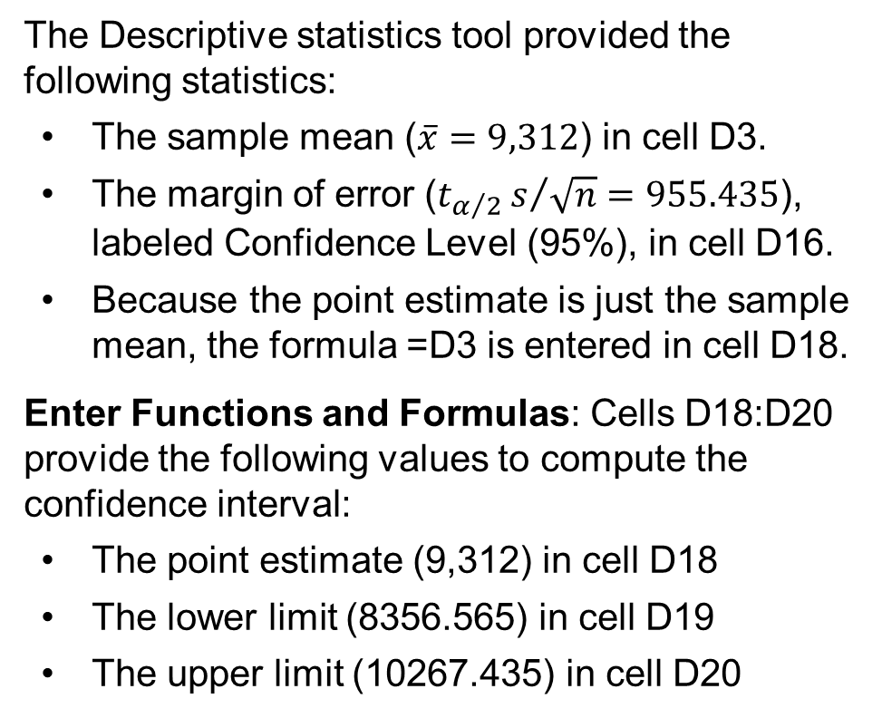
8.2 Excel: Construct a 95% Confidence Interval
The Descriptive statistics tool provided the following statistics:
The sample mean ($\overline{x}=9,312$) in cell D3.
The margin of error ($t_{α/2}s/{\sqrt{n}}=955.435$), labeled Confidence Level (95%), in cell D16.
Because the point estimate is just the sample mean, the formula =D3 is entered in cell D18.
Enter Functions and Formulas: Cells D18:D20 provide the following values to compute the confidence interval:
The point estimate (9,312) in cell D18
The lower limit (8356.565) in cell D19
The upper limit (10267.435) in cell D20

Slide 18
8.2 Practical Advice
Adequate Sample Size
The sampling distribution of $\overline{x}$ is normal if the underlying population distribution is normal; otherwise, a sample size of n ≥ 30 is required.
If the population distribution is highly skewed or contains outliers, a sample size of 50 or more is recommended.
If the population is not normally distributed but is roughly symmetric, a sample size as small as 15 will suffice.
If the population is believed to be at least approximately normal, a sample size of less than 15 can be used.
For small sample sizes, a histogram of the sample data should be built to learn about the shape of the population distribution.

Slide 19
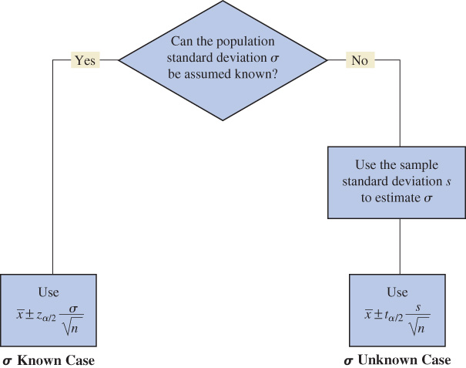
8.2 Summary of Interval Estimation Procedures for μ

Slide 20
8.3 Determining the Sample Size
Given a desired the margin of error $E$, selected prior to sampling such that
$$E=z_{α/2}\frac{σ}{\sqrt{n}}$$
The sample size necessary for the desired margin of error can be determined solving for $n$
$$n=\frac{{\left(z_{α/2}\right)}^{2}σ^{2}}{E^{2}}$$
A preliminary or planning value for the unknown population standard deviation 𝜎, may be determined using:
the estimate of the population standard deviation 𝜎, computed in a previous study.
a preliminary sample and the sample standard deviation $s,$ selected from a pilot study.
judgment or a “best guess” for the value of the population standard deviation, σ.

Slide 21
8.3 Application of Sample Size Determination
A previous study that investigated the cost of renting midsize automobiles found a mean cost of approximately $55 per day, with a standard deviation of $9.65.
Objective: conduct a new study to estimate the mean cost of renting midsize automobiles with a margin of error of $E=\$2$, a 95% confidence level, and a planning value for the population standard deviation, $σ=9.65$.
Thus, with a $\left(1−α\right)=0.95$ confidence coefficient, the $z$ value is $z_{0.025}=1.96$.
Plugging the values into the necessary sample size equation, we obtain
$$n=\frac{{\left(z_{α/2}\right)}^{2}σ^{2}}{E^{2}}=\frac{{\left(1.96\right)}^{2}{\left(9.65\right)}^{2}}{{\left(2\right)}^{2}}=89.43$$
In cases where the computed $n$ is not an integer, we round up to the next integer value.
Hence, the recommended sample size is 90 midsize automobile rentals.

Slide 22
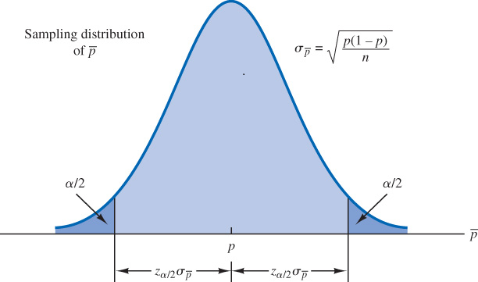
8.4 Population Proportion
The general form of an interval estimate of a
population proportion is
$$\overline{p}±z_{α/2}\sqrt{\frac{\overline{p}\left(1−\overline{p}\right)}{n}}$$
Where,
$1−α$ is the confidence coefficient, $z_{α/2}$ the z
value providing an area of α/2 in the upper tail
of the standard normal probability distribution,
and $\overline{p}$ the sample proportion.
The sampling distribution of $\overline{p}$ plays a key role in computing the margin of error for the interval estimate, and it can be approximated by a normal distribution whenever $n\overline{p}≥5$ and $n\left(1−\overline{p}\right)≥5$.

Slide 23
8.4 Application of Population Proportion Estimate
A national survey of 900 randomly selected patients was conducted to assess the satisfaction with the wait times patients experienced in the medical system.
The survey found that 396 patients were satisfied with the wait times they experienced.
Thus, the point estimate of the proportion of the population of patients who are satisfied with the wait times they experienced is
$$\overline{p}=\frac{396}{900}=0.44$$
Using the expression for the interval estimate of the population proportion at a 95% confidence level, we obtain
$$\overline{p}±z_{α/2}\sqrt{\frac{\overline{p}\left(1−\overline{p}\right)}{n}}=0.44±1.96\sqrt{\frac{0.44(1−0.44)}{900}}=0.44±0.0324$$
Thus, we are 95% confident that between $0.44 –0.0324=0.4076=40.76\%$ and $0.44+0.0324=0.4724=47.24\%$of all patients are satisfied with the wait times they experienced.

Slide 24
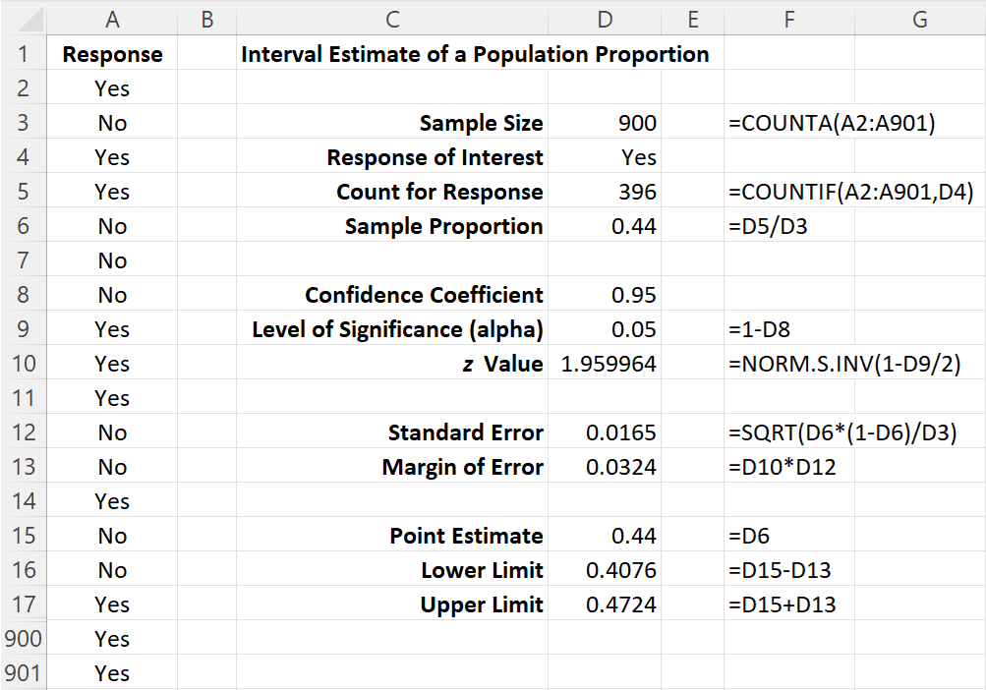
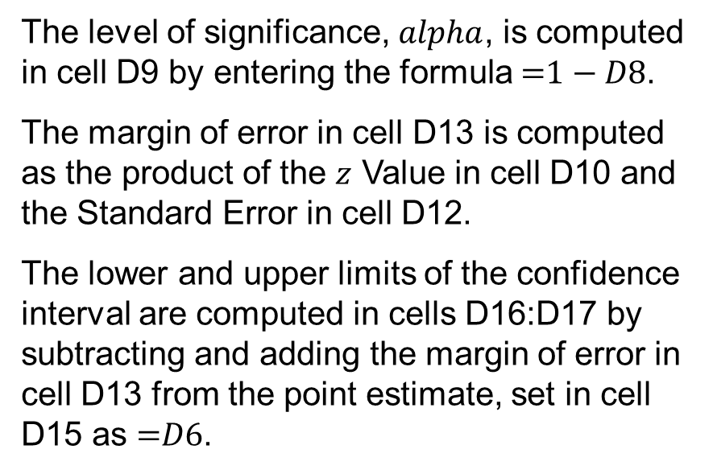
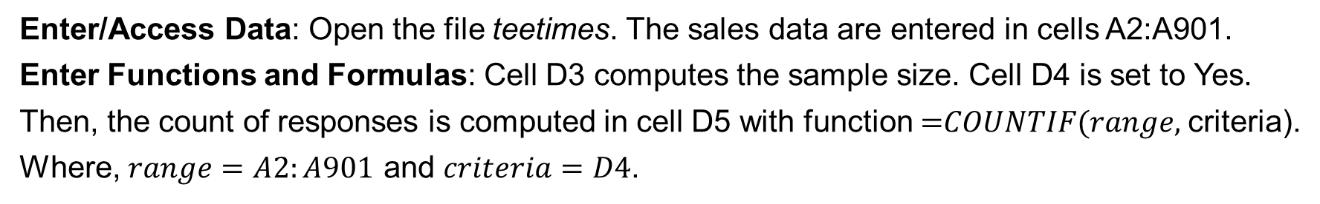
8.4 Excel: Construct a 95% Confidence Interval
Enter/Access Data: Open the file teetimes. The sales data are entered in cells A2:A901.
Enter Functions and Formulas: Cell D3 computes the sample size. Cell D4 is set to Yes.
Then, the count of responses is computed in cell D5 with function $\text{=}COUNTIF(range,$criteria).
Where, $range=A2:A901$ and $criteria=D4$.
The level of significance, $alpha$, is computed in cell D9 by entering the formula $\text{=}1−D8$.
The margin of error in cell D13 is computed as the product of the $z$ Value in cell D10 and the Standard Error in cell D12.
The lower and upper limits of the confidence interval are computed in cells D16:D17 by subtracting and adding the margin of error in cell D13 from the point estimate, set in cell D15 as $\text{=}D6$.

Slide 25
8.4 Determining the Sample Size for the Estimate of p
Given a desired the margin of error $E$, selected prior to sampling such that
$$E=z_{α/2}\sqrt{\frac{p^{∗}\left(1−p^{∗}\right)}{n}}$$
The sample size necessary for the desired margin of error can be determined solving for $n$
$$n=\frac{{\left(z_{α/2}\right)}^{2}p^{∗}\left(1−p^{∗}\right)}{E^{2}}$$
The planning value $p^{∗}$ replaces the unknown sample proportion, $\overline{p}$, and can be chosen using
the sample proportion $\overline{p}$ from a previous sample of the same or similar units.
the sample proportion $\overline{p}$ from a preliminary study as the planning value, $p^{∗}$.
a “best guess” for the value of $p^{∗}$.
a planning value of $p^{∗}=0.50$, if none of the preceding alternatives applies (*see notes.)
Notes:
Note: a planning value of p* = 0.50 always produces the largest sample size because p* = 0.50 maximizes the expression p*(1 – p*):
p* p*(1 - p*)____
0.1 (0.1)(0.9) = 0.09
0.2 (0.2)(0.8) = 0.16
0.3 (0.3)(0.7) = 0.21
0.4 (0.4)(0.6) = 0.24
0.5 (0.5)(0.5) = 0.25 ← largest value
0.6 (0.6)(0.4) = 0.24
0.7 (0.7)(0.3) = 0.21
0.8 (0.8)(0.2) = 0.16
0.9 (0.9)(0.1) = 0.09

Slide 26
8.4 Application of Sample Size Determination
As an application of sample size determination, consider again the national survey conducted to assess the satisfaction with the wait times patients experienced in the medical system.
In its preliminary version, we used a random sample of $n=900$ patients to estimate at a 95% confidence level the proportion of patients’ satisfaction with a 0.0324 margin of error.
If the requirement on the margin of error is 0.025 and the confidence level still 95%, we have
$$z_{α/2}=1.96$$
$$E=0.025$$
$$p^{∗}=\overline{p}=0.44 \text{from} \text{the} \text{preliminary} \text{study} \text{of} n=900 \text{patients}$$
The required sample size to estimate the proportion of patients’ wait times is
$$n=\frac{{\left(z_{α/2}\right)}^{2}p^{∗}\left(1−p^{∗}\right)}{E^{2}}=\frac{{\left(1.96\right)}^{2}0.44(1−0.44)}{{\left(0.025\right)}^{2}}=1,514.5≈1,515 \text{patients}$$
Thus, we need to survey an additional $1,515−900=615$ patients.

Slide 27
8.5 Practical Advice: Big Data and Confidence Intervals
A review of the equations for the calculations of confidence intervals for the population mean μ and population proportion p reveals that the sampling error decreases as the sample size increases.
This is due to the presence of $\sqrt{n}$ at the denominator of the standard error in the equations of the confidence intervals.
As the sample size becomes arbitrarily large, the margin of error becomes smaller and smaller and the resulting confidence intervals become so extremely narrow to have no longer any practical significance.
However, no interval estimate, no matter how precise, will accurately reflect the parameter being estimated unless the sample is relatively free of nonsampling error.
Therefore, when using interval estimation, it is always important to carefully consider whether a random sample of the population of interest has been taken.

Slide 28
Summary
In this chapter we presented methods for developing interval estimates of a population mean and a population proportion in the form of point estimate ± margin of error.
We presented interval estimates for a population mean for two cases.
σ known: historical data or other information is used to develop an estimate of $σ$ prior to taking a sample, and a confidence interval is built using the standard normal distribution
σ unknown: sample data are used to estimate $μ$ and $σ$, and a confidence interval is built using a $t$ distribution with $n–1$ degrees of freedom.
Practical advice about the sample size necessary to obtain good approximations was also included. In most cases, a sample size of at least 30 suffices.
The general form of the interval estimate for a population proportion based on the standard normal distribution was also given.
Finally, we discussed the ramifications of extremely large samples on the precision of confidence interval estimates of the mean and proportion.

