Slide 1


Slide 2
Chapter Contents
9.1 Developing Null and Alternative Hypotheses
9.2 Type I and Type II Errors
9.3 Population Mean: σ Known
9.4 Population Mean: σ Unknown
9.5 Population Proportion
9.6 Practical Advice: Big Data and Hypothesis Testing
Summary

Slide 3
Chapter Objectives (1 of 2)
After completing this chapter, you will be able to:
LO 9-1 Formulate appropriate one- and two-tailed null and alternative hypotheses for problem scenarios and interpret the results.
LO 9-2 Interpret the results of a hypothesis test.
LO 9-3 Identify the Type I error and Type II error associated with a hypothesis test and explain their potential consequences.
LO 9-4 Test one- and two-tailed hypotheses about a population mean when the population standard deviation σ is known using the p-value approach, critical value approach, and the confidence interval approach.
LO 9-5 Test one- and two-tailed hypotheses about a population mean when the population standard deviation σ is unknown using the p-value approach, critical value approach, and the confidence interval approach.

Slide 4
Chapter Objectives (2 of 2)
LO 9-6 Test one- and two-tailed hypotheses about a population proportion using the p-value approach, critical value approach, and the confidence interval approach.
LO 9-7 Calculate the probability of making a Type II error for a hypothesis test.
LO 9-8 Determine the sample size for a hypothesis test about a population mean.
LO 9-9 Distinguish between statistical significance and practical significance and identify when statistically significant results may lack practical significance.

Slide 5
Introduction
Hypothesis testing can be used to determine whether a statement about the value of a population parameter should or should not be rejected.
The hypothesis testing procedure uses data from a sample to test the two competing statements indicated by $H_{0}$ and $H_{a}$.
The null hypothesis, denoted by $H_{0}$, is a tentative assumption about a population parameter.
The alternative hypothesis, denoted by $H_{a}$, is the opposite of what is stated in the null hypothesis.
This chapter shows how hypothesis tests can be conducted about a population mean and a population proportion.
We begin by providing examples that illustrate approaches to developing null and alternative hypotheses.

Slide 6
9.1 Developing Null and Alternative Hypotheses
Care must be taken to understand the context of the situation and structure the hypotheses appropriately so that the test conclusion provides the desired information.
All hypothesis testing applications involve collecting a sample and using the sample results to provide evidence for drawing a conclusion.
Good questions to consider when formulating the null and alternative hypotheses are:
What is the purpose of collecting the sample?
What conclusions are we hoping to make?
In some situations, it is easier to identify the alternative hypothesis first, and then the null hypothesis. In other situations, starting with the null hypothesis is easier.
The examples in this section are intended to provide guidelines on how to formulate correct hypotheses.

Slide 7
9.1 The Alternative Hypothesis as a Research Hypothesis
When an attempt is being made to gather evidence in support of a research hypothesis, it is often best to begin with the alternative hypothesis and make it the conclusion that the researcher hopes to support.
The conclusion that the research hypothesis is true is made if the sample data provide sufficient evidence to show that the null hypothesis can be rejected.
Example: A new fuel injection unit being developed is believed to provide more than 24 miles per gallon.
So, we set the population mean miles per gallon, $μ>24$, as the alternative hypothesis, and the null hypothesis as $μ≤24$.
$H_{0}: μ≤24$
$H_{a}: μ>24$

Slide 8
9.1 The Null Hypothesis as an Assumption to be Challenged
We might begin with a belief or assumption that a statement about the value of a population parameter is true.
We then use a hypothesis test to challenge the assumption and determine if there is statistical evidence to conclude that the assumption is incorrect.
In these situations, it is helpful to develop the null hypothesis first.
Example: The label on a soft drink bottle states that it contains 67.6 fluid ounces.
We assume the label correct, provided the population mean filling weight, μ, is 67.6 fluid ounces, and set it as the null hypothesis. Then, we challenge the assumption in the alternative hypothesis.
$H_{0}: μ=67.6$
$H_{a}: μ≠67.6$

Slide 9
9.1 Summary of Forms for Null and Alternative Hypotheses
The equality part of the hypotheses always appears in the null hypothesis.
In general, a hypothesis test about the value of a population mean μ must take one of the following three forms, where $μ_{0}$ is the hypothesized value of the population mean.
In this chapter, we show how statistical inference from sample results can be used together with hypothesis testing to determine whether a statement about the value of a population parameter should or should not be rejected.
If the sample results support $H_{a}$, then we reject $H_{0}$. Otherwise, we do not reject $H_{0}$.
One-tailed (Lower-tail) | One-tailed (Upper-tail) | Two-tailed
$$H_{0}: μ≥μ_{0}$$ | $$H_{0}: μ≤μ_{0}$$ | $$H_{0}: μ=μ_{0}$$
$$H_{a}: μ<μ_{0}$$ | $$H_{a}: μ>μ_{0}$$ | $$H_{a}: μ≠μ_{0}$$

Slide 10
9.2 Type I and Type II Errors
Because hypothesis tests are based on sample data, we must allow for the possibility of errors.
There are two types of error that can be made in hypothesis tests: Type I and Type II errors.
Type I Error
Type II Error
A Type I error is rejecting $H_{0}$ when it is true.
The probability of making a Type I error when the null hypothesis is true as an equality is called the level of significance.
Applications of hypothesis testing that only control for the Type I error are often called significance tests.
A Type II error is accepting $H_{0}$ when it is false.
It is difficult to control for the probability of making a Type II error (*see notes.)
Statisticians avoid the risk of making a Type II error by using “do not reject $H_{0}$” rather than “accept $H_{0}$”.
Notes:
*Note: Although controlling for a Type II error in hypothesis testing is not common, it can be done. In Sections 9.7 and 9.8, we will illustrate procedures for determining and controlling the probability of making a Type II error. If proper controls have been established for this error, action based on the “accept $H_{0}$” conclusion can be appropriate.

Slide 11
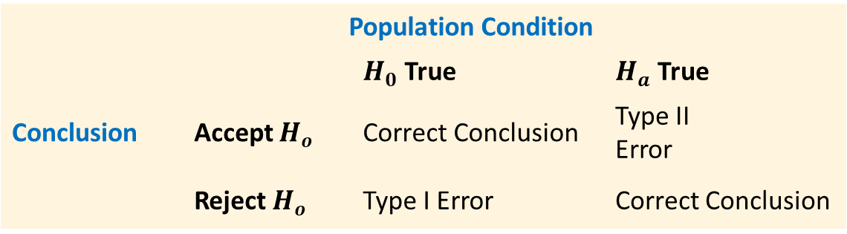
9.2 Example of Type I and Type II Errors
Recall the hypothesis testing example about the new fuel injection unit.
$H_{0}: μ≤24$
$H_{a}: μ>24$
In this situation, the Type I error of rejecting $H_{0}$ when true corresponds to claiming that the new system improves the miles-per-gallon rating ($μ>24$) when in fact it does not.
In contrast, the Type II error of accepting $H_{0}$ when false corresponds to claiming that the new system does not improve the miles-per-gallon rating ($μ≤24$) when in fact it does.
 |  | Population Condition
 |  | $H_{0}$ True | $H_{a}$ True
Conclusion | Accept $H_{o}$ | Correct Conclusion | Type II Error
 | Reject $H_{o}$ | Type I Error | Correct Conclusion

Slide 12
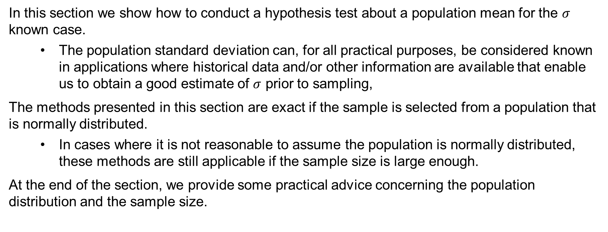
9.3 Population Mean: σ Known
In this section we show how to conduct a hypothesis test about a population mean for the $σ$ known case.
The population standard deviation can, for all practical purposes, be considered known in applications where historical data and/or other information are available that enable us to obtain a good estimate of $σ$ prior to sampling,
The methods presented in this section are exact if the sample is selected from a population that is normally distributed.
In cases where it is not reasonable to assume the population is normally distributed, these methods are still applicable if the sample size is large enough.
At the end of the section, we provide some practical advice concerning the population distribution and the sample size.

Slide 13
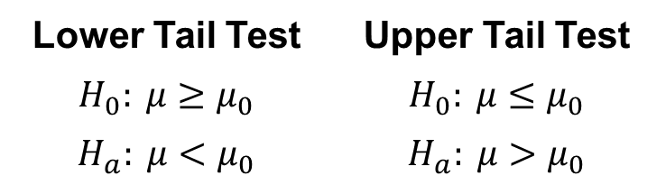
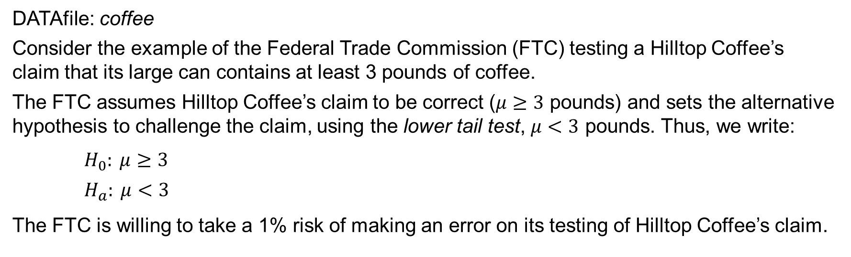
9.3 One-Tailed Test About a Population Mean
One-tailed tests about a population mean take one of the following two forms.
Lower Tail Test | Upper Tail Test
$$H_{0}: μ≥μ_{0}$$ | $$H_{0}: μ≤μ_{0}$$
$$H_{a}: μ<μ_{0}$$ | $$H_{a}: μ>μ_{0}$$
DATAfile: coffee
Consider the example of the Federal Trade Commission (FTC) testing a Hilltop Coffee’s claim that its large can contains at least 3 pounds of coffee.
The FTC assumes Hilltop Coffee’s claim to be correct ($μ≥3$ pounds) and sets the alternative hypothesis to challenge the claim, using the lower tail test, $μ<3$ pounds. Thus, we write:
$H_{0}: μ≥3$
$H_{a}: μ<3$
The FTC is willing to take a 1% risk of making an error on its testing of Hilltop Coffee’s claim.

Slide 14
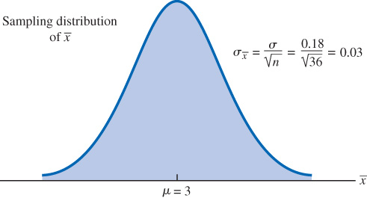
9.3 Test Statistic for the Hilltop Coffee Example (Population Mean: σ Known)
Suppose a sample of $n=36$ cans of coffee is selected, and the sample mean $\overline{x}$ is computed as an estimate of the population mean μ.
Also, previous FTC tests show that the population of filling weights can be assumed normally distributed with a known standard deviation of value $σ=0.18$.
We can write the sampling distribution of $\overline{x}$ as normally distributed, centered around the hypothesized mean, ${μ=μ}_{0}=3$, and with standard error, $σ_{\overline{x}}=σ/{\sqrt{n}}={0.18}/{\sqrt{36}}=0.03$.
For the test statistic of a hypothesis test about a population mean: σ known, we can use the standard normal random variable, $z$.
Formally, we write:
$$z=\frac{\overline{x}−μ_{0}}{σ_{\overline{x}}}$$

Slide 15
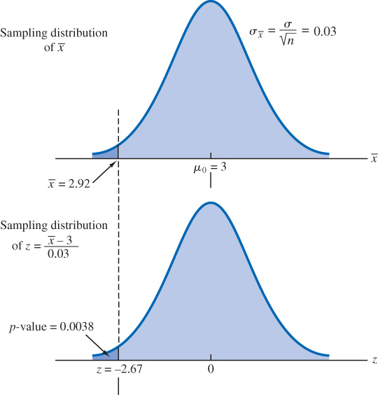
9.3 p-Value Approach to a Lower Tail Test About a Population Mean: σ Known
A p-value is a probability, computed using the test statistic, that measures the support provided by the sample for the null hypothesis.
Suppose the sample of $n=36$ coffee cans revealed $\overline{x}=2.92$ pounds. Then, the test statistic is
$$z=\frac{\overline{x}−μ_{0}}{σ_{\overline{x}}}=\frac{2.92−3}{0.03}=−2.67$$
For a lower tail test, the p-value is the probability that z is less than or equal to −2.67.
$$p\text{−}\text{value}=P\left(z≤−2.67\right)=0.038$$
This p-value indicates a small probability of obtaining a sample mean of $\overline{x}=2.92$ or smaller when sampling from a population with $μ=3$.

Slide 16
9.3 Rejection Rule Using p-Value
In the previous slide, we concluded that the calculated p-value does not provide much support for the null hypothesis, but is it small enough to cause us to reject $H_{0}$?
The answer depends upon the level of significance $α$ for the test:
If a p-value is less than or equal to the level of significance $α$, the value of the test statistic is in the rejection region.
Because the FTC stated to be willing to take a 1% risk of making a Type I error, we set the significance level $α=0.01$.
We write the rejection rule using the p-value as:
Reject $H_{0}$ if p-value ≤ α
With the $p\text{−}\text{value}=0.0038$ being less than or equal to $α= 0.01$, we reject $H_{0}$.
Therefore, the FTC finds sufficient statistical evidence to conclude at the 0.01 level of significance that the filling weight of Hilltop Coffee cans is less than 3 pounds.

Slide 17
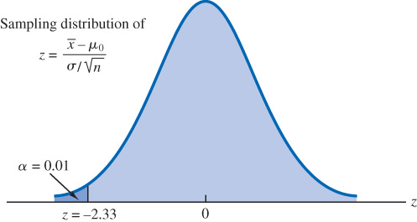
9.3 Rejection Rule Using Critical Value for a One-Tailed Test
We can use the standard normal probability distribution to find the 𝑧-value with an area of $α$ in the lower (or upper) tail of the distribution.
The value of the test statistic that establishes the boundary of the rejection region is called the critical value for the test.
The rejection rule for a one-tailed test using the critical value is:
Lower tail: Reject $H_{0}$ if $z≤z_{α}$
Upper tail: Reject $H_{0}$ if $z≥z_{α}$
$z_{α}$ is such that $P\left(z≤z_{α}\right)=α$. In the Hilltop
Coffee case, when $α=0.01$, $z_{α}=−2.33$.
The rejection rule for a lower tail test becomes
$$\text{Reject} H_{0} \text{if} z≤−2.33$$
Because $z=−2.67$, we reject $H_{0}$.

Slide 18
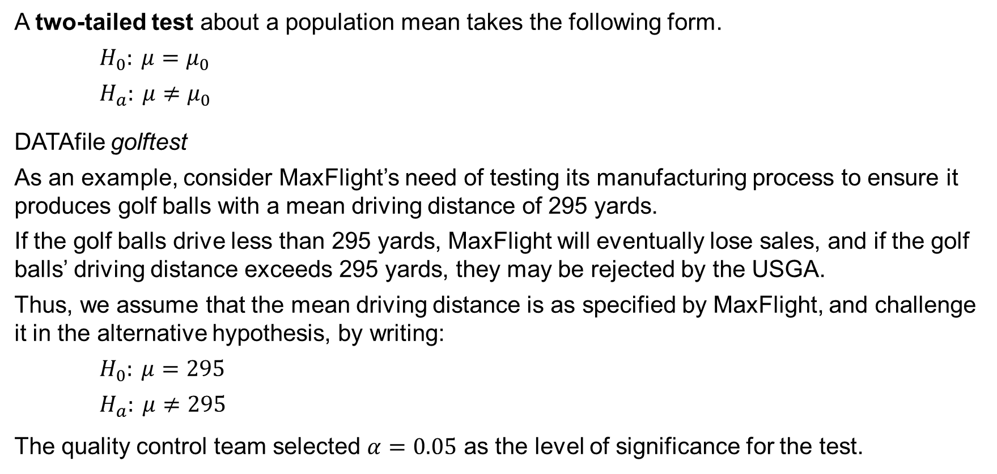
9.3 Two-Tailed Test About a Population Mean
A two-tailed test about a population mean takes the following form.
$H_{0}: μ=μ_{0}$
$H_{a}: μ≠μ_{0}$
DATAfile golftest
As an example, consider MaxFlight’s need of testing its manufacturing process to ensure it produces golf balls with a mean driving distance of 295 yards.
If the golf balls drive less than 295 yards, MaxFlight will eventually lose sales, and if the golf balls’ driving distance exceeds 295 yards, they may be rejected by the USGA.
Thus, we assume that the mean driving distance is as specified by MaxFlight, and challenge it in the alternative hypothesis, by writing:
$H_{0}: μ=295$
$H_{a}: μ≠295$
The quality control team selected $α=0.05$ as the level of significance for the test.

Slide 19
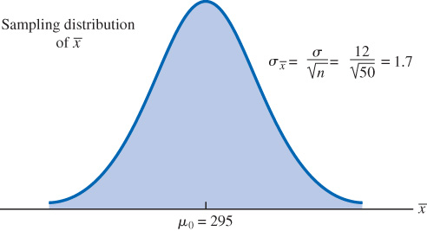
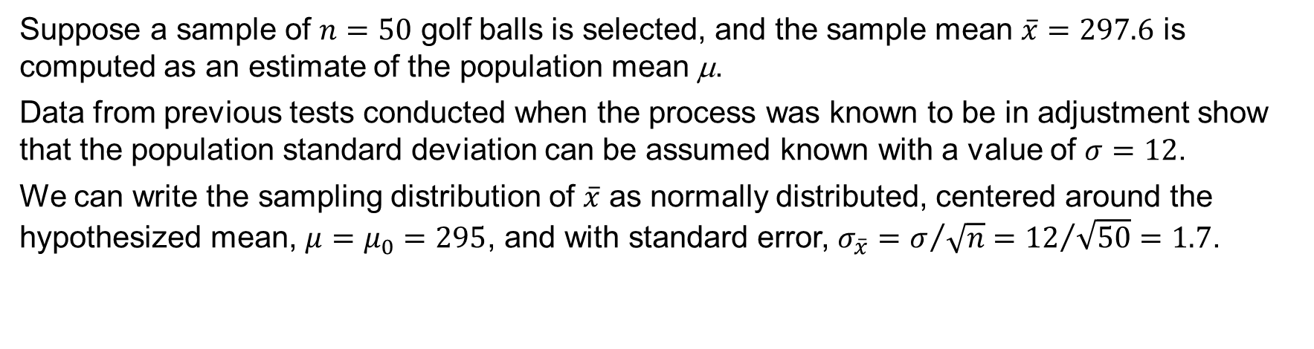
9.3 Test Statistic for the MaxFlight Example (Population Mean: σ Known)
Suppose a sample of $n=50$ golf balls is selected, and the sample mean $\overline{x}=297.6$ is computed as an estimate of the population mean μ.
Data from previous tests conducted when the process was known to be in adjustment show that the population standard deviation can be assumed known with a value of $σ=12$.
We can write the sampling distribution of $\overline{x}$ as normally distributed, centered around the hypothesized mean, ${μ=μ}_{0}=295$, and with standard error, $σ_{\overline{x}}=σ/{\sqrt{n}}={12}/{\sqrt{50}}=1.7$.
We write the test statistic of a hypothesis test about a population mean: σ known, using the standard normal random variable, $z$, as:
$$z=\frac{\overline{x}−μ_{0}}{σ_{\overline{x}}}=\frac{297.6−295}{1.7}=1.53$$

Slide 20
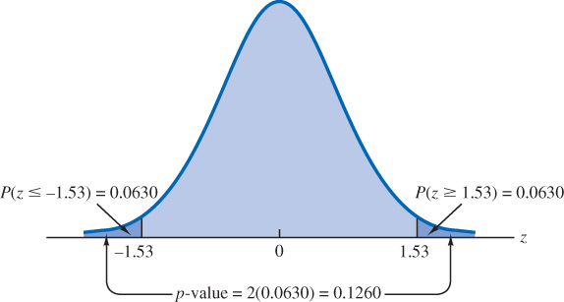
9.3 p-Value Approach to a Two-Tailed Test
For the MaxFlight two-tailed test, the p-value corresponds to the probability of finding a value for z that is at least as unlikely as $z=1.53$.
For a two-tailed test of a symmetric sampling distribution, values of $z≥1.53$ are just as unlikely as values of $z≤−1.53$. Thus, we can write the p-value as:
$$p\text{−}\text{value}=P\left(z≤−1.53\right)+P\left(z≥1.53\right)$$
Because the normal distribution is symmetric,
we can calculate the p-value as
$$p\text{−}\text{value}=2P\left(z≤−1.53\right)=$$
$$2\left(0.0630\right)=0.1260$$
Next, we apply the rejection rule:
Because $p\text{−}\text{value}=0.1260>0.05$, we
cannot reject $H_{0}$. Thus, no action will be taken
to adjust the MaxFlight’s manufacturing process.

Slide 21
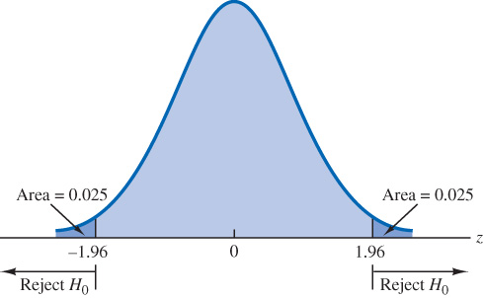
9.3 Rejection Rule Using Critical Value for a Two-Tailed Test
The rejection rule for a two-tailed test using the
critical value is:
Reject $H_{0}$ if $z≤{−z}_{α/2} \text{or} z≥z_{α/2}$
In the MaxFlight case, we have $α=0.05$.
Thus, $α/2=0.025$, and $z_{α/2}=z_{.025}=1.96$.
The rejection rule for this two-tail test becomes
$\text{Reject} H_{0} \text{if} z≤−1.96 \text{or} z≥1.96$.
Because the value of the test statistic for the MaxFlight study is $z=1.53$, the statistical evidence will not permit us to reject the null hypothesis at the 0.05 level of significance.

Slide 22
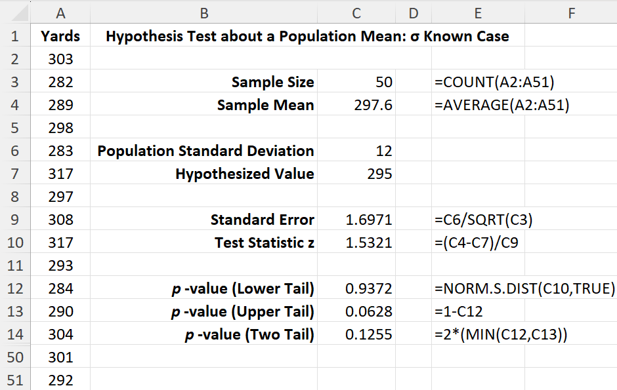
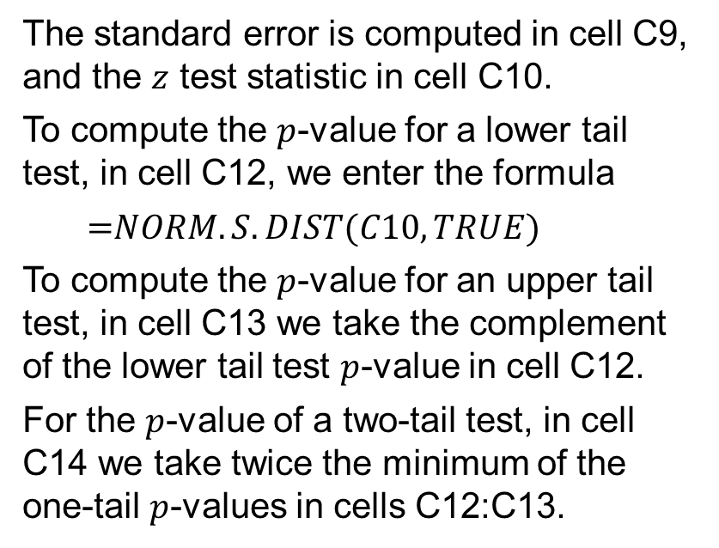
9.3 Excel: Conduct a Hypothesis Test
Enter/Access Data: Open the file golftest. The sales data are entered in cells A2:A51.
Enter Functions and Formulas: The sample size and sample mean are computed in cells C3:C4 using Excel’s COUNT and AVERAGE functions, respectively.
The standard error is computed in cell C9, and the $z$ test statistic in cell C10.
To compute the $p$-value for a lower tail test, in cell C12, we enter the formula
$$\text{=}NORM.S.DIST(C10,TRUE)$$
To compute the $p$-value for an upper tail test, in cell C13 we take the complement of the lower tail test $p$-value in cell C12.
For the $p$-value of a two-tail test, in cell C14 we take twice the minimum of the one-tail $p$-values in cells C12:C13.

Slide 23
9.3 Summary of Hypothesis Tests About a Population Mean: σ Known Case
 | Lower Tail Test | Upper Tail Test | Two-Tailed Test
Hypotheses | $$H_{0}: μ≥μ_{0}$$ $$H_{a}: μ<μ_{0}$$ | $$H_{0}: μ≤μ_{0}$$ $$H_{a}: μ>μ_{0}$$ | $$H_{0}: μ=μ_{0}$$ $$H_{a}: μ≠μ_{0}$$
Test Statistic | $$z=\frac{\overline{x}−μ_{0}}{σ/{\sqrt{n}}}$$ | $$z=\frac{\overline{x}−μ_{0}}{σ/{\sqrt{n}}}$$ | $$z=\frac{\overline{x}−μ_{0}}{σ/{\sqrt{n}}}$$
Rejection Rule: p-Value Approach | Reject H₀ if p-value ≤ α | Reject H₀ if p-value ≤ α | Reject H₀ if p-value ≤ α
Rejection Rule: Critical Value Approach | Reject H₀ if z ≤ $−z_{α}$ | Reject H₀ if z ≥ $z_{α}$ | Reject H₀ if z ≤ $−z_{α/2}$ or z ≥ $z_{α/2}$

Slide 24
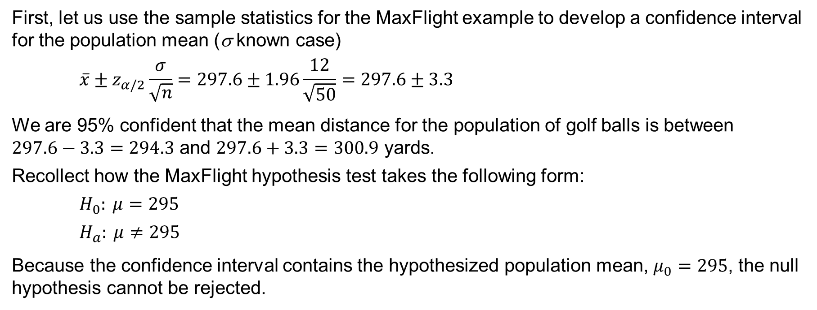
9.3 A Confidence Interval Approach to the Testing of a Hypothesis
First, let us use the sample statistics for the MaxFlight example to develop a confidence interval for the population mean (σ known case)
$$\overline{x}±z_{α/2}\frac{σ}{\sqrt{n}}=297.6±1.96\frac{12}{\sqrt{50}}=297.6±3.3$$
We are 95% confident that the mean distance for the population of golf balls is between $297.6−3.3=294.3$ and $297.6+3.3=300.9$ yards.
Recollect how the MaxFlight hypothesis test takes the following form:
$H_{0}: μ=295$
$H_{a}: μ≠295$
Because the confidence interval contains the hypothesized population mean, $μ_{0}=295$, the null hypothesis cannot be rejected.

Slide 25
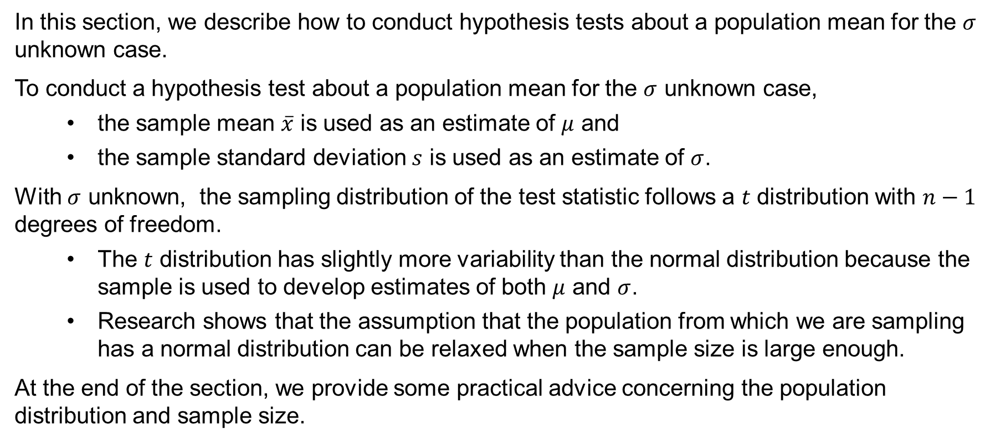
9.4 Population Mean: σ Unknown
In this section, we describe how to conduct hypothesis tests about a population mean for the $σ$ unknown case.
To conduct a hypothesis test about a population mean for the $σ$ unknown case,
the sample mean $\overline{x}$ is used as an estimate of $μ$ and
the sample standard deviation $s$ is used as an estimate of $σ$.
With $σ$ unknown, the sampling distribution of the test statistic follows a $t$ distribution with $n−1$ degrees of freedom.
The $t$ distribution has slightly more variability than the normal distribution because the sample is used to develop estimates of both $μ$ and $σ$.
Research shows that the assumption that the population from which we are sampling has a normal distribution can be relaxed when the sample size is large enough.
At the end of the section, we provide some practical advice concerning the population distribution and sample size.

Slide 26
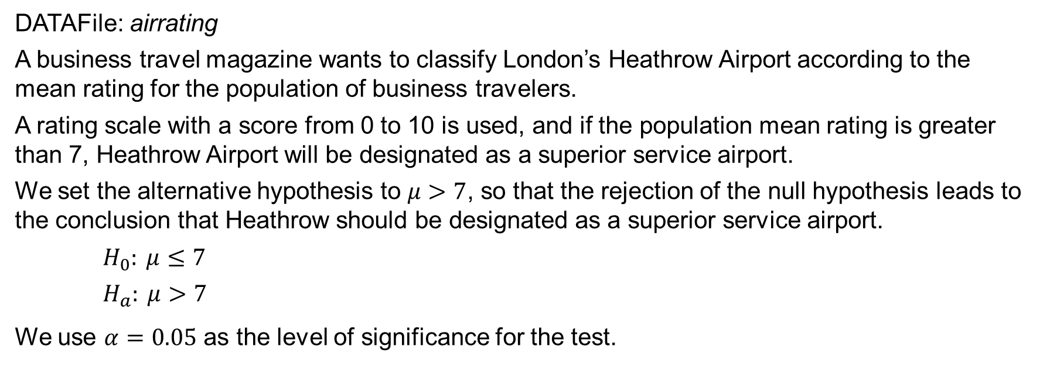
9.4 A One-Tailed Test Example About a Population Mean
DATAFile: airrating
A business travel magazine wants to classify London’s Heathrow Airport according to the mean rating for the population of business travelers.
A rating scale with a score from 0 to 10 is used, and if the population mean rating is greater than 7, Heathrow Airport will be designated as a superior service airport.
We set the alternative hypothesis to $μ>7$, so that the rejection of the null hypothesis leads to the conclusion that Heathrow should be designated as a superior service airport.
$H_{0}: μ≤7$
$H_{a}: μ>7$
We use $α=0.05$ as the level of significance for the test.

Slide 27
9.4 Test Statistic for the Air Ratings Example (Population Mean: σ Unknown)
In Section 8.2 we learned that when we use the sample standard deviation, $s$, as an estimate of the population standard deviation, σ, the sampling distribution of $\overline{x}$ follows a $t$ distribution with $n−1$ degrees of freedom.
The test statistic for hypothesis tests about a population mean when σ is unknown is
$$t=\frac{\overline{x}−μ_{0}}{s/{\sqrt{n}}}$$
The surveyed sample of $n=60$business travelers at Heathrow Airport provided sample mean rating $\overline{x}=7.25$, and sample standard deviation $s=1.052$ (*see notes.) Thus, we have
$$t=\frac{\overline{x}−μ_{0}}{s/{\sqrt{n}}}=\frac{7.25−7}{{1.052}/{\sqrt{60}}}=1.84$$
The p-value is in the upper tail of a $t$ distribution with $n−1=59$ degrees of freedom.
$$p\text{−}\text{value}=P(t≥1.84)$$
Notes:
*Note: The applicability of the hypothesis testing procedures of this section is dependent on the distribution of the population being sampled from and the sample size. When the population is normally distributed, the hypothesis tests described in this section provide exact results for any sample size. When the population is not normally distributed, the procedures are approximations. Nonetheless, we find that sample sizes of 30 or greater will provide good results in most cases. If the population is approximately normal, small sample sizes (e.g., n< 15) can provide acceptable results. If the population is highly skewed or contains outliers, sample sizes approaching 50 are recommended.

Slide 28
9.4 p-Value Approach to a One-Tailed Test About a Population Mean: σ Unknown
The $t$ distribution table included in most textbooks will only provide information about a range of p-values.
For instance, using Table 2 in Appendix B, the $t$ distribution with 59 degrees of freedom provides the following information.
Area in upper tail | 0.20 | 0.10 | 0.05 | 0.025 | 0.01 | 0.005
t Value ($df=59$) | 0.848 | 1.296 | 1.671 | 2.001 | 2.391 | 2.662
Because $t=1.84$ is between 1.671 and 2.001, the values in the “Area in Upper Tail” row show that the p-value range must be: $0.025≤p\text{−}\text{value}≤ 0.05$.
We can also use Excel to compute the exact p-value as: $\text{=}\text{T}\text{.}\text{DIST}\text{.}\text{RT}\text{(1.84,59)}=0.0354$
Either approach allows us to make the decision to reject the null hypothesis and conclude that Heathrow should be classified as a superior service airport.

Slide 29
9.4 Critical Value Approach to a One-Tailed Test About a Population Mean: σ Unknown
The decision of whether to reject the null hypothesis in the σ unknown case can also be made using the critical value approach.
We use the same information from Table 2 in Appendix B we just considered for the p-value approach.
Area in upper tail | 0.20 | 0.10 | 0.05 | 0.025 | 0.01 | 0.005
t Value ($df=59$) | 0.848 | 1.296 | 1.671 | 2.001 | 2.391 | 2.662
The critical value corresponding to an area of $α=0.05$ in the upper tail of a $t$ distribution with 59 degrees of freedom is $t_{0.05}=1.671.$
We can also use Excel to compute the critical value as: $\text{=}\text{T}\text{.}\text{INV}\text{(}\text{1}‒\text{0.05}\text{,59)}=1.671$
Thus, because the rejection rule in this example is $t=1.84≥1.671=t_{0.05}$, we can conclude that Heathrow should be classified as a superior service airport.

Slide 30
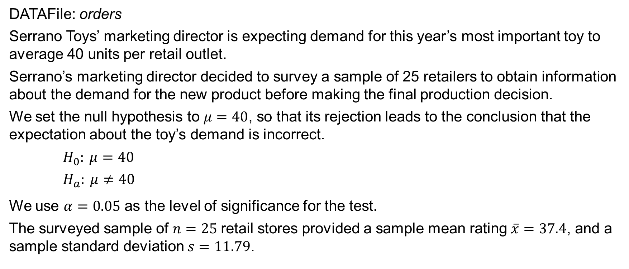
9.4 Two-Tailed Test Example About a Population Mean
DATAFile: orders
Serrano Toys’ marketing director is expecting demand for this year’s most important toy to average 40 units per retail outlet.
Serrano’s marketing director decided to survey a sample of 25 retailers to obtain information about the demand for the new product before making the final production decision.
We set the null hypothesis to $μ=40$, so that its rejection leads to the conclusion that the expectation about the toy’s demand is incorrect.
$H_{0}: μ=40$
$H_{a}: μ≠40$
We use $α=0.05$ as the level of significance for the test.
The surveyed sample of $n=25$retail stores provided a sample mean rating $\overline{x}=37.4$, and a sample standard deviation $s=11.79$.

Slide 31
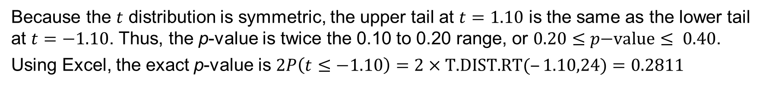
9.4 p-Value Approach to a Two-Tailed Test About a Population Mean: σ Unknown
The test statistic for the population mean, σ unknown case is
$$t=\frac{\overline{x}−μ_{0}}{s/{\sqrt{n}}}=\frac{37.4−40}{{11.79}/{\sqrt{25}}}=−1.10$$
Because we have a two-tailed test, the p-value is two times the area under the curve of the $t$ distribution for $t≤−1.10$, and with $n−1=24$ degrees of freedom.
Using Table 2 in Appendix B, the t distribution table for 24 degrees of freedom provides
Area in upper tail | 0.20 | 0.10 | 0.05 | 0.025 | 0.01 | 0.005
t Value ($df=24$) | 0.857 | 1.318 | 1.711 | 2.064 | 2.492 | 2.797
Because the $t$ distribution is symmetric, the upper tail at $t=1.10$ is the same as the lower tail at $t=−1.10$. Thus, the p-value is twice the 0.10 to 0.20 range, or $0.20≤p\text{−}\text{value}≤ 0.40$.
Using Excel, the exact p-value is $2P\left(t≤−1.10\right)=\text{2}×\text{T}\text{.}\text{DIST}\text{.}\text{RT}\text{(}‒\text{1.10}\text{,}\text{24}\text{)}=0.2811$

Slide 32
9.4 Critical Value Approach to a Two-Tailed Test About a Population Mean: σ Unknown
For a two-tail test, σ unknown case, Table 2 in Appendix B provides the critical value with 24 degrees of freedom as
Area in upper tail | 0.20 | 0.10 | 0.05 | 0.025 | 0.01 | 0.005
t Value ($df=24$) | 0.857 | 1.318 | 1.711 | 2.064 | 2.492 | 2.797
Thus, the two critical values for a two-tailed test are ${−t}_{.025}=−2.064$ and $t_{.025}=2.064$.
We can also use Excel to compute the critical values as: $\text{=}\text{T}\text{.}\text{INV}\text{(}\text{1}‒\text{.025}\text{,}\text{24}\text{)}=2.064$
Using either approach, we have the following rejection rules:
p-value approach: Reject $H_{0}$ if $p\text{−}value≤0.05$
critical value approach: $\text{Reject} H_{0} \text{if} t≤−2.064 \text{or} t≥2.064$
Thus, $H_{0}$ cannot be rejected, and Serrano should continue its production planning for the coming season based on an expected demand of 40 toys per retail store.

Slide 33
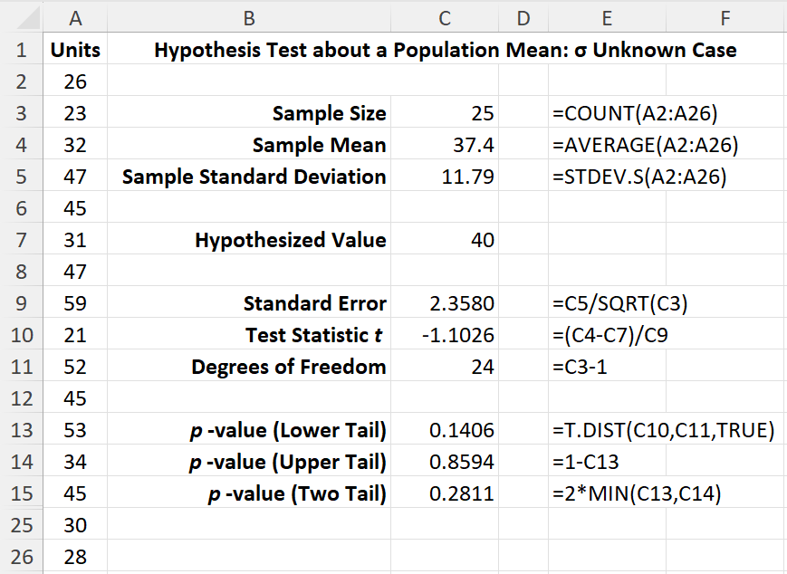
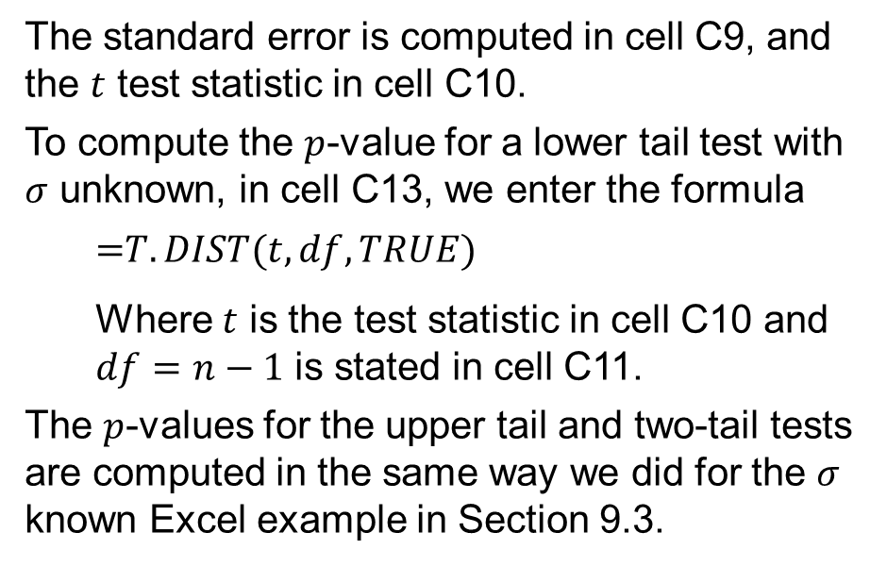
9.4 Excel: Conduct a Hypothesis Test
Enter/Access Data: Open the file orders. The data are entered in cells A2:A26.
Enter Functions and Formulas: The sample size, sample mean, and sample standard deviation are computed in cells C3:C5 using Excel’s COUNT, AVERAGE, and STDEV.S functions, respectively.
The standard error is computed in cell C9, and the $t$ test statistic in cell C10.
To compute the $p$-value for a lower tail test with $σ$ unknown, in cell C13, we enter the formula
$$\text{=}T.DIST(t,df,TRUE)$$
Where $t$ is the test statistic in cell C10 and $df=n−1$ is stated in cell C11.
The $p$-values for the upper tail and two-tail tests are computed in the same way we did for the $σ$ known Excel example in Section 9.3.

Slide 34
9.4 Summary of Hypothesis Tests About a Population Mean: σ Unknown Case
 | Lower Tail Test | Upper Tail Test | Two-Tailed Test
Hypotheses | $$H_{0}: μ≥μ_{0}$$ $$H_{a}: μ<μ_{0}$$ | $$H_{0}: μ≤μ_{0}$$ $$H_{a}: μ>μ_{0}$$ | $$H_{0}: μ=μ_{0}$$ $$H_{a}: μ≠μ_{0}$$
Test Statistic | $$t=\frac{\overline{x}−μ_{0}}{s/{\sqrt{n}}}$$ | $$t=\frac{\overline{x}−μ_{0}}{s/{\sqrt{n}}}$$ | $$t=\frac{\overline{x}−μ_{0}}{s/{\sqrt{n}}}$$
Rejection Rule: p-Value Approach | Reject H₀ if p-value ≤ α | Reject H₀ if p-value ≤ α | Reject H₀ if p-value ≤ α
Rejection Rule: Critical Value Approach | Reject H₀ if t ≤ $−t_{α}$ | Reject H₀ if t ≥ $t_{α}$ | Reject H₀ if t ≤ $−t_{α/2}$ or t ≥ $t_{α/2}$

Slide 35
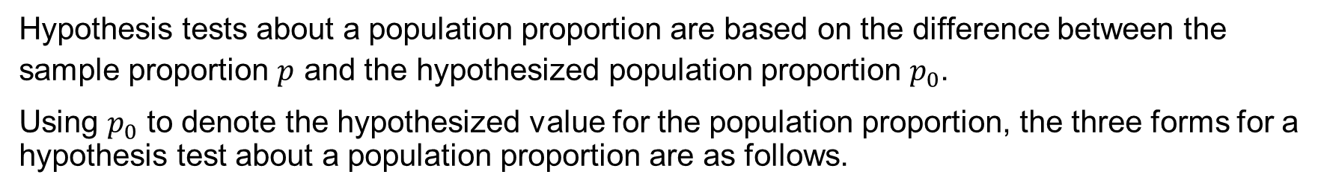
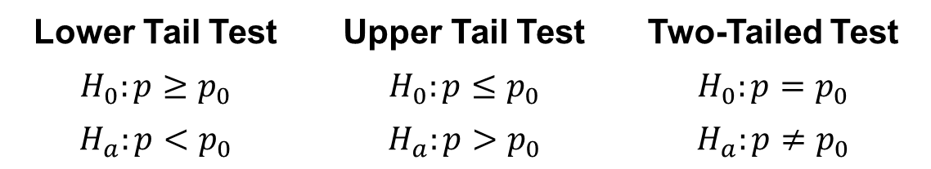
9.5 Population Proportion
Hypothesis tests about a population proportion are based on the difference between the sample proportion $p$ and the hypothesized population proportion $p_{0}$.
Using $p_{0}$ to denote the hypothesized value for the population proportion, the three forms for a hypothesis test about a population proportion are as follows.
Lower Tail Test | Upper Tail Test | Two-Tailed Test
$$H_{0}:p≥p_{0}$$ | $$H_{0}:p≤p_{0}$$ | $$H_{0}:p=p_{0}$$
$$H_{a}:p<p_{0}$$ | $$H_{a}:p>p_{0}$$ | $$H_{a}:p{≠p}_{0}$$
The methods used to conduct the hypothesis test are similar to those used for hypothesis tests about a population mean.
The only difference is that we use the sample proportion and its standard error to compute the test statistic.

Slide 36
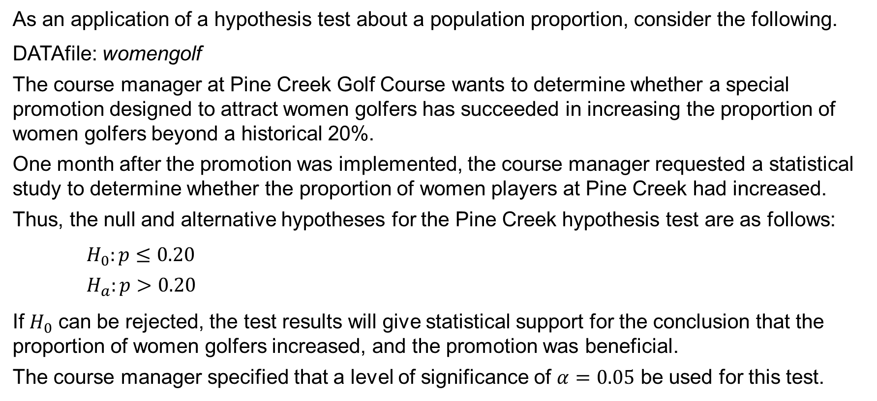
9.5 A Hypothesis Test About a Population Proportion
As an application of a hypothesis test about a population proportion, consider the following.
DATAfile: womengolf
The course manager at Pine Creek Golf Course wants to determine whether a special promotion designed to attract women golfers has succeeded in increasing the proportion of women golfers beyond a historical 20%.
One month after the promotion was implemented, the course manager requested a statistical study to determine whether the proportion of women players at Pine Creek had increased.
Thus, the null and alternative hypotheses for the Pine Creek hypothesis test are as follows:
$H_{0}:p≤0.20$
$H_{a}:p>0.20$
If $H_{0}$ can be rejected, the test results will give statistical support for the conclusion that the proportion of women golfers increased, and the promotion was beneficial.
The course manager specified that a level of significance of $α=0.05$ be used for this test.

Slide 37
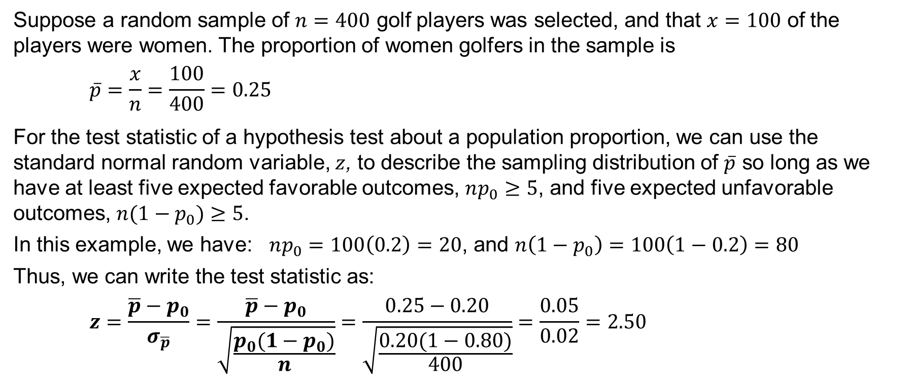
9.5 Test Statistic for a Population Proportion
Suppose a random sample of $n=400$ golf players was selected, and that $x=100$ of the players were women. The proportion of women golfers in the sample is
$$\overline{p}=\frac{x}{n}=\frac{100}{400}=0.25$$
For the test statistic of a hypothesis test about a population proportion, we can use the standard normal random variable, $z$, to describe the sampling distribution of $\overline{p}$ so long as we have at least five expected favorable outcomes, $np_{0}≥5$, and five expected unfavorable outcomes, $n(1−p_{0})≥5$.
In this example, we have: $np_{0}=100\left(0.2\right)=20$, and $n\left(1−p_{0}\right)=100\left(1−0.2\right)=80$
Thus, we can write the test statistic as:
$$z=\frac{\overline{p}−p_{0}}{σ_{\overline{p}}}=\frac{\overline{p}−p_{0}}{\sqrt{\frac{p_{0}({1−p}_{0})}{n}}}=\frac{0.25−0.20}{\sqrt{\frac{0.20(1−0.80)}{400}}}=\frac{0.05}{0.02}=2.50$$

Slide 38
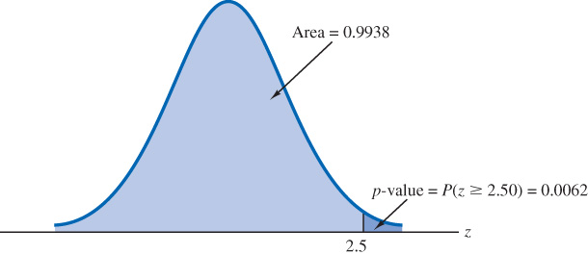
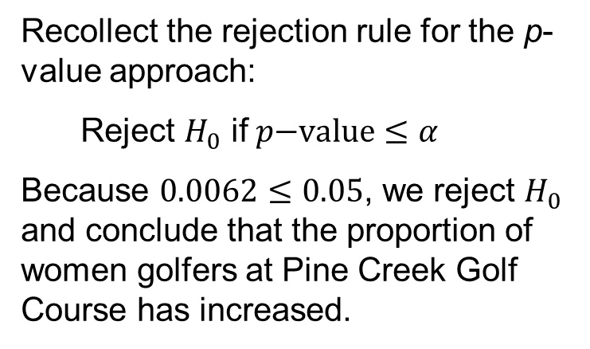
9.5 p-Value Approach to a One-Tailed Test About a Population Proportion
We can use a statistical software package or the standard normal probability table to calculate the p-value for an upper tail test as
$$p\text{−}\text{value}=P\left(z≥2.50\right)=1−P\left(z<2.50\right)=1−0.9938=0.0062$$
Recollect the rejection rule for the p-value approach:
Reject $H_{0}$ if $p\text{−}\text{value}≤α$
Because $0.0062≤0.05$, we reject $H_{0}$ and conclude that the proportion of women golfers at Pine Creek Golf Course has increased.

Slide 39
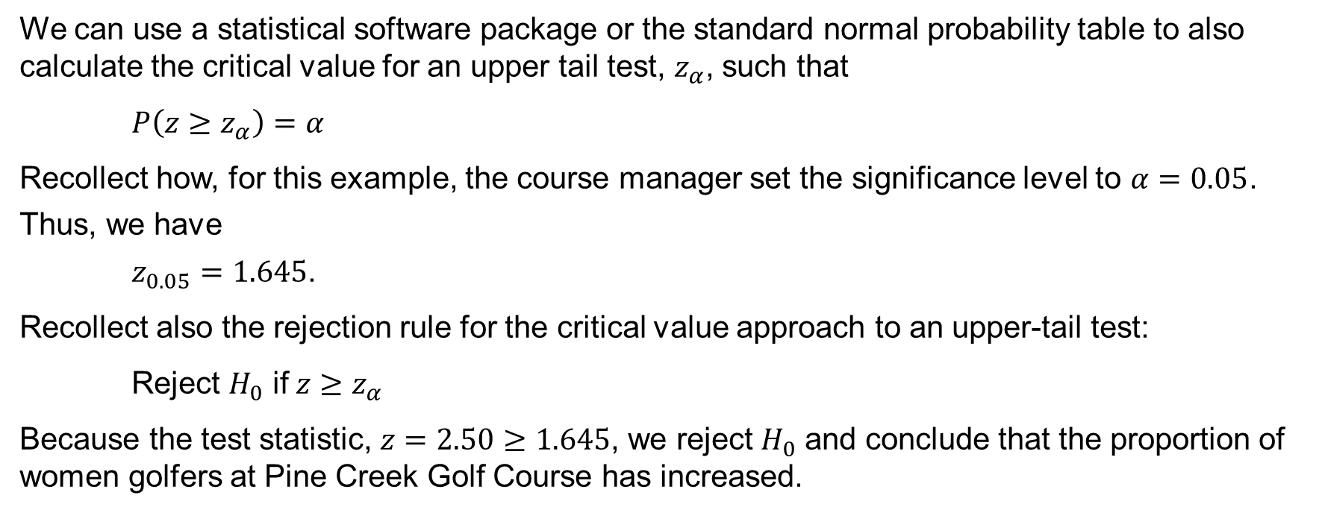
9.5 Critical Value Approach to a One-Tailed Test About a Population Proportion
We can use a statistical software package or the standard normal probability table to also calculate the critical value for an upper tail test, $z_{α}$, such that
$P\left(z≥z_{α}\right)=α$
Recollect how, for this example, the course manager set the significance level to $α=0.05$.
Thus, we have
$z_{0.05}=1.645$.
Recollect also the rejection rule for the critical value approach to an upper-tail test:
Reject $H_{0}$ if $z≥z_{α}$
Because the test statistic, $z=2.50≥1.645$, we reject $H_{0}$ and conclude that the proportion of women golfers at Pine Creek Golf Course has increased.

Slide 40
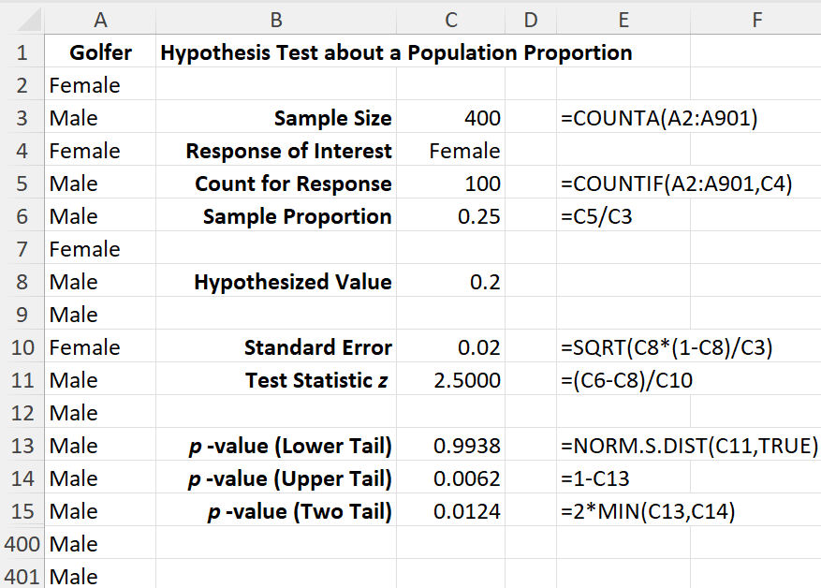
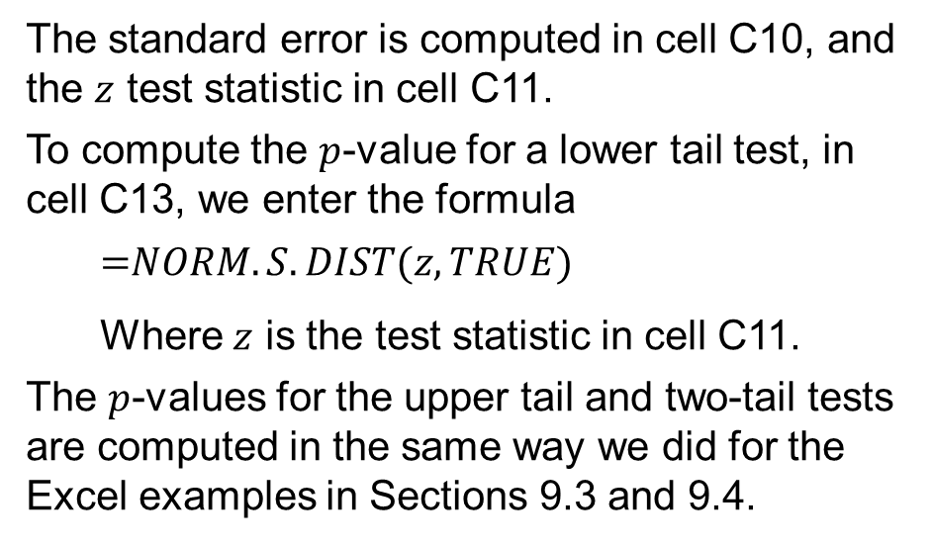
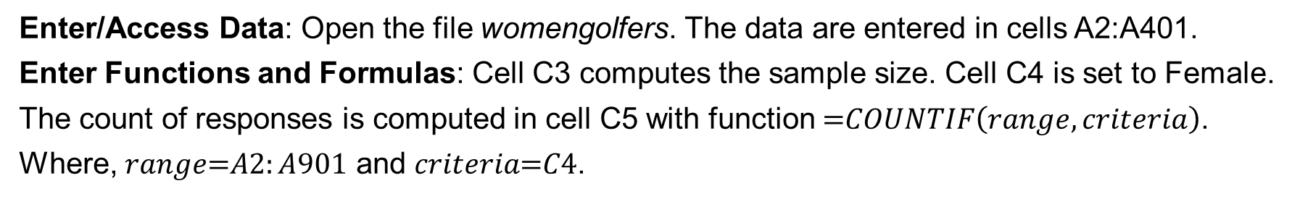
9.5 Excel: Conduct a Hypothesis Test
Enter/Access Data: Open the file womengolfers. The data are entered in cells A2:A401.
Enter Functions and Formulas: Cell C3 computes the sample size. Cell C4 is set to Female.
The count of responses is computed in cell C5 with function $\text{=}COUNTIF\left(range, criteria\right)$.
Where, $range\text{=}A2:A901$ and $criteria\text{=}C4$.
The standard error is computed in cell C10, and the $z$ test statistic in cell C11.
To compute the $p$-value for a lower tail test, in cell C13, we enter the formula
$$\text{=}NORM.S.DIST(z,TRUE)$$
Where $z$ is the test statistic in cell C11.
The $p$-values for the upper tail and two-tail tests are computed in the same way we did for the Excel examples in Sections 9.3 and 9.4.

Slide 41
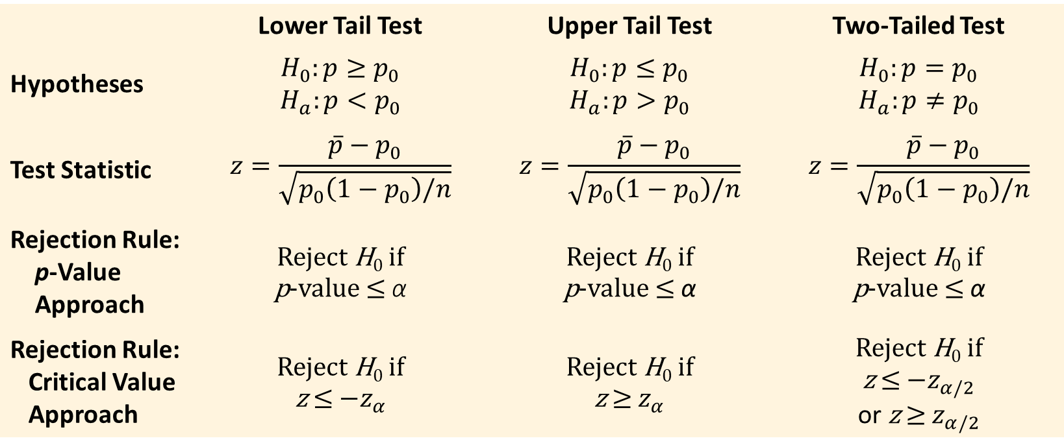
9.5 Summary of Hypothesis Tests About a Population Proportion
 | Lower Tail Test | Upper Tail Test | Two-Tailed Test
Hypotheses | $$H_{0}:p≥p_{0}$$ $$H_{a}:p<p_{0}$$ | $$H_{0}:p≤p_{0}$$ $$H_{a}:p>p_{0}$$ | $$H_{0}:p=p_{0}$$ $$H_{a}:p≠p_{0}$$
Test Statistic | $$z=\frac{\overline{p}−p_{0}}{\sqrt{p_{0}\left(1−p_{0}\right)/n}}$$ | $$z=\frac{\overline{p}−p_{0}}{\sqrt{p_{0}\left(1−p_{0}\right)/n}}$$ | $$z=\frac{\overline{p}−p_{0}}{\sqrt{p_{0}\left(1−p_{0}\right)/n}}$$
Rejection Rule: p-Value Approach | Reject H₀ if p-value ≤ α | Reject H₀ if p-value ≤ α | Reject H₀ if p-value ≤ α
Rejection Rule: Critical Value Approach | Reject H₀ if z ≤ $−z_{α}$ | Reject H₀ if z ≥ $z_{α}$ | Reject H₀ if z ≤ $−z_{α/2}$ or z ≥ $z_{α/2}$

Slide 42
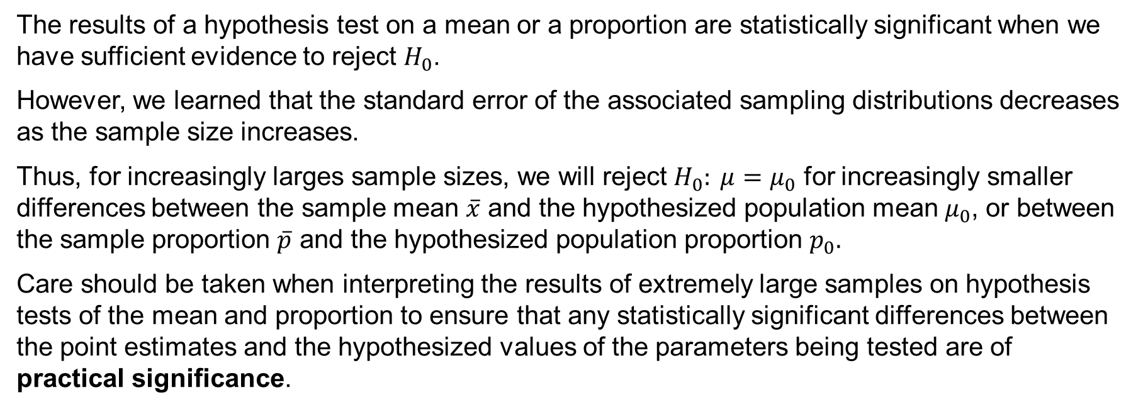
9.6 Practical Advice: Big Data and Hypothesis Testing
The results of a hypothesis test on a mean or a proportion are statistically significant when we have sufficient evidence to reject $H_{0}$.
However, we learned that the standard error of the associated sampling distributions decreases as the sample size increases.
Thus, for increasingly larges sample sizes, we will reject $H_{0}: μ=μ_{0}$ for increasingly smaller differences between the sample mean $\overline{x}$ and the hypothesized population mean $μ_{0}$, or between the sample proportion $\overline{p}$ and the hypothesized population proportion $p_{0}.$
Care should be taken when interpreting the results of extremely large samples on hypothesis tests of the mean and proportion to ensure that any statistically significant differences between the point estimates and the hypothesized values of the parameters being tested are of practical significance.

Slide 43
Summary
Hypothesis testing is a statistical procedure that uses sample data to determine whether a statement about the value of a population parameter should or should not be rejected.
We first provided guidelines for developing hypotheses for situations frequently encountered in practice. Then, we introduced Type I and Type II errors that occur when we reject a true H₀ or do not reject a false H₀, respectively.
Whenever historical data or other information provides a basis for assuming that σ is known, the hypothesis testing procedure for μ is based on the standard normal distribution.
Whenever σ is unknown, the sample standard deviation s is used to estimate σ and the hypothesis testing procedure is based on the t distribution.
In all cases, the value of the test statistic is used to determine whether the null hypothesis should be rejected, either through a p-value or a critical value approach.

